Slide 1
How Xiaoming succeeded his business with The Wisp?
Enjoy the show…

Slide 2

Better business, higher salary, bigger house,
pretty girlfriend…

Slide 3

Hi! You may try TheWisp in SAP Business One

Slide 4

What if I want future purchase prices?
Piece of cake!

Slide 5
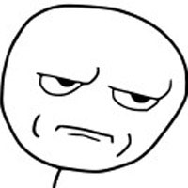
How could I trust you?!
The MAE is 0.0164!

Slide 6

Customers are mean……
I can foresee their price bottom line!

Slide 7

Making too many mantous may waste flour…
Let’s make as many as we could sell!

Slide 8

Any body could tell me how much would I earn?
You have no idea about the power of intelligence!

Slide 9

Just tell me what to do!
Watch and learn!

Slide 10

How could I attract Xiaohong?
……

Slide 11
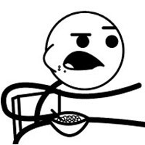
Who did this brilliant job?
Open your eyes!

Slide 12
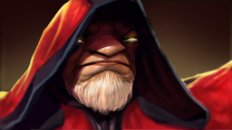



Zhengya Yu
Horus Qiu
Jerry Tan

