Slide 1
Defect Classifications of AOI
Group 5
陳昱仲
邱泓斌

Slide 2
01
Introduction
02
Model Architecture
Outline
03
Tricks
04
Results

Slide 3
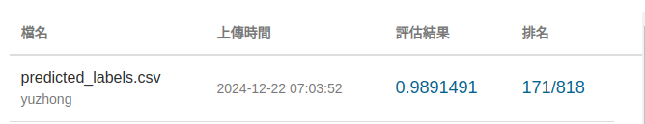
Introduction
We referred to Alexnet’s model architecture and experimented with various techniques to enhance performance, ultimately achieving an accuracy of 98.91%

Slide 4
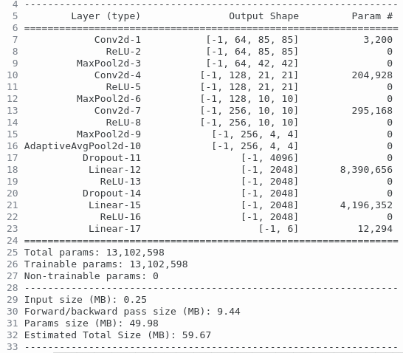
Model Architecture
Refer to Alexnet.
(CNN + MaxPool) * 3
(Linear + Dropout) * 3
Snapshot from the torch-summary

Slide 5
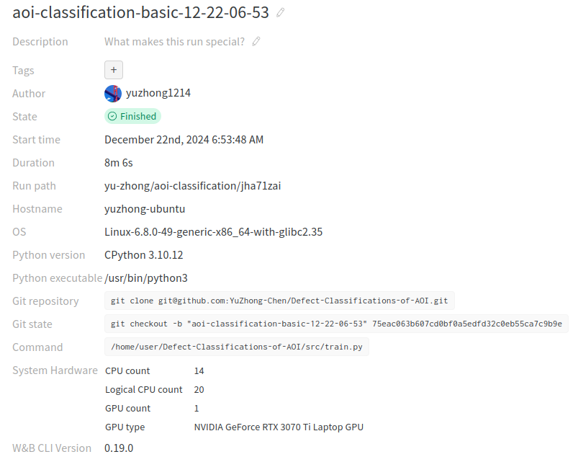
Env Setup
Memory
40G
8G

Slide 6



Tricks
Weights & Biases
NVIDIA Nsight Systems
Torchvision
Tracing the training result.
Profiling the system,
finding the bottlenecks,
and then optimizing it.
Transforming and
augmenting images.

Slide 7
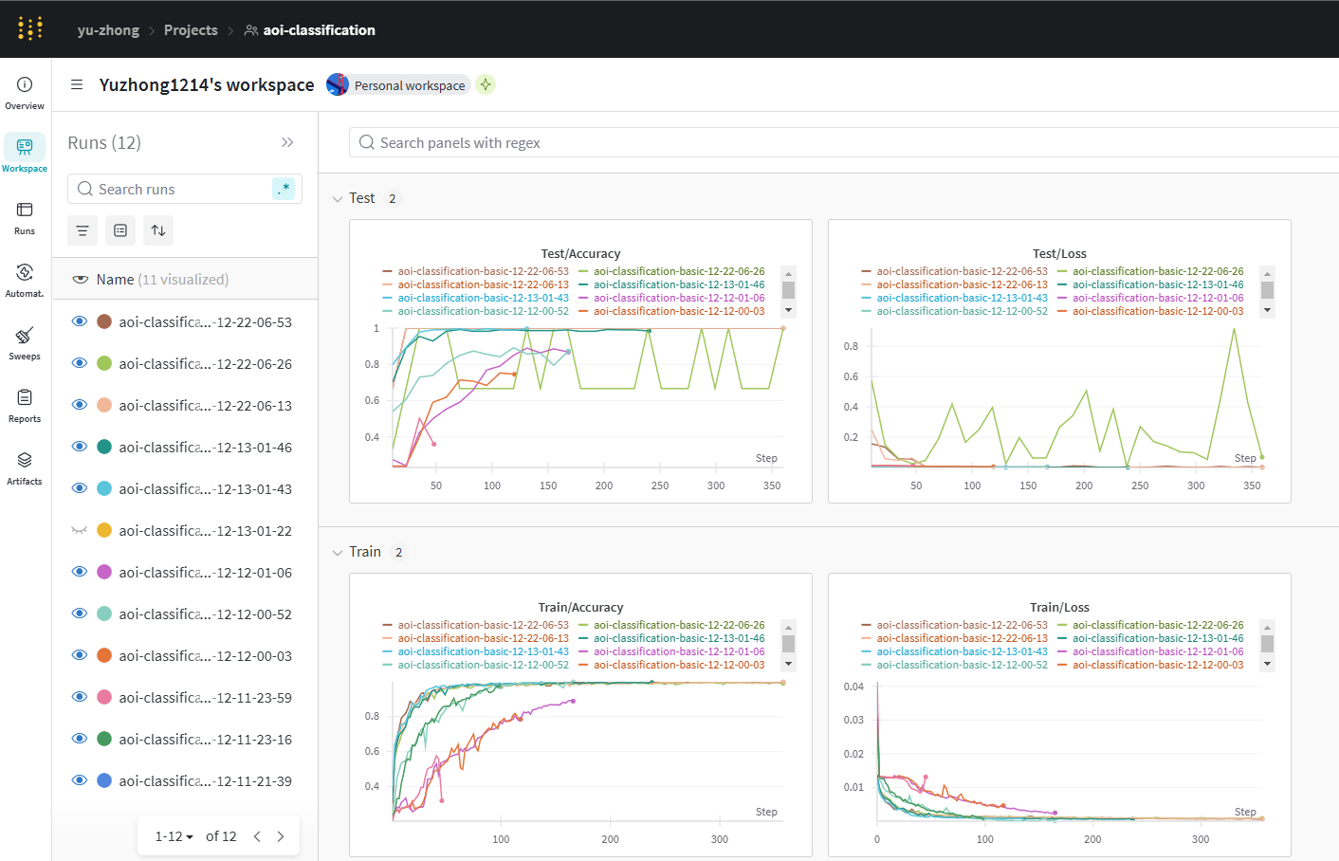
Weights & Biases
Notes:
可以有效追蹤訓練過程，而且他會記錄 git state / model config 所以可以不用擔心沒辦法重現實驗結果。

Slide 8
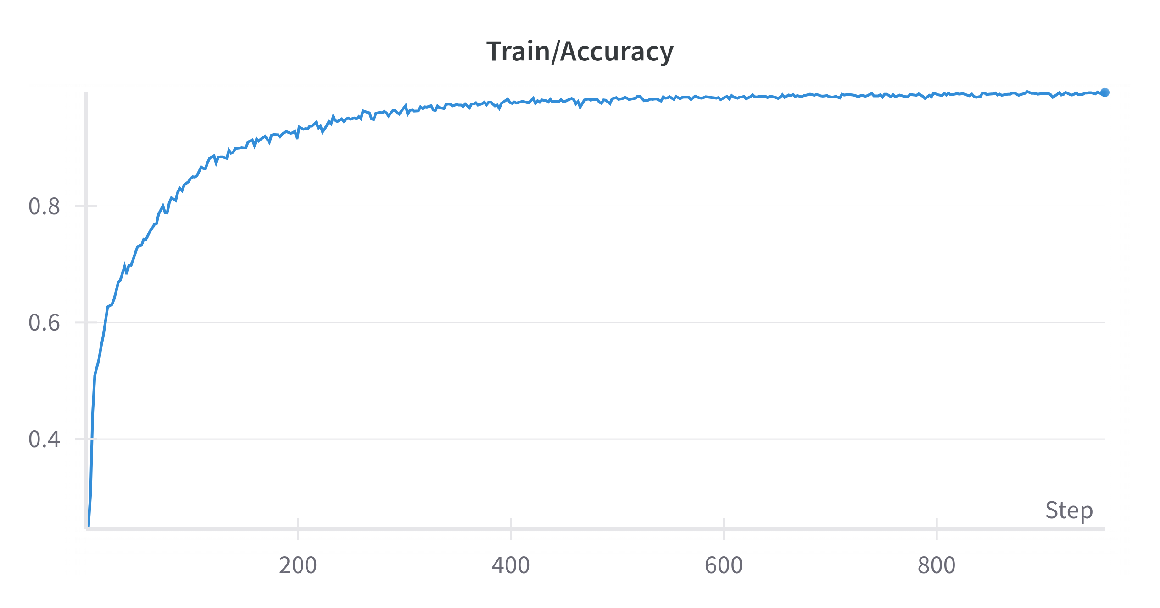
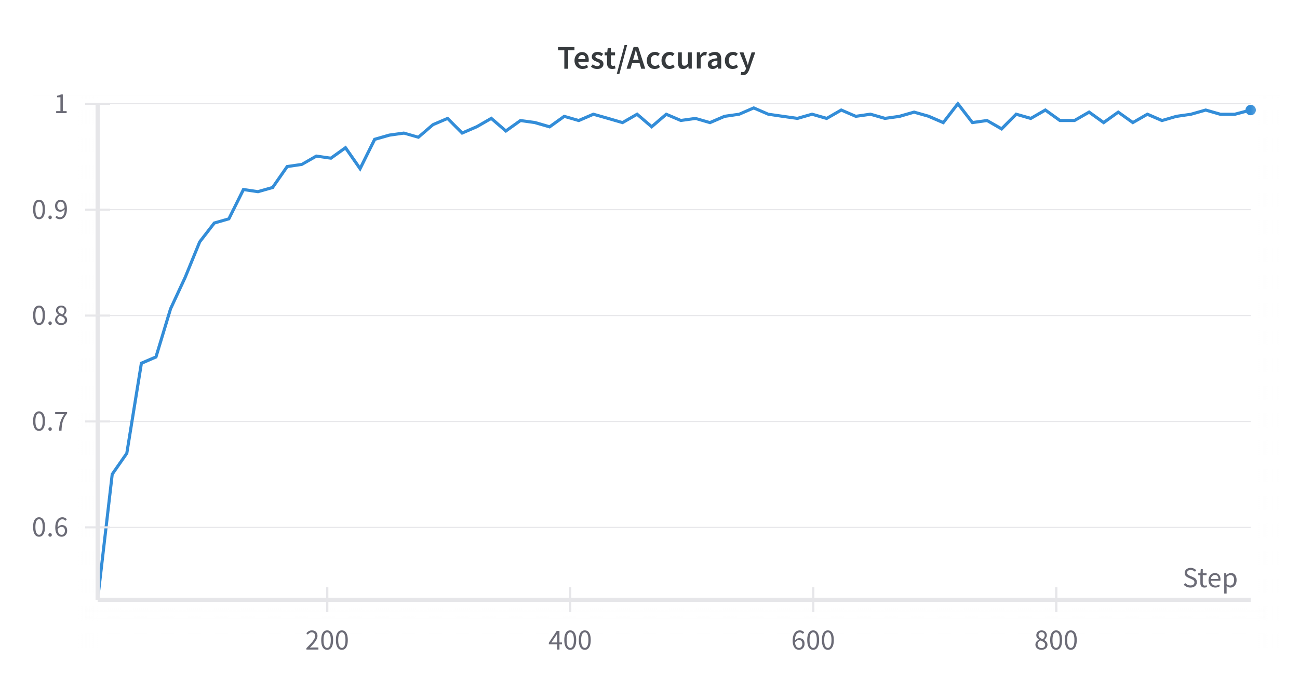
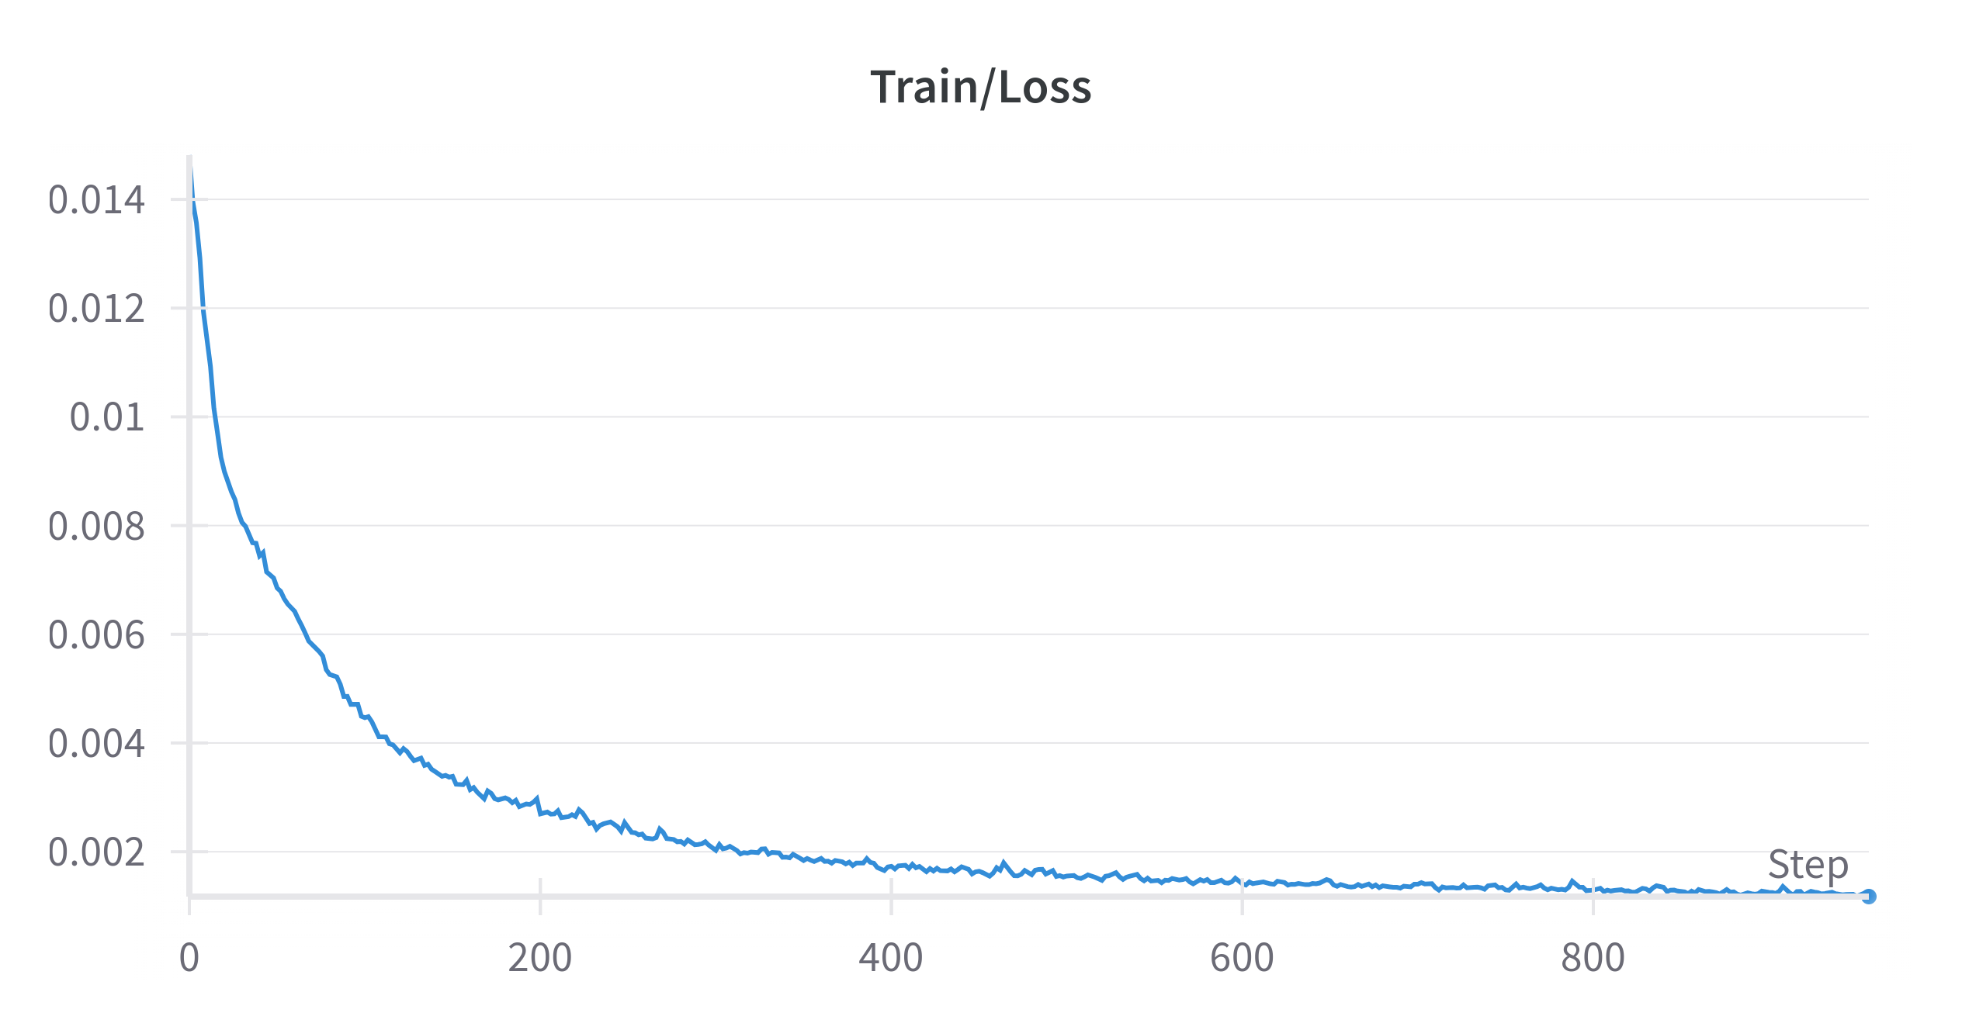
Weights & Biases

Slide 9
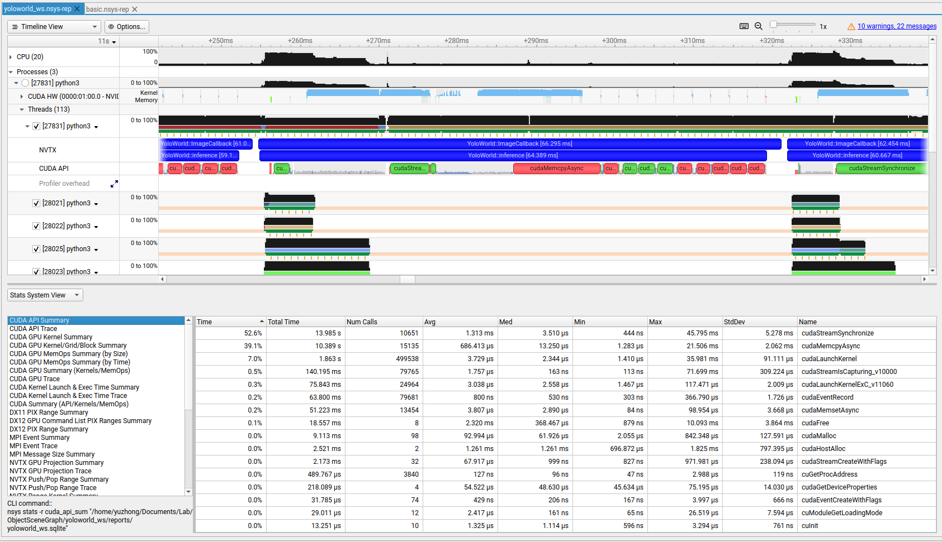
NVIDIA Nsight Systems + NVTX
Notes:
我在分析的時候忘記截圖，注意這是我其他實驗的紀錄，不是這次的截圖
因為程式相對單純，就沒有用 Pytorch Profiler

Slide 10

NVIDIA Nsight Systems + NVTX
$$\left(Height×Width\right)×Data type×Total Image Size$$
$512×512×1×2528=662,700,032 Bytes≅0.6 GB$
20 ~ 30 minutes
8 minutes
Notes:
主要是 Load Dataset 那邊

Slide 11
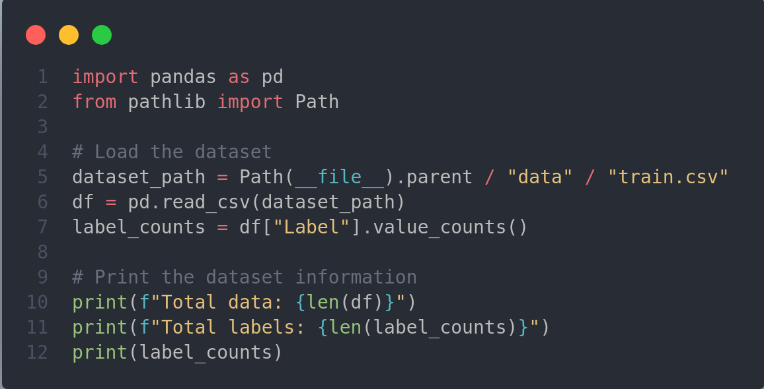
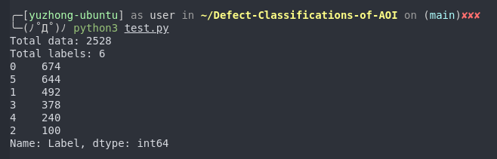
Torchvision

Slide 12
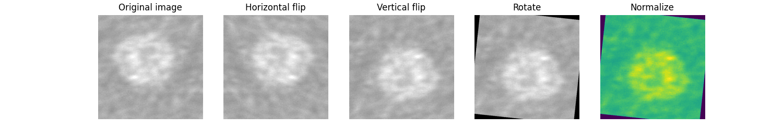
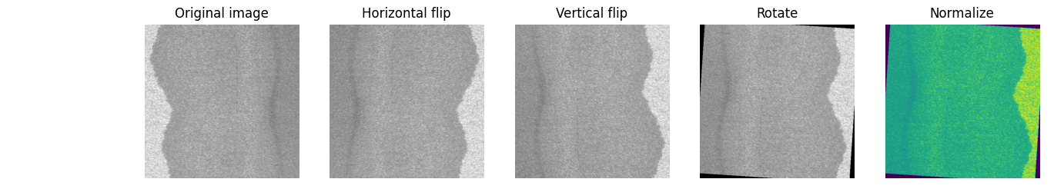
Torchvision

Slide 13
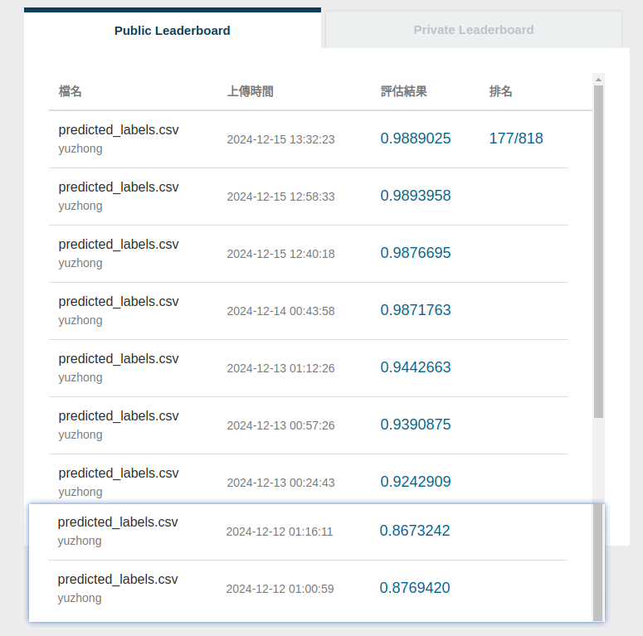
Results

Slide 14
Thanks.

