Slide 1
CS 135601
Introduction to Programming II
Mini project 1
Compiler: A Simple Calculator
Po-Chih Kuo 郭柏志

Slide 2
Week | Date | Tuesday (13:20-15:10) | Friday (13:20-15:10)
1 | 2/15, 2/18
2 | 2/22, 2/25
3 | 3/1, 3/4
4 | 3/8, 3/11
5 | 3/15, 3/18
6 | 3/22, 3/25 |  | C++: Basic Mini-project 1: simple calculator
7 | 3/29, 4/1
8 | 4/5, 4/8 | Tomb Sweeping Day
9 | 4/12, 4/15 | [Lab 2] C++ basic, class
 | 4/17 (Sun) | Mini Project 1 Exam 9-12am
10 | 4/19, 4/22
11 | 4/26, 4/29
12 | 5/3, 5/6
13 | 5/10, 5/13
 | 5/14 (Sat)
14 | 5/17, 5/20
15 | 5/24, 5/27
16 | 5/31, 6/3
17 | 6/7, 6/10
18 | 6/14
 | TBA

Slide 3
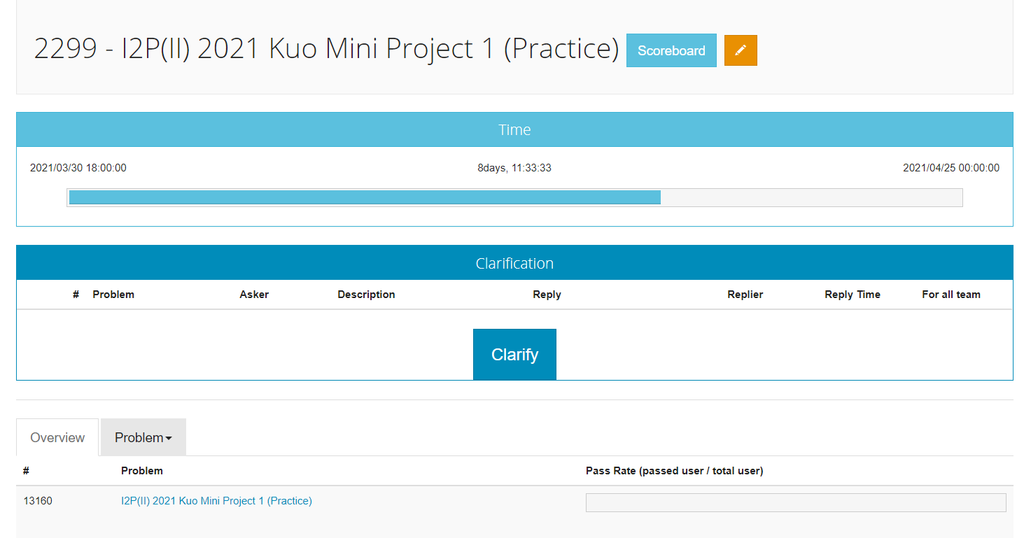
This is for the last year

Slide 4
Compiler
A compiler is computer software that transforms computer code written in one programming language (the source language) into another computer language (the target language).
Example: C compiler
Source language: C language
Target language: Assembly code or intermediate code or machine code

Slide 5
Stages of compilation
Source code .c file
Tokenizer (scanner)
Token stream
Parser
Syntax tree
Assembly code
Assembler
Object code .o file
Linker
Executable .exe file
Code generator

Slide 6
Lexical Analysis (Tokenizer)
Read an input string
Identify symbols and words (Token)
Symbols include: + - * / = ( )
Word includes numbers and variables
Each type of token is given a code.
typedef enum {UNKNOWN, END, INT, ID, FLOAT, ADDSUB, MULDIV, ASSIGN, LPAREN, RPAREN} TokenSet;

Slide 7
Example
Input: a string of expression
If the expression is 20*(30000+x)
Output: a stream of tokens
Tokens are
20 * ( 3000 + x )
INT MULDIV LPAREN INT ADDSUB ID RPAREN

Slide 8
Scanner
What is an integer (expressed in a string)?
INT: digits include 0 to 9
How about negative sign “-”?
What is a floating point?
FLOAT: digits include 0 to 9 and a period
What is a variable?
Started with a alphabet, a-z, A_Z, or an underline_
Followed by a string of alphabets, number, underlines
Not included in this project

Slide 9
Parser
We have seen this before.
FACTOR = ID | NUM | (EXPR)
EXPR = FACTOR | EXPR OP FACTOR
Parsing EXPR = FACTOR| EXPR OP FACTOR
Find a factor from the end of expression
If there is an OP in front of the factor
Let factor be OP’s right child
Parse the remaining expression recursively and make it OP’s left child

Slide 10
Are we done yet?
There are multiplication/division, whose priority is higher than add/sub. What is the grammar?
Multiplication/division: Ex: 3+7*8 = 3+(7*8) not (3+7)*8
*
+
+
8
3
*
7
8
3
7

Slide 11
Handling mul/div
We need to distinguish ADDSUB and MULDIV
If it is ADDSUB, we can use the previous grammar.
If it is MULDIV, we need to process it immediately, just like handing parenthesis “(expr)”.
We need to add a new grammar rule (which means a new recursive function) to handle it.
FACTOR = ID | NUM| (EXPR)
TERM = FACTOR | TERM MULDIV FACTOR
EXPR = TERM | EXPR ADDSUB TERM

Slide 12
Other considerations
How to handle assignment?
Ex: x = 3 + y
How to handle the sign of ID or NUM?
For example, 3 + -2
How to handle empty statements?
How to handle errors?

Slide 13
Code Generation
Generate assembly code from the syntax tree
Tasks of code generation include:
Instruction arrangement
Register and memory management
Instruction arrangement: using post-order traversal
Ex: 3+7*8
MOV r0, 3 MOV r1, 7
MOV r2, 8
MUL r1, r2 ADD r0, r1
+
3
*
7
8
(Post-order: left subtree, right subtree, and root)

Slide 14
Symbol Table
Recall the relation between variables, memory, registers, and value.
A symbol table which indexed by the variable is usually use to map variables to memory, register, and value, and to track the types of variables
Use array of struct for implementation
Symbol name | Type
bar | function, double
x | double
foo | function, double
count | int
sum | double
i | int

Slide 15
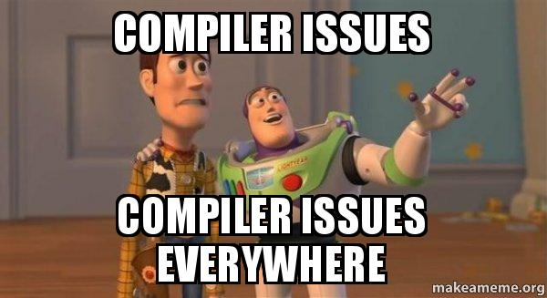

Slide 16
Mini-project Goal
A calculator to demonstrate how does a compiler work.
Input: a list of expressions.
Output: corresponding assembly codes.
Example
MOV r1, 3
MOV r2, -5
MOV r0, 4
MUL r1, r0
MOV r0, -6
MUL r2, r0
ADD r1, r2
>> x = 3
>> y = -5
>> z = 4*x + y*-6

Slide 17
What will we provide?
main.c
lex.h / lex.c
parser.h/parser.c
codeGen.h/codeGen.c

Slide 18
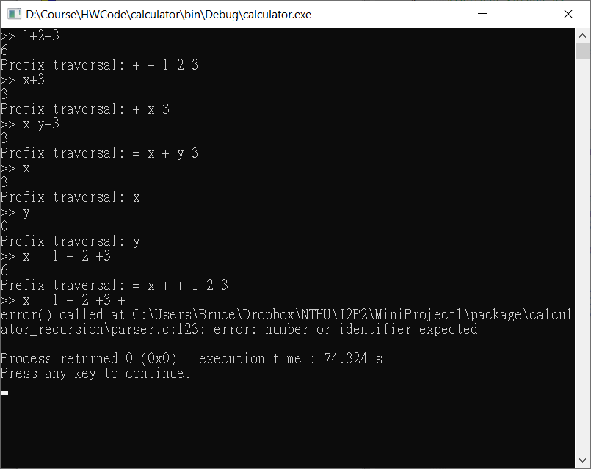

Slide 19
Lexical analysis (lex.h / lex.c)
Tokenizer “getToken()”: a function that
extracts the next token from the input string;
stores the token in “char lexeme[MAXLEN]”;
identifies the token’s type
typedef enum {UNKNOWN, END, INT, FLOAT, ID, ADDSUB, MULDIV, ASSIGN, LPAREN, RPAREN, ENDFILE} TokenSet;

Slide 20
The parser (parser.h/parser.c)
The parsing process:
group tokens into statements based on a set of rules, collectively called a grammar.
The grammars:
statement := ENDFILE | END | expr END
expr := term expr_tail
expr_tail := ADDSUB term expr_tail | NiL
term := factor term_tail
term_tail := MULDIV factor term_tail| NiL
factor := INT | ADDSUB INT |
ID | ADDSUB ID |
ID ASSIGN expr |
LPAREN expr RPAREN |
ADDSUB LPAREN expr RPAREN

Slide 21
Tail Recursion -> Loop (1/2)
Recursion Version
Loop Version
BTNode* expr(void)
{
BTNode *node;
node = term();
return expr_tail(node);
}
BTNode* expr_tail(BTNode *left)
{
BTNode *node;
if (match(ADDSUB)) {
node = makeNode(ADDSUB, getLexeme());
advance();
node->left = left;
node->right = term();
return expr_tail(node);
}
else
return left;
}
BTNode* expr(void)
{
BTNode *retp, *left;
//int retval;
retp = left = term();
while (match(ADDSUB)) {
retp = makeNode(ADDSUB, getLexeme());
advance();
retp->right = term();
retp->left = left;
left = retp;
}
return retp;
}

Slide 22
Tail Recursion -> Loop (2/2)
Recursion Version
Loop Version
BTNode* term(void)
{
BTNode *node;
node = factor();
return term_tail(node);
}
BTNode* term_tail(BTNode *left)
{
BTNode *node;
if (match(MULDIV)) {
node = makeNode(MULDIV, getLexeme());
advance();
node->left = left;
node->right = factor();
return term_tail(node);
}
else
return left;
}
BTNode* term(void)
{
BTNode *retp, *left;
retp = left = factor();
while (match(MULDIV)) {
retp = makeNode(MULDIV, getLexeme());
advance();
retp->right = factor();
retp->left = left;
left = retp;
}
return retp;
}

Slide 23
The syntax trees based on the grammars
10+2*5+(1+1)*(1+1)
+
+
*
10
*
+
+
2
5
1
1
1
1

Slide 24
The syntax trees based on the grammars
-5*10-100
-
*
100
-
10
0
5

Slide 25
The syntax trees based on the grammars
y=2*10-7
=
y
-
*
7
2
10

Slide 26
The code generator (codeGen.h/codeGen.c)
The code generation process:
constructing the machine-language instructions to implement the statements recognized by the parser and represented as syntax trees
In codeGen.h/codeGen.c, we provide a function: evaluateTree(BTNode *root)
that calculates the answer by pre-order traversal of the syntax tree

Slide 27
Symbol table
Note that, to deal with expressions including variables such as
>> x=3
>> 4*x+(y=((10-2)/4))
we use a symbol table to record variables’ current values
we use getval() and setval() to manipulate the symbol table
The symbol table are used both in the parser and the code generator.

Slide 28
Symbol table
#define TBLSIZE 65535
typedef struct {
char name[MAXLEN];
int val;
} Symbol;
Symbol table[TBLSIZE];

Slide 29
What you need to do in this mini-project?
Trace all the code if you like to
understand each detail and
review what you have learnt during the courses.
Modify the grammar and parser.c to accept new operators, including &, |, ^, ++, --.
Replace the current evaluateTree () in codeGen.c to generate assembly code during the pre-order tree traversal.
Check the error handling in the parser.c to print “EXIT 1” when encountering errors.
Optimize your assembly code to get extra credits!

