Slide 1
Modelling Stochastic Order in the Analysis of Receiver Operating Characteristic Data: Bayesian Non-parametric Approaches
Yu Zhu
Department of Statistical Science
University of California, Santa Cruz

Slide 2
Reference:
Hanson, T.E., Kottas, A. and Branscum, A.J. (2008), Modelling stochastic order in the analysis of receiver operating characteristic data: Bayesian non-parametric approaches. Journal of the Royal Statistical Society: Series C (Applied Statistics), 57: 207-225
Outline:
Background on ROC curves
Bayesian Nonparametric Approaches
Motivations
Order Constraints
Dirichlet process mixtures (DPM)
Mixtures of finite Polya trees (MPT)
Prior Elicitation
Model Comparison
Simulation Study
Implement DPM
Case Study: Serology Score Analysis
Compare between DPM and MPT

Slide 3
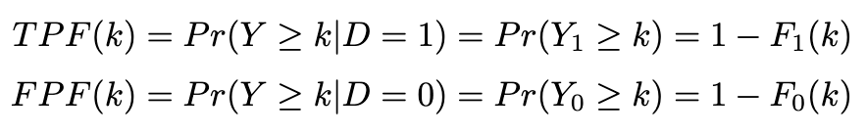



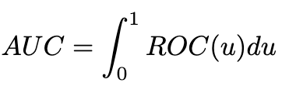




ROC Curve
For some continuous test, we define the true positive response probability (TPF) and the false positive response probability (FPF) under some cut-off value k as below:
ROC curve represents the plot for all cut-off values k.
Denote , ROC curve is given as:
Area under the ROC curve (AUC):
One of the information summarization measures for ROC curve
The probability that the test outcome for a randomly chosen diseased subject exceeds the one exhibited by a randomly selected non-diseased individual
AUC = 0.5 indicates a non-informative test
A nature consequence of the stochastic order constraint:
if and only if
$$⟹$$
Notes:
is a graphical measure of the accuracy of a continuous diagnostic test.

Slide 4



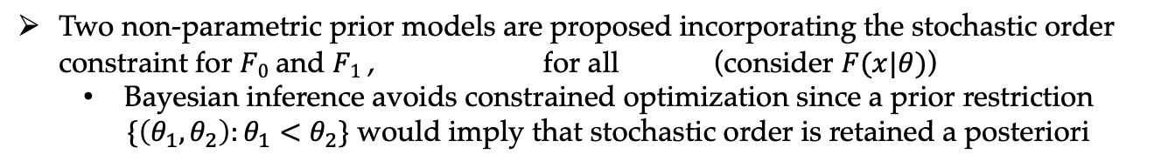
Bayesian Nonparametric Approaches
Motivations for non-parametric models:
The distributions F₀ and F₁ often exhibit non-standard features such as multimodality and skewness that parametric models are not as flexible to capture
Non-parametric models can handle some other non-standard features that aren't known in advance
Two non-parametric prior models are proposed incorporating the stochastic order constraint for $F0$ and $F1$ , for all (consider $F(x|θ)$)
Bayesian inference avoids constrained optimization since a prior restriction
$\{\left(θ_{1}, θ_{2}\right):θ_{1}<θ_{2}\}$ would imply that stochastic order is retained a posteriori
Dirichlet process mixtures:
DPMs generalize finite mixture models, offering practical advantages in modelling and inference for data that arise from non-standard distributions
Mixtures of finite Polya trees:
It’s straightforward to elicit prior information, because the parametric model is a centering special case
Notes:
the two prior processes that we have considered here are quite different. The DPM model behaves like a f inite mixture model with an unknown numberofcomponents, and this fact has been exploited for modelling multimodal densities and data where clumping naturally occurs. In contrast, the MPT prior model is centred at a parametric family and can inherit the overall shape of the centring density when sample sizes are small or the MPT weight parameter is relatively large.
a finite PT prior for a distribution F is constructed by partitioning the sample space into increasingly fine disjoint sets at successive levels of the tree up to level J.

Slide 5




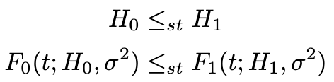


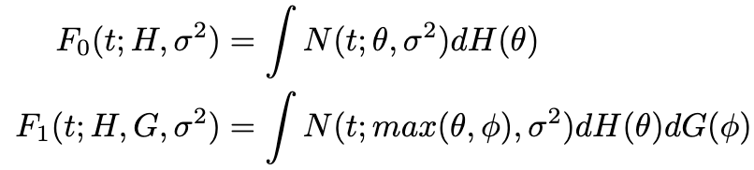
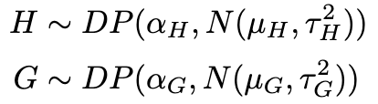

Dirichlet Process Mixtures (DPM)
Location normal mixture models for the distributions for diseased and non-diseased
populations:
The distribution is stochastically ordered in θ for fixed σ²
i.e. if
so we obtain the stochastic ordering for mixtures if the mixing distributions are stochastically ordered:
Introduce latent distribution functions H and G on $ℝ$:
The stochastically ordered DPM model is defined as:
Hyper-parameters:

Slide 6
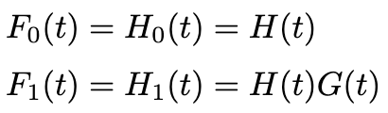
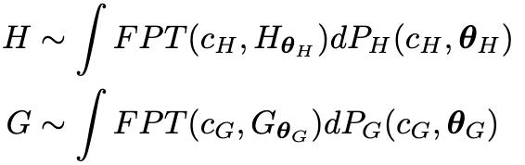





Mixtures of Finite Polya Trees (MPT)
Define the model directly as :
The mixture of finite PT priors are assigned as:
H is randomly centered at with
G is randomly centered at with
The levels of finite Polya trees:
Fix as
Bias-Variance tradeoff: increasing J to J +1 essentially doubles the number of conditional probabilities and decrease the bias, while also increases overall variability and can reduce the predictive ability

Slide 7








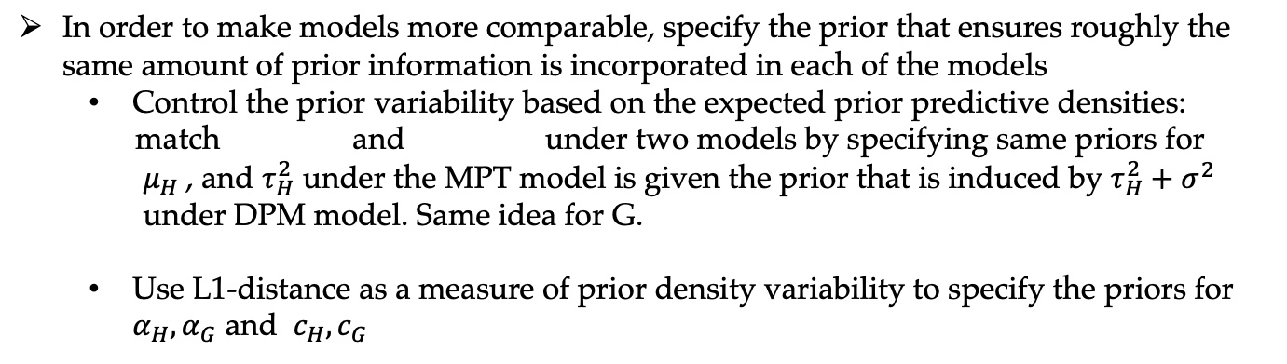
Prior Elicitation and Model Comparison
In order to make models more comparable, specify the prior that ensures roughly the same amount of prior information is incorporated in each of the models
Control the prior variability based on the expected prior predictive densities:
match and under two models by specifying same priors for
$μ_{H}$, and $τ_{H}^{2}$ under the MPT model is given the prior that is induced by $τ_{H}^{2}+σ^{2}$
under DPM model. Same idea for G.
Use L1-distance as a measure of prior density variability to specify the priors for $α_{H},α_{G}$ and $c_{H},c_{G}$
w.l.o.g., assume
Through simulation of prior densities under both models, can find out the specifications constructing similar prior median and corresponding 95% CI
Compare models via log-pseudo-marginal likelihood(LPML) based on predictive utility
Calculate conditional predictive ordinate (CPO) for each observation under each model and calculate LPML

Slide 8
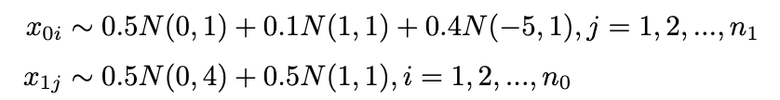


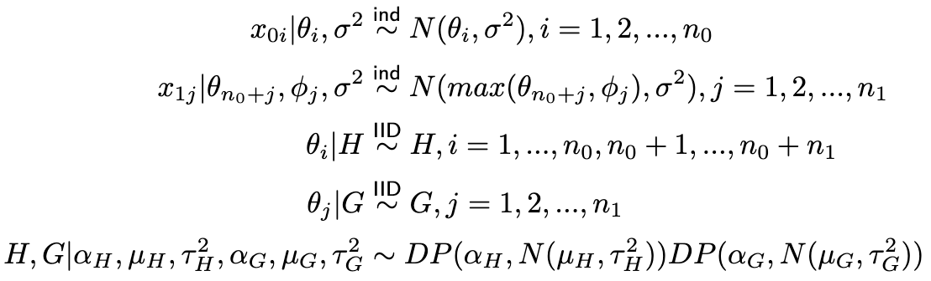

Simulation Study
Random sample n₀ = n₁ = 500 observations for each population:
We establish the DPM model and express in the hierarchical form with latent mixing parameters: and
Introduce the additional mixing parameters can retain the first-stage conditionally independent specification in the hierarchical model after marginalizing in model the random distribution functions H and G over their DP priors

Slide 9
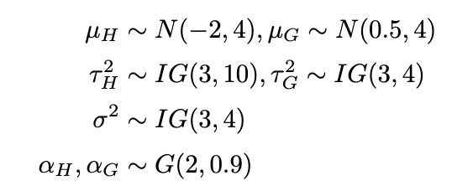








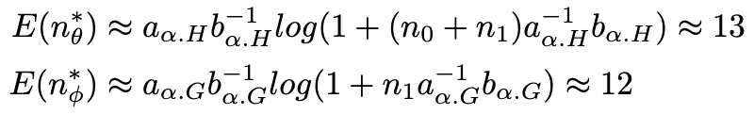

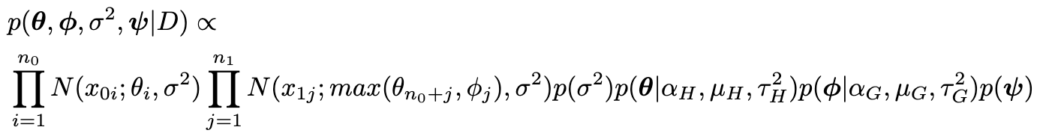
Simulation Study
Prior settings:
Let with and with be the number of and values of the distinct components in and. .
Posterior simulation: The posterior simulation can be performed from by integrating H and G over their DP priors:

Slide 10
Simulation Study

Slide 11
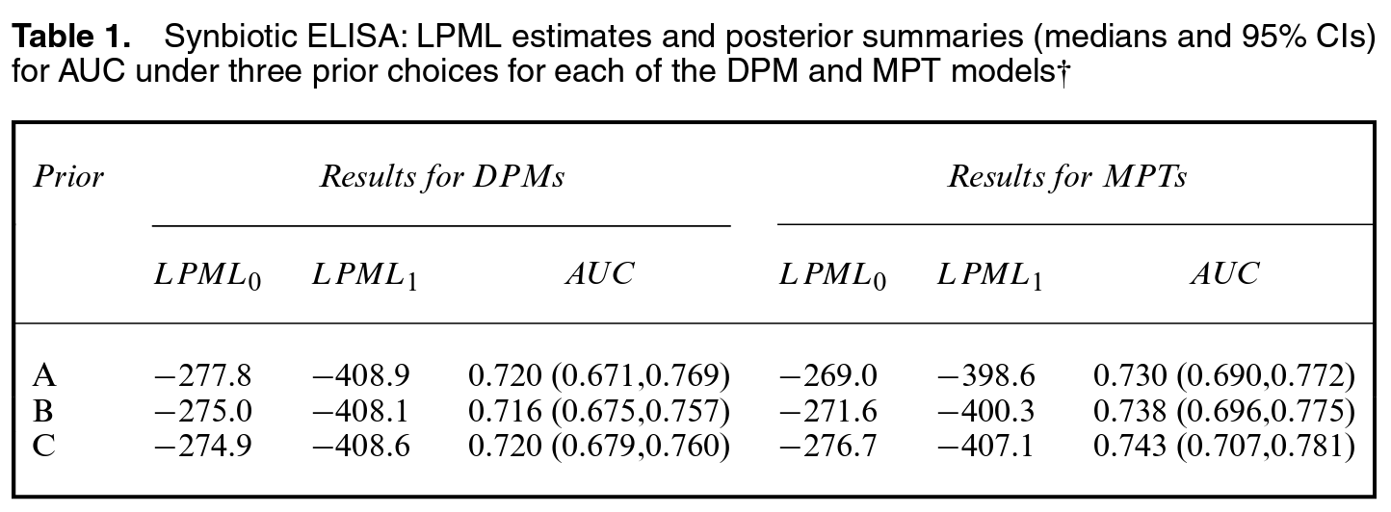
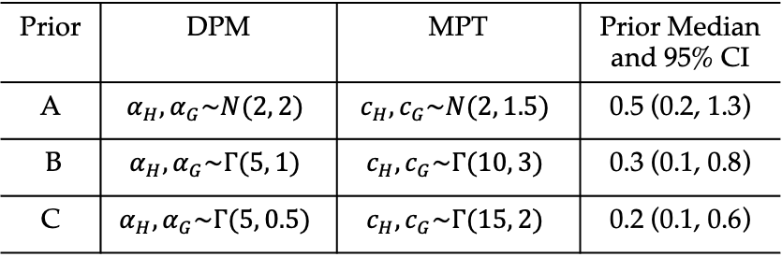
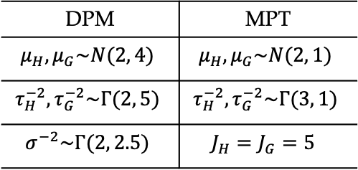
Serology Score Analysis
Analyze the serology data from two different ELISA kits for detection of MAP in dairy cattle, the serology scores were log-transformed to facilitate the use of normal centering distributions of the non-parametric priors
Prior specification:
Prior | DPM | MPT | Prior Median and 95% CI
A | $$α_{H},α_{G}\sim N(2, 2)$$ | $$c_{H},c_{G}\sim N(2, 1.5)$$ | 0.5 (0.2, 1.3)
B | $$α_{H},α_{G}\sim Γ(5, 1)$$ | $$c_{H},c_{G}\sim Γ(10, 3)$$ | 0.3 (0.1, 0.8)
C | $$α_{H},α_{G}\sim Γ(5, 0.5)$$ | $$c_{H},c_{G}\sim Γ(15, 2)$$ | 0.2 (0.1, 0.6)
DPM | MPT
$$μ_{H},μ_{G}\sim N(2, 4)$$ | $$μ_{H},μ_{G}\sim N(2, 1)$$
$$τ_{H}^{−2},τ_{G}^{−2}\sim Γ(2, 5)$$ | $$τ_{H}^{−2},τ_{G}^{−2}\sim Γ(3, 1)$$
$$σ^{−2}\sim Γ(2, 2.5)$$ | $$J_{H}=J_{G}=5$$
Three priors for the DPM model precision parameters were considered, reflecting different levels of prior variability about the prior predictive density

Slide 12
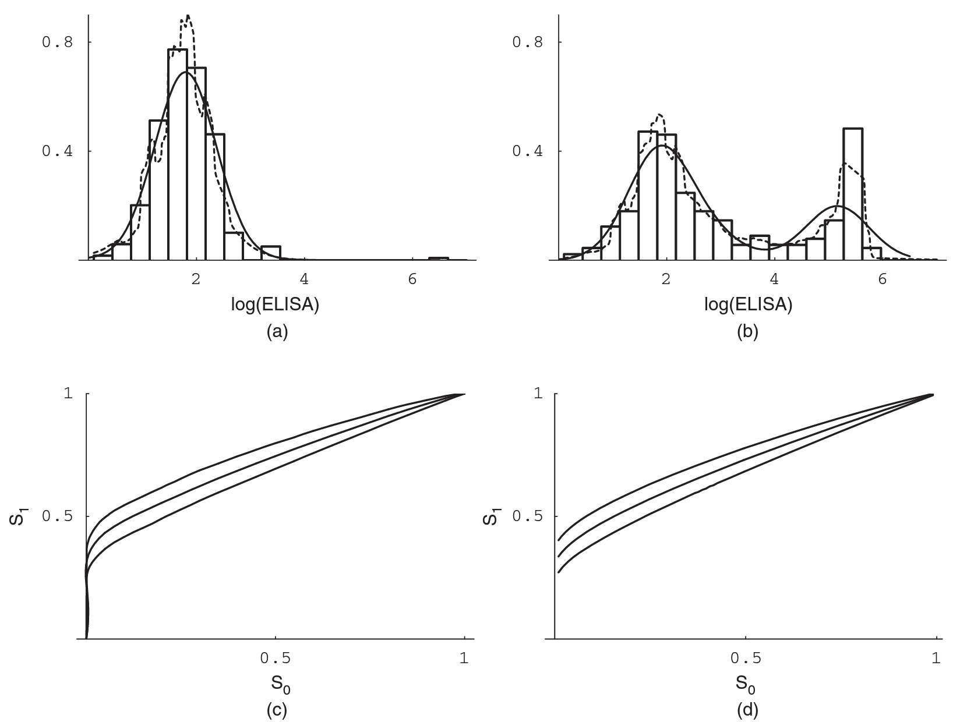
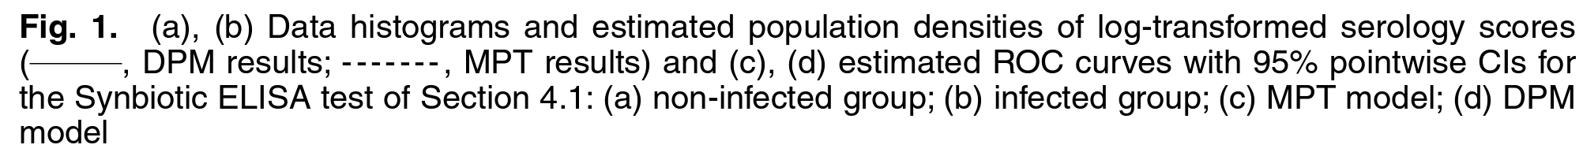
Serology Score Analysis

Slide 13
Thank you !

Slide 14
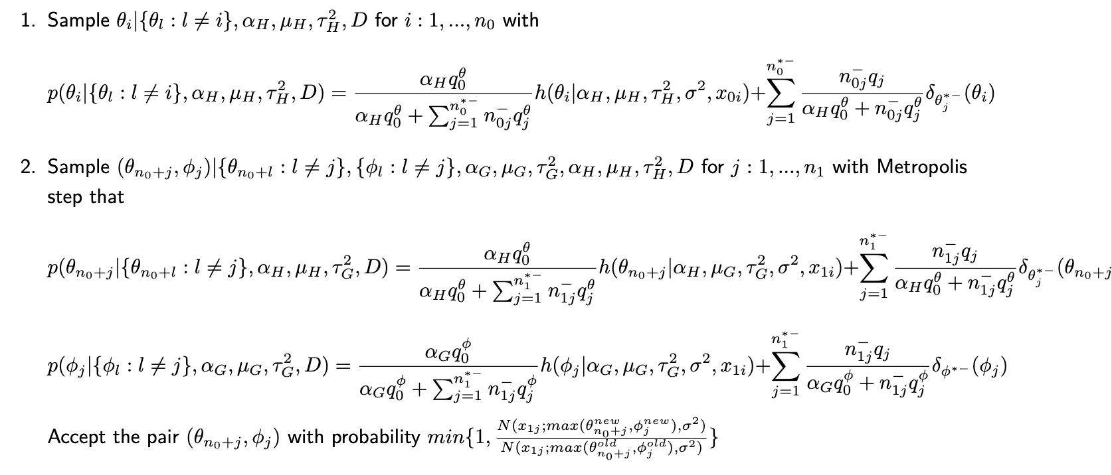
Appendix:
We performed the posterior sampling based on Polya urn representation:

Slide 15
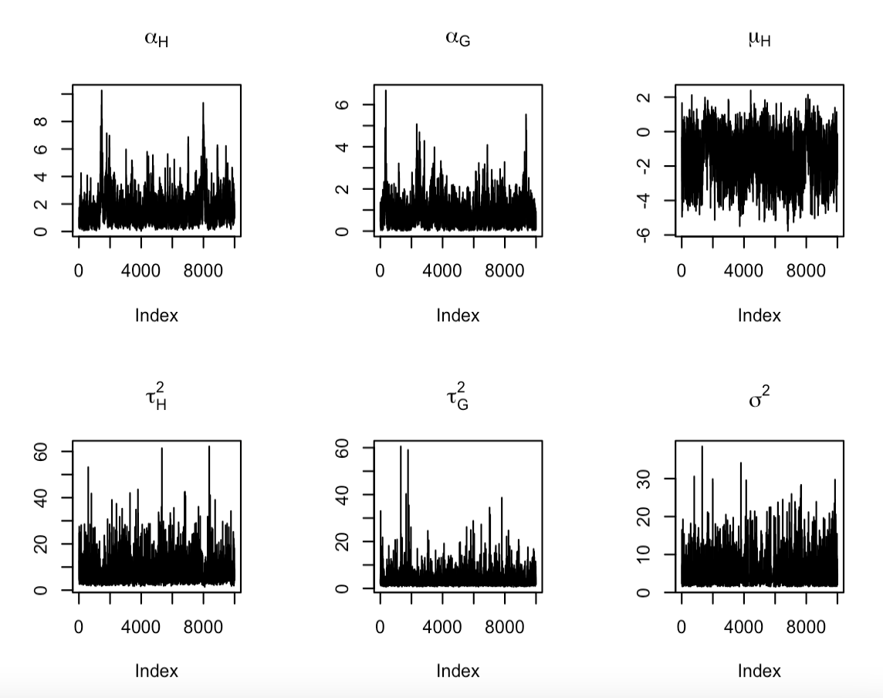
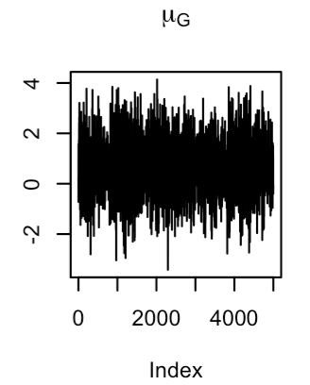

Slide 16
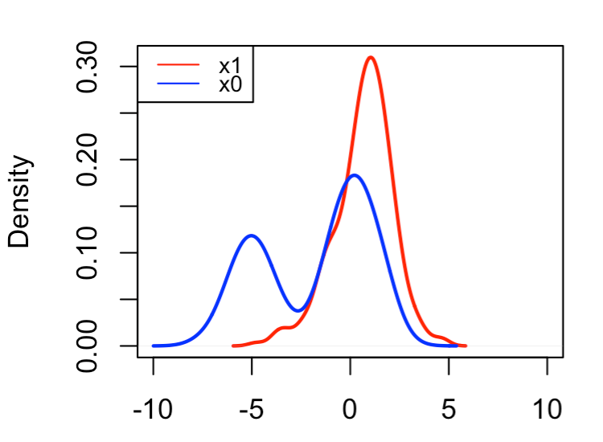
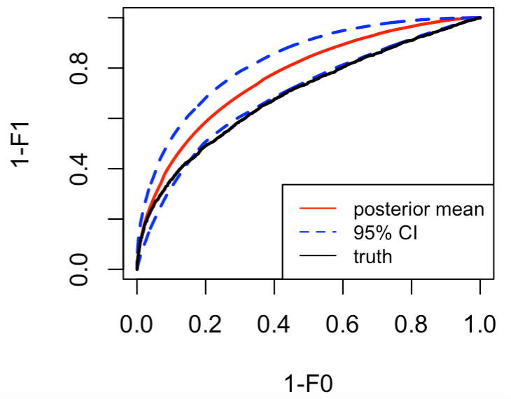

Slide 17
Q1
Q2
(a) don’t care
(b) no continuity correction: -2
Use 16 and 18 as correction: -1
(c) no continuity correction/wrong correction: -1
Q3
(a)
(b)
(c) if use 0.275 instead of 0.2 :-1
Incorrect formula/bullshit: -2
Q4
(a) if H0 says as <=: -1
(b) if they calculate Z alpha/2 or did not calculate critical value : -1
(c) if no technical terms: -1
if compare z stat with alpha: -1

