Slide 1
Not Quite Any Way You Slice It: How Different Analogical Constructions Affect Raven’s Matrices Performance
Yuan Yang¹
Keith McGreggor²
Maithilee Kunda¹ ¹Electrical Engineering and Computer Science, Vanderbilt University
²School of Interactive Computing, Georgia Tech

Slide 2
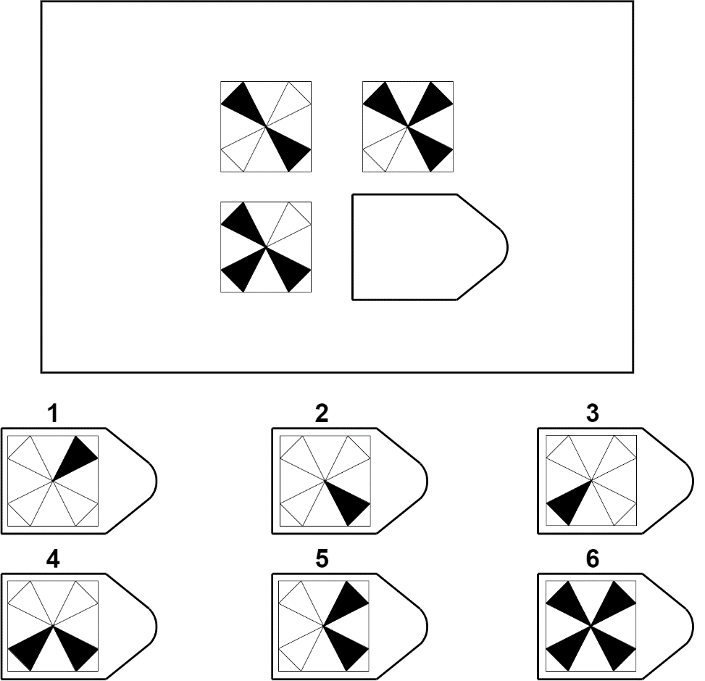
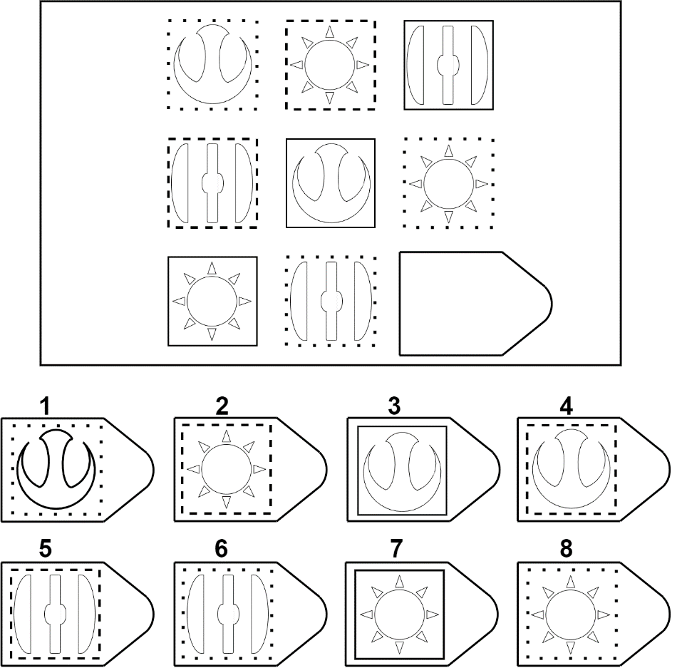

Slide 3
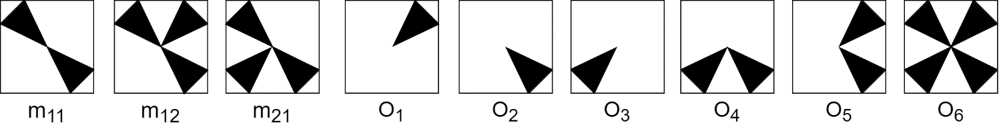
Integration Strategies
Answer Choice
Image Transformations
Analogies
Affine and Set Transformation Induction Model (ASTI)

Slide 4


Image Similarity
Symmetric
Asymmetric
(directional)

