Slide 1
Not Quite Any Way You Slice It: How Different Analogical Constructions Affect Raven’s Matrices Performance
Yuan Yang¹
Keith McGreggor²
Maithilee Kunda¹ ¹Electrical Engineering and Computer Science, Vanderbilt University
²School of Interactive Computing, Georgia Tech

Slide 2
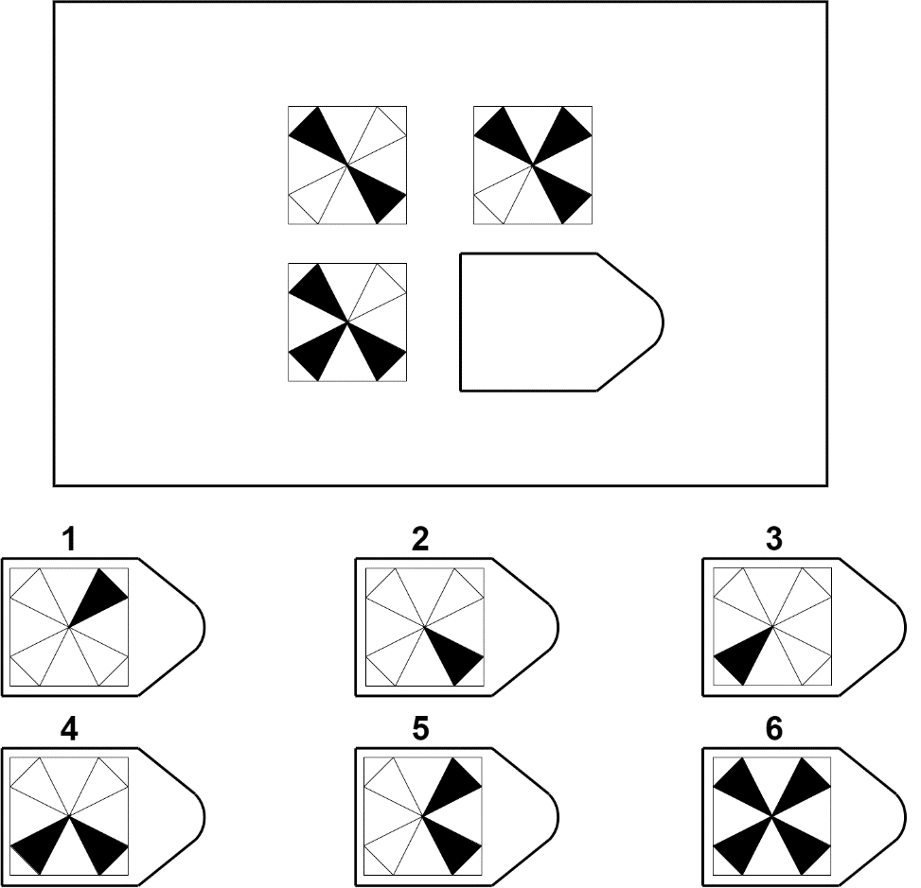
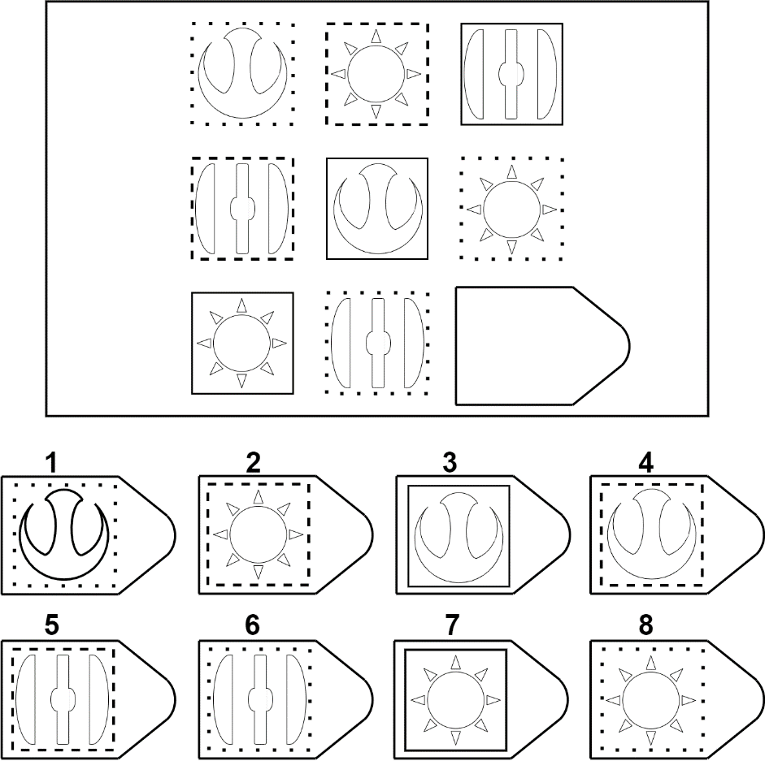

Slide 3
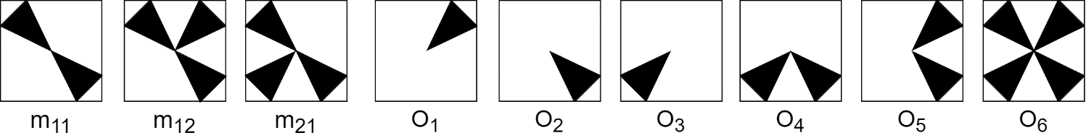
Integration Strategies
Answer Choice
Image Transformations
Analogies
Affine and Set Transformation Induction Model (ASTI)

Slide 4


Jaccard Index
Similarity Procedures
Symmetric
Asymmetric
(directional)
Alignment

Slide 5
Transformations
Unary
Unary
Affine
Set
Binary
Binary
Affine
Set

Slide 6
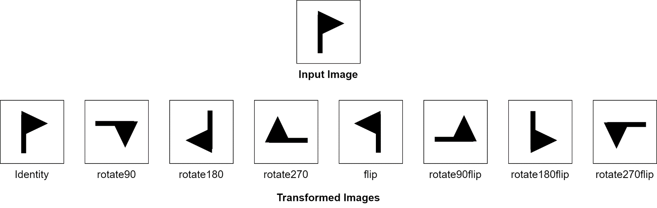
Transformations
Unary
Unary
Affine
Set
Binary
Binary
Affine
Set

Slide 7
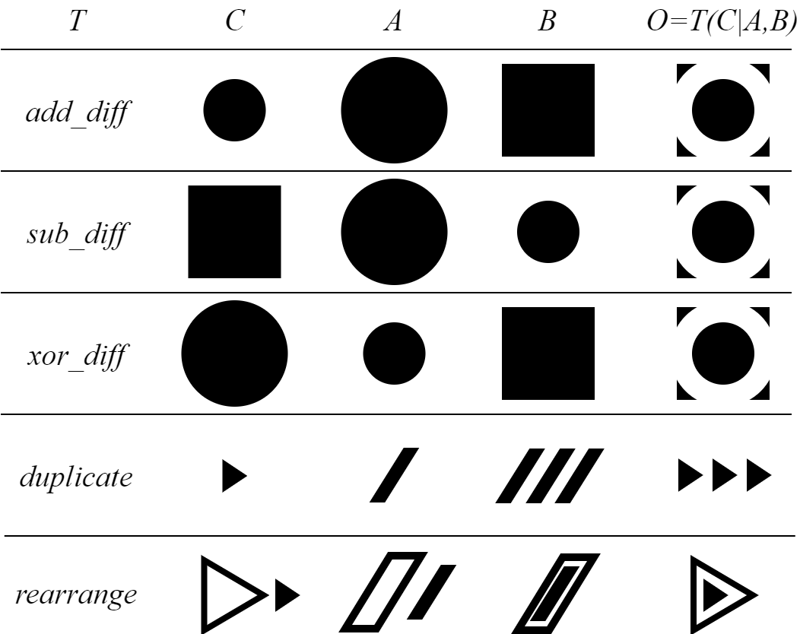
Transformations
Unary
Unary
Affine
Set
Binary
Binary
Affine
Set

Slide 8
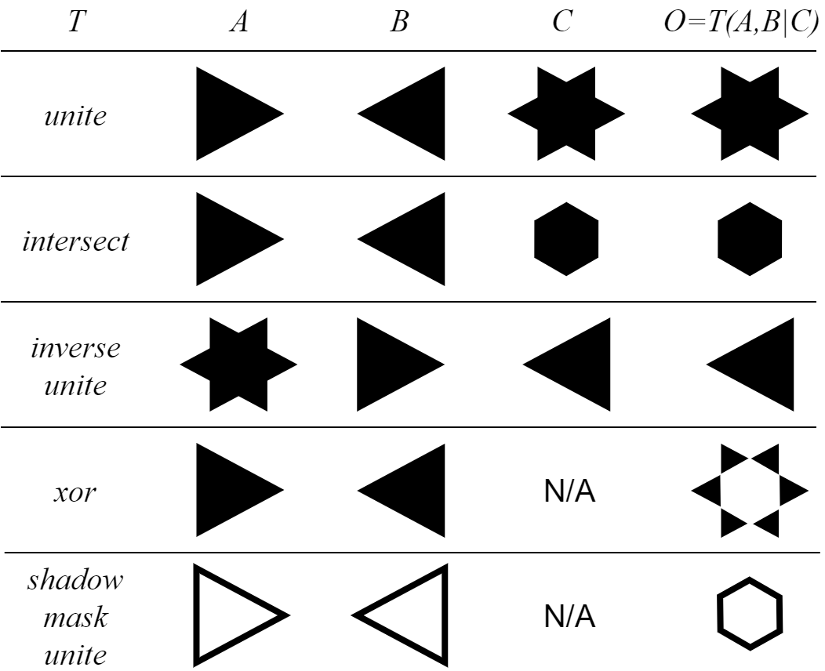
Transformations
Unary
Unary
Affine
Set
Binary
Binary
Affine
Set

