Slide 1
Not Quite Any Way You Slice It: How Different Analogical Constructions Affect Raven’s Matrices Performance
Yuan Yang¹
Keith McGreggor²
Maithilee Kunda¹ ¹Electrical Engineering and Computer Science, Vanderbilt University
²School of Interactive Computing, Georgia Tech

Slide 2
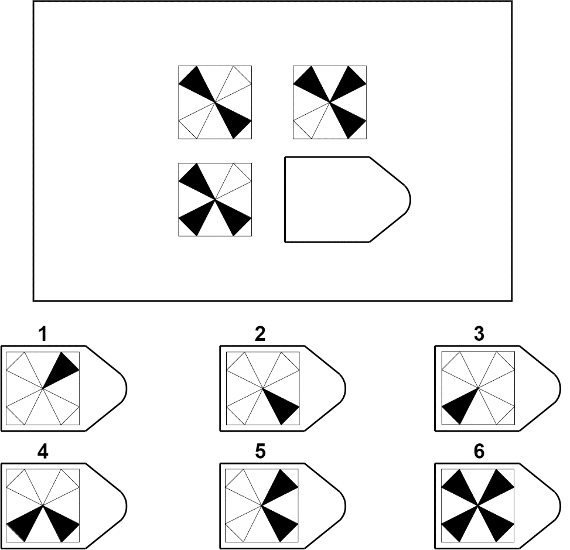
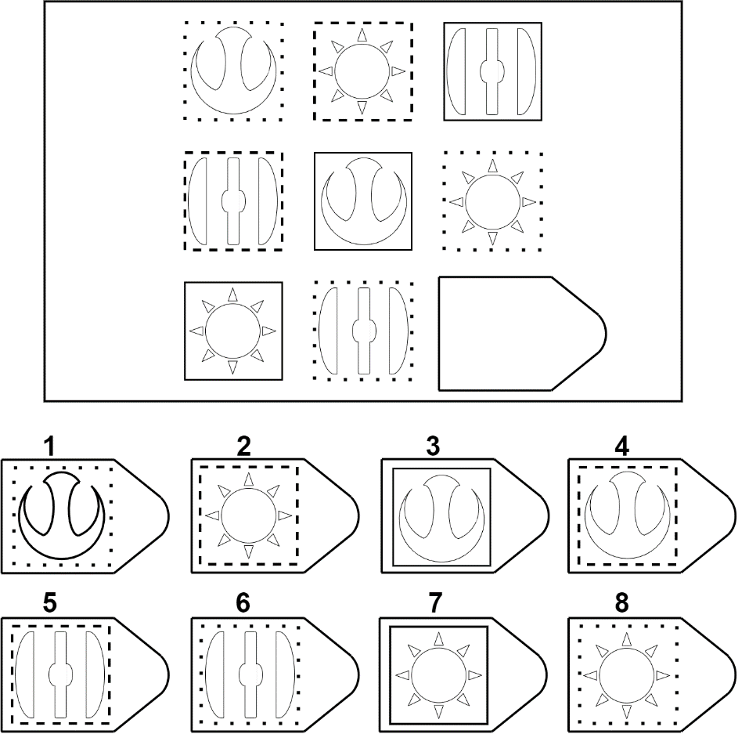

Slide 3
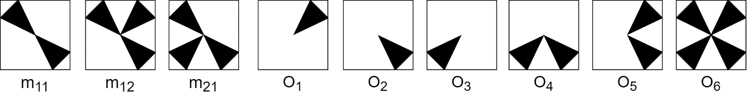
Integration Strategies
Answer Choice
Image Transformations
Analogies
Affine and Set Transformation Induction Model (ASTI)

Slide 4


Jaccard Index
Similarity Procedures
Symmetric
Asymmetric
(directional)
Alignment

Slide 5
Transformations
Unary
Unary
Affine
Set
Binary
Binary
Affine
Set

Slide 6
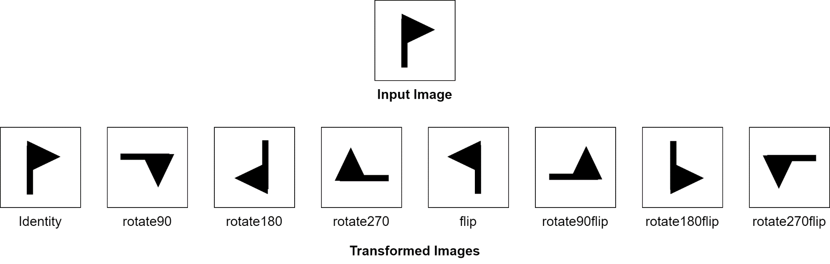
Transformations
Unary
Unary
Affine
Set
Binary
Binary
Affine
Set

Slide 7
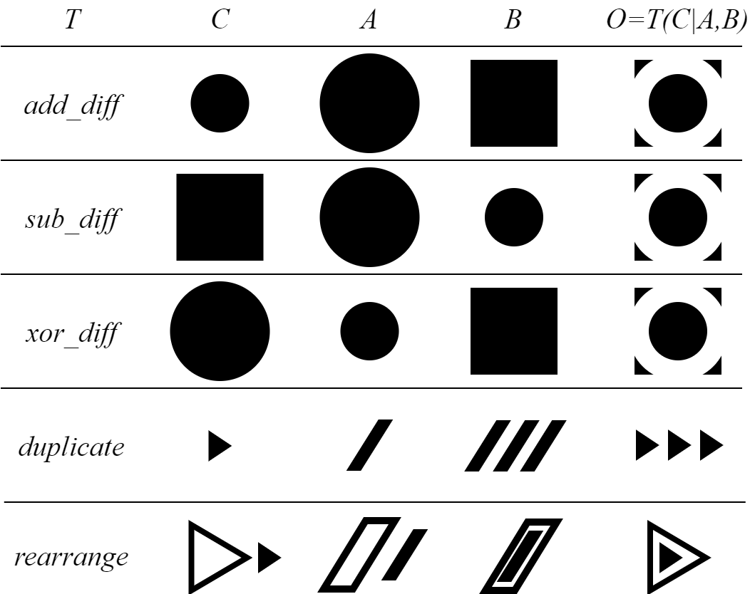
Input
parameters
Output
Transformations
Unary
Unary
Affine
Set
Binary
Binary
Affine
Set

Slide 8
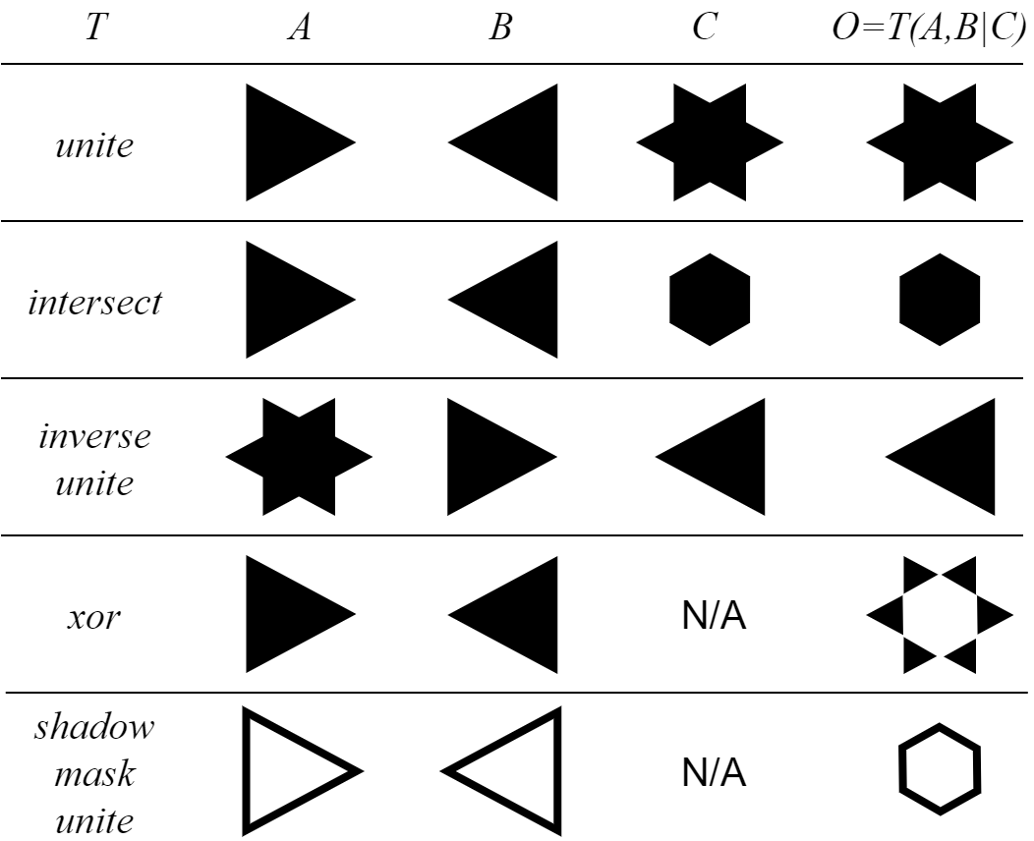
Input
param
Output
Transformations
Unary
Unary
Affine
Set
Binary
Binary
Affine
Set

Slide 9
Analogies
Simple
Simple
Pair
3-Tuple
Recursive
Recursive
Pair
3-Tuple

Slide 10
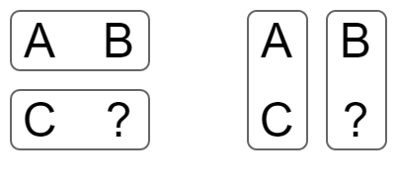
Analogies
Simple
Simple
Pair
3-Tuple
Recursive
Recursive
Pair
3-Tuple
A:B::C:?
A:C::B:?

Slide 11
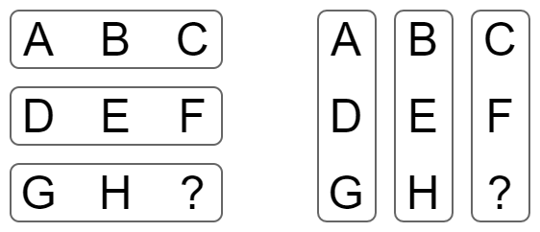
Analogies
Simple
Simple
Pair
3-Tuple
Recursive
Recursive
Pair
3-Tuple
A:B:C::G:H:?
D:E:F::G:H:?
A:D:G::C:F:?
B:E:H::C:F:?

Slide 12
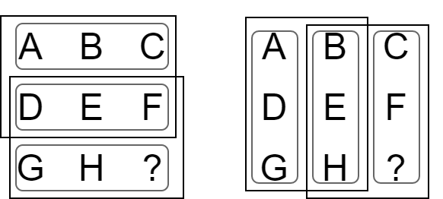
A:D:G::B:E:? with H as the only option
B:E:H::C:F:? with the original options
Analogies
A:D:G::B:E:H:::B:E:H::C:F:?
Simple
Simple
Pair
3-Tuple
Recursive
Recursive
Pair
3-Tuple
A:B:C::D:E:F:::D:E:F::G:H:?
A:B:C::D:E:? with F as the only option
D:E:F::G:H:? with the original options

Slide 13
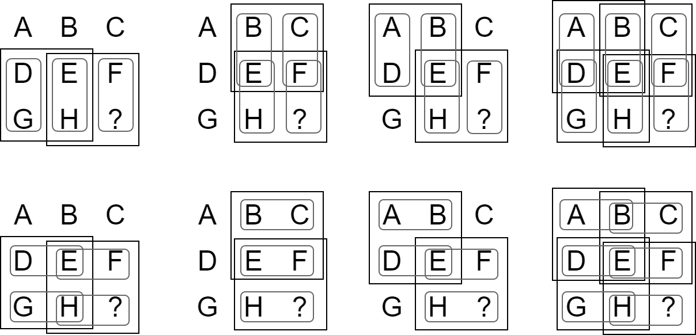
Analogies
Simple
Simple
Pair
3-Tuple
Recursive
Recursive
Pair
3-Tuple

Slide 14
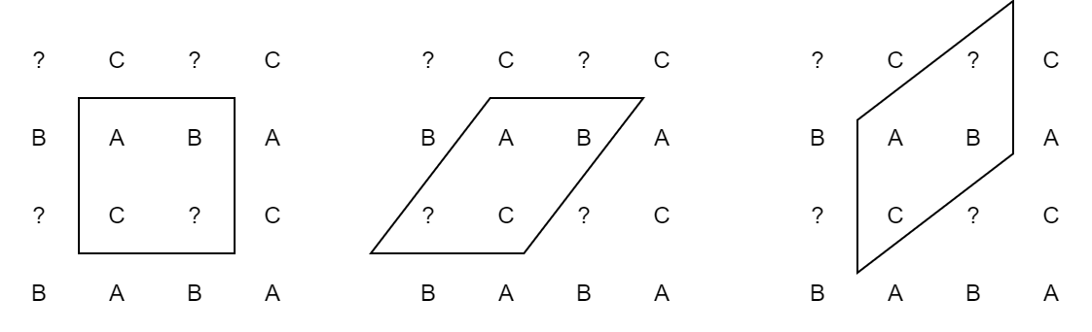
More Analogies

Slide 15
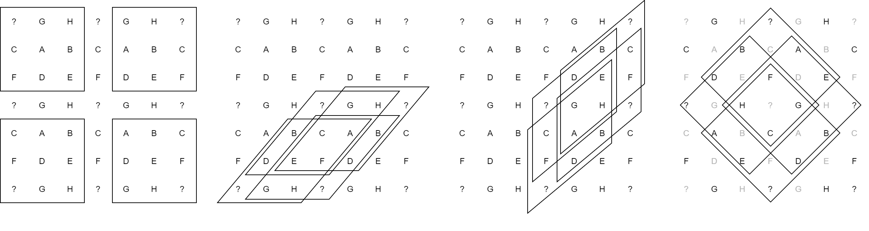
More Analogies

Slide 16
Given transformations and analogies, how do humans solve Raven’s problem?

Slide 17
Explain: pairs of analogy and transformation
Verify: the explanations with options
Decide: which one to choose
(rotate90, A:B::C:?), (filp, A:B::C:?), …
(sub_diff, A:B::C:?),(add_diff, A:B::C:?), (xor_diff, A:B::C:?)…
……

Slide 18
Explain: pairs of analogy and transformation
Verify: the explanations with options
Decide: which one to choose
(unite, A:B:C::G:H:?), (unite, D:E:F::G:H:?), …
(intersect, A:D:G::B:E:H:::B:E:H::C:F:?), …
(inv_unite, G:F:B::C:H:D:::C:H:D::A:E:?), …
(xor, A:B::C:?)…
……

Slide 19
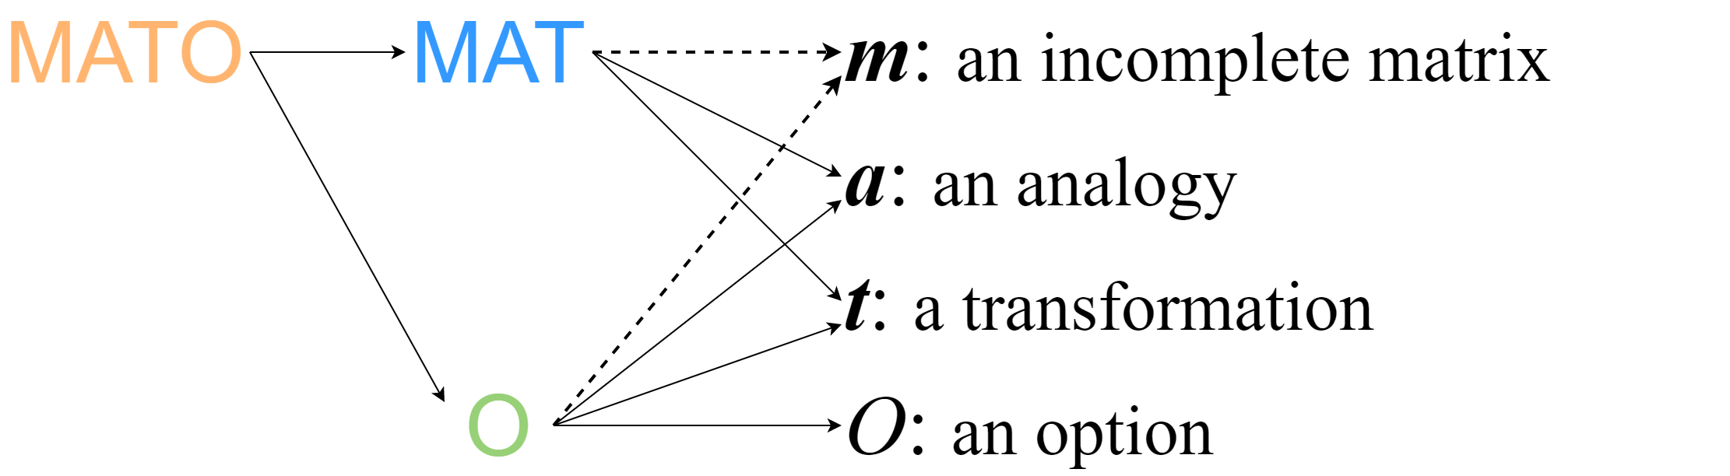
To quantify this process, scores based on similarity metrics
Explain: pairs of analogy and transformation
Decide: which one to choose
Verify: the explanations with options

Slide 20
A helpful heuristic:
Ideally, A good MAT score implies good O scores, and thus good MATO scores.
Explain: pairs of analogy and transformation
Decide: which one to choose
Verify: the explanations with options

Slide 21
Put all thing together - Integration Strategies
MATO
O
Confident
Confident
MATO
O
How much it relies on the heuristic
Neutral
Neutral
MATO
O
Prudent
Prudent

Slide 22
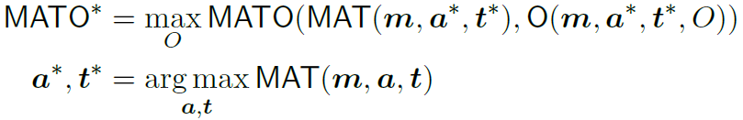
Put all thing together - Integration Strategies
MATO
O
M-confident:
Confident
Confident
MATO
O
How much it relies on the heuristic
Neutral
Neutral
MATO
O
Prudent
Prudent

Slide 23
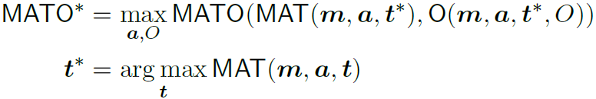
Put all thing together - Integration Strategies
MATO
O
Confident
Confident
MATO
O
How much it relies on the heuristic
M-neutral:
Neutral
Neutral
MATO
O
Prudent
Prudent

Slide 24
Put all thing together - Integration Strategies
MATO
O
Confident
Confident
MATO
O
How much it relies on the heuristic
Neutral
Neutral
MATO
O
M-prudent:
Prudent
Prudent

Slide 25
Put all thing together - Integration Strategies
MATO
O
O-confident strategy is mathematically equivalent to M-confident strategy.
Confident
Confident
MATO
O
How much it relies on the heuristic
Neutral
Neutral
MATO
O
Prudent
Prudent

Slide 26
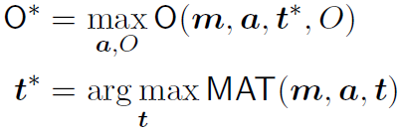
Put all thing together - Integration Strategies
MATO
O
Confident
Confident
MATO
O
How much it relies on the heuristic
O-prudent:
Neutral
Neutral
MATO
O
Prudent
Prudent

Slide 27

Put all thing together - Integration Strategies
MATO
O
Confident
Confident
MATO
O
How much it relies on the heuristic
Neutral
Neutral
MATO
O
O-prudent:
Prudent
Prudent

Slide 28
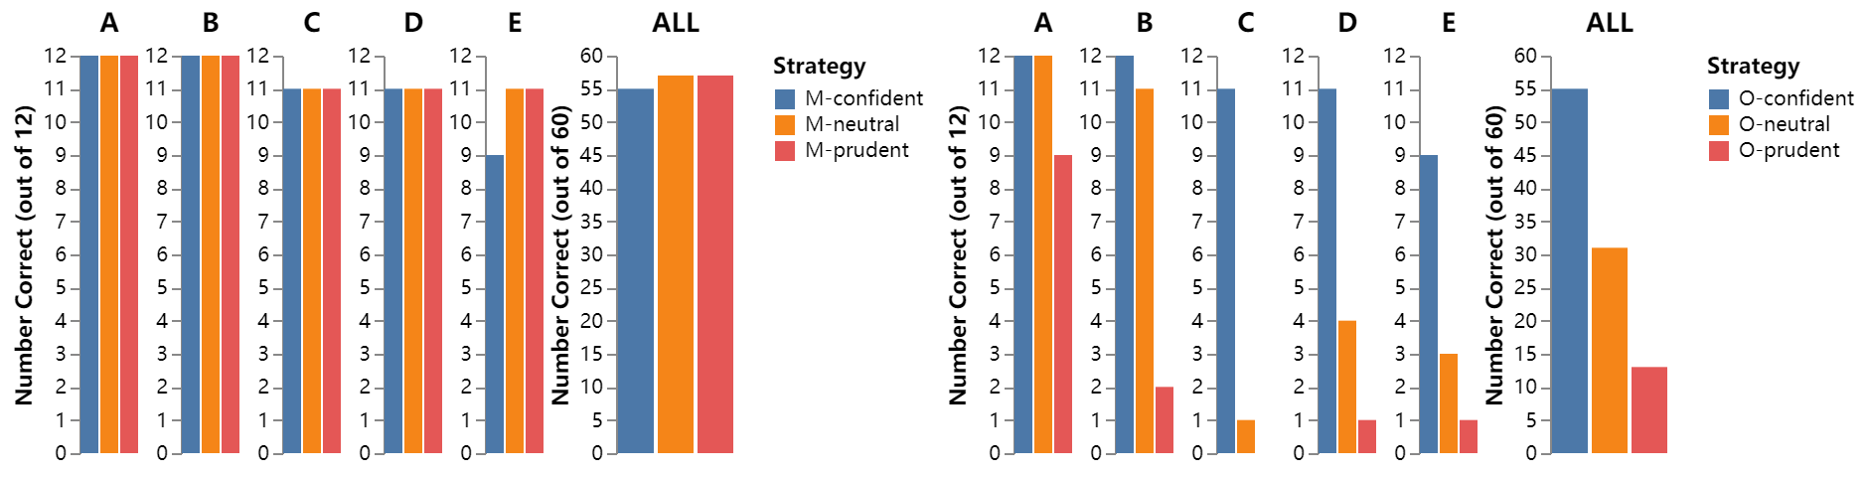
How strategies compare?

Slide 29
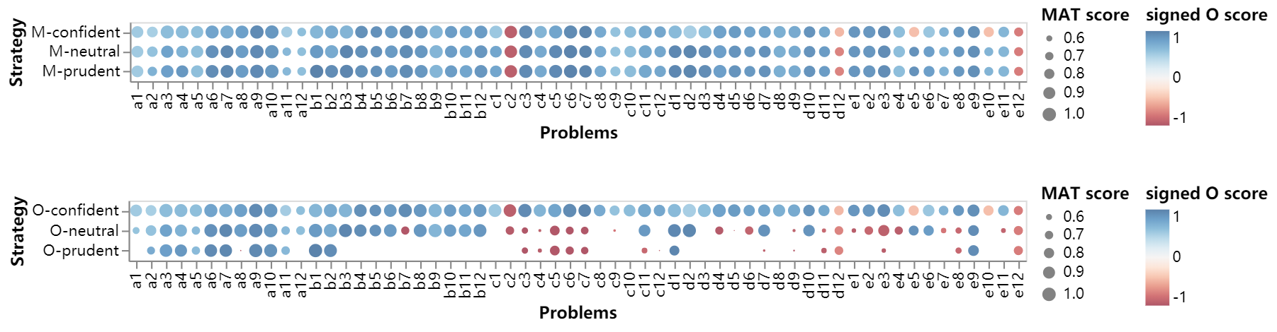
How strategies compare?

Slide 30
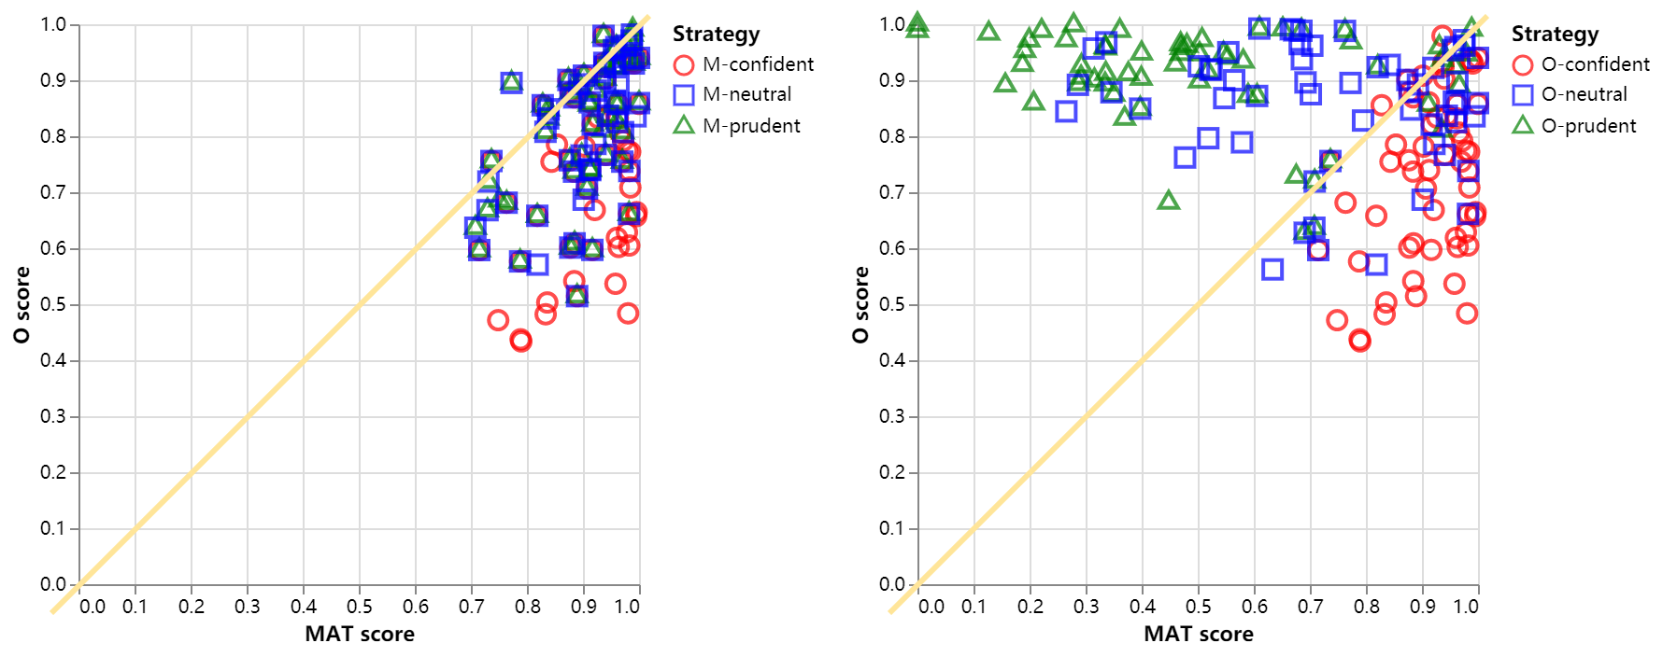
How strategies compare?

Slide 31
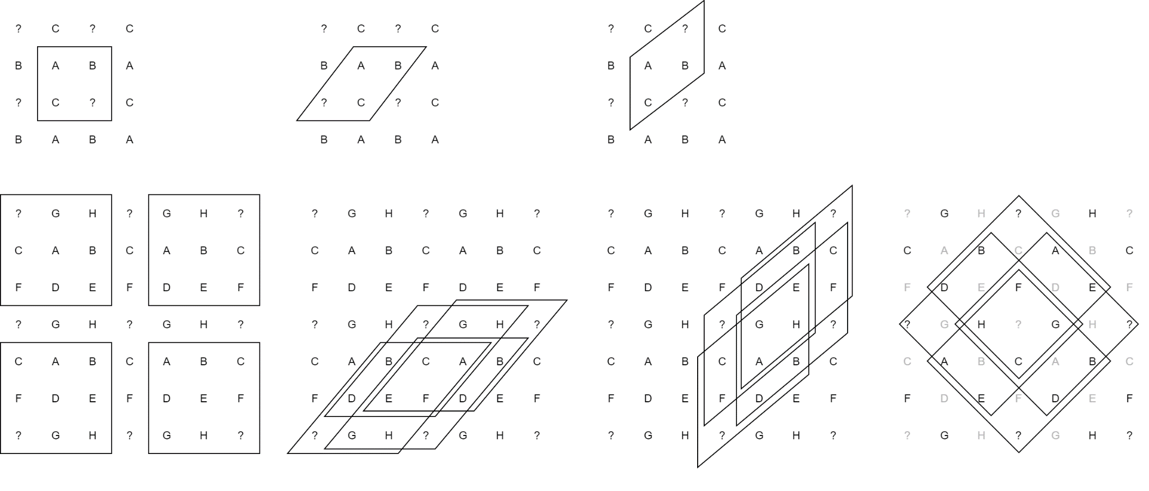
Grouping of Transformations and Analogies
Affine = {all the affine transformations }
Diff = {add_diff, sub_diff, xor_diff }
Match = {duplicate, rearrange }
Set = {Other set operations }
S
H
V
R

Slide 32
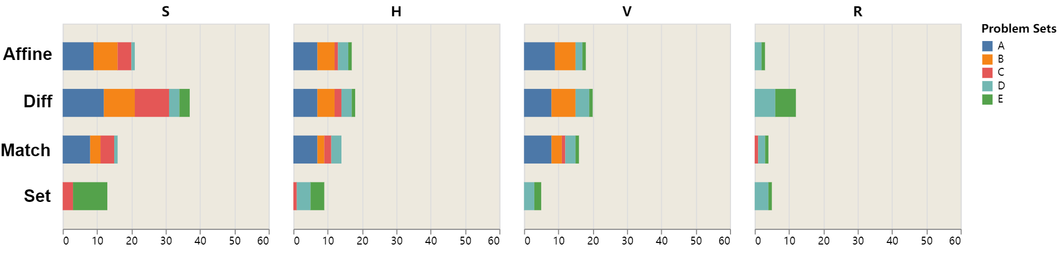
How Transformations and Analogies Compares?
(Using M-prudent strategy)
1-to-1 Comparison

Slide 33
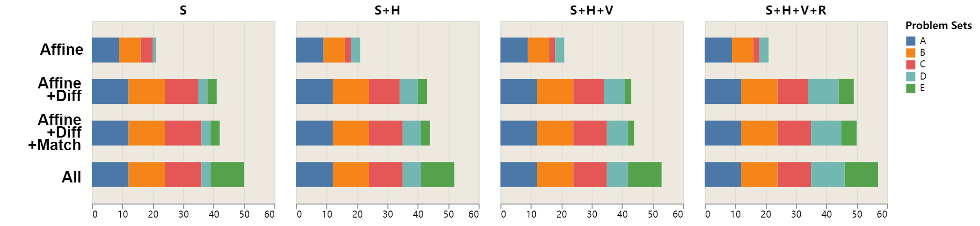
How Transformations and Analogies Compares?
(Using M-prudent strategy)
Incremental Comparison

Slide 34
Some Reflections on Analogical Constructions in Raven’s
From an outsider perspective
Tests like Raven’s, what characteristic do they have?
Fluid intelligence, especially eductive ability, is tested.
Ideally, the scenarios in the test should be completely new to the test-takers.
So if it is completely new to me, how do I know I am solving the problem correctly ?
Redundancy!
Analogy is thus required to organize redundant information to give you that “aha” moment.

Slide 35
Conclusion and Future Work
Try to push the performance to the limit, using only pixel-level operations.
Thoroughly study the influences of transformations, analogies, and integration strategies.
For AI, analogical ability is an unavoidable issue.
For human, analogical ability causes individual difference in these tests.
Some future work:
Go beyond the proportional analogy.
More robust similarity metrics.

