Slide 1
Not Quite Any Way You Slice It: How Different Analogical Constructions Affect Raven’s Matrices Performance
Yuan Yang¹
Keith McGreggor²
Maithilee Kunda¹ ¹Electrical Engineering and Computer Science, Vanderbilt University
²School of Interactive Computing, Georgia Tech

Slide 2
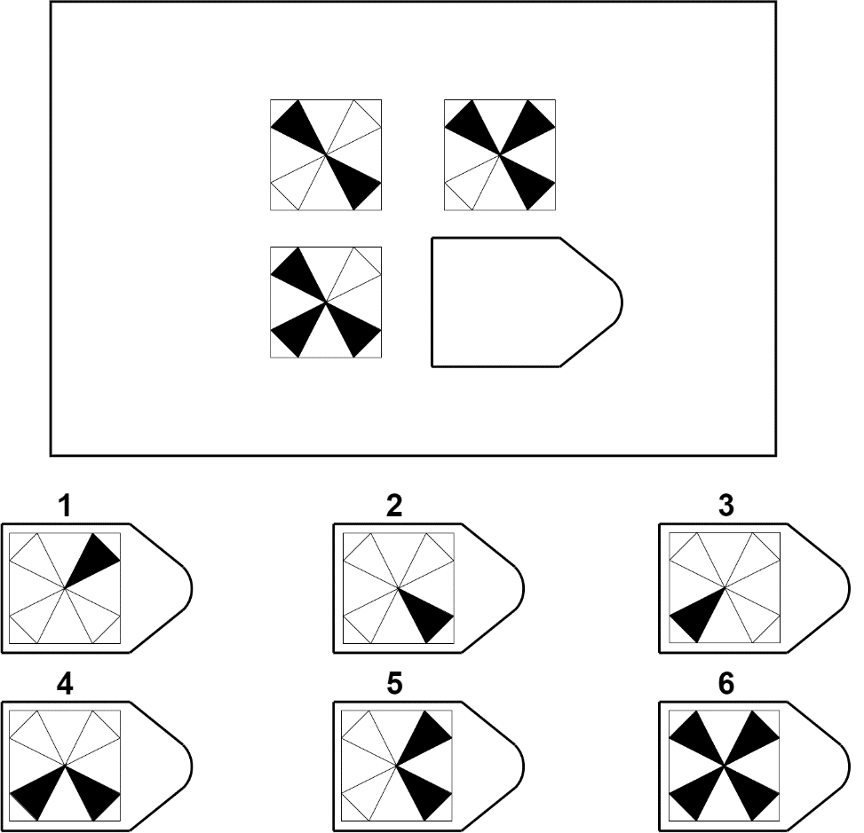
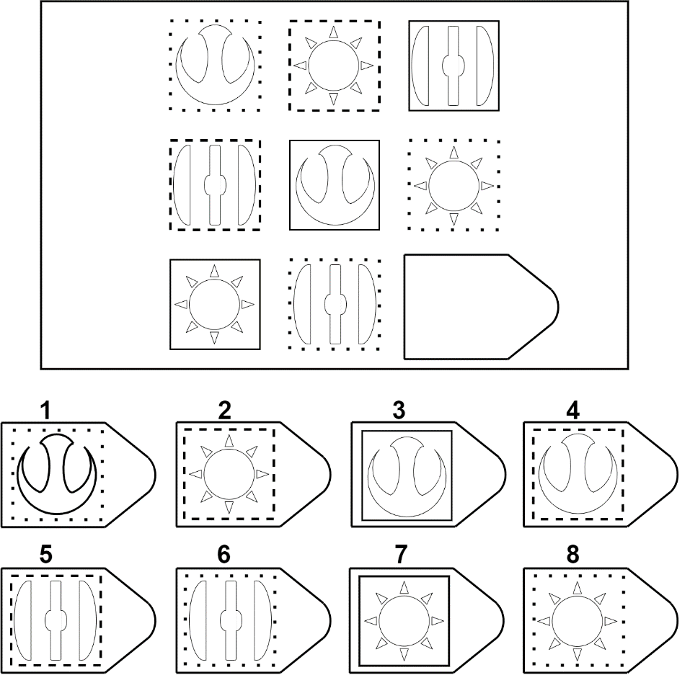

Slide 3
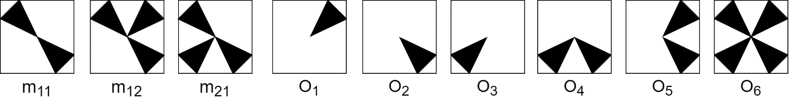
Integration Strategies
Answer Choice
Image Transformations
Analogies
Affine and Set Transformation Induction Model (ASTI)

Slide 4




Reasoning with Visual Imagery
Problem information is represented as pixel-based images.
Reasoning operations are quantitative transformations over those images.
$$+$$
$$−$$
$$×$$
$$÷$$

Slide 5


Jaccard Index
Similarity Procedures
Symmetric
Asymmetric
(directional)
Alignment
Notes:
One important piece of many of our imagery-based models is the similarity metric, how you compute similarity between two images.
We use variations of the Jaccard index, including a way to obtain similarity under different relative translations of the two images.

Slide 6
Transformations
Unary
Unary
Affine
Set
Binary
Set

Slide 7
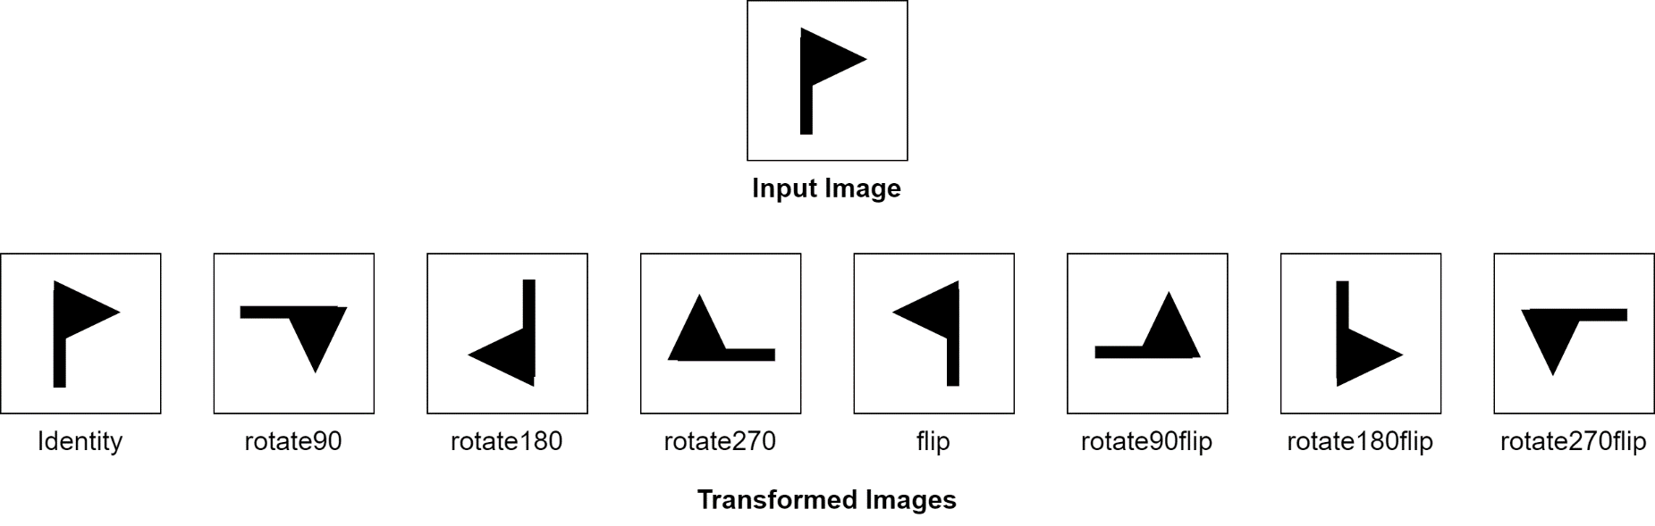
Transformations
Unary
Unary
Affine
Set
Binary
Set

Slide 8
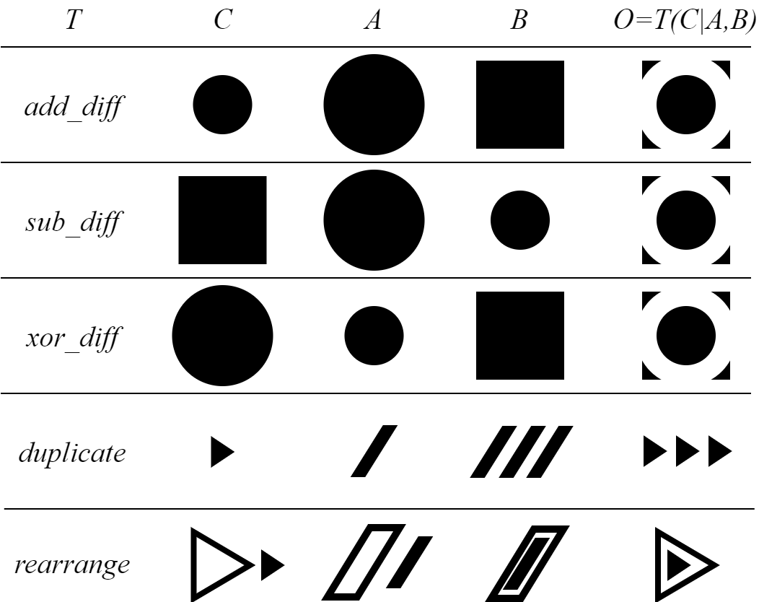
Input
parameters
Output
Transformations
Unary
Unary
Affine
Set
Binary
Set

Slide 9
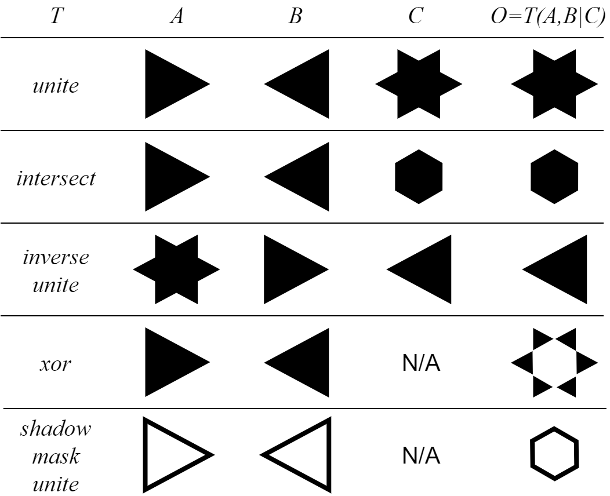
Input
param
Output
Transformations
Unary
Unary
Affine
Set
Binary
Set

Slide 10
Analogies
Simple
Simple
Pair
3-Tuple
Recursive
Recursive
Pair
3-Tuple

Slide 11
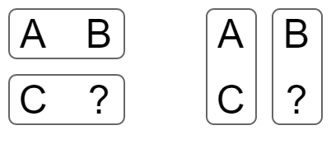
Analogies
Simple
Simple
Pair
3-Tuple
Recursive
Recursive
Pair
3-Tuple
A:B::C:?
A:C::B:?

Slide 12
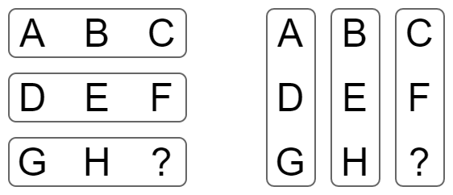
Analogies
Simple
Simple
Pair
3-Tuple
Recursive
Recursive
Pair
3-Tuple
A:B:C::G:H:?
D:E:F::G:H:?
A:D:G::C:F:?
B:E:H::C:F:?

Slide 13
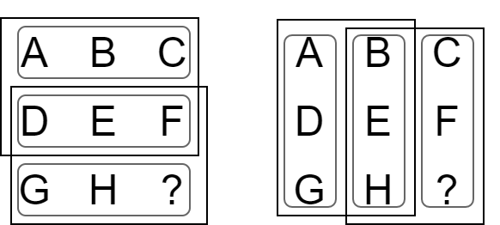
A:D:G::B:E:? with H as the only option
B:E:H::C:F:? with the original options
Analogies
A:D:G::B:E:H:::B:E:H::C:F:?
Simple
Simple
Pair
3-Tuple
Recursive
Recursive
Pair
3-Tuple
A:B:C::D:E:F:::D:E:F::G:H:?
A:B:C::D:E:? with F as the only option
D:E:F::G:H:? with the original options

Slide 14
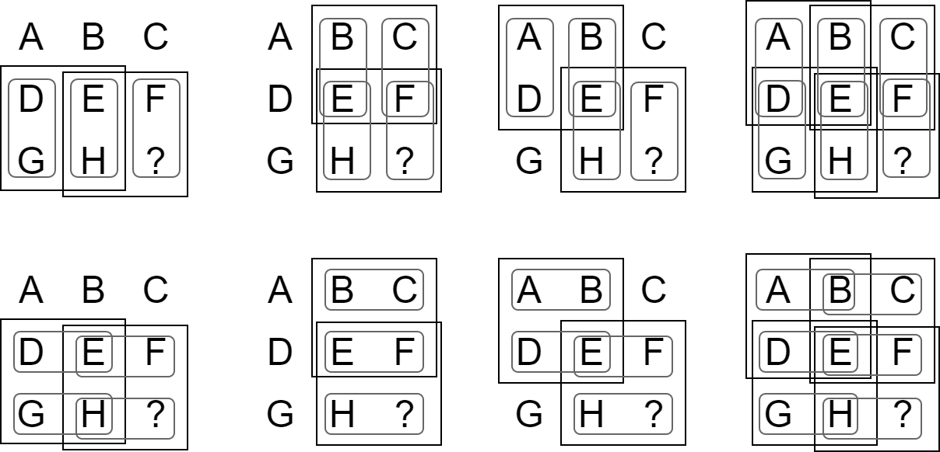
Analogies
Simple
Simple
Pair
3-Tuple
Recursive
Recursive
Pair
3-Tuple

Slide 15
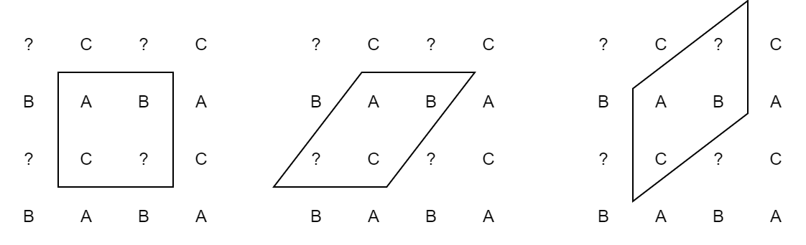
More Analogies

Slide 16
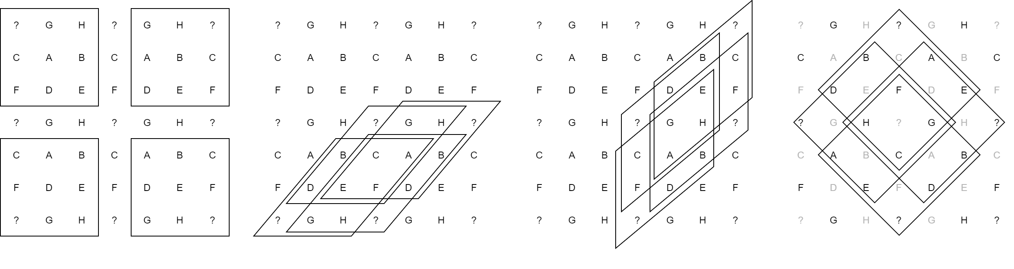
More Analogies

Slide 17
Given transformations --- that relate individual matrix elements --- and analogies --- that suggest which sets of matrix elements to relate --- , how might intelligent agents solve Raven’s problems?

Slide 18
Explain: pairs of analogy and transformation
Verify: the explanations with options
Decide: which one to choose
(rotate90, A:B::C:?), (filp, A:B::C:?), …
(sub_diff, A:B::C:?),(add_diff, A:B::C:?), (xor_diff, A:B::C:?)…
……

Slide 19
Explain: pairs of analogy and transformation
Verify: the explanations with options
Decide: which one to choose
(unite, A:B:C::G:H:?), (unite, D:E:F::G:H:?), …
(intersect, A:D:G::B:E:H:::B:E:H::C:F:?), …
(inv_unite, G:F:B::C:H:D:::C:H:D::A:E:?), …
(xor, A:B::C:?)…
……

Slide 20
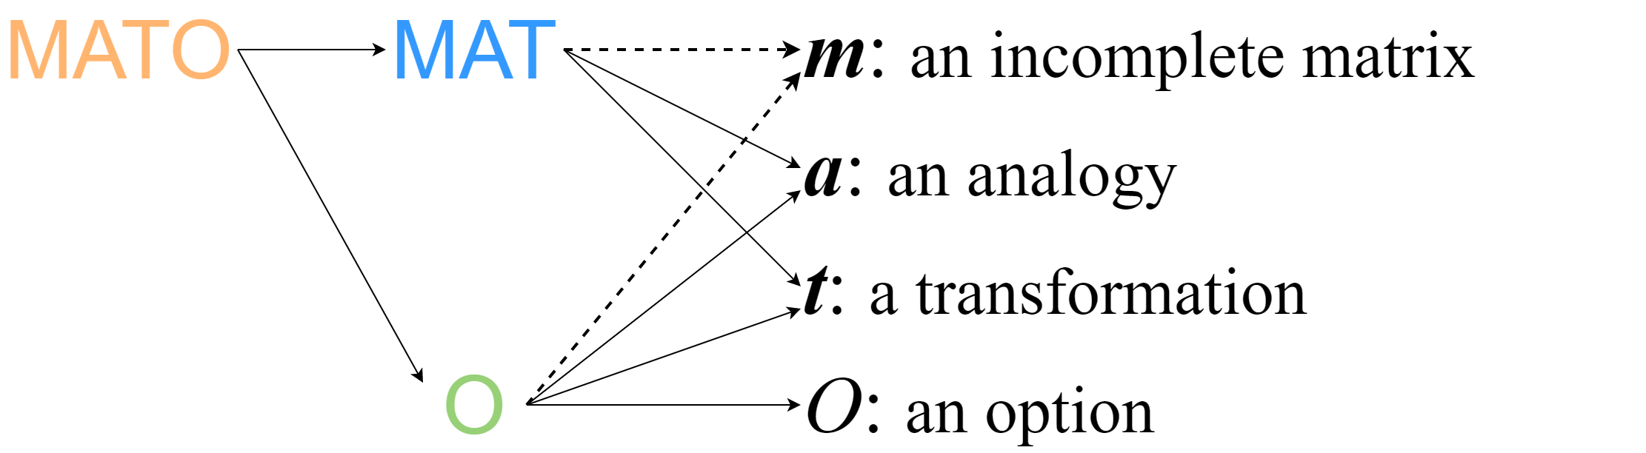
To quantify this process, scores based on similarity metrics
Explain: pairs of analogy and transformation
Decide: which one to choose
Verify: the explanations with options

Slide 21
A helpful heuristic:
Ideally, A good MAT score implies good O scores, and thus good MATO scores.
Explain: pairs of analogy and transformation
Decide: which one to choose
Verify: the explanations with options
Notes:
inspired by some of our own introspective observations about how we as humans solve Raven's problems

Slide 22
Put everything together - Integration Strategies
MATO
O
Confident
Confident
MATO
O
How much it relies on the heuristic
Neutral
Neutral
MATO
O
Prudent
Prudent
M Strategies
O Strategies

Slide 23
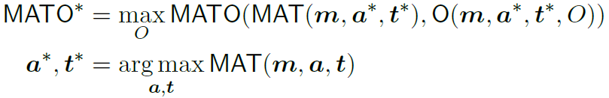
Put everything together - Integration Strategies
MATO
O
Confident
Confident
MATO
O
How much it relies on the heuristic
Neutral
Neutral
MATO
O
Prudent
Prudent
M Strategies
O Strategies

Slide 24
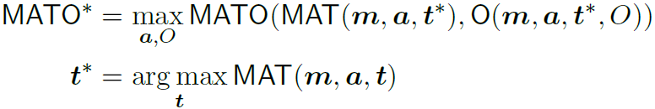
Put everything together - Integration Strategies
MATO
O
Confident
Confident
MATO
O
How much it relies on the heuristic
Neutral
Neutral
MATO
O
Prudent
Prudent
M Strategies
O Strategies

Slide 25
Put everything together - Integration Strategies
MATO
O
Confident
Confident
MATO
O
How much it relies on the heuristic
Neutral
Neutral
MATO
O
Prudent
Prudent
M Strategies
O Strategies

Slide 26
Put everything together - Integration Strategies
MATO
O
O-Confident is mathematically equivalent to M-confident.
Confident
Confident
MATO
O
How much it relies on the heuristic
Neutral
Neutral
MATO
O
Prudent
Prudent
M Strategies
O Strategies

Slide 27
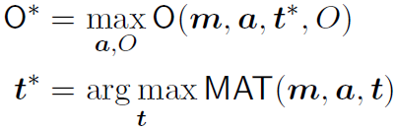
Put everything together - Integration Strategies
MATO
O
O-Confident is mathematically equivalent to M-confident.
Confident
Confident
MATO
O
How much it relies on the heuristic
Neutral
Neutral
MATO
O
Prudent
Prudent
M Strategies
O Strategies

Slide 28

Put everything together - Integration Strategies
MATO
O
O-Confident is mathematically equivalent to M-confident.
Confident
Confident
MATO
O
How much it relies on the heuristic
Neutral
Neutral
MATO
O
Prudent
Prudent
M Strategies
O Strategies

Slide 29
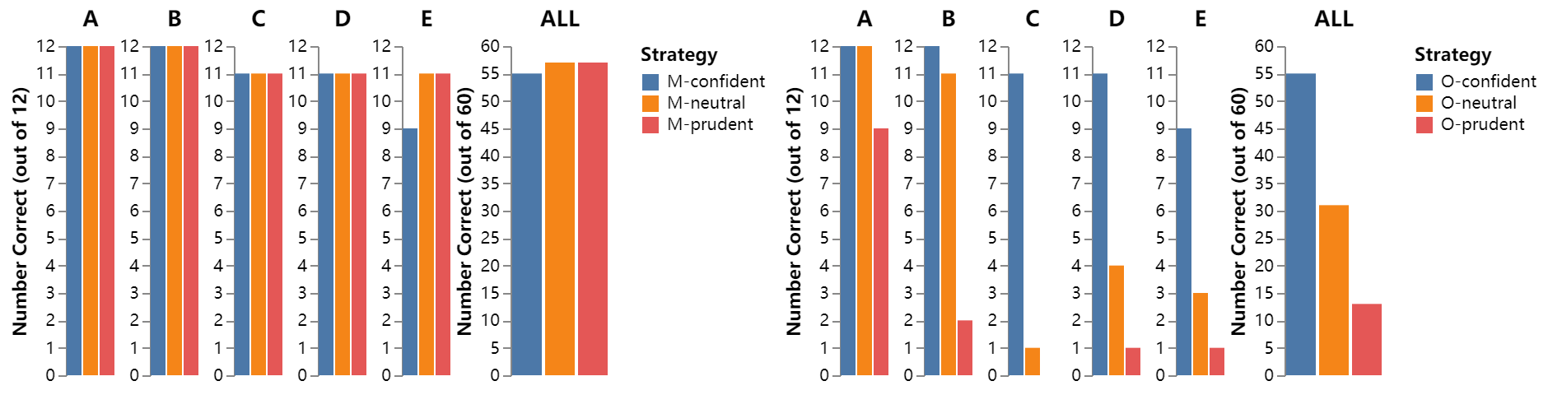
How strategies compare?

Slide 30
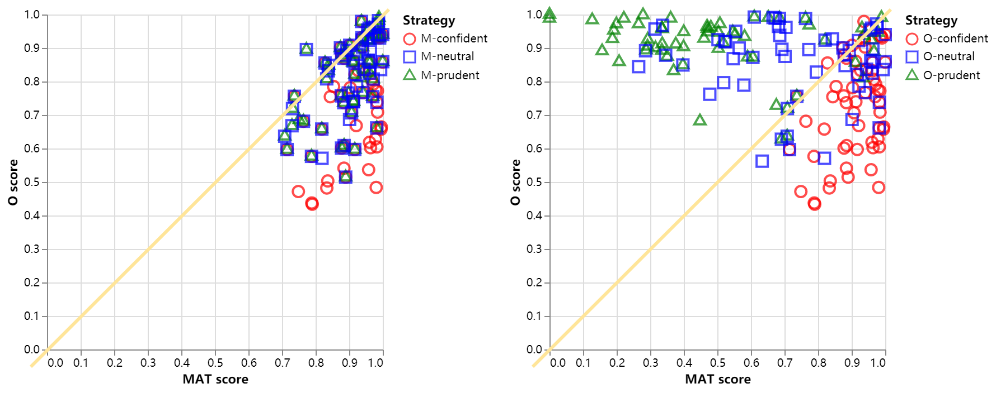
How strategies compare?

Slide 31
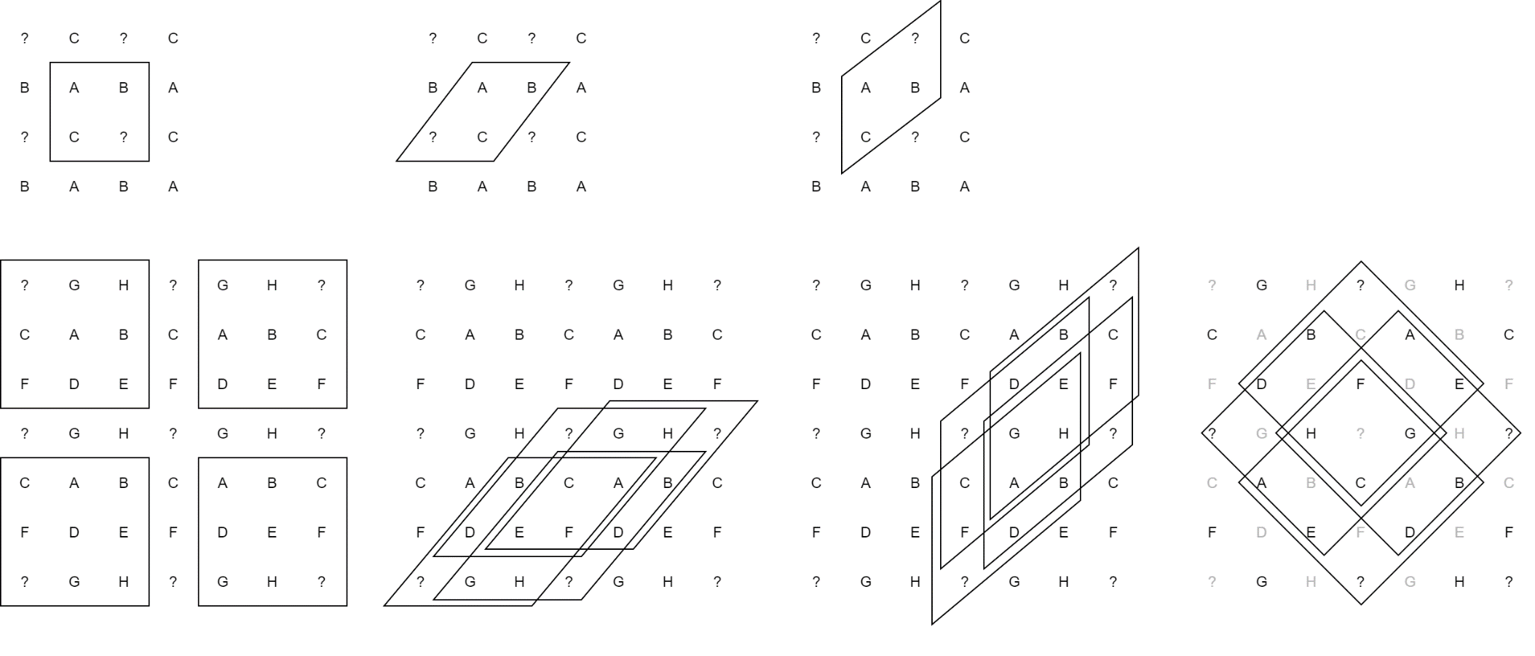
Grouping of Transformations and Analogies
Affine = {all the affine transformations }
Diff = {add_diff, sub_diff, xor_diff }
Match = {duplicate, rearrange }
Set = {Other set operations }
S
H
V
R

Slide 32
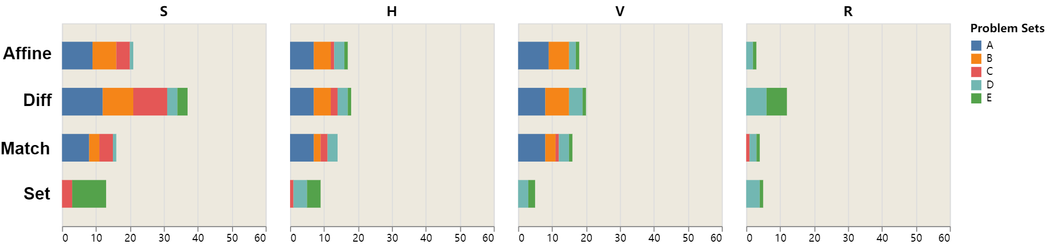
How Transformations and Analogies Compares?
(Using M-prudent strategy)
1-to-1 Comparison

Slide 33
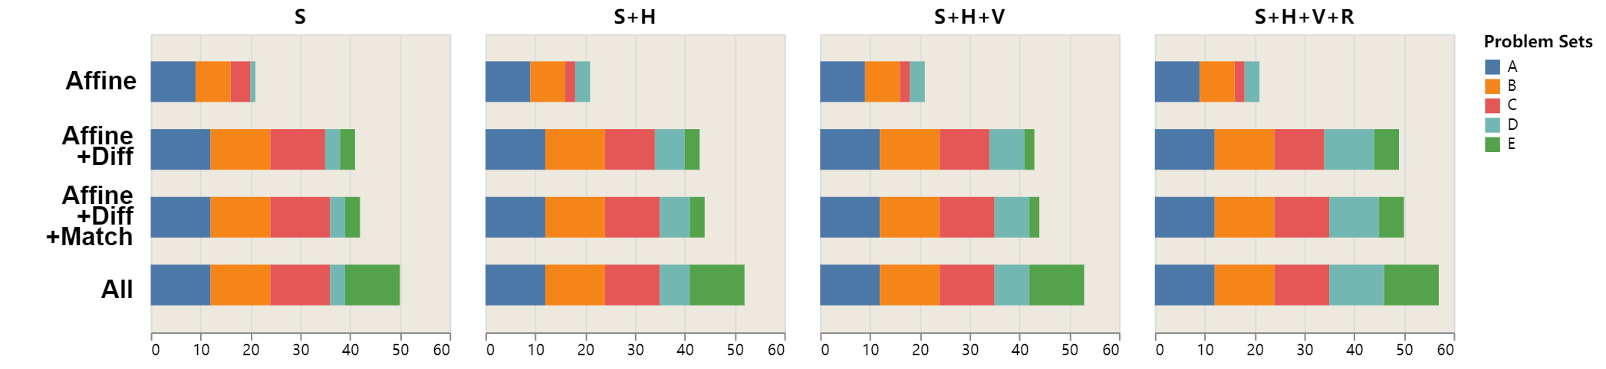
How Transformations and Analogies Compares?
(Using M-prudent strategy)
Incremental Comparison

Slide 34
Some Reflections on Analogical Constructions in Raven’s
From an outsider perspective
Tests like Raven’s, what characteristic do they have?
Fluid intelligence, especially eductive ability, is tested.
Ideally, the scenarios in the test should be completely new to the test-takers.
So if it is completely new to me, how do I know I am solving the problem correctly ?
Redundancy!
Analogy is can be used to organize redundant information to give you that “aha” moment.
Future Question: How can an intelligent agent discover these organizational patterns and integration strategies on its own?

Slide 35
Q&A
Thank you for being so attentive !

