Slide 1
Chapter 4 Multi-Page Websites

Slide 2


Slide 3
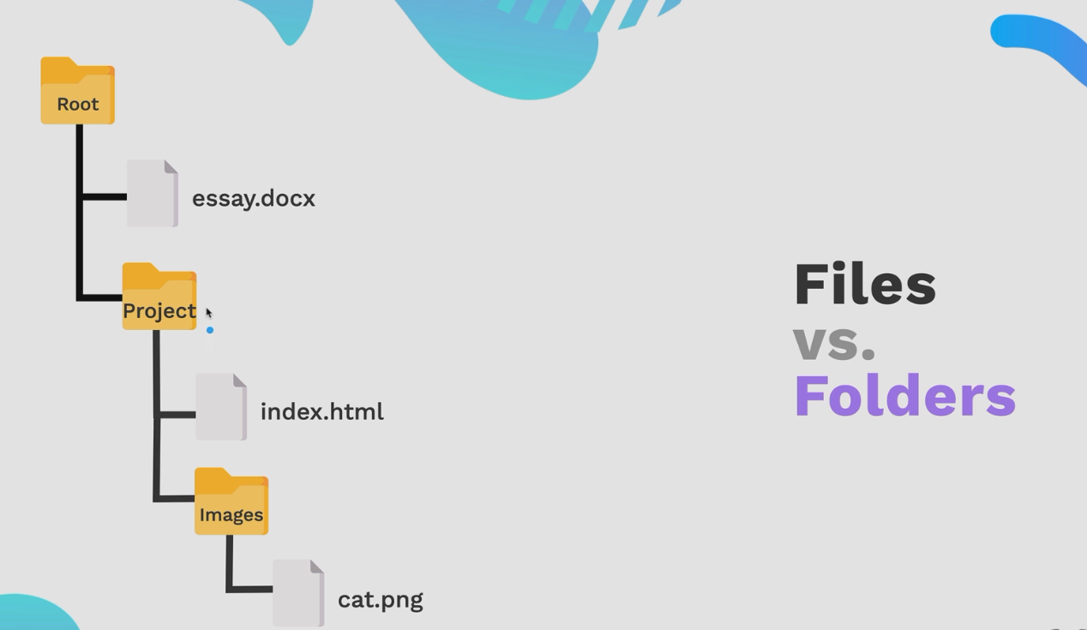

Slide 4
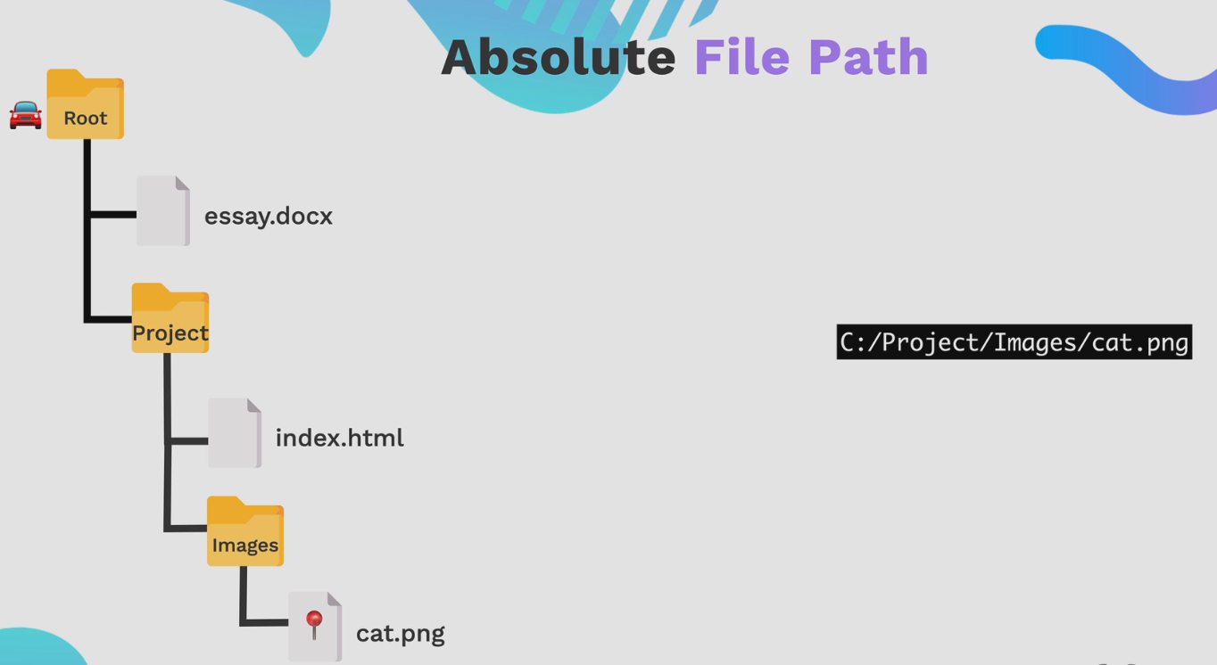

Slide 5
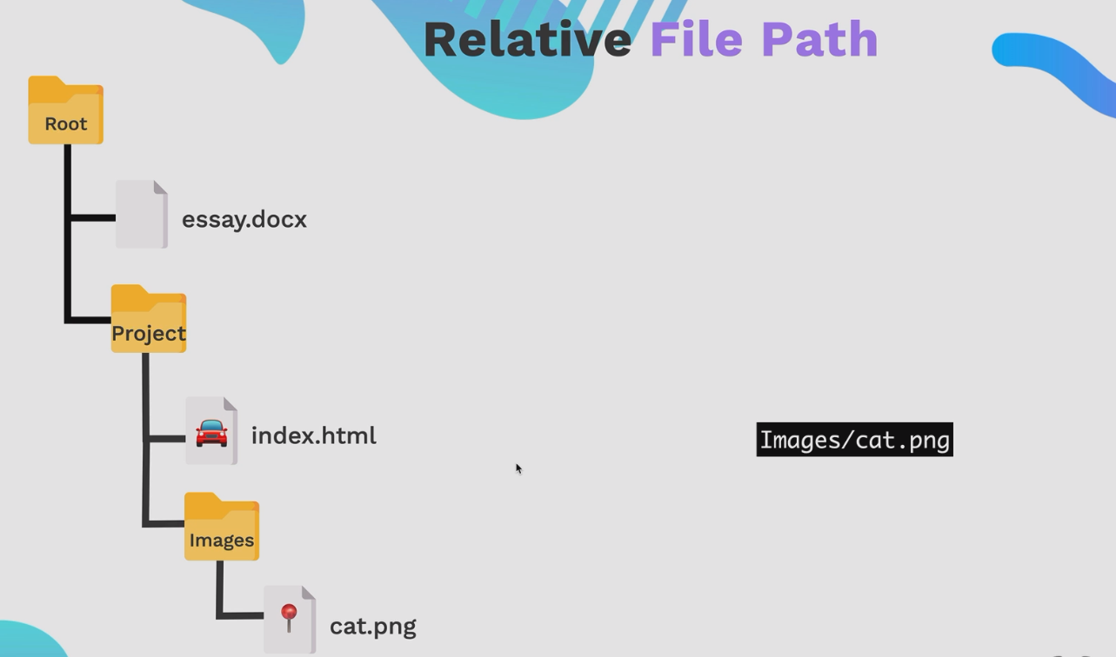
Advatage: Could move the project as a whole.

Slide 6
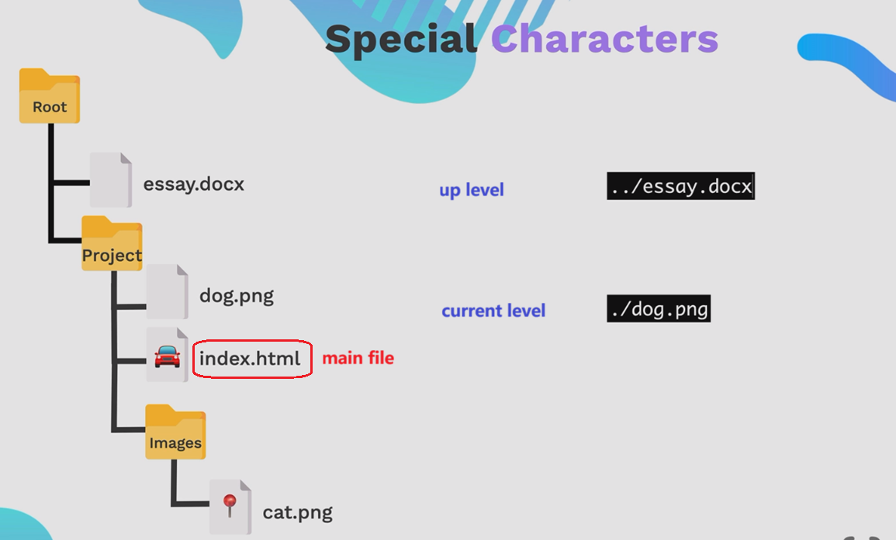

Slide 7
Try an Exercise
Exercise 4.0： File Paths

Slide 8


Slide 9
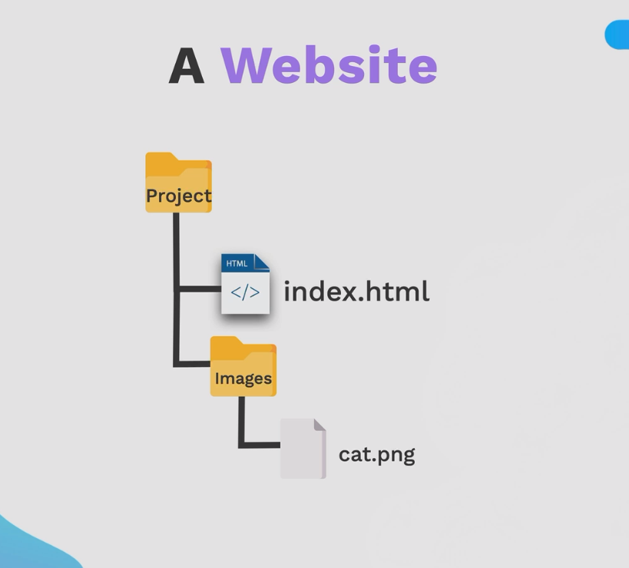

Slide 10
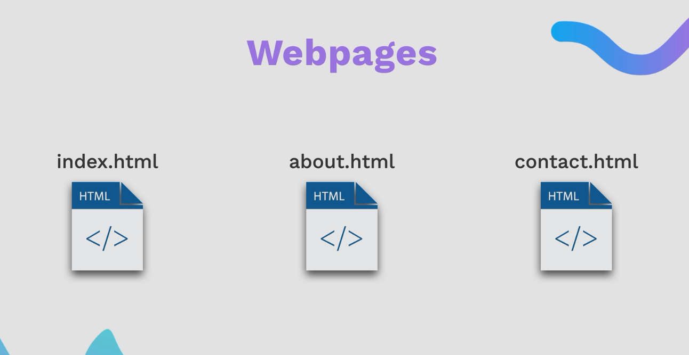

Slide 11
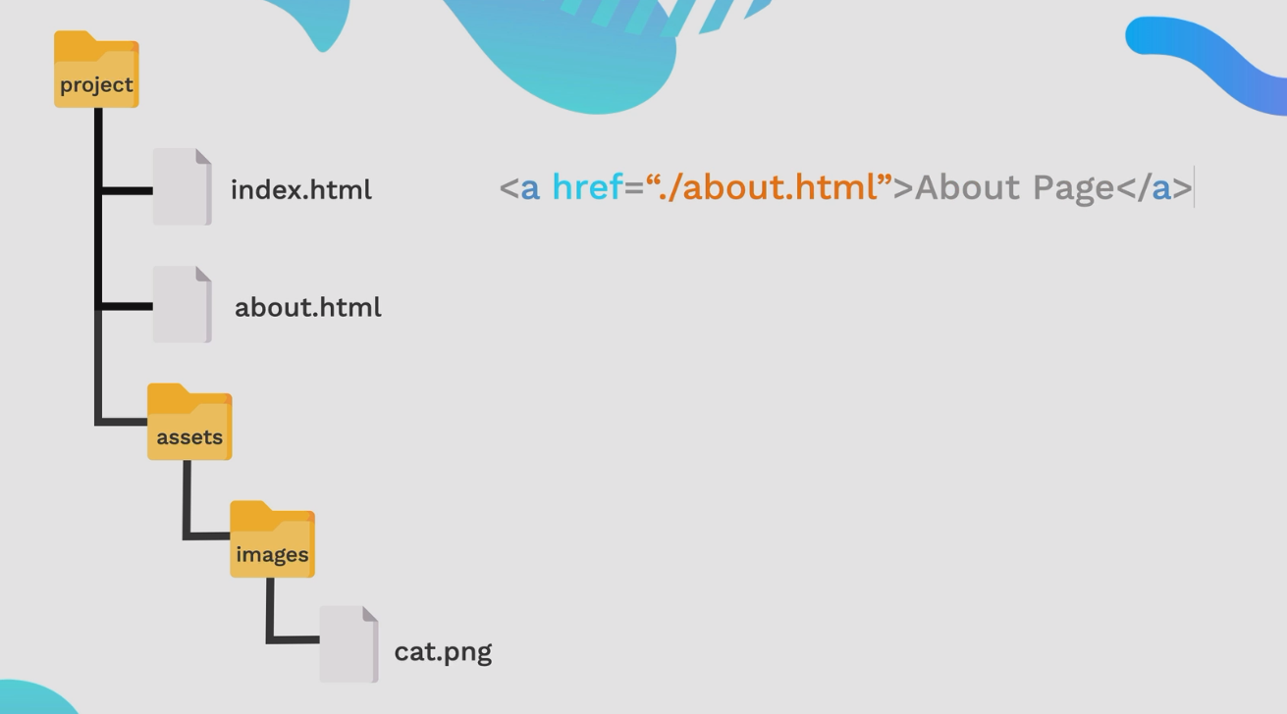

Slide 12
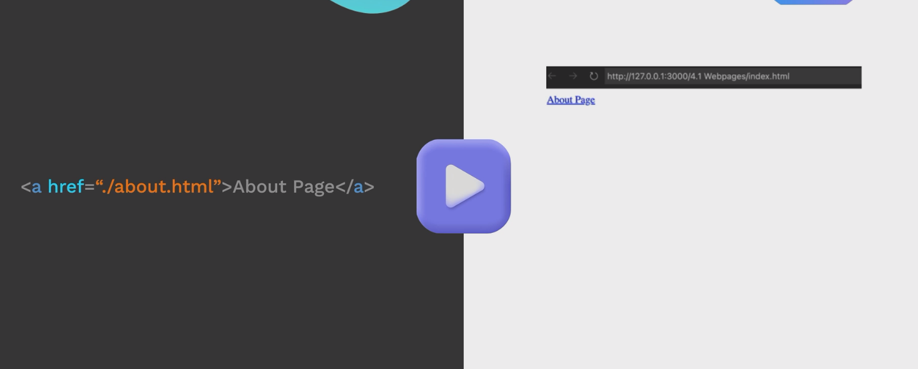

Slide 13
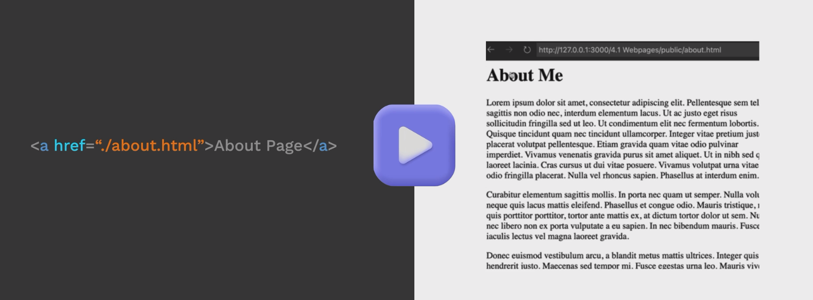

Slide 14
Try an Exercise
Exercise 4.1： Webpages

Slide 15
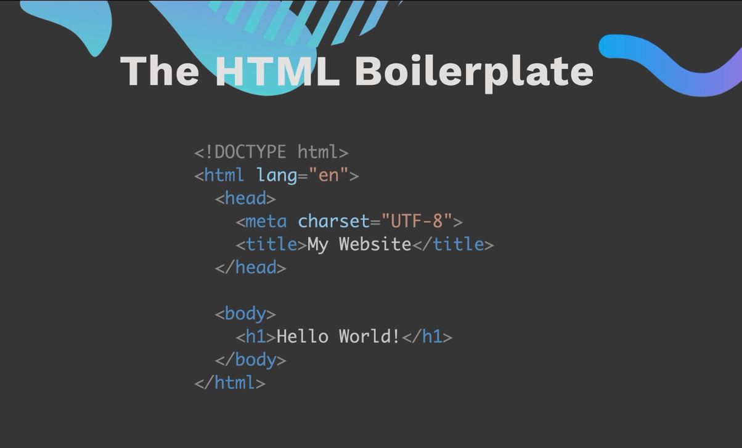

Slide 16
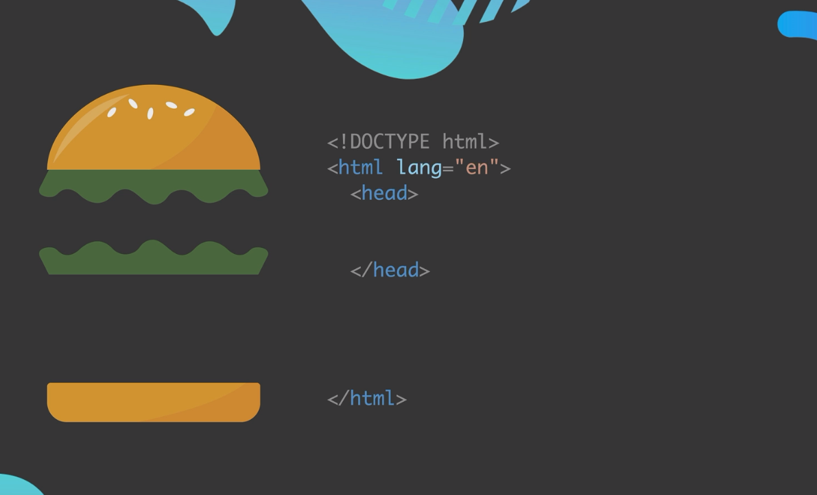

Slide 17
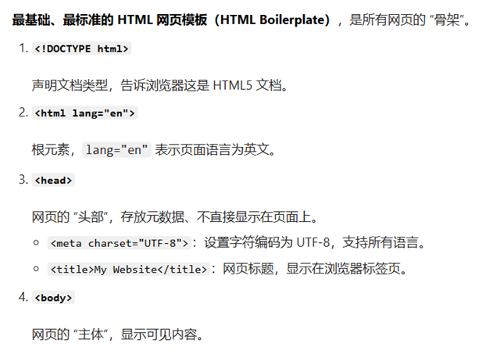

Slide 18
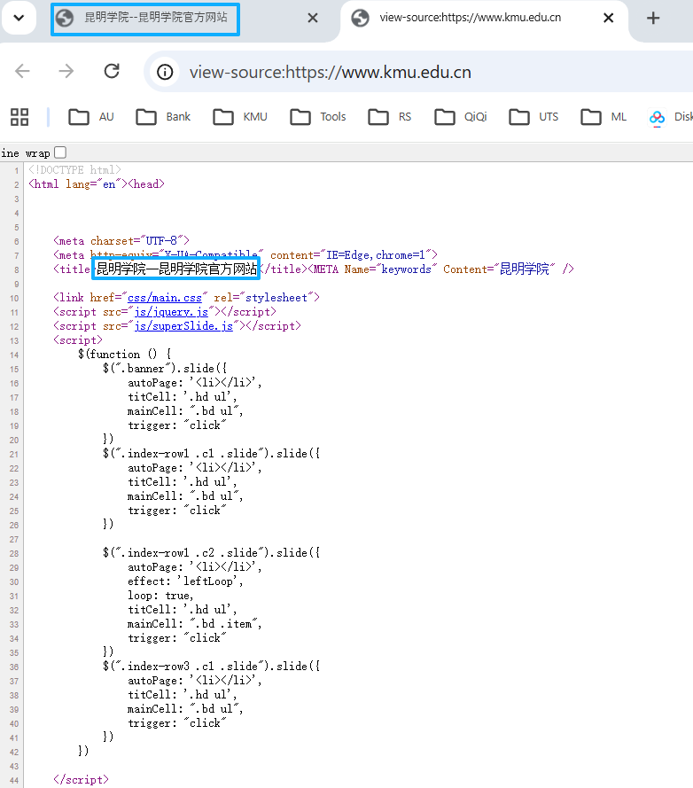

Slide 19
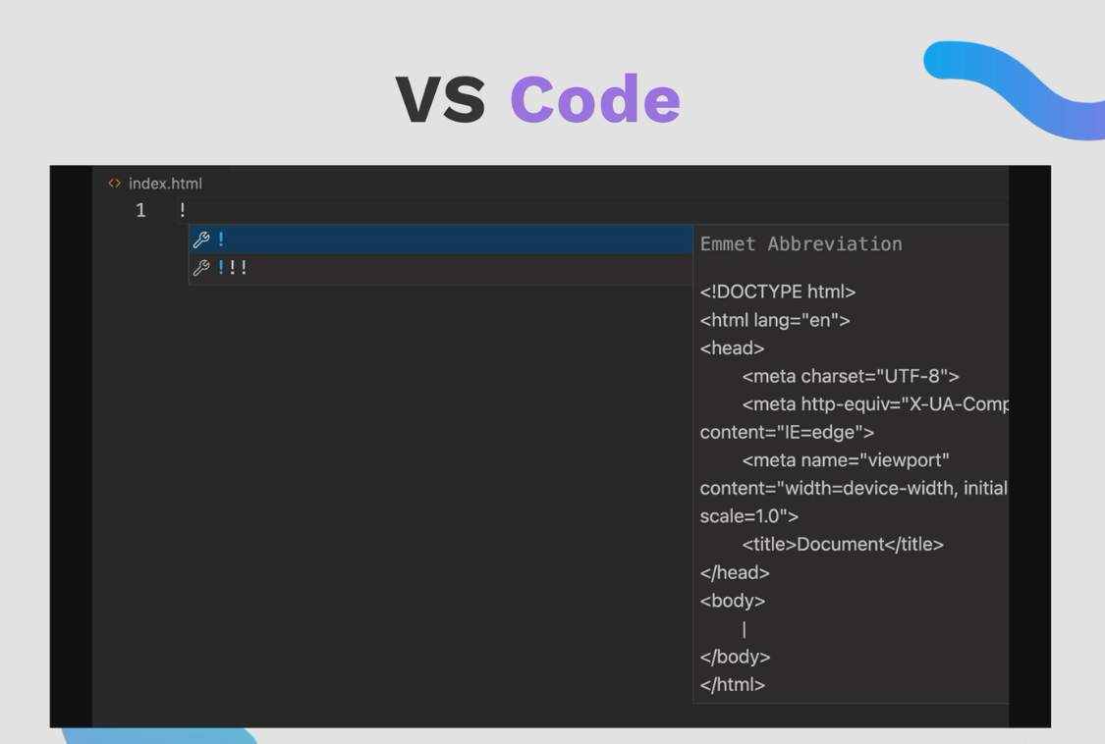

Slide 20
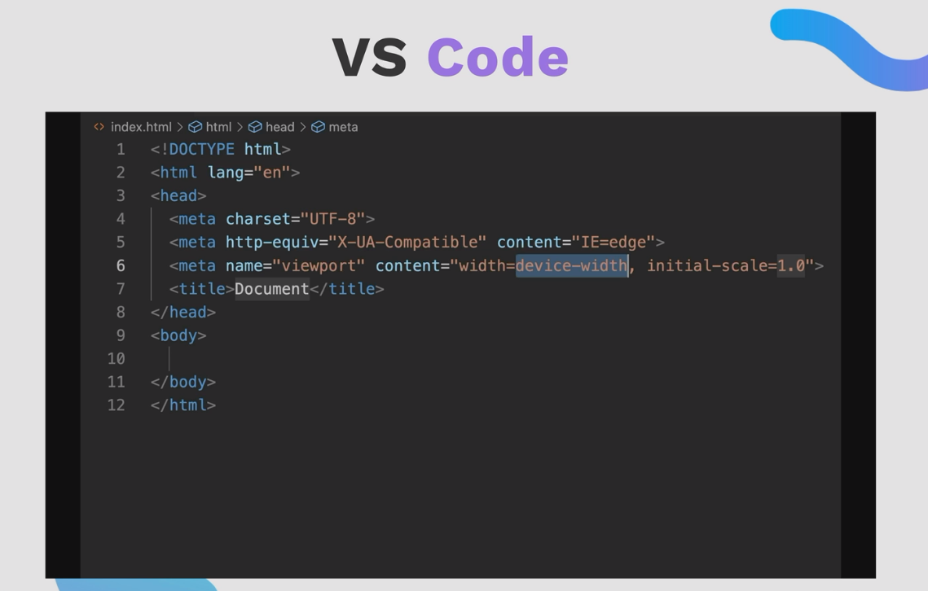

Slide 21


Slide 22


Slide 23
Try an Exercise
Exercise 4.1： Webpages

Slide 24
Try an Exercise
Exercise 4.2： Begin Html

Slide 25
Try an Exercise
Exercise 4.3： HTML Porfolio Project

