Slide 1
The role of partisanship in the battle with COVID-19
Talk Data to Me

Slide 2
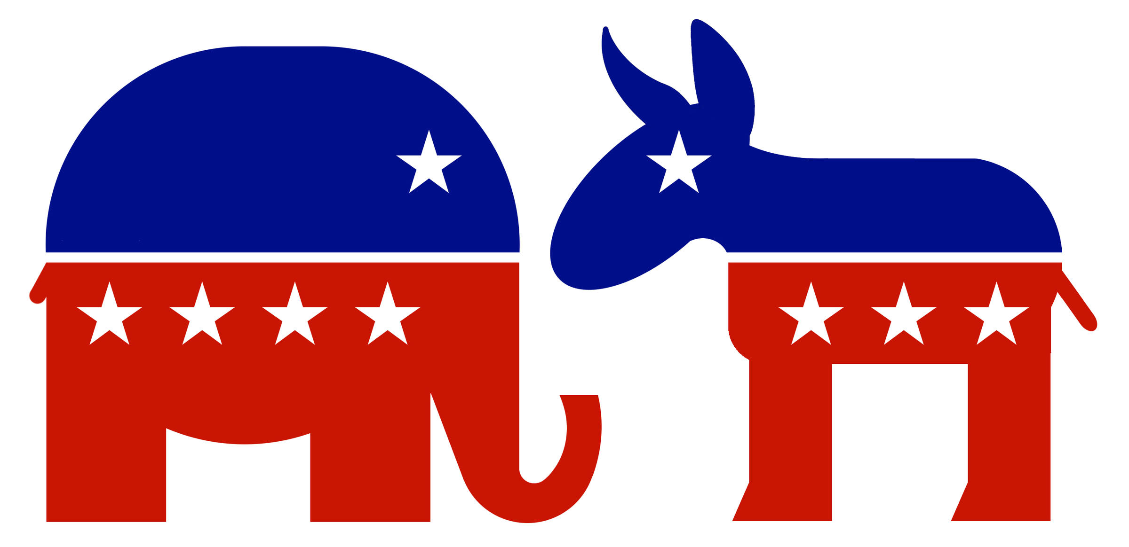
Is the split over COVID-19 really about politics?
+1.95 cases/1 million people/day
When comparing the Republican states to the Democratic states
Notes:
When controlling for the density of population, the republican states are generating 1.95 more cases per million people per day than the democratic states on average.
Across states, the average of cases/1 million people/day is 3.68. Therefore, the coefficient of 1.95 means a lot!
This indicates that politics may play an influential role in the battle with the COVID-19.

Slide 3
Why do democratic states outperform republican states?
Government Interventions
Public Awareness
Community Mobility
Notes:
To answer the question, we narrowed our research down to three main topics:
Government interventions: Several mitigation measures have been taken on a state-level. We wanted to first explore the relationship between partisanship and intervention. And then try to understand the significance of the state’s influence on the severity of cases.
Public Awareness: Awareness of a disease can change people’s behavior in response to the outbreak, thus, altering the progression of the infections. We wanted to try to understand if the public had reacted differently across states based on government interventions.
Mobility: Several states enforced measures to restrict mobility from non-essential locations. We wanted to measure the significance of such mobility changes to the number of severe cases.

Slide 4
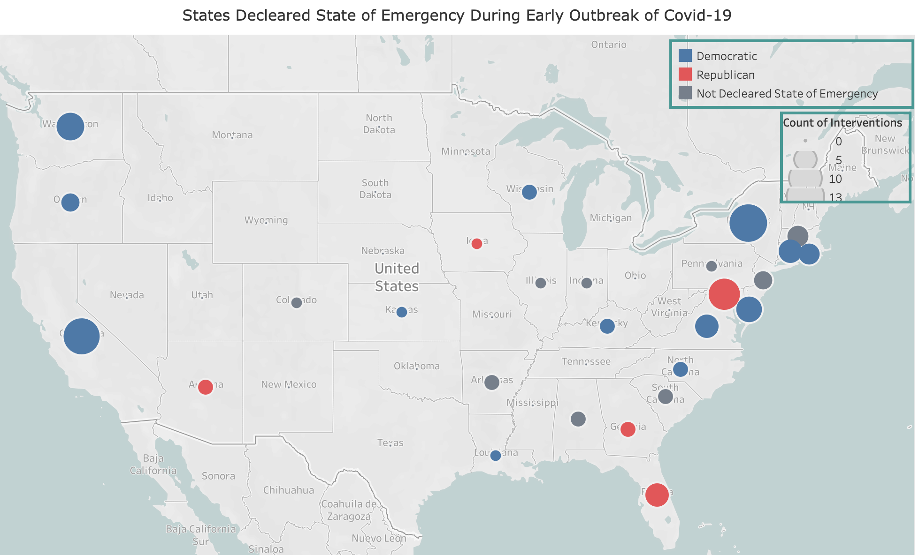
Government Intervention
Notes:
To assess government interventions, we wanted to observe the severity of cases based on measures taken across different party affiliations.
Through building a regression model (Appendix 1) , we were able to identify that a party affiliation does indeed have a correlation on the number of cases. Accordingly, we wanted to assess if that could be due to interventions taken earlier and at a higher frequency (as observed in the image above).

Slide 5
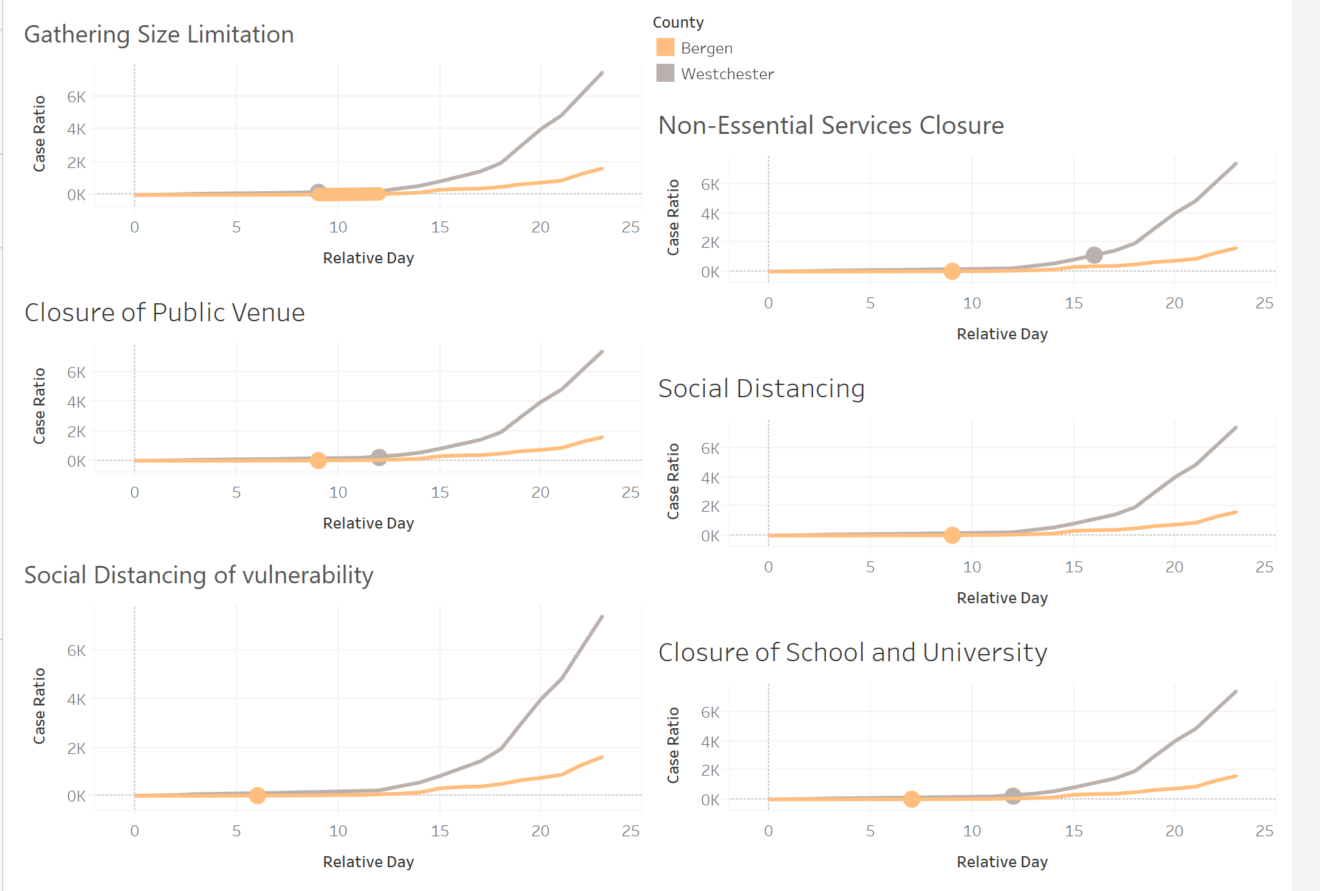
Does the intervention really matter?
Notes:
Does the intervention really matter? How does it impact severity?
We wanted to understand whether having harsher government measures does indeed yield lower cases per population. To do that, we employed a Diff in diff method. Here’s an example for a couple of counties we analyzed.
How did we pair the treatment and control?
1. Using demographic attributes to cluster the counties and make sure the treatment and control are in the same cluster
2. Parallel trend before the treatment
3. Similar both in the absolute COVID start date and the relative start date (to get rid of the time confounding issues)
4. Similar in population, so the sensitivity of the case/population is equal for both counties.
5. All the intervention of one county is behind the other, to make sure there is no mixture of timing of the action
Our interpretation: The county with intervention is associated with lower speed of spread. It proves that the intervention does have a positive impact on containing the spread.

Slide 6
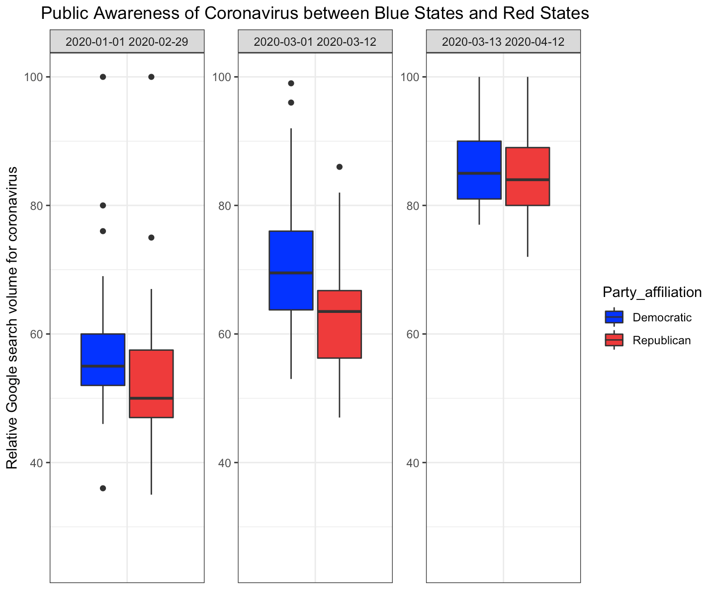
The Public Awareness
Notes:
Next, we wanted to analyze the level of public awareness of residents in blue states vs red states . The results were interesting: During the initial outbreak (second period), we observed a statistically (Appendix 2) higher volume in Google searches volume for democratic states.
By pinpointing key search terms such as Coronavirus disease or N-95 respirators, we were able to extract relative number of hits on three different time frames to use as metrics for assessing population awareness. We took three time periods into account:
Pre-Outbreak (prior to March) - Well before the outbreak. This is to provide a baseline showing that prior to the outbreak, there was no relationship between the partisanship of media markets and searches for coronavirus.
During Outbreak / Government measures (early to Mid March) - This was a period during which the outbreak was becoming a major problem but during which Republicans were downplaying the issue.
Mid March to Mid April - President Trump declared a national emergency on March 13th. After this point, Republicans largely changed their attitude on the crisis, taking is more seriously than they had been previously.
Across these three different time frames, we analyzed the relative google search volumes across republican and democratic states to identify the significant difference.

Slide 7
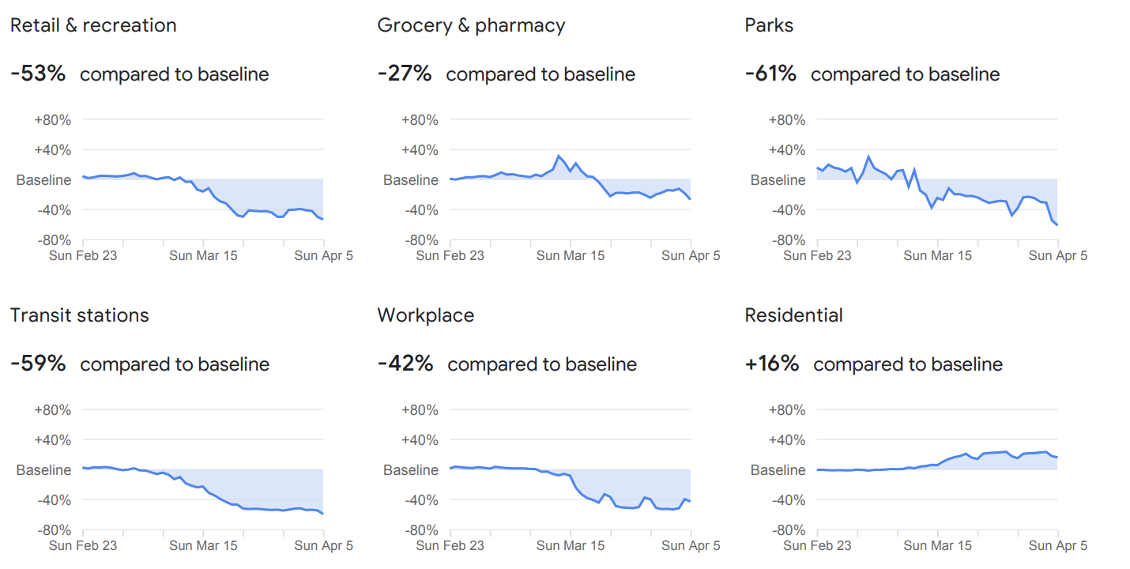
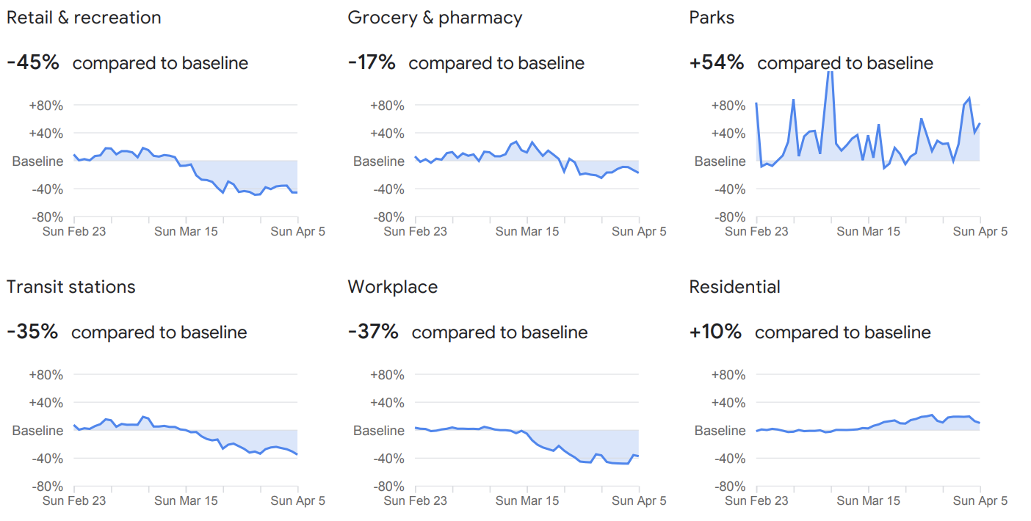
How does it all come to play?
California
130 cases / 1M
VS.
Indiana
250 cases / 1M
Notes:
So how do government interventions and increased awareness come into play?
It is hard to separate the effect of intervention and awareness on the severity of the outbreak. They are correlated with each other. Based on our regression model (Appendix 3) , we did see that higher number of interventions, specifically for the declare of state of emergency, is correlated with higher awareness. So we tried to find a good proxy to represent both of them at the same time - the mobility.
Using Google’s mobility report, we were able to observe mobility patterns over a 5 week period to try to understand how residents movements has changed during the outbreak. Looking at the example above, we can see that California has almost half the number of cases per 1M population when compared to Indiana. It’s also evident that California residents have significantly reduced their movement in public areas in comparison to Indiana.

Slide 8
Could it be a fluke?
-0.9 decrease in new cases/1 million people can be achieved as a result of 1 unit decrease in mobility compared to the baseline
(Average new cases/million people is 3.67)
Notes:
But could that just be a fluke? Perhaps mobility doesn’t necessarily make a difference?
To investigate further, we seeked to identify the relationship between the mobility on the number of severe cases developed over time.
Independent / control Variables:
Digitized time-series mobility report.
Health spending
Med-Large Airport
Dependent variable: time-series of cases/million people.
Since the data was both time and region dependent, we decided to design a panel dataset to build a random effect model (Appendix 4).
Given the exponential growth nature of the new cases in the early stage of spread, in order to assess the causal impact of mobility changes on the growth rate of new cases, we controlled for time variable (the relative day to the start of the COVID in each state).
We used PCA to combine different mobility matrices that were highly correlated.
Based on the generated model, the coefficient of the combined mobility is 0.9. This indicates that the mobility associated with the three venues is positively correlated with the growth rate of new cases. The finding justifies that the decrease in mobility does have a positive role in containing the spread.

Slide 9
In summary, how does bipartisan affect the spread of COVID-19?
Partisanship
Intervention
Mobility
COVID-19 Severity
Mobility
Public Awareness

Slide 10
What does the story tell us?
A state’s public awareness and government intervention is dependent on its political leaning.
Government intervention plays an important role in containing the spread.
Reduced mobility is effectively reducing severity.

Slide 11

Most importantly, the crisis calls for a collective response from both the Democratic and Republican Party

Slide 12
Data Sources
Party Affiliation | 2018 Midterm Election Result
Government Measures | Keystone Strategy
Social Awareness | Google Search Trends
Mobility | Google Community Mobility Report
Population | World Population Review
Time-Series Cases | John Hopkins CSSEGISandData

Slide 13
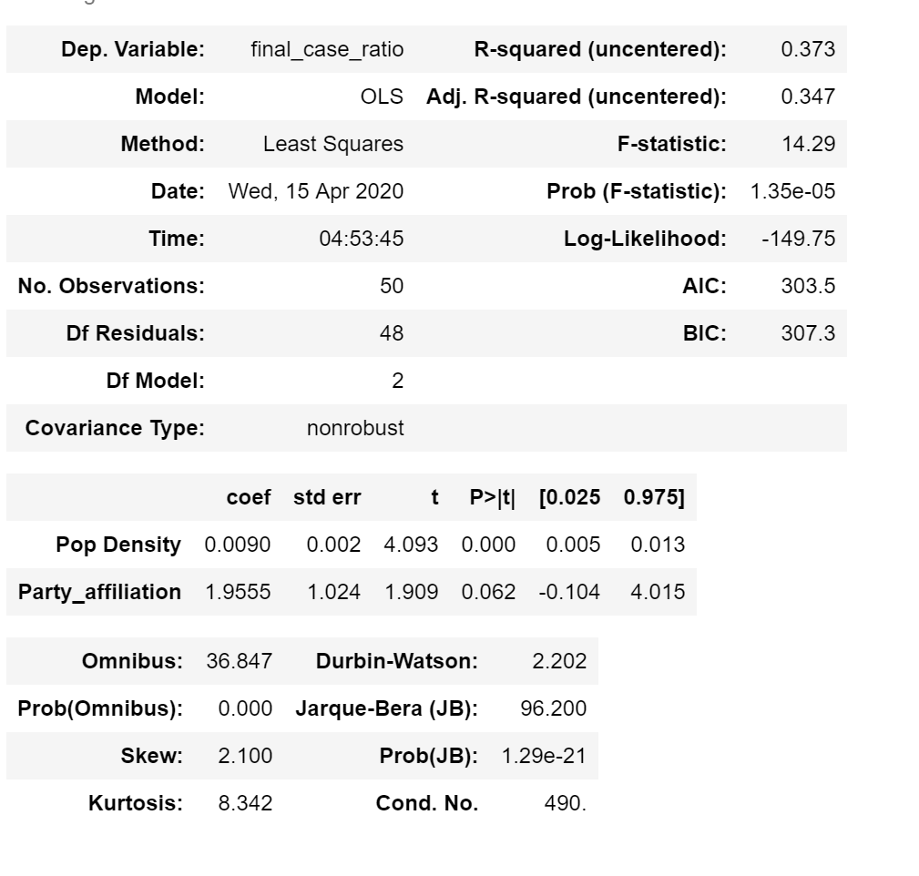
Appendix 1
Severity of the Covid-19 breakout between Blue States and Red States

Slide 14
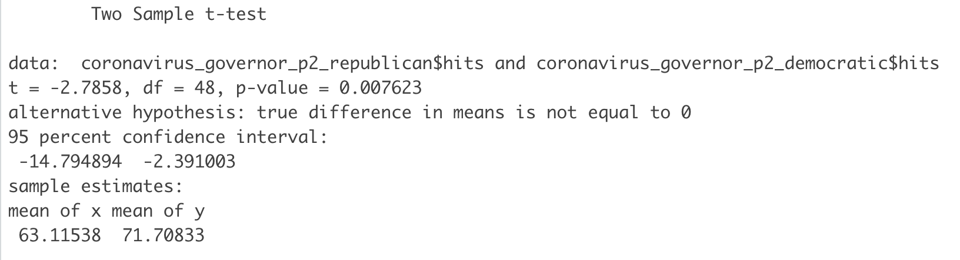
Appendix 2
Significant difference exists between Blue States and Red States during early outbreak of Covid-19

Slide 15
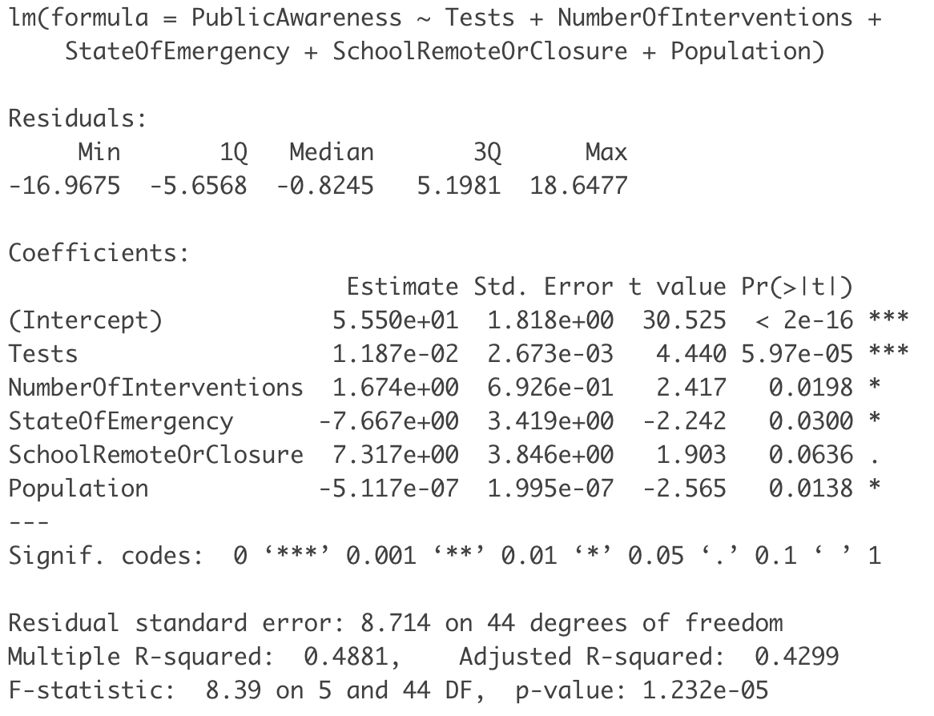
Appendix 3
Regress public awareness on interventions while control for number of tests and population by state

Slide 16
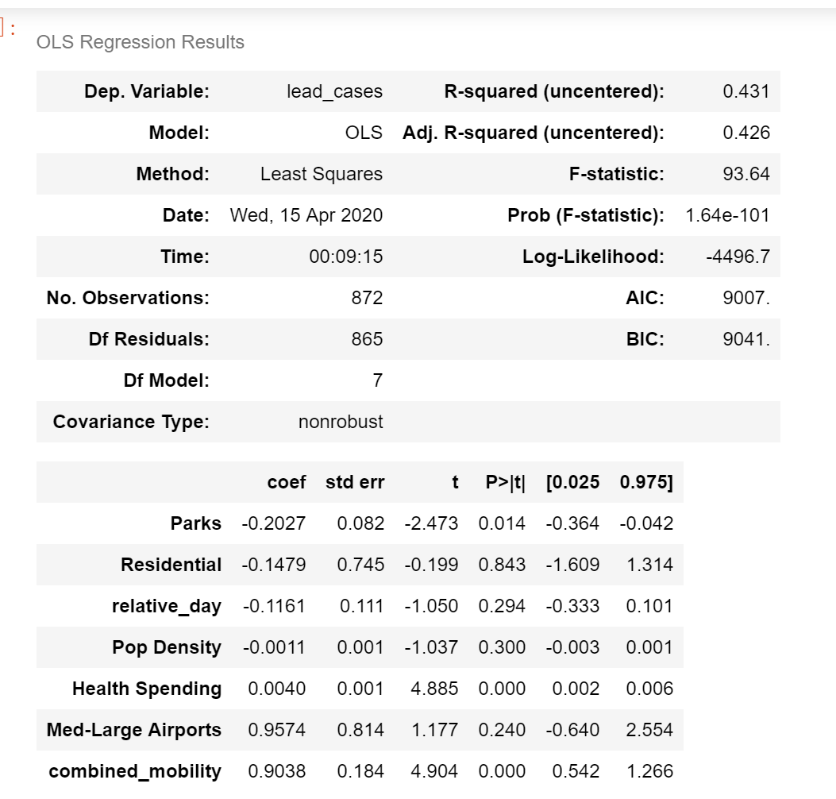
Appendix 4
Regress social mobility on lead cases while control for number state demographics
Notes:
Since coronavirus symptoms take time to take place, we considered a 5-day lead for the reported new cases from the mobility time-series data.
Additionally, since different mobility indexes are highly correlated, multicollinearity arise. To avoid the distortion of the coefficient estimates, we used Principal Component Analysis to summarize all the three mobility indexes except for the Residence Mobility.
Moreover, in order to smooth the daily variance, we are using a 10-days moving average of both X and Y variables. Given the exponential growth nature of the COVID-19 in the early stage, we controlled for the relative date since the outbreak in order to avoid the confounding issue incurred by time.

