Slide 1
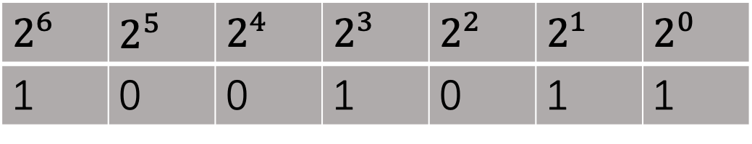
$2^{6}$ | $2^{5}$ | $2^{4}$ | $2^{3}$ | $2^{2}$ | $2^{1}$ | $2^{0}$
1 | 0 | 0 | 1 | 0 | 1 | 1
1 | 0 | 0 | 1 | 0 | 1 | 1

Slide 2

$$a_{0} a_{1} { a}_{2} …… a_{n−1}$$
1 | 0 | 1 | ... | 0
... ... | $A_{k}$ | $A_{k+1}$ | $A_{k+2}$ | ... ... | $A_{k+n−1}$ | $A_{k+n}$ | $A_{k+n+1}$ | $A_{k+n+2}$ | ... ...

Slide 3
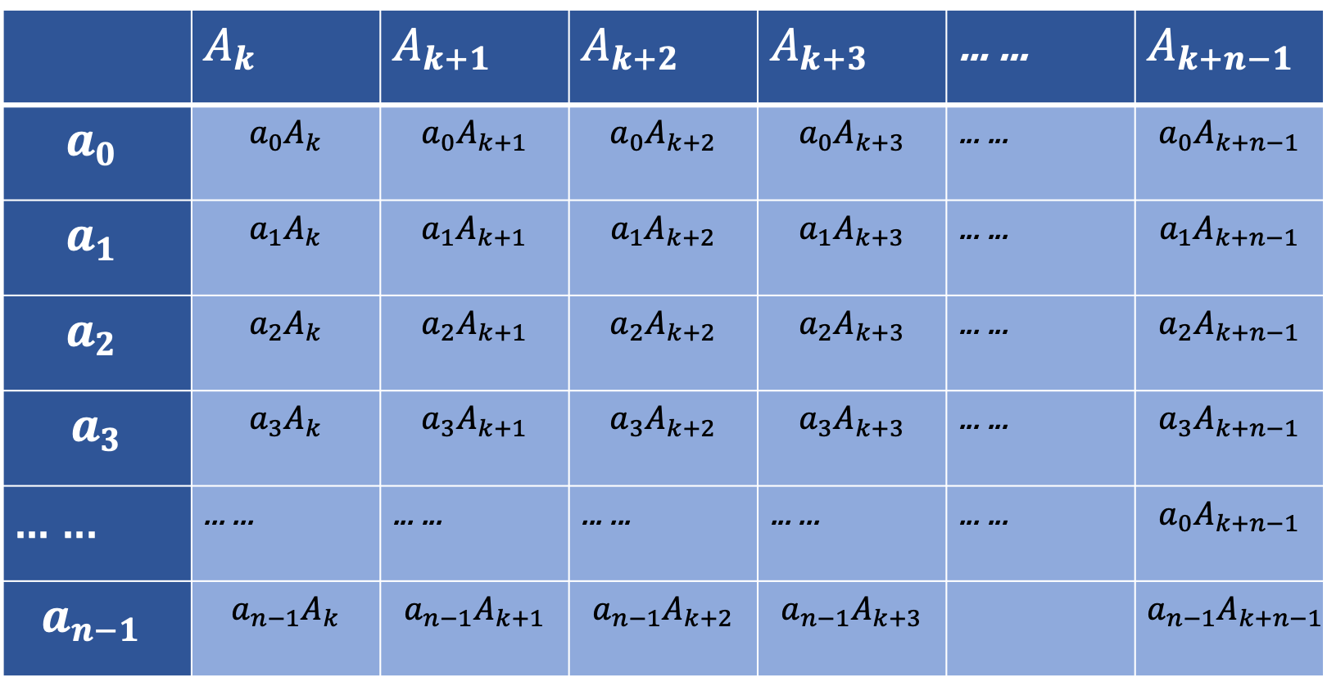
 | $A_{k}$ | $A_{k+1}$ | $A_{k+2}$ | $A_{k+3}$ | ... ... | $A_{k+n−1}$
$$a_{0}$$ | $$a_{0}A_{k}$$ | $$a_{0}A_{k+1}$$ | $$a_{0}A_{k+2}$$ | $$a_{0}A_{k+3}$$ | ... ... | $$a_{0}A_{k+n−1}$$
$$a_{1}$$ | $$a_{1}A_{k}$$ | $$a_{1}A_{k+1}$$ | $$a_{1}A_{k+2}$$ | $$a_{1}A_{k+3}$$ | ... ... | $$a_{1}A_{k+n−1}$$
$$a_{2}$$ | $$a_{2}A_{k}$$ | $$a_{2}A_{k+1}$$ | $$a_{2}A_{k+2}$$ | $$a_{2}A_{k+3}$$ | ... ... | $$a_{2}A_{k+n−1}$$
$$a_{3}$$ | $$a_{3}A_{k}$$ | $$a_{3}A_{k+1}$$ | $$a_{3}A_{k+2}$$ | $$a_{3}A_{k+3}$$ | ... ... | $$a_{3}A_{k+n−1}$$
... ... | ... ... | ... ... | ... ... | ... ... | ... ... | $$a_{0}A_{k+n−1}$$
$$a_{n−1}$$ | $$a_{n−1}A_{k}$$ | $$a_{n−1}A_{k+1}$$ | $$a_{n−1}A_{k+2}$$ | $$a_{n−1}A_{k+3}$$ |  | $$a_{n−1}A_{k+n−1}$$

Slide 4

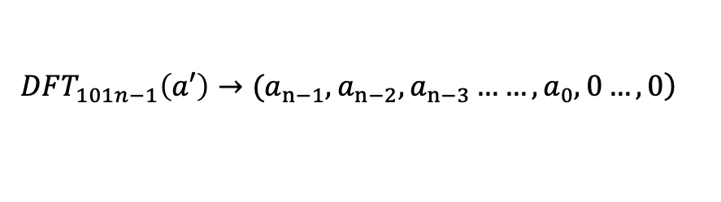

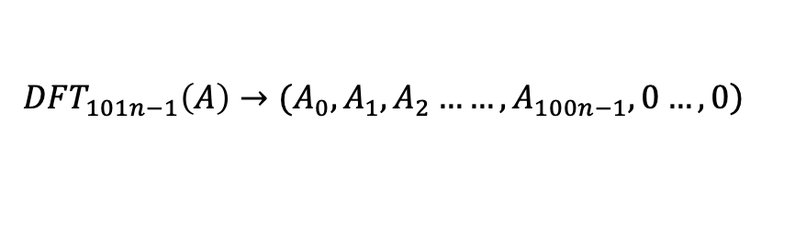
$$\left.DFT_{101n−1}\left(a′\right)→(a_{n−1}, a_{n−2},a_{n−3}……,a_{0},0…,0\right)$$
$$100n−1$$
$$\left.DFT_{101n−1}\left(A\right)→(A_{0}, A_{1},A_{2}……,A_{100n−1},0…,0\right)$$
$$n−1$$

Slide 5










$$1 0 0 ……0 0 1$$
$$k$$
$$1 0 0 ……0 0 1$$
$$k$$
$$1 0 0 ……0 0 1$$
$$1 0 0 ……0 0 1$$
$$k$$
$$k$$
$$1 0 0 ……0 0 2$$
$$0 0 ……0 0 1$$
$$k$$
$$k$$

Slide 6
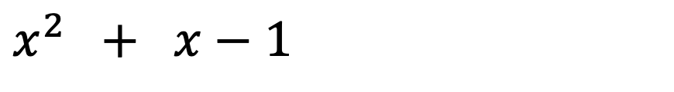

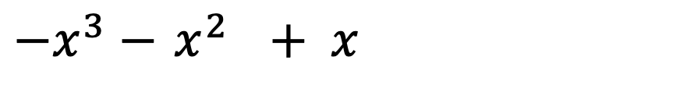

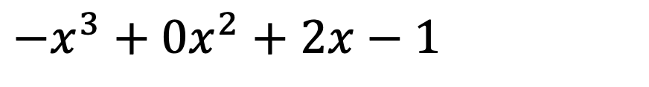

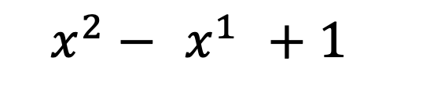
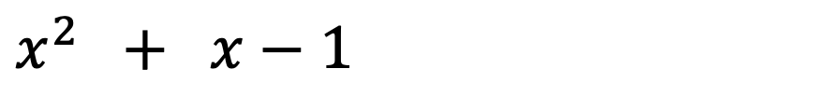
$${ x}^{2} −{ x}^{1} +1$$
$$x^{2}+x^{1}−1$$
$$x^{4}+0x^{3}−x^{2}+2x−1$$
$$x^{4}+x^{3}−x^{2}$$
$${−x}^{3}+{0x}^{2}+2x−1$$
$${−x}^{3}−{ x}^{2} + x$$
$$x^{2} + x−1$$
$$x^{2} + x−1$$
0

