Slide 1
Grid
1 | 2 | 3
1 | 3 | 2
2 | 5 | 1
dp Array
0 | 0 | 0
0 | 0 | 0
0 | 0 | 0
0 | 1 | 2
0 | 1 | 1
1 | 2 | 1
result = 1

Slide 2
a₀ | b₀ | c₀
a₁ += max | b₁+= max | c₁+= max
a₂+= max | b₂+= max | c₂+= max
a₃+= max | b₃+= max | c₃+= max
a₄+= max | b₄+= max | c₄+= max
... ...
a_{n}+= max | b_{n}+= max | c_{n}+= max

Slide 3



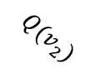




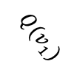












Cp1
$$P(v_{1})$$
Cq1
$$P(v_{2})$$
$$P(v_{1})$$
Cq2
$$Q(v_{1})$$
Cp2
$$∞$$
$$P(v_{1})$$
$$P(v_{2})$$
$$Q(v_{2})$$
$$∞$$
Cq3
Cp3
$$P(v_{3})$$
$$Q(v_{3})$$
$$∞$$
S
$$P(v_{4})$$
T
Cq4
$$Q(v_{4})$$
$$∞$$
Cp4
$$P(v_{4})$$
$$P(v_{3})$$
$$∞$$
$$P(v_{i})$$
$$Q(v_{i})$$
... ...
... ...
Cpi
$$P(v_{i})$$
Cqi

Slide 4
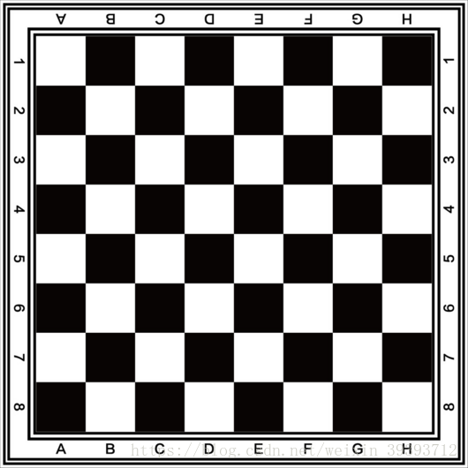
White
bishops

Slide 5









1
1
$$1$$
2
$$1$$
2
$$1$$
$$1$$
$$1$$
3
3
$$1$$
$$1$$
S
T
4
$$1$$
$$1$$
4
$$1$$
$$1$$
... ...
... ...
n
n

