Slide 1




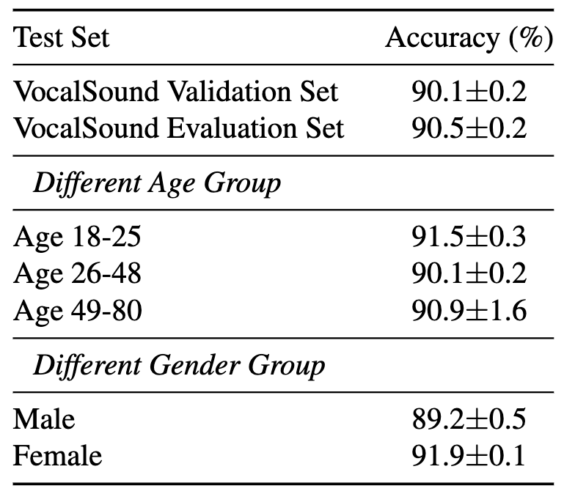
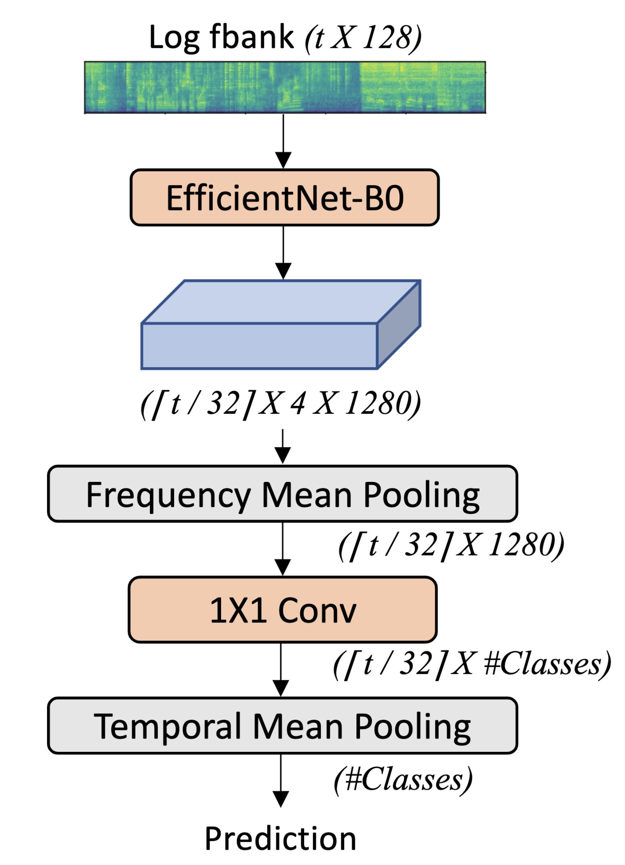
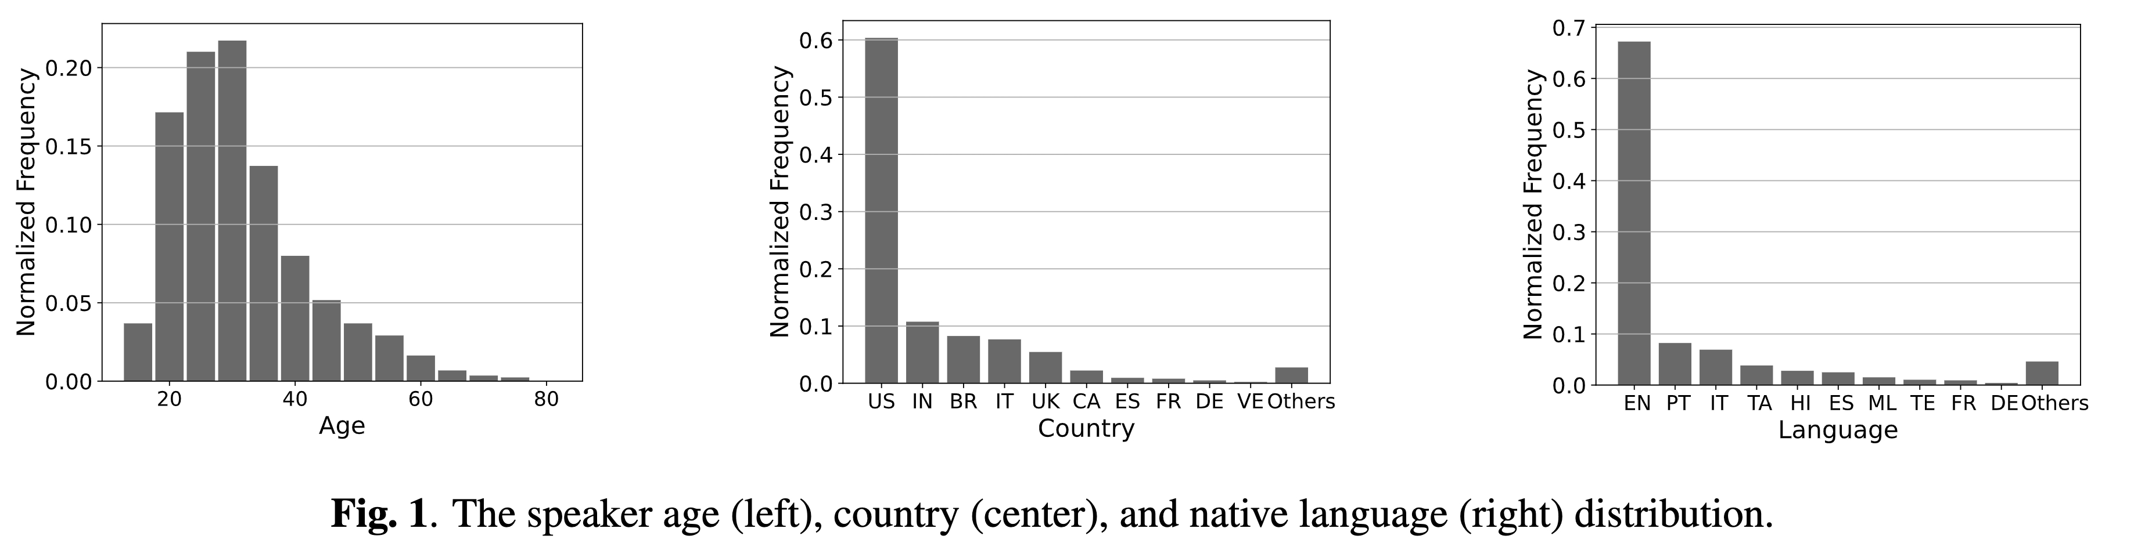
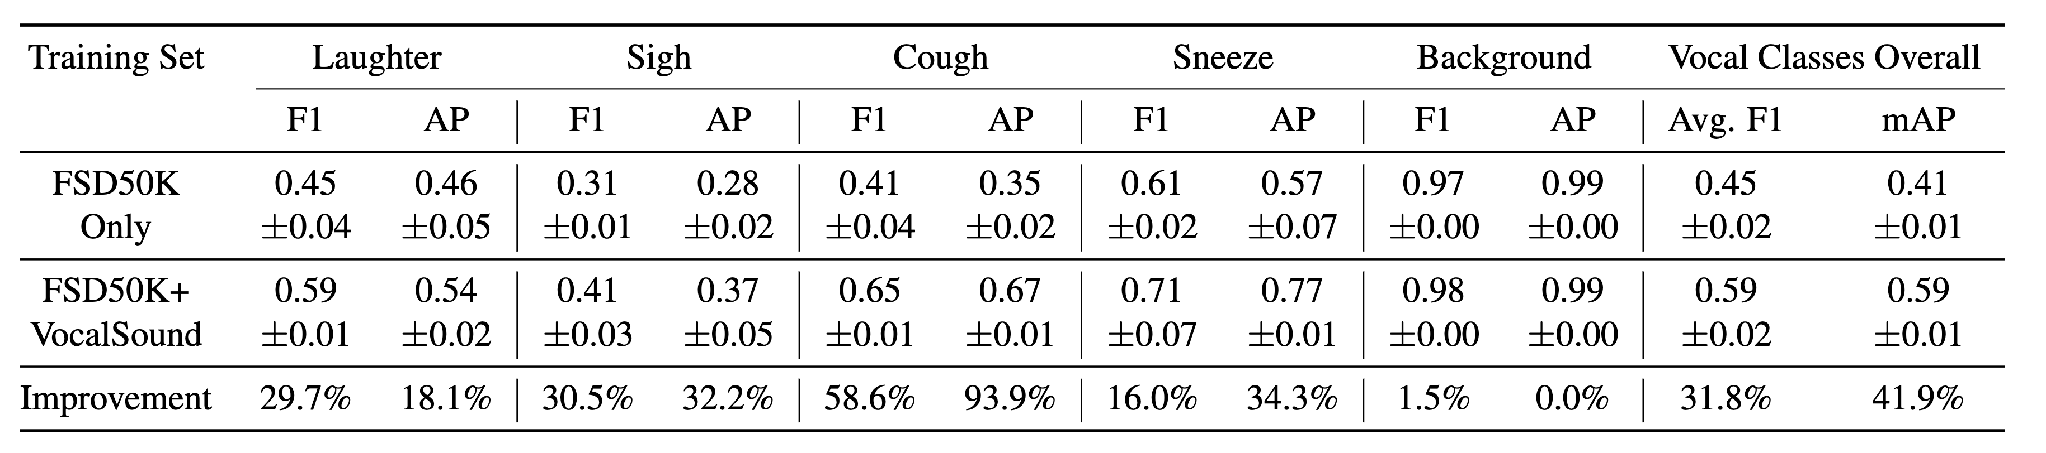
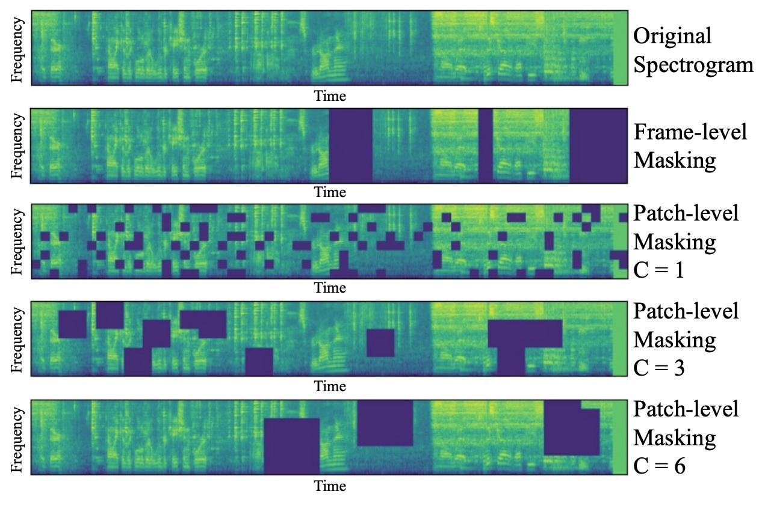
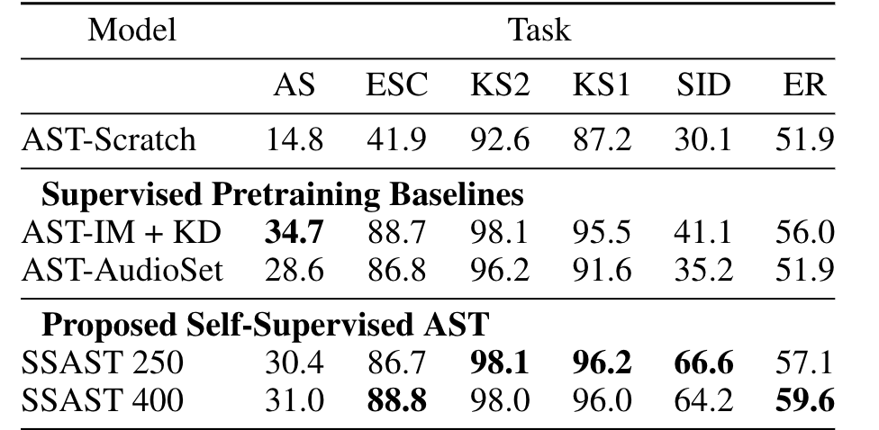
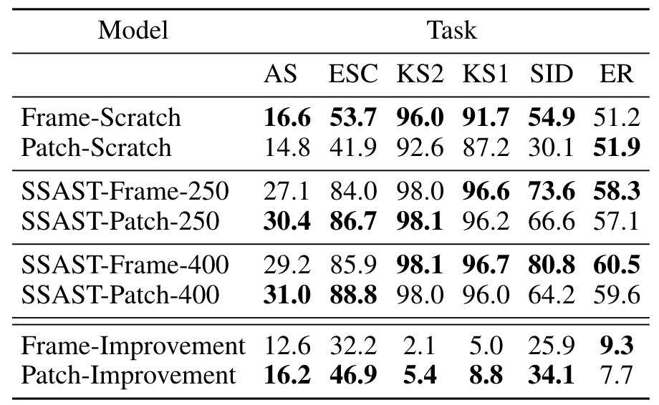
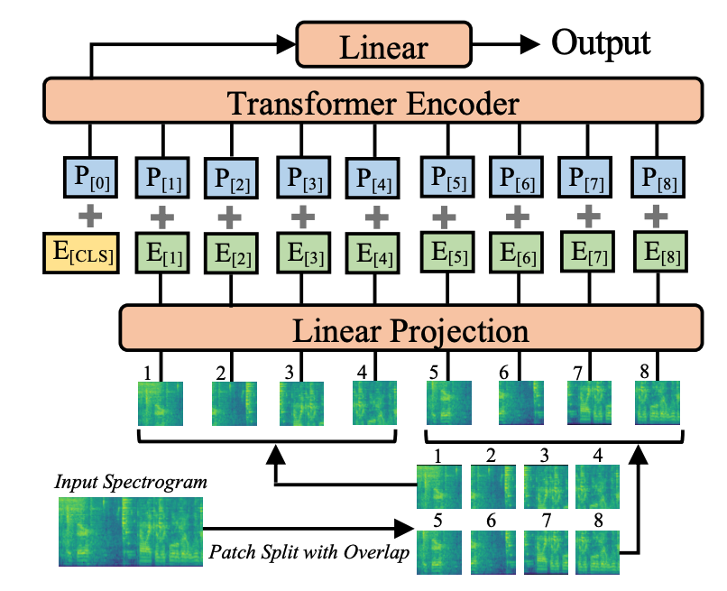
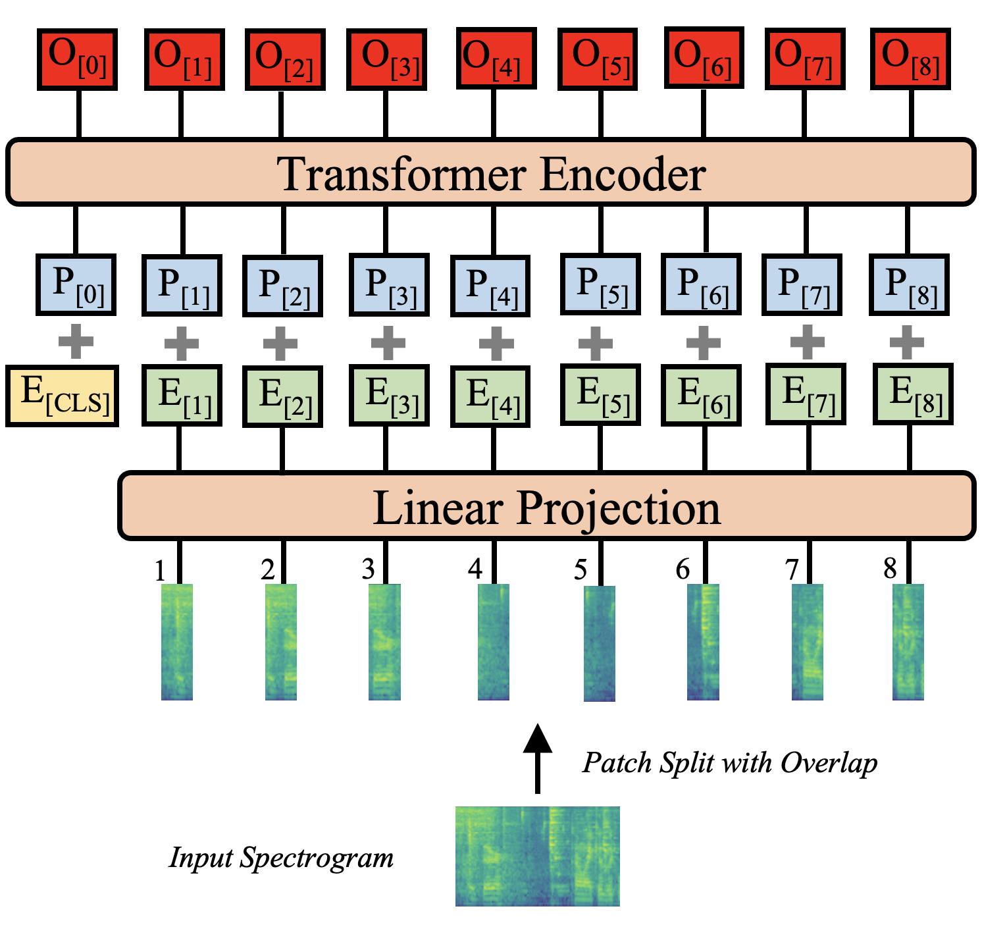
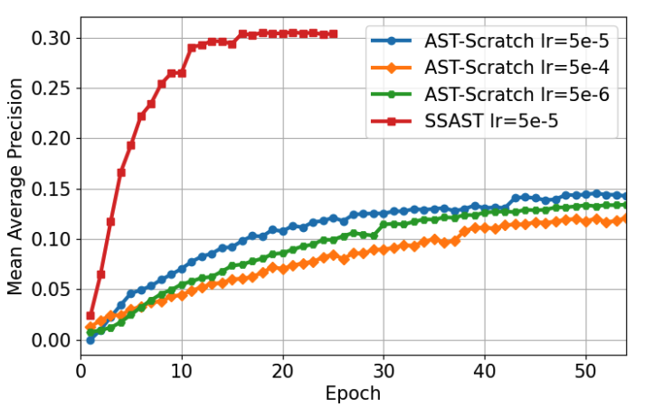
VocalSound: A Dataset for Improving Human Vocal Sound Recognition
Yuan Gong¹, Jin Yu², James Glass¹ (¹MIT CSAIL & ²Signify Research)
Dataset and baseline code at: groups.csail.mit.edu/sls/downloads/vocalsound
Introduction
Data Collection and Distribution
Baseline
Audio Spectrogram Transformer (AST) is the first convolution-Free, purely attention-based model for audio classification and achieves SOTA performance.
Problem: Original AST needs more labeled data to train, previous ImageNet supervised pretraining constrains AST to use 16*16 square patch.
Proposed: A self-supervised pretraining framework that matches or outperforms previous supervised pretraining methods and supports arbitrary patch size and shape.
Key Contribution
First self-supervised pretraining framework for purely attention-based audio classification models.
1. More masked patches leads to better performance.
2. Joint pretraining objective helps.
3. The proposed SSL works with small data.
4. With same AudioSet 2M data, SSL pretraining generalizes better than supervised pretraining.
5. Joint AudioSet and Librispeech pretraining leads to best performance for all tasks.
First patch masking based self-supervised pretraining framework in the audio & speech field.
Conventional frame-masking based SSL that only learns temporal spectrogram structure
Dataset Usage
Patch Based- vs Frame Based- AST
Proposed patch-masking based SSL that learns both temporal and frequency structure
All models are pretrained and end-to-end fine-tuned (i.e., without layer freezing) on downstream datasets AS=AudioSet-20K; ESC=ESC-50; KS=SpeechCommands; SID=VoxCeleb1; ER=IEMOCAP
Compare models pretrained and fine-tuned with 16*16 square patches and 128 *2 time frames
The model is forced to learn more local spectrogram structure with smaller masked patch size and more global spectrogram structure with larger masked patch size
No Pretraining
Audio Speech
Unlike ImageNet pretraining, SSAST supports arbitrary patch size and shape.
ImageNet Pretrain
AudioSet Pretrain
Square Patch Based AST
Frame Based AST
SSL Pretrain with 250/400 Masked Patches
Cannot be used for frame-level feature extraction. Only designed for classification
Ideal for both classification and frame-level audio representation extraction
The proposed self-supervised pretrained models significantly outperforms from-scratch models with an average improvement of 60.9%, and can match or even outperform previous supervised pretrained models.
SSAST
Support Both
Frame-based AST is better for speech tasks while patch-based AST is better for audio Tasks.
SSL pretraining helps more for patch-based AST.
During fine-tuning, SSAST model learns much faster and better. Using a different learning rate or increasing training epochs cannot improve the from-scratch model performance.
Acknowledgement
Works for both audio and speech Tasks.
This work is partly supported by Signify.

