Slide 1

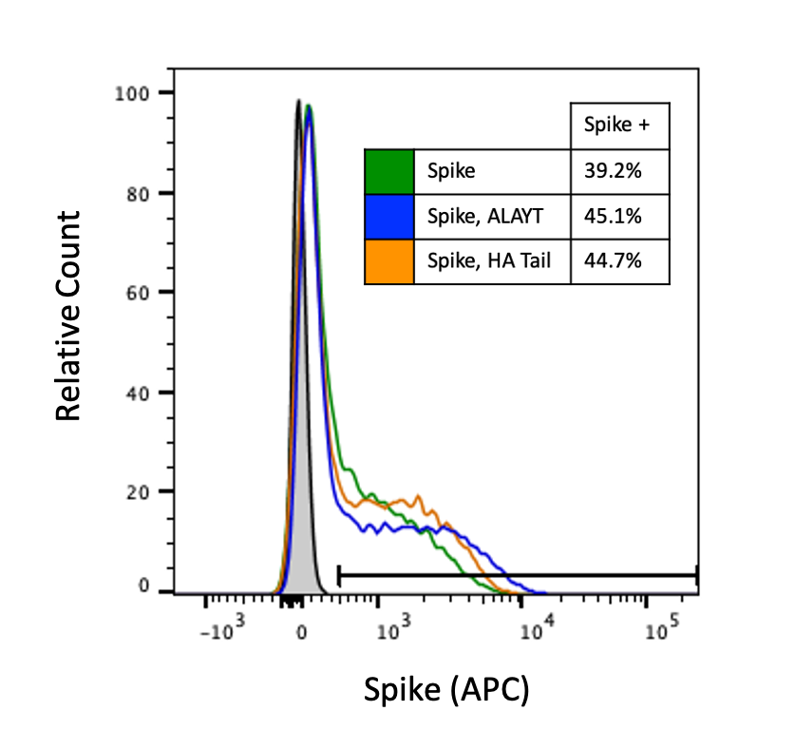
A
Plasmids encoding non-surface proteins for lentivirus production
Tat
GagPol
Rev
ACE2
Plasmid encoding SARS-CoV-2 Spike
293T cells
Infection of 293T cells expressing ACE2. Infected cells express ZsGreen and/or Luciferase.
Spike
Lentiviral backbone plasmid expressing ZsGreen or Luciferase-IRES-ZsGreen
Spike-pseudotyped lentiviral particles
B
C

