Slide 1
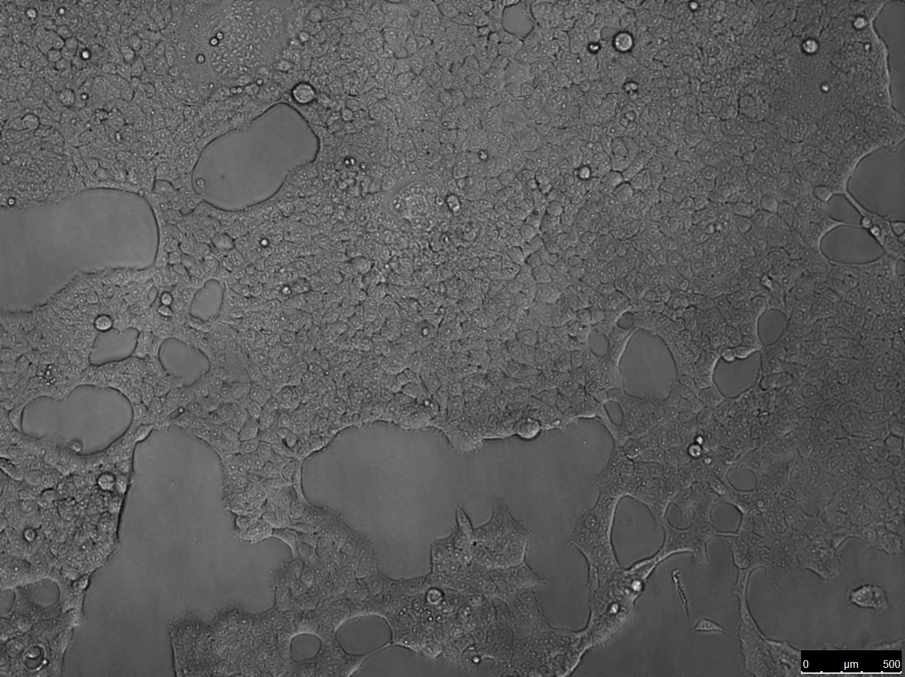
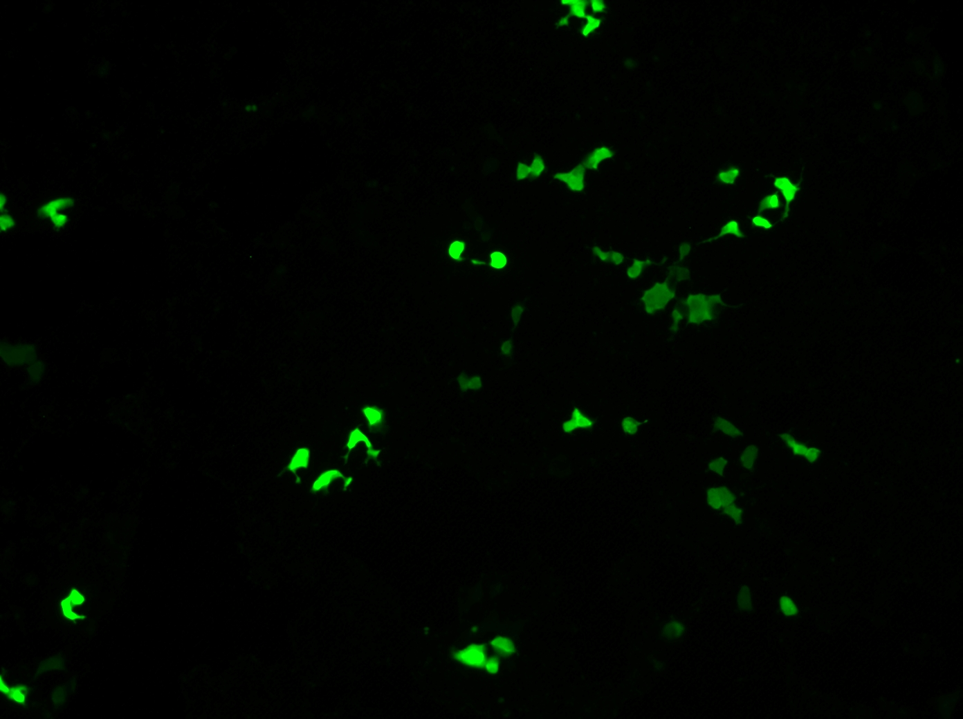
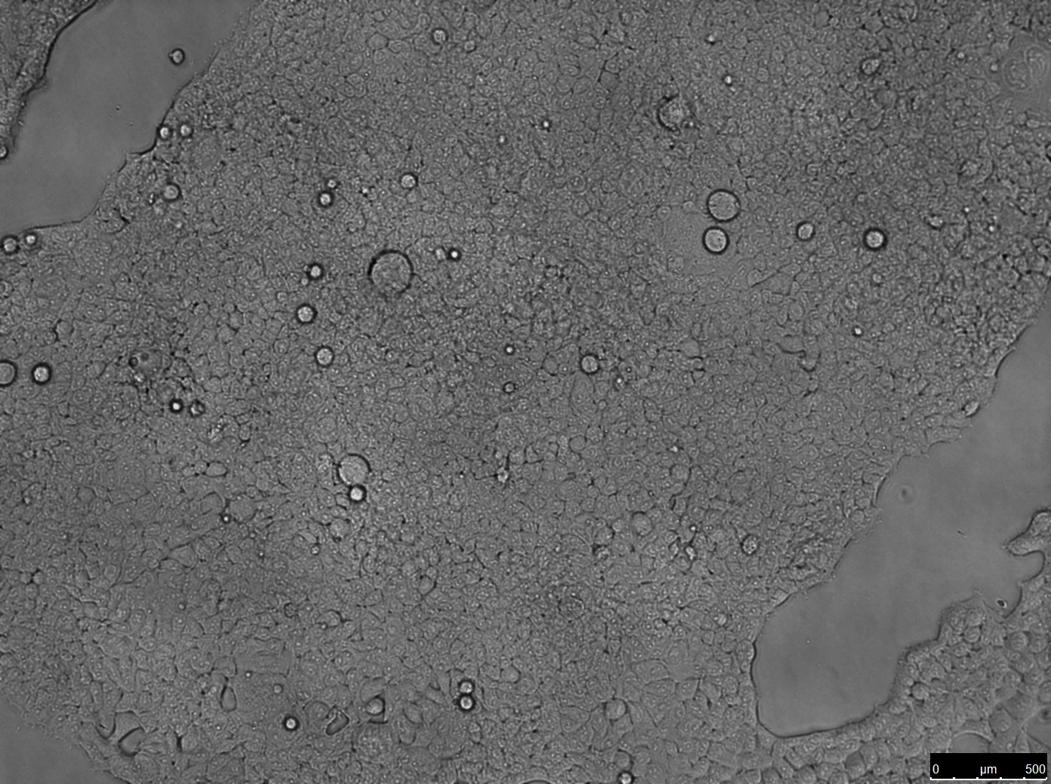
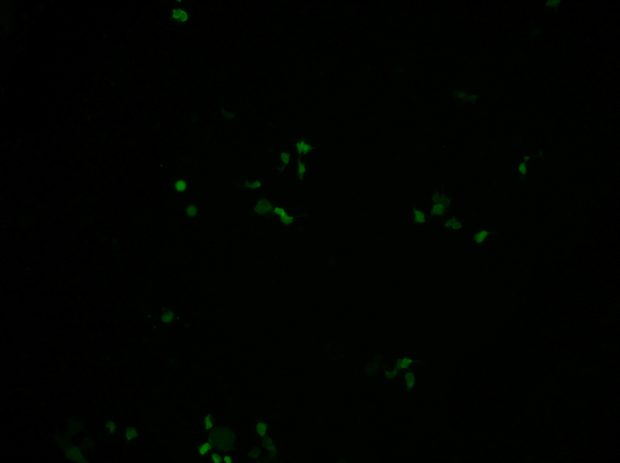
A
B
10⁷
10⁹
10⁶
10⁸
10⁵
10⁷
10⁶
10⁴
10⁵
10³
10⁴
10²
10³
10¹
10²
C
Spike pseudotyped ZsGreen backbone
Spike pseudotyped Luciferase-IRES-ZsGreen backbone
Bright Field
Fluorescence
Bright Field
Fluorescence

