Slide 1
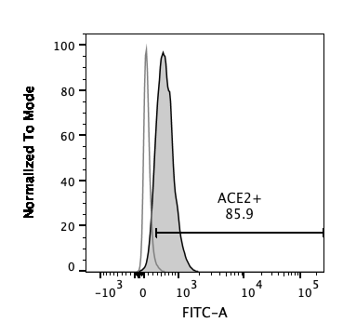
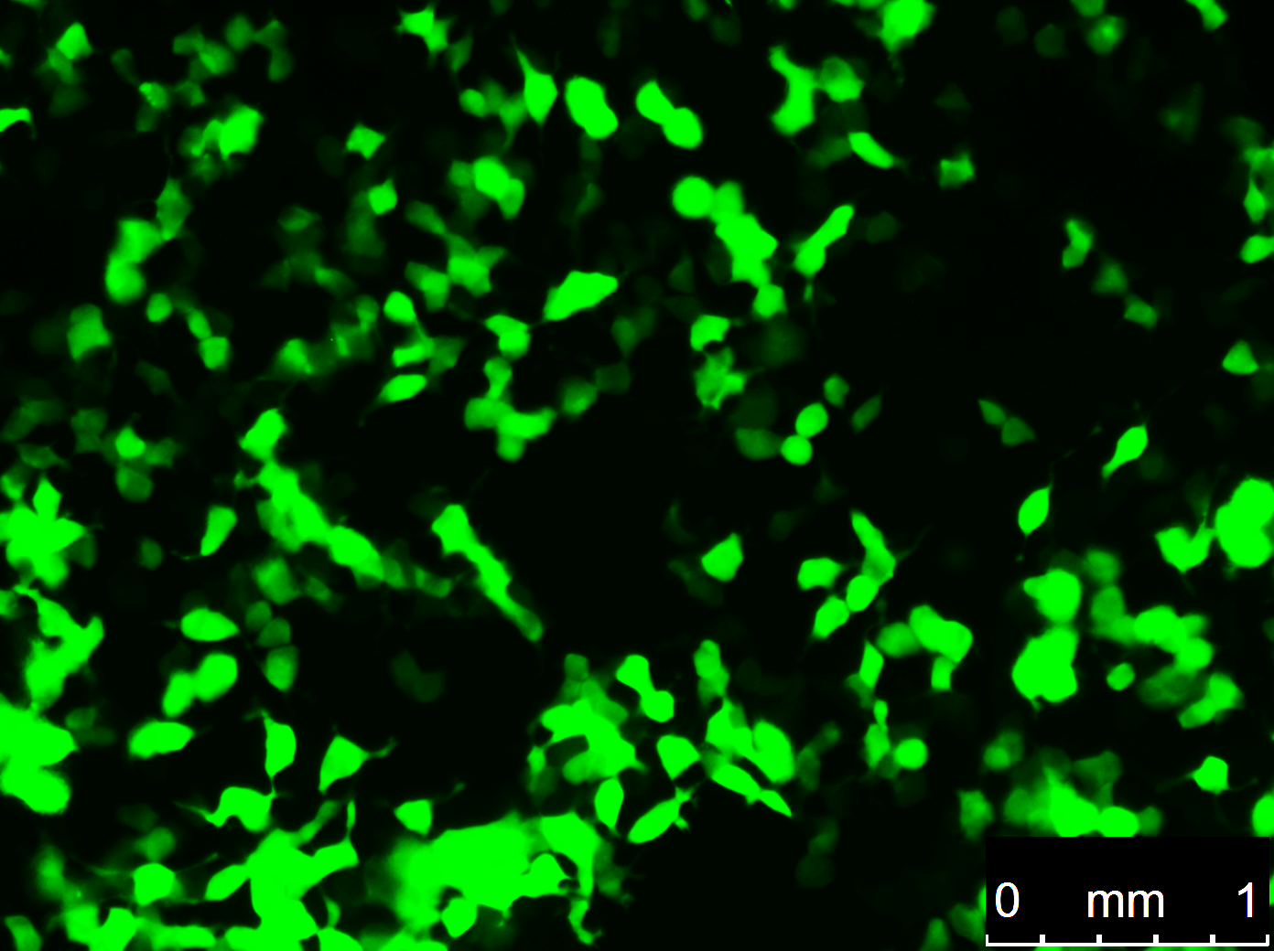



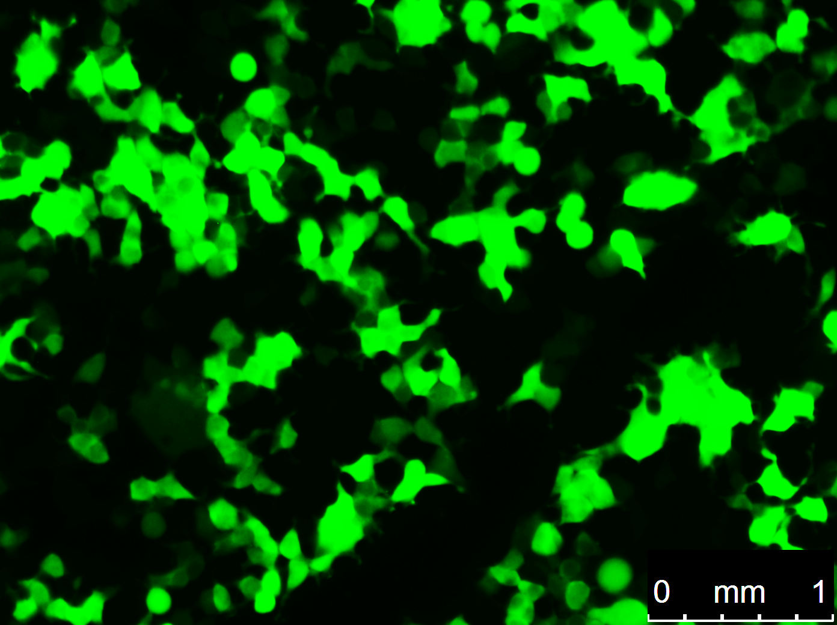
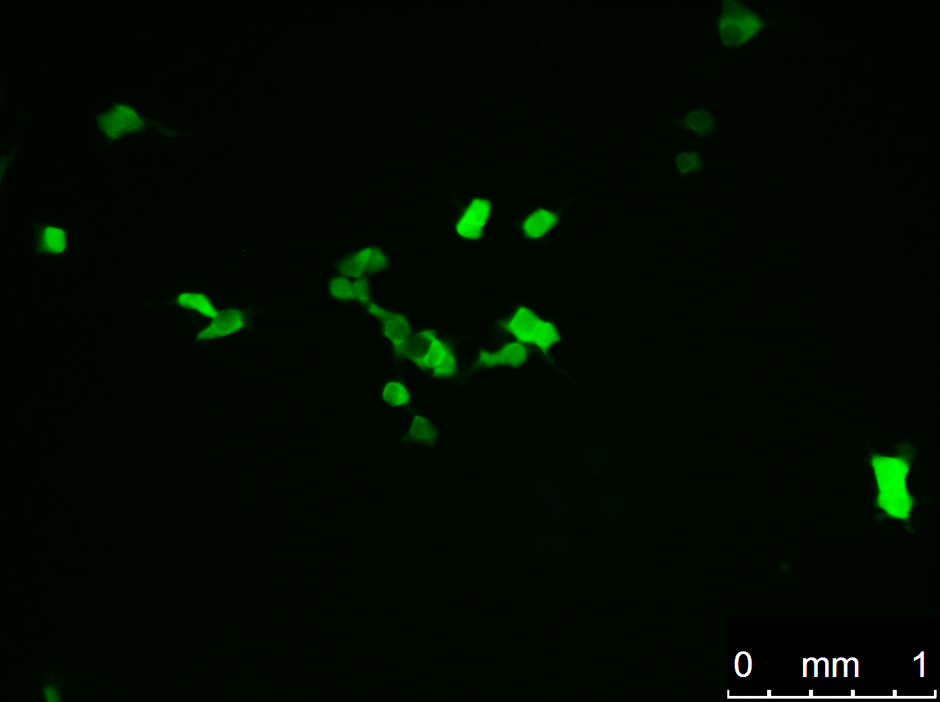
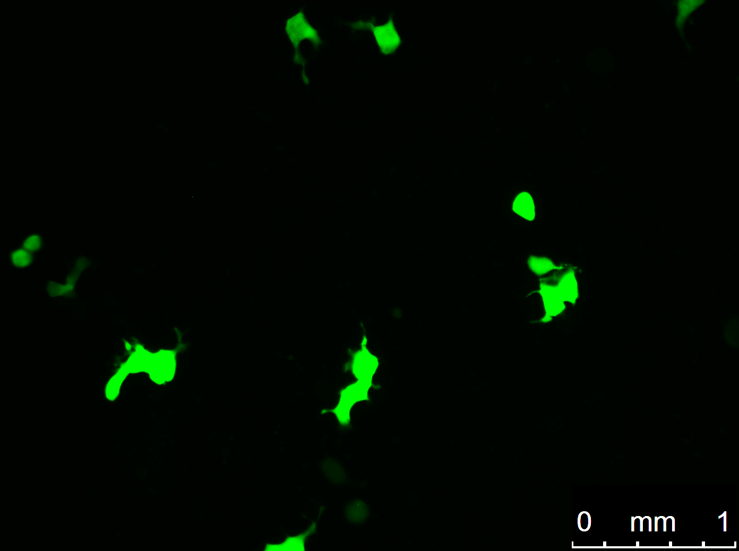
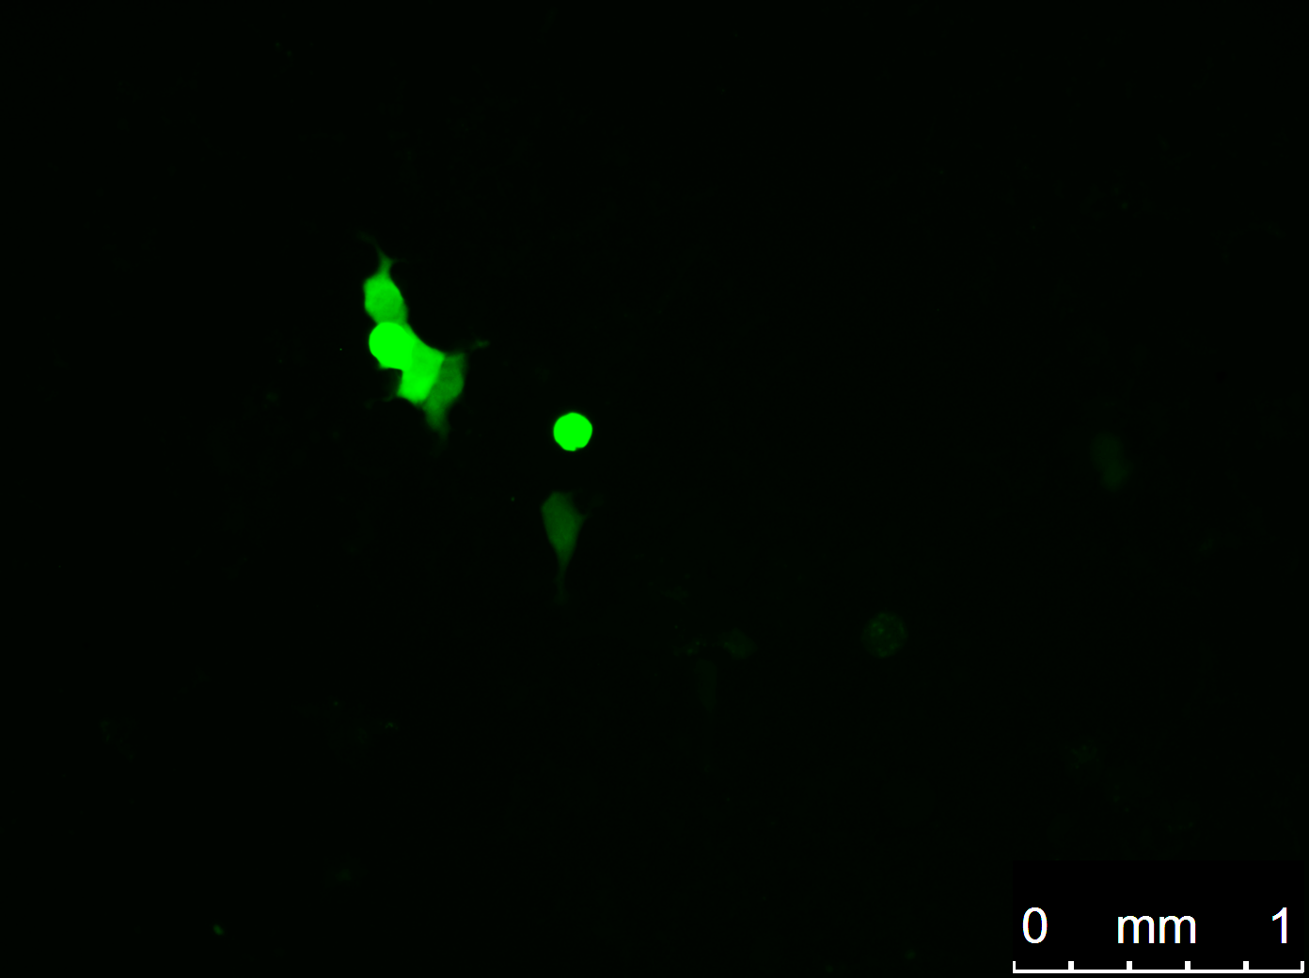
A
B
VSV G
Spike
Spike, ALAYT
Spike, HA Tail
293T
Relative Count
85.9%
293T-ACE2
ACE2 (AF488)
Notes:
Picture files:
ALAYT-7
IDT-1
HATail-1
VSVG-293T-1
VSVG-ACE2-4
Only took 1 picture of the 293Ts for the Spikes

