Slide 1
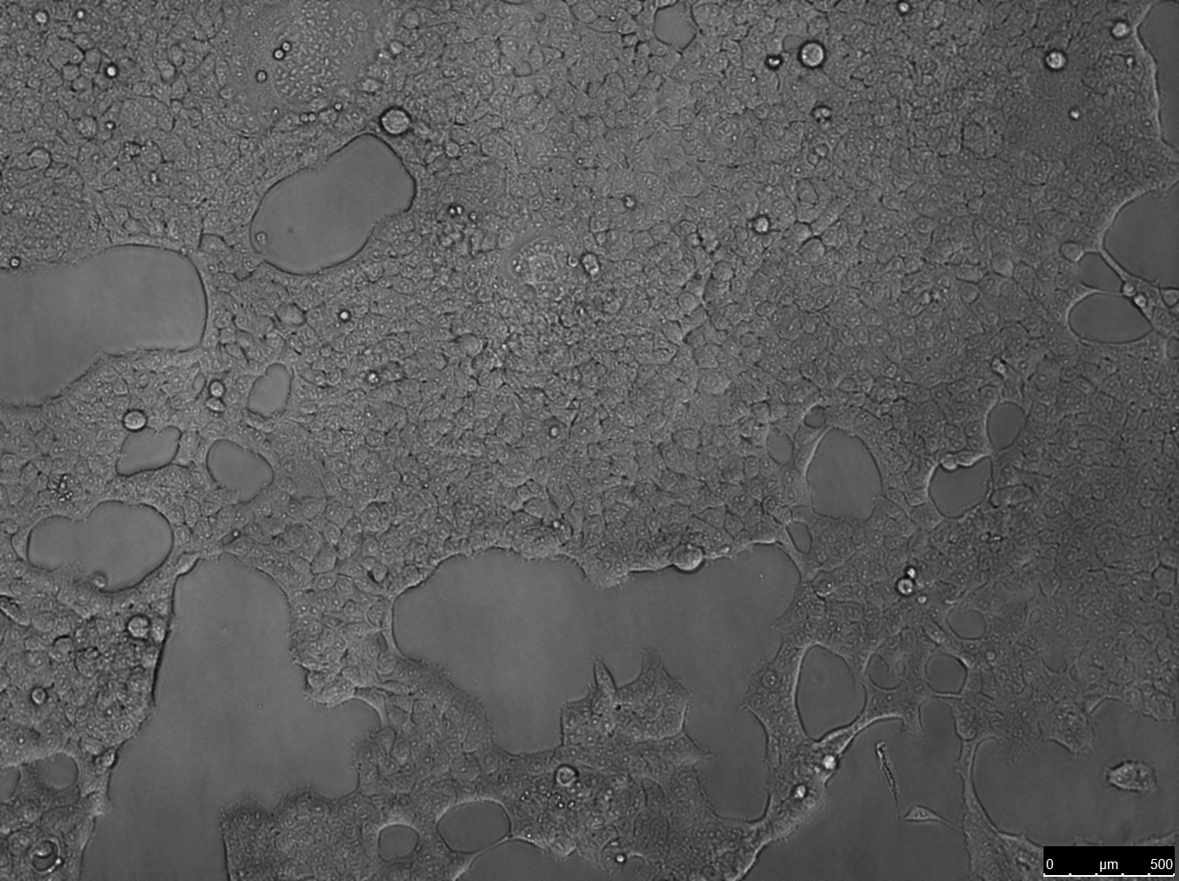
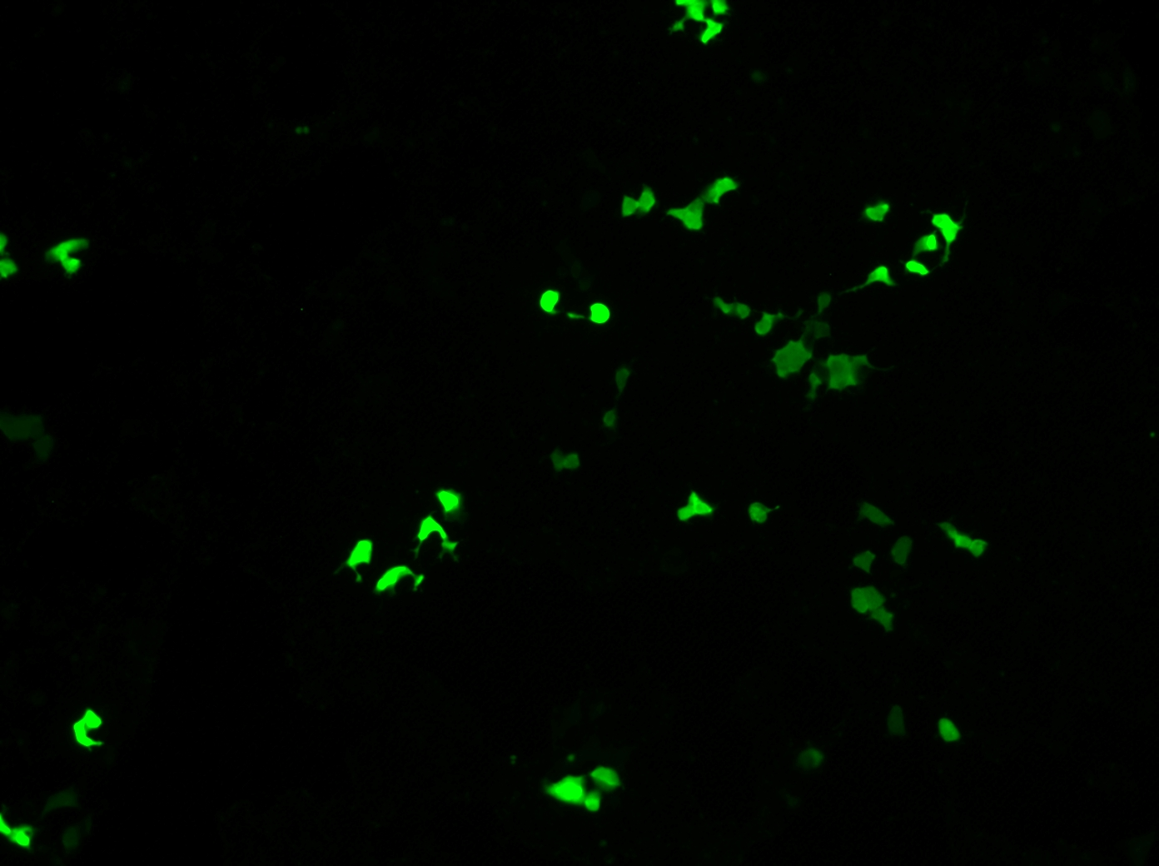
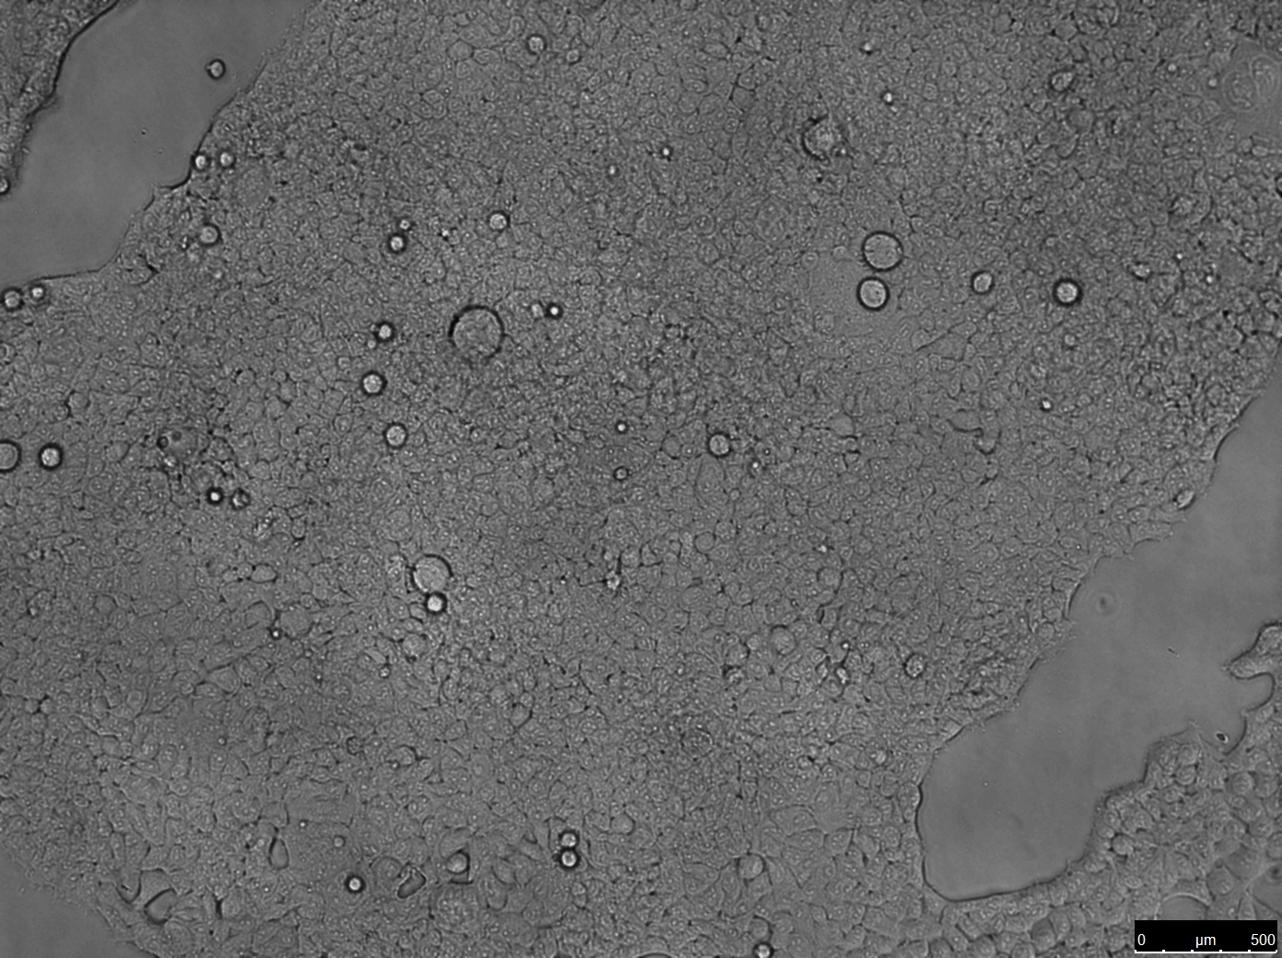
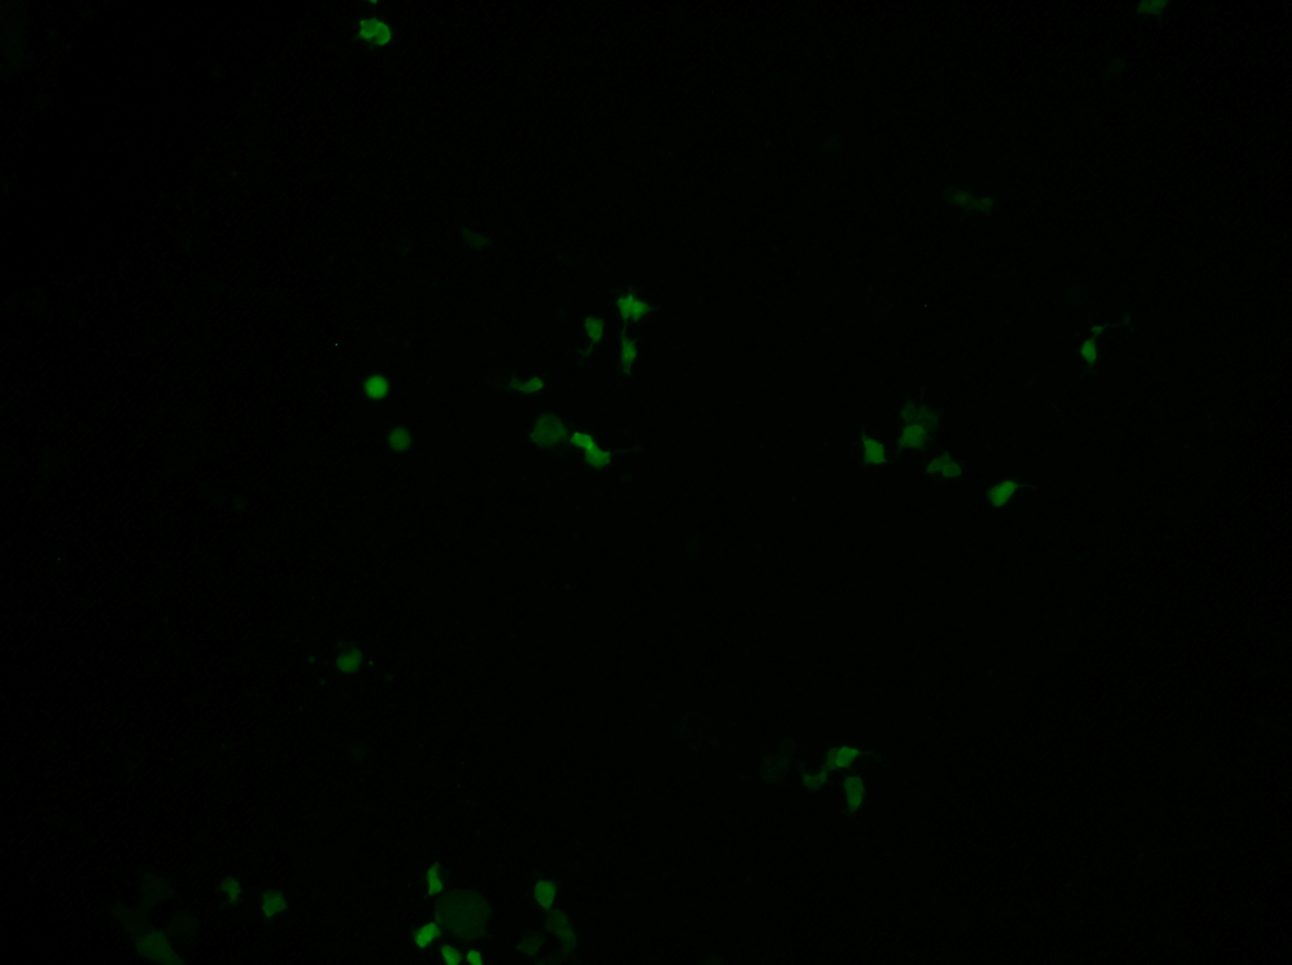
A
B
C
Spike pseudotyped ZsGreen backbone
Spike pseudotyped Luciferase-IRES-ZsGreen backbone
Bright Field
Fluorescence
Bright Field
Fluorescence

