Slide 1


BookBlend
Group 7:
Ashley Pafko
Shiwen Hou
Yuan Lu

Slide 2

BookBlend: Where Reading Meets Insight
A fusion of bookstore and community for the insightful reader
BookBlend: Where reading meets insight
For tech-savvy book enthusiasts who crave interactive and insightful reading experiences,
Who seek a seamless blend of book purchasing and engaging content consumption,
The BookBlend platform is a dynamic fusion of an online bookstore and a vibrant blogging community,
That provides users with the opportunity to not only discover and purchase books but also to share their insights and learnings through blog posts,
Unlike traditional bookstores or standalone blogging platforms,
Our product offers a unique convergence of literature discovery and community engagement, fostering a culture of continuous learning and discussion among readers.

Slide 3
Overview of User Stories
User Stories explain the functionality of the system from the perspective of different users.
Key Stories: Discover and Purchase Books, Share Reading Insights, Engage with Community.

Slide 4
User Story: Discover and Purchase Books
User Story: "As a book enthusiast, I want to discover books through personalized recommendations, so that I can find new reads that match my interests."
Goal: Find and buy books aligned with personal interests.
Definition of Done: User can search, find, and purchase books.
Subtasks: Implement recommendation engine, integrate payment gateway, design user interface.

Slide 5
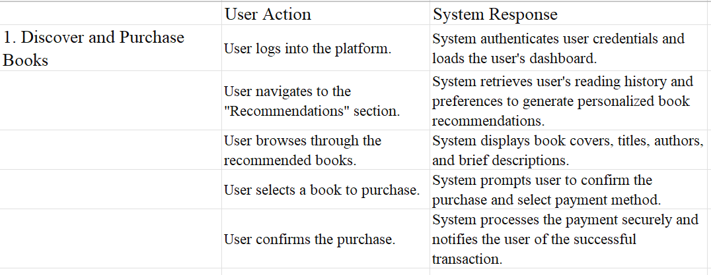
User cases for User Stories

Slide 6
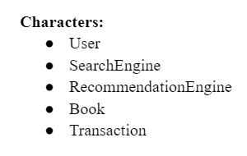
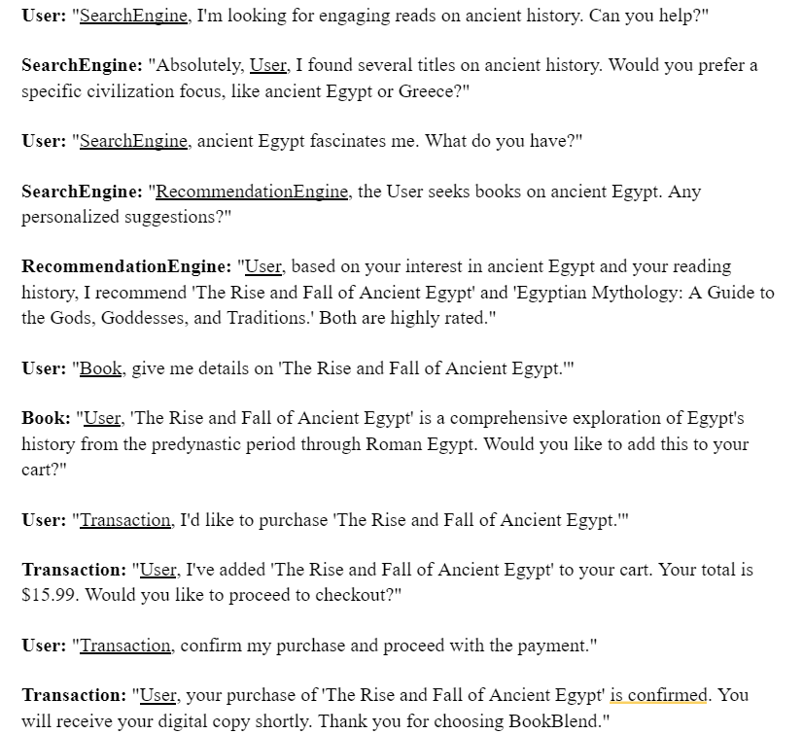
Scenario: Discover and Purchase Books

Slide 7

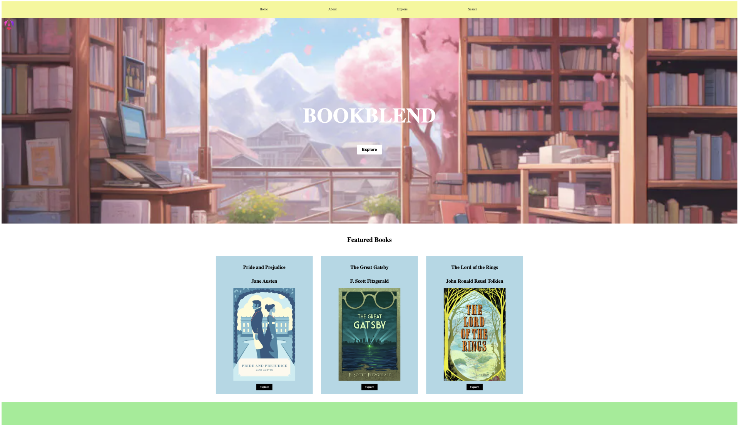
Live Demonstration of BookBlend

Slide 8
Class Diagram
User: Represents a system user with attributes like username, password, and preferences. Responsibilities include managing personal information, preferences, and interacting with various system features.
Book: Encapsulates all details about books such as title, author, ISBN, price, and condition. Responsibilities include maintaining book metadata and linking to transactions or blog posts.
BlogPost: Represents articles or posts written by users. Attributes include title, content, tags, and author. Responsibilities are to manage the creation, modification, and viewing of blog posts.
Transaction: Manages all transactions within the system, including book purchases and sales. Responsibilities include processing payments, managing order history, and handling transaction status updates.

Slide 9
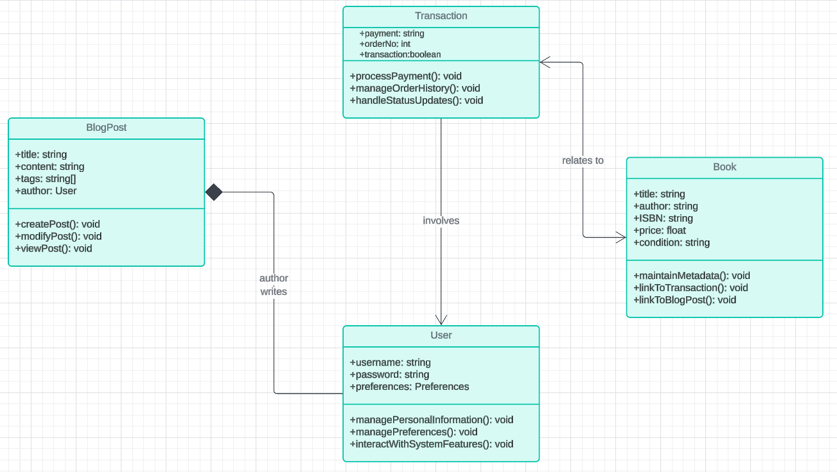
Class Diagram

Slide 10
Conclusion
Throughout this project, we've learned about:
the importance of clear and actionable user stories,
the challenges of integrating multiple functionalities into one platform,
and the effectiveness of thoughtful system architecture in creating a smooth user experience.

Slide 11
Thank you!

