Slide 1
Introduction to Multi-Core CPU and GPU Computation 多核心CPU和GPU計算
Class 11 Prof. Matthew Smith, msmith@mail.ncku.edu.tw

Slide 2
Today’s Class…
Today’s class will cover:
A sample 3D heat transfer problem,
Application of AVX together with OpenMP

Slide 3
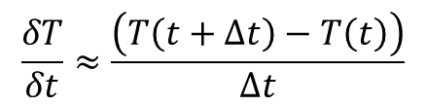
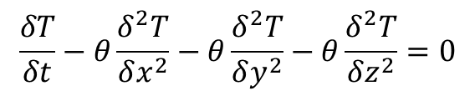
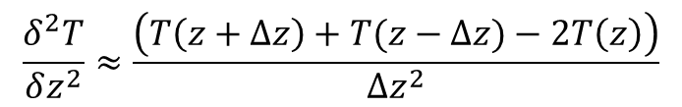
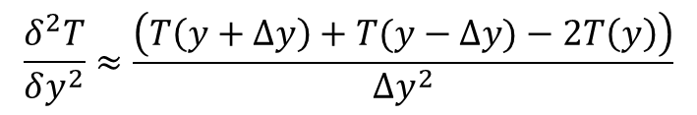
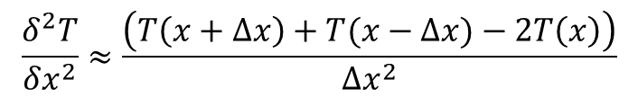
CASE STUDY – 3D Transient Heat Transfer
In class 4 – during class time and in the notes – we presented this result for the 3D heat transfer problem.
$$\frac{δT}{δt}−θ\frac{δ^{2}T}{δx^{2}}−θ\frac{δ^{2}T}{δy^{2}}−θ\frac{δ^{2}T}{δz^{2}}=0$$
$$\frac{δ^{2}T}{δx^{2}}≈\frac{\left(T\left(x+∆x\right)+T(x−∆x)−2T\left(x\right)\right)}{∆x^{2}}$$
Difference in x
$$\frac{δ^{2}T}{δy^{2}}≈\frac{\left(T\left(y+∆y\right)+T(y−∆y)−2T\left(y\right)\right)}{∆y^{2}}$$
$$\frac{δT}{δt}≈\frac{\left(T\left(t+∆t\right)−T\left(t\right)\right)}{∆t}$$
Difference in y
$$\frac{δ^{2}T}{δz^{2}}≈\frac{\left(T\left(z+∆z\right)+T(z−∆z)−2T\left(z\right)\right)}{∆z^{2}}$$
Difference in z

Slide 4
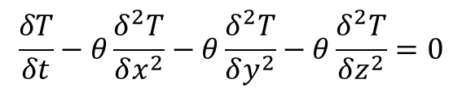
CASE STUDY – 3D Transient Heat Transfer
Since we are mixing variables here (space and time), we need to define the differences in each.
We can use k superscripts to indicate time, and i,j,k subscripts for space.
$$\frac{δT}{δt}−θ\frac{δ^{2}T}{δx^{2}}−θ\frac{δ^{2}T}{δy^{2}}−θ\frac{δ^{2}T}{δz^{2}}=0$$
Evaluate at (i,j,k)
Evaluate at time k
$$\frac{\left(T_{i,j,k}^{k+1}−T_{i,j,k}^{k}\right)}{∆t}−θ\frac{\left(T_{i+1,j,k}^{k}+T_{i−1,j,k}^{k}−{2T}_{i,j,k}^{k}\right)}{∆x^{2}}−θ\frac{\left(T_{i,j+1,k}^{k}+T_{i,j+1,k}^{k}−{2T}_{i,j,k}^{k}\right)}{∆y^{2}}−θ\frac{\left(T_{i,j,k+1}^{k}+T_{i,j,k−1}^{k}−{2T}_{i,j,k}^{k}\right)}{∆z^{2}}=0$$

Slide 5




CASE STUDY – 3D Transient Heat Transfer
Assuming our grid is a uniform, structured grid, we can rearrange and simplify to obtain a formula for the new T:
where we have constants:
The minimum of these constants must be less than 0.5 (i.e. )
This scheme is known as the Forward Time Centered Space (FTCS) scheme.
$$T_{i,j,k}^{k+1}=T_{i,j,k}^{k}+∅_{X}\left(T_{i+1,j,k}^{k}+T_{i−1,j,k}^{k}−{2T}_{i,j,k}^{k}\right)+∅_{Y}\left(T_{i,j+1,k}^{k}+T_{i,j+1,k}^{k}−{2T}_{i,j,k}^{k}\right)+∅_{Z}\left(T_{i,j,k+1}^{k}+T_{i,j,k−1}^{k}−{2T}_{i,j,k}^{k}\right)$$
$$∅_{X}=\frac{∆tθ}{∆x^{2}}$$
$$∅_{Y}=\frac{∆tθ}{∆y^{2}}$$
$$∅_{Z}=\frac{∆tθ}{∆z^{2}}$$
$$min\left(∅_{X},∅_{Y},∅_{Z}\right){<0.5}$$

Slide 6
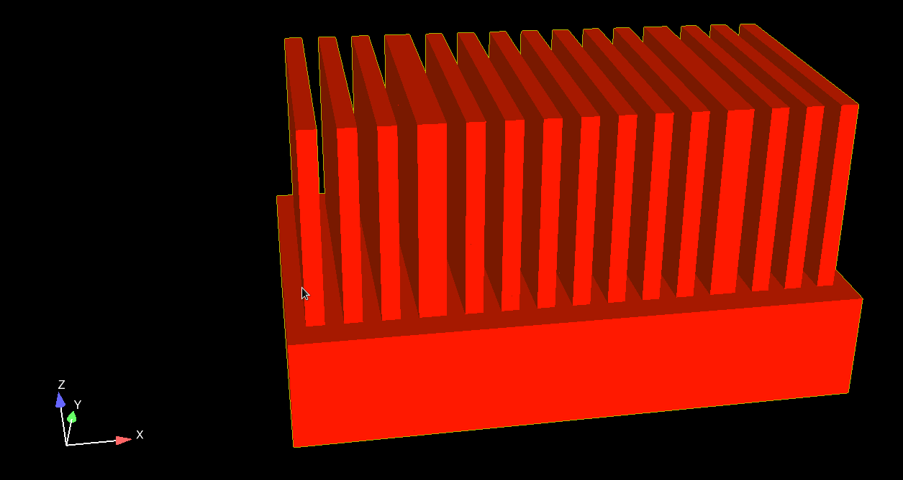
CASE STUDY – 3D Transient Heat Transfer
Let’s apply it to the 3D transient simulation of a heat sink for CPU’s.
No. of x cells: 64
No. of y cells: 64
No. of z cells: 64
Total number of cells: 0.26 million
Number of time steps: 200,000
Theta: 0.1
Timestep: 2.5e-7 seconds

Slide 7
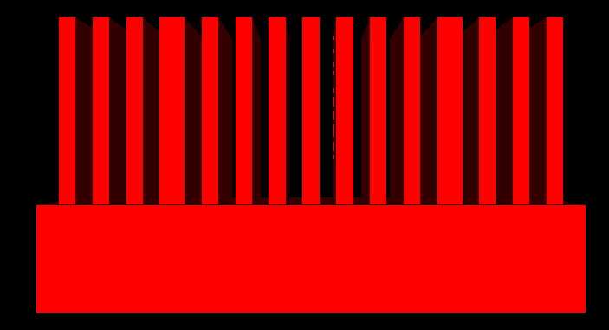
CASE STUDY – 3D Transient Heat Transfer
Let’s apply it to the 3D transient simulation of a heat sink for CPU’s.
No. of x cells: 64
No. of y cells: 64
No. of z cells: 64
Total number of cells: ~0.26 million
Number of time steps: 200,000
Theta: 0.1
Timestep: 2.5e-7 seconds
15 fins of length 0.8W and height (1/3)H
H=W=0.03m
L = 0.05 m

Slide 8
CASE STUDY – 3D Transient Heat Transfer
The real challenge here lies in the efficient use of AVX together with OpenMP.
To make this work, we need to think in advance about:
How we will store the data → How many variables, and what will each store,
How to allow each OpenMP thread to control each of its AVX elements,
How to minimize the time performing serial computations and maximize the time performing parallel operations.

Slide 9
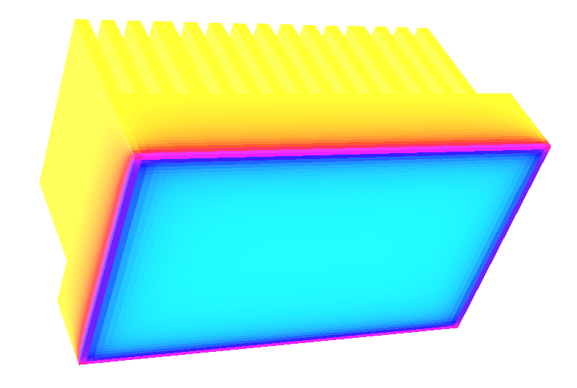
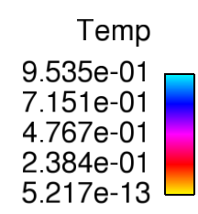
CASE STUDY – 3D Transient Heat Transfer
We set the temperature on the lower surface to be 1 K, and the surrounding air and external edges of the heat sink to be 0K.

Slide 10
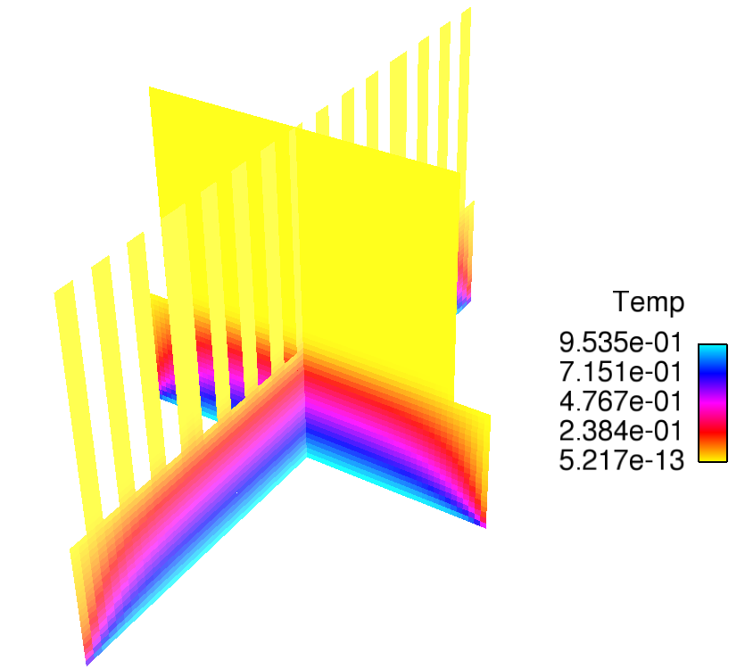
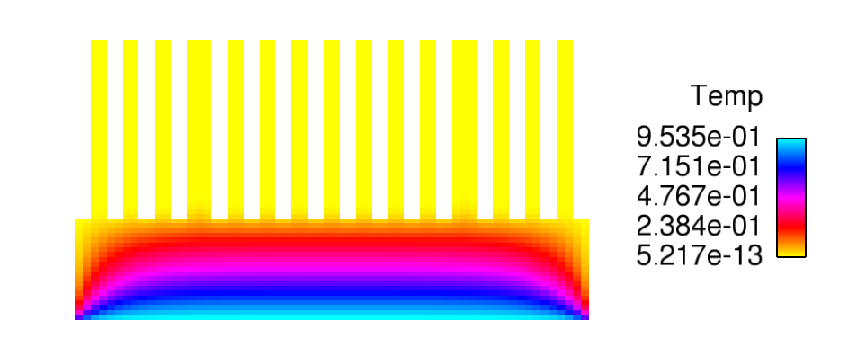
CASE STUDY – 3D Transient Heat Transfer
It’s a rough simulation, but hey – it took me 10 minutes to write the code and I did it as a demonstration for you guys. ☺

Slide 11
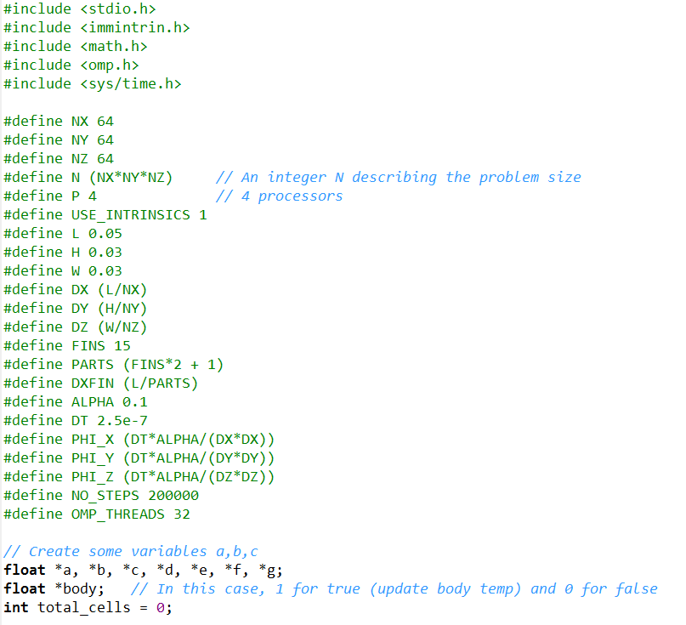
CASE STUDY – 3D Transient Heat Transfer
Problem Initialization in-code.
Temperature stored in variable *a.
The temperature of the neighbouring cells is stored in *b, *c, *d, *e, *f, *g.
The type of cell is controlled using variable *body.

Slide 12
CASE STUDY – 3D Transient Heat Transfer
Stencil:
f[i]
d[i]
c[i]
a[i]
b[i]
z
y
e[i]
g[i]
x

Slide 13
CASE STUDY – 3D Transient Heat Transfer
You might think this is a lot of redundant data: the same information stored in our original grid (the cell temperature) is stored an extra 6x in the neighbor information variables.
That means we are using a lot of extra memory to obtain a performance increase.
This is common in computing – we can often show the computational performance (speed) is proportional to the memory usage.
Low memory use can often imply poor performance (not guaranteed!)

Slide 14
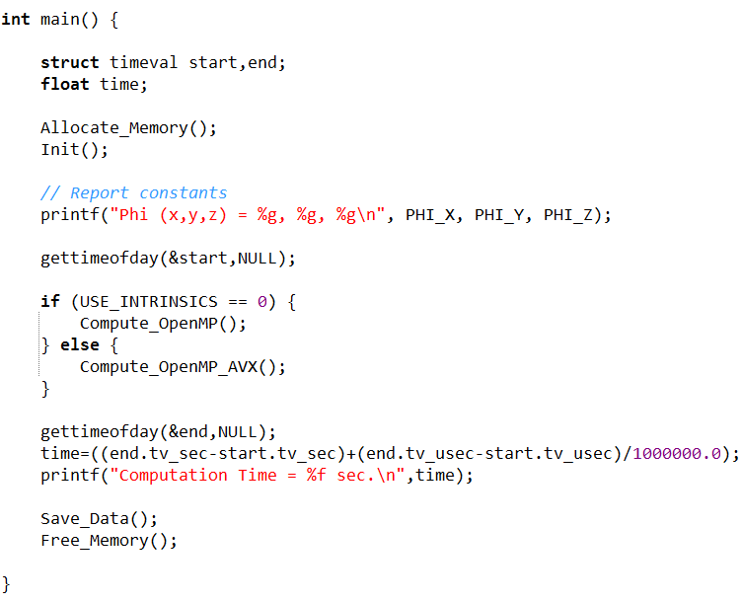
CASE STUDY – 3D Transient Heat Transfer
The main function.
First, we need to make sure our PHI variables are less than 0.5.
We use the “gettimeofday” function to measure the time of execution.
Don’t forget to save and free the result.

Slide 15
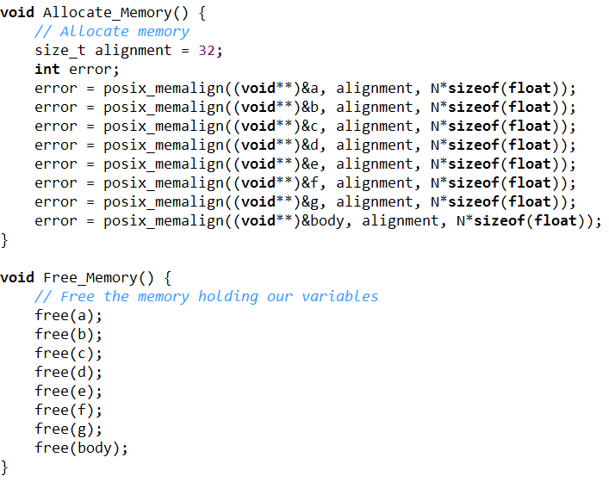
CASE STUDY – 3D Transient Heat Transfer
Memory allocation should be aligned.
Using OpenMP: This is not required, but may increase performance.
Using AVX: Compulsory. Will result in segmentation fault if memory is not aligned.

Slide 16
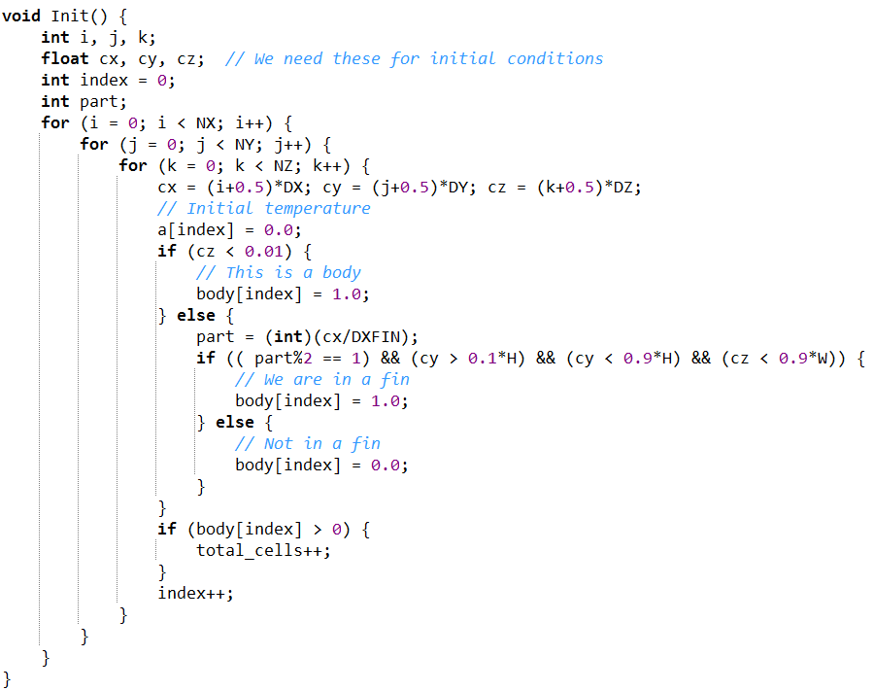
CASE STUDY – 3D Transient Heat Transfer
We use the Init() function to decide which cells in our simulations are solid or gas.
This is a rough way of dealing with the problem – it’s called “aliasing” and/or voxellizing.
For a large number of cells, it’s usually sufficient.
Note how we are using 1D arrays to store our 3D data.
This is common in HPC.

Slide 17
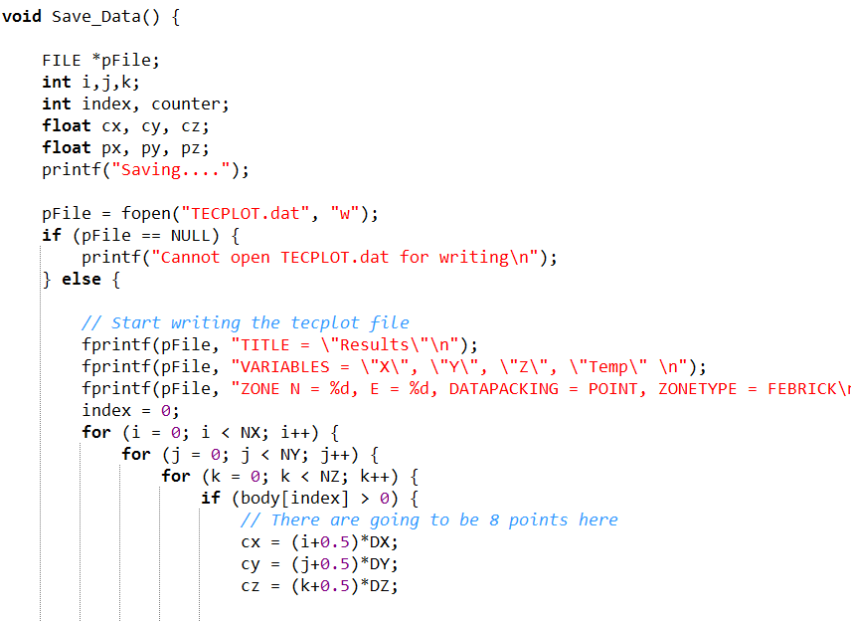
CASE STUDY – 3D Transient Heat Transfer
We output the result using the TECPLOT ASCII format.
This is simple to learn, though in this case I’ve implemented it very roughly.
Google about it online for more information.
ASCII Tecplot files can be used for visualization by most post-processors.

Slide 18
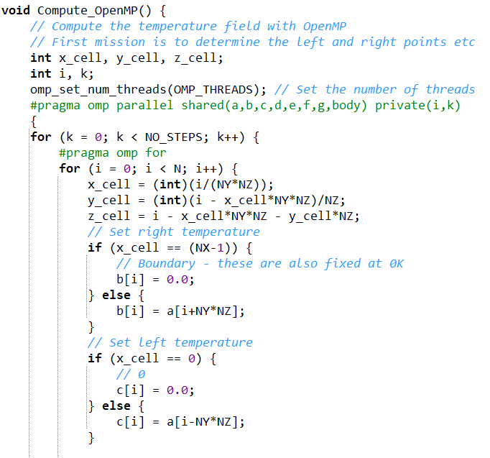
CASE STUDY – 3D Transient Heat Transfer
The computation is broken into two steps:
A loop over N elements to allocate the temperatures in neighbouring cells (i.e. set b,c,d,e,f,g).
A second loop over N elements to compute the new temperature (a) based on the old temperature and those of the neighbours (b-g).

Slide 19

CASE STUDY – 3D Transient Heat Transfer
The first loop needs to know about its left, right, top, bottom, front and back neighbours.
It also needs to know if it is near a boundary.
For this, we need to compute the i,j and k index:
Computing the x,y and z cell indices using the global index i.

Slide 20
CASE STUDY – 3D Transient Heat Transfer
First, we set the right cell temperature (assign it to b).
If we are at the boundary in the x direction, we set the temperature to be 0.0.
Otherwise, its the temperature in the cell to the right.
b[i] = a[i + NY*NZ]
The cell to the right has an index i + NY*NZ.

Slide 21
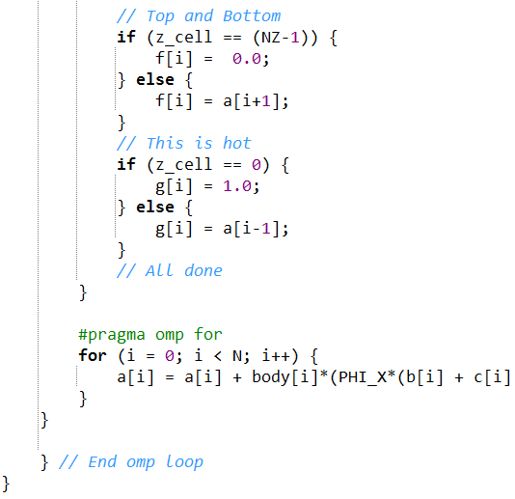
CASE STUDY – 3D Transient Heat Transfer
We do this for each direction:
After we do this, we have another for loop to update the temperature:
Direction | Left index | Right index
X | i-NY*NZ | i+NY*NZ
Y | i-NZ | i+NZ
Z | i-1 | i+1

Slide 22
CASE STUDY – 3D Transient Heat Transfer
We also take care of some of the gas cells here:
Note we only update the temperature for body cells.
This way we can avoid an if statement in this section.

Slide 23
CASE STUDY – 3D Transient Heat Transfer
You can also see that we use OpenMP to control all loops.
The #pragma omp parallel statement must be placed before the time loop.
The time for loop cannot be parallelized.
We use #pragma omp for for the two loops over N points.

Slide 24
CASE STUDY – 3D Transient Heat Transfer
To further increase the performance, we can use AVX intrinsics.
These cannot be easily used with the first loop – however, intrinsics are easily applied to the 2nd loop.
First, we have to set it up.

Slide 25
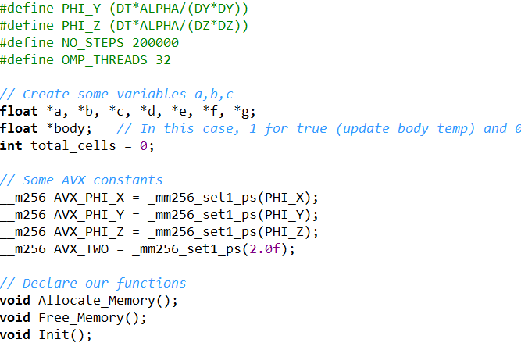
CASE STUDY – 3D Transient Heat Transfer
First, there are some common constants we need to take care of.
We cannot use #define variables in AVX → so we have to create some global variables:
Example:
__m256 AVX_PHI_X

Slide 26
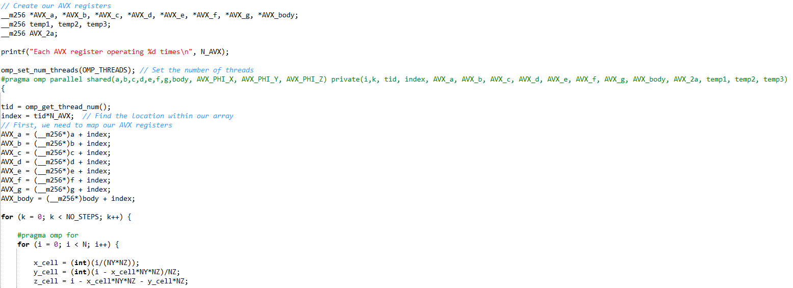
CASE STUDY – 3D Transient Heat Transfer
We also need to create AVX versions of our variables a-g:
In my implementation, AVX_a to AVX_g are private → All AVX variables except constants are private.
Map the AVX variables onto the data contained within the regular variables.

Slide 27
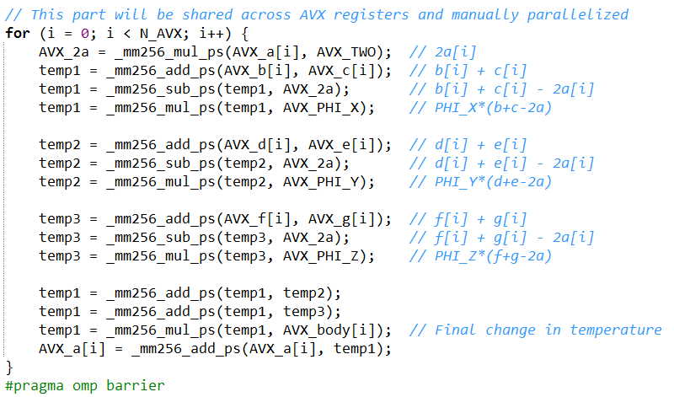
CASE STUDY – 3D Transient Heat Transfer
The second loop is replaced by a 100% AVX computation.
We use different temp variables (temp1 for x, temp2 for y etc) and then add them at the end.
Since we didn’t use #pragma omp for, we need to include a barrier.

Slide 28
CASE STUDY – 3D Transient Heat Transfer
Performance:
Code | Time | Speedup
Serial code, no optimization | 2085 seconds | 1x
Serial code, -O3 optimization (auto-vectorization using SSE) | 720 seconds | ~2.9x
OpenMP code, -O3 opt, 16 cores | 89 seconds | ~23.4x
OpenMP code with AVX, -O3, 16 cores | 72 seconds | ~29x
OpenMP code with AVX, -O3, 16 cores, Binded Threads | 46.9 seconds | ~44.4x

Slide 29
CASE STUDY – 3D Transient Heat Transfer
Commercial software packages will arrive at a solution in a similar time to that of the serial code without optimization.
After applying everything you’ve learned so far in the course, you can turn a 2000 second simulation into a 45 second one.
Another way of thinking about it → Larger problem → Transform from 45 hours to 1 hour.
Code | Time | Speedup
Serial code, no optimization | 2085 seconds | 1x
Serial code, -O3 optimization (auto-vectorization using SSE) | 720 seconds | ~2.9x
OpenMP code, -O3 opt, 16 cores | 89 seconds | ~23.4x
OpenMP code with AVX, -O3, 16 cores | 72 seconds | ~29x
OpenMP code with AVX, -O3, 16 cores, Binded Threads | 46.9 seconds | ~44.4x

Slide 30
CASE STUDY – 3D Transient Heat Transfer
This is something to think about when you find work.
At your next job, your boss will most likely ask you to perform a simulation using commercial software.
While you should do this (what your boss says), you’ll have the opportunity to write code which provides the same result in much less time.
Code | Time | Speedup
Serial code, no optimization | 2085 seconds | 1x
Serial code, -O3 optimization (auto-vectorization using SSE) | 720 seconds | ~2.9x
OpenMP code, -O3 opt, 16 cores | 89 seconds | ~23.4x
OpenMP code with AVX, -O3, 16 cores | 72 seconds | ~29x
OpenMP code with AVX, -O3, 16 cores, Binded Threads | 46.9 seconds | ~44.4x

Slide 31
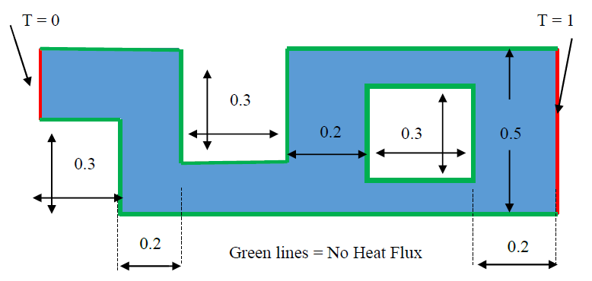
Tutorial
For today’s tutorial, I want you to work on this 2D heat transfer problem:
Set your initial temperatures to be 0 everywhere.
Use whatever thermal diffusivity coefficient you like.
Run your simulation until the steady solution is obtained.

Slide 32
Tutorial
Your solution will look something like this:
Solution using 640 unknowns
See if you can make a movie of the transient heating of this object before the end of class!

