Slide 1
Introduction to Multi-Core CPU and GPU Computation 多核心CPU和GPU計算
Class 12 Prof. Matthew Smith, msmith@mail.ncku.edu.tw

Slide 2
Mid-Semester Exam
We will hold your mid-semester exam during next Wednesday’s class.
I will review the material you need to know next Monday.
There will be no classes this Wednesday.
Today’s topics will not be on the exam next week.

Slide 3
Today’s Class
Today, we start looking at heterogeneous systems.
That is, a computer system which is made up of a variety of components which employ different architecture types.
This influences:
The performance of our applications,
The type and design of algorithms we use on such components.

Slide 4
Heterogeneous Computing
So far, all codes we’ve written in this course have been:
Executed on the CPU located on the motherboard, and
Written to use the memory located on the motherboard.
Since each OpenMP core is identical, and the memory used by each core is identical, we call this form of computing homogenous.
By using this form of computing, we neglect the possibility of using other components to perform computation.

Slide 5
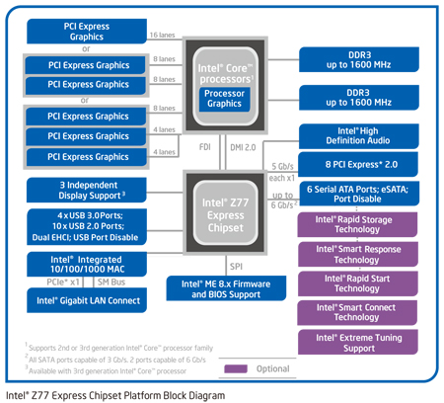
Heterogeneous Computing
Layout of your computer system:
Previously, all computation resided on this part of the computer.
However, the most powerful computational tool in your computer may be located on a PCIe slot.
The work happens here.

Slide 6
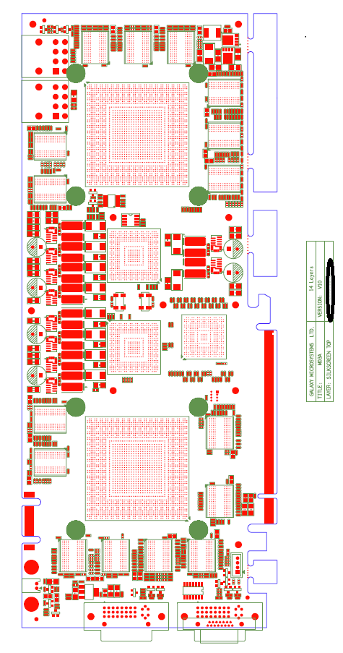
Heterogeneous Computing

Slide 7
Heterogeneous Computing
When we are using computer hardware of different architecture to work together in solving a problem – we are using Heterogeneous Computing.
A good example of this form of computing is the use of the Graphics Processing Units (GPU’s) to aid in the computation.
However, there is now an additional consideration:
Moving data between the GPU device takes significant time!

Slide 8
Heterogeneous Computing
When we are using computer hardware of different architecture to work together in solving a problem – we are using Heterogeneous Computing.
A good example of this form of computing is the use of the Graphics Processing Units (GPU’s) or Coprocessors to aid in the computation.
Let’s have a look at some of these devices.

Slide 9
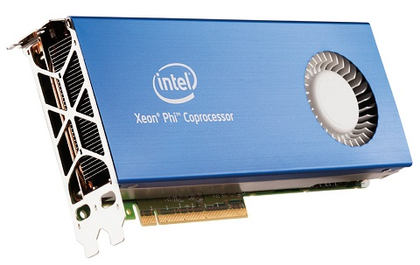
Intel Xeon phi coprocessor
Intel Xeon Phi Coprocessor
There are several variations of the Xeon Phi Coprocessor – one of them is the 3120A, which possesses active cooling.
The 3120A comes complete with:
57 cores, each capable of managing 4 threads.
6 GB DDR3 Ram.
Can be operated in heterogeneous mode or native mode.

Slide 10
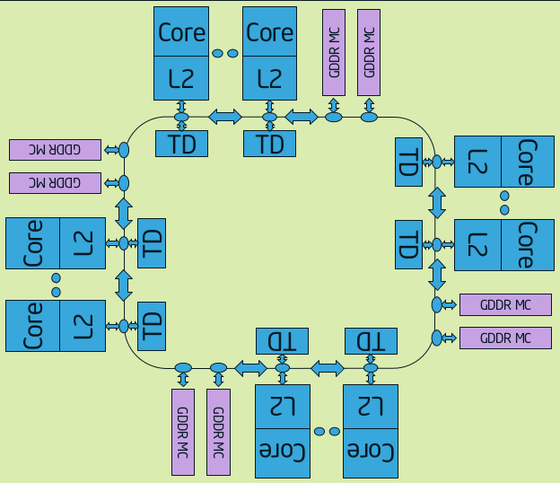
Intel Xeon phi coprocessor
The Intel Xeon Phi connects to the compute via the PCI-E x16 slot.
On the Phi card, each core is connected by a ring-type network.
Each core has its own cache, and is connected to a large section of global memory which is shared by each core.

Slide 11
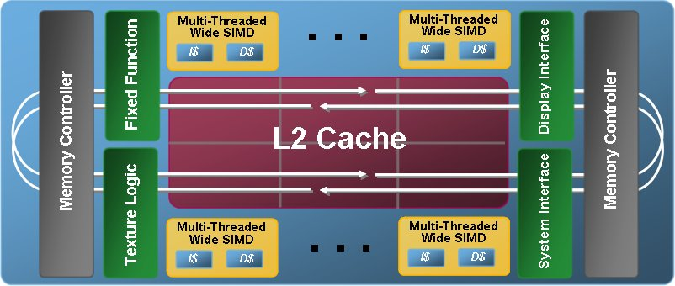
Intel Xeon phi coprocessor
The most important feature of the Phi design is the Wide SIMD registers.
Each core has access to 512 bit wide SIMD registers in the same style as AVX – only double the size.
These SIMD registers allow instructions on 512 bits of data (i.e. 16 floats or 8 doubles) in a single instruction cycle.

Slide 12
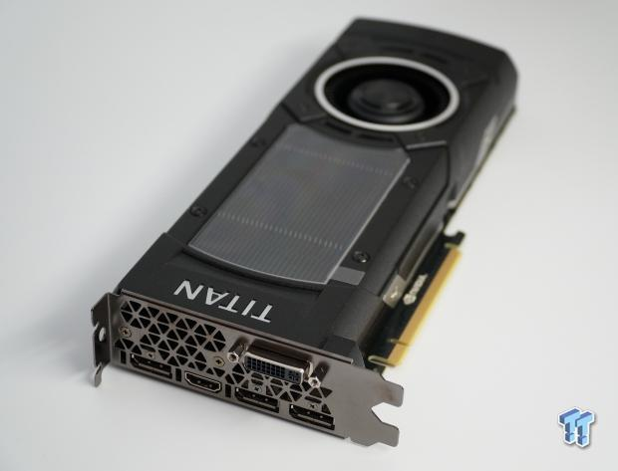
Graphics Processing Units
GTX Titan X
Probably one of the best cheaper GPU devices you can purchase.
Cost: $35,000 NTD (approx.)
Contains 3072 CUDA cores – but these cores are different to conventional CPU cores.

Slide 13
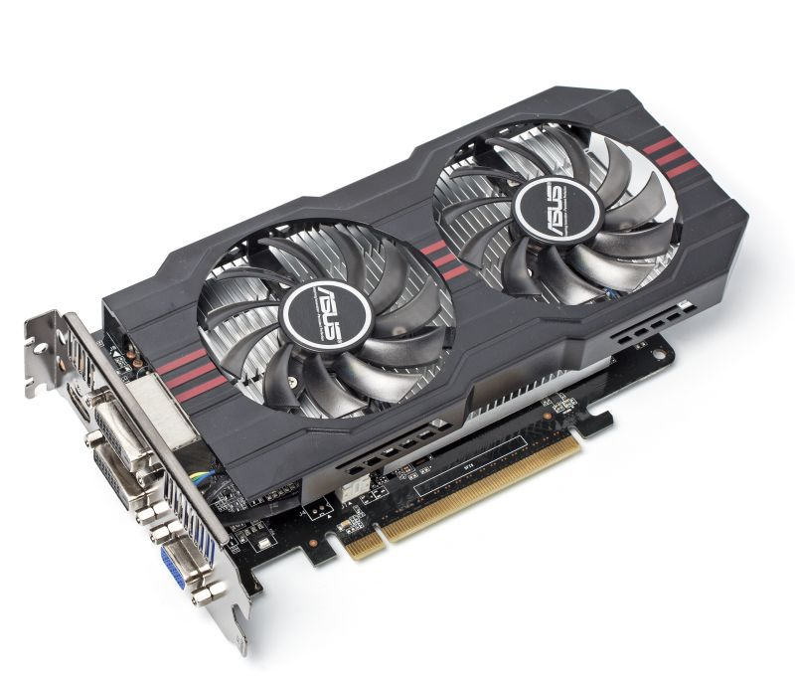
Graphics Processing Units
GTX 750 Ti
Probably the cheapest good GPU devices you can purchase.
Cost: $4,000 NTD (approx.)
Contains 640 CUDA cores – but these cores are different to conventional CPU cores.

Slide 14
Heterogeneous Computing
When performing any computation using GPU or Intel Xeon Phi, we need to take into account:
Data used for computation on the device needs to be manually sent to the memory on the device.
Computation performed on the device behaves fundamentally differently to conventional computations, and
Our results on the device needs to be copied from the device memory back into CPU memory.

Slide 15
Heterogeneous Computing
Review:
Let’s say we have this algorithm, and that the Calculation(i) across N elements is done in Parallel. What is the:
Fraction of parallel work?
Expected speedup for P cores?
Start
Initialization()
W₁ work
t < T?
i < N?
t = t + dt
Save()
W₂ work
W₃ work
Calculation(i)
End
i = i + 1

Slide 16
Heterogeneous Computing
Review:
Let’s now introduce a function which transfers data between the GPU and CPU.
Calculation() is still performed in parallel across N elements. However, Transfer() is not.
What is the:
Fraction of parallel work,
Expected speedup limit as P goes to inifinity?
Start
Initialization()
W₁ work
W₃ work
Transfer()
t < T?
i < N?
t = t + dt
Save()
W₂ work
W₄ work
Calculation(i)
End
i = i + 1

Slide 17
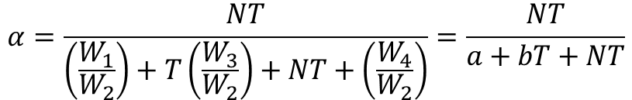



Heterogeneous Computing
It should be easy to prove that the limit of speedup with infinite P is:
Where b is the ratio of computational work (performed per element in the parallel section) to the communication expense (b = W₃/W₂)
For GPU computation – and any computation using a coprocessor attached to the PCIe slot, b is a function of N and your SU will not be good.
$$α=W_{P}/W_{T}$$
$$α=\frac{NT}{\left(\frac{W_{1}}{W_{2}}\right)+T\left(\frac{W_{3}}{W_{2}}\right)+NT+\left(\frac{W_{4}}{W_{2}}\right)}=\frac{NT}{a+bT+NT}$$
$$SU\sim \frac{1}{1−α}=\frac{a+\left(b+N\right)T}{a+bT}$$
$$SU\sim \frac{\left(b+N\right)}{b}=1+\frac{N}{b}$$

Slide 18
Heterogeneous Computing
So, this gives us a guide on how best to use these devices:
Communications between the device (GPU or Phi) and the CPU should be limited to an absolute minimum.
All computations performed on the device need to be run in parallel.
All computations on the device will be special:
Intel Xeon Phi computations require AVX512 vectorization to be efficient,
GPU computations need to take advantage of the thousands of cores available to be efficient.

Slide 19
Heterogeneous Computing
These insights also reveal information into what we need to lean in order to use these devices:
We need to know how to transfer information to the device, and back.
We need to know how to provide instructions to the device so we may perform parallel computation on it.
We need to know how we can write our codes to run efficiently on these devices.
It doesn’t matter if the device is a GPU or Phi card – it’s all the same.

Slide 20
Heterogeneous Computing
So – how do we design a good computer system for performing heterogeneous computation?
Well, there are several parts to a computer which need to be reviewed to answer this question.
The key parts are (i) CPU, (ii) Motherboard, (iii) GPU or Device, (iv) PSU, and (v) RAM.
Let’s have a quick look.

Slide 21
Heterogeneous Computing
CPU First.
The CPU issues instructions to your heterogeneous devices, and manages all non-device computations. The CPU also runs the O/S.
In general, you’re most likely to be running two different types of codes on your machine:
Multi-core computations, and
GPU computations.

Slide 22
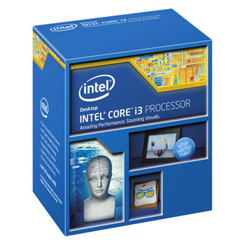
Heterogeneous Computing
If you are designing a small GPU computing machine, we can afford to buy a good 2 core CPU.
The Intel i3-4370 has two cores, which is enough for us to perform GPU type computing only.
It has a very high core speed (3.8 GHz standard) and a large amount of cache, and costs $4300 NTD.
This is a type 1150 socket, which means....

Slide 23
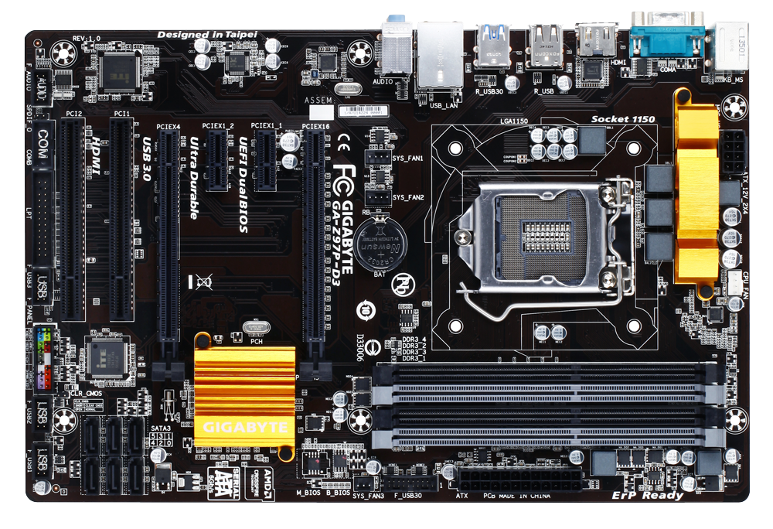
Heterogeneous Computing
You are going to need a motherboard with 2 GPU slots, regardless.
One of these will be used by the GPU you use for graphics.
The other will be computation.
Asus Z97-P $3000 NTD

Slide 24
Heterogeneous Computing
You’ll also need to keep an eye on:
The number of slots for your memory.
The number of SATA3 and USB connections managed by your south bridge.
You won’t ever use the on-board GPU (which is now in-chip)
Asus Z97-P $3000 NTD

Slide 25
Heterogeneous Computing
Since we are building a cheap GPU machine, we’ll go with the GTX 750 Ti.
This is the smallest (cheapest) GPU which allows SLI.
We won’t use SLI for computing, but SLI will come in handy for rendering.
Asus GTX-750 Ti x2 = $8000 NTD

Slide 26
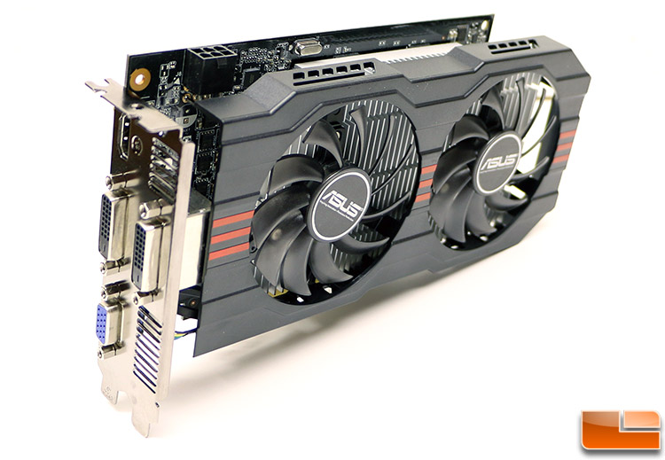
Heterogeneous Computing
If you have a close look a the GTX-750 Ti, you’ll see something else...
You’ll need a 6-pin connector for the power.
Hence our PSU becomes important – the power for GPU devices comes straight from the PSU.
Asus GTX-750 Ti x2 = $8000 NTD

Slide 27
Heterogeneous Computing
Total cost for a cheap system:
CPU : $4300
Motherboard: $3000
GPUx2: $8000
PSU: $2500 (approx.)
Ram: Minimum 16 GB (2x 8 GB dimms) $2200
H/D: $1700 (1 TB standard or 120 GB SSD)
Case: Meh
Total: Approximately $25,000 (Maximum)

Slide 28
Heterogeneous Computing
And it goes up from here.
More advanced systems will have multiple CPU cores, more than 2 GPU devices etc.
We can discuss this as we see fit now.

