Slide 1
Introduction to Multi-Core CPU and GPU Computation 多核心CPU和GPU計算
Class 13 Prof. Matthew Smith, msmith@mail.ncku.edu.tw

Slide 2
MID-SEMESTER EXAM
Length: 2 hours
Close book: no internet, no notes.
Will be held in this room (602) but computers will not be turned on.
This means there are some differences between this years exam and last years exam, since last years exam was:
Open Book, and
Computer based – needed to write code to complete.
This year, you will need to write code, but by hand – not in the computer.

Slide 3
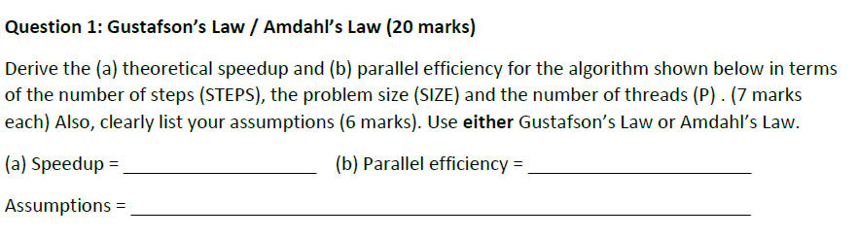
Mid-Semester Exam
Let’s review last years mid-semester exam anyway.

Slide 4
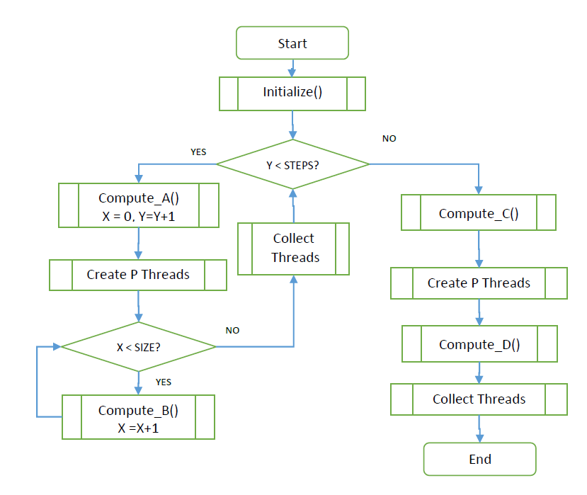
Mid-Semester Exam

Slide 5
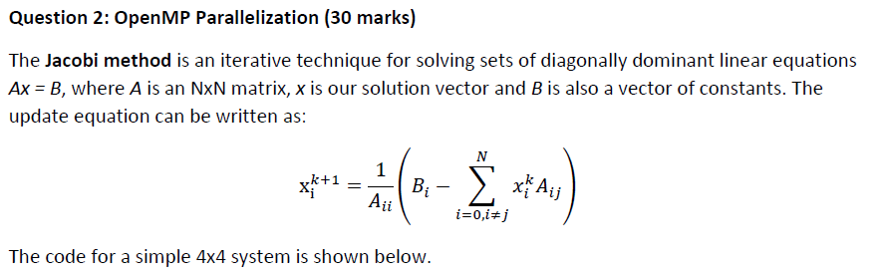
Mid-Semester Exam
Question 2 now:

Slide 6
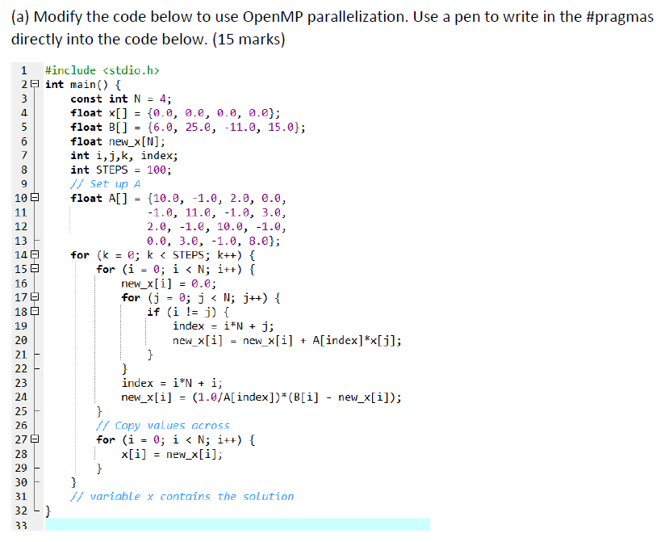
Mid-Semester Exam
To finish this problem, first you had to write this code into your computer and run it.
After you’ve made sure it worked – you can check the answer yourself using MATLAB – you need to write the OpenMP version of the code.
This was worth 15 marks.

Slide 7
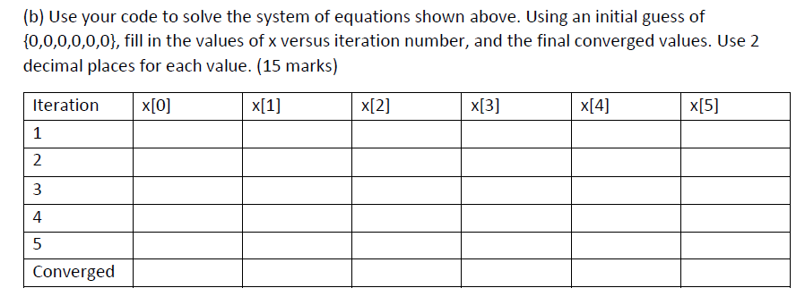
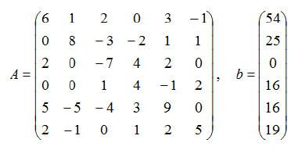
Mid-Semester Exam
So, here is where you change the value of A and B in your code and run it to compute x. (where Ax = B) given an initial value x = (0,0,0,0,0,0).
Hence, this code is essentially a method for inverting a diagonally dominant matrix.

Slide 8
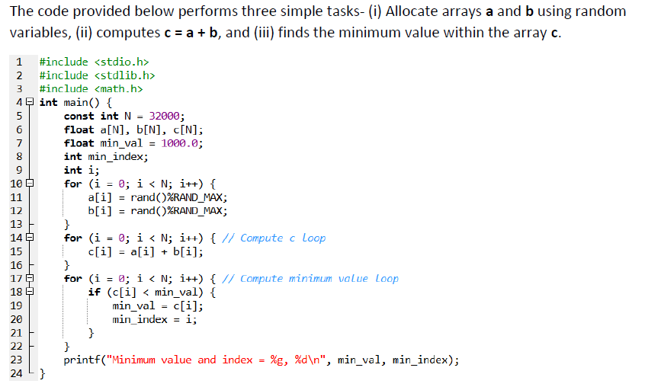
Mid-Semester Exam
Question 3 now.
This is a code which computes c = a + b and then finds the minimum.
The question starts with the students writing this code into their computers.

Slide 9

Mid-Semester Exam
Following this, students needed to alter the code to perform AVX computations.
The first part (a) focused on modifying the code to compute c = a + b.
The second part (b) needed to find the minimum of c.
extern __m256 _mm256_min_ps(__m256 m1, __m256 m2);
Remember – this was an open book exam, which meant students had access to notes and internet sites to help solve the problem!

Slide 10
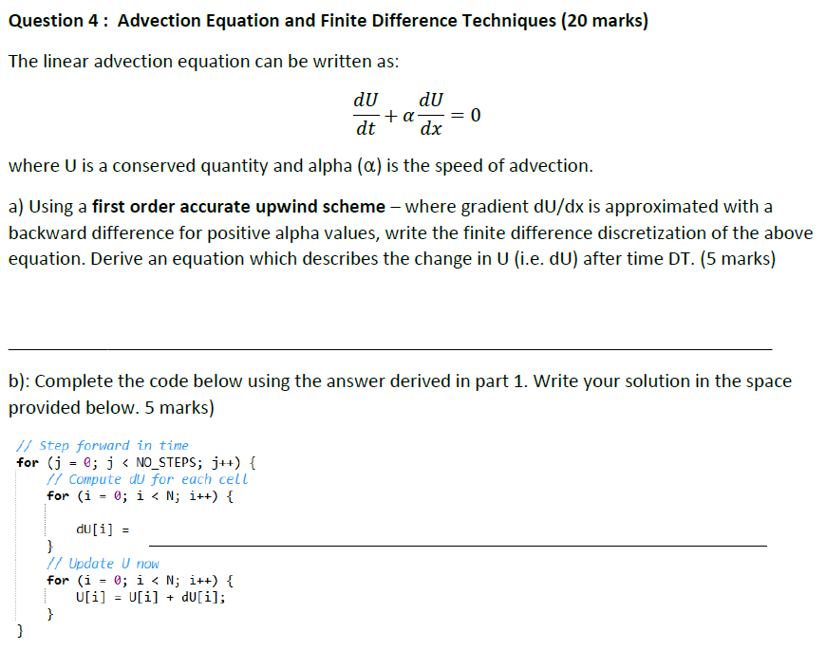
Mid-Semester Exam
Question 4 now.
Here, you had to either (i) remember how to write a 1st order accurate upwind scheme, or (ii) be able to find it on the internet.
Write the formula in this space....
Write the code in this space....

Slide 11
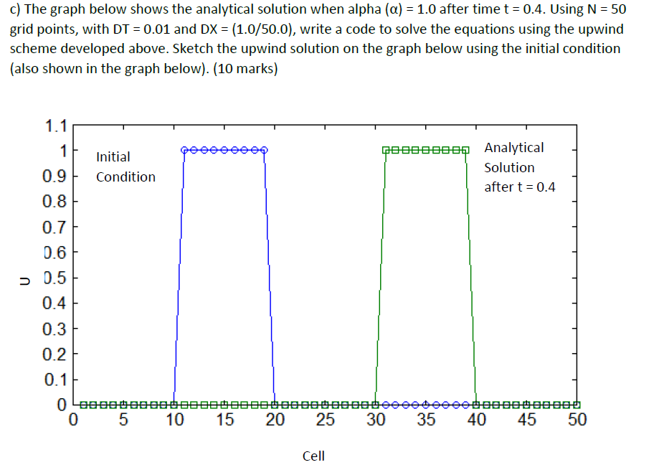
Mid-Semester Exam
The final part of Question 4 asked students to write a code to simulate the problem with the conditions shown.
Students then had to draw their results onto the graph provided (as shown).

Slide 12
Mid-Semester Exam
Note: I never said any of the following details:
The language (i.e. C/C++, etc)
Whether or not it is parallel.
Students could write a simple serial MATLAB code to solve this problem if they wanted.

Slide 13
REVIEW
Last year’s exam was focused on the ability of students to solve unfamiliar problems in real time using the internet and notes as a tool.
The average score for last year’s exam was 63 out of 100. About 40% passed the exam. This was because the average student’s typing speed was too slow.
This years exam is designed to test your skills at solving familiar problems in real time without the internet or notes.
Since there is no programming – just writing code with your hands – you should not have the same time problems students had last year.

Slide 14
REVIEW
Things we will cover:
Question 1: Something about Amdahl’s Law. (5 mins)
Question 2: Something about Gustafson’s Law. (5 mins)
Question 3: Applied question of Amdahls / Gustafson’s Law (10 mins)
Question 4: Something about SIMD / MIMD. (5 mins)
Question 5: Applied question about SSE or AVX (10 mins)
Question 6: Applied question about SSE or AVX (10 mins)
Question 7: Applied question about OpenMP (10 mins)
Question 8: Something about OpenMP (5 mins)
Question 8: Applied question about OpenMP (10 mins)
You should be able to finish this exam in about 70 minutes – I will give you 2 hours to check your work.
Applied question ➔ Means you will need to do math, or write code by hand, to solve a specific problem.

Slide 15
REVIEW
In general, because the exam is closed book and only 2 hours, the questions will be shorter / easier.
However, you cannot use your notes or the internet – so you’ll have to remember:
General C/C++ programming rules and syntax.
The specific SSE, AVX and OpenMP code syntax.
Mathematical formulas for speedup and efficiency computation.
You’ll have to be able to analyze a code and find bugs without a computer.

Slide 16
REVIEW
And those are all the clues I can give you.
Good luck on Wednesday.

