Slide 1
Introduction to Multi-Core CPU and GPU Computation 多核心CPU和GPU計算
Class 16 Prof. Matthew Smith, msmith@mail.ncku.edu.tw

Slide 2
Today’s class
Review of the code from Monday,
Memory copies to and from device, and
Tutorial Activity.

Slide 3
Review
When dealing with memory transfers and allocation on the device, the most common error is the “Segmentation Fault”.
Segmentation Faults occur when the program attempts to access memory which is:
Out of bounds of the original allocation of memory declared, and/or
Not permitted or able to be accessed by the program.
The error may arise when students tried to use this command:
printf(“Value of d_a[%d] = %f\n”, i, d_a[i]);
That is, if d_a is allocated on the device. We cannot print it’s values!

Slide 4
Review
When the CPU attempts to access the memory on the GPU device, we will see this error.
The values contained within the array d_a cannot be accessed or used by the CPU because of the separated architecture.
The variable d_a can only be used by the GPU device.
In this case, how do we check if the values held in d_a are correct? How do we know if our data allocation or operations are valid?

Slide 5
CUDA and ERRORS
One of the commands demonstrated in your first code this week was:
An alternate form for using this function is:
The “Error” variable is what the cudaMalloc function returns to the CPU upon completion of its operations.
Error = cudaMalloc((void**)&d_a, size);
cudaMalloc((void**)&d_a, size);

Slide 6
CUDA and ERRORS
The variable “Error” is a special data type – a structure containing many smaller pieces of information.
In CUDA, this data type is known as a “CUDA Error Data Type”.
These variables are declared by:
cudaError_t Error;
Data structure name
(i.e. just like float, or int)
Name of variable.

Slide 7
CUDA and ERRORS
Each time we use a CUDA function (of almost any kind), we can use this tool to let us know if something has gone wrong.
By using CUDA Error Types, we can see where things have gone wrong on the GPU side of the computation.
Example:
printf("CUDA error = %s\n", cudaGetErrorString(Error));

Slide 8
CUDA and ERRORS
Sample Code for today’s tutorial:
void Copy_Memory() {
size_t size = N*sizeof(float);
cudaError_t Error;
// Copy h_a to d_a
Error = cudaMemcpy(d_a, h_a, size, cudaMemcpyHostToDevice);
printf(“Error = %s\n”, cudaGetErrorString(Error));
// Copy d_a to h_b
Error = cudaMemcpy(h_b, d_a, size, cudaMemcpyHostToDevice);
printf(“Error = %s\n”, cudaGetErrorString(Error));
}
>> ./test.run
Error = no error
Error = invalid argument

Slide 9
CUDA and ERRORS
This code will compile and run without any reported errors or segmentation faults.
However, the results will be incorrect. Examination of the CUDA Error type reveals the error:
void Copy_Memory() {
size_t size = N*sizeof(float);
cudaError_t Error;
// Copy h_a to d_a
Error = cudaMemcpy(d_a, h_a, size, cudaMemcpyHostToDevice);
printf(“Error = %s\n”, cudaGetErrorString(Error));
// Copy d_a to h_b
Error = cudaMemcpy(h_b, d_a, size, cudaMemcpyHostToDevice);
printf(“Error = %s\n”, cudaGetErrorString(Error));
}
>> ./test.run
Error = no error
Error = invalid argument

Slide 10
CUDA and ERRORS
Another example of an error can be found if we attempt to copy a section of memory larger than allocated:
>> ./test.run
Error = invalid argument
Error = invalid argument
void Copy_and_Allocate_Memory() {
size_t sizeA = N*sizeof(float);
size_t sizeB = (N+1)*sizeof(float);
cudaError_t Error;
// Allocate d_a
cudaMalloc((void**)&d_a, sizeA);
// Copy h_a to d_a
Error = cudaMemcpy(d_a, h_a, sizeB, cudaMemcpyHostToDevice);
printf(“Error = %s\n”, cudaGetErrorString(Error));
// Copy d_a to h_b
Error = cudaMemcpy(h_b, d_a, sizeB, cudaMemcpyHostToDevice);
printf(“Error = %s\n”, cudaGetErrorString(Error));
}

Slide 11
CUDA and ERRORS
The primary role of the Error type is to inform the user than an error has occurred.
In a working code, the error type will return “no error”.
Otherwise, there are many possible values the error type may return:
invalid argument
unspecified launch error
unknown error
If there are errors, but you do not use the CUDA error types or print out their values, you will not know if the code is working or not (except by looking at your solution…)

Slide 12
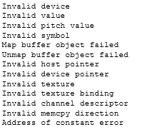
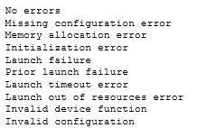
CUDA Error codes

Slide 13
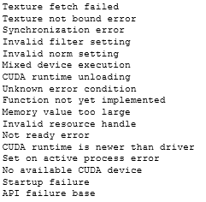

CUDA Error codes (2)
UNKNOWN ERROR!!
NOT READY ERROR?
These two are my favorite errors.

Slide 14
Memory Transfer for GPU/CPU

Slide 15
TALKING TO THE GPU
As I’ve also already mentioned several times, the GPU cannot talk to the CPU directly.
However, to perform computation on the GPU, the CPU MUST be able to do something..
Communication occurs by copying information from the CPU ram into the GPU ram (and vice versa).
So far today, you’ve already seen these codes in action.

Slide 16
TALKING TO THE GPU
The function we use to do this is called cudaMemcpy.
It’s used like this:
Error = cudaMemcpy(d_a, h_a, size, cudaMemcpyHostToDevice);
printf("CUDA error (memcpy d_a) = %s\n", cudaGetErrorString(Error));
Performs the transfer operation
Checks to see if the transfer operation was successful.

Slide 17
TALKING TO THE GPU
The capacity to copy memory between the host and device requires special treatment due to the separated architecture.
CUDA has a special function to manage memory copies:
cudaMemcpyHostToHost – this is much like the standard memcpy, copying data from a host variable to another host variable.
cudaMemcpyHostToDevice – copy data from a host variable to a device variable,
cudaMemcpyDeviceToHost – copy data from a device variable to a host variable,
cudaMemcpyDeviceToDevice – copy data from a device variable to another device variable.
cudaMemcpy(destination variable, source variable, size, type of transfer);
Returns a CUDA error type variable
(recommended)

Slide 18
Memory Copying
The destination and source variables are pointers to our locations in memory.
Example:
float *h_a, *d_a; // Declared as pointers
// After initialization and memory allocation
cudaMemcpy(d_a, h_a, size, cudaMemcpyHostToDevice);
These arrays do not have to be the same size. Control of how many elements to transfer is managed by the size variable.

Slide 19
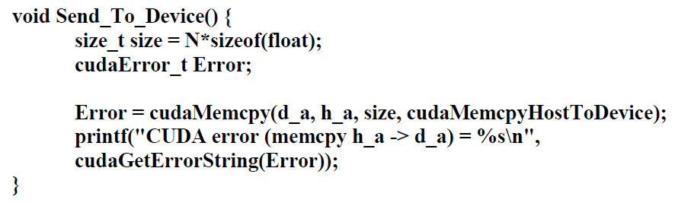
Memory Copying
Full Function:
Sends the data stored in h_a and places it in the device variable d_a.

Slide 20
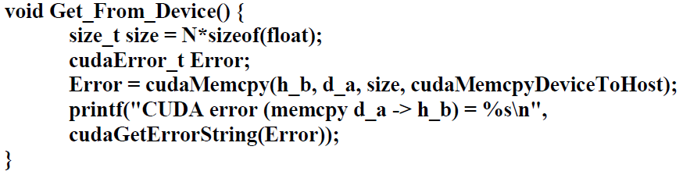
Memory Copying
Getting data from the device is performed in the same way:
Sends the data stored in d_a and places it in the device variable h_b.

Slide 21
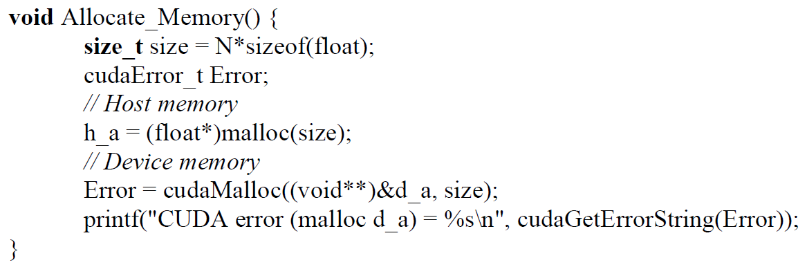
MEMORY COPYING
Care must be taken when copying data to (and from) the GPU.
If the size of the data to be copied must be less than (or equal) to the space reserved:

Slide 22
MEMORY COPYING
Care must be taken when copying data to (and from) the GPU.
If this size of the data being transferred to the GPU is larger than that reserved, there will be an error.
If the memory being transferred is too large, you’ll need to print the Error out to identify it.

Slide 23
MEMORY COPYING
Care must be taken when copying data to (and from) the GPU.
If the memory for the GPU has not been prepared, there will be an error.
If the incorrect mode is used for the transfer (i.e. device-to-device for a device-host transfer), there might be an error.
In fact, there are many possible ways to make a mistake. Be careful.

Slide 24
COMPLETE EXAMPLE
Let’s consider a program which:
Creates a variable (h_a) and defines it. Also create a variable (h_b) but leave it empty.
Create a variable on the GPU (d_a).
Copy the data contained within h_a to the GPU variable d_a.
Copy the data on the GPU (d_a) to the CPU variable (h_b).
Check the data contained within h_b. If the GPU operation is successful, the variable h_b will contain the information originally in h_a.

Slide 25
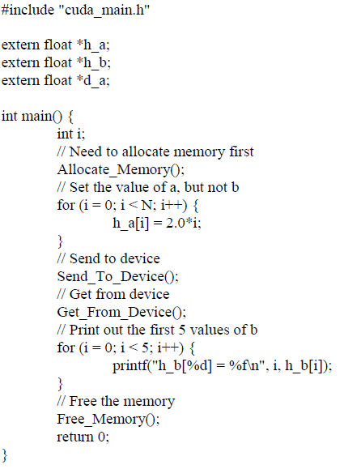
COMPLETE EXAMPLE
Main program:
Allocate the memory Allocate_Memory();
Set the values of h_a
Send the data to the device,
Return the data from the device,
Check the result,
Free memory.

Slide 26
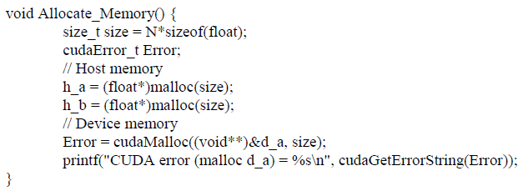
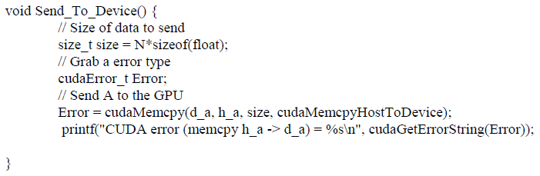
COMPLETE EXAMPLE
Allocate_Memory():
Use malloc() to allocate h_a and h_b.
Use cudaMalloc() to allocate d_a.
Send_To_Device():
Use cudaMemcpy() to transfer the data from h_a to d_a.
We use the cudaMemcpyHostToDevice argument to perform the transfer.

Slide 27
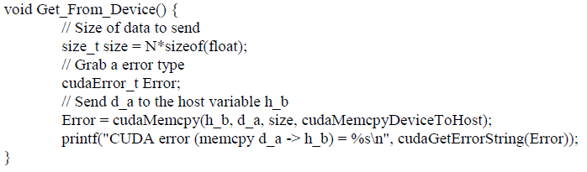
COMPLETE EXAMPLE
Get_From_Device():
Use cudaMemcpy() to transfer the data from d_a to h_b.
We use the cudaMemcpyDeviceToHost argument to perform the transfer.
The form is identical to the Send_To_Device function, only there is a minor change to the arguments in the cudaMemcpy() function.

Slide 28
TUTORIAL
Overview of the code contained here:
Create three codes: main.c, gpumain.cu and gpumain.h.
Create three variables – h_a and h_b (on the host) and d_a (on the device).
h_a, h_b and d_A are all arrays of floats containing N = 100 elements.
Create 3 functions – allocate_memory, free_memory and copy_memory().
Goals
Reserve memory for h_a, h_b and d_a on the device and host.
Create h_a to initially contain non-zero values: h_a = [....]
Create h_b to contain zeros: h_b = [0, 0, 0,….]
Copy h_a to to d_a on the GPU device.
Copy d_a to h_b on the host.
Confirm that h_b now contains the values h_b = [0,1,2,3….99]
If h_b contains data, then the process must have worked!

Slide 29
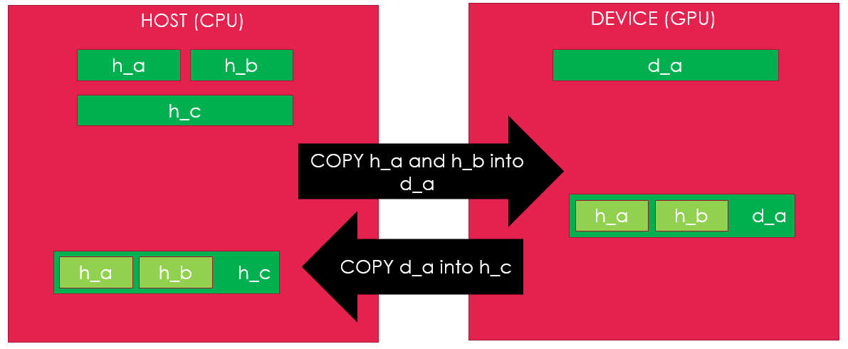
TUTORIAL
Write a GPU (CUDA) code which performs the following tasks. You should use a makefile to help compile your codes.
Use malloc to create three arrays of floating point variables (a,b,c) on the host (CPU) machine. These arrays should be of length N (for array a and b) and length 2N (for array c).
Use CUDA to allocate memory for a single array a on the GPU device. The array should be of length 2N, also using floating point variables.
Fill variables a and b on the host with random data.
Copy the data from a (on the host) into the first half of a (on the GPU).
Copy the data from b (on the host) into the second half of a (on the GPU).
Copy the data from a (on the GPU) back into c (on the host).
Check to make sure the data is correct.
This process is described in Figure 1. Don’t forget to check the code for errors and use CUDA error_type variables during the memory copying process.
After you’ve written this code, write a code which does this.
When you are done, you can go home!

