Slide 1
Introduction to Multi-Core CPU and GPU Computation 多核心CPU和GPU計算
Class 17 Prof. Matthew Smith, msmith@mail.ncku.edu.tw

Slide 2
Today’s class
Review each groups progress on their major assignments.
GPU Hardware – SMPs (SMX’s), SPs and memory.
Thread Creation on the GPU
Single threads
Multiple threads
Launching a simple kernel on the GPU

Slide 3
REVIEW OF GPU HARDWARE
The layout of the GPU device helps dictate (control) how we write our programs and design our algorithms.
As a preview / summary, we can see that:
The GPU contains a small number of Streaming Multi-Processors (SMPs’), generally referred to as SMX (Kepler) or SMM (Maxwell).
Each SMP (SMM) contains a larger number of streaming processors.
Each SMP/SMM has access to its own cache, plus global memory.

Slide 4
REVIEW OF GPU HARDWARE
Basic Representation of the GPU hardware:
SMP
SMP
SMP
SMP
….
Local Memory
Local Memory
Local Memory
Local Memory
Global Memory and/or L2 Cache

Slide 5
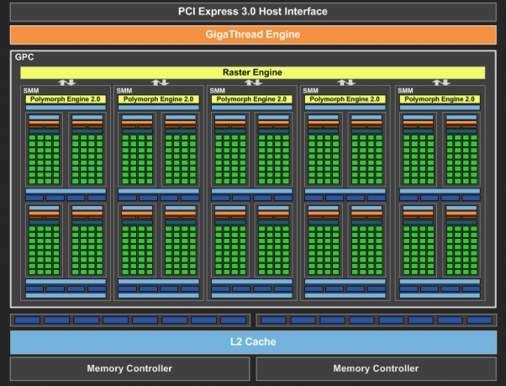
REVIEW OF GPU HARDWARE
Picture of Maxwell architecture:
SMM = (Maxwell) Streaming Multiprocessor
We can see each has access to global memory and some local L2 cache.

Slide 6
REVIEW OF GPU HARDWARE
Each Streaming Multi-processor contains a large amount of streaming processors.
Each SP is able to use local memory to work together with other SP – however, generally speaking, they are designed to work alone.
Each SMP is designed to perform computations on a single group of threads. This group of threads is known as a block.
SMP
SP
SP
SP
SP
SP
SP
SP
SP
SP
SP
SP
SP
SP
SP
SP
SP
SP
SP
SP
SP
Local Memory
Global Memory and/or L2 Cache

Slide 7
REVIEW OF GPU HARDWARE
Since each thread within a block is performed on the same SMP, each thread within a block can have access to the same local memory on-chip.
The question remains, however: how do we split our work into blocks of threads?
The solution is associated with how we store our data.
SMP
SP
SP
SP
SP
SP
SP
SP
SP
SP
SP
SP
SP
SP
SP
SP
SP
SP
SP
SP
SP
Local Memory
Global Memory and/or L2 Cache

Slide 8
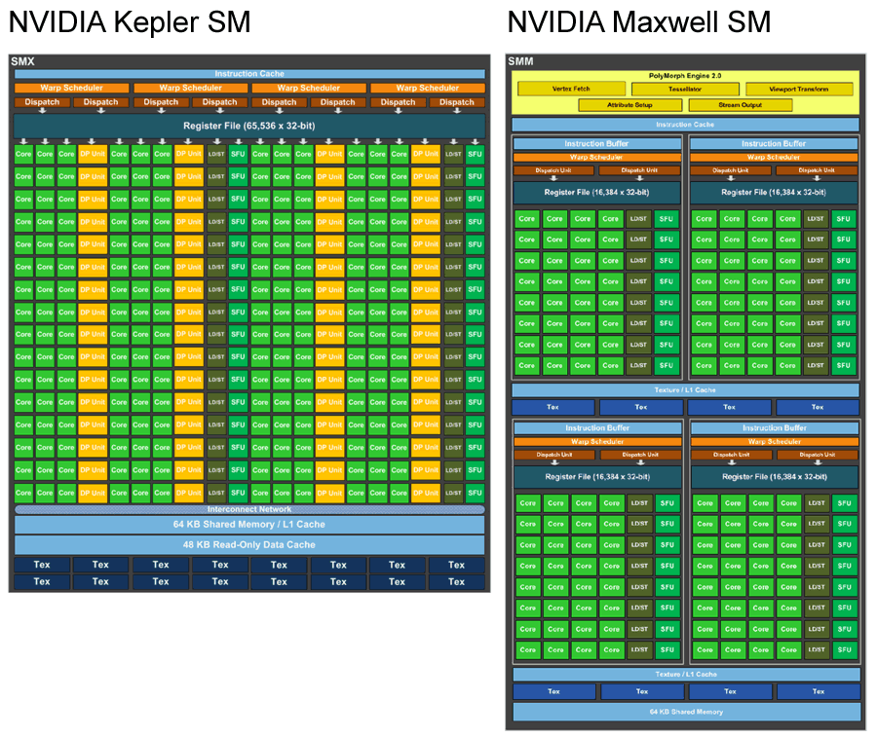
REVIEW OF GPU HARDWARE
In the move from Kepler to Maxwell, we can see that the engineers have created smaller groups of SMP’s inside the SMM.
Let’s compare...
GTX-Titan
GTX-Titan X

Slide 9
REVIEW OF GPU HARDWARE
Comparison of GK110 and GM200-400

Slide 10
THREAD CREATION ON THE GPU
We have previously reviewed threads during the OpenMP part of the course.
OpenMP threads are each controlled by a complete CPU core, which means that:
Each thread is quite “heavy” - i.e. can do very complicated work.
There are often an equal number of threads to the number of CPU cores available in the system.
CUDA also makes uses of threads, but in a very different way due to the different requirements of the GPU’s core purpose.

Slide 11
THREAD CREATION ON THE GPU
Key to understanding how (and why) threads on the GPU device are created differently, we need to understand what the GPU device is made for.
The GPU is designed to:
Perform computations in support of rendering operations, and
Support display operations.
The rendering process is quite simple to understand. Consider the process of rendering a three dimensional object onto a two dimensional plane.

Slide 12
THREAD CREATION ON THE GPU

Slide 13
THREAD CREATION ON THE GPU
In modern visualizations, there are often many millions of three dimensional objects in our scene.
Each object / node needs to perform the transformation computation to determine the pixel location on the monitor – millions of computations.
Similar rendering / shading computations are also performed by pixel – 1920 x 1080 = > 2 million pixels.
Each of these operations on the GPU is handled by its own thread.

Slide 14
THREAD CREATION ON THE GPU
Here, we begin to see the main differences between a GPU thread and an OpenMP thread:
There are often millions of GPU threads.
Each GPU thread has a very specific purpose, and is often used for very simple computation.
In GPU programming, the main challenge is understanding how millions of threads are operated by the GPU hardware.

Slide 15
THREAD CREATION ON THE GPU
Therefore, for the GPU to perform its original task correctly:
The SP’s contained within the Streaming Multi-Processors (SMP, SMM, etc) do NOT need to talk to each other. They were designed to compute independently.
Hence, communication between SP’s is generally discouraged.
Since these SP’s don’t need to talk to each other (much), SP’s contained within different SMP’s don’t communicate – ever.
So, communication between SMP’s is – generally – impossible.

Slide 16
THREAD CREATION ON THE GPU
So – how do we do this?

Slide 17
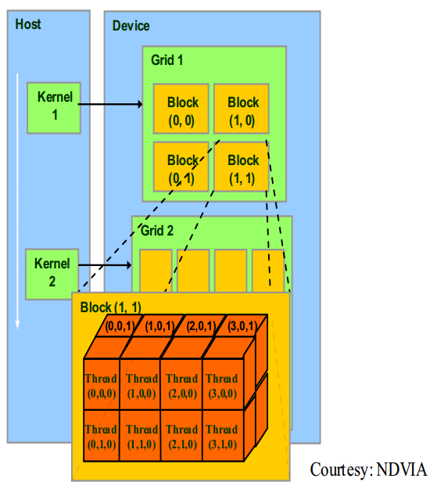
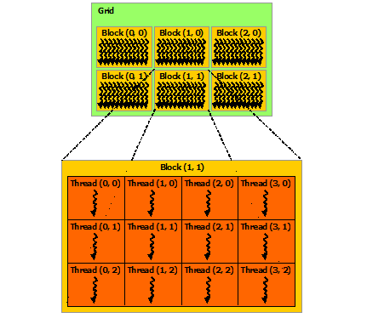
REVIEW OF GPU HARDWARE
The GPU is accustomed to creating millions of threads.
This number is too large to treat each thread individually – hence, we group these threads into groups, called “thread blocks”.
We create a large number of thread blocks, each containing a large number of threads, to solve large problems.

Slide 18
REVIEW OF GPU HARDWARE
We have complete control over how many threads are contained within each group of threads (i.e. blocks).
We also have complete control over how many blocks we create.
Total number of threads = No. of threads / block * No. of blocks
Block 0
Block 1
Thread 0
Thread 1
Thread 0
Thread 1
Thread 2
Thread 3
Thread 2
Thread 3
Block 2
Block 3
Thread 0
Thread 1
Thread 0
Thread 1
Thread 2
Thread 3
Thread 2
Thread 3

Slide 19
REVIEW OF GPU HARDWARE
So, in this case, we have:
4 Blocks of threads.
Each block contains 4 threads.
So, in total we have 16 threads using this approach.
If we wanted, we could create 1 block with 1 threads (i.e. serial computation).
Block 0
Block 1
Thread 0
Thread 1
Thread 0
Thread 1
Thread 2
Thread 3
Thread 2
Thread 3
Block 2
Block 3
Thread 0
Thread 1
Thread 0
Thread 1
Thread 2
Thread 3
Thread 2
Thread 3

Slide 20
REVIEW OF GPU HARDWARE
When we perform computation on the GPU, each of these blocks of threads is passed to the GPU separately.
Block 0
Thread 0
Thread 1
SMP
SMP
SMP
SMP
Block 1
Thread 0
Thread 1
Block 2
Thread 0
Thread 1
Block 3
Thread 2
Thread 0
Thread 1
Thread 3
Thread 2
Thread 3
Thread 2
Thread 3
Thread 2
Thread 3
Global Memory and/or L2 Cache

Slide 21
REVIEW OF GPU HARDWARE
But – since each GPU device has a different number of SMP’s, and each problem has different numbers of blocks with different numbers of threads, how is this work shared?
Block 0
Thread 0
Thread 1
SMP
SMP
SMP
SMP
Block 1
Thread 0
Thread 1
Block 2
Thread 0
Thread 1
Block 3
Thread 2
Thread 0
Thread 1
Thread 3
Thread 2
Thread 3
Thread 2
Thread 3
Thread 2
Thread 3
Global Memory and/or L2 Cache

Slide 22
REVIEW OF GPU HARDWARE
Block 0
Block 1
Block 2
Block 3
We pass these blocks of threads for processing on SMP’s as they become available.
Sometimes, SMP’s are large enough (or blocks are small enough) so we can fit more than one block in an SMP (if we need to)
If there was only 1 SMP, we would have to queue each block if the blocks didn’t fit.
Thread 0
Thread 1
Thread 0
Thread 1
Thread 0
Thread 1
Thread 0
Thread 1
Thread 2
Thread 3
Thread 2
Thread 3
Thread 2
Thread 3
Thread 2
Thread 3
SMP
SMP
SMP
SMP
Global Memory and/or L2 Cache

Slide 23
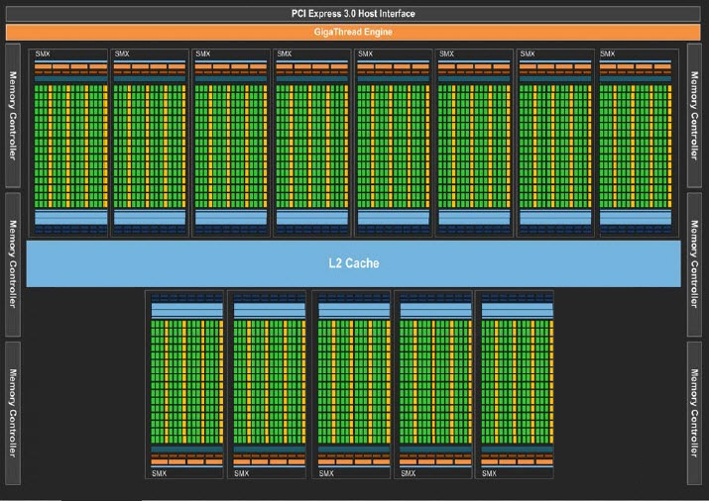
REVIEW OF GPU HARDWARE
To summarize:
Each thread block is then passed into a Streaming Multi-Processor.
Work contained within each block of threads is shared among the Streaming Processors (SP’s) inside each block.
In this way, we can have thousands of threads running at the same time on the GPU.

Slide 24
Serial CODING FOR GPU
What happens if we have an algorithm which cannot use all of the cores inside the GPU?
Perhaps we have an algorithm which is sequential – i.e. cannot be made parallel.
Then we need to create one thread, and one block, and then pass information onto the GPU.
Let’s get started.

Slide 25
SERIAL GPU COMPUTATION
If we want to run a serial computation on the GPU, we need to:
Tell the GPU that we will use exactly 1 block of threads.
Tell the GPU that we will use 1 thread per thread block.
Then the total number of threads on the GPU = 1 = serial!!
1 thread

Slide 26
SERIAL GPU COMPUTATION
Consider the simplest possible example:
Take an array a* and multiply it by 2.
Save the result back into a.
The CPU function is shown on the right.
How do we make this a GPU function?
void CPUSerialFunction(float *a) {
int i;
for (i = 0; i < N; i++) {
a[i] = 2.0*a[i];
}
}

Slide 27
SERIAL GPU COMPUTATION
The transformation is quite simple.
There are two types of functions which can be run on the GPU – functions which are callable from the CPU, and functions which are only called from the GPU.
__global__ void GPUSerialFunction(float *a) {
int i;
for (i = 0; i < N; i++) {
a[i] = 2.0*a[i];
}
}
void CPUSerialFunction(float *a) {
int i;
for (i = 0; i < N; i++) {
a[i] = 2.0*a[i];
}
}
GPU function
Serial function

Slide 28
SERIAL GPU COMPUTATION
Functions which can be called from the CPU are known as global functions.
Hence, we insert the __global__ phrase in front of the function declaration / definition.
__global__ void GPUSerialFunction(float *a) {
int i;
for (i = 0; i < N; i++) {
a[i] = 2.0*a[i];
}
}
void CPUSerialFunction(float *a) {
int i;
for (i = 0; i < N; i++) {
a[i] = 2.0*a[i];
}
}
GPU function
Serial function

Slide 29
SERIAL GPU COMPUTATION
There are several things worth mentioning:
This function is still a serial computation – you can see, the computation is performed over N elements.
The variable *a used in the argument of the function must be declared on the GPU device.
__global__ void GPUSerialFunction(float *a) {
int i;
for (i = 0; i < N; i++) {
a[i] = 2.0*a[i];
}
}
void CPUSerialFunction(float *a) {
int i;
for (i = 0; i < N; i++) {
a[i] = 2.0*a[i];
}
}
GPU function
Serial function

Slide 30
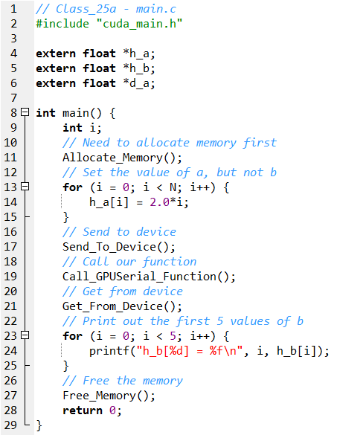
SERIAL GPU COMPUTATION
We still need to write a C function to run this function on the GPU.
The summary of the program is:
Allocate Memory() – Allocate the memory inside the CPU (host) and GPU (device).
Send_To_Device() – Send the data from the host to the device.
Call_GPUSerial_Function() – Perform a computation using a single SP.
Get_From_Device() – Get the resulting data from the GPU to the CPU.
Free_Memory() – Free the data from memory on the host and device.

Slide 31
SERIAL GPU COMPUTATION
It is important to see that the C function – main.c – contains no CUDA related code.
We use functions – which are defined inside the CUDA file – to perform GPU operations.
These functions are called “wrapping functions”, because they “wrap” the GPU code and allow it to be used by the CPU.

Slide 32
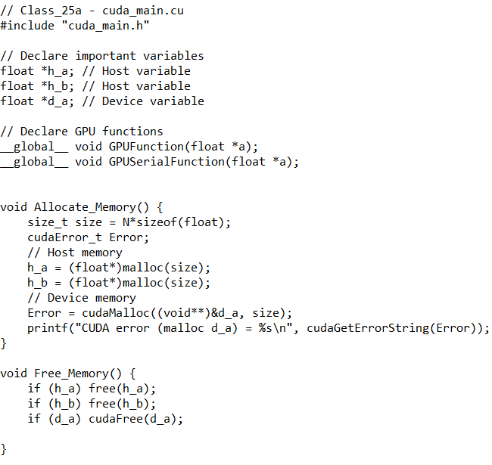
SERIAL GPU COMPUTATION
Memory allocation and freeing of memory is the same as we covered previously in class.
malloc() is used for the host variables *h_a and *h_b. (posix_memalign is OK too)
cudaMalloc is used for the GPU variable *d_a.

Slide 33
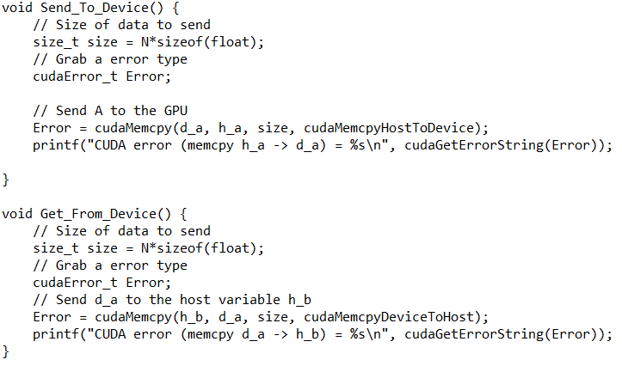
SERIAL GPU COMPUTATION
We have an array containing N floats.
Hence, we are sending N*sizeof(float) data to the GPU.
Remember to be careful with how we use the HostToDevice and DeviceToHost arguments with cudaMemcpy().

Slide 34
SERIAL GPU COMPUTATION
You can see that we copy the variable h_a into the GPU variable d_a.
After our computation is complete, we copy the result from d_a back into h_b.
So our solution will be contained within the h_b variable.

Slide 35
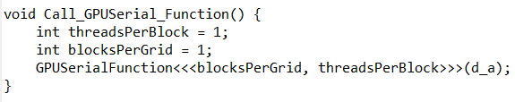
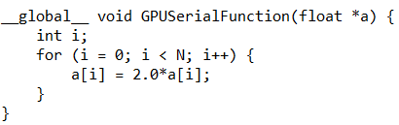
SERIAL GPU COMPUTATION
Now, to calling our GPU function with our wrapper function.
When we call our function, we need to:
Tell the GPU which data to use.
Tell the GPU how to share the work across the SMP’s and SP’s.
Wrapper function
GPU function

Slide 36
SERIAL GPU COMPUTATION
Because we are only using 1 thread and 1 block, that single thread needs to manage all N elements of the array *a.
Hence, we need to have a for loop inside our function.
If we use one thread per element (next week) then this for loop will disappear.
Wrapper function
GPU function

Slide 37
SERIAL GPU COMPUTATION
Remember, we are performing a serial GPU computation first: that means:
1 Thread per block, and
1 Thread Block in the entire simulation.
Here, I’ve introduced the number of threads per block as threadsPerBlock.
The total number of blocks in the simulation will be blocksPerGrid.
Run 1 thread per block.
Employ 1 block of threads.

Slide 38
SERIAL GPU COMPUTATION
When we call our GPU function, we will use the command:
In this case, we have:
Function_Name<<<Information about blocks, Information about threads>>(Function arguments)
Of course, we need to use the device variable (d_a) here.
We cannot use CPU variables.

Slide 39
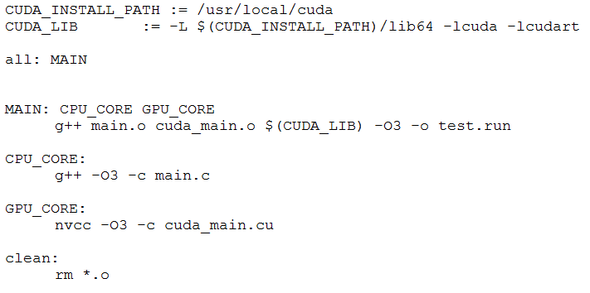
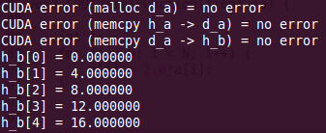
SERIAL GPU COMPUTATION
Of course, the code runs:
Makefile
Output from code execution

Slide 40
SERIAL GPU COMPUTATION
In the next 15 minutes, please write a code which:
Creates 2 arrays on the host : h_a and h_b containing N elements.
Creates 1 array on the host: d_a, also containing N elements.
Initialize h_a = [0,1,2,3......N-1] but leaves h_b = [0,0,0,0......0]
Copies h_a to d_a.
Run a GPU kernel function with 1 thread, 1 block to double d_a (i.e. d_a = 2*d_a)
Copy the answer back to the host, into h_b.
Check the answer, free all memory.

Slide 41
NEXT...
After this, I’ll show you how to use more than 1 thread to perform parallel computation.

