Slide 1
Introduction to Multi-Core CPU and GPU Computation 多核心CPU和GPU計算
Class 18 Prof. Matthew Smith, msmith@mail.ncku.edu.tw

Slide 2
REVIEW OF PREVIOUS CLASS

Slide 3
SERIAL GPU COMPUTATION
Last class I wrote a GPU code which would use a single thread on the GPU.
This is a serial computation, and not very efficient.
__global__ void GPUSerialFunction(float *a) {
int i;
for (i = 0; i < N; i++) {
a[i] = 2.0*a[i];
}
}
void CPUSerialFunction(float *a) {
int i;
for (i = 0; i < N; i++) {
a[i] = 2.0*a[i];
}
}
GPU function
Serial function

Slide 4
SERIAL GPU COMPUTATION
You may recall that GPU functions – which are callable from the host – begin with the __global__ prefix.
__global__ void GPUSerialFunction(float *a) {
int i;
for (i = 0; i < N; i++) {
a[i] = 2.0*a[i];
}
}
void CPUSerialFunction(float *a) {
int i;
for (i = 0; i < N; i++) {
a[i] = 2.0*a[i];
}
}
GPU function
Serial function

Slide 5
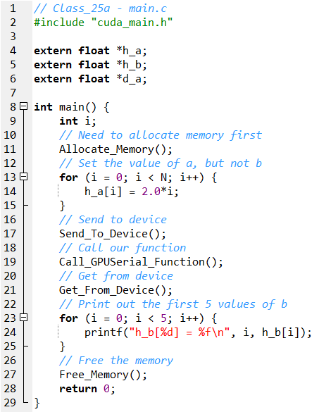
SERIAL GPU COMPUTATION
We still need to write a C function to run this function on the GPU.
The summary of the program is:
Allocate Memory() – Allocate the memory inside the CPU (host) and GPU (device).
Send_To_Device() – Send the data from the host to the device.
Call_GPUSerial_Function() – Perform a computation using a single SP.
Get_From_Device() – Get the resulting data from the GPU to the CPU.
Free_Memory() – Free the data from memory on the host and device.

Slide 6
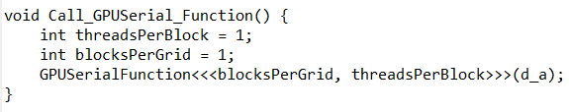
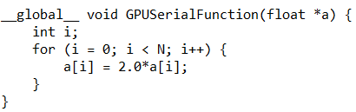
SERIAL GPU COMPUTATION
The threads employed on the GPU are grouped together into “blocks” of threads.
In this instance, we create a serial computation by:
Using 1 thread per block,
Using 1 block.
Wrapper function
GPU function

Slide 7
SERIAL GPU COMPUTATION
Because we only have one block and one thread per block, we have one thread in total.
We have N elements in our array – meaning that our function requires a for loop to compute the value of a[i] for i = 0 to N-1.
Wrapper function
GPU function

Slide 8
PARALLEL COMPUTING ON THE GPU

Slide 9
MOVING to PARALLEL ON THE GPU
It should follow that, if we wish to perform a parallel computation on the GPU, that we need to do two additional tasks:
Assign more than 1 thread per block, and/or assign more than 1 block of threads.
Adjust the __global__ GPU kernel (i.e. function) to take into account the additional threads.

Slide 10

MOVING to PARALLEL ON THE GPU
First, let’s review the concept of threads in blocks.
Each of these blocks is passed to an SMP for computation.
Each thread has it’s own unique ID within it’s block.
If there are 256 threads per block (T_{PB}), the threads are given an ID ranging from 0 to 255.
A “block” of GPU threads
(containing T_{PB} threads)

Slide 11
MOVING to PARALLEL ON THE GPU
In the case of large problems, we often need many more threads than 256.
In this case, we require many blocks.
Each block is given it’s own ID – much like threads – ranging from 0 to (NB-1) when NB blocks are used.
Block 0
Block 1
Block (NB-2)
Block (NB-1)

Slide 12
REVIEW OF THREAD HEIRARCHY
In the previous example, we employed a single block with a single thread.
Block 0
1 GPU Thread

Slide 13
REVIEW OF THREAD HEIRARCHY
In reality, we are going to use a large number of threads per block (T_{BP}) and a large number of blocks.
Thread T_{PB}-1
Thread T_{PB}-1
Thread T_{PB}-1
Thread T_{PB}-1
Thread 0
Thread 0
Thread 0
Thread 0
Block 0
Block 1
Block (NB-2)
Block (NB-1)

Slide 14
MOVING TO PARALLEL ON THE GPU
A
A[0]
A[1]
A[N-1]
B
B[0]
B[1]
B[N-1]
Thread T_{PB}-1
Thread T_{PB}-1
So how do we take our problem – a vector addition problem c[i] = a[i] + b[i] – and make use of these threads?
Thread T_{PB}-1
Thread T_{PB}-1
Thread 0
Thread 0
Thread 0
Thread 0
Block 0
Block 1
Block (NB-2)
Block (NB-1)

Slide 15
MOVING TO PARALLEL ON THE GPU
A
A[0]
A[1]
A[N-1]
B
B[0]
B[1]
B[N-1]
Thread T_{PB}-1
Thread T_{PB}-1
Let’s use 1 thread per element of our array.
This means we need to share the work in our array across the blocks.
Thread T_{PB}-1
Thread T_{PB}-1
Thread 0
Thread 0
Thread 0
Thread 0
Block 0
Block 1
Block (NB-2)
Block (NB-1)

Slide 16
MOVING TO PARALLEL ON THE GPU
Let’s use TPB threads per blocks. If each thread computes c[i] = a[i] + b[i] for a single i, how many blocks do we need to compute N elements?
A
A[0]
A[1]
A[N-1]
B
B[0]
B[1]
B[N-1]
Block 0
Block 1
Block …
Block (NB-1)
If we say that each block contains T_{PB} threads per block, we will have….
NB blocks.

Slide 17
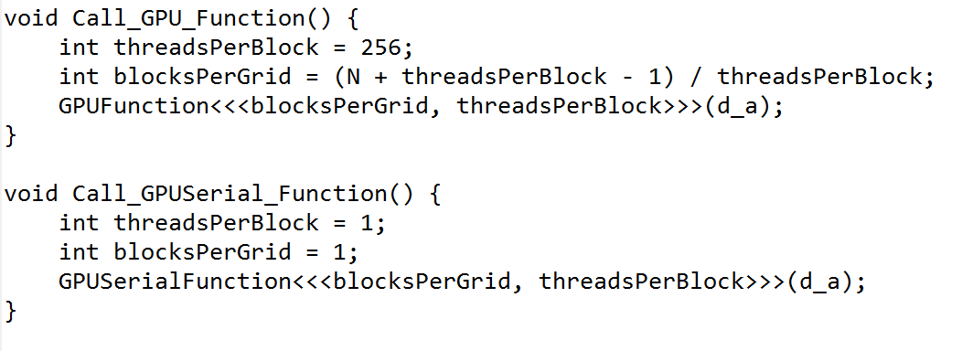
MOVING TO PARALLEL ON THE GPU
Hence, we can modify our wrapper function accordingly.
Using N elements, with T_{PB} = 256 and each thread controlling one element, we will need a total of blocks.
New code ➔ 256 threads per blocks, (int)(N+TPB-1)/TPB blocks.
Previous code – using 1 thread per block and one block.

Slide 18
MOVING TO PARALLEL ON THE GPU
Since we are allowing each thread to manage one element of our array, the GPU function itself will need to change.
You’ll need to create a new GPU kernel accordingly...
GPUFunction(float *a)
GPUSerialFunction(float *a)

Slide 19
MOVING TO PARALLEL ON THE GPU
0
255
a
Block 0
Block 1
…
Block (NB-1)
0
255
Thread ID
How do we know which element is controlled by which thread and which block?

Slide 20
MOVING TO PARALLEL ON THE GPU
0
255
a
Block 0
Block 1
…
Block (NB-1)
0
255
Thread ID
Simple: if we have 256 threads per block (TPB = 256), threads 0 to 255 in block 0 will take care of elements 0 to 255.

Slide 21
MOVING TO PARALLEL ON THE GPU
256
511
a
Block 0
Block 1
…
Block (NB-1)
0
255
Thread ID
Threads 0 to 255 from block 1 will manage elements 256 to 511...

Slide 22
MOVING TO PARALLEL ON THE GPU
Assume that we have N = 20 elements and we use 4 threads per block.
How do we compute the global index into our memory from our block ID and our thread ID?
Global Index
0
1
2
3
4
5
6
7
8
9
10
11
Thread ID
0
1
2
3
0
1
2
3
0
1
2
3
Block ID
Block 0
Block 1
Block 2
12
13
14
15
16
17
18
19
Cell index = Thread ID
+ (Block ID * Threads Per Block)
0
1
2
3
0
1
2
3
Block 3
Block 4

Slide 23
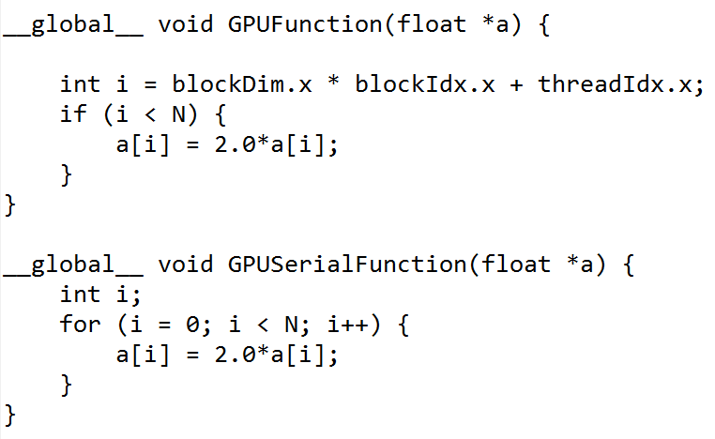
MOVING TO PARALLEL ON THE GPU
Consider the previous example – a[i] = 2*a[i] over N elements.
Using 1 thread meant we required a for loop inside the GPU kernel.
If we have a thread managing 1 element, we no longer require a for loop.
Parallel Example
Serial Example

Slide 24
MOVING TO PARALLEL ON THE GPU
In this case, we have introduced several new variables.
blockDim.x → The number of threads contained within each block.
blockIdx.x → The block ID number (from 0 to NB)
threadIdx.x → The thread ID within that block.
Parallel Example
Serial Example

Slide 25
MOVING TO PARALLEL ON THE GPU
To compute the array index i from these values is just as we predicted:
Parallel Example
Previous slide(s)
Cell index = Thread ID
+ (Block ID * Threads Per Block)
This code
Cell index = threadIdx.x + blockDim.x*blockIdx.x
Serial Example

Slide 26
Now...
Using the information provided today, and from the last class, write a code which will:
Initialize an array a on the GPU containing 1000 elements.
Using one thread to manage one element, compute the sqrt(a) on the GPU, and
Return the answer to the host.
Use printf to show me the first 5 values of your array a after computing.
Show me before you leave!

