Slide 1
Introduction to Multi-Core CPU and GPU Computation 多核心CPU和GPU計算
Class 22 Prof. Matthew Smith, msmith@mail.ncku.edu.tw

Slide 2
Today’s Class…
Application of Finite Difference Techniques to Parallel Computing
Case Study – 3D Transient Heat Conduction
Previously, we did this using AVX and OpenMP.
Today, we look at the GPU implementation.

Slide 3
CASE STUDY – 3D Transient Heat Transfer
This was our previous result.
The fastest time was recording using:
OpenMP to share work across 16 CPU cores.
AVX intrinsic functions.
This was 46.9 seconds, a 44x speedup over the standard C code.
Code | Time | Speedup
Serial code, no optimization | 2085 seconds | 1x
Serial code, -O3 optimization (auto-vectorization using SSE) | 720 seconds | ~2.9x
OpenMP code, -O3 opt, 16 cores | 89 seconds | ~23.4x
OpenMP code with AVX, -O3, 16 cores | 72 seconds | ~29x
OpenMP code with AVX, -O3, 16 cores, Binded Threads | 46.9 seconds | ~44.4x

Slide 4
GPU IMPLEMENTATION
The GPU solution is made of three files:
main.c → Contains the int main() function and is the primary point of entry. Manages all CPU work, including initialization and saving to file.
cuda_main.cu → Contains all memory control and GPU functions.
cuda_main.h → Contains function declarations for both CUDA and C files.

Slide 5
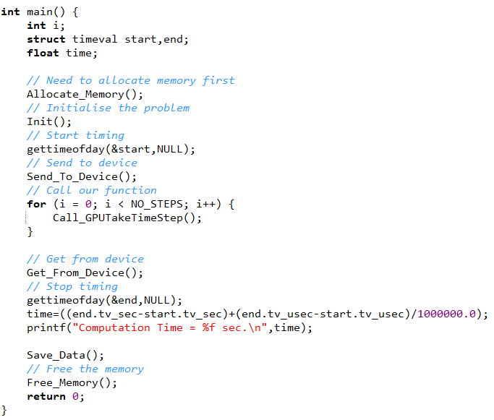
GPU IMPLEMENTATION
The GPU code for a 3D heat transfer problem looks much like all of the other codes.
The process is identical:
Allocate memory on the host and device (step 1)
Initialize the problem (step 2)
Send information to the GPU (step 3)
Perform the simulation (step 4)
Get information from the GPU (step 5)
Save the result (step 6)
Free data on the host and device (step 7)
1
2
3
4
5
6
7

Slide 6
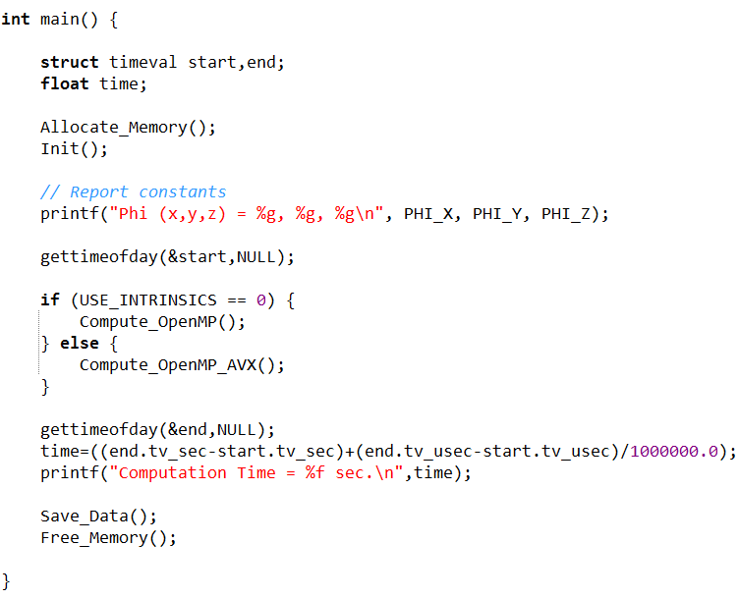
GPU SOLVER
GPU solver
OpenMP and OpenMP/AVX solver

Slide 7
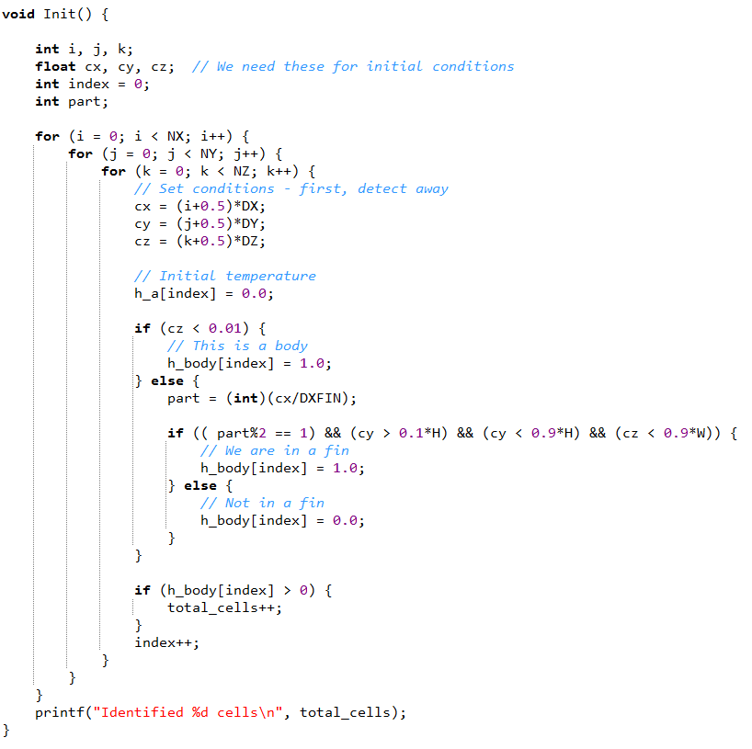
GPU SOLVER
The initialization employs the same code we used before, only replacing the a and body variables with h_a and h_body.
The temperature for our 3D problem is stored in a 1D array in exactly the same way we stored it before.

Slide 8
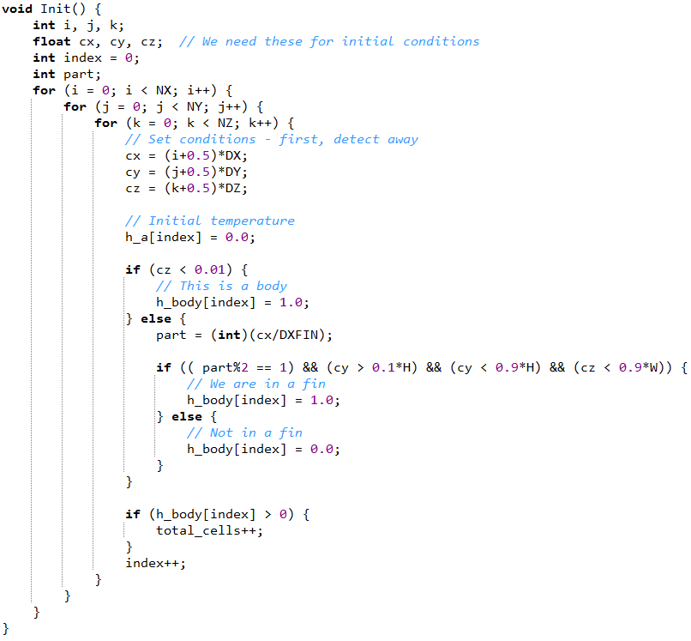
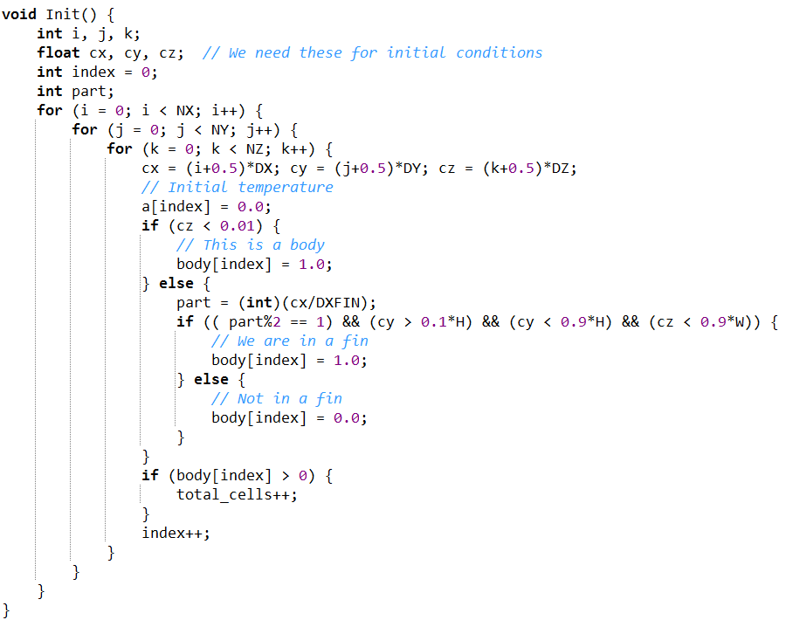
GPU SOLVER
GPU solver
OpenMP and OpenMP/AVX solver

Slide 9
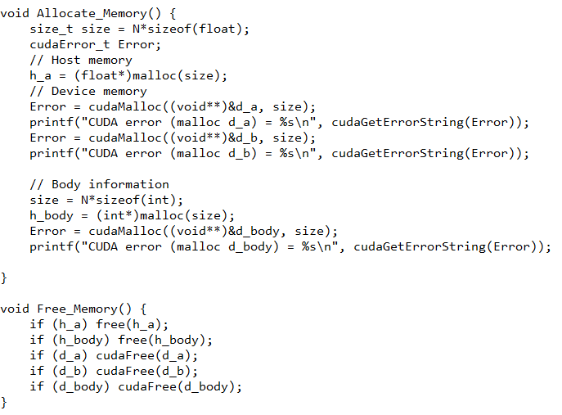
GPU SOLVER
Memory initialization and freeing needs to be adjusted to take into account the GPU memory.
We need to allocate 2 variables on the host here – h_a (temperature), and h_body (same as before).
We allocate 3 variables on the device - d_a, d_b and d_body.

Slide 10
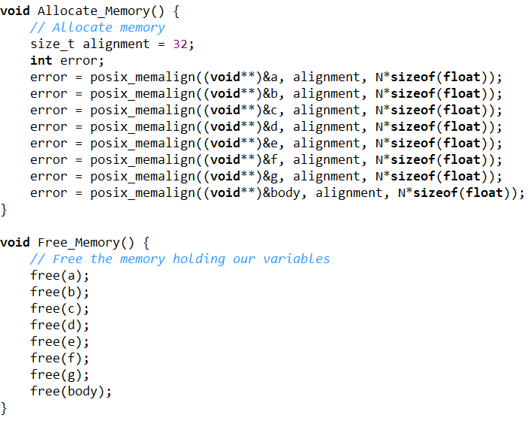
GPU SOLVER
GPU solver
OpenMP and OpenMP/AVX solver

Slide 11
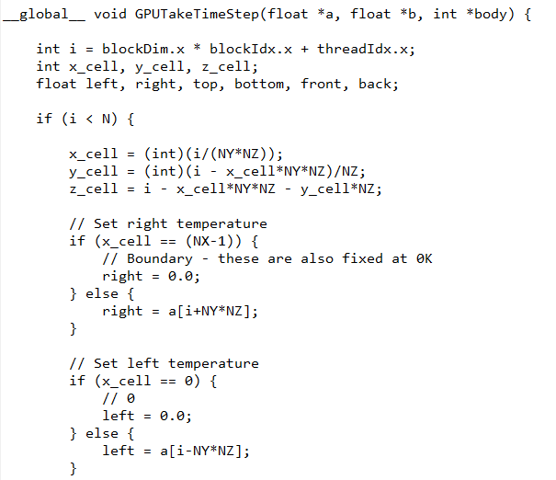
GPU SOLVER
To compute the new temperature (stored in d_b), we assign one CUDA thread to each cell.
Just like our OpenMP solution, we require knowledge of the x_cell, y_cell and z_cell (index in our Cartesian grid) in order to compute neighbors.
Here, we store neighbor temperatures in local (register) variables called left, right, etc.

Slide 12
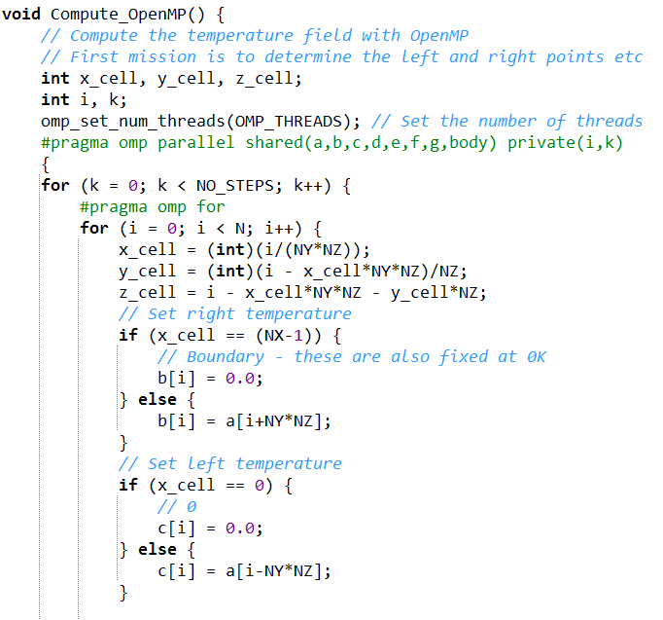
GPU SOLVER
GPU solver
OpenMP and OpenMP/AVX solver

Slide 13
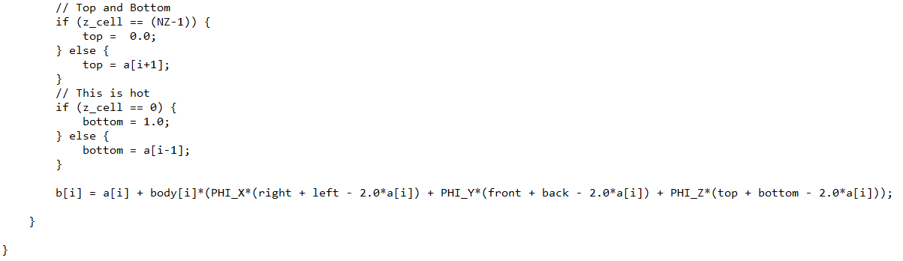
GPU SOLVER
Before, we used a separate loop to update temperature – now, we compute the new temperature (placed inside d_b) after assigning neighbor values.
GPU solver
OpenMP solver

Slide 14
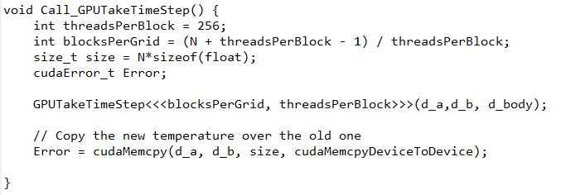
GPU SOLVER
Because we place the new temperature (after a single time step) into variable d_b, we need to copy it over d_a each time step.
We use cudaMemcpy() to do this in a convenient manner, using the cudaMemcpyDeviceToDevice argument.
The number of threads per block begins to influence performance when:
TPB < 128, and
TPB > 1024.
Using TPB = 128 and 256 results in optimal performance.

Slide 15
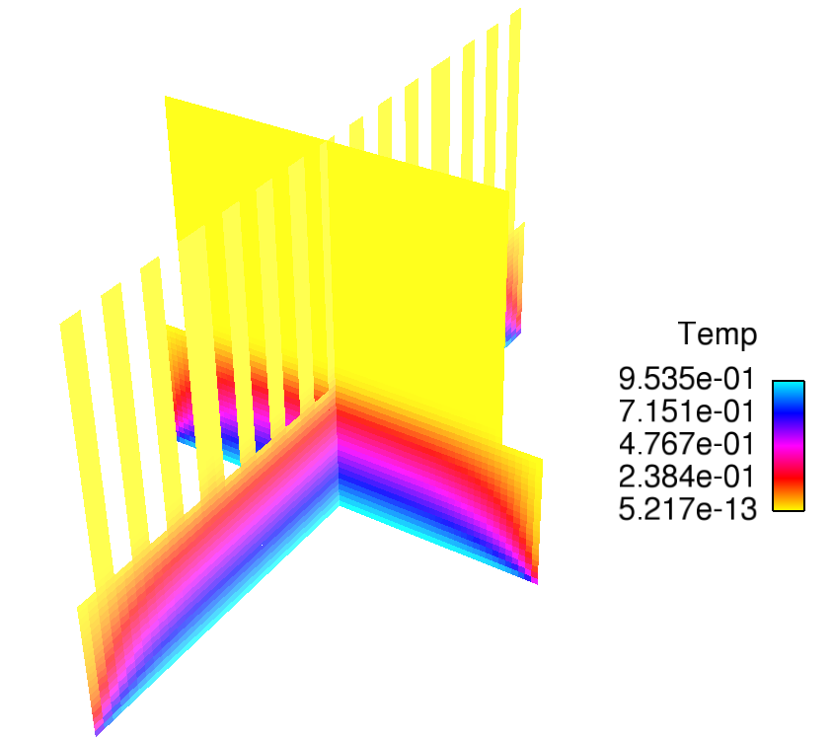
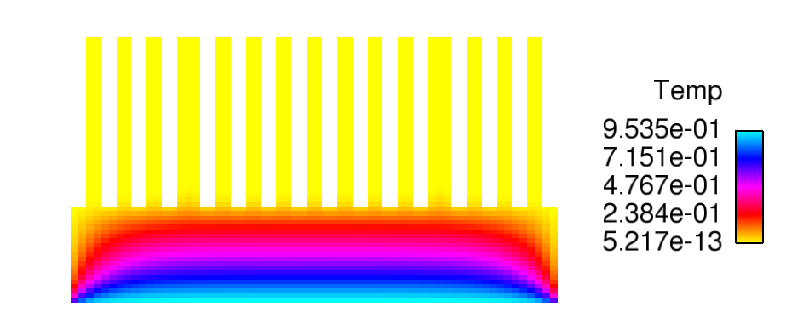
GPU SOLVER
Of course, the results are identical to those obtained using AVX / OpenMP.

Slide 16
Performance
The GPU computation is much faster than using 16 cores.
The total computational time was about 11.5 seconds.
This is approximately 181x faster than our previous result.
The GPU code required about 15 minutes to create – after using a standard GPU code as a starting point.
Code | Time | Speedup
Serial code, no optimization | 2085 seconds | 1x
Serial code, -O3 optimization (auto-vectorization using SSE) | 720 seconds | ~2.9x
OpenMP code, -O3 opt, 16 cores | 89 seconds | ~23.4x
OpenMP code with AVX, -O3, 16 cores | 72 seconds | ~29x
OpenMP code with AVX, -O3, 16 cores, Binded Threads | 46.9 seconds | ~44.4x
GPU – 256 threads per block, GTX-TITAN | 11.57 seconds | ~ 180.2 x
GPU – 256 threads per block, shared memory, GTX-TITAN | 11.49 seconds | ~ 181.4 x

Slide 17
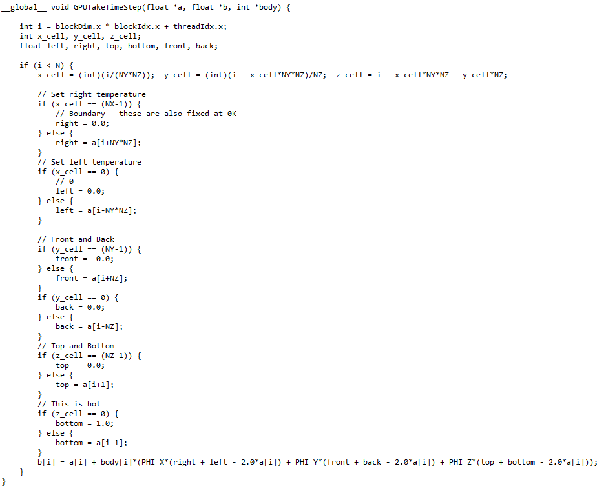
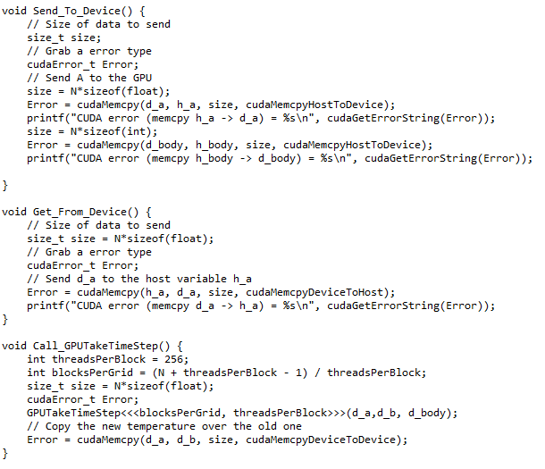
WHOLE GPU CODE

Slide 18
CONCLUSIONS
A well written OpenMP or serial code should be quite simple to transform into a CUDA application.
The key is to remember the simple steps involved: allocation of memory, transfer of data to GPU, computation on GPU (be sure to leave the CPU idle), transfer of data to CPU, freeing of memory.
The performance increase is significant → from longer than half and hour to approximately 10 seconds. (about 180x)
Larger simulations will demonstrate an increased performance increase!

Slide 19
TODAY’s TUTORIAL
Students now have a choice.
The tutorial this week – which students have two weeks to complete – is the simulation of 2D transient heat flow on the GPU over an irregular geometry.
You should be able to modify the code I’ve provided here to solve this problem quite easily.
Or, you could work on your major assignment. It’s your call.

Slide 20
TODAY’s TUTORIAL
Tutorial – things to do:
Change my 3D GPU code (or write your own) to 2D by setting (i) NZ = 1, and (ii) removing the Z-direction terms for the computation of b[i] in the GPU kernel.
Load the geometry from the image file into MATLAb, and then into a text file for loading by your C/C++ code.

Slide 21
TODAY’s TUTORIAL
Processing the geometry information of the disk brake problem is simple:
In MATLAB, use A = imread(FILENAME) which will create an [NX,NY,3] size variable (A) which contains the RGB component for each pixel.
For your tutorial, you can set the number of cells in the X-Y direction to be equal to the number of pixels (NX,NY).

Slide 22
TODAY’s TUTORIAL
A casual inspection – using MESH or SURF – of this data shows us how to insert the data into our simulation.
For example, I’ve attached an image of the red component of the RGB data from the image.
In this case, anything with an R component less than 200 is going to be the solid disk brake, while R >= 201 is going to be air.
R ~ 255, air
R < 250, part of the brake

Slide 23
TODAY’s TUTORIAL
Following this, you can use MATLAB to create a body variable and save it to file using IMWRITE.
After the body data has been loaded into your 2D simulation, you need to consider:
Heat source – the brake itself, which moves in time around the outer rim of the brake, and
Heat losses – transfer of heat from the brake to the ambient via (i) radiation, and (ii) convection, a function of the radial distance.

