Slide 1
Introduction to Multi-Core CPU and GPU Computation 多核心CPU和GPU計算
Class 20 Prof. Matthew Smith, msmith@mail.ncku.edu.tw

Slide 2
Today’s Class…
Review of last week’s activity.
Introduction to Shared Memory on the GPU

Slide 3
Last WeeK’s TUTORIAL
In last week’s tutorial, we looked at the transient 2D heat transfer across a brake disk with a moving heat source.
You will still have the chance to finish this today, but in the meantime we can talk about a possible improvement to my method.
Let’s review my approach first → Look at my source code.

Slide 4
Last WeeK’s TUTORIAL
Although this code runs quickly on the GPU upstairs (my code: 500x500 cells, 10,000 time steps in about 3-5 seconds), it is not as quick as we would like it to be.
Good measure of performance:
Speedup compared to CPU (~180x), or
Time (in seconds) per cell per timestep is an internationally accepted measure.
(i.e. 5 seconds / (500x500 cells * 10000) = 2e-9)
Not bad for a single GPU

Slide 5
Last WeeK’s TUTORIAL
What is making my code slow?
Computation?
Communication?
According to Amdahls / Gustafson’s Law, we want the parallel work to be as large as possible. Our work is too small (too simple).
We spent too much time checking the value of T in neighbor cells – this means our main expense is memory communication.

Slide 6
And TODAY...
Is there a way we can go faster? Global memory on the GPU is far too slow...
There is a faster memory available on GPU than global.
It is called Shared Memory – and it is located on the GPU chip itself instead of being on the GPU board.
Let’s try applying Shared Memory to a simple 1D computation.

Slide 7
SHARED MEMORY IN CUDA
The previous example (a simple vector computation on array a) employed the main section of memory on the GPU device.
This section of memory is known as the “global memory”, and is the largest memory bank on the device.
This global memory is the large bank of memory contained on the GPU device – but is physically separated from the actual GPU cores.
You can see this on a picture of a GPU:

Slide 8
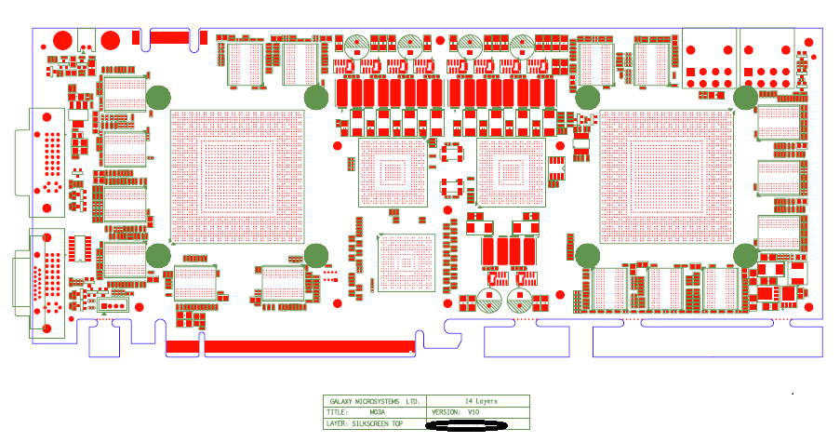
SHARED MEMORY IN CUDA
Off-Chip Memory
(This is where the Global Memory is)
On-Chip Memory
= SLOW
= FAST

Slide 9
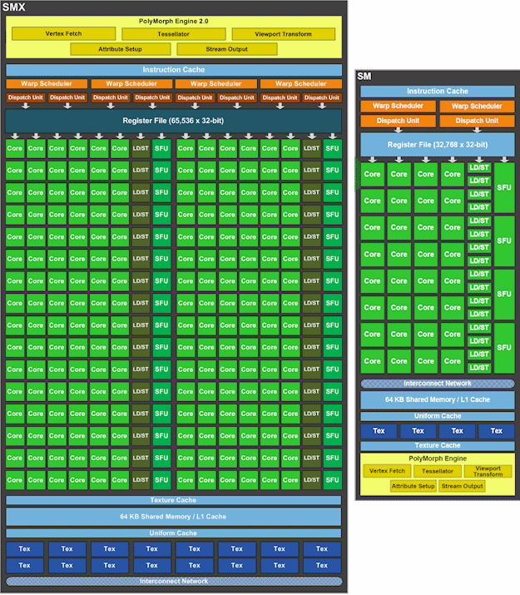
SHARED MEMORY
If you recall, there is some memory located within the SMX/SMP/SMM.
This is memory which is actually within the GPU die.
This is fast memory – one form of this memory is Shared Memory.

Slide 10
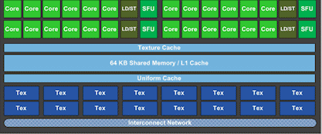
SHARED MEMORY IN CUDA
Newer GPU devices (i.e. GTX Titan, GTX680, 670) have 64 KB shared memory.
Older Devices have less than this.

Slide 11
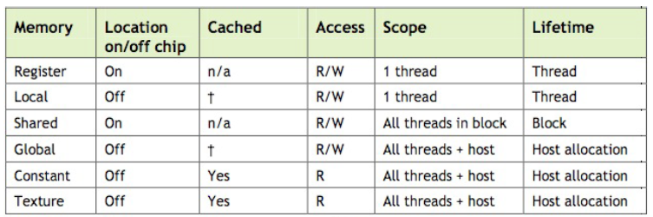
SHARED MEMORY IN CUDA
Here is a list of the different forms of memory available for use on the GPU.

Slide 12
SHARED MEMORY IN CUDA
Previously, we have been using global memory. This is allocated by the host using cudaMalloc(), and remains active until it is freed using cudaFree.
Note that global memory is “off chip” – meaning the performance is very slow.

Slide 13
SHARED MEMORY IN CUDA
Today, I will introduce you to shared memory.

Slide 14
SHARED MEMORY IN CUDA
Shared memory is shared by all of the SP within an SMX/SMP/SMM.
Since blocks of threads are all performed on the same SMP, all threads can see the same memory. Hence, variables created in Shared memory have the lifetime of the block they are created in.

Slide 15

SHARED MEMORY IN CUDA
Shared memory is shared by all of the SP within an SMX/SMP/SMM.
Since blocks of threads are all performed on the same SMP, all threads can see the same memory. Hence, variables created in Shared memory have the lifetime of the block they are created in.
Each block of threads is computed within the same SMX at the same time.
Hence, each thread within a block can access shared memory at the same time.
This is why its called shared memory.

Slide 16
SHARED MEMORY IN CUDA
Shared Memory is also much faster than global memory. (4 cycles)
On older devices, the difference in speed was as much as 150x!
It is common practice to place commonly used variables in shared memory for use.
If we are going to perform a computation, we can use the variables stored in shared memory – and only send the results of the computation back to global memory.

Slide 17
SHARED MEMORY IN CUDA
The only challenge with shared memory is the size.
There is not a lot of shared memory available for each thread to use.
This is because it is possible that there may be more than one block running within an SMX at once (don’t count on this happening, though)
Hence, we need to find a way to fit the information each thread needs into this small space.

Slide 18
SHARED MEMORY IN CUDA
Also worth mentioning is the location
Shared : On-Chip.
Global : Off-Chip.
This means we have to manually move the information from global memory into shared memory.

Slide 19
REVIEW OF PREVIOUS 1D VECTOR COMPUTATION

Slide 20
REVIEW
We create threads on the GPU device in large numbers by (i) creating groups of threads, known as blocks, containing T_{PB} threads, and (ii) creating large numbers of blocks.
Each thread has it’s own ID (from 0 to T_{PB}-1) and each block has it’s own ID.
Thread T_{PB}-1
Thread T_{PB}-1
Thread T_{PB}-1
Thread T_{PB}-1
Thread 0
Thread 0
Thread 0
Thread 0
Block 0
Block 1
Block (NB-2)
Block (NB-1)

Slide 21
REVIEW
A
A[0]
A[1]
A[N-1]
B
B[0]
B[1]
B[N-1]
Thread T_{PB}-1
Thread T_{PB}-1
In the previous example, we allowed one thread from each block to control one element of our computation.
Thread T_{PB}-1
Thread T_{PB}-1
Thread 0
Thread 0
Thread 0
Thread 0
Block 0
Block 1
Block (NB-2)
Block (NB-1)

Slide 22
REVIEW
By sharing the computation across N elements across blocks of threads with TPB threads per block, we can compute the correct number of blocks.
A
A[0]
A[1]
A[N-1]
B
B[0]
B[1]
B[N-1]
Block 0
Block 1
Block …
Block (NB-1)
If we say that each block contains T_{PB} threads per block, we will have….
NB blocks.

Slide 23
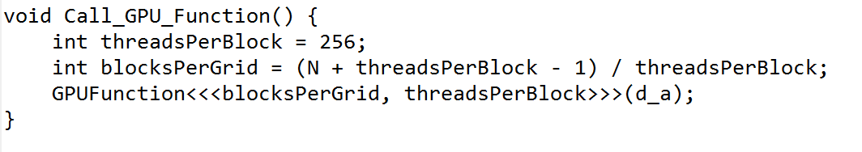
REVIEW
The information regarding the number of threads per block and the total number of blocks is defined prior to launching the GPU kernel.
To launch the GPU kernel “GPUFunction”, we use the form:
GPUFunction<<<blocksPerGrid, threadsPerBlock>>>(d_a);

Slide 24
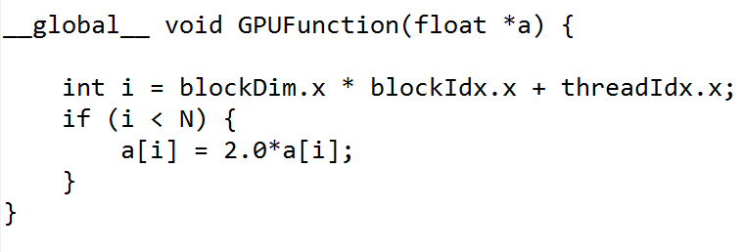
REVIEW
Since we have a one-to-one mapping of threads to cells, each thread will control a single element i of the array.
We need only make sure that i is a valid index (from 0 to N-1).
This function will be called N times, by N different threads.
i = index to our array ➔ Computed from the block and thread ID.

Slide 25
REVIEW
The design of the code itself is quite simple. Your codes will always follow this pattern:
Allocate memory on the host and GPU using malloc and cudaMalloc.
Initialize the values of your host variables. Copy these values to their GPU equivalents using cudaMemcpy.
Perform your GPU computation.
Copy the solution back to the CPU using cudaMemcpy.
Save your results, and free memory using free and cudaFree.
90% of all problems from the last class were because (i) one of these steps was not done, or (ii) the order was incorrect.

Slide 26
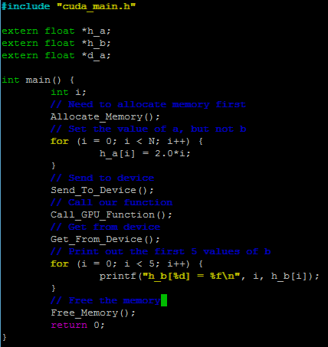
REVIEW
Example – the main function from the previous class.
The Allocate_Memory(), Free_Memory(), Send_To_Device() and Get_From_Device() functions were written on the board, and included in notes, from previous classes.
Since all your codes will look like this, you should use this code as a template (i.e. starting point) for class activities.

Slide 27
APPLYING SHARED MEMORY ON GPU

Slide 28
Conventional use of Shared Memory in GPU
a
Large variable a exists in global memory
a
We can break this down into chunks which will fit into shared memory.

Slide 29
Conventional use of Shared Memory in GPU
a
Each one of these “chunks” might be controlled by a block of threads.

Slide 30
Conventional use of Shared Memory in GPU
0
255
Shared Array Index
a
Block 0
Block 1
…
Block (NB-1)
0
255
Thread ID
For very convenient treatment, we can make the number of threads per block equal to the size of shared memory to be copied across.

Slide 31
Conventional use of Shared Memory in GPU
0
255
Shared Array Index
a
Block 0
Block 1
…
Block (NB-1)
0
255
Thread ID
This means that each thread can copy a small piece of information from global to shared memory by itself.

Slide 32
Conventional use of Shared Memory in GPU
0
255
Shared Array Index
a
Block 0
Block 1
…
Block (NB-1)
Block 0
Block 1
Block …
Block (NB-1)
0
255
Thread ID
We perform computations using the info on-chip in shared memory – NOT using the global memory.

Slide 33
Conventional use of Shared Memory in GPU
0
255
Shared Array Index
a
Block 0
Block 1
…
Block (NB-1)
Block 0
Block 1
Block …
Block (NB-1)
0
255
Thread ID
Remember – each thread within a block can access any part of this shared memory data contained within the SMX the block is being computed on.

Slide 34
Conventional use of Shared Memory in GPU
0
255
Shared Array Index
a
Block 0
Block 1
…
Block (NB-1)
Block 0
Block 1
Block …
Block (NB-1)
0
255
Thread ID
Once the computation is completed, the solution – contained within shared memory – can be moved back into global memory.

Slide 35
Conventional use of Shared Memory in GPU
0
255
Shared Array Index
a
Block 0
Block 1
…
Block (NB-1)
Block 0
Block 1
Block …
Block (NB-1)
0
255
Thread ID
This step is critical because the information stored within the shared memory for that block will be deleted once the computation is completed.

Slide 36
SHARED MEMORY IN CUDA
Setting up shared memory is very simple.
Let’s say we are performing the computation:
b[i] = a[i] + sqrt(a[i])
This code places a into a section of shared memory
__global__ void SOMENAME(float *a, float *b) {
int I = threadIdx.x;
int i = blockDim.x * blockIdx.x + I;
__shared__ float a_shared[256];
a_shared[I] = a[i];
// Compute the square root
a_shared[I] = a_shared[I] + sqrt(a_shared[I]);
// Map back to global memory
b[i] = a_shared[I];
}

Slide 37
SHARED MEMORY IN CUDA
Shared memory in the GPU is declared by:
__shared__ float a_shared[256];
where a_shared is the name of the variable.
This data can be 1D, 2D or 3D.
__global__ void SOMENAME(float *a, float *b) {
int I = threadIdx.x;
int i = blockDim.x * blockIdx.x + I;
__shared__ float a_shared[256];
a_shared[I] = a[i];
// Compute the square root
a_shared[I] = a_shared[I] + sqrt(a_shared[I]);
// Map back to global memory
b[i] = a_shared[I];
}

Slide 38
SHARED MEMORY IN CUDA
In this case, I have manually declared the size of our shared variable → a 1D array.
Ideally, since (again) we have one thread managing one element, the size of a_shared should be the same size as the number of threads within a block.
Hence, blockDim.x = 256 here.
__global__ void SOMENAME(float *a, float *b) {
int I = threadIdx.x;
int i = blockDim.x * blockIdx.x + I;
__shared__ float a_shared[256];
a_shared[I] = a[i];
// Compute the square root
a_shared[I] = a_shared[I] + sqrt(a_shared[I]);
// Map back to global memory
b[i] = a_shared[I];
}
In this example, these should be equal.

Slide 39
SHARED MEMORY IN CUDA
There is a potential risk here: if we were to use shared memory to accelerate our FTCS algorithm, we need each thread to look around and view other elements from shared memory.
Remember, each thread manages its own element – it is therefore possible that some threads are faster/slower and their work is not complete…
__global__ void SOMENAME(float *a, float *b) {
int I = threadIdx.x;
int i = blockDim.x * blockIdx.x + I;
__shared__ float a_shared[256];
a_shared[I] = a[i];
// Compute the square root
a_shared[I] = a_shared[I] + sqrt(a_shared[I]);
// Map back to global memory
b[i] = a_shared[I];
}
Some threads might be faster…..

Slide 40
SHARED MEMORY IN CUDA
__global__ void SOMENAME(float *a, float *b) {
int I = threadIdx.x;
int i = blockDim.x * blockIdx.x + I;
__shared__ float a_shared[256];
a_shared[I] = a[i];
__syncthreads();
// Compute the square root
if (I > 0) {
a_shared[I] = a_shared[I] + sqrt(a_shared[I-1]);
}
// Map back to global memory
b[i] = a_shared[I];
}
Before we allow threads to view other thread’s sections of shared memory, we need to tell the GPU to make sure all threads in the block are finished.
We use a special command for this:
__syncthreads();
Make all of the threads wait here before continuing.

Slide 41
ADVANCED CUDA – SHARED MEMORY
__global__ void FTCS(float *a, float *b) {
int I = threadIdx.x;
int i = blockDim.x * blockIdx.x + I;
__shared__ float a_shared[256]; __shared__ float b_shared[256];
a_shared[I] = a[i];
__syncthreads();
// Solve for 1D FTCS Heat Transfer
if ((I > 0) && (I < 255)) {
// Use shared memory
b_shared[I] = a_shared[I] +
PHI*(a_shared[I-1] – 2.0*a_shared[I] + a_shared[I+1]);
} else {
// We need global memory
b_shared[I] = a_shared[I] + PHI*(a[i-1] – 2.0*a[i] + a[i+1]);
}
// Map back to global memory
b[i] = b_shared[I];
}
For example – let’s say we want to make our 1D FTCS faster.
We can use shared memory to reduce the time required to look at neighbours.
If we are in the middle of a block – use shared memory. Otherwise, use global.

Slide 42
ADVANCED CUDA – SHARED MEMORY
__global__ void FTCS(float *a, float *b) {
int I = threadIdx.x;
int i = blockDim.x * blockIdx.x + I;
__shared__ float a_shared[256]; __shared__ float b_shared[256];
a_shared[I] = a[i];
__syncthreads();
// Solve for 1D FTCS Heat Transfer
if ((I > 0) && (I < 255)) {
// Use shared memory
b_shared[I] = a_shared[I] +
PHI*(a_shared[I-1] – 2.0*a_shared[I] + a_shared[I+1]);
} else {
// We need global memory
b_shared[I] = a_shared[I] + PHI*(a[i-1] – 2.0*a[i] + a[i+1]);
}
// Map back to global memory
b[i] = b_shared[I];
}
Using 100% shared memory for the FTCS calculation.
Using (mostly) global memory on the edges of our thread block.
(NOTE: CAUTION HERE)

Slide 43
ADVANCED CUDA – SHARED MEMORY
__global__ void FTCS(float *a, float *b) {
int I = threadIdx.x;
int i = blockDim.x * blockIdx.x + I;
__shared__ float a_shared[256]; __shared__ float b_shared[256];
a_shared[I] = a[i];
__syncthreads();
// Solve for 1D FTCS Heat Transfer
if ((I > 0) && (I < 255)) {
// Use shared memory
b_shared[I] = a_shared[I] +
PHI*(a_shared[I-1] – 2.0*a_shared[I] + a_shared[I+1]);
} else {
// We need global memory
b_shared[I] = a_shared[I] + PHI*(a[i-1] – 2.0*a[i] + a[i+1]);
}
// Map back to global memory
b[i] = b_shared[I];
}
To review:
Each block of threads will create one section of shared memory called a_shared and b_shared.
(If you don’t declare this memory as shared, each thread will attempt to create an array → This will be too large to fit in local memory).

Slide 44
ADVANCED CUDA – SHARED MEMORY
__global__ void FTCS(float *a, float *b) {
int I = threadIdx.x;
int i = blockDim.x * blockIdx.x + I;
__shared__ float a_shared[256]; __shared__ float b_shared[256];
a_shared[I] = a[i];
__syncthreads();
// Solve for 1D FTCS Heat Transfer
if ((I > 0) && (I < 255)) {
// Use shared memory
b_shared[I] = a_shared[I] +
PHI*(a_shared[I-1] – 2.0*a_shared[I] + a_shared[I+1]);
} else {
// We need global memory
b_shared[I] = a_shared[I] + PHI*(a[i-1] – 2.0*a[i] + a[i+1]);
}
// Map back to global memory
b[i] = b_shared[I];
}
To review:
Each thread within the same block can see the same a_shared and b_shared variable at the same time.
Before we start letting threads see sections of a_shared computed by other threads, we need to make sure all threads are ready – that’s why we have __syncthreads() here.

Slide 45
ADVANCED CUDA – SHARED MEMORY
To review:
After we’ve sync’d our threads, we have stored our T inside shared memory.
If we can, we want to read from shared memory – and not from global memory.
Cells on the edges of our “blocks” have no choice and must look at global memory.
__global__ void FTCS(float *a, float *b) {
int I = threadIdx.x;
int i = blockDim.x * blockIdx.x + I;
__shared__ float a_shared[256]; __shared__ float b_shared[256];
a_shared[I] = a[i];
__syncthreads();
// Solve for 1D FTCS Heat Transfer
if ((I > 0) && (I < 255)) {
// Use shared memory
b_shared[I] = a_shared[I] +
PHI*(a_shared[I-1] – 2.0*a_shared[I] + a_shared[I+1]);
} else {
// We need global memory
b_shared[I] = a_shared[I] + PHI*(a[i-1] – 2.0*a[i] + a[i+1]);
}
// Map back to global memory
b[i] = b_shared[I];
}

Slide 46
ADVANCED CUDA – SHARED MEMORY
To review:
__global__ void FTCS(float *a, float *b) {
int I = threadIdx.x;
int i = blockDim.x * blockIdx.x + I;
__shared__ float a_shared[256]; __shared__ float b_shared[256];
a_shared[I] = a[i];
__syncthreads();
// Solve for 1D FTCS Heat Transfer
if ((I > 0) && (I < 255)) {
// Use shared memory
b_shared[I] = a_shared[I] +
PHI*(a_shared[I-1] – 2.0*a_shared[I] + a_shared[I+1]);
} else {
// We need global memory
b_shared[I] = a_shared[I] + PHI*(a[i-1] – 2.0*a[i] + a[i+1]);
}
// Map back to global memory
b[i] = b_shared[I];
}
Cells inside each block:
Global Memory
Shared
Shared
Shared
All info here!
Cells on the edge of each block:
Global Memory
Shared
Shared
Shared
Threads in this block can’t see the shared memory of other blocks – so → global.

Slide 47
Now...
You have two different possible challenges:
Write a 1D heat transfer code which uses shared memory, (BORING)
Modify your 2D transient heat transfer code for the disk brake problem to use 2D Shared Memory.

Slide 48
Now...
If you take challenge 2 – modify your transient 2D code – you should:
Create a 2D chunk of shared memory for your threads to share.
Threads should operate in corresponding parts of this block – this should represent a physical 2D region in your simulation.
Bonus points go to those who try multi-dimensional threads for this problem.
16x16 block
16x16 block
16x16 block

Slide 49
Now...
Regardless, I hope you can show me a cool movie by the end of today’s class of your transient 2D heat transfer.
Unless you want to work on your major project – then you can find a way to include shared memory in your final GPU code.
(Your assignment final solution should use shared memory to increase performance)

