Slide 1
Introduction to Multi-Core CPU and GPU Computation 多核心CPU和GPU計算
Class 21 Prof. Matthew Smith, msmith@mail.ncku.edu.tw

Slide 2
Today’s Class…
Multi-Dimensional Threads in CUDA

Slide 3
MULTIDIMENSIONAL THREADS

Slide 4
1D Thread/Block Parallelism on the GPU
Previously when writing GPU programs, we assumed that (i) threads each managed one element, and (ii) threads had a 1D data structure.
Global Index
0
1
2
3
4
5
6
7
8
9
10
11
Thread ID
0
1
2
3
0
1
2
3
0
1
2
3
Block ID
Block 0
Block 1
Block 2
12
13
14
15
16
17
18
19
Cell index = Thread ID
+ (Block ID * Threads Per Block)
0
1
2
3
0
1
2
3
Block 3
Block 4

Slide 5
Higher Dimensionality in threads and blocks
Is there any reason this needs to be true?
The concept of one, two or any higher dimension is a human construct.
We can rearrange our threads into any dimensionality we like.
CUDA supports 1D, 2D and 3D threads within a block. Let’s look at 2D.

Slide 6
1D threads
Previously, each block contained a 1D number (N) of threads:
Let’s take our 1D array, and reshape it into a 2D structure – much like a matrix:
0
1
2
3
4
5
6
7
..
..
..
N-1
0
1
2
3
4
5
0
1
2
3
4
5
6
7
..
..
..
N-1
6
7
8
..
..
..
..
..
N-1

Slide 7
2D threads
Let’s give some dimensions to the problem:
NTX
The number of threads in the x direction
0
1
2
3
4
5
NTY
6
7
8
Remember – we still have a one dimensional problem here with N threads in our block.
..
..
..
The number of threads in the y direction
..
..
N-1

Slide 8
2D threads
In CUDA, there are special names for each variable here:
NTX
The number of threads in the x direction
0
1
2
blockDim.x
3
4
5
NTY
6
7
8
..
..
..
Therefore, each block of threads contains blockDim.y*blockDim.x threads.
Right!?!?!
The number of threads in the y direction
..
..
N-1
blockDim.y

Slide 9
2D threads
We are now going to have 2 thread ID’s – one X thread ID and one Y thread ID.
threadIdx.x
Examine the way we’ve created our 2D structure. For the following X and Y thread ID’s, find the original 1D thread ID:
Q) threadIdx.x = 0, threadIdx.y = 0
Q) threadIdx.x = 2, threadIdx.y = 0
Q) threadIdx.x = 1, threadIdx.y = 2
0
1
2
threadIdx.y
3
4
5
6
7
8
..
..
..
..
..
N-1
Original 1D thread ID

Slide 10
2D threads
Therefore, we can use the dimensions of our 2D thread block to get our original 1D thread index (ID):
threadIdx.x
0
1
2
threadIdx.y
3
4
5
0
1
2
3
4
5
6
7
..
..
..
N-1
6
7
8
..
..
..
..
..
N-1
1D Thread ID = threadIdx.x + threadIdx.y*blockDim.x

Slide 11
1D BLOCKS WITH 2D THREAD BLOCKS
Keep in mind – to calculate the 1D index for our entire array, we previously used this formula:
We have new formulas for several things:
1D thread 1D:
Threads Per Block:
Global Cell index = 1D Thread ID + (Block ID * Threads Per Block)
1D Thread ID = threadIdx.x + threadIdx.y*blockDim.x
TPB = blockDim.x * blockDim.y

Slide 12
1D BLOCKS WITH 2D THREAD BLOCKS
We can substitute these values in:
Using 1D blocks and 2D threads in each block, we have a new formula:
Global Cell index = 1D Thread ID + (Block ID * Threads Per Block)
threadIdx.x + threadIdx.y*blockDim.x
blockDim.x * blockDim.y
int i = (blockDim.x *blockDim.y)* blockIDx.x + (threadIDx.x + threadIDx.y*blockDim.x);
We need to use this formula for i inside our CUDA kernel now.

Slide 13
Launching KERNELS with 1D / 2D structures of blocks/threads
Previously, we told the GPU about how many threads per block and how many blocks we needed:
Similarly, when we launch the GPU kernel, if we are using 2D threads within each block, the GPU needs to know:
int threadsperblock = 512;
int blockspergrid = (N + threadsperblock – 1)/threadsperblock;
GPU_function_name<<<blockspergrid, threadsperblock>>>(arguments);
int ntx = 16;
int nty = 16;
dim3 threads(ntx, nty, 1);
dim3 grid(N/(ntx*nty), 1);
GPU_function_name<<<grid, threads >>>(arguments);

Slide 14
RESTRICTIONS
The maximum number of threads per block is the same.
For current versions of CUDA on current devices, this is 1024.
This means that:
Please be careful. Previous students have been burned before.
blockDim.x * blockDim.y <= 1024

Slide 15
Restrictions
Can we use 256 threads in x and 256 threads in y?
Answer: No way.
The total number of threads per block is restricted – it doesn’t matter what the dimensionality is.

Slide 16

Let’s chill for a second here.

Slide 17
REVIEW OF THE SITUATION
Imagine each block contains 2 threads in both the X and Y direction.
We have a large 1D problem, and we are dividing it up using 1D blocks containing 2D threads.
0
1
2
3
4
5
6
7
..
..
..
N-1

Slide 18
REVIEW OF THE SITUATION
Group this into 1D blocks of 2D threads.
0
1
2
3
4
5
6
7
8
9
10
11
1D eff. ID
Global ID
1D eff. ID
Global ID
(IDx, IDy)
1D eff. ID
Global ID
(IDx, IDy)
(IDx, IDy)
0,0
1,0
0
1
0
1
0,0
1,0
0
1
4
5
0,0
1,0
0
1
8
9
0,1
1,1
2
3
2
3
0,1
1,1
2
3
6
7
0,1
1,1
2
3
10
11
Block 0
Block 1
Block 2

Slide 19
REVIEW OF THE SITUATION
Recall what each part represents:
1D thread ID: threadIdx.x + threadIdx.y*blockDim.x
Starting index for each block: (blockDim.x *blockDim.y)* blockIDx.x
1D eff. ID
Global ID
1D eff. ID
Global ID
1D eff. ID
Global ID
(IDx, IDy)
(IDx, IDy)
(IDx, IDy)
0,0
1,0
0
1
0
1
0,0
1,0
0
1
4
5
0,0
1,0
0
1
8
9
0,1
1,1
2
3
2
3
0,1
1,1
2
3
6
7
0,1
1,1
2
3
10
11
Block 0
Block 1
Block 2

Slide 20
Application – 1D FTCS Heat TRANSFER
Let’s modify an existing 1D FTCS heat transfer code to use:
Thread blocks containing 2D threads, and
1D blocks (as we are familiar with)
Again, we will allow each thread to control one cell in our FTCS simulation.
Hence, we need only apply the formulas written on the board previously.

Slide 21
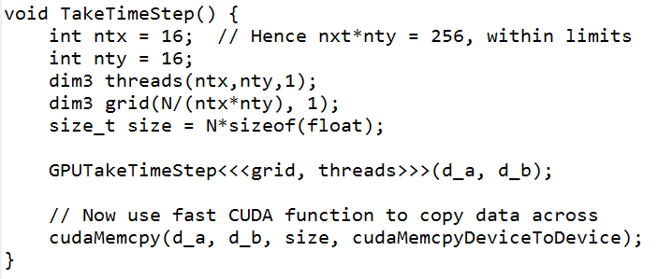
Application – 1D FTCS Heat TRANSFER
You can see that our TakeTimeStep wrapping function exactly follows the rules specified earlier.
Key Concept: NTX*NTY must not exceed the maximum number of allowable threads per block.
We use dim3 types to pass the dimensionality information onto the GPU.

Slide 22
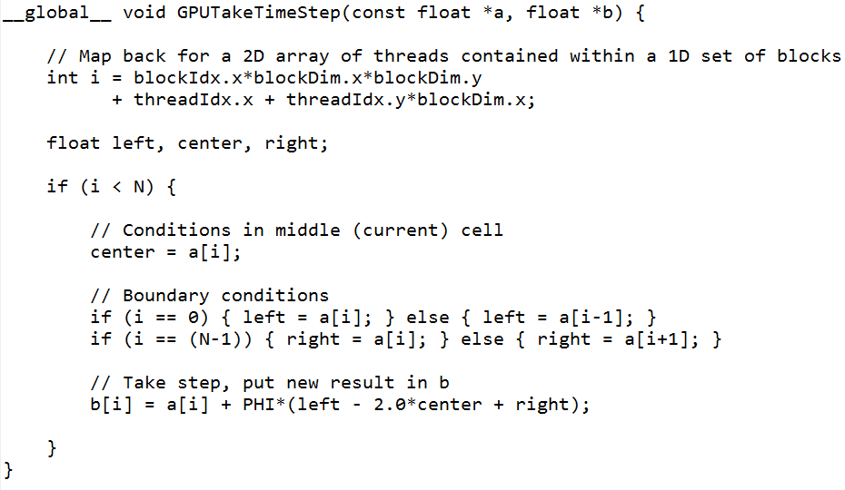
Application – 1D FTCS Heat TRANSFER
The CUDA Kernel itself remains unchanged from previously – except for how we compute the index i.
Everything else remains identical – the variable b contains the new temperature, while a contains the old one.

Slide 23
Application – 1D FTCS Heat TRANSFER
The effective number of threads is computed as predicted:
(blockDim.x*blockDim.y)
The effective (1D) thread ID for relating threads back to our 1D array is computed as:
threadIdx.x + threadIdx.y*blockDim.x

Slide 24
MULTIDIMENSIONAL BLOCKS

Slide 25
BLOCK Multidimensionality
We just reviewed the concept of multidimensionality in threads.
We can use 1, 2 or 3D thread structures within a block (to a maximum of 1024 threads per block on older GPU devices).
It should make sense that, when using CUDA, we can also have multidimensionality in the blocks of threads.
CUDA allos us to use 1 or 2D block structures within our grid (workspace) up to a maximum of ~ 65k x 65k (blocks in the X and Y direction).

Slide 26
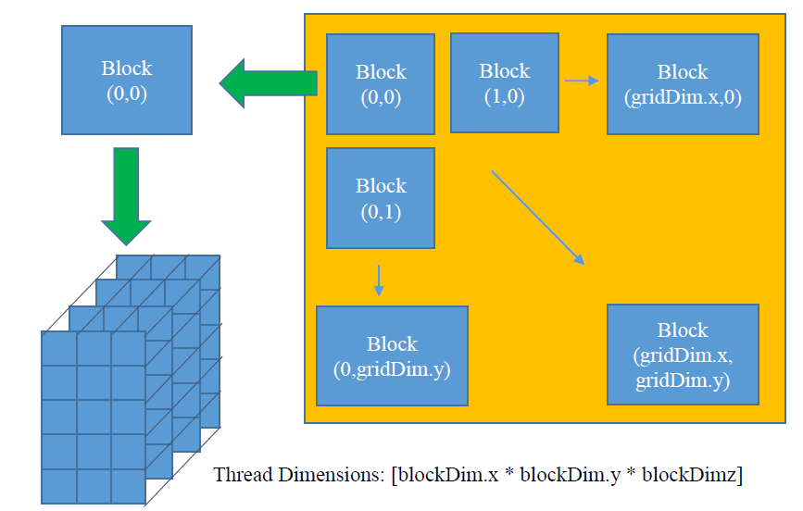
BLOCK Multidimensionality
In it’s fullest form, this allows us to employ a structure like this:
Each block containing threads in 3 dimensions.
Hence, each thread has:
An X ID,
A Y ID,
A Z ID.
2D Blocks of threads, each with:
An X ID,
A Y ID,
An X Dimension, and
A Y Dimension.
z
y
x

Slide 27
BLOCK Multidimensionality
0,0
1,0
0
1
0,0
1,0
4
5
y
Thread ID
0,1
1,1
2
3
0,1
1,1
6
7
Index to cell: (int i) = x + y
Block 0,0
Block 1,0
0,0
1,0
8
9
0,0
1,0
12
13
0,1
1,1
10
11
0,1
1,1
14
15
x
Start of current block
Block 0,1
Block 1,1
Total Threads per block
Overall Effective Block ID
x = (blockDim.x*BlockDim.y) * (gridDim.x*blockIdx.y + blockIdx.x)
y = threadIdx.x + threadIdy.y*blockDim.x
Overall Effective Thread ID

Slide 28
Example: 2D Blocks / 3D Threads
y
Thread ID
0,1
0,1
Block 0,0
Block 1,0
0,1
x
0,1
Start of current block
Block 0,1
Block 1,1
Total Threads per block
Overall Effective Block ID
x = (blockDim.x*BlockDim.y*BlockDim.z) * (gridDim.x*blockIdx.y + blockIdx.x)
y = threadIdx.x + threadIdx.y*blockDim.x + threadIdx.z*blockDim.y*blockDim.x
Overall Effective Thread ID

Slide 29
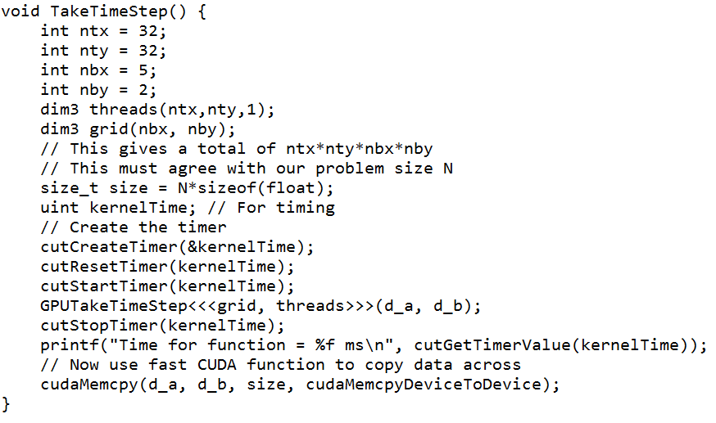
FTCS Example – 2D THREADS / 2D BLOCKS
Here, we use the same dim3 structures to pass information about dimensionality to the GPU.
2D threads (32x32)
2D blocks (5x2)
The total number of threads must be 32*32*5*2!

Slide 30
FTCS Example – 2D THREADS / 2D BLOCKS
You can see I’ve also introduced the cuda timing utilities – in case you wish to use the timers provided by Nvidia.
These are often more reliable than the wall time.

Slide 31
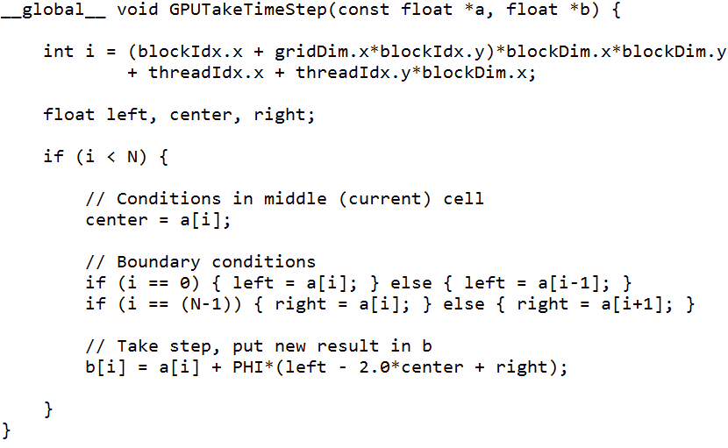
FTCS Example – 2D THREADS / 2D BLOCKS
The actual kernel function is also much like the one we covered earlier.
All we need to do is modifiy i → You can see how each line computes the index according to the formulas covered earlier.

Slide 32
COMPARISONS...
2D threads, 1D blocks
2D threads, 2D blocks

Slide 33
COMPARISONS...
In this case, the key is that the only part of your code which changes is the computation of cell index i based on thread ID’s and block ID’s.

Slide 34
applications
Having a 2D thread + 2D block structure makes 2D Heat Transfer simulation very convenient.
We can use the 2D thread ID (in the X and Y direction) as the indices for 2D shared memory.
You might imagine this is also very useful for Matrix Multiplication – we will look at this on Wednesday.

