Slide 1
Introduction to Multi-Core CPU and GPU Computation 多核心CPU和GPU計算
Class 22 Prof. Matthew Smith, msmith@mail.ncku.edu.tw

Slide 2
Today’s Class…
Matrix Multiplication using Shared Memory

Slide 3
MATRIX MULTIPLICATION

Slide 4
MATRIX MULTIPLICATION
Consider the multiplication of two matrices A and B to provide a product matrix C.

Slide 5
MATRIX MULTIPLICATION
This can be quite an expensive operation – for a matrix size N, the order of complexity is approximately N³.
Hence, finding a way to parallelize this computation will become valuable as N increases in size.
Let’s consider a matrix of size 1024 x 1024 (a million elements).

Slide 6
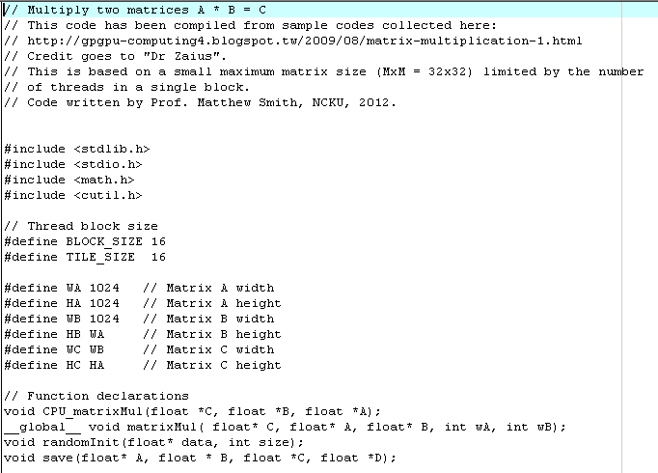
Setting up my CUDA code
First, we need to define some constants and create some function declarations.
The size of our matrix is 1024x1024 – note that my implementation does not require the matrix to be square.

Slide 7
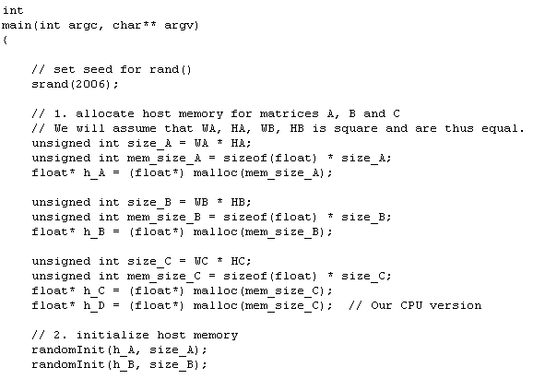
Setting up my CUDA code
Setting the random seed. Normally, we use a time variable as the argument.
The size of A, B and C may be different.
Hence, the memory allocation for each of these must be handled carefully.
In this code, we are going to fill A and B with random numbers using the custom function randomInit().

Slide 8
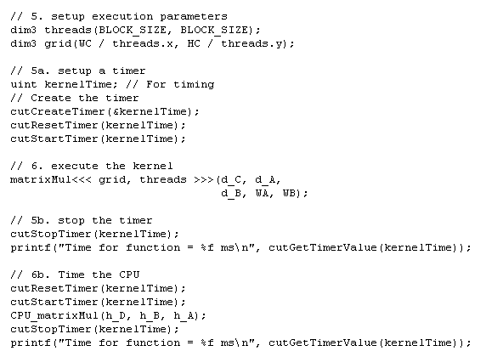
Setting up my CUDA code
BLOCK_SIZE = 16 → Hence, this code uses 16x16 (2D) threads per block.
Add the CUDA Utilier timer (present in CUDA 4.2)
The size of C controls how many blocks to use. We’ll revisit this in a little bit..
Code for calling the CUDA kernel
Add a CPU multiplication function and time it as well.

Slide 9
Review of the concepts
That was the basic setup of the code – the details of the implementation are a little dirtier – namely, the CUDA kernel itself.
We need to review how we perform a matrix multiplication before we can find an efficient way to do it on GPU.
Let’s start with the CPU code.

Slide 10
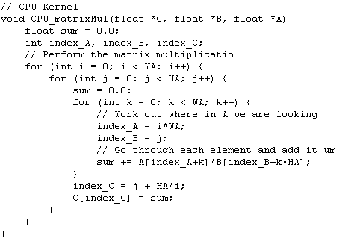
Review of the concepts
First thing to note….
This is proportional in cost to N³

Slide 11
Review of the concepts
2nd thing to note..
The final sum can be broken down..
We don’t have to do this all at once.

Slide 12
Review of the concepts
We move across these k elements…
..and sum them here.
=

Slide 13
Review of the concepts
We can perform these in blocks….
..and sum them here.
=
This would be the ideal approach. However, we are going to look at several different ways to doing this...

Slide 14
Implementation on the GPU
Since the GPU is treated as a separate device, we know that we are going to need to:
Copy information to the device,
Perform the computation, and
Retrieve the information from the device.
We can use cudaMemcpy for this.

Slide 15
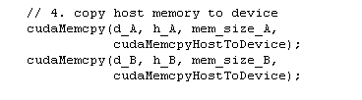
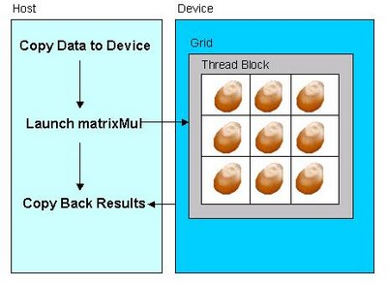



Implementation on the GPU

Slide 16
Implementation on the GPU
The simplest way to perform a matrix multiplication on the GPU might be to:
Allocate one block (a 1D array of blocks with only 1 block)
2D threads using NxN threads for an NxN matrix.
Let’s look at the code for this…

Slide 17
Implementation on the GPU
=
If each thread is allocated to one row and one column, then we will need a single for loop to sum the values along the row/column and compute the result.

Slide 18
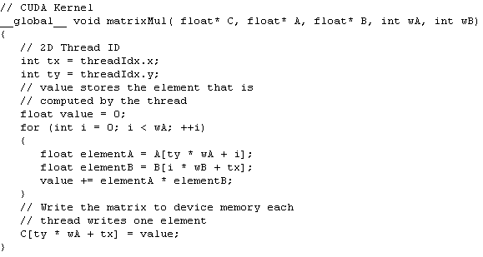
Implementation on the GPU
=
tx
Global Index = ty*wA + i
ty
Global Index = i*wB + tx

Slide 19
Implementation on the GPU
This is too simple. There are several problems with this approach:
Global memory access is slow.
Each thread needs to access the same variable in global memory several times – this will lead to delays.
Each thread only does a small amount of work.
Limit of workable size (32x32 matrix)

Slide 20
Implementation on the GPU
If we want to look at larger matrix problems, then we are going to need more than 1 block.
This is ok – we can use 2D blocks with 2D threads to break the work down.
Let’s have a look at an animation..

Slide 21
Implementation on the GPU
Step 3: We will need 16 blocks to solve this problem, so we create 16 blocks (see bottom left hand corner)
Step 1: Initialize the matrices.
Step 2: Break the result matrix (bottom left hand corner) into small groups of 3x3 tiles.
Step 4: Threads from different blocks compute the solution for each tile → giving us the solution.
http://gpgpu-computing4.blogspot.tw/2009/08/matrix-multiplication-2.html

Slide 22
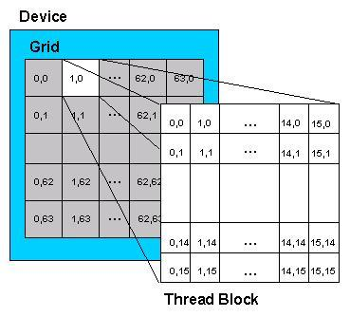
Implementation on the GPU
If we employ thread blocks of 16x16 threads, we will need 64x64 blocks to solve a 1024x1024 problem.
http://gpgpu-computing4.blogspot.tw/2009/08/matrix-multiplication-2.html

Slide 23
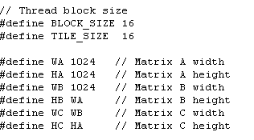
Implementation on the GPU..
// 5. perform the calculation // setup execution parameters dim3 threads(BLOCK_SIZE, BLOCK_SIZE); dim3 grid(WC / threads.x, HC / threads.y); // execute the kernel matrixMul<<< grid, threads >>>(d_C, d_A, d_B, WA, WB);
http://gpgpu-computing4.blogspot.tw/2009/08/matrix-multiplication-2.html

Slide 24
Implementation on the GPU..
__global__ void matrixMul( float* C, float* A, float* B, int wA, int wB) { int tx = blockIdx.x * TILE_SIZE + threadIdx.x; int ty = blockIdx.y * TILE_SIZE + threadIdx.y; float value = 0; for (int i = 0; i < wA; ++i) { float elementA = A[ty * wA + i]; float elementB = B[i * wB + tx]; value += elementA * elementB; } C[ty * wA + tx] = value; }
This is where 2D threads are useful.
Column ID
Row ID
http://gpgpu-computing4.blogspot.tw/2009/08/matrix-multiplication-2.html

Slide 25
Implementation on the GPU..
__global__ void matrixMul( float* C, float* A, float* B, int wA, int wB) { int tx = blockIdx.x * TILE_SIZE + threadIdx.x; int ty = blockIdx.y * TILE_SIZE + threadIdx.y; float value = 0; for (int i = 0; i < wA; ++i) { float elementA = A[ty * wA + i]; float elementB = B[i * wB + tx]; value += elementA * elementB; } C[ty * wA + tx] = value; }
The rest of the code is basically identical – all we had to do was modify how we compute tx and ty.
http://gpgpu-computing4.blogspot.tw/2009/08/matrix-multiplication-2.html

Slide 26
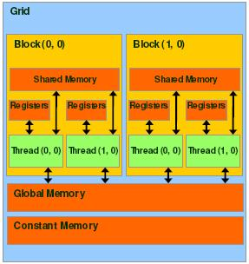
Implementation on the GPU
This modification changed our capacity from 32x32 matrix a matrix of almost any size.
However, there is still room for significant optimization.
http://gpgpu-computing4.blogspot.tw/2009/08/matrix-multiplication-2.html

Slide 27
Implementation on the GPU
We should make use of shared memory instead of global memory.
All operations should be performed on it.
http://gpgpu-computing4.blogspot.tw/2009/08/matrix-multiplication-2.html

Slide 28
Implementation on the GPU
The challenge is: the amount of shared memory is limited, so we need to break the problem down further.
http://gpgpu-computing4.blogspot.tw/2009/08/matrix-multiplication-2.html

Slide 29
Implementation on the GPU
This is because a single thread block might contain too much information to hold all of the data in shared memory..
http://gpgpu-computing4.blogspot.tw/2009/08/matrix-multiplication-2.html

Slide 30
Implementation on the GPU
Step 1: Create a 2D array in shared memory the same size as the block size for each sub problem.
// Declaration of the shared memory array As
// used to store the sub-matrix of A
__shared__ float As[BLOCK_SIZE][BLOCK_SIZE];
// Declaration of the shared memory array Bs
// used to store the sub-matrix of B
__shared__ float Bs[BLOCK_SIZE][BLOCK_SIZE];
http://gpgpu-computing4.blogspot.tw/2009/08/matrix-multiplication-2.html

Slide 31
Implementation on the GPU
Step 2: Assign values and synchronize following the assignment to shared memory.
// Load the matrices from global memory
// to shared memory; each thread loads
// one element of each matrix
As[ty][tx] = A[a + wA * ty + tx];
Bs[ty][tx] = B[b + wB * ty + tx];
// Synchronize to make sure the matrices
// are loaded
__syncthreads();
http://gpgpu-computing4.blogspot.tw/2009/08/matrix-multiplication-2.html

Slide 32
Implementation on the GPU
Step 3: Perform the computation over the sub-domain:
// Multiply the two matrices together;
// each thread computes one element
// of the block sub-matrix
for (int k = 0; k < BLOCK_SIZE; ++k)
Csub += As[ty][k] * Bs[k][tx];
// Synchronize to make sure that the preceding
// computation is done before loading two new
// sub-matrices of A and B in the next iteration
__syncthreads();
Same as the previous code…
(Except now we use shared memory here)
We need to synchronize to prevent threads from using old information
http://gpgpu-computing4.blogspot.tw/2009/08/matrix-multiplication-2.html

Slide 33
Implementation on the GPU
Step 4: All of this is looped over sub-domains within the current block:
// Index of the first sub-matrix of A processed
// by the block
int aBegin = wA * BLOCK_SIZE * by;
int aEnd = aBegin + wA - 1;
int aStep = BLOCK_SIZE;
int bBegin = BLOCK_SIZE * bx;
int bStep = BLOCK_SIZE * wB;
for (int a = aBegin, b = bBegin;
a <= aEnd;
a += aStep, b += bStep)
{
These values depend on how you store information within your matrix….
http://gpgpu-computing4.blogspot.tw/2009/08/matrix-multiplication-2.html

Slide 34
Implementation on the GPU
Step 5: Add the results of all sub-domains….
// Write the block sub-matrix to device memory;
// each thread writes one element
int c = wB * BLOCK_SIZE * by + BLOCK_SIZE * bx;
C[c + wB * ty + tx] = Csub;
}
Global index for result in C
End of loop over domains.
http://gpgpu-computing4.blogspot.tw/2009/08/matrix-multiplication-2.html

Slide 35
Performance
Comparison of the performance:
Time for CUDA Code: 0.043000 ms
Time for CPU Code: ~7800 ms.
This computation is able to be performed in a completely parallel fashion – there is no parallel reduction. Hence, the theoretical parallel efficiency is 100%.

Slide 36
NEXT CLASS...
In the final series of classes, we will look at the following topics:
The Dot Product on the GPU, and Matrix-Vector Multiplication. (This requires parallel reduction to work).
Iterative techniques for matrix inversion – namely Jacobi and the CG method.

