Slide 1
Introduction to Multi-Core CPU and GPU Computation 多核心CPU和GPU計算
Class 23 Prof. Matthew Smith, msmith@mail.ncku.edu.tw

Slide 2
TODAY’s CLASS
Parallel Reduction Concept,
Parallel Reduction on the GPU,
Preparations for the Conjugate Gradient (CG) method on GPU.

Slide 3
DOT PRODUCT
The dot product is a commonly used tool in engineering and mathematics.
It plays a crucial role in many computations – however, we’ll see that it is critical for matrix operations and computations on linear systems of equations.

Slide 4

DOT PRODUCT
The computation itself is simple: take two vectors x, y of length N.
The dot product is simply the sum of the element wise multiplication of these arrays:
$$dot\left(x,y\right)=\sum_{i=1}^{N}{x_{i}y_{i}}$$

Slide 5
Dot Product
The serial code for this computation is trivial.
The serial code is written on the whiteboard for your reference.
Note how the variable dot is used to perform a sum over all of the elements.
How can we make this parallel – it is essentially a serial process.

Slide 6
Dot Product
This serial process is commonly used in many similar computations:
Let’s use this example to see how we might parallelize this process for this example:

Slide 7
Review of previous strategy
Previously, we used OpenMP (and just a few threads) to perform this work.
Each OpenMP thread would find the sum over a small fraction of the entire length:
CPU 0
CPU 1
CPU 2

Slide 8
Review of previous strategy
CPU 0
CPU 1
CPU 2
Sum = 110
Sum = 190
Sum = 142
After each thread has calculated the minimum value in its own section, we can use a single CPU to find the sum of the remaining 3 elements…
CPU 0
110 + 190 + 142 = 442

Slide 9
Dot Product
The dot product computation can be broken down into two steps:
Element-wise multiplication
Element-wise addition.
This has varying degrees of parallel efficiency:
First step – 100% parallel, easily shared on GPU.
Second step – much harder to share across GPU threads.

Slide 10
Element-wise multiplication
On the GPU, this is a relatively simple issue. The code can be written in 4 lines.
(Find code on the board)
All we need to is assign a single thread per element of the array and perform the multiplication on that element.

Slide 11
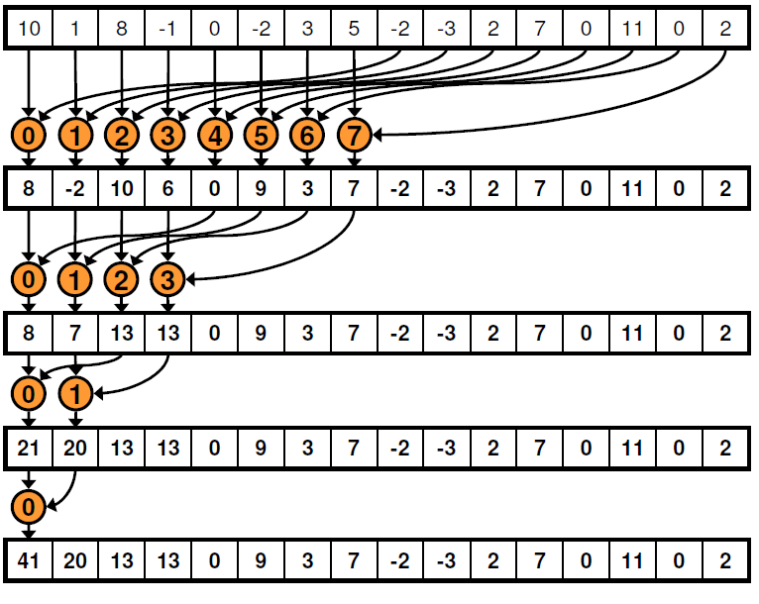
Element-wise ADDITION
Much research has been invested into how to perform parallel, element wise addition.
The concept is quite simple – each thread adds two elements at once, producing a solution vector which is half the length of the previous one.
Each iteration uses fewer and fewer threads until a sum is reached.

Slide 12
Element-wise ADDITION
We can use this strategy on the GPU:
Create a block of N threads controlling 2N elements.
Place the 2N elements of our array in shared memory for fast access.
Use the threads inside each block to find a local sum.
Add all of the block solutions together to find the solution.

Slide 13
Parallel Reduction
Start with our arrays x and y....
x
y
z
Assume length is N = 1028

Slide 14
Parallel Reduction
First, let’s perform our element multiplication (dot product) and place the result into shared memory:
global
x
0
1027
global
y
0
1027
shared
0
255
0
255
0
255
0
255
Block 0
(256 threads)
Block 1
(256 threads)
Block 2
(256 threads)
Block 3
(256 threads)

Slide 15
Parallel Reduction
x
global
0
i
1027
y
global
0
i
1027
shared
0
I
255
0
255
0
255
0
255
__shared__ float temp[256];
int i = blockDim.x*blockIdx.x + threadIdx.x;
int I = threadIdx.x;
temp[I] = x[i]*y[i];

Slide 16
Parallel Reduction
Following this, we have our multiplied elements in shared memory.
We shall employ a tree algorithm and varying numbers of threads to sum these into a single value.
In a dot product (sum phase), we add two elements into a single value.
For a minimum search, we choose one value from two values – the smaller one.
Using this strategy, each block will return its own minimum.

Slide 17
Parallel Reduction
a
0
255
Divide the work into two.
a
a₀
a₁
a₁₂₈
a₁₂₉
0
127
128
255
128 pairs
= 128 threads.
Using 128 threads, we select the minimum of a pair of elements and create an array which is 128 long.
Min. of
a₀,a₁₂₈
Min. of
a₁,a₁₂₉
Min. of
a₁₂₇,a₂₅₅

Slide 18
Parallel Reduction
We’ve used (1/2) the number of available threads to reduce the length down to (1/2) it’s previous length.
We can do it again to get an array of length (1/4) that we originally had..

Slide 19
Parallel Reduction
a
0
127
Now we have 127 elements from our previous reduction
Divide the work into two.
a
a₀
a₁
a₆₄
a₆₅
0
63
64
127
64 pairs
= 64 threads.
Using 64 threads, we can add two elements together at the same time and create an array which is 64 long.
Min. of
a₀,a₆₄
Min. of
a₁,a₆₅
Min. of
A₆₄,a₁₂₇

Slide 20
Final Step in Reduction
Regardless of what you do (dot product, binary comparison operations), you will have an array of length (NO_BLOCKS) containing values.
Let’s have a look…

Slide 21
Final Step in Reduction
global
y
0
1027
shared
0
255
0
255
0
255
0
255
Final Array
(NO_BLOCKS long)
For N = 1028, with 256 threads per block, this final array is 4 elements long.
We can use either:
(i) The CPU to sum these 4 elements for us, or
(ii) Perform ANOTHER reduction on the final array.

Slide 22
Parallel Reduction EFFICIENCY
In each subsequent iteration, we employ (1/2) the previous number of threads.
How will this impact on the parallel efficiency?

Slide 23
Parallel Reduction EFFICIENCY
Let’s think about it….
T total threads
N total number of reductions.

Slide 24
Parallel Reduction EFFICIENCY
For N reduction steps, with T threads, the maximum firepower we could obtain (linearly) is NT:
For the proposed algorithm, we only use a fraction (half) of the number of threads in each iteration:

Slide 25
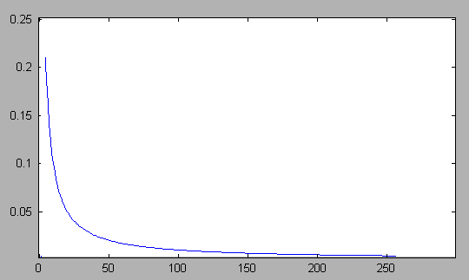
Parallel Reduction
The ratio of these tells us the parallel efficiency, disregarding other communication expenses:
With high ratios of elements to threads, the efficiency of the operation will decrease.
With increased numbers of steps, we significantly decrease the efficiency.

Slide 26
Parallel Reduction Pseudocode
Int i = global array ID
Int I = thread ID
Set shared value Temp = x[i]*y[i]
Synchronize threads
For stride = BLOCK_DIM/2; stride > 0; stride = stride / 2
if (I < stride)
Set Temp[I] = Temp[I] + Temp[I + stride]
Synchronize threads
end if
End for
With each step in our for loop, we should be using fewer and fewer threads!
Each cycle will employ stride threads.
Between reduction cycles, we must synchronize the threads to ensure the results are up-to-date in all parts of the array.

Slide 27
Parallel Reduction CODE
The code is written on the board.
This code – or code which is even faster than this – can be found online with a simple google search.

Slide 28
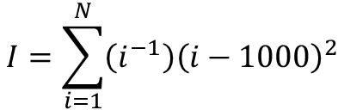
EXERCISE
If you’d like a test run, write a code to compute the result for:
Create two arrays to store your variables (a=i⁻¹), (b=(i-1000)²) and allocate 256 elements per block.
Find the solution with N = 2000 using a serial code.
Write a GPU code to find the solution.
Check your answer using MATLAB. Precision may be important.
$$I=\sum_{i=1}^{N}{\left(i^{−1}\right){\left(i−1000\right)}^{2}}$$

