Slide 1
Introduction to Multi-Core CPU and GPU Computation 多核心CPU和GPU計算
Class 23b Prof. Matthew Smith, msmith@mail.ncku.edu.tw

Slide 2
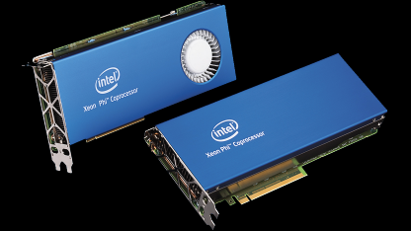
What is this?
You’re reading this file because you want more information about how we might perform large-scale dot product operations using OMP and AVX.
This won’t be tested, but in the future if you wish to perform the CG method on the Intel Xeon Phi Coprocessor, this might be important.

Slide 3
Advanced dot products
Computation of dot products is an important part of the Conjugate Gradient (CG) method – useful for inverting matrix systems.
We can use AVX to speed up this process.
There are two parts:
Multiplication, and
Addition / Summation

Slide 4
Advanced dot products
There are many ways we can do this efficiently using AVX:
Use separate multiplication and addition operations with AVX, or
Use AVX’s built in dot product feature.
Let’s review each one.

Slide 5
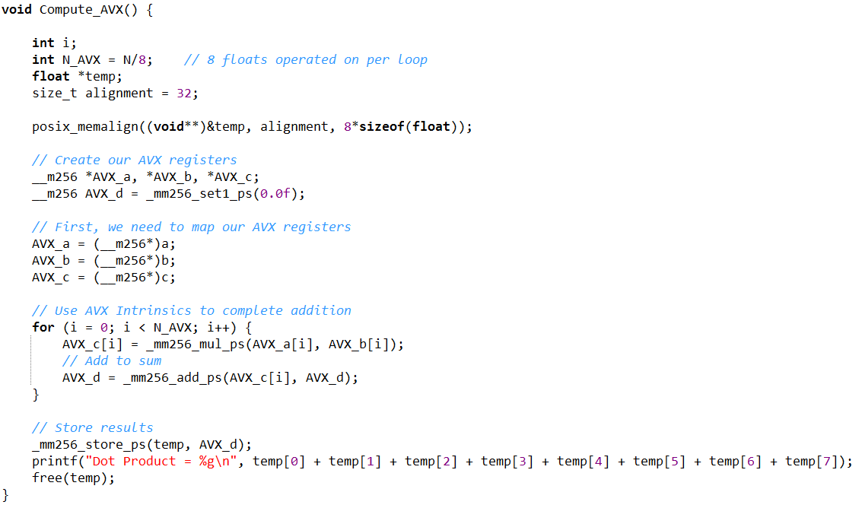
Advanced dot products
Approach 1:
Loop over N/8 elements.
Each time, compute c[i] = a[i]*b[i].
Add each of these results to a sum variable AVX_d.
Once the operation is complete, sum across AVX_d.

Slide 6
Advanced dot products
Approach 1: - First Iteration of Computation (i = 0)
c
0
1
2
3
4
5
6
7
8
AVX_c[0]
The first use of the loop increments AVX_d by AVX_c[0].
AVX_d contains 8 floating point elements.
AVX_d
AVX_d

Slide 7
Advanced dot products
Approach 1 – 2nd Iteration (i = 1)
c
0
1
2
3
4
5
6
7
8
9
10
11
12
13
14
15
16
AVX_c[1]
The second iteration adds the values contained within AVX_c[1] to AVX_d.
Hence, AVX_d = AVX_c[0] + AVX_c[1].
AVX_d
AVX_d

Slide 8

Advanced dot products
Class demo – for N = 32, compute the value of AVX_D for each iteration.
There will be 4 iterations since we compute across 8 floats on each loop.
Iteration
0
1
2
3
AVX_D
c
0
1
4
9
16
25
36
..
..
..
..
..
..
..
..
..
(N-1)²
Use approach 1.

Slide 9
Advanced dot products
Approach 1:
The final step is the summation across 8 elements.
We need to send the information stored in AVX_d to an array on the host.
This variable may need to be aligned*.

Slide 10
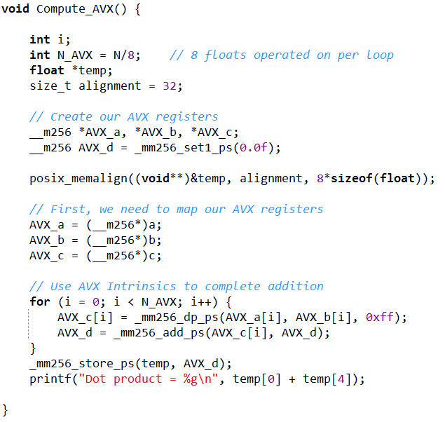
Advanced dot products
Approach 2:
Use a built-in dot product function.
The start is essentially identical.
Instead of using the _mm256_mul_ps command, we use the _mm256_dp_ps (dot product)
By doing so, AVX automatically sums some of the vector.

Slide 11
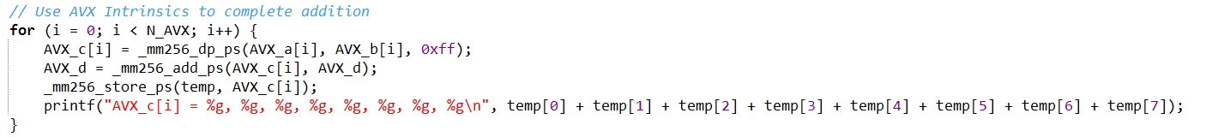
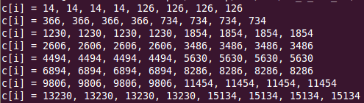
Advanced dot products
Approach 2:
We gain a little more insight by looking at each step:
Each AVX iteration works on 8 elements.
_mm256_dp_ps performs (i) multiple of a and b for all elements, and (ii) sums the first 4 and the second 4 together.

Slide 12
Advanced dot products
Approach 2:
16 + 25 + 36 + 49 = 126
a[i].b[i] =
0
1
4
9
16
25
36
49
14
14
14
14
126
126
126
126
AVX_c[0] =
0 + 1 + 4 + 9 = 14
Hence, we really only need to add the 0th and 4th element from each of these.
The rest of the data is redundant.

Slide 13
Advanced dot products
Approach 2:
Instead of only adding the 0th and 4th element from each c[i] to our overall sum (AVX_d), we get lazy and just add them all.
Hence, from our sum (AVX_d), we only need to sum the 0th and 4th element.

Slide 14

Advanced dot products
Class demo – for N = 32, compute the value of AVX_D for each iteration.
There will be 4 iterations since we compute across 8 floats on each loop.
Iteration
0
1
2
3
AVX_D
c
0
1
4
9
16
25
36
..
..
..
..
..
..
..
..
..
(N-1)²
Use method 2 this time.

Slide 15
Other useful methods..
There are horizontal addition functions in AVX for adding components within an AVX variable.
These are known by the name HADD (Horizontal add).
Information about these can be found online.

Slide 16
Using OpenMP with AVX
To make the fastest possible code – for CPU – we need to combine:
The power of AVX – performing parallel computation across 8 floating point variables on a single core in a single instruction cycle,
The power of multiple cores and OpenMP – sharing the computational workload across a number of processing cores.
Maximum theoretical increase in performance vs single core: 8*P (128x on the computer upstairs)
The implementation of this is quite straightforward for simple problems.

Slide 17
Using OpenMP with AVX
There are only a few things you need to remember:
How to share access to an array,
Which variables are shared (or private),
The header (omp.h) and precompiled libraries (-fopenmp),
Setting the number of omp threads etc.

Slide 18
class CHALLENGE
In groups of 2-3 students each, try to transform approach 1’s method for computing the dot product to employ OpenMP.
I’ll give you an hour before I review my solution.
Good luck!

Slide 19
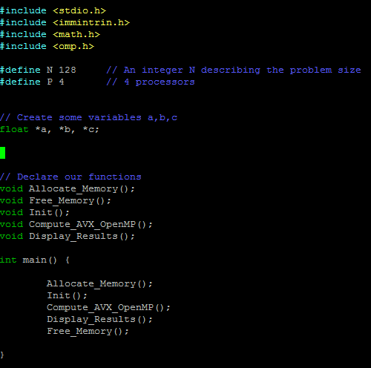
MY SOLUTION
First, we need to add the #include <omp.h> at the top.
Secondly, I’ve included a new defined variable → P = 4
#define P 4

Slide 20
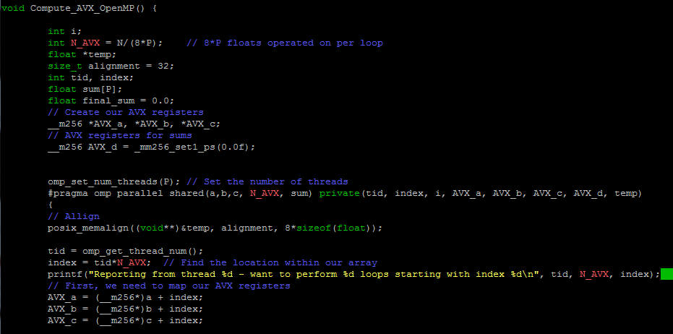
MY SOLUTION
Now, each loop will need to work on (N/(8*P)) elements because we share the previous work over P cores.

Slide 21
MY SOLUTION
We are using OpenMP → we are going to need to remember the tid and index.
tid = thread ID.
index = starting point for work on our arrays.

Slide 22
MY SOLUTION
I’m going to keep a track of the dot product computed on each core in the variable sum.
Since we have P cores, it will be an array:
float sum[P]

Slide 23
MY SOLUTION
We need to set the number of OpenMP threads:
omp_set_num_threads(P)

Slide 24
MY SOLUTION
Start the parallel session.
All of the AVX variables are private.

Slide 25
MY SOLUTION
Thread 0 (tid=0)
Thread 1 (tid=1)
Thread 1 (tid=2)
Thread 1 (tid=3)
a
0
31
32
63
64
95
96
127
AVX_a*
AVX_a*
AVX_a*
AVX_a*
Each thread will operate on N/4 floats, or (N/32) AVX variables.
The index of AVX_a is positioned differently for each thread:
index = tid*N_AVX;

Slide 26
MY SOLUTION
This means that a,b,c must all be shared.
When each thread starts, we tell them to look in a different place of a.

Slide 27
MY SOLUTION
One more thing…
Each processor (i.e. thread) has a unique memory access pattern.
Hence, the temp variable must be aligned by each thread separately.

Slide 28
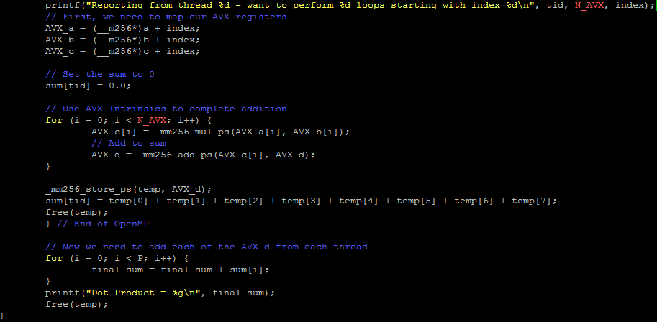
MY SOLUTION
Our loop here doesn’t change – we only need remember to make sure N_AVX is correct.

Slide 29
MY SOLUTION
Each thread can store it’s own AVX_d into its own temp array.
The sum of these will be the dot product of the elements controlled by that thread.
Store inside sum[tid]
Hence sum must be shared.

Slide 30
MY SOLUTION
Don’t forget to ask each thread to free it’s temp variable.
This has to be done now – don’t try it later.

Slide 31
MY SOLUTION
Finally, add each sum up over the total number of processors.
We could use parallel reduction, but we only have P = 4 threads.
Could also write:
dp = sum[0] + sum[1] + sum[2] + sum[3];

Slide 32
MY SOLUTION
Stupid mistake, don’t copy this.

Slide 33
Comments
This dot product should be quite fast – you’ll find that it will be faster than using a GPU to perform the computation.
This is because the memory and cache system on shared core systems is very fast.
It’s very difficult to beat AVX + OpenMP → world’s fastest codes are programmed in this way.
No set rules – you will all have your own approach.

Slide 34
Tutorial!
I’ve pretty much solved the first tutorial question for you.
Good luck with the second – ask me or Josh for help if you get stuck.

