Slide 1
Introduction to Multi-Core CPU and GPU Computation 多核心CPU和GPU計算
Class 24 Prof. Matthew Smith, msmith@mail.ncku.edu.tw

Slide 2
TODAY’s CLASS
Review of systems of linear equations
The Conjugate Gradient (CG) method on GPU

Slide 3





Linear Systems of Equations
Many common engineering problems – with large numbers of unknowns $x=\left[x_{1}, x_{2}…x_{n}\right]$– can be described by a series of coupled linear equations.
These equations can be written in matrix form such that:
$$Ax=B$$
$$A=\left[\begin{matrix}A_{11} & A_{12} & .. \\ A_{21} & A_{22} & .. \\ .. & .. & A_{nn}\end{matrix}\right]$$
$$x=\left[\begin{matrix}x_{1} \\ .. \\ x_{n}\end{matrix}\right]$$
B$=\left[\begin{matrix}B_{1} \\ .. \\ B_{n}\end{matrix}\right]$

Slide 4
Linear Systems of Equations
Assuming the matrix A has a non-zero determinant, the system of equations can be solved by inverting A and multiplying this matrix by the vector B.
However, for large values of n (A is size n*n), this calculation can be difficult and very time consuming.
Hence, we often employ techniques where the solution to A⁻¹ is not computed explicitly.
There are many such techniques – today we will examine the Conjugate Gradient (CG) technique.

Slide 5
Conjugate Gradient
The CG (Conjugate Gradient) method was originally conceived as a direct solver which solved an nxn system in n steps.
However, since this is impractical on computer systems due to rounding errors, the method has since been re-envisioned as an iterative solver.
Iterative solver → A large number of steps are required to solve for the system unknowns x.

Slide 6
Conjugate Gradient
The method is only applicable to symmetrical A matrices.
One can use a modification of the CG method, named the Bi-Conjugate Gradient (BiCG) scheme for general A matrices.
Of course, the convergence is much slower.

Slide 7
CONJUGATE GRADIENT
The CG method relies upon a concept known as the residual of a system of linear equations.
Residual → What is left over from the system when an incomplete/incorrect/selected x is inserted into the equations:
If the x we use is correct (our solution), R will be zero for each element (since R is a vector).

Slide 8
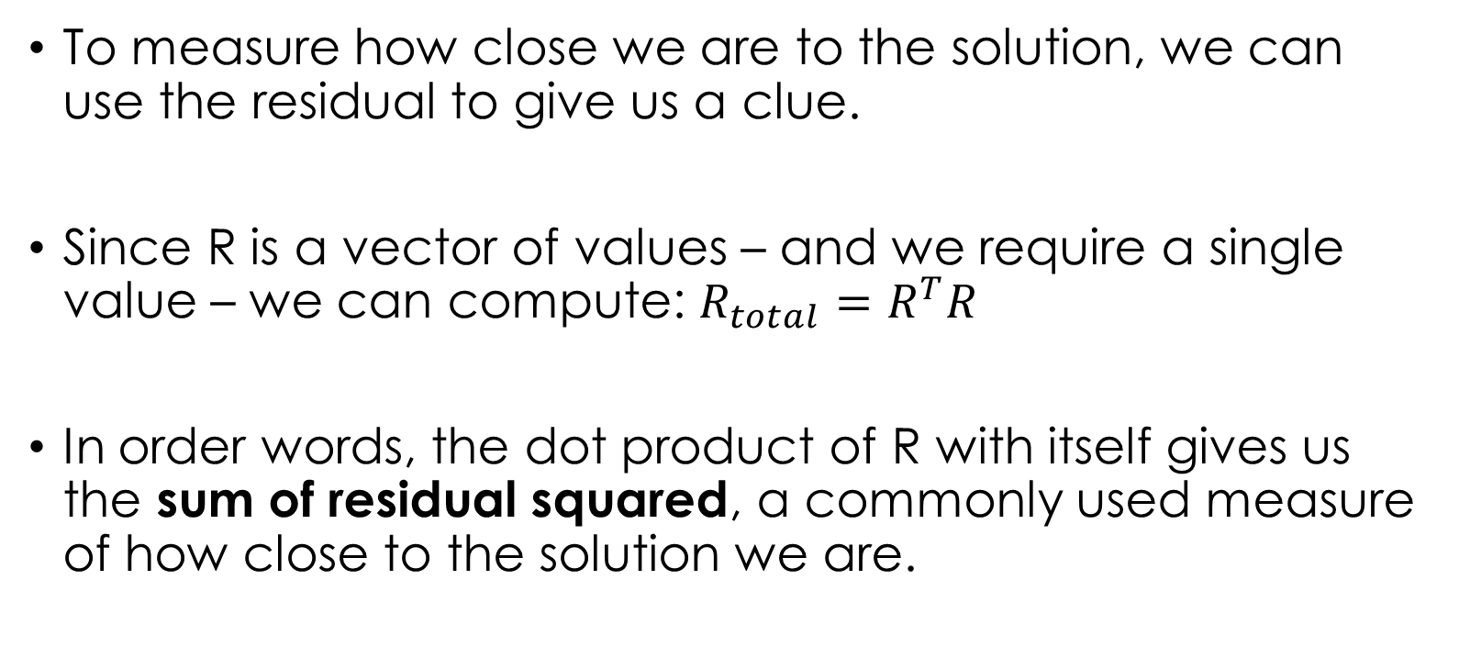
CONJUGATE GRADIENT
To measure how close we are to the solution, we can use the residual to give us a clue.
Since R is a vector of values – and we require a single value – we can compute: $R_{total}=R^{T}R$
In order words, the dot product of R with itself gives us the sum of residual squared, a commonly used measure of how close to the solution we are.

Slide 9
CONJUGATE GRADIENT
This value is, in fact, required for the CG method computation.
The remainder of computations can be described as (i) matrix-vector multiplications, and (ii) dot product computations.
Hence, the application of parallel reduction to GPU computing (as covered in the previous class) is very important to efficiently implementing the CG method.

Slide 10
CG ALGORITHM
The first step of the CG algorithm is to start with an initial guess of the solution.
If we have no information on-hand about a good initial guess, then we can set the initial x to a vector of zeros.
Hence, we set x = [0,0,0,0.....0,0] at the beginning of the computation.
We also require the initial residual → which must be B if x = 0.
We also require an initial value for a variable P (which is also B)
Step 1: P = B, R = B, x = [0,0,0....0] (prior to iteration)

Slide 11
CG ALGORITHM
After we have set the initial values of P, R and x, the iterative procedure may commence.
We continue iterating until either (i) a maximum number of iterations has been reached (we choose this) or (ii) the sum of residual squared is less than an amount (we choose this also).
Let’s start the iterative procedure, starting with step 2...

Slide 12
CG ALGORITHM
Step 2: Compute AP (matrix-vector computation)
This will give us a vector (AP)
Step 3: Compute dot(P, AP) → which will give us a scalar.
Step 4: Compute dot(R,R) – the sum of residual squared – which is also a scalar.

Slide 13
CG ALGORITHM
Step 5: Compute the ratio of RTR and PTAP (the scalars computed in steps 3 and 4)
Step 6: Using alpha (step 5) and P, update the values of x. This gives us new estimates of the value of x.
Step 7: Compute the new residual R* and the dot product of the new residual (R^{*T}R*)
Step 8: Compute the ratio of new to old sum of residuals.
Step 9: Compute new P based on the new residuals R*, beta and P.

Slide 14
CG ALGORITHM
The flowchart demonstrates the procedure.
Different coloured blocks tell us what kind of computation is required – this is important for the GPU implementation of the CG method.
Start
x = 0, P = R = B
R^{T}R < 1e-5?
Calc AP
Calc P = R*+βP
Matrix vector
Parallel, 100% efficient
Calc P^{T}AP
Finished.
Calc β
Dot Product Parallel, low efficiency
Calc R^{T}R
Calc R*^{T}R*
Scalar Serial (0% Parallel efficiency)
Calc α
Calc x = x + αP
Calc R*=AX-B
Vector Computation Parallel, 100% efficient

Slide 15

CG ALGORITHM
There are same ways to speed up parts of this algorithm.
The residual computation can be replaced with an approximation:
This is less computationally expensive – but with a lower parallel efficiency.
This may also introduce errors due to rounding.
$$R^{∗}=R−αAP$$

Slide 16
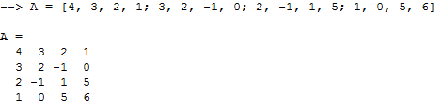
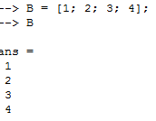
CG IN MATLAB
Let’s set up a CG solver in MATLAB.
Then we can test our CG algorithm with a known solution, create a plot of residual versus iteration etc.
Use this info to start:

Slide 17
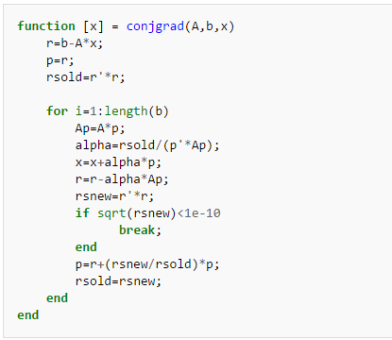
CG IN MATLAB
Follow my example code – write your own copy with me.

Slide 18
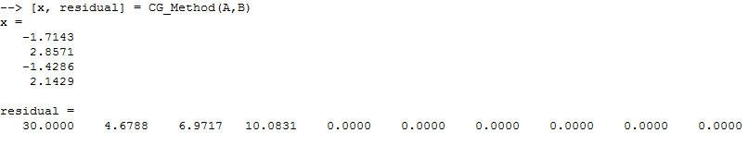
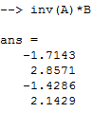
CG TESTING
Your solution should look something like this:
We can check to make sure this is correct by computing the inverse directly in MATLAB and looking at the solution:

Slide 19
GPU APPLICATION - MEMORY

Slide 20
APPLICATION TO GPU
There are several things we need to consider before running this on the GPU.
Let’s consider which variables we’ll need:
Scalars: RTR, RTR_new, PTAP, alpha, beta (a total of 5)
1D arrays: B, x, R, P, AP (a total of 5, length N)
2D matrix: A (size N*N)

Slide 21
APPLICATION TO GPU
We can create a small array of floats (or doubles) to contain our 5 scalar values. This will be handy for us.
We can create 5 1D arrays of length N for the variables B, x, R, P, AP.
We can create a 1D array of length N*N for the variable A → We can store it row-wise.
If we do this, is it the best way?

Slide 22
APPLICATION TO GPU
In most engineering applications, the A matrix is:
Sparse – most of the matrix contains 0’s.
Diagonally dominant – the most important and largest elements of A lie close to the diagonal of the matrix A,
Symmetric – this is convenient, since CG only handles symmetric matrices.

Slide 23
APPLICATION TO GPU
Consider the only time the A matrix is used – in the AP computation.
If an element of A is zero, then the computation is just wasted time (see demonstration on the whiteboard).
Is there a way that we can:
Remove the 0’s from the computation, and
Reduce the amount of data we need to store for our A matrix?

Slide 24
APPLICATION TO GPU
There is indeed. CSR.
You can google CSR in your own time – to complete this course, you don’t need to know it.
However, if you continue to use CG or any matrix computation for your research, you should use CSR to reduce the storage requirement for your matrix and increase computational efficiency.

Slide 25
GPU APPLICATION - KERNELS

Slide 26
APPLICATION TO GPU
Since the type of computation is different for each section of CG, the best way to make CG run efficiently on the GPU is to write a different kernel for each section.
Write a dot-product kernel to compute the RTR, PTAP etc.
Write a vector computation kernel to compute x, R etc.
Write a matrix-vector computation kernel to compute AP.
Already done
Already done
Not done

Slide 27
APPLICATION TO GPU
To get CG working on the GPU, all you need to do is write a GPU kernel to compute the product of matrix A and vector B.
This is quite simple to do:
You can break the matrix – vector computation down into many row elements.
We can assign each thread to each individual row.
=

Slide 28
APPLICATION TO GPU
To get CG working on the GPU, all you need to do is write a GPU kernel to compute the product of matrix A and vector B.
This is quite simple to do:
Thread 0
You can see that each thread has its own vector computation to complete.
This means each kernel will have a single for loop over N elements.
This is also perfectly parallel.
Thread 1
..
=
..
Thread N-1

Slide 29
APPLICATION TO GPU
If we have time, try writing a kernel which finds the product of a matrix A and vector B.
Store the result in an array C.
You should be able to use this code to complete the CG solver for the GPU.

Slide 30
APPLICATION TO GPU
There are several things we need to consider before running this on the GPU.
Let’s consider which variables we’ll need:
Scalars: RTR, RTR_new, PTAP, alpha, beta (a total of 5)
1D arrays: B, x, R, P, AP (a total of 5, length N)
2D matrix: A (size N*N)

Slide 31
APPLICATION TO GPU
We can create a small array of floats (or doubles) to contain our 5 scalar values. This will be handy for us.
We can create 5 1D arrays of length N for the variables B, x, R, P, AP.
We can create a 1D array of length N*N for the variable A → We can store it row-wise.

Slide 32
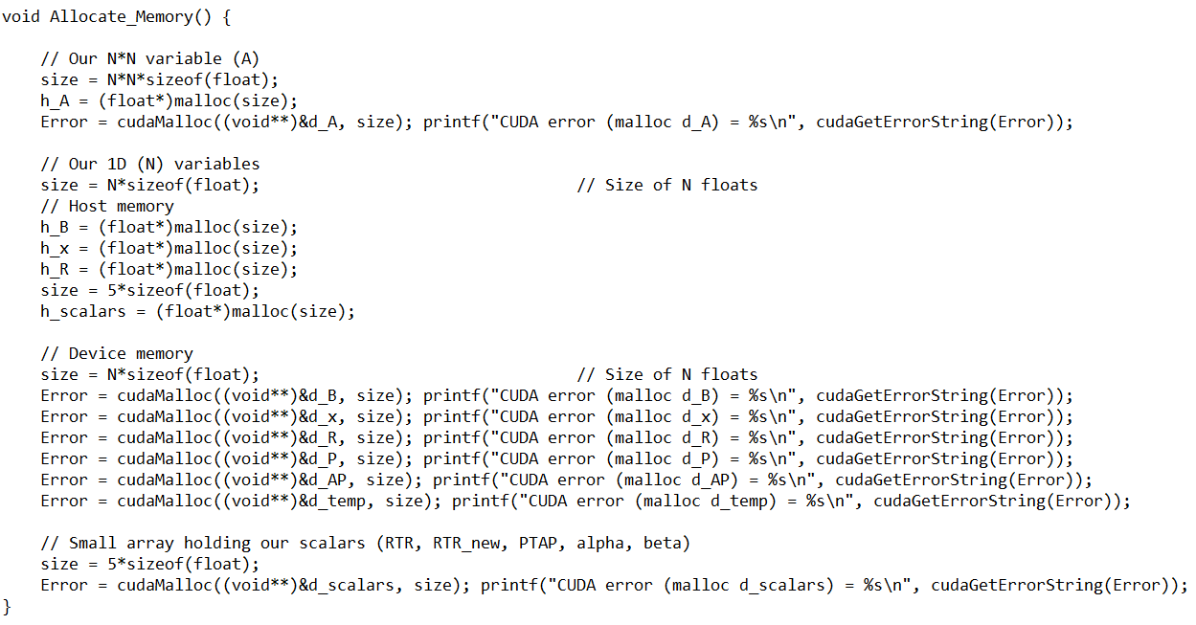
APPLICATION TO GPU
h_scalars = d_scalars =
RTR
RTR_new
PTAP
α
β

Slide 33
APPLICATION TO GPU
In most engineering applications, the A matrix is:
Sparse – most of the matrix contains 0’s.
Diagonally dominant – the most important and largest elements of A lie close to the diagonal of the matrix A,
Symmetric – this is convenient, since CG only handles symmetric matrices.

Slide 34
APPLICATION TO GPU
Consider the only time the A matrix is used – in the AP computation.
If an element of A is zero, then the computation is just wasted time (see demonstration on the whiteboard).
Is there a way that we can:
Remove the 0’s from the computation, and
Reduce the amount of data we need to store for our A matrix?

Slide 35
APPLICATION TO GPU
There is indeed. CSR.
You can google CSR in your own time – to complete this course, you don’t need to know it.
However, if you continue to use CG or any matrix computation for your research, you should use CSR to reduce the storage requirement for your matrix and increase computational efficiency.

Slide 36
GPU APPLICATION – WRAPPING FUNCTIONS

Slide 37
APPLICATION TO GPU
Since the type of computation is different for each section of CG, the best way to make CG run efficiently on the GPU is to write a different kernel for each section.
Write a dot-product kernel to compute the RTR, PTAP etc.
Write a vector computation kernel to compute x, R etc.
Write a matrix-vector computation kernel to compute AP.
Already done
Already done
Not done

Slide 38
APPLICATION TO GPU
To get CG working on the GPU, all you need to do is write a GPU kernel to compute the product of matrix A and vector B.
This is quite simple to do:
You can break the matrix – vector computation down into many row elements.
We can assign each thread to each individual row.
=

Slide 39
APPLICATION TO GPU
To get CG working on the GPU, all you need to do is write a GPU kernel to compute the product of matrix A and vector B.
This is quite simple to do:
Thread 0
You can see that each thread has its own vector computation to complete.
This means each kernel will have a single for loop over N elements.
This is also perfectly parallel.
Thread 1
..
=
..
Thread N-1

Slide 40
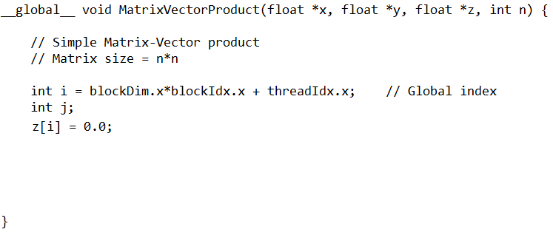
APPLICATION TO GPU
Your function should take on the form:
Here you will insert your own code to find the result (z) of the product of matrix (x) and vector (y).

Slide 41
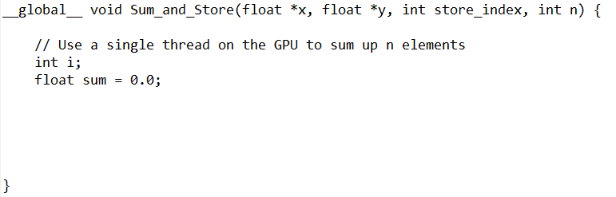
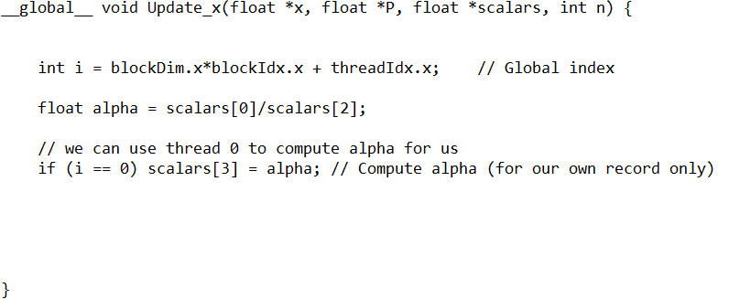
REVIEW OF KERNELS
Each kernel should be prepared as such:
Code to sum elements of x and store in y
Code to update x from P

Slide 42
PUTTING IT ALL TOGETHER...

Slide 43
BEFORE YOU START...
Check to make sure you have GPU kernels to perform this work:
Compute a matrix-vector product of a matrix X and vector Y, producing a vector Z.
Compute the dot product of a vector X and vector Y, producing a scalar Z.
Compute a vector operation X = X + const.*Y where X and Y are vectors.

Slide 44
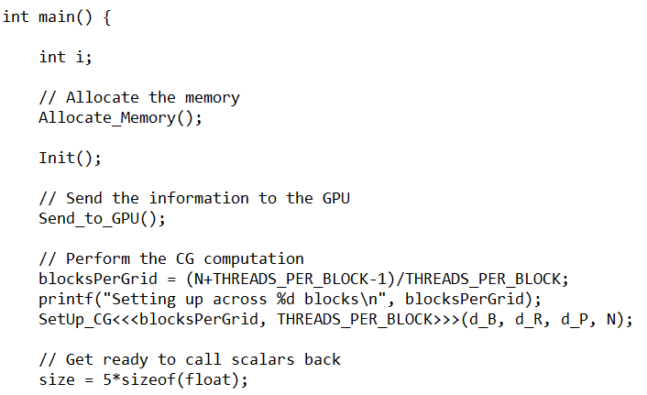
Application of GPU for CG
The general layout of your code isn’t going to change much when compared to your previous codes.
Of course, we need to allocate the memory for our problem on the CPU and GPU first.
After this, we can (i) Init() (Initialize the problem), and (ii) Send_to_GPU() (Send information to the GPU)

Slide 45
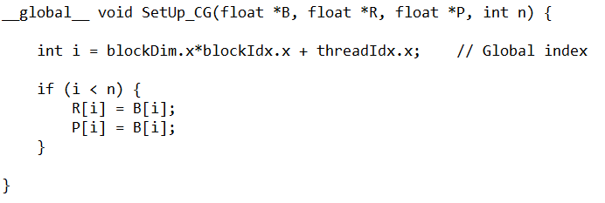
Application of GPU for CG
After the information is on the GPU, we can use some threads on the device to perform some initialization for us.
Here, we use the SetUp_CG() function, which sets the values for d_B, d_R and d_P on the device.

Slide 46
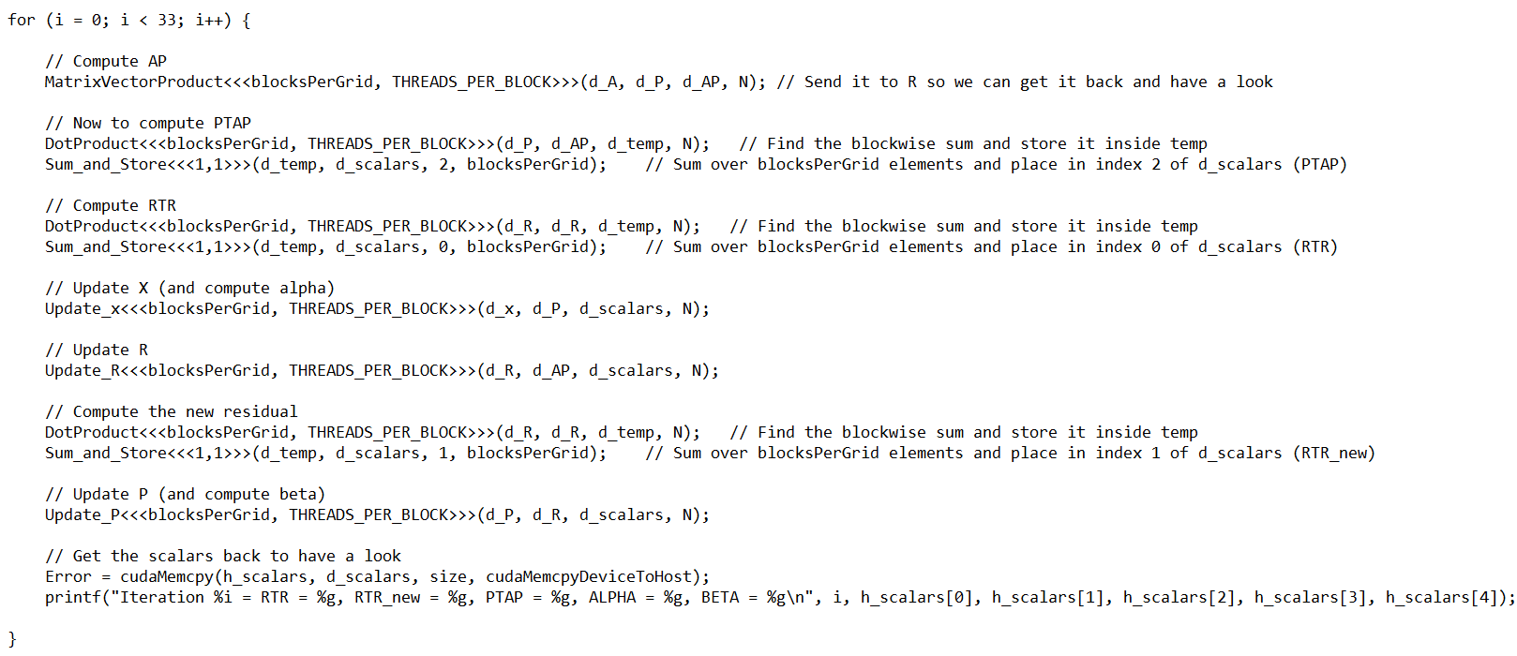
Application of GPU for CG

Slide 47
Application – steady 2D heat transfer

Slide 48
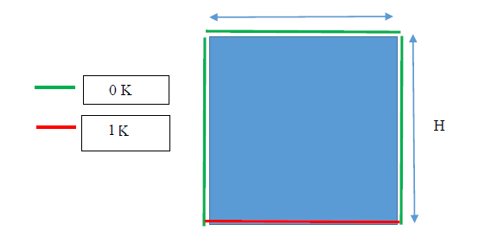
Application – 2D Heat TRANSFER
Consider the problem shown:
A two dimensional (square) domain with fixed temperatures around the edge.
Determine the steady temperature distribution throughout the square region.

Slide 49
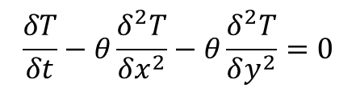
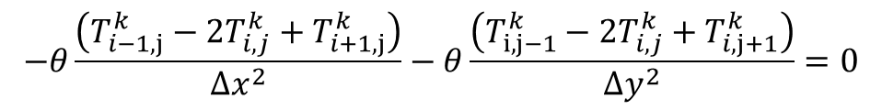
2D Heat Transfer Problem
The governing equations are:
The FTCS discretization is:
Of course, we want the steady result. That means the term on the left disappears:
$$\frac{δT}{δt}−θ\frac{δ^{2}T}{δx^{2}}−θ\frac{δ^{2}T}{δy^{2}}=0$$
$$\frac{T_{i}^{k+1}−T_{i}^{k}}{∆t}−θ\frac{\left(T_{i−1,j}^{k}−{2T}_{i,j}^{k}+T_{i+1,j}^{k}\right)}{∆x^{2}}−θ\frac{\left(T_{i,j−1}^{k}−{2T}_{i,j}^{k}+T_{i,j+1}^{k}\right)}{∆x^{2}}=0$$
$$−θ\frac{\left(T_{i−1,j}^{k}−{2T}_{i,j}^{k}+T_{i+1,j}^{k}\right)}{∆x^{2}}−θ\frac{\left(T_{i,j−1}^{k}−{2T}_{i,j}^{k}+T_{i,j+1}^{k}\right)}{∆y^{2}}=0$$

Slide 50
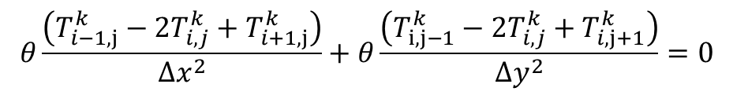
2D Heat Transfer Problem
There are several observations to draw:
We need to solve for the unknown temperature at i,j.
All of these temperatures are at the same time level.
This means that we need to solve all of these temperatures at the same time.
Fortunately, the system is linear – we have T in terms of other T¹ values.
$$θ\frac{\left(T_{i−1,j}^{k}−{2T}_{i,j}^{k}+T_{i+1,j}^{k}\right)}{∆x^{2}}+θ\frac{\left(T_{i,j−1}^{k}−{2T}_{i,j}^{k}+T_{i,j+1}^{k}\right)}{∆y^{2}}=0$$

Slide 51
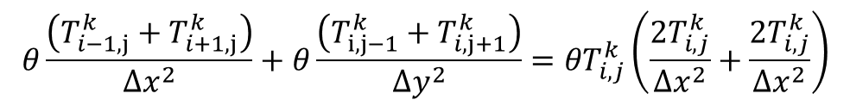
2D Heat Transfer Problem
Since the system is linear, we can make a system of linear equations to solve the problem.
Let’s rearrange the governing equation to solve for T(i,j):
You can remove (theta) at this stage if you like – it doesn’t influence the solution – IF theta is the same everywhere.
This was the case for your assignment, I believe.
$$θ\frac{\left(T_{i−1,j}^{k}+T_{i+1,j}^{k}\right)}{∆x^{2}}+θ\frac{\left(T_{i,j−1}^{k}+T_{i,j+1}^{k}\right)}{∆y^{2}}={θT}_{i,j}^{k}\left(\frac{{2T}_{i,j}^{k}}{∆x^{2}}+\frac{{2T}_{i,j}^{k}}{∆x^{2}}\right)$$

Slide 52
2D Heat Transfer Problem
We wish to rearrange these things into a linear system.
Let’s write out each equation explicitly in terms of a linear equation:
This is easy to put into matrix form….
$$T_{i−1,j}^{k}\left(\frac{θ}{∆x^{2}}\right)+T_{i+1,j}^{k}\left(\frac{θ}{∆x^{2}}\right){+T}_{i,j−1}^{k}\left(\frac{θ}{∆y^{2}}\right)+T_{i,j+1}^{k}\left(\frac{θ}{∆y^{2}}\right)−T_{i,j}^{k}\left(\frac{{2θT}_{i,j}^{k}}{∆x^{2}}+\frac{{2θT}_{i,j}^{k}}{∆x^{2}}\right)=0$$

Slide 53
2D Heat Transfer Problem
For our general – Matrix form:
$$T_{i−1,j}^{k}\left(\frac{θ}{∆x^{2}}\right)+T_{i+1,j}^{k}\left(\frac{θ}{∆x^{2}}\right){+T}_{i,j−1}^{k}\left(\frac{θ}{∆y^{2}}\right)+T_{i,j+1}^{k}\left(\frac{θ}{∆y^{2}}\right)−T_{i,j}^{k}\left(\frac{{2θT}_{i,j}^{k}}{∆x^{2}}+\frac{{2θT}_{i,j}^{k}}{∆x^{2}}\right)=0$$
A
A
B
B
-2A-2B
The key is understanding which row the left, right, up and down cell is located on!
Only include temperatures we are solving for inside the vector of temperatures here.
Constant temperatures become source terms!
A
B
-2A-2B
A
B
Left
Up
Center
Down
Right

Slide 54
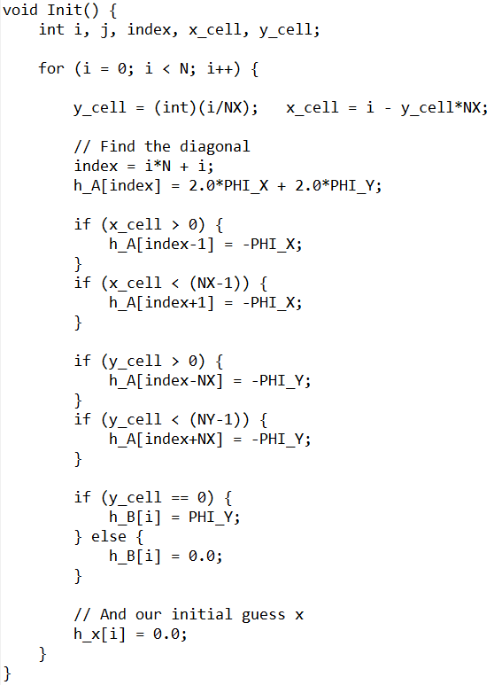
Application – 2D Heat TRANSFER
The creation of the matrix A for a 2D problem is straight forward.
We need to create a sparse, diagonal matrix with the coefficients determined earlier at the relevant places.
Cells lying on the simulation boundary (i.e. x_cell = 0 etc) do not have contributions from computed temperatures – instead, we use source terms (in vector B) to manage these contributions.

Slide 55
Application – 2D Heat TRANSFER
First, using cell index i, compute the x and y cell value for our 2D problem.
Each cell will have the same diagonal term:
If the cell is located away from the boundary, adjust A accordingly.
Also, we compute B and initialize our guess at the solution (x) here.

Slide 56
Application – 2D Heat TRANSFER
The solution is trivial, and can be determined from MATLAB:
Solution after 33 iterations of CG on GPU

