Slide 1
Introduction to Multi-Core CPU and GPU Computation 多核心CPU和GPU計算
Class 2 Prof. Matthew Smith, msmith@mail.ncku.edu.tw

Slide 2
PROBLEM BASED LEARNING TIME
In groups of 3 students (or in your project groups), please complete the following tasks:
Connect to the HPC server upstairs using your login as assigned.
Create a directory called “Prac_1”.
Write a C/C++ code on the server (in the folder Prac_1) which (i) adds the integers i = 1,2,3...1000, and
(ii) Creates a text file (answer.txt) which contains the answer.
Write a Makefile (inside the folder Prac_1) for the compilation of this code.
Run the code.
Every student should have a folder Prac_1 inside their home directory (with the C code inside it) before the end of this class.

Slide 3
PROBLEM BASED LEARNING TIME
Let’s do some brainstorming on the board:
Topic: What do we need to know to solve this problem?

Slide 4
PROBLEM BASED LEARNING TIME
Items you will need to check on google:
How to create / destroy a folder in linux,
How to navigate through the file system in linux,
How to compile a code from the linux command prompt,
How to create / edit a code on another machine using ssh / putty,
How to create a Makefile to help compile your code,
*How to write a C/C++ code?*
I created this list earlier. Hopefully it will be similar to the brainstorming results.

Slide 5
PROBLEM BASED LEARNING TIME
The only help you’ll get from me – for the next few hours – is:
Help with logging into the HPC system
Help with connecting to the FTP for the subject.
In 2 hours time, I’ll start intervening (i.e. I’ll help you to do it).

Slide 6
PROBLEM BASED LEARNING TIME
Hints:
Write down your discoveries in your log book / note book.
Look around the classroom – talk to other students if you like the approach they are using.
Record which websites you use for looking up help – some will be useful, and might be useful later on.

Slide 7
GETTING NOTES FOR THIS SUBJECT

Slide 8

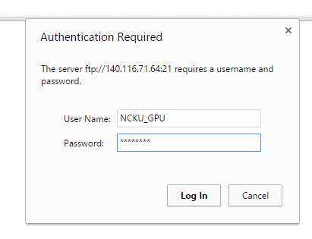
FTP SERVER ACCESS
The notes for this class are on a separate server: 140.116.71.64
Type: ftp://140.116.71.64 into chrome or ie (any internet browser)
In the username and password, type NCKU_GPU in both fields.

Slide 9
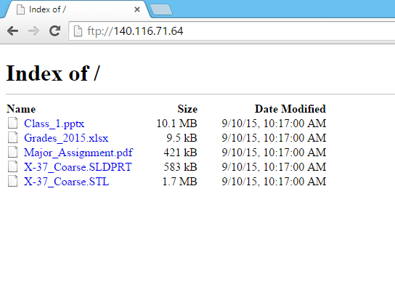
FTP SERVER ACCESS
From here, right click on the file you want and “Save as” to copy the file to your computer.
Close the browser when you are done.
Opening files inside the browser window is a bad idea - it creates a high workload on the server bandwidth.

Slide 10
Connecting to the server

Slide 11
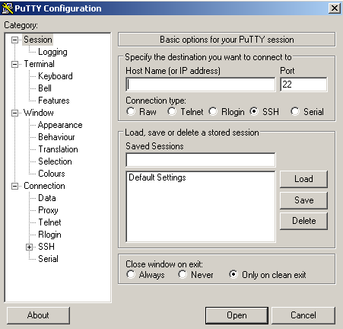
Connecting to the server
Connecting to the server:
Open Putty.exe (it’s on the desktop)
In the Host Name, enter this IP address:
Click “Open”
140.116.71.47 (Leave port as 22)

Slide 12
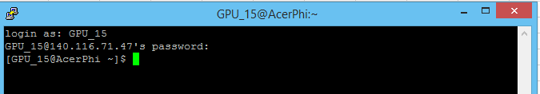
Connecting to the server
Connecting to the server:
4) Your computer might ask you to verify the security key. Click yes.
5) Enter your username, and press enter.
6) Enter your password, and press enter.
When you see your username@AcerPhi, you know you are logged in.

Slide 13
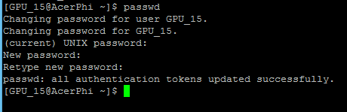
Connecting to the server
Connecting to the server:
7) Seeing as everyone knows everyone’s password, you should change yours.
Type “passwd”, and press enter (no “ marks).
It will ask you to type your old password (i.e. student number) and then type your new one twice.

Slide 14
TRANSFERING FILES FROM SERVER

Slide 15
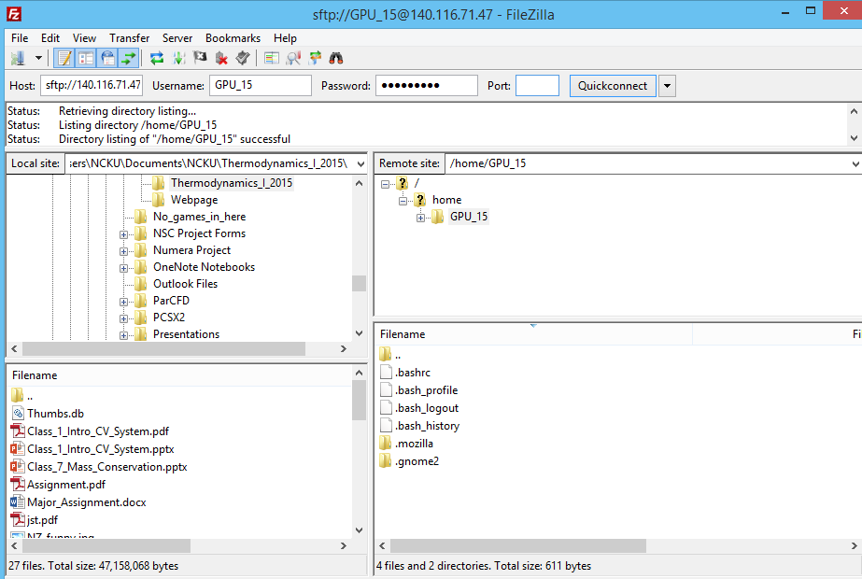
FILE TRANSFER
To move files from the server (and to the server), use Filezilla.
The Host is the same: 140.116.71.47
Enter your user name and password.
You’ll be able to transfer files from your computer to the server, and vice versa.

Slide 16
FILE TRANSFER
Please do not write your codes on these computers, and then transfer them to the server.
It is fine, however, to use Filezilla to move files from the server and onto your own computer.
Please do not enter the root directory (/) ever for any reason – there are important system files here.

Slide 17
GOOD LUCK!

