Slide 1
Introduction to Multi-Core CPU and GPU Computation 多核心CPU和GPU計算
Class 3 Prof. Matthew Smith, msmith@mail.ncku.edu.tw

Slide 2
Today’s Class…
Today’s class will cover:
Building applications on a linux server, and
Review of C / C++ Language I

Slide 3
BUILDING APPLICATIONS IN LINUX

Slide 4
Review of Programming
Before we begin, you need to know a few basics about writing computer programs.
This is the same, regardless of which language we use.
More often than not, it’s the lack of understanding about how programs are made that cause trouble.

Slide 5
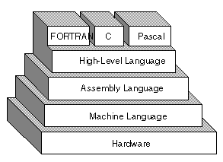
Review of Programming
Humans cannot write programs in a way that computers can understand natively.
This is because every CPU is different – AMD, Intel, ARM cores all have unique hardware.
As humans, we start with high level languages – in this course, C.

Slide 6
Review of Programming
Using compilers and linkers (assemblers), we take our source code and change it into something the hardware can understand.
This requires 3 steps:
Write source code.
Compile into Machine Language
Assemble into Program for Hardware.
1
2
3

Slide 7
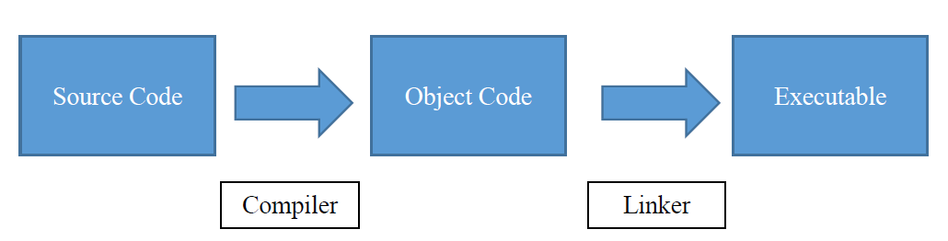
Review of Programming
Let’s review each of the steps:

Slide 8
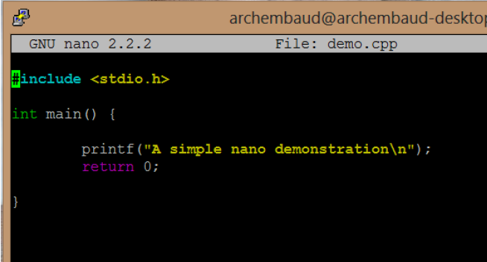
Review of Programming
First, we write one (or many) source codes.
To do this, we need a text editor.
Any text editing program will do here…

Slide 9


Review of Programming
Following this, we need to compile the source code.
There are many compilers available!
nvcc
gcc, g++

Slide 10
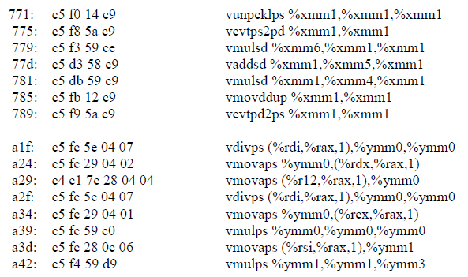
Review of Programming
Compiling your source code transforms it into machine code.
This code can be disassembled into Assembly Machine Language (AML).

Slide 11
Review of Programming
A long time ago, engineers needed to write their programs in this language.
When I went to school, we still learned it.

Slide 12
Review of Programming
The final step is to use a linker to transform your machine code objects into an executable file. The program is called a linker or assembler.
Only after this is complete can we run our program.

Slide 13
Review of Programming
In conclusion – the summary of the steps...
Step 1: Write source code.
Step 3: Transform your Machine Code into an Executable by Linking.
Step 2: Compile into Machine Code (Object)

Slide 14
MAKEFILES IN LINUX
With the key steps in mind, we can investigate how to use Makefiles in Linux to improve our efficiency in building applications.
When our programs consist of a single source code, a makefile is often not required.
However, in this course, we are going to be creating programs which:
Contain many codes, and
Use different compilers as part of the build process.

Slide 15
MAKEFILES IN LINUX
First, to use a makefile, we need to create one.
Type “nano Makefile” (without the “ “) marks to open the NANO editor.
Of course, you can use VI / VIM or some other editor if you like.
Make sure you save your file once you’ve finished editing.

Slide 16
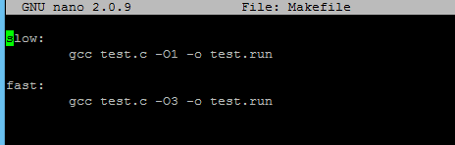
MAKEFILES IN LINUX
Here is a simple example: a Makefile with two build options.
Here, our makefiles contain two labels: “slow” and “fast” – these are our build options.
These are TAB spaces, not spaces created with your space bar.
You must use TAB to create this space.

Slide 17

MAKEFILES IN LINUX
You can see that I can call my labels by typing “make”, followed by the label.
When I type “make slow”, the instructions under the slow label are used.
When I type “make fast”, the instructions under the fast label are used.

Slide 18
MAKEFILES IN LINUX
We can also use Makefiles to build the application in multiple steps.
For example, we can create a Makefile which:
First, creates the objects by compiling the source code into a *.o file.
Secondly, creates the executable by building the objects into an executable file.

Slide 19
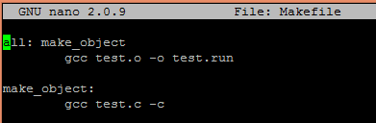

MAKEFILES IN LINUX
When we type “make <enter>”, the first (and most important) instruction is “all”.
Next to the label is another label, called make_object.
When the makefile hits this instruction, it knows it needs to complete the instructions contained there before continuing.

Slide 20
MAKEFILES IN LINUX
Meaning: the make_object instruction will be completed before the all instruction will be.
When we type “make <enter>”, we can see that we first execute the command “gcc test.c –c” → This command produces the file test.o → The compiled object.
Only after test.o is completed will the main instruction be performed.
2nd
1st

Slide 21
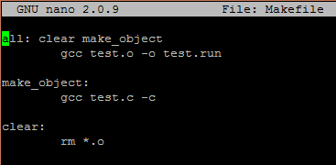

MAKEFILES IN LINUX
Discussion: What will happen with this makefile?

Slide 22
MAKEFILES IN LINUX
In the last example, in a single command (make), we did 3 things:
Removed all previous object files inside the directory,
Created new object files from the source code, and
Created the executable from the object,
By using makefiles, we can save ourselves a lot of time when working on new applications.

Slide 23
C / C++ Review

Slide 24
C / C++ REVIEW
C / C++ Programming is a prerequisite for this subject.
Hence, we need to review some of the basic concepts quickly before moving on – as you will need a solid understanding of these.
Today, we will review:
Functions in C/C++,
IF and FOR loops,
Arrays in C / C++,
Memory Management

Slide 25
FUNCTIONS IN C
A function in C is much like a variable:
It needs to be declared before it can be used in your code (for compiling)
It needs to be defined before it can be used as an executable (for linking).
The declaration of a function always has the form:
<datatype> functionname ( argument 1, argument 2….);

Slide 26
FUNCTIONS IN C
Several good examples of function declarations are:
This function might be used to calculate the area of a circle from its radius.
This function might be used to compute the greatest common denominator from two integers a and b.
float CircleArea(float radius);
int GCD(int a, int b);

Slide 27
FUNCTIONS IN C
The function declaration must take place before the function is used in your code.
A good way to ensure your functions can be used everywhere is by declaring your function as a global function.
Example:
#include <stdio.h>
float CircleArea(float radius);
int main() {
float Area;
Area = CircleArea(0.5);
}

Slide 28
FUNCTIONS IN C
The function definition can occur anywhere in the code.
The definition of the function only becomes important during the linking phase of the program creation.
Before this, the compiler only needs to know the name of the function, what it produces and what it needs.
During this course, we will employ two strategies for writing out the function definition.

Slide 29
FUNCTIONS IN C
Option 1:
Write your function definition within the same file as the one which contains the int main() function.
The compiler will construct the object file containing all of your functions together.
Option 2:
Write your function definition within a separate C file.
When making your program, compile each file separately and then link the files together in two separate steps.

Slide 30
FUNCTIONS IN C
There are several good reasons for writing your functions in a separate code.
During this course, we’ll find this is the ideal approach when using two unique pieces of hardware working together:
CPU functions will go into one file to be compiled by GCC or G++.
GPU functions (later in the course) will also go into one file to be compiled by NVCC.

Slide 31
SIMPLE EXAMPLE
#include <stdio.h>
float c, d; // Global variables
float a = 12.43;
float b = 0.056;
void Calculate(void); // Function Declaration
int main(void) {
Calculate();
printf(“c = %f, d = %f\n”, c, d);
return 0;
}
// Place function definition here
void Calculate(void) {
c = a*b;
d = a + b;
}
Consider this code, were we create a function called “Calculate”.
This function returns a void value – meaning, essentially, that the program does not return anything.
In this case, it is used to perform work on the global variables c and d using a and b.

Slide 32
SIMPLE EXAMPLE
#include <stdio.h>
float c, d; // Global variables
float a = 12.43;
float b = 0.056;
void Calculate(void); // Function Declaration
int main(void) {
Calculate();
printf(“c = %f, d = %f\n”, c, d);
return 0;
}
// Place function definition here
void Calculate(void) {
c = a*b;
d = a + b;
}
There are several things to note:
The function declaration is located before the main() function.
The function definition is located after the main function.
It is OK for the calculate() function to be defined before main(). Only the location of the declaration is important.

Slide 33
CONDITIONAL STATEMENTS – IF AND FOR

Slide 34
Conditionals
Any real computer program needs the capacity to make decisions.
In C, this is done using the if – else series of commands.
Usage:
if (statement) {
// Perform if statement is true
{ else {
// Perform if the above statement(s) are all false.
}

Slide 35
Conditionals
The statement can be one of three things:
A comparison between two variables / numbers which produces a “true” or a “false” answer,
A Boolean type variable – which only takes the values “true” or “false”, or
An integer with a value of 1 or 0. (1 = true, 0 = false).

Slide 36
Conditionals
Example using an integer.
This will work in C and C++.
#include <stdio.h>
int main() {
int test = 0;
if (test) {
printf("Test must have been 1!\n");
} else {
printf("Test must not have been 1\n");
}
return 0;
}

Slide 37
Conditionals
Example using a Boolean variable.
This will only work in C++ since C does not support Boolean variables.
#include <stdio.h>
int main() {
bool test = true;
if (test) {
printf("Test must have been true!\n");
} else {
printf("Test must not have been false\n");
}
return 0;
}

Slide 38
Conditionals
Example using a comparison.
This will work for C and C++.
#include <stdio.h>
int main() {
float a = 1.52;
float b = 1.53;
if (b > a) {
printf("b must be larger than a!\n");
} else {
printf("b must be smaller than or equal to a\n");
}
return 0;
}

Slide 39
Conditionals
It is possible to use multiple if statements together to capture different possibilities.
The if statement may be used together with the else statement to form the “if else” statement.
This must follow after a previously used if statement.
One may also employ a single “else” statement to catch remaining possibilities.

Slide 40
Conditionals
#include <stdio.h>
int main() {
float a = 1.52;
float b = 1.52;
if (b > a) {
printf("b must be larger than a!\n");
} else if (b == a) {
printf("b must be equal to a\n");
} else {
printf("b must be smaller than a\n");
}
return 0;
}
Example using two comparison conditions and an else statement.
This way, we can catch all of the possible ways in which a and b compare.
This will work for C and C++.

Slide 41
FOR LOOPS
Many of the algorithms used by mechanical engineers employ some form of iteration:
Iteration over space (for steady, multiple DOF problems)
Iteration over time (for unsteady, single DOF problems)
Iterations over both space and time (for unsteady, multiple DOF problems).
Hence, in order to use C for engineering problems, we need some way of making a section of code repeat itself.

Slide 42
FOR LOOPS
The best way to do this is through the use of a FOR loop:
USAGE:
for (statement, statement, statement) {
// Perform this part of the code over and over
}

Slide 43
FOR LOOPS
Since the measure of an iteration is an integer (Z) type, we use integers to keep “count” of the loop.
There are 3 steps in the use of a for loop, as indicated by the 3 statements:
Initializing the variable which keeps count of the loop,
Testing to see if the loop should continue or not (using a comparison), and
Increasing the count variable each time a loop is performed.

Slide 44
FOR LOOPS
In this example, we use the for statement with the arguments:
for (i = 0; i < 10; i++) {
}
The contents of this loop (a print statement) will repeat 10 times.
#include <stdio.h>
int main() {
int i;
for (i = 0; i < 10; i++) {
printf("i = %d\n", i);
}
getchar();
return 0;
}

Slide 45
FOR LOOPS
There is a subtle but important difference between C and C++ here:
In C, the variable keeping count of the loop must be declared before the “for” loop is written.
In C++, we can declare the variable inside the “for” statement.
for (int i = 0; i < 10; i++) {
// The variable i exists within this scope only
// This won’t work in C!
}

Slide 46
ARRAYS IN C/C++

Slide 47
ARRAYS IN C
An example of an array might be:
A = [A₀, A₁, A₂, ….. A_{N-1}]
The variable A holds N elements of information.
In an engineering problem, A might represent the temperature at a given point (where there are N points in space), or the temperature at a given time (where there are N points in time).

Slide 48
ARRAYS IN C
There are two ways to create an array in C:
Create a pointer to the array, and then allocate the memory.
Create the array directly upon declaration.
Both of these approaches are useful for this course.
The second option is easier.
The first option is perhaps more useful.
Let’s look at both of these.

Slide 49
ARRAYS IN C
To create an array of variables in C upon declaration, we use the form:
DATATYPE varname[constant integer number of elements]
The DATATYPE is the type of data you want stored in the array.
For this course, this will most often be a floating point (float) variable.
varname is the name of the variable storing the array.
There must be a constant integer describing the number of elements.
The number of elements in the array cannot change.

Slide 50
ARRAYS IN C
Here we create a variable A which contains N = 10 elements.
These values are stored in
A[0], A[1]…..A[9]
#include <stdio.h>
int main(void) {
float A[10];
int i;
// Assign value to A, print to screen
for (i = 0; i < 10; i++) {
A[i] = 2.0*i;
printf(“A[%d] = %f\n”, i, A[i]);
}
return 0;
}

Slide 51
ARRAYS IN C
Expected output:
Value of each element obtained by accessing the A[i] element.
This contains a floating point variable.
A[0] = 0, A[1] = 2, A[2] = 4 etc.
#include <stdio.h>
int main(void) {
float A[10];
int i;
// Assign value to A, print to screen
for (i = 0; i < 10; i++) {
A[i] = 2.0*i;
printf(“A[%d] = %f\n”, i, A[i]);
}
return 0;
}

Slide 52
ARRAYS IN C
Indexes into arrays start with 0 in C and C++.
Hence, an array containing N elements will run from 0 to N-1.
If you attempt to access a part of A which is outside our declared size, you will cause a segmentation fault.
A segmentation fault is a special error created by the computer to protect areas of memory which are not available to a program.

Slide 53
ARRAYS IN C
Example:
A has a size of 10 floating point variables.
This code might even run.
But (depending on the system) you have a good chance of something going wrong).
// Seg Fault Demo
#include <stdio.h>
int main(void) {
float A[10];
int i;
// Assign value to A, print to screen
for (i = 0; i < 20; i++) {
A[i] = 2.0*i;
printf(“A[%d] = %f\n”, i, A[i]);
}
return 0;
}

Slide 54
ARRAYS IN C
The other approach for creating an array in C is to use a pointer, followed by the manual allocation of memory.
This is required for the GPU component of the course, and is generally good practice.
The process is simple:
Declare a pointer - a pointer is a special data type (the size of an integer) which refers to a location in memory.
Use the malloc() function to reserve a section of memory of a specified size and “point” the pointer to it.

Slide 55
ARRAYS IN C
#include <stdio.h>
#include <malloc.h>
int main(void) {
float *A;
int no_elements = 10;
int i;
printf("Allocating memory..");
A = (float*)malloc(no_elements*sizeof(float));
printf("done\n");
for (i = 0; i < no_elements; i++) {
A[i] = 2.0*i;
printf("A[%d] = %f\n", i, A[i]);
}
free(A);
return 0;
}
A good example of this can be found in this code here.
A is the name of the pointer, declared using the instruction:
float *A;
The command which reserves the memory and shifts the pointer is:
A = (float*)malloc(no_elements*sizeof(float));

Slide 56
ARRAYS IN C
#include <stdio.h>
#include <malloc.h>
int main(void) {
float *A;
int no_elements = 10;
int i;
printf("Allocating memory..");
A = (float*)malloc(no_elements*sizeof(float));
printf("done\n");
for (i = 0; i < no_elements; i++) {
A[i] = 2.0*i;
printf("A[%d] = %f\n", i, A[i]);
}
free(A);
return 0;
}
Using the array is identical to the previous example: The value of each element is still obtained using the command
➔ A[integer index]
There is one critical difference between this example and the previous example, however:
Previously, when the program completed and closed, the memory taken by A was cleared.
Here, the memory will not (usually) be cleared unless we manually clear it.

Slide 57
ARRAYS IN C
This is called “Trash Collection” in C.
Since we manually reserved the memory using malloc, we need to manually remove it.
This is done using the free() command. In this case, the code was:
free(A)
There are some open-source garbage collectors available (GC).

Slide 58
ARRAYS IN C
Things to note about these codes:
#include <malloc.h>: Malloc.h contains the header files required for the malloc and free operations. Depending on the system, this may or may not be required.
The size (amount) of memory reserved in these examples was
no_elements*sizeof(float)
We’ve used the function sizeof to return the number of bytes required per element. We can manually enter the amount of ram required.

Slide 59
MEMORY USAGE
Just to review...
#include <stdio.h>
#include <malloc.h>
int main(void) {
float *A;
int no_elements = 10;
int i;
printf("Allocating memory..");
A = (float*)malloc(no_elements*sizeof(float));
printf("done\n");
for (i = 0; i < no_elements; i++) {
A[i] = 2.0*i;
printf("A[%d] = %f\n", i, A[i]);
}
free(A);
return 0;
}
A = (float*)malloc(N*sizeof(float)) To create an array of floats containing N parts.
free(A)
To remove the variable A and the memory used by it from the heap.
If you are not careful and forget to free the space used by A, it will not be released!

Slide 60
MEMORY USAGE
The advantages to this approach are numerous – namely:
Simulations using large arrays is possible - it’s important for engineering problems.
The size of the array can be determined at operation time – important for general solvers where the simulation size changes.
The allocation can be checked by checking the pointer to the array.
90% of the problems in this course will require dynamic memory allocation.

Slide 61
MEMORY USAGE
A note on dimensionality:
A 2D array is easily allocated to the stack at compile time using A[10][20].
A 2D array can be allocated to the heap (run-time) using:
How is this stored in computer memory?
int** someNumbers = malloc(arrayRows*sizeof(int*));
for (i = 0; i < arrayRows; i++) {
someNumbers[i] = malloc(arrayColumns*sizeof(int));
}
Discussion, Conclude Later.

Slide 62
SAVING TO FILE

Slide 63
SAVING TO FILE
As engineers, we often need the outcomes of a simulation to:
Analyze the results – i.e. compute drag forces, etc.
Visualize the results – i.e. plot temperature profiles and/or contours.
Therefore, we need to output the information from a simulation to a file which can be read by other software packages (such as MATLAB).
To do this in C, we use file pointers.

Slide 64
SAVING TO FILE
A file pointer is declared using the commands:
FILE *name;
Where name is the name of the pointer variable which will “point” to our actual file.
To open a file in C, we use the command:
name = fopen(“example.txt”, “w”);
Name of file = example.txt
“w” = write to file.

Slide 65
SAVING TO FILE
The fopen() command can also be used to read information from file.
The parameter after the filename controls the behavior of the file:
"r" | read: Open file for input operations. The file must exist.
"w" | write: Create an empty file for output operations. If a file with the same name already exists, its contents are discarded and the file is treated as a new empty file.
"a" | append: Open file for output at the end of a file. Output operations always write data at the end of the file, expanding it. Repositioning operations (fseek, fsetpos, rewind) are ignored. The file is created if it does not exist.
"r+" | read/update: Open a file for update (both for input and output). The file must exist.
"w+" | write/update: Create an empty file and open it for update (both for input and output). If a file with the same name already exists its contents are discarded and the file is treated as a new empty file.
"a+" | append/update: Open a file for update (both for input and output) with all output operations writing data at the end of the file. Repositioning operations (fseek, fsetpos, rewind) affects the next input operations, but output operations move the position back to the end of file. The file is created if it does not exist.
During this course, you are only going to use w (90%) and r (10%) of the time.

Slide 66
SAVING TO FILE
To perform the actual writing, we use a function which is very similar to the printf function.
This function – the fprintf function – is used as such:
fprintf(pointer to file, string, variables to supplement string)
All of the string parameters which are used by printf can be used by fprintf. It is essentially the same – except that, instead of writing to the screen, we write to a file.

Slide 67
SAVING TO FILE
#include <stdio.h>
int main(void) {
FILE *pFile;
int a = 5;
float b = 5.0;
char c = '5';
pFile = fopen("test.txt", "w");
if (pFile != NULL) {
fprintf(pFile, "These values are: %d \t %f \t
%c\n", a, b, c);
fclose(pFile);
} else {
printf("Couldn't open file\n");
}
return 0;
}
An example of writing a series of results to file is demonstrated in here.
The command used to open the file:
pFile = fopen(“test.txt” , “w”);
means we are creating an empty file called “text.txt” for writing to.

Slide 68
SAVING TO FILE
#include <stdio.h>
int main(void) {
FILE *pFile;
int a = 5;
float b = 5.0;
char c = '5';
pFile = fopen("test.txt", "w");
if (pFile != NULL) {
fprintf(pFile, "These values are: %d \t %f \t
%c\n", a, b, c);
fclose(pFile);
} else {
printf("Couldn't open file\n");
}
return 0;
}
We check to make sure the file is available for writing to here:
if (pFile != NULL) {
}
Often, you (and therefore your program) may not have permission to create a file at that location.
We use this check to make sure we can before continuing.

Slide 69
SAVING TO FILE
#include <stdio.h>
int main(void) {
FILE *pFile;
int a = 5;
float b = 5.0;
char c = '5';
pFile = fopen("test.txt", "w");
if (pFile != NULL) {
fprintf(pFile, "These values are: %d \t %f \t
%c\n", a, b, c);
fclose(pFile);
} else {
printf("Couldn't open file\n");
}
return 0;
}
The command used to write the data is:
fprintf(pFile, "These values are: %d \t
%f \t %c\n", a, b, c);
Hence, we are writing the values of a (an integer), b (a float) and c (a character type variable) to the file “text.txt”.
These values are separated by tabs (\b) and finally by a new line (\n).

Slide 70
NEXT CLASS
In the next class, we will continue the application of C/C++ in a linux environment to solve a simple engineering problem.

