Slide 1
Introduction to Multi-Core CPU and GPU Computation 多核心CPU和GPU計算
Class 4 Prof. Matthew Smith, msmith@mail.ncku.edu.tw

Slide 2
Today’s Class…
Today’s class will cover:
Partial Differential Equations (PDE’s) in Engineering and Science
Finite Difference Method (FDM),
Finite Volume Method (FVM),
Finite Element Methods (FEM), and
The Computational characteristics of each technique.

Slide 3
Partial Differential Equations

Slide 4
PDE’s
In physics and science, we often find problems where a quantity (such as mass or energy) is distributed across space and time.
We know that these quantities can not be destroyed or created – hence, these are often called conservative quantities.
By examining how these quantities move across space and time, we often rely on differential mathematics for help.

Slide 5
PDE’s
The result of this differential analysis is often a Partial Differential Equation, or PDE.
Such PDE’s play a role in many aspects of engineering and science, and are certainly not restricted to mechanical engineering.
If you learn how to solve a mechanical engineering PDE, you’ll almost be guaranteed to have an understanding in how to solve a non-ME PDE.

Slide 6
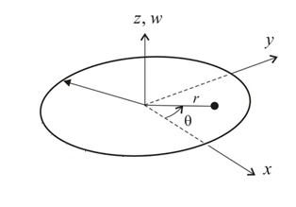
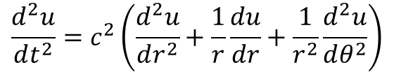
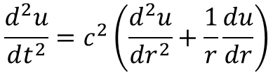
Example: Circular Membranes
In polar form, the wave equation for a circular membrane can be shown to be:
Without variations in the angular direction, this reduces to:
$$\frac{d^{2}u}{dt^{2}}=c^{2}\left(\frac{d^{2}u}{dr^{2}}+\frac{1}{r}\frac{du}{dr}+\frac{1}{r^{2}}\frac{d^{2}u}{dθ^{2}}\right)$$
$$\frac{d^{2}u}{dt^{2}}=c^{2}\left(\frac{d^{2}u}{dr^{2}}+\frac{1}{r}\frac{du}{dr}\right)$$

Slide 7

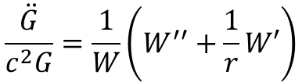
Circular Membranes
Using the method of separation, were u(r,t) = W(r)G(t), we can substitute this into our PDE:
If we say these are equal to a constant (i.e. –k²), then we can show that:
So, at least this part we know the solution to.
$$\frac{\ddot{G}}{c^{2}G}=\frac{1}{W}\left(W^{′′}+\frac{1}{r}W′\right)$$
$$\ddot{G}+λ^{2}G=0 where λ=ck$$
$$G\left(t\right)=A_{m}\cos\left(λ_{m}t\right)+B_{m}\sin\left(λ_{m}t\right)$$

Slide 8
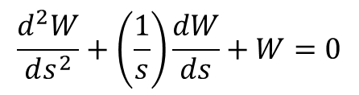
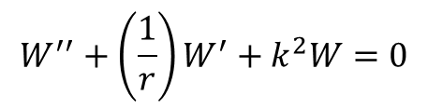
Circular Membranes
As for the other part, let’s have a look – some simple maths will give us the ODE:
Now, I’m hoping you remember equations of this form – we have solved them using series solutions to ODE’s, namely Frobenius’s method. This equation can be shown to be equivalent to Bessel’s equation, which we covered earlier.
$$W^{′′}+\left(\frac{1}{r}\right)W^{′}+k^{2}W=0$$
$$\frac{d^{2}W}{ds^{2}}+\left(\frac{1}{s}\right)\frac{dW}{ds}+W=0$$
where s = kr

Slide 9

Circular Membranes
The solution can be shown to be a power series:
(Note: we are neglecting a second solution to the governing PDE due to the B/C of the problem)
This gives us a final fundamental solution of:
Again, these are eigenvalues of our solution which contribute towards a general solution.
$$u\left(r,t\right)=W(r)G\left(t\right)=J(k_{m}r)(A_{m}\cos\left(λ_{m}t\right)+B_{m}\sin\left(λ_{m}t\right))$$

Slide 10
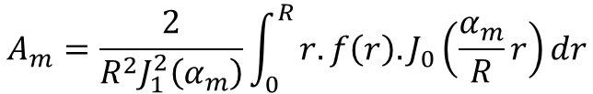
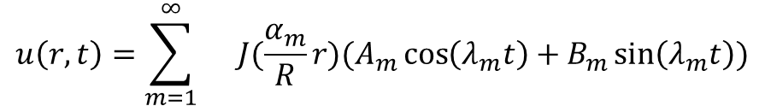
Circular Membranes
The general solution is the weighted sum of all fundamental solutions:
This is called a Fourier-Bessel series. And yet again, we need to find a way to solve for Am and Bm. This is the first time we see the general theory of Sturm and Liouville applied to a practical problem (at least in this course for a non-trivial problem):
$$u\left(r,t\right)=\sum_{m=1}^{∞}{}J(\frac{α_{m}}{R}r)(A_{m}\cos\left(λ_{m}t\right)+B_{m}\sin\left(λ_{m}t\right))$$
$$A_{m}=\frac{2}{R^{2}J_{1}^{2}\left(α_{m}\right)}\int_{0}^{R}{r.f\left(r\right).J_{0}\left(\frac{α_{m}}{R}r\right)dr}$$

Slide 11
PDE’s
The problem is: most membranes are not circular, and are in-fact arbitrary shapes.
The analytical approach – double Fourier-type series – will not work in 99% of cases.
Hence, we need a way of solving this problem numerically, with the assistance of computers.

Slide 12
Finite Difference Method

Slide 13
Finite Difference Techniques
The Finite Difference Method (FDM) is an approach for numerical evaluation of Partial Differential Equations (PDE’s).
Unlike Finite Volume Methods (FVM’s) and Finite Element Methods (FEM’s), the goal of FDM is to replace continuum derivative terms with point-wise discrete approximations.
We essentially replace our continuum governing equation with a series of expressions describing the equation in discrete form at discrete points in space. No knowledge of what happens between points is known.

Slide 14

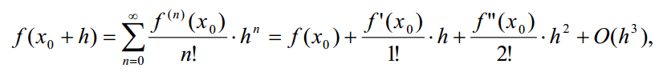
Finite Difference Techniques
The core of the FDM is the Taylor series expansion.
The Taylor series expansion of a function f(x) around point x₀ is described as:
Let’s say that we wish to evaluate the function f(x) at x = x₀ + h, then we have:

Slide 15

Finite Difference Techniques
Let’s examine this equation:
f(x₀ + h) = evaluation of f at point x₀ + h
f(x₀) = evaluation of f at point x₀.
f’(x₀) = (gradient of f in x) evaluated at point x₀.
$$\frac{df(x0)}{dx}$$

Slide 16
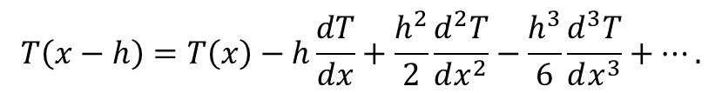
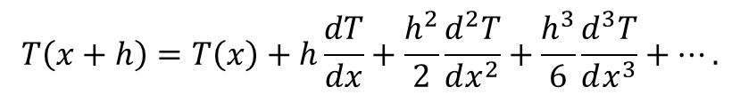
Finite Difference Techniques
Let’s say we are computing Temperature T at some location.
We can use the same method to connect T in various discrete locations to the continuous gradient field:
$$T\left(x+h\right)=T\left(x\right)+h\frac{dT}{dx}+\frac{h^{2}}{2}\frac{d^{2}T}{dx^{2}}+\frac{h^{3}}{6}\frac{d^{3}T}{dx^{3}}+….$$
Evaluated at x+h, centered on x.
$$T\left(x−h\right)=T\left(x\right)−h\frac{dT}{dx}+\frac{h^{2}}{2}\frac{d^{2}T}{dx^{2}}−\frac{h^{3}}{6}\frac{d^{3}T}{dx^{3}}+….$$
Evaluated at x-h, centered on x.
The first equation is known as a forward series (x+h) while the second is a backwards series.
They are essentially identical.

Slide 17
Finite Difference Techniques
There is one interesting property which will become important later.
The even terms of these two series have the same sign (positive).
$$T\left(x+h\right)=T\left(x\right)+h\frac{dT}{dx}+\frac{h^{2}}{2}\frac{d^{2}T}{dx^{2}}+\frac{h^{3}}{6}\frac{d^{3}T}{dx^{3}}+….$$
This is because h² , h⁴, h⁶ etc is always positive, even for –h values.
$$T\left(x−h\right)=T\left(x\right)−h\frac{dT}{dx}+\frac{h^{2}}{2}\frac{d^{2}T}{dx^{2}}−\frac{h^{3}}{6}\frac{d^{3}T}{dx^{3}}+….$$

Slide 18
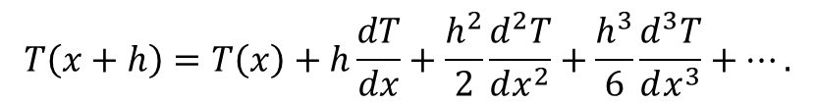
Finite Difference Techniques
The series is actually infinitely long – so we cannot work with the actual series.
We need to ignore some terms – this is known as truncation.
Any error we introduce at this point is called truncation error.
$$T\left(x+h\right)=T\left(x\right)+h\frac{dT}{dx}+\frac{h^{2}}{2}\frac{d^{2}T}{dx^{2}}+\frac{h^{3}}{6}\frac{d^{3}T}{dx^{3}}+….$$
Valid if h is extremely small, or the lower gradients are very small.

Slide 19
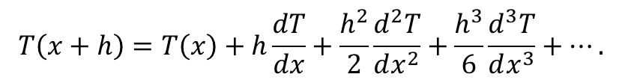
Finite Difference Techniques
Let’s name each term for convention’s sake:
Since our method only takes into account h^1 → a first order term → then we call this truncation “1st order accurate”.
It is the worst possible solution next to 0th order accuracy (which is useless to us)
$$T\left(x+h\right)=T\left(x\right)+h\frac{dT}{dx}+\frac{h^{2}}{2}\frac{d^{2}T}{dx^{2}}+\frac{h^{3}}{6}\frac{d^{3}T}{dx^{3}}+….$$
0th
1st
2nd
3rd

Slide 20
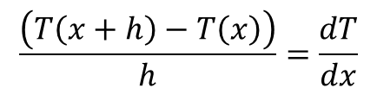
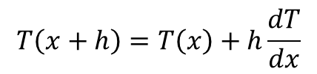
Finite Difference Techniques
Rewrite the terms:
The goal of FDM is to determine an approximation to continuous gradients in terms of a series of discrete points.
In this case, we can rearrange for our goal → dT/dx
$$T\left(x+h\right)=T\left(x\right)+h\frac{dT}{dx}$$
$$\frac{\left(T\left(x+h\right)−T\left(x\right)\right)}{h}=\frac{dT}{dx}$$
This is known as a forward difference approximation of dT/dx.

Slide 21
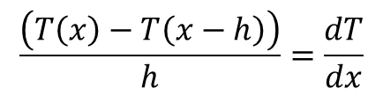
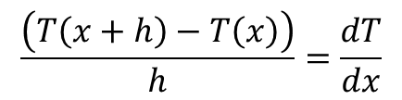
Finite Difference Techniques
$$\frac{\left(T\left(x+h\right)−T\left(x\right)\right)}{h}=\frac{dT}{dx}$$
Forward difference:
Backward difference:
These are all correct approximations, but only 1st order accurate.
These techniques use these points, often known as a stencil:
$$\frac{\left(T\left(x\right)−T\left(x−h\right)\right)}{h}=\frac{dT}{dx}$$
Backward
Forward
T(x-h)
T(x)
T(x+h)

Slide 22
Finite Difference Techniques
Let’s say that 1st order is not good enough for us:
First order accurate results converge poorly when using more cells.
Forward differences cannot take into account information from “backward” sources, and vice versa for backward differences.
There must be a way of evaluating T(x) in terms of both T(x+h) and T(x-h).

Slide 23
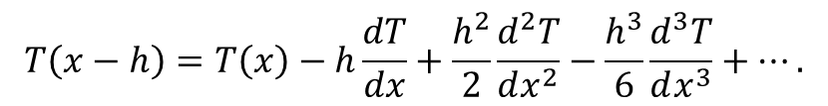
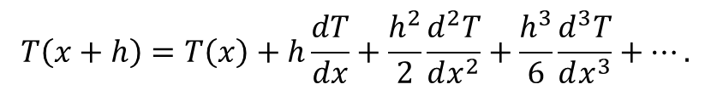
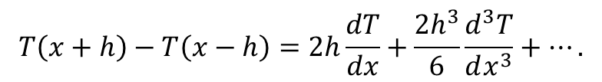
Finite Difference Techniques
Take our forward and backward expansions:
Subtract these expressions – both sides of the equations:
$$T\left(x+h\right)=T\left(x\right)+h\frac{dT}{dx}+\frac{h^{2}}{2}\frac{d^{2}T}{dx^{2}}+\frac{h^{3}}{6}\frac{d^{3}T}{dx^{3}}+….$$
$$T\left(x−h\right)=T\left(x\right)−h\frac{dT}{dx}+\frac{h^{2}}{2}\frac{d^{2}T}{dx^{2}}−\frac{h^{3}}{6}\frac{d^{3}T}{dx^{3}}+….$$
$$T\left(x+h\right)−T\left(x−h\right)=2h\frac{dT}{dx}+\frac{2h^{3}}{6}\frac{d^{3}T}{dx^{3}}+….$$

Slide 24
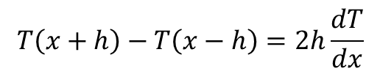
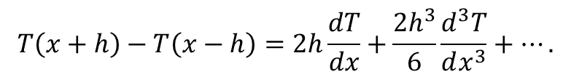
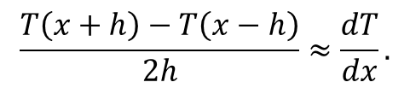
Finite Difference Techniques
$$T\left(x+h\right)−T\left(x−h\right)=2h\frac{dT}{dx}+\frac{2h^{3}}{6}\frac{d^{3}T}{dx^{3}}+….$$
Label each term:
We are going to truncate the 3rd order term. Everything before it (including the now-killed 2nd order term) is included. So, fairly or not, we call this a 2nd order approximation.
New expression:
Solve for dT/dx:
1st
3rd
$$T\left(x+h\right)−T\left(x−h\right)=2h\frac{dT}{dx}$$
$$\frac{T\left(x+h\right)−T\left(x−h\right)}{2h}≈\frac{dT}{dx}.$$
2nd order expression for dT/dx at x in terms of x+h and x-h.

Slide 25
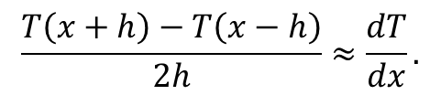
Finite Difference Techniques
$$\frac{T\left(x+h\right)−T\left(x−h\right)}{2h}≈\frac{dT}{dx}.$$
The stencil for this scheme:
Since we have an expression for dT/dx in the center between two points, we call this the central differences expression for dT/dx.
We can arrive at central difference expressions for many gradient terms...
Central
T(x-h)
T(x)
T(x+h)

Slide 26
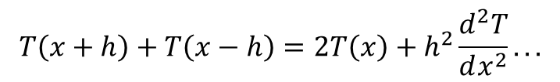
Finite Difference Techniques
Take our forward and backward expansions:
Instead of subtracting these terms, let’s add them together...
$$T\left(x+h\right)=T\left(x\right)+h\frac{dT}{dx}+\frac{h^{2}}{2}\frac{d^{2}T}{dx^{2}}+\frac{h^{3}}{6}\frac{d^{3}T}{dx^{3}}+….$$
$$T\left(x−h\right)=T\left(x\right)−h\frac{dT}{dx}+\frac{h^{2}}{2}\frac{d^{2}T}{dx^{2}}−\frac{h^{3}}{6}\frac{d^{3}T}{dx^{3}}+….$$
$$T\left(x+h\right)+T\left(x−h\right)=2T\left(x\right)+h^{2}\frac{d^{2}T}{dx^{2}}...$$

Slide 27
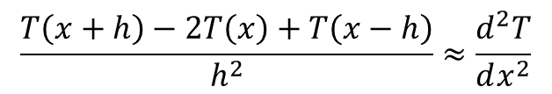
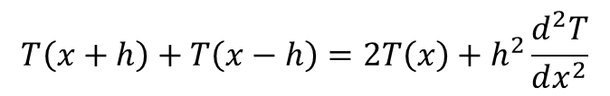
Finite Difference Techniques
I’ve already truncated the other terms. Interestingly, now we have an expression for the higher (2nd) gradient:
This is our goal – let’s rearrange and solve:
This is the 2nd order accurate for the 2nd gradient of T in variable x.
$$T\left(x+h\right)+T\left(x−h\right)=2T\left(x\right)+h^{2}\frac{d^{2}T}{dx^{2}}$$
$$\frac{T\left(x+h\right)−2T\left(x\right)+T\left(x−h\right)}{h^{2}}≈\frac{d^{2}T}{dx^{2}}$$

Slide 28
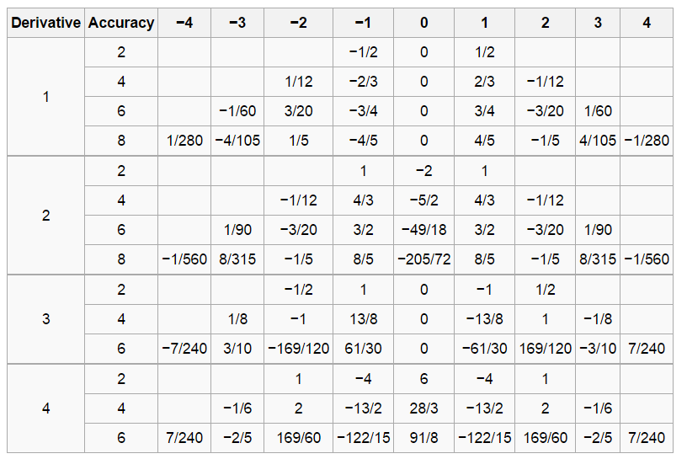
Finite Difference Techniques
Of course, we can generate higher order approximations to most of these gradients:
I’ll draw some examples on the blackboard.
Generally speaking, as the accuracy increases, the size of the stencil increases.
Central order approximations for different derivatives with different accuracy.

Slide 29
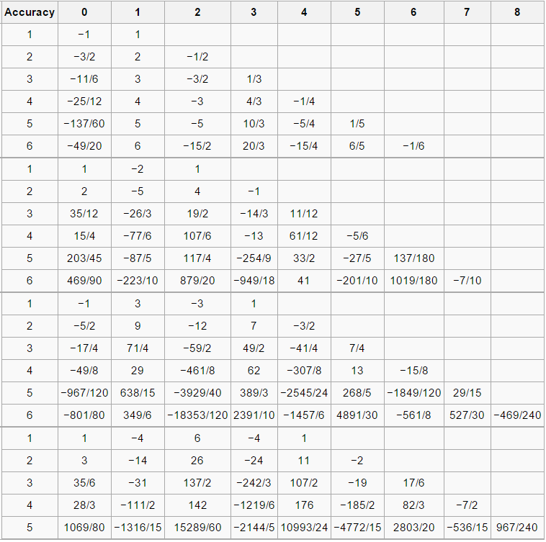
Finite Difference Techniques
Of course, we can generate higher order approximations to most of these gradients:
I’ll draw some examples on the blackboard.
Generally speaking, as the accuracy increases, the size of the stencil increases.
Forward finite differences.

Slide 30
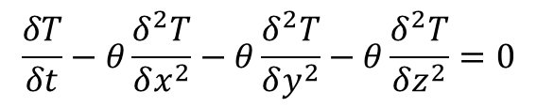
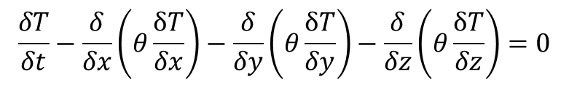
CASE STUDY – 3D Transient Heat Transfer
3D Heat Transfer using finite differences is taught as a numerical method for undergraduate engineers all over the world.
The Heat Transfer equations are ideally suited to the FDM due to their nature.
These equations can be written as:
Assuming spatially constant thermal diffusivity obtains:
$$\frac{δT}{δt}−\frac{δ}{δx}\left(θ\frac{δT}{δx}\right)−\frac{δ}{δy}\left(θ\frac{δT}{δy}\right)−\frac{δ}{δz}\left(θ\frac{δT}{δz}\right)=0$$
$$\frac{δT}{δt}−θ\frac{δ^{2}T}{δx^{2}}−θ\frac{δ^{2}T}{δy^{2}}−θ\frac{δ^{2}T}{δz^{2}}=0$$

Slide 31
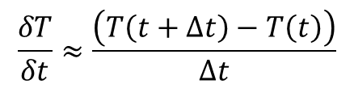
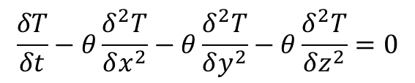
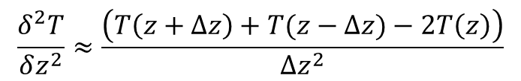
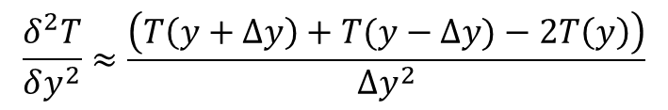
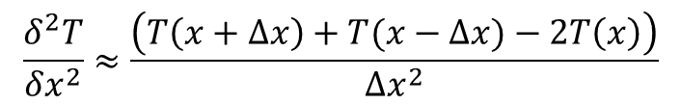
CASE STUDY – 3D Transient Heat Transfer
We need some finite difference approximations for each term:
$$\frac{δT}{δt}−θ\frac{δ^{2}T}{δx^{2}}−θ\frac{δ^{2}T}{δy^{2}}−θ\frac{δ^{2}T}{δz^{2}}=0$$
$$\frac{δT}{δt}≈\frac{\left(T\left(t+∆t\right)−T\left(t\right)\right)}{∆t}$$
$$\frac{δ^{2}T}{δx^{2}}≈\frac{\left(T\left(x+∆x\right)+T(x−∆x)−2T\left(x\right)\right)}{∆x^{2}}$$
Difference in x
$$\frac{δ^{2}T}{δy^{2}}≈\frac{\left(T\left(y+∆y\right)+T(y−∆y)−2T\left(y\right)\right)}{∆y^{2}}$$
Difference in y
$$\frac{δ^{2}T}{δz^{2}}≈\frac{\left(T\left(z+∆z\right)+T(z−∆z)−2T\left(z\right)\right)}{∆z^{2}}$$
Difference in z

Slide 32
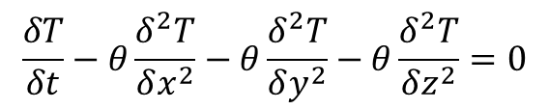
CASE STUDY – 3D Transient Heat Transfer
Since we are mixing variables here (space and time), we need to define the differences in each.
We can use k superscripts to indicate time, and i,j,k subscripts for space.
$$\frac{δT}{δt}−θ\frac{δ^{2}T}{δx^{2}}−θ\frac{δ^{2}T}{δy^{2}}−θ\frac{δ^{2}T}{δz^{2}}=0$$
Evaluate at (i,j,k)
Evaluate at time k
$$\frac{\left(T_{i,j,k}^{k+1}−T_{i,j,k}^{k}\right)}{∆t}−θ\frac{\left(T_{i+1,j,k}^{k}+T_{i−1,j,k}^{k}−{2T}_{i,j,k}^{k}\right)}{∆x^{2}}−θ\frac{\left(T_{i,j+1,k}^{k}+T_{i,j+1,k}^{k}−{2T}_{i,j,k}^{k}\right)}{∆y^{2}}−θ\frac{\left(T_{i,j,k+1}^{k}+T_{i,j,k−1}^{k}−{2T}_{i,j,k}^{k}\right)}{∆z^{2}}=0$$

Slide 33




CASE STUDY – 3D Transient Heat Transfer
Assuming our grid is a uniform, structured grid, we can rearrange and simplify to obtain a formula for the new T:
where we have constants:
The minimum of these constants must be less than 0.5 (i.e. )
This scheme is known as the Forward Time Centered Space (FTCS) scheme.
$$T_{i,j,k}^{k+1}=T_{i,j,k}^{k}+∅_{X}\left(T_{i+1,j,k}^{k}+T_{i−1,j,k}^{k}−{2T}_{i,j,k}^{k}\right)+∅_{Y}\left(T_{i,j+1,k}^{k}+T_{i,j+1,k}^{k}−{2T}_{i,j,k}^{k}\right)+∅_{Z}\left(T_{i,j,k+1}^{k}+T_{i,j,k−1}^{k}−{2T}_{i,j,k}^{k}\right)$$
$$∅_{X}=\frac{∆tθ}{∆x^{2}}$$
$$∅_{Y}=\frac{∆tθ}{∆y^{2}}$$
$$∅_{Z}=\frac{∆tθ}{∆z^{2}}$$
$$min\left(∅_{X},∅_{Y},∅_{Z}\right){<0.5}$$

Slide 34
CASE STUDY – 3D Transient Heat Transfer
The FTCS scheme provides us a formula to compute a new T in terms of old values of T in space.
Hence, our solution technique requires two main loops:
A loop over time – computing the new T values at each step, and
A loop over 3D space, to compute the spatial derivatives.
$$T_{i,j,k}^{k+1}=T_{i,j,k}^{k}+∅_{X}\left(T_{i+1,j,k}^{k}+T_{i−1,j,k}^{k}−{2T}_{i,j,k}^{k}\right)+∅_{Y}\left(T_{i,j+1,k}^{k}+T_{i,j+1,k}^{k}−{2T}_{i,j,k}^{k}\right)+∅_{Z}\left(T_{i,j,k+1}^{k}+T_{i,j,k−1}^{k}−{2T}_{i,j,k}^{k}\right)$$

Slide 35
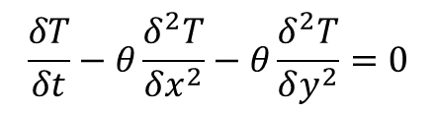
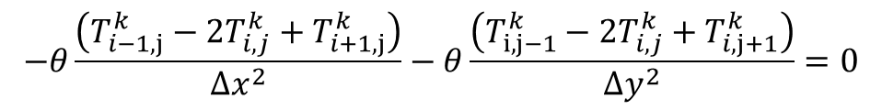
2D STEADY Heat Transfer Problem
Consider the 2D HT equations, where the governing equations are:
The FTCS discretization is:
Imagine we want the steady result. That means the term on the left disappears:
$$\frac{δT}{δt}−θ\frac{δ^{2}T}{δx^{2}}−θ\frac{δ^{2}T}{δy^{2}}=0$$
$$\frac{T_{i}^{k+1}−T_{i}^{k}}{∆t}−θ\frac{\left(T_{i−1,j}^{k}−{2T}_{i,j}^{k}+T_{i+1,j}^{k}\right)}{∆x^{2}}−θ\frac{\left(T_{i,j−1}^{k}−{2T}_{i,j}^{k}+T_{i,j+1}^{k}\right)}{∆x^{2}}=0$$
$$−θ\frac{\left(T_{i−1,j}^{k}−{2T}_{i,j}^{k}+T_{i+1,j}^{k}\right)}{∆x^{2}}−θ\frac{\left(T_{i,j−1}^{k}−{2T}_{i,j}^{k}+T_{i,j+1}^{k}\right)}{∆y^{2}}=0$$

Slide 36
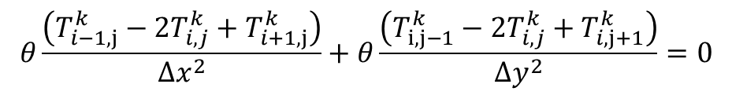
2D Heat Transfer Problem
There are several observations to draw:
We need to solve for the unknown temperature at i,j.
All of these temperatures are at the same time level.
This means that we need to solve all of these temperatures at the same time.
Fortunately, the system is linear – we have T in terms of other T¹ values.
$$θ\frac{\left(T_{i−1,j}^{k}−{2T}_{i,j}^{k}+T_{i+1,j}^{k}\right)}{∆x^{2}}+θ\frac{\left(T_{i,j−1}^{k}−{2T}_{i,j}^{k}+T_{i,j+1}^{k}\right)}{∆y^{2}}=0$$

Slide 37
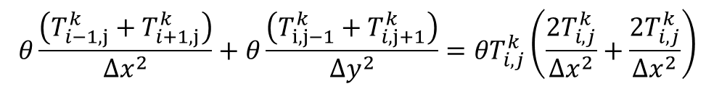
2D Heat Transfer Problem
Since the system is linear, we can make a system of linear equations to solve the problem.
Let’s rearrange the governing equation to solve for T(i,j):
You can remove (theta) at this stage if you like – it doesn’t influence the solution – IF theta is the same everywhere.
$$θ\frac{\left(T_{i−1,j}^{k}+T_{i+1,j}^{k}\right)}{∆x^{2}}+θ\frac{\left(T_{i,j−1}^{k}+T_{i,j+1}^{k}\right)}{∆y^{2}}={θT}_{i,j}^{k}\left(\frac{{2T}_{i,j}^{k}}{∆x^{2}}+\frac{{2T}_{i,j}^{k}}{∆x^{2}}\right)$$

Slide 38
2D Heat Transfer Problem
We wish to rearrange these things into a linear system.
Let’s write out each equation explicitly in terms of a linear equation:
This is easy to put into matrix form….
$$T_{i−1,j}^{k}\left(\frac{θ}{∆x^{2}}\right)+T_{i+1,j}^{k}\left(\frac{θ}{∆x^{2}}\right){+T}_{i,j−1}^{k}\left(\frac{θ}{∆y^{2}}\right)+T_{i,j+1}^{k}\left(\frac{θ}{∆y^{2}}\right)−T_{i,j}^{k}\left(\frac{{2θT}_{i,j}^{k}}{∆x^{2}}+\frac{{2θT}_{i,j}^{k}}{∆x^{2}}\right)=0$$

Slide 39
2D Heat Transfer Problem
For our general – Matrix form:
$$T_{i−1,j}^{k}\left(\frac{θ}{∆x^{2}}\right)+T_{i+1,j}^{k}\left(\frac{θ}{∆x^{2}}\right){+T}_{i,j−1}^{k}\left(\frac{θ}{∆y^{2}}\right)+T_{i,j+1}^{k}\left(\frac{θ}{∆y^{2}}\right)−T_{i,j}^{k}\left(\frac{{2θT}_{i,j}^{k}}{∆x^{2}}+\frac{{2θT}_{i,j}^{k}}{∆x^{2}}\right)=0$$
A
A
B
B
-2A-2B
The key is understanding which row the left, right, up and down cell is located on!
Only include temperatures we are solving for inside the vector of temperatures here.
Constant temperatures become source terms!
A
B
-2A-2B
A
B
Left
Up
Center
Down
Right

Slide 40
2D Heat Transfer Problem
In this form, we can show that we will need to solve a linear system of equations (at least for this PDE): where we have Ax = B.
We need to compute x = A⁻¹B, essentially.
A
x
=
B

Slide 41
2D Heat Transfer Problem
We will see the need for solutions to the Ax = B system later in the course.
What is important to know is that we no longer have the same simple system as we used in FTCS.
This will be important when it comes time to use the GPU to solve these equations, or when trying to share the computational load across multiple CPU cores.
I.e. how do we share a A⁻¹ calculation across multiple CPU cores?

Slide 42
Finite ELEMENT Method

Slide 43
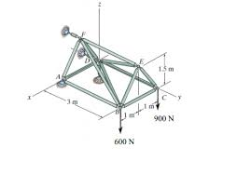
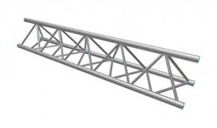
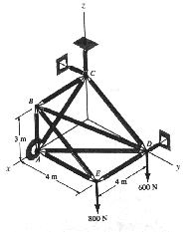
STIFFNESS METHOD
Many formulations of the Finite Element Method (FEM) are most easily explained using the Stiffness Method.
This is commonly employed in the analysis of space trusses such as these:

Slide 44
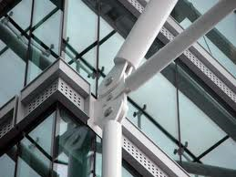
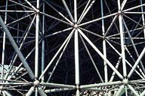
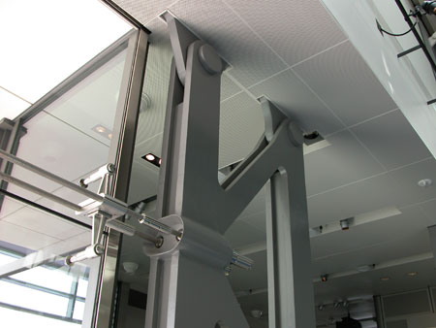
STIFFNESS METHOD
Each space truss is made up of a number of beams.
The analysis of the beams depends on the connections between them.
If joints are rigidly attached, beam elements may bend.
If joints are attached with pins, then no moment can be sustained at the connection points (i.e. no bending)

Slide 45
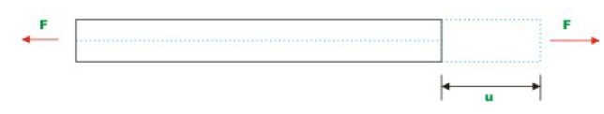
STIFFNESS METHOD
Since we want to give you a simple introduction, we will assume elements are connected using pins.
Hence, the only force inside elements are compressive or tensile forces:

Slide 46

STIFFNESS METHOD
We can very simply relate the axial force F with the displacement u:
When written in this form (Hooke’s Law form F = Kx), we can see that AE/L is the stiffness of the beam.
$$F=\frac{AE}{L}u=Ku$$

Slide 47
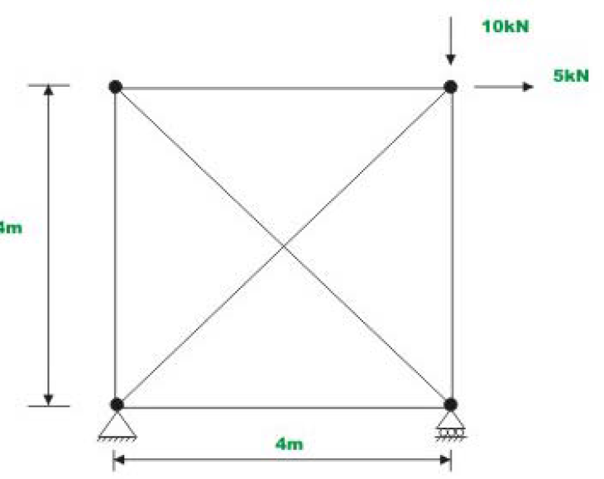
STIFFNESS METHOD
We can use this formula to analyze large numbers of beams via the superposition theorem.
Consider this planar truss as an example.
We have 6 beam elements connect with pins.
First, we need to decide what our variables are.

Slide 48
STIFFNESS METHOD
We can use this formula to analyze large numbers of beams via the superposition theorem.
Consider this planar truss as an example.
We have 6 beam elements connect with pins.
First, we need to decide what our variables are.

Slide 49
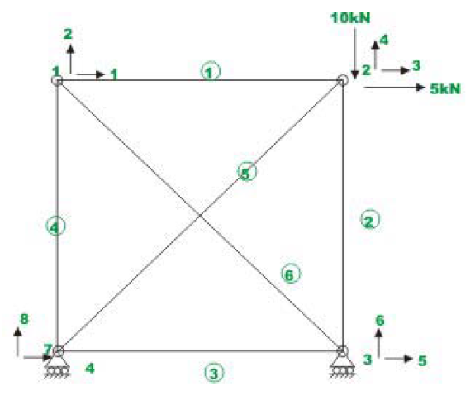
STIFFNESS METHOD
We consider the displacement of the connecting points – nodes – as our unknowns.
Each node may move in two directions – in the x and y direction.
Hence, for our problem, we have 8 unknowns.

Slide 50
STIFFNESS METHOD
However, not all of these variables are actually unknown.
Variable 6 must be 0 (vertically constrained)
Variables 7 and 8 are also 0 (constrained)
Hence, we have 5 unknowns in our system.

Slide 51

STIFFNESS METHOD
We need to formulate a relationship between the displacements of nodes connected with beam elements to continue.
In order to do this, we need to consider the local coordinate system x’ and y’ connecting the nodes 1 and 2 (for example)

Slide 52


STIFFNESS METHOD
The formulas relating the axial force inside this element with the displacements can be written as:
We can write this in matrix form as:
u₁’ = displacement of 1 in the x’ direction.

Slide 53


STIFFNESS METHOD
Hence, we can write the equations of the form:
Where K is our local stiffness matrix:
$$\left[p′\right]=K′[x′]$$
$$K=\frac{EA}{L}\left[\begin{matrix}1 & −1 \\ −1 & 1\end{matrix}\right]$$

Slide 54


STIFFNESS METHOD
Unfortunately, the local coordinate frame does not help us.
Hence, we need to perform a coordinate transformation to relate the local (x’, y’) coordinates to the global (x, y) coordinates.

Slide 55


STIFFNESS METHOD
In matrix form, this is written as:
Or we can shorten this notation down:
$$u^{′}=\left[T\right]u$$
Where T is our 4x2 coordinate transformation matrix.

Slide 56




STIFFNESS METHOD
We can replace the elements of our T matrix using actual coordinate positions of points 1 and 2:
The axial forces (p’) on the element also need to be transformed as well:

Slide 57







STIFFNESS METHOD
Recall our governing equation:
Multiply both sides by [T]^{T}:
Our previous slide showed us that:
A similar substitution exists for x’:
Hence, we can write: where
$$\left[p′\right]=K′[x′]$$
$${\left[T\right]}^{T}\left[p′\right]={\left[T\right]}^{T}K′[x′]$$
Sub in
$$[p]={\left[T\right]}^{T}K′[x′]$$
$$[p]={\left[T\right]}^{T}{[K}^{′}{]\left[T\right]}^{T}[x]$$
$$\left[p\right]=K\left[x\right]$$
$$\left[K\right]={\left[T\right]}^{T}\left[K′\right]{\left[T\right]}^{T}$$

Slide 58

STIFFNESS METHOD
Our final stiffness matrix is of the form:
Now we are ready to begin solving for the system.
All we need to do is construct our global stiffness matrix – governing all of the system unknowns – from the smaller (4x4) local stiffness matrices.

Slide 59

STIFFNESS METHOD
The global stiffness matrix starts off as zero and has the dimensions of the number of DOF:
Consider element 1, connecting node 1 and node 2.
$$\left[F\right]=\left[\begin{aligned}\begin{matrix}0 & 0 \\ 0 & 0\end{matrix} \begin{matrix}0 & 0 \\ 0 & 0\end{matrix} \begin{matrix}0 & 0 \\ 0 & 0\end{matrix} \begin{matrix}0 & 0 \\ 0 & 0\end{matrix} \\ \begin{matrix}0 & 0 \\ 0 & 0\end{matrix} \begin{matrix}0 & 0 \\ 0 & 0\end{matrix} \begin{matrix}0 & 0 \\ 0 & 0\end{matrix} \begin{matrix}0 & 0 \\ 0 & 0\end{matrix} \\ \begin{matrix}0 & 0 \\ 0 & 0\end{matrix} \begin{matrix}0 & 0 \\ 0 & 0\end{matrix} \begin{matrix}0 & 0 \\ 0 & 0\end{matrix} \begin{matrix}0 & 0 \\ 0 & 0\end{matrix} \\ \begin{matrix}0 & 0 \\ 0 & 0\end{matrix} \begin{matrix}0 & 0 \\ 0 & 0\end{matrix} \begin{matrix}0 & 0 \\ 0 & 0\end{matrix} \begin{matrix}0 & 0 \\ 0 & 0\end{matrix}\end{aligned}\right]\left[\begin{aligned}u_{1} \\ u_{2} \\ u_{3} \\ u_{4} \\ u_{5} \\ u_{6} \\ u_{7} \\ u_{8}\end{aligned}\right]$$

Slide 60


STIFFNESS METHOD
The local stiffness matrix can be written as:
All we need do is insert it into our global matrix:
We need to repeat this process for each element and node pair.
$$\left[F\right]=\left[\begin{aligned}\begin{matrix}K_{11} & K_{12} \\ K_{21} & K_{22}\end{matrix} \begin{matrix}K_{13} & K_{14} \\ K_{23} & K_{24}\end{matrix} \begin{matrix}0 & 0 \\ 0 & 0\end{matrix} \begin{matrix}0 & 0 \\ 0 & 0\end{matrix} \\ \begin{matrix}K_{31} & K_{32} \\ K_{41} & K_{42}\end{matrix} \begin{matrix}K_{33} & K_{34} \\ K_{43} & K_{44}\end{matrix} \begin{matrix}0 & 0 \\ 0 & 0\end{matrix} \begin{matrix}0 & 0 \\ 0 & 0\end{matrix} \\ \begin{matrix}0 & 0 \\ 0 & 0\end{matrix} \begin{matrix}0 & 0 \\ 0 & 0\end{matrix} \begin{matrix}0 & 0 \\ 0 & 0\end{matrix} \begin{matrix}0 & 0 \\ 0 & 0\end{matrix} \\ \begin{matrix}0 & 0 \\ 0 & 0\end{matrix} \begin{matrix}0 & 0 \\ 0 & 0\end{matrix} \begin{matrix}0 & 0 \\ 0 & 0\end{matrix} \begin{matrix}0 & 0 \\ 0 & 0\end{matrix}\end{aligned}\right]\left[\begin{aligned}u_{1} \\ u_{2} \\ u_{3} \\ u_{4} \\ u_{5} \\ u_{6} \\ u_{7} \\ u_{8}\end{aligned}\right]$$
$$\left[\begin{aligned}F_{u1} \\ F_{u2} \\ F_{u3} \\ F_{u4}\end{aligned}\right]=\left[\begin{aligned}\begin{matrix}K_{11} & K_{12} \\ K_{21} & K_{22}\end{matrix} \begin{matrix}K_{13} & K_{14} \\ K_{23} & K_{24}\end{matrix} \\ \begin{matrix}K_{31} & K_{32} \\ K_{41} & K_{42}\end{matrix} \begin{matrix}K_{33} & K_{34} \\ K_{43} & K_{44}\end{matrix}\end{aligned}\right]\left[\begin{aligned}u_{1} \\ u_{2} \\ u_{3} \\ u_{4}\end{aligned}\right]$$

Slide 61


STIFFNESS METHOD
Consider element 6 (connecting 1 and 3):
We need to insert these elements at the correct position in our global stiffness matrix.
$$\left[F\right]=\left[\begin{aligned}\begin{matrix}K_{11}+Z_{11} & K_{12}+Z_{12} \\ K_{21}+Z_{21} & K_{22}+Z_{22}\end{matrix} \begin{matrix}K_{13} & K_{14} \\ K_{23} & K_{24}\end{matrix} \begin{matrix}Z_{13} & Z_{14} \\ Z_{23} & Z_{24}\end{matrix} \begin{matrix}0 & 0 \\ 0 & 0\end{matrix} \\ \begin{matrix} K_{31} & { K}_{32} \\ K_{41} & K_{42}\end{matrix} \begin{matrix}K_{33} & K_{34} \\ K_{43} & K_{44}\end{matrix} \begin{matrix}0 & 0 \\ 0 & 0\end{matrix} \begin{matrix}0 & 0 \\ 0 & 0\end{matrix} \\ \begin{matrix}{ Z}_{31} & Z_{31} \\ Z_{41} & { Z}_{42}\end{matrix} \begin{matrix}0 & 0 \\ 0 & 0\end{matrix} \begin{matrix}Z_{33} & Z_{34} \\ Z_{34} & Z_{44}\end{matrix} \begin{matrix}0 & 0 \\ 0 & 0\end{matrix} \\ \begin{matrix}0 & 0 \\ 0 & 0\end{matrix} \begin{matrix}0 & 0 \\ 0 & 0\end{matrix} \begin{matrix}0 & 0 \\ 0 & 0\end{matrix} \begin{matrix}0 & 0 \\ 0 & 0\end{matrix}\end{aligned}\right]\left[\begin{aligned}u_{1} \\ u_{2} \\ u_{3} \\ u_{4} \\ u_{5} \\ u_{6} \\ u_{7} \\ u_{8}\end{aligned}\right]$$
$$\left[\begin{aligned}F_{u1} \\ F_{u2} \\ F_{u5} \\ F_{u6}\end{aligned}\right]=\left[\begin{aligned}\begin{matrix}Z_{11} & Z_{12} \\ Z_{21} & Z_{22}\end{matrix} \begin{matrix}Z_{13} & Z_{14} \\ Z_{23} & Z_{24}\end{matrix} \\ \begin{matrix}Z_{31} & Z_{31} \\ Z_{41} & Z_{42}\end{matrix} \begin{matrix}Z_{33} & Z_{34} \\ Z_{34} & Z_{44}\end{matrix}\end{aligned}\right]\left[\begin{aligned}u_{1} \\ u_{2} \\ u_{5} \\ u_{6}\end{aligned}\right]$$

Slide 62
STIFFNESS METHOD
After we are done, we can eliminate the unrequired rows and columns for elements which have 0 displacements (i.e. restraints, or boundary conditions).
We need to follow a similar procedure for the Force vector on the left hand side.
After we are finished, we will have a (i) symmetric, and (ii) often sparse matrix system for us to invert.
Once you have the force matrix F and the stiffness matrix K, you can use the CG method to solve for displacement.

Slide 63
Finite Element Method SUMMARY
After a little work, its clear that the FEM approach will result in an Ax = B system, just like the steady heat transfer approach using FDM.
A
x
=
B
It should be clear that this course is going to require us to develop a method for solving this system on GPU.

Slide 64
Finite VOLUME Method

Slide 65
FINITE VOLUME METHOD
The previous two methods are (generally) suitable for linear PDE’s – of course, there are exceptions.
We require an approach which can be applied to non-linear systems – for this, the Finite Volume Method is well suited.
In addition, the FVM approach is the one best suited to arbitrary geometries.

Slide 66
Partial Differential Equations
We will consider Partial Differential Equations of the form:
U = Conserved Quantities
F = Fluxes in x direction
H = Fluxes in y direction

Slide 67
Partial Differential Equations
Let’s start by looking at the 1D equations:
In many ways, this is identical to the PDE’s you have examined in the past (i.e. for heat transfer).
There are several key differences.

Slide 68
Partial Differential Equations
This term is wave dominated in the Euler and Shallow Water Equations.
Care must be taken with how we formulate dF/dx.
This term is non-zero.
In fact, in real life, you will soon understand that there is no such thing as perfect steady state.

Slide 69
Time Discretization
Let’s begin by treating the first term – the time differential of U.
For the purposes of this course, it’s discretization is the same as you’ve seen previously in the FTCS scheme:

Slide 70
Space Discretization
Now, we need to treat the spatial gradient of the flux term.
This can also be done in a straight forward fashion.
First, let’s create cells (finite volumes, or control volumes):
i-1
i
i+1

Slide 71
Space Discretization
These are our Finite Volumes.
To understand the evolution of U in time, we need to keep track of the fluxes across the surfaces of these finite volumes.
i-1
i
i+1
F_{i-1/2}
F_{i+1/2}

Slide 72
Space Discretization
These fluxes are the fluxes at the interface separating cells i-1, i and i+1.
i-1
i
i+1
F_{i-1/2}
F_{i+1/2}
Flux at interface between cell i and i-1.
Flux at interface between cell i and i+1.

Slide 73
Flux Consistency
In the Finite Volume Method, there is only one given, valid flux for any interface.
i-1
i
Unlike other numerical methods, in which values of F at cell edges may differ, the Finite Volume Method forces these to be consistent.
F_{i-1/2}
From cell i point of view
i
F_{i+1/2}
i+1
From cell i-1 point of view
Same cells

Slide 74
Flux Consistency
Hence, for a 1D problem with N cells, there are N+1 unique fluxes…
We need to compute each of these surface fluxes to solve the conservation equations.
0
1
2
…
N-1
F₀
F₁
F₂
F…
F_{N-1}
F_{N}

Slide 75
Conservation Equation
For a Finite Volume Method, we employ the basic laws of conservation to solve for the change of state:
F_{i-1/2}
i
F_{i+1/2}
Flux of conserved quantities entering cell i
Flux of conserved quantities leaving cell i

Slide 76
Conservation Equation
This is why the Finite Volume Method is 100% conservative.
The evolution of any cell is perhaps more easily understand by the integral form of the equations:
F_{i-1/2}
i
F_{i+1/2}

Slide 77
Conservation Equation
Strictly speaking, this is the form of the governing equation employed by the Finite Volume Method.
This is the form we discretize when we employ the Finite Volume Method.

Slide 78
Left Hand Side
Assume 1D.
Assume U here is the average U over cell width Δx, and is constant over the cell width.
This simplifies our integral considerably…

Slide 79
Right Hand Side
F_{i-1/2}
F_{i+1/2}
Assume that F is constant over element dS.
For a 1D problem with a pair of dS (of arbitrary length), we have:
n=-1
n=1

Slide 80
Combining the two…
If we combine these, we find:

Slide 81

Finite Volume Method
$$U_{i}^{k+1}=U_{i}^{k}−\left(\frac{∆t}{∆x}\right)\left(F_{i+\frac{1}{2}}^{k}−F_{i−\frac{1}{2}}^{k}\right)$$
This is essentially just like a Finite Difference Scheme – we can, in fact, show that these are very similar.

Slide 82
General Algorithm
The basic unsteady Finite Volume Method code can be easily broken down into a loop containing:
Flux calculation across all cell surfaces. For a 1D problem with N cells, there will be N+1 flux calculations.
State calculation, where U is computed at the next time step.

Slide 83
General Algorithm
Start
Loop over time
Initialisation
t<T?
Termination
Calculate Fluxes
End
Calculate New U
Loop(s) over space

Slide 84
Flux Calculation Phase
0
1
2
…
N-1
F₀
F₁
F₂
F…
F_{N-1}
F_{N}
Each flux F is calculated from existing conditions U in each cell.
After each F is calculated, we update U (the conserved properties).
See the pseudo-code attached on the RHS:
for (k = 0; k < NT; k++) {
// Calculate the flux across each interface
for (i = 1; i < NX; i++) {
// Calculate the flux
F[i] = *Insert Magic Here*;
}
F[0] = F[1];
F[NX] = F[NX-1];
for (i = 0; i < NX; i++) {
U[i] = U[i] - (dt/dx)*(F[i+1]-F[i]);
}
}

Slide 85
FVM Summary
It is clear that the FVM approach can be broken down in the same way that a transient FDM is:
A loop over time, and
A loop over space (for calculation of the fluxes).
The real trick – for an FVM approach – lies in the computation of the fluxes, which are often non-trivial given the non-linear systems we may attempt to solve.

