Slide 1
Introduction to Multi-Core CPU and GPU Computation 多核心CPU和GPU計算
Class 5 Prof. Matthew Smith, msmith@mail.ncku.edu.tw

Slide 2
Today’s Class…
Today’s class will cover:
Introduction to Parallel Computing,
Parallel Computing Paradigms,

Slide 3
Partial Differential Equations

Slide 4
Introduction to Parallel Computing
Parallel computing occurs when you perform multiple calculations simultaneously, in cooperation with each other, with the goal of performing a calculation faster than if each calculation were merged into a single one.
In simple terms – parallel computation involves:
Taking a single goal – perhaps the calculation of stress in a substance,
Dividing this computation in such a way as it can be performed simultaneously,
Taking each part and executing them on different CPU (or otherwise) cores.

Slide 5
Introduction to Parallel Computing
This is important for several reasons:
The CPU speed of modern CPU’s is gradually decreasing as application of CPU’s to mobile computing becomes more popular.
The demands on accuracy for modern computational analysis is increasing – our simulations are getting larger and require more computational power.
Hence, demands by industrial engineers mean that, in order to reach new levels of technology, we must use multiple CPU cores as part of our computation.

Slide 6
Introduction to Parallel Computing
Parallel Computing is not a new idea.
Ever since the development of computers, scientists and engineers have been working to take advantage of multiple CPU cores to accelerate computations.
Before we continue, we need a way of categorizing types of computational work into those which may be parallelized, or not.

Slide 7
TYPES OF COMPUTATION
Computational tasks may be categorized into two groups:
Sequential Computations: This is where a computational task involves multiple steps, which must be computed in a specific order.
Parallel Computations: This is where a computational task can be clearly divided into a group of subtasks which may be computed separately, simultaneously.
In reality, most tasks consist of sequential parts and parallel parts. It is important we be able to identify these.

Slide 8
TYPES OF COMPUTATION
An example of sequential computation:
Compute the series a_{n+1} = 2*a_{n} for a₀ = 1 and n = 1,2,3.....1000.
We can see that, for any value a_{n+1}, we must first compute a_{n} (the term before it).
We cannot break this task up into a series of smaller tasks which can be divided.

Slide 9
TYPES OF COMPUTATION
An example of parallel computation:
Compute the vector sum c = a + b (where c = [c₁, c₂, ...c_{n}])
Let’s visualize this:
1
2
3
4
5
6
7
8
a
There is no reason why this task cannot be broken down into two parts:
perform addition of elements 1-4 as a single task.
perform addition of elements 5-8 as a separate task.
1
2
3
4
5
6
7
8
b
1
2
3
4
5
6
7
8
c
CPU 1
CPU 2

Slide 10
TYPES OF COMPUTATION
The human mind, unfortunately, has evolved around performing tasks sequentially.
This makes separating tasks into smaller tasks which can be completed in parallel a little hard.
Let’s try a class activity – adding a large group of numbers up.
I need some volunteers...

Slide 11
TYPES OF COMPUTATION
We can see from this task that adding numbers in a vector is a typical combination of sequential and parallel tasks.
The task of adding numbers together may be broken down into N parts.
Each task can be completed – resulting in N numbers.
However, the final step – adding these N numbers – must eventually be done sequentially.

Slide 12
PARALLEL COMPUTATION
A sequential task must be completed by a single CPU.
If we have many CPU’s available, it won’t matter – we MUST use a single CPU to compute this work.
A parallel task may be completed by many CPU’s.
If we have many CPU’s available, we can share the work across these to make the work go faster.

Slide 13
THEORY OF COMPUTATION

Slide 14
Theory of Computation
Computational work is quite simply defined as “the amount of computation performed”.
One measure used for computational work is the “flop” – or “floating point operation”.
For the sake of this course, we can generalize the amount of computation performed using a constant value K.

Slide 15
Theory of Computation
Example:
Arrays A and B are N elements long. How much computational work is performed when computing C = A + B?
Solution:
We need to compute C[i] = A[i] + B[i] for each of i = 0 to N-1 (N times). Therefore, we perform N computations.
Assuming we perform K operations per element, the total work is W = KN.

Slide 16
Theory of Computation
We never actually need to compute the value of K.
There is still a lot of research being performed into what “K” is.
There are several contributing factors to the value of K:
Work required for accessing (i.e. read, write) the value of variables in memory,
Work required for performing the actual computation.
For the purpose of analysis, using the variable K is enough.

Slide 17

Theory of Computation
Computational Time is the amount of time required to complete a computation.
The computational work and time are correlated:
Where K here is the speed at which the work is performed. This is directly related to the clock speed and model of your CPU. Again, we don’t explicitly need to know what K is.
$$T=KW$$

Slide 18
Theory of Computation
Example: How long will it take to add the arrays C = A + B over N elements?
Solution: Time = K*Work = K*(K*N) = K²*N = KN.

Slide 19

PARALLEL COMPUTATION
Parallel Computing is the practice of using more than one computing core to perform computational work.
Theoretically, the use of multiple computing cores will result in less time (i.e. faster computation).
In parallel computing, a commonly used measure of success is the “speedup” or “speedup ratio”. This is defined as the ratio of the computational time required for one core and multiple cores:
$SU= T_{SERIAL}/T_{PARALLEL}$

Slide 20

PARALLEL COMPUTATION
Example:
A code requires 25 mins to run using a single CPU and 5 mins using multiple CPU cores. Calculate the speedup:
In practice:
SU > 1 : Successful application of parallel computing
SU <= 1: Danger!
$SU=\frac{T_{SERIAL}}{T_{PARALLEL}}=\frac{25}{5}=5$

Slide 21

PARALLEL COMPUTATION
Theoretically, one might expect that the amount of computational time will vary linearly with the number of cores used.
If a code requires N time (in seconds) with one CPU core, one might expect that the same code with two cores would require N/2 seconds.
This is related to the computational efficiency – which is defined as the speedup divided by the number of processors:
$E=\frac{SU}{P}= T_{SERIAL}/PT_{PARALLEL}$

Slide 22

PARALLEL COMPUTATION
Example:
A code requires 25 mins to run using a single CPU and 5 mins using 10 CPU cores. Calculate the speedup and the efficiency:
E > 1: Theoretically impossible, but practically possible due to cache effects.
E <= 1: Normal – the actual parallel efficiency depends on the algorithm.
$SU=\frac{T_{SERIAL}}{T_{PARALLEL}}=\frac{25}{5}=5$
$E=\frac{SU}{P}=\frac{5}{10}=0.5$

Slide 23
PARALLEL COMPUTATION
The efficiency of any code for application to parallel computing depends highly on how much of the code can be performed in parallel.
If an algorithm contains large sections which can be computed using multiple CPU cores, then the efficiency will be high.
If an algorithm cannot be computing using multiple CPU cores, then the parallel efficiency will be very low – since the computational time will be similar to using a single core.

Slide 24
PARALLEL COMPUTATION
The fraction of computational work performed in parallel computation is an important measure, and is defined as:
a = W_{PARALLEL}/W_{TOTAL}=WP/WT
Where Wtotal is the total computational work in a program and Wparallel is the amount of work which is performed in parallel (using multiple CPU cores).
Note: While the computational time will (theoretically) change with the number of cores, the computational work is a constant.
The serial work can therefore be written as: 𝑊𝑆=𝑊𝑇−𝑊𝑃=𝑊𝑇(1−𝑎).

Slide 25
AMDAHLS LAW
Gene Amdahl proposed that the amount of speedup possible in a parallel code was directly proportional to the amount of work which is parallelized.
Consider the time required to complete the serial section of a code:
TS = K*WS
Consider the time required, theoretically and ideally, to complete the parallel section of a code using P processors:
TP = K*WP/P

Slide 26
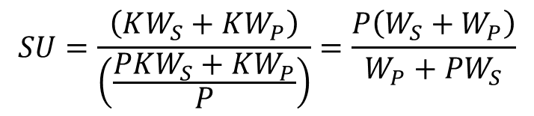
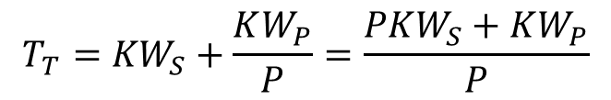
AMDAHLS LAW
The total time ideally required will be:
If we only had one core, the required computational time would be K*WS + K*WP.
Therefore, the speedup can be predicted by computing the ratio of the serial (one core) time and the ideal parallel time:
$$T_{T}={KW}_{S}+\frac{KW_{P}}{P}=\frac{PKW_{S}+KW_{P}}{P}$$
$$SU=\frac{\left(KW_{S}+KW_{P}\right)}{\left(\frac{PKW_{S}+KW_{P}}{P}\right)}=\frac{P\left(W_{S}+W_{P}\right)}{W_{P}+PW_{S}}$$

Slide 27
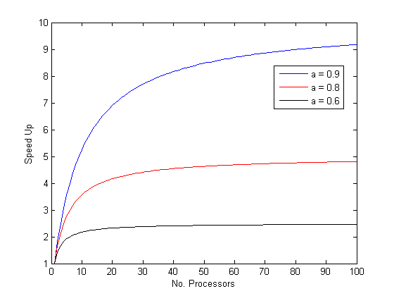
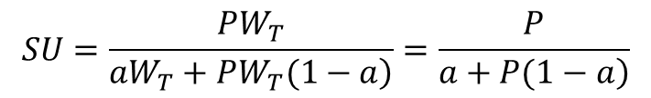
AMDAHLS LAW
Substituting W_{P} = aW_{T} and W_{S} = W_{T}(1-a), we find:
This is Amdahls Law. Take the limit of an infinite P to obtain 1/[(a/P) +(1-a)] = 1/(1-a)
Example: If 90% of your work is parallelized, what is your maximum possible speedup?
Ans: 10 (1/(1-0.9))
$$SU=\frac{PW_{T}}{\left.{aW}_{T}+PW_{T}(1−a\right)}=\frac{P}{\left.a+P(1−a\right)}$$

Slide 28
AMDAHLS LAW
Generally speaking, this is quite depressing. Even with 90% of your work parallelized, the performance increase with an infinite number of processors will only be 10x.
Another example:
Example:
An algorithm is able to perform 80% of the work in parallel. A typical Intel i5 has 4 processing cores. What is the expected speedup on the i5? What is the maximum speedup assuming you had an infinite number of processors?
Solution:
Speedup SU = 4/(0.8 + 4*0.2) = 2.5 times. The maximum possible SU is 1/0.2 = 5 times.

Slide 29
GUSTAFSONS LAW
Amdahls law examined the computational work performed in parallel. A good parallel code will perform more than 99% of its work in parallel.
Another law is Gustafson’s Law – developed by John Gustafson.
He states that the speedup will continue to increase with increasing numbers of processors as the problem size increases.

Slide 30

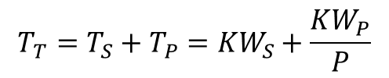
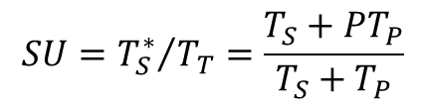
GUSTAFSONS LAW
Review: The time required to complete a parallel / serial code under ideal conditions is:
The time required for a serial computation would then be:
The speedup is the ratio of these:
$$T_{T}={T_{S}+T_{P}=KW}_{S}+\frac{KW_{P}}{P}$$
$$T_{S}^{∗}=T_{S}+PT_{P}$$
$${{SU=T}_{S}^{∗}}/{T_{T}}=\frac{T_{S}+{PT}_{P}}{T_{S}+T_{P}}$$

Slide 31
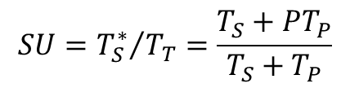
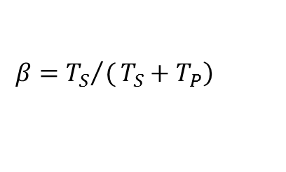
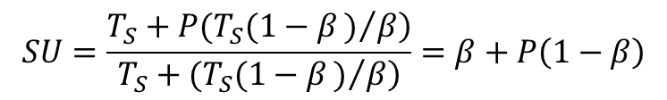
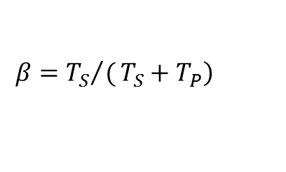
GUSTAFSONS LAW
Instead of defining the ratio of parallel to total work, let’s define a new variable (beta) as the ratio of the computational time:
Where TS + TP = the total time required for the computation.
We can substitute these equations together to get:
$$\left.β={{T_{S}}/(T}_{S}+T_{P}\right)$$
$${{SU=T}_{S}^{∗}}/{T_{T}}=\frac{T_{S}+{PT}_{P}}{T_{S}+T_{P}}$$
$$SU=\frac{\left.T_{S}+P(T_{S}(1−β)/β\right)}{\left.T_{S}+(T_{S}(1−β)/β\right)}=β+P\left(1−β\right)$$
$$\left.β={{T_{S}}/(T}_{S}+T_{P}\right)$$

Slide 32
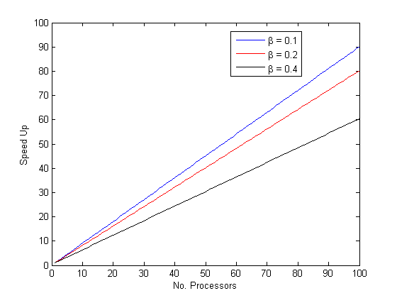
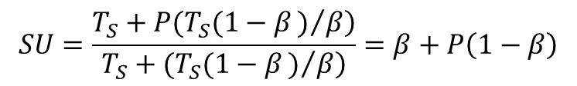
GUSTAFSONS LAW
This is Gustafson’s Law.
It should be very clear that beta and (a) (from Amdahl’s law) represent different things.
However, these equations are essentially the same.
$$SU=\frac{\left.T_{S}+P(T_{S}(1−β)/β\right)}{\left.T_{S}+(T_{S}(1−β)/β\right)}=β+P\left(1−β\right)$$

Slide 33
GUSTAFSONS vs AMDAHLS LAW
These two laws can be compared by computing the parallel speedup for a simple algorithm.
Start
This is essentially the same as a single time step from an FTCS calculation.
We only require iteration over N elements in space.
Initialization()
W₁ work
Yes
i < N?
No
W₂ work
Calculation(i)
Print “Finished”
i = i + 1
End

Slide 34
GUSTAFSONS vs AMDAHLS LAW
Consider sharing the loop over N elements across P processors.
Each processor will control a separate section of the loop.
Start
Initialization()
W₁ work
0
1
2
3
4
5
6
7
8
9
10
11
Yes
i < N?
No
Processor 0
Processor 1
Processor 2
W₂ work
Calculation(i)
Print “Finished”
If we had N = 12 and 3 processors, each processor would control N/P elements (4).
i = i + 1
End

Slide 35
GUSTAFSONS vs AMDAHLS LAW
The work performed during initialization = W1.
Each calculation requires W2 work.
Therefore, the total amount of work performed in our loop – which will be parallelized, and is therefore parallel work – is N*W2.
Start
Initialization()
W₁ work
Yes
i < N?
No
W₂ work
Calculation(i)
Print “Finished”
i = i + 1
End

Slide 36
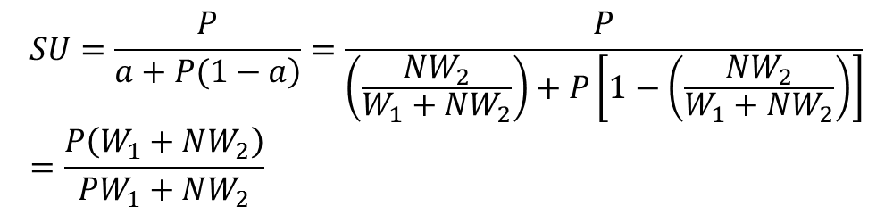
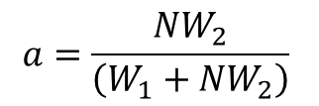
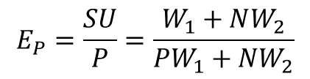
GUSTAFSONS vs AMDAHLS LAW
Using Amdahls Law – the ratio of parallel work to total work is:
Therefore, the speedup and efficiency will be:
Start
$$a=\frac{NW_{2}}{\left(W_{1}+NW_{2}\right)}$$
Initialization()
W₁ work
Yes
i < N?
No
W₂ work
Calculation(i)
Print “Finished”
$$SU=\frac{P}{\left.a+P(1−a\right)}=\frac{P}{\left(\frac{NW_{2}}{W_{1}+NW_{2}}\right)+P\left[1−\left(\frac{NW_{2}}{W_{1}+NW_{2}}\right)\right]}=\frac{P\left(W_{1}+NW_{2}\right)}{PW_{1}+NW_{2}}$$
i = i + 1
End
$$E_{P}=\frac{SU}{P}=\frac{W_{1}+NW_{2}}{{PW}_{1}+NW_{2}}$$

Slide 37
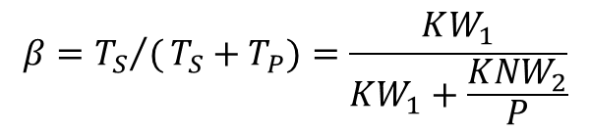
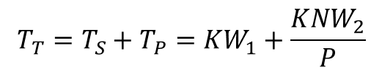
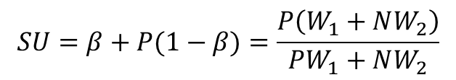
GUSTAFSONS vs AMDAHLS LAW
Using Gustafson’s Law – the total time required to complete this computation is:
Therefore, the fraction of serial time to total time is:
The predicted speedup is:
Start
$$T_{T}={T_{S}+T_{P}=KW}_{1}+\frac{KNW_{2}}{P}$$
Initialization()
W₁ work
Yes
i < N?
No
$$β={{T_{S}}/(T}_{S}+T_{P})=\frac{KW_{1}}{KW_{1}+\frac{KNW_{2}}{P}}$$
W₂ work
Calculation(i)
Print “Finished”
i = i + 1
End
$$SU=β+P(1−β)=\frac{P\left(W_{1}+NW_{2}\right)}{PW_{1}+NW_{2}}$$

Slide 38
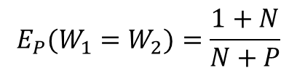
GUSTAFSONS vs AMDAHLS LAW
You can see these two approaches both find the same result.
If you make assumptions about the work W1 and W2, you can predict the speedup and efficiency in terms of N and P alone:
Therefore, for a finite P, we need a very large N to make the parallel efficiency = 1. This is our goal!
Please keep in mind: You’ll need to use these laws to predict your speedup in your minor assignment.
$$E_{P}(W_{1}=W_{2})=\frac{1+N}{N+P}$$
Limit of E with infinite N = 1
Limit of E with infinite P = 0 (?)

Slide 39
PARALLELIZATION PARADIGMS

Slide 40
PARALLELIZATION PARADIGMS
There are several ways in which tasks may be shared across multiple CPU cores.
These can be categorized by comparing the separate tasks performed as part of the parallelization.
Are these tasks very different from each other?
Is the data accessed by each of these tasks very different from each other?

Slide 41
PARALLELIZATION PARADIGMS
In modern operating systems, there are many tasks running in parallel to make your computer work.
Just open up your task manager to see for yourself.
These tasks are all different, and they are running at the same time.
They perform different jobs, use different data.
Hence, we can say these are Multiple Instructions on Multiple Data.

Slide 42
PARALLELIZATION PARADIGMS
Actually, some time ago a researcher came up with a system based on these ideals to categorize the kids of parallelization:
Single Data
Multi Data
Single-
Instructions
SISD
SIMD
Multiple
Instructions
MISD
MIMD
This was the example we just discussed – the Windows O/S employs MIMD parallelization.

Slide 43
PARALLELIZATION PARADIGMS
The design of the modern CPU has been centered on the idea of Multiple Instructions on Multiple Data, or MIMD parallelization.
This means each task is fundamentally different from each other.
Single Data
Multi Data
Single-
Instructions
SISD
SIMD
Multiple
Instructions
MISD
MIMD

Slide 44
Basic Paradigms of Parallelization
During this course, we will only consider the “engineering” option – Multi-Data (i.e. Large Scale)
Single Data
Multi Data
Single-
Instructions
SISD
SIMD
Multi-
Instructions
MISD
MIMD

Slide 45
MIMD
This is the standard means for parallel computation.
MIMD = Multiple Instructions on Multiple Data.
Means each CPU core has the capacity to perform unique instructions on unique data elements.

Slide 46
SIMD vs MIMD
Operation/Instruction
Operation/Instruction(s)
A
A
B
C
D
A
CPU
A
SIMD
MIMD
CPU
B
CPU
B
CPU
Data
Data
C
CPU
C
CPU
CPU
D
CPU
D
Dr. M.R. Smith msmith@nchc.narl.org.tw

Slide 47
SIMD vs MIMD
Operation/Instruction
Operation/Instruction(s)
A
A
B
C
D
A
CPU
A
CPU
B
CPU
Each CPU performs operation A on their respective data set.
B
CPU
Data
Data
C
CPU
C
CPU
CPU
D
CPU
D
Dr. M.R. Smith msmith@nchc.narl.org.tw

Slide 48
SIMD vs MIMD
Operation/Instruction
Operation/Instruction(s)
A
A
B
C
D
A
CPU
A
CPU
B
CPU
Each CPU performs operation A-D on data A-D
B
CPU
Data
Data
C
CPU
C
CPU
CPU
D
CPU
D
Dr. M.R. Smith msmith@nchc.narl.org.tw

Slide 49
MIMD
The architecture (i.e. bus lines, cache, and controller) for MIMD efficient CPU’s is very complicated.
The additional complexity results in additional computational overhead: i.e. MIMD is slower than SIMD (but more flexible)

Slide 50
SIMD and Vector Computation
In the simplified case where each process only operates upon a single (dedicated) set of data, we have a vector computation.
Vector Computation is the most ideal form of parallel computation.
An example of vector computation was covered earlier: c = a + b.
In this case, the addition of element i requires access to the i’th element from a and b – and only this element.

Slide 51
SIMD and Vector Computation
That gives us 3 kinds of parallelization:
MIMD: where each task is unique and unlike the other tasks. This is the most flexible and least efficient manner for parallel computation.
SIMD: where each task is identical, only performed on different data elements.
Vector Parallelization: this is a subset of SIMD computation, where task i will only access data from elements i of vectors used as part of the calculation.*

Slide 52
SUMMARY
By breaking up the task into (i) sequential parts, and (ii) parallel parts, we may estimate what the potential parallel speed up and efficiency is for the algorithm.
The efficiency by which these parallel tasks are computed depends on the style:
MIMD: Multiple (different) Instructions on Multiple Data types.
SIMD: Single Instructions on Multiple Data types.
Vector: Like SIMD, with each thread restricted to what data may be accessed.

Slide 53
SUMMARY
The hardware we perform this parallel computation on depends heavily on the selection of parallelization type.
Vector Computation: Suitable for parallel computing within a single CPU core.
SIMD Computation: Suitable for multiple CPU cores and Graphics Processing Units.
MIMD Computation: Suitable for multiple CPU cores.

Slide 54
NEXT CLASS
In the next class, we will examine the parallelization we may perform in a single CPU core.
This is vector computation using the vector computation registers in the FP computation unit of the CPU.

