Slide 1
Introduction to Multi-Core CPU and GPU Computation 多核心CPU和GPU計算
Class 6 Prof. Matthew Smith, msmith@mail.ncku.edu.tw

Slide 2
Today’s Class…
Today’s class will cover:
Introduction to applied vector computation,
MMX and SSE – background
Introduction to applied SSE

Slide 3
applied SIMD Vector computation

Slide 4
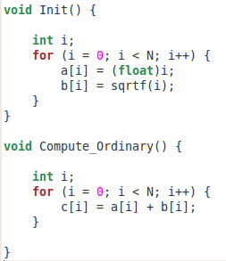
Vector Computation Introduction
The clearest example of a vector computation is…well…a vector computation.
Consider the two functions as shown:
Init(): Sets the values of a[i] and b[i] for N values as shown here.
Compute_Ordinary(): computes c[i] = a[i] + b[i] ➔ a vector addition problem.

Slide 5
Vector Computation Introduction
If this wasn’t a vector addition, how can we be sure it is a vector computation?
Answer: if element c[i] is ONLY a function of the ith element of any number of values from an array, then it is a vector computation.
Example: c[i] = a[i]*b[i] is a vector computation, as is d[i] = a[i]*b[i]*c[i].

Slide 6
Vector Computation Introduction
Right now, I want you to write a code which:
Creates 3 arrays a, b and c with N elements. (N = 32000)
Allocates the memory using malloc,
Uses the Init() function to set the values of a and b,
Uses the Compute_Ordinary() function to compute c,
Print the first 10 values of c to the screen, and
Frees the memory for a,b and c.
When everyone here is done, we will continue.

Slide 7
Vector Computation Introduction
The real question is: Without using more CPU cores, how can we make this code go faster?
The answer to this puzzle was developed by Intel about 15 years ago.
It all starts with MMX…

Slide 8
MMX and SSE

Slide 9
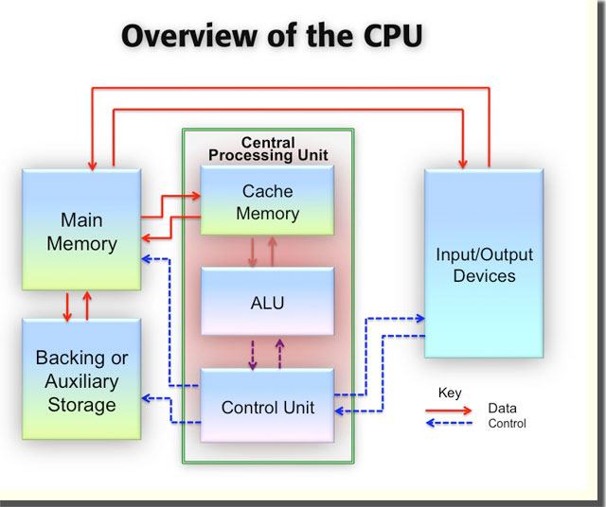
MMX
The actual design of the CPU hasn’t changed too much over the last 30 years.
See this diagram – main memory is still located off-chip, the CPU still consists mainly of Cache (though we have several layers now), a control unit and an ALU.
So, how can we make this work faster without adding more ALU’s?

Slide 10


MMX
It all started with the Intel Pentium II back in 1997 (when I was an undergrad at uni).
Intel was pressured into a way to increase performance – but had not yet developed multi-core technology.
Instead, they found a way to improve the ALU in the CPU...
https://www.youtube.com/watch?v=5zyjSBSvqPc

Slide 11
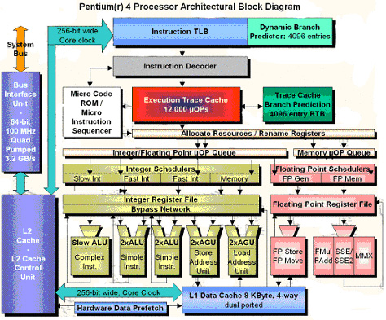
MMX
We can see what changes they made on the Intel P4 processor.
In addition to standard ALU, they added a new part to the CPU – a series of SIMD registers.
Because this is the Pentium 4, we can see both MMX and SSE (later) on the chip.
ALU
SIMD Registers

Slide 12
MMX
The MMX registers could contain 64 bits of data.
MMX was designed such that one may “pack” 4x 16 bit integers into this space...
ALU
int (16 bit)
X0
X1
X2
X3
MMX Registers
SIMD Registers
64 bit

Slide 13
MMX Concept
The MMX registers would then allow operations to be performed across the data held there.
Since there were 4 integers held inside, this single step would perform the computation across all 4 integers in a single cycle.
Hence, it is a form of parallel computing – but must be SIMD.
X0
X1
X2
X3
MMX Registers
Single Operation
MMX Functions
X0’
X1’
X2’
X3’
MMX Registers

Slide 14
MMX Concept
At this time, MMX was designed to parallelize – on a single core – operations on integers.
This was because – at this stage – all graphics and media related calculations were performed on integers.
However, it wasn’t long before we started to need more...
X0
X1
X2
X3
MMX Registers
Single Operation
MMX Functions
X0’
X1’
X2’
X3’
MMX Registers

Slide 15
SSE
The SIMD parallel registers in your CPU were upgraded later to:
Hold more data (128 bits), and
Perform floating point operations.
These were called “Streaming SIMD Extensions”, or SSE.
Builds upon what MMX started, allowing the CPU to perform a larger amount of parallel computation in a single core.
int (16 bit)
X0
X1
X2
X3
MMX Registers
float (32 bit)
64 bit
X0
X1
X2
X3
SSE Registers
128 bit

Slide 16
SSE
This allowed engineers to either:
Start performing parallel computation on 4 floats in each cycle, or
Continue performing integer computations, only using 8 integers instead of four.
Hence, the move from MMX to SSE made computers approximately twice as fast.
int (16 bit)
X0
X1
X2
X3
MMX Registers
float (32 bit)
64 bit
X0
X1
X2
X3
SSE Registers
128 bit

Slide 17
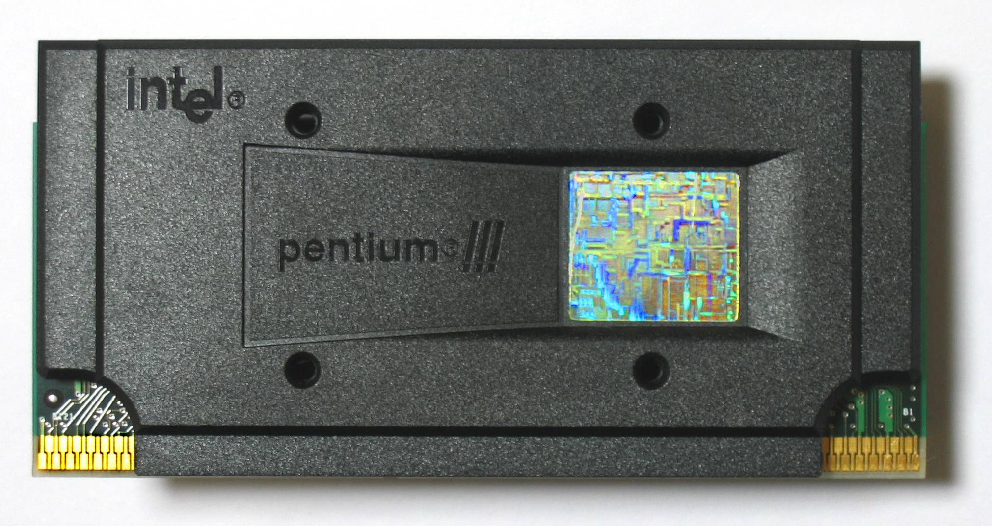
SSE
The Pentium 3 (introduced 1999) was the first CPU to use SSE instructions.
SSE continued to be the primary in-core parallelization tool until the development of AVX (next week) in 2012.
All modern CPU’s continue to support SSE, since AVX is still very new.

Slide 18
INTRODUCTION TO SSE

Slide 19
Introduction to SSE
Ideally, SSE vectorization is performed automatically by the compiler.
When you use the –O3 flag, one of the main processes performed by the compiler is:
The search for sections of code which can be vectorized, and
The construction of machine code for SSE registers.
For simple code, this is easy…

Slide 20
Introduction to SSE
Let’s perform an object dump to see what the compiler is doing.
Compile your last code into an object now (i.e. icc –c , not icc –o). Use –o0 optimization (lowest level)
Use this command to perform an object dump and place the results into a file called machine.txt:
objdump –d code_name.o > machine.txt

Slide 21
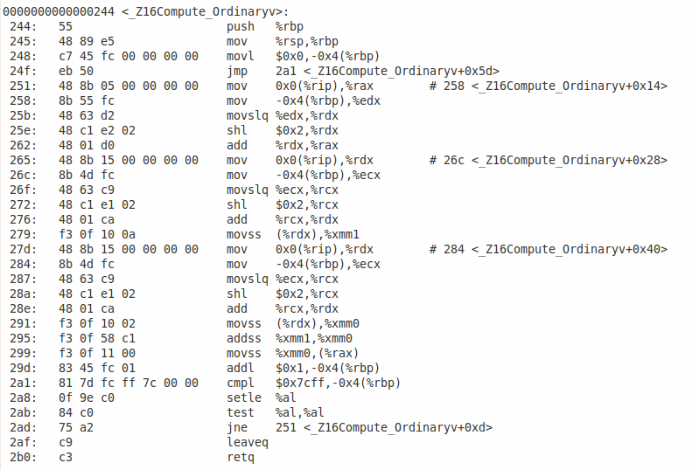
Introduction to SSE
Let’s see what is inside machine.txt
You’ll see all of your functions are separated.
Look for your compute_ordinary() function. Does it look like this?

Slide 22
Introduction to SSE
The gold will be here, with the command addss.
What does that mean?
Add: add two numbers together.
Ss: scalar – single values.

Slide 23
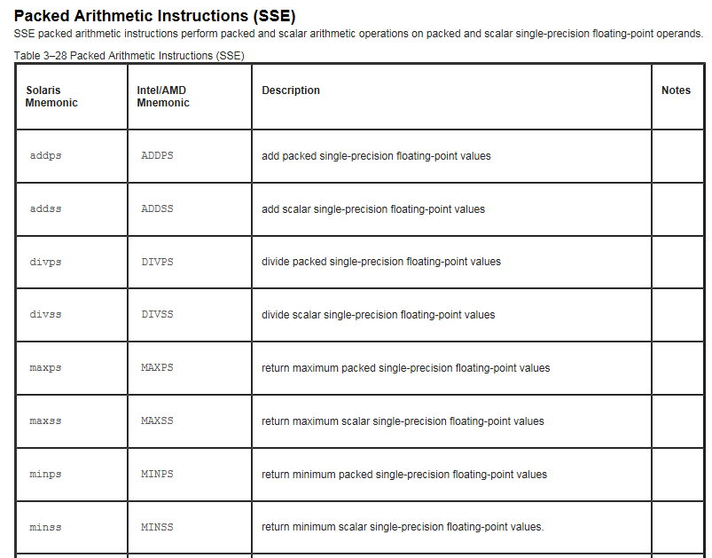
Introduction to SSE
A quick google search will locate the list of SSE instructions, which are used inside your machine code.
We can see here that ADDSS will add scalar (single) single precision values.
This means that, in each cycle, you add two numbers together.

Slide 24
Introduction to SSE
Really, what we want is ADDPS.
This is where, in a single cycle, we use the SSE registers to compute 4 floating point values in a single cycle.
This will be (perhaps) 4 times faster!

Slide 25
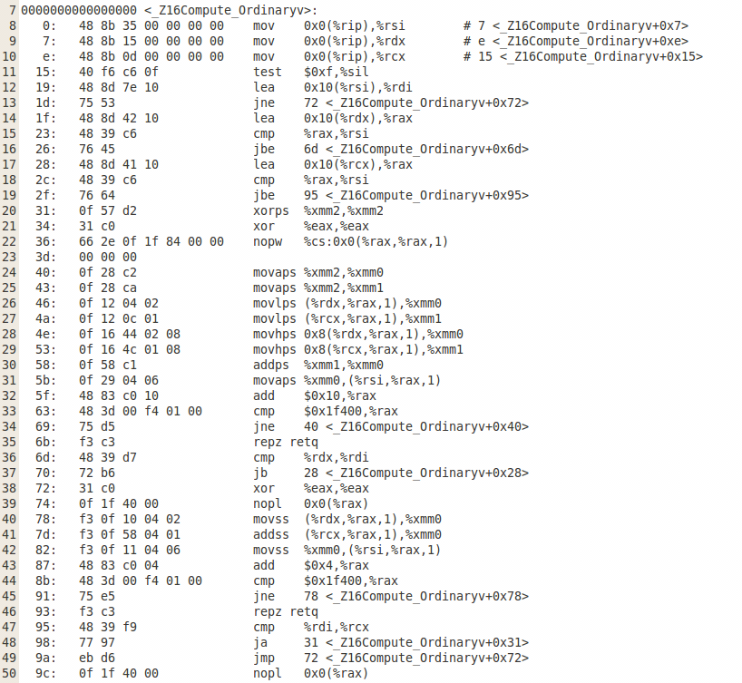
Introduction to SSE
Now, recompile your code using –O3 optimization.
Perform the object dump again, and look at the “machine” instructions.
Here, you should see that you have an addps in here → your code is using the registers properly now. Hooray.

Slide 26
Introduction to SSE
Because your code is using these SSE (SIMD) registers, your code will run much faster.
For small values of N, you may not be able to see the difference on the server for this class – but if you had a VERY large N, you’d notice.
This is also the reason I chose N = 32000 → It can be evenly divided by 4.

Slide 27
SSE Intrinsic Functions
So, what’s the problem?
The compiler is able to perform vectorization using SSE registers for simple problems or very simple code.
It cannot perform vectorization for advanced or tricky code.
So, how do you ensure the vectorization occurs for complex code which:
You know can be vectorized using SSE, and
Isn’t vectorized using a compiler?

Slide 28
SSE Intrinsic Functions
We can manually perform the vectorization – write the instructions into the code so the compiler knows what to do.
This way, we are essentially performing parallel computation – since all SSE computations occur over a group of variables at once – all in a single CPU core.
The instructions we write for the compiler to guarantee the use of SSE are known as “compiler intrinsic functions”, or just “intrinsics”.

Slide 29
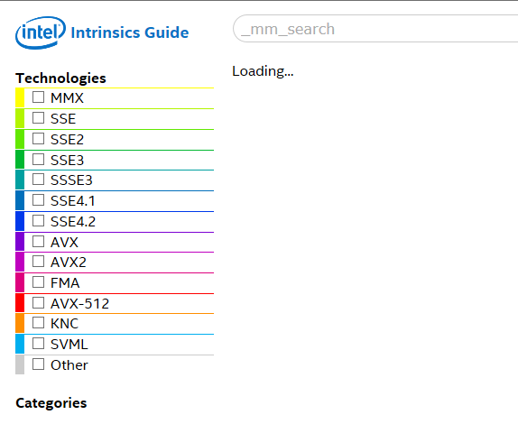
SSE Intrinsic Functions
A good place to start is to look at these intrinsic functions.
Google “Intel Intrinsics guide”, and see what pops up.
You want to look for Intel’s official guide.

Slide 30
SSE Intrinsic Functions
MMX is ancient history.
Look for SSE functions – just SSE. You’ll see that there are more recent developments (such as SSE4.1, AVX etc)
Tick the SSE box – and let’s see what we can see..

Slide 31
SSE Intrinsic Functions
The SSE intrinsic function we are looking for is this one:
SSE_type c = _mm_add_ps(SSE_type a, SSE_type b);
Here, SSE_type is MY way of telling you: this isn’t a float, or a double: it’s a new type.
_mm_add_ps is the parallel add of two single precision packed SSE type variables.

Slide 32
SSE Intrinsic Functions
First, we need to change our array of single precision values (a,b,c) into an SSE type.
In C/C++, the SSE type variable is __m128 → Note, we cannot tell what kind of data is inside, all we know is the size of each SSE variable (128 bits, or 4 x 32 bits = 4 floating point variables)
In C/C++, we have a simple way of converting data types: forced type conversion using ().

Slide 33
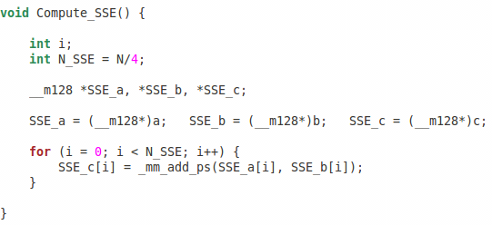
SSE Intrinsic Functions
Copy this function into your existing code:

Slide 34
SSE Intrinsic Functions
We can see our type conversions, and the use of our intrinsic function..
SSE variable declaration
Conversion
Intrinsic function

Slide 35
SSE Intrinsic Functions
My question to you: Why do we use N_SSE = N/4 in our for loop instead of N?

Slide 36
SSE Intrinsic Functions
I’m sure someone figured it out.
The reason is because a single SSE variable contains 4 elements – so we only need to iterate N/4 times instead of N times.
No wonder this method is faster…
Compile your code – but don’t run it yet – and have a look:
[PS: Add #include <xmmintrin.h> to your header collection]

Slide 37
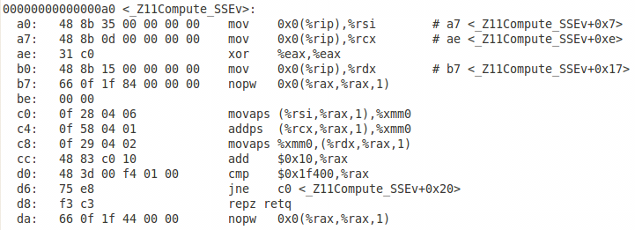
SSE Intrinsic Functions
For me, this is my machine code for the compute_SSE function.
We can see that, as expected, we are using the addps command.
Let’s compare this code against the compute_ordinary function when using –O3 optimization…

Slide 38
Manually written intrinsic functions (Compute_SSE())
So, which code will be faster?
Which program will be smaller?
We can see – the compiler is not superman.
Compiler-performed optimization using –O3

Slide 39
SSE Intrinsic Functions
Don’t get carried away yet.
Go ahead – try to compile and run your program, using Compute_SSE() instead of Compute_Ordinary() and check your answer. [PS: Add #include <xmmintrin.h> to your header collection]
Did your code run, or did it crash?
Did you (perhaps) get a segmentation fault?

Slide 40
Aligned Memory
IF you got a segmentation fault – and I think it is likely – it is because the computer does not know how to “line up” the data stored in a,b and c for the registers.
Using malloc, the data for a,b and c is placed pretty haphazardly (i.e. badly, not neatly) in memory.
We want to find a way to place this data in memory so it is easier to collect for the CPU.

Slide 41
Aligned Memory
Each time the CPU needs data from memory for a computation, it reaches out and grabs a group of data.
If, each time the CPU collects data, it collects half of a value, it means that it will need to make a second trip to get the 2nd half of the value. This takes time.
We can “align” the data in memory so that we are guaranteed to make sure that each “grab” collects whole floating point values.

Slide 42
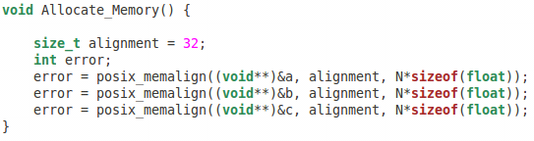
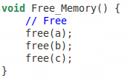
Aligned Memory
There are many functions for this:= in this class, we’ll use one of the oldest and best for linux systems ➔ posix_memalign
Copy my memory allocation function:
New Memory Allocation Function
Free Memory Function (This isn’t changed)

Slide 43
…Finished (or are we?)
By now, your code should compile, run and you should get the correct answer.
But – how do we check our answer? Isn’t our answer contained in SSE_C? We can’t print that out….
SSE_C points to the array C → all of our operations on SSE_C are actually being stored in the memory occupied by the variable C.
So, we need only print the C variable.

Slide 44
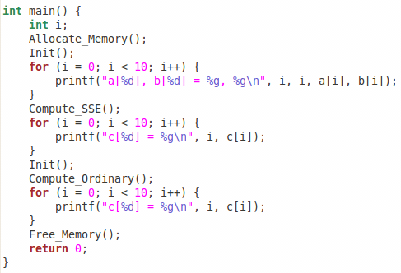
…Finished (or are we?)
To check your code is working, you might do something like this…
Check your Init() function to make sure a and b are correct.
Check your SSE results,
Re-init the values of a and b,
Check your ordinary results,
Free your memory.

Slide 45
…Finished (or are we?)
Do this now.
If you finish before the person next to you, help them if they get stuck.
I want to see everyone finished before I continue.

Slide 46
Tutorial Questions
During today’s tutorial, there are two questions
Q1 you must complete, and I will help you to make sure you do, and
Q2 is more challenging, and I will let you try on your own.
Let’s get started.

Slide 47
Question 1:
Create 4 variables: a, b, c and d → all arrays of floats containing 32,000 elements.
Define a[i] = (float)i, b[i] = 2.0*a[i] and c[i] = 0.5*a[i].
Using SSE intrinsic functions, write a code which computes d = a*b*c.
Print the first 10 values to the screen and show me your machine code obtained using objdump.

Slide 48
Question 2:
Write a code which uses SSE intrinsic functions to do either:
Solve a 1D advection problem (like last week), or
Solve the 1D heat transfer problem.
You can choose which, and choose the initial conditions.
Show me your (i) result, (ii) C/C++ code, and (iii) machine code to finish today’s tutorial.
$$\frac{dU}{dt}+α\frac{dU}{dx}=0$$
$$\frac{dU}{dt}−α\frac{d^{2}U}{dx^{2}}=0$$

