Slide 1
Introduction to Multi-Core CPU and GPU Computation 多核心CPU和GPU計算
Class 7 Prof. Matthew Smith, msmith@mail.ncku.edu.tw

Slide 2
Today’s Class…
Today’s class will cover:
Introduction to AVX – Advanced Vector eXtensions
Your first AVX code,
More advanced AVX implementations.

Slide 3
Advanced vector eXtensions

Slide 4
Advanced Vector Extensions
The Streaming SIMD Extensions (SSE) were used successfully to accelerate calculations for many years.
It was inevitable, however, that the demands for increased performance in graphics and music related applications would result in change.
With the increasing presence of Graphics Processing Units for use in media applications, CPU manufacturers were forced to develop new means of increasing performance.
Hence, they developed AVX.

Slide 5
Advanced Vector Extensions
The Streaming SIMD Extensions (SSE) were used successfully to accelerate calculations for many years.
It was inevitable, however, that the demands for increased performance in graphics and music related applications would result in change.
With the increasing presence of Graphics Processing Units for use in media applications, CPU manufacturers were forced to develop new means of increasing performance.
Hence, they developed AVX.

Slide 6
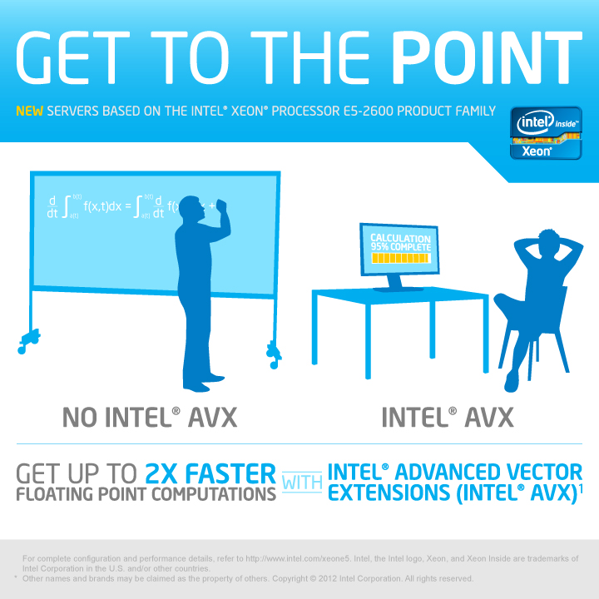

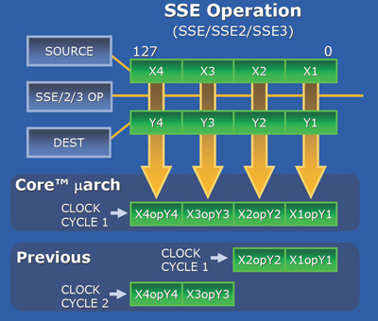
Advanced Vector Extensions
AVX stands for Advanced Vector eXtensions.
It is basically an extension of the SSE instruction set – the concept is the same.
However, AVX registers contain 256 bits of data.
MMX - 64 bit wide registers for parallel computing on integer types.
SSE - 128 bit wide registers for parallel computing on integers, floats and (later) doubles.
AVX - 256 bit wide registers for parallel computing on integers, floats and doubles.

Slide 7
Advanced Vector Extensions
The additional space in the registers means that, instead of performing simultaneous operations across 4 floats, we can now do the same for 8 floats.
This means that we should see a vast improvement in performance!
X0
X1
X2
X3
X4
X5
X6
X7
Single Operation
X0’
X1’
X2’
X3’
X4’
X5’
X6’
X7’

Slide 8
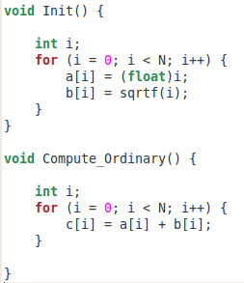
Advanced Vector Extensions
Let’s start by modifying your original code to use AVX instead of SSE.
We’ll do the same computation as before:
Init(): Sets the values of a[i] and b[i] for N values as shown here.
Compute_Ordinary(): computes c[i] = a[i] + b[i] ➔ a vector addition problem.

Slide 9
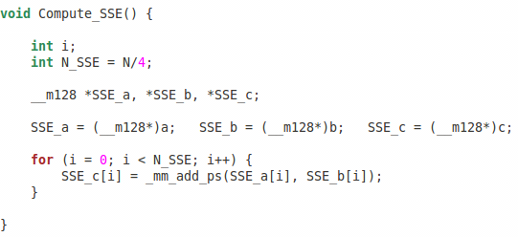
SSE Intrinsic Functions
This was the code we used previously (with SSE) to compute the sum:
SSE variable declaration
Conversion
Intrinsic function

Slide 10
AVX Intrinsic Functions
What needs to change in this code?
The number of operations per AVX packed data type is now 8 instead of 4. This means our loop will run over N/8 instead of N/4.
We need to change the data types from SSE’s __m128 to whatever the AVX type is.
We need to change the intrinsic function: the previous SSE one was _mm_add_ps() – what is the equivalent AVX function?
We need to include the AVX header file and change how we compile too.

Slide 11
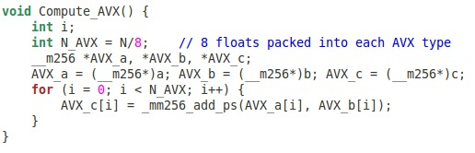
AVX Intrinsic Functions
Let’s have a look at the solution now:

Slide 12
AVX Intrinsic Functions
First – we can see that the correct AVX type is: __m256.
This makes sense – since we have 256 bits in our AVX registers.

Slide 13
AVX Intrinsic Functions
Just like before, we need to “pack” our data into the AVX arrays.
Hence, we transform an array with N floats into an array with N/8 AVX variables.

Slide 14
AVX Intrinsic Functions
Next, we see our intrinsic function: _mm256_add_ps().
This is the AVX version of the same function we used before.

Slide 15
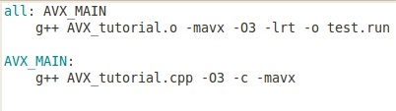
AVX Intrinsic Functions
Finally – when we make our file, we need to add a special library containing the AVX instructions.
For the g++ compiler, it is –mavx (I think it is the same for icc as well).

Slide 16
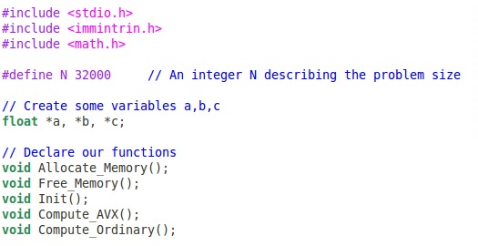
AVX Intrinsic Functions
Before you go to far, we need to change the header file.
We can see the new header – immintrin.h.
Make sure you update your codes to take this into account.

Slide 17
AVX Intrinsic Functions
In the time remaining, please:
Take your existing SSE code and save it as a new file.
Add the new header file for the AVX intrinsics.
Write a new function into your code – Compute_AVX() to compute the sum of A and B.
Use the __m256 types and AVX intrinsic functions to complete the function.
Compile and run your code.

Slide 18
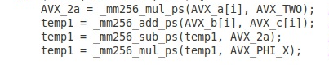
Next class
At the end of the previous class, we assigned the following problem:
Use SSE intrinsic functions to accelerate the FTCS calculation in 1D.
You need to consider how we can use SSE and/or AVX to complete this task.
You may need some of the following instructions:
Multiplication of two AVX types
Addition of two AVX types
Subtraction of two AVX types

Slide 19
Next class
Things you need to consider:
How will you store your data,
How will you pack your data into AVX registers.

