Slide 1
Introduction to Multi-Core CPU and GPU Computation 多核心CPU和GPU計算
Class 8 Prof. Matthew Smith, msmith@mail.ncku.edu.tw

Slide 2
Today’s Class…
Today’s class will cover:
Introduction to cores and concept of threads,
OpenMP

Slide 3
Commonly Used Vocabulary
Parallel Programming is closely related to Multi-threaded programming.
There aren’t any parallel programming methods which do not create threads.
What is a thread? Definition: Thread
A small sequence of instructions executed by a computer system, which may (or may not) be executed simultaneously with other threads.
Generally speaking, a modern CPU core is capable of executing a single thread at a time.

Slide 4
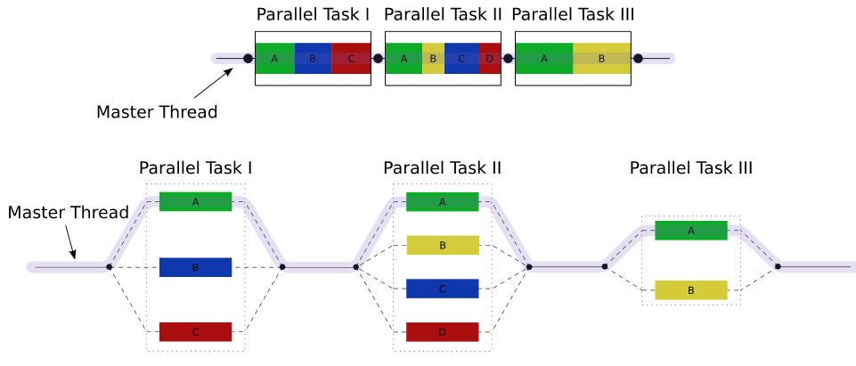
Multi-Threading
As part of this course, we will create programs (processes) which create multiple threads:

Slide 5
Multi-Threading
In most current O/S (Operating Systems), one of our threads will occupy/use one CPU core.
If there aren’t enough cores, then these threads will form a queue (and wait for a free core).

Slide 6
Multi-Threading
Thread 4
Thread 3
Thread 4
Thread 2
Thread 1
Thread 2
Thread 3
Thread 0
Thread 0
Thread 1
CPU 0
CPU 0
CPU 1
CPU 1

Slide 7

Modern Multi-Core Architectures
Can anyone guess which company made the first multi-core CPU?
Can anyone guess when?
The AMD Athlon X2 was the worlds first multi-core CPU and was released in 2005.

Slide 8
Modern Multi-Core Architectures
Multi-Core (on a single die) computation is still a new field of research.
Placing more than one core on a die has several very important advantages…

Slide 9
Modern Multi-Core Architectures
Thread Level Parallelism (TLP) is what this course will focus on.
In TLP, threads within a process have access to multiple cores (for improved efficiency)
There is another important thing threads have access to…

Slide 10
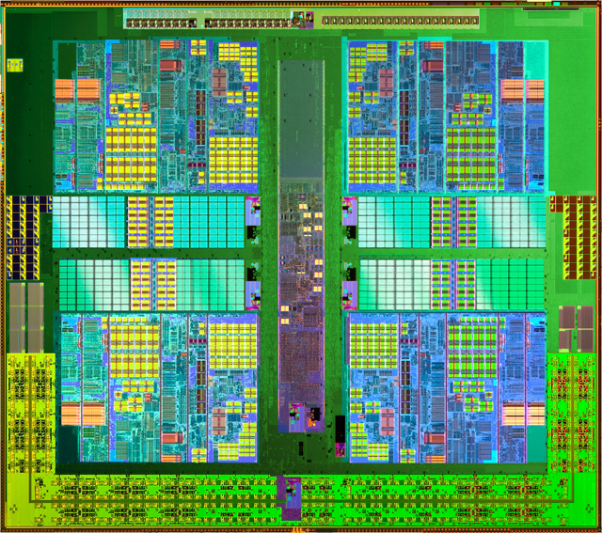
Modern Multi-Core Architectures
Each core has its own cache for storing commonly used things. (L1)
Connecting the cores is a large area of (larger) cache (L2).

Slide 11
Modern Multi-Core Architectures
Most importantly – these cores all share the same memory in the computer system!
“Shared Memory
Parallel Computing”

Slide 12
Shared Memory Implementation
Since this course is focused on shared memory parallelization, we will look at these methods during this course:
1) OpenMP = Open Multiprocessing
2) Posix Threads (Pthreads)
3) CUDA (for GPU)

Slide 13
OpenMP
Open Multi-Processing
OpenMP is a multi-platform API for shared memory multi-processor computation.

Slide 14
OpenMP
OpenMP works by creating (and destroying) threads from a main thread using directives.

Slide 15
Commonly Used Vocabulary
Create Threads
Tell the compiler/computer to create an independent small set of instructions.
Collect Threads
Tell the compiler/computer to destroy previously created threads.

Slide 16
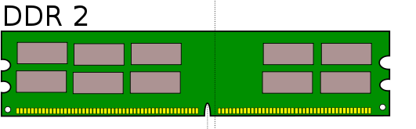
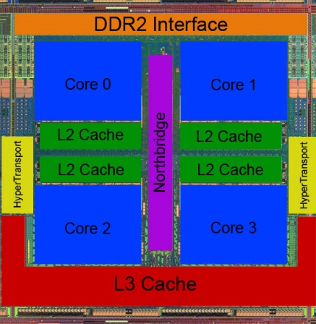
OpenMP
OpenMP can use 100% shared memory…
Each CPU core has access to the same memory.
That means each thread CAN write to the same variable….

Slide 17
OpenMP
…but allows for each CPU to have its own “memory” when required.

Slide 18
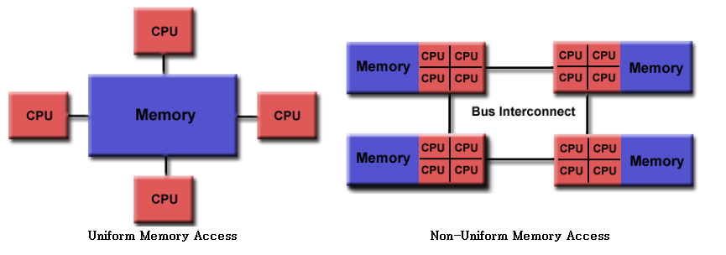
OpenMP
We will use this one.
https://computing.llnl.gov/tutorials/openMP/#ProgrammingModel

Slide 19
Multi-Threading
All programs start as a single thread.
This is the master thread.
(You might call him the “king” thread)
Your program will start (and finish) with the master thread.

Slide 20
Master Thread
START
#include <stdio.h>
int main() {
}
Master Thread
END

Slide 21
Multi-Threading using OpenMP
We use normal programs to write parallel programs using OpenMP using 3 things:
Compiler Directives
Runtime Functions (Libraries)
Environment Variables.

Slide 22
Compiler Directives
Do you remember how we pass on instructions to the compiler?
Actually, we do something a little special for OpenMP – we use pramga:
#
#pragma

Slide 23
Compiler Directives
We use compiler directives to:
Create threads,
Divide chunks of code among threads,
Divide loops among threads, and
Synchronize threads.

Slide 24
Runtime Functions
OpenMP includes a library of useful functions:
These functions are used during the run-time (i.e. not during compilation, but when the program is running)
#include <omp.h>

Slide 25
Runtime Functions
These functions can do things like:
Set the number of threads to use,
Ask about the number of threads,
Ask about the current level of parallelization,
Check the timing (thread CPU time, or wall time),
Plus a whole lot of other things…

Slide 26
The simplest possible example
START
// First OpenMP Code
#include <stdio.h>
#include <omp.h>
int main() {
// Create threads
#pragma omp parallel
{
printf("Hello!\n");
} // Destroy threads
return 0;
}
Create Threads
Print Hello!
Collect Threads
END

Slide 27
Review of the program
For a 4x core system, our program will return:
>> gcc OMP_Demo.c –fopenmp –o test.run
>> ./test.run
Hello!
Hello!
Hello!
Hello!
>>
Tells the compiler that we will be needing OpenMP’s pre-compiled libraries.

Slide 28
Review of the program
We made use of a pragma to create the threads:
Create Threads
#pragma omp parallel
{
printf("Hello!\n");
}
Collect Threads

Slide 29
Review of the program
This program used the Environment variable OMP_NUM_THREADS to decide how many threads to use.
We can use some of OpenMP’s cool library functions to do this for us.
Lets do it.

Slide 30
The next simplest possible example
// Your Second OpenMP code
#include <stdio.h>
#include <omp.h>
int main() {
int P = 4; // No. of threads
int tid;
omp_set_num_threads(P);
// Create threads
#pragma omp parallel private(tid)
{
tid = omp_get_thread_num();
printf("Hello from thread %d\n", tid);
} // Destroy threads
return 0;
}
START
Set number of threads P
Create i = 1:1:P Threads
Print “Hello from thread i”
Collect Threads
END

Slide 31
Review of that program
This program is much more useful.
There is something else important:
#pragma omp parallel private(tid)

Slide 32
Private Variables
OpenMP is a shared memory method for parallelization.
We have to be careful to make sure different threads don’t write to the same data by mistake.
That is what “private” is for.

Slide 33
Private Variables
START
tid
--
--
--
Set number of threads 4
Create i = 1:1:4 Threads
#pragma omp parallel private(tid)
tid
tid
tid
tid
Collect Threads
tid
--
--
--
END

Slide 34
Private Variables
Each thread has it’s own “tid” to write to.
This way, we don’t have each thread trying to write to the same place in memory.
(That’s called “Data Racing”)

Slide 35
Private Variables
What are the drawbacks?
If you have a very large variable, like an array, making it private will mean you will use A LOT of memory.
And sometimes, allowing different threads to access the same array is very, very useful. (Even required)

Slide 36
End of Class
I recommend that you spend the next couple of days reviewing online resources for OpenMP.
There are several very useful pages – especially from the US government research institutions for High Performance Computing (e.g. Lawrence Livermore Laboratories, Sandia, Los Almos).
You will need OpenMP to complete your shock tube task in your major assignment, so good luck.

