Slide 1

Exception Handling
Fundamentals of Programming
LEO GABRIEL V. VILLANUEVA, MIT
Leo Gabriel Villanueva

Slide 2
Introductory Concepts to Programming
1.1 Computer Systems
1.2 Programming Tools
1.3 Basic Steps in Problem Solving
Problem Definition
Problem Analysis
Algorithm Design & Representation (Flowcharting)
1.4 Coding & Debugging

Slide 3
Pretest : Introductory Concepts to Programming
1. Hardware vs. Software Which component of a computer system refers to the tangible, physical parts you can touch, such as the Central Processing Unit (CPU) or Random Access Memory (RAM)?
a) Operating System
b) Hardware
c) Application Software
d) IDE

Slide 4
Pretest : Introductory Concepts to Programming
2. Programming Tools When translating source code into machine code, which tool translates and executes the code line-by-line on the fly, rather than translating the entire file at once?
a) Compiler
b) Text Editor
c) Interpreter
d) Operating System

Slide 5
Pretest : Introductory Concepts to Programming
3. Problem Definition What is the primary risk of skipping the "Problem Definition" phase when developing a program?
a) The code will run too slowly.
b) You risk building a brilliant solution to the wrong problem.
c) The computer will run out of RAM.
d) The flowchart will have crossed lines.

Slide 6
Pretest : Introductory Concepts to Programming
4. Problem Analysis (IPO Model) In the IPO (Input-Process-Output) model, which stage represents the logic, calculations, and step-by-step actions the program must perform to transform raw data into a final result?
a) Input
b) Process
c) Output
d) Storage

Slide 7
Pretest : Introductory Concepts to Programming
5. Flowcharting In standard algorithm flowcharting, which geometric symbol is used to ask a Yes/No or True/False question, splitting the path of the program?
a) Oval (Terminal)
b) Parallelogram (Input/Output)
c) Rectangle (Process)
d) Diamond (Decision)

Slide 8
Pretest : Introductory Concepts to Programming
Answer Key for the Instructor
b) Hardware - Hardware refers to the tangible parts of the computer.
c) Interpreter - An interpreter translates and executes code line-by-line, on the fly.
b) You risk building a brilliant solution to the wrong problem. - If you skip problem definition, you risk building a solution for the wrong problem.
b) Process - Processes are the logic, calculations, or steps the program performs to transform input into output.
d) Diamond (Decision) - The diamond symbol asks a Yes/No or True/False question, splitting the program's path.

Slide 9
1.1 Computer Systems
Computer system is a machine that takes input, processes that information, and produces an output. Every computer system relies on a partnership between two elements:
Hardware
Software

Slide 10
1.1 Computer Systems
Hardware (The Physical Machine)
Hardware refers to the tangible parts of the computer—the things you can physically touch. When you write a program, you are ultimately writing instructions that control these physical components.
CPU (Central Processing Unit): The "brain" of the computer. It executes the actual instructions in your code, performing calculations and logic operations.

Slide 11
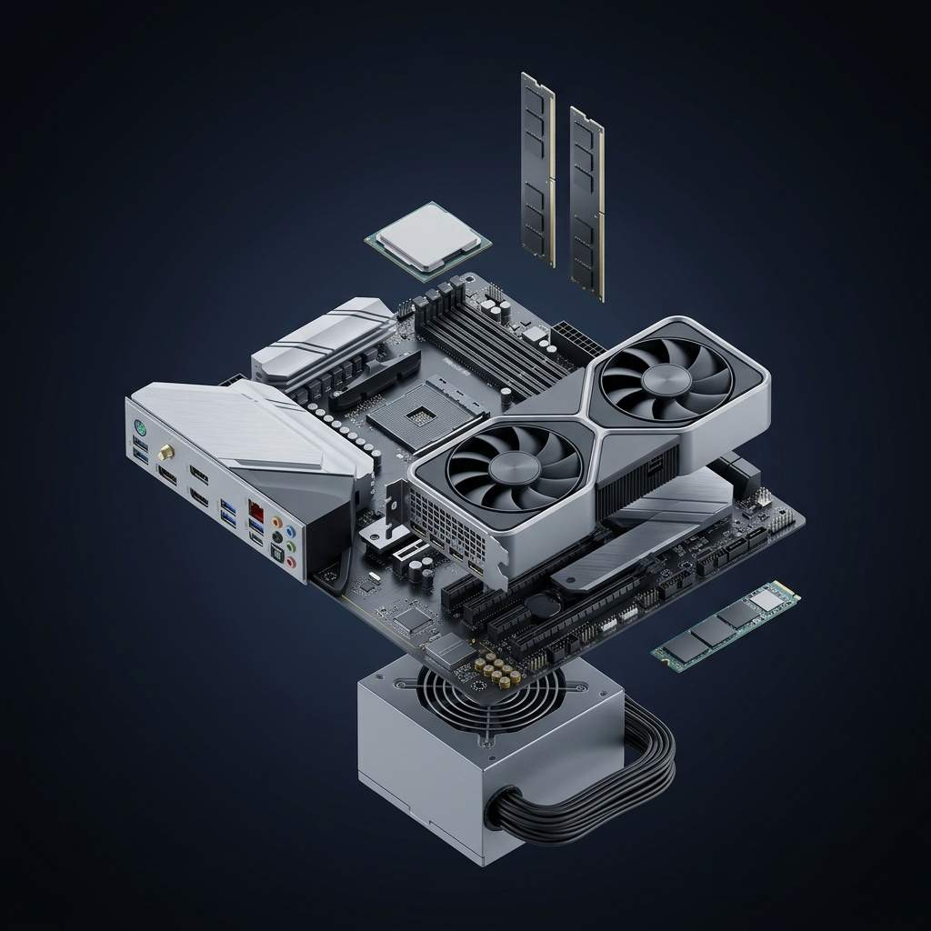
1.1 Computer Systems
RAM (Random Access Memory): The short-term memory. When your program is running, the computer stores the data it is actively using in the RAM because it can be read incredibly fast. When the computer turns off, RAM is wiped clean.
Storage (Hard Drive/SSD): The long-term memory. This is where your code, files, and operating system live permanently, even when the power is off.

Slide 12
1.1 Computer Systems
RAM (Random Access Memory): The short-term memory. When your program is running, the computer stores the data it is actively using in the RAM because it can be read incredibly fast. When the computer turns off, RAM is wiped clean.
Storage (Hard Drive/SSD): The long-term memory. This is where your code, files, and operating system live permanently, even when the power is off.

Slide 13
Software (The Instructions)
Software is the intangible set of instructions that tells the hardware what to do.
System Software: The core software that manages the hardware. The most important piece is the Operating System (OS) like Windows, macOS, or Linux. It acts as the middleman between your programs and the physical hardware.
Application Software: The programs you use every day, like web browsers, video games, or word processors. As a programmer, this is usually what you are building.

Slide 14




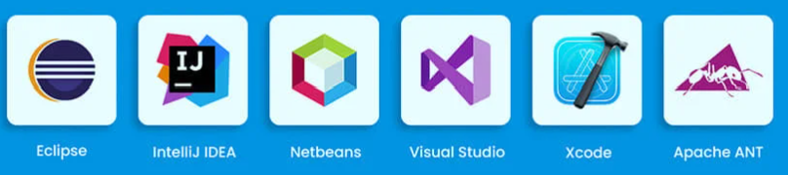
Programming Tools
Text Editors and IDEs
Text Editor: A simple program for writing text. You could technically write code in Notepad, but it wouldn't be very helpful.
Modern code editors (like VS Code or Sublime Text) are designed specifically for coding, offering features like color-coding your text so it's easier to read.

Slide 15
Programming Tools
Text Editors and IDEs
IDE (Integrated Development Environment): A heavier, more powerful tool. An IDE (like Visual Studio, PyCharm, or IntelliJ) bundles a text editor with a bunch of other tools you need, like debuggers (to help find errors) and built-in automation tools. Think of it as a fully equipped workbench rather than just a notepad.

Slide 16
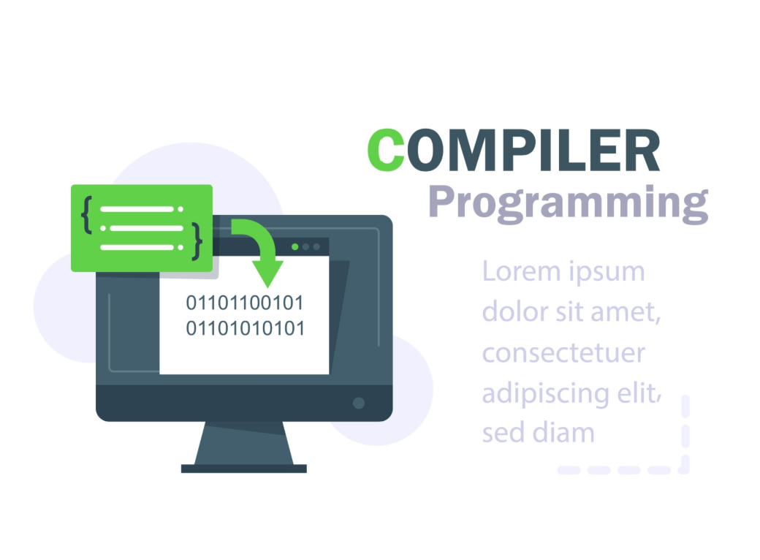
Programming Tools
Compilers and Interpreters
Computers only understand machine code—a binary language of 1s and 0s. Humans write source code (like Python, Java, or C++) which uses English-like keywords. We need a translator to bridge that gap.

Slide 17
Programming Tools
Compilers and Interpreters
Compiler: Takes your entire source code file, translates it all at once into a complete machine code file (an executable), and then runs it. Languages like C++ and Java use compilers. It takes a little longer to prepare, but runs very fast.
Interpreter: Translates and executes your code line-by-line, on the fly. Languages like Python, Java and JavaScript use interpreters. It's faster to start running your code, but the execution itself might be slightly slower.

Slide 18
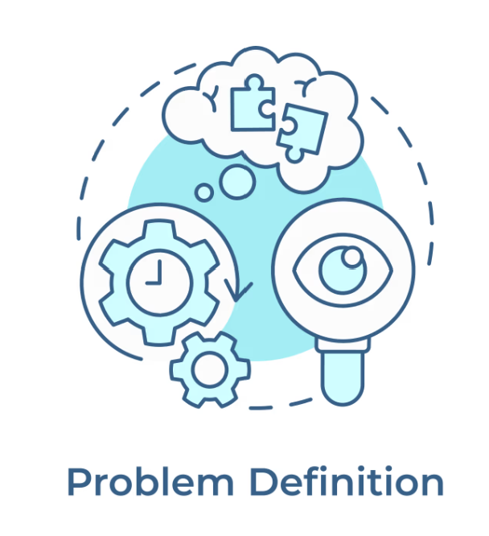
Problem Definition
Problem Definition is the process of clearly outlining the goal, the boundaries, and the expected outcome of the program.
If you skip this step, you risk building a brilliant solution to the wrong problem.
What is the core task? We need to give people a number so they know their place in line.
What are the constraints? The numbers must go in order, and two people cannot receive the same number.
What is the expected outcome? A system that outputs a unique, sequential number every time a user requests one.

Slide 19
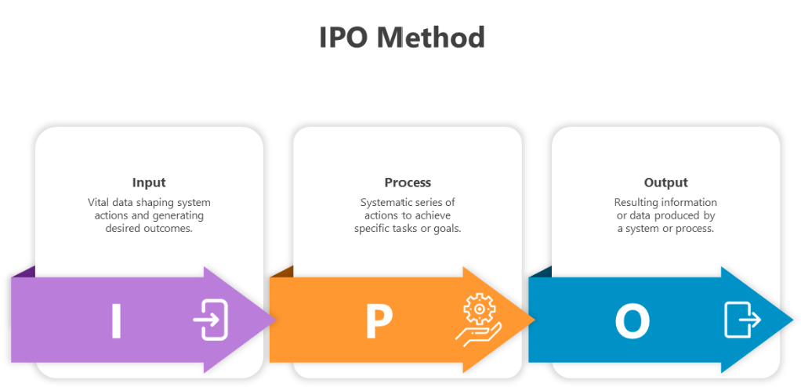
Problem Analysis
Once the problem is defined, we break it down into actionable pieces. We do this by analyzing the problem using the IPO Model: Inputs, Processes, and Outputs.

Slide 20
Problem Analysis
Inputs: What raw data or actions does the program need to receive?
Our Queue System: The only input is the user clicking the "Get Ticket" button.
Processes: What logic, calculations, or steps must the program perform to transform the input into the output?
Our Queue System: - Look at the last number that was given out, Add 1 to that number to generate the new ticket number, Save this new number as the "last number given out" for the next person.
Outputs: What is the final result the program delivers?
Our Queue System: Displaying or printing the new ticket number for the user.

Slide 21

Algorithm Design & Representation (Flowcharting)
An algorithm is simply a step-by-step set of instructions designed to perform a specific task. A recipe for baking a cake is an algorithm. The process we just outlined above is an algorithm.
A set of instructions for solving problem or accomplishing tasks

Slide 22
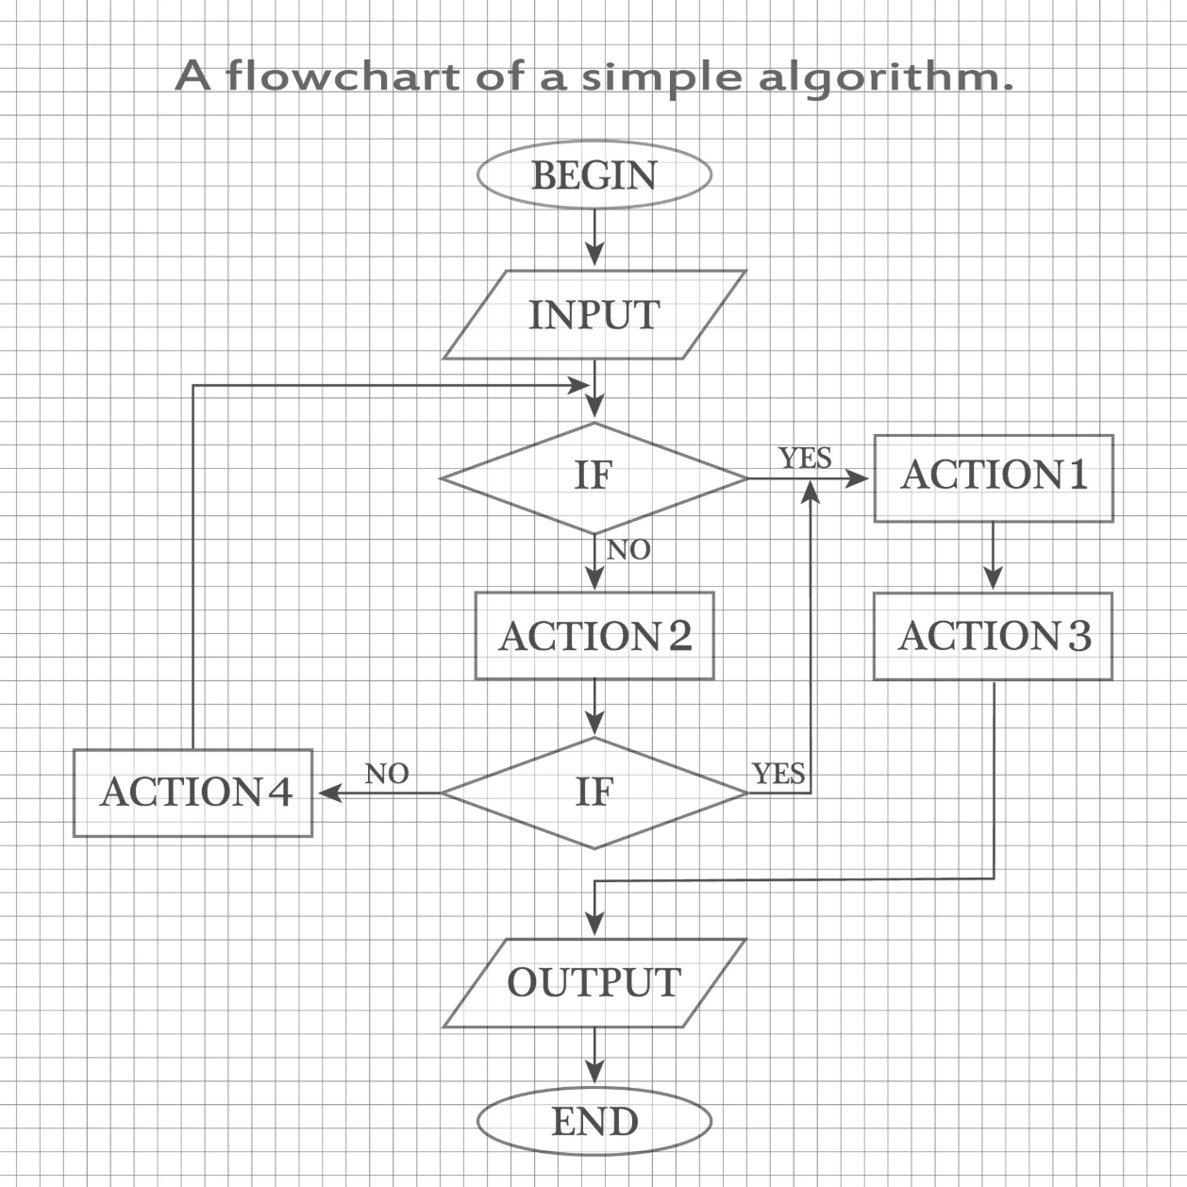
Flowchart Symbols
Flowcharts use standard geometric shapes to represent different types of actions in your algorithm.
Standard algorithmic flowchart structure. Source: NATALIA NOSOVA / Getty Images

Slide 23
Flowchart Symbols
Best Practice Tip: Flowcharts should always flow from top to bottom, or left to right. Keep your arrows clear, and avoid crossing lines whenever possible.
Here are the four primary symbols
Symbol Shape | Name | Purpose | Example in our Queue System
Oval | Terminal / Terminator | Indicates the Start or End of the entire program. | Start Program
Parallelogram | Input / Output | Shows data entering the system or results leaving the system. | Output: "Ticket #5"
Rectangle | Process | Represents an action, calculation, or internal operation. | CurrentNumber = CurrentNumber + 1
Diamond | Decision | Asks a Yes/No or True/False question, splitting the path of the program. | Is the printer out of paper?
Standard algorithmic flowchart structure. Source: NATALIA NOSOVA / Getty Images

Slide 24
Algorithm Design (Flowchart Steps)
Problem Definition
Goal: Cook a standard pot of pork adobo.
Constraint: The meat must be simmered until it is perfectly tender. The process cannot finish until this condition is met.
Problem Analysis (IPO Model)
Input | Process | Output
Ingredients: Pork, Soy Sauce, Vinegar, Garlic, Peppercorns, Bay Leaves, Water, Heat | 1. Combine all ingredients in a pot. 2. Apply heat to bring to a boil. 3. Lower heat to simmer. 4. Loop / Decision: Is the pork tender? - If No: Wait 10 minutes, then check again. - If Yes: Proceed to step 5. 5. Turn off heat. | A cooked pot of Adobo.

Slide 25
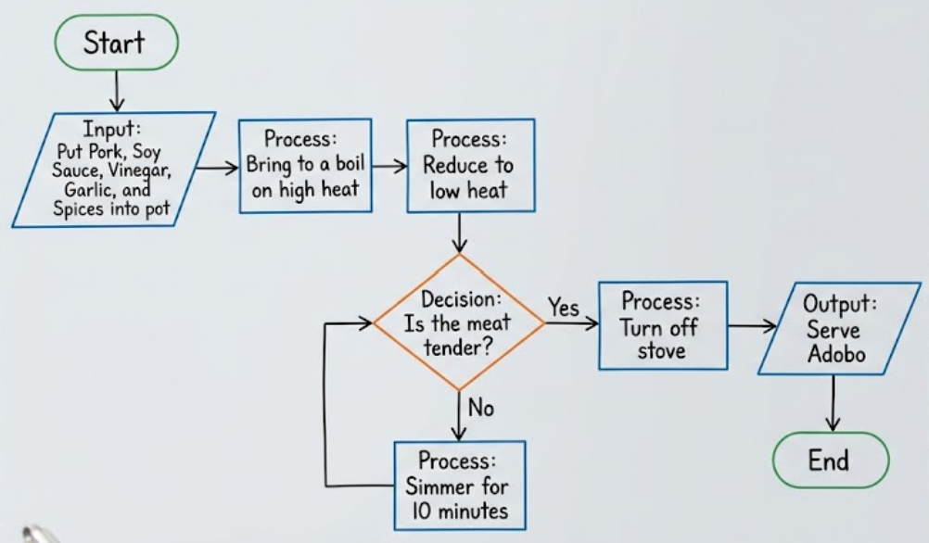
Example: The Adobo Algorithm (Introducing Loops)
Start (Oval)
Input: Put Pork, Soy Sauce, Vinegar, Garlic, and Spices into pot (Parallelogram)
Process: Bring to a boil on high heat (Rectangle)
Process: Reduce to low heat (Rectangle)
Decision: Is the meat tender? (Diamond)
If No: Process: Simmer for 10 minutes -> Loop back to Step 5 (Decision)
If Yes: Proceed to Step 6
Process: Turn off stove (Rectangle)
Output: Serve Adobo (Parallelogram)
End (Oval)

Slide 26
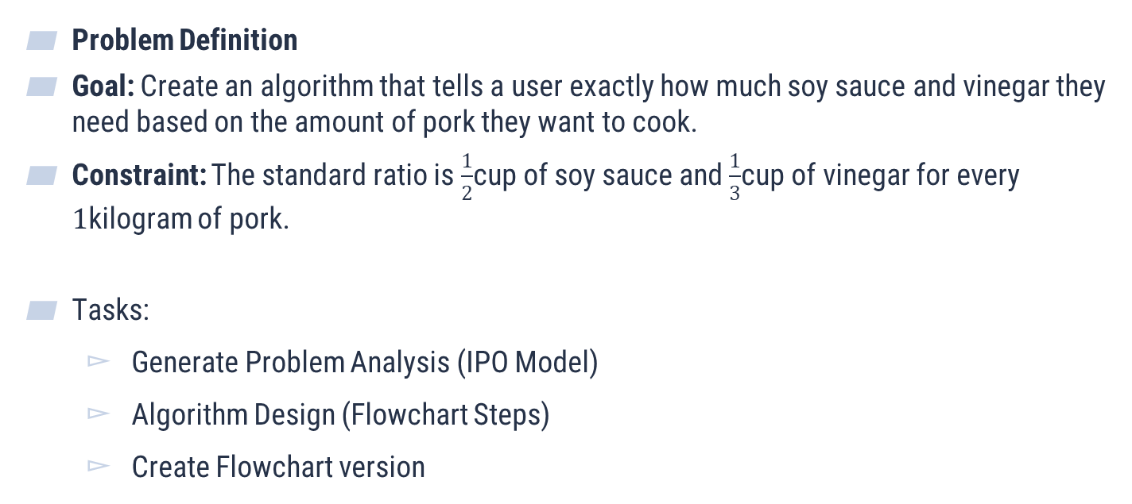
Activity 1: The Dynamic Adobo Algorithm (Input & Calculation)
Problem Definition
Goal: Create an algorithm that tells a user exactly how much soy sauce and vinegar they need based on the amount of pork they want to cook.
Constraint: The standard ratio is $\frac{1}{2}$cup of soy sauce and $\frac{1}{3}$cup of vinegar for every $1$kilogram of pork.
Tasks:
Generate Problem Analysis (IPO Model)
Algorithm Design (Flowchart Steps)
Create Flowchart version

Slide 27
Activity 2: The PSU admission process
Problem Definition
Goal: Create an algorithm regarding your experience during admission
Tasks:
Generate Problem Analysis (IPO Model)
Algorithm Design (Flowchart Steps)
Create Flowchart version

Slide 28
THANK YOU

