Slide 1
Dynamic Albedo
1 surface data
2 Fortran script
3 CESM compile

Slide 2
1 surface data - stream data
integer :: begg, endg ! beginning and ending gridcell index
integer :: begl, endl ! beginning and ending landunit index
integer :: begc, endc ! beginning and ending column index
integer :: begp, endp ! beginning and ending patch index

Slide 3
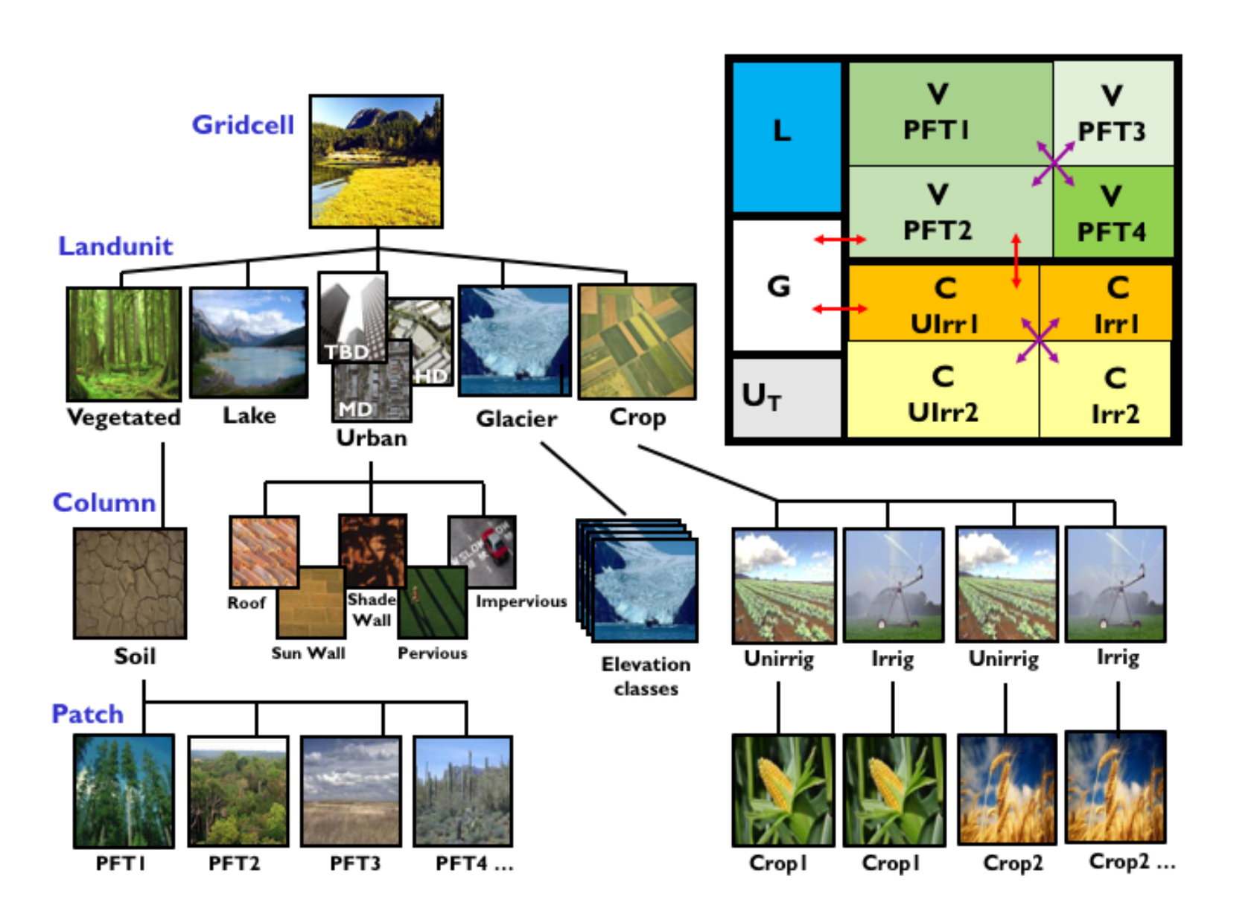
1 surface data - stream data

Slide 4
1 surface data - stream data
Module | surface data Variable | Dimension | Index
UrbanTimeVarType.F90 | tbuildingmax_TBD; tbuildingmax_HD; tbuildingmax_MD | time=258, lat=192, lon=288 | t_building_max ( l )
ndepStreamMod.F90 | NDEP_NHx_month; NDEP_NOy_month; NDEP_month; dry_deposition_NHx_as_N; dry_deposition_NOy_as_N | time=2004, lat=192, lon=288 | forc_ndep_grc ( g )
laiStreamMod.F90 | LAI_1; ...; LAI_16 | time=156, lat=360, lon=720 | tlai_patch ( p )
FireDataBaseType.F90 | hmd | time=251, lat=360, lon=720 | forc_hdm ( g ); forc_lnfm ( g )
SoilMoistureStreamMod.F90 | H2OSOI | time=12, levsoi=20, lat=192, lon=288 | h2osoi_vol ( c , j )
ch4FInundatedStreamType.F90 | F0; FWS_TWS_A; FWS_TWS_B; P3; ZWT0 | time=1, lsmlat=192, lsmlon=288 | zwt0_gdc(g); f0_gdc(g); p3_gdc(g); fws_slope_gdc(g); fws_intercept_gdc(g)
ExcessIceStreamType.F90 | EXICE | time=1, lat=1440, lon=2880

Slide 5
1 surface data - create stream file in Python
# create dimension
numrad = f.createDimension (‘numrad’, 2)
# create new variables
dyn_alb_roof_TBD = f.createVariable(‘dyn_alb_roof_TBD’, np.float64, (‘time’, ‘numrad’, ‘lat’, ‘lon’), zlib=True, complevel =3)
# write in value
roof_albedo_value = f2.variables[‘ALB_ROOF_DIR’][:, :, :, :]
for i in range (258)
f.variables [‘dyn_alb_roof_TBD’][i,:,:] = roof_albedo_value[0,0,:,:]

Slide 6
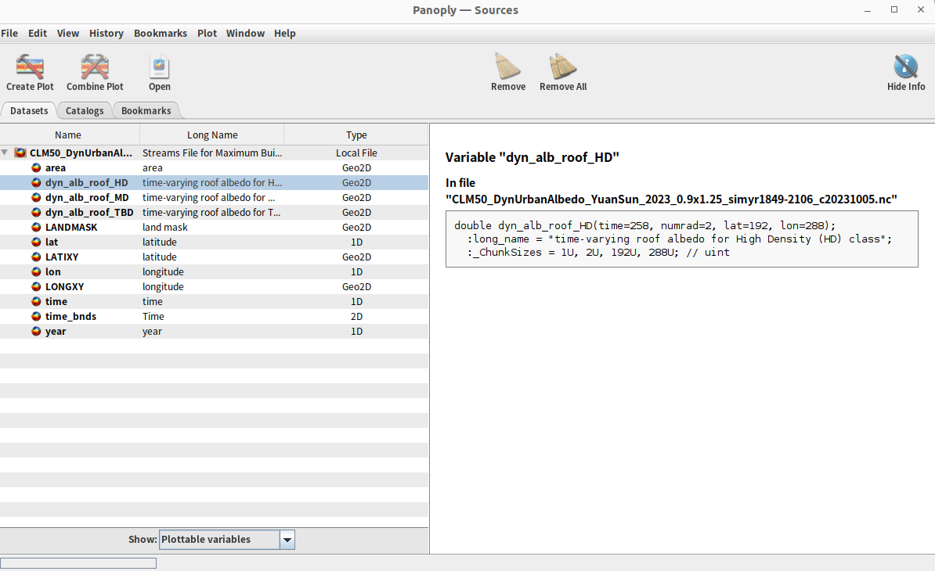

Slide 7
2 Fortran Script - defult in ‘UrbanParamsType.F90’
public variables:
this%t_building_min (begl:endl)
this%t_building_max(l) = this%sdat_urbantv%avs(1)%rAttr(ip,ig)
this%alb_roof_dir (begl: endl, numrad)
input variables:
urbinp%t_building_min(begg:endg, numrl)
urbinp%alb_roof_dir (begg:endg, numrl, numrad)
Thus:
this%dyn_alb_roof_dir(l, numrad) = this%sdat_urbantv%avs(1)%rAttr(ip,ig,ib)

Slide 8
3 CESM compile
UrbanDynAlbMod.F90
UrbanParamsType.F90
clm_instMode.F90
CLMBuildNamelist.pm
clm_driver.F90
namelist_default_clm4_5.xml
namelist_definition_clm4_5.xml
clm_initializeMod.F90
clm_varctl.F90

