Slide 1
Representation of Time-Varying Urban Albedo in the Community Earth System Model (CESM)

Slide 2
1 Introduction
why urban albedo
urban heat issues
urban climate-sensitive design——white roof, cooling pavement
quantify the cooling effects of high albedo
regional climate model
global Earth system model
constant urban parameters
why dynamic albedo
large-scale deployment of urban albedo changes like white roof installation is a progressive process and could not be realized instantly in the real life
we describe time-varying albedo in the CESM to imitate implementable actions in response to adaptation

Slide 3
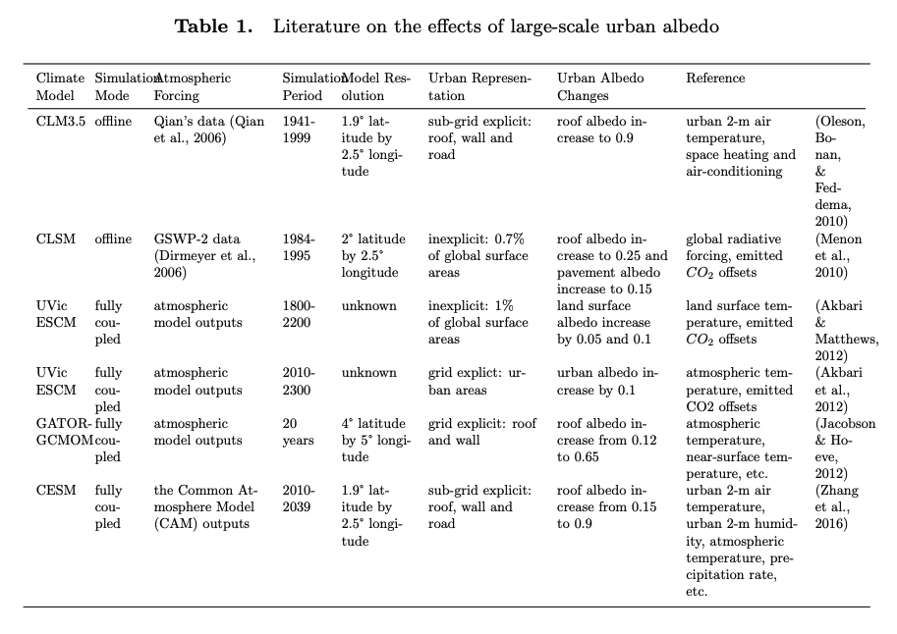

Slide 4
Knowledge gap
Many regional climate models have quantified coolling effects of urban albedo, but few at the global scale;
There are sevel global ESMs assess the cooling effects of urban albedo, but use insufficient urban modelling
urban parameters remain constent over time;
only concerns about urban horizontal surfaces but few on verical surface;
omit urbanization (urban areas did not change over time).

Slide 5
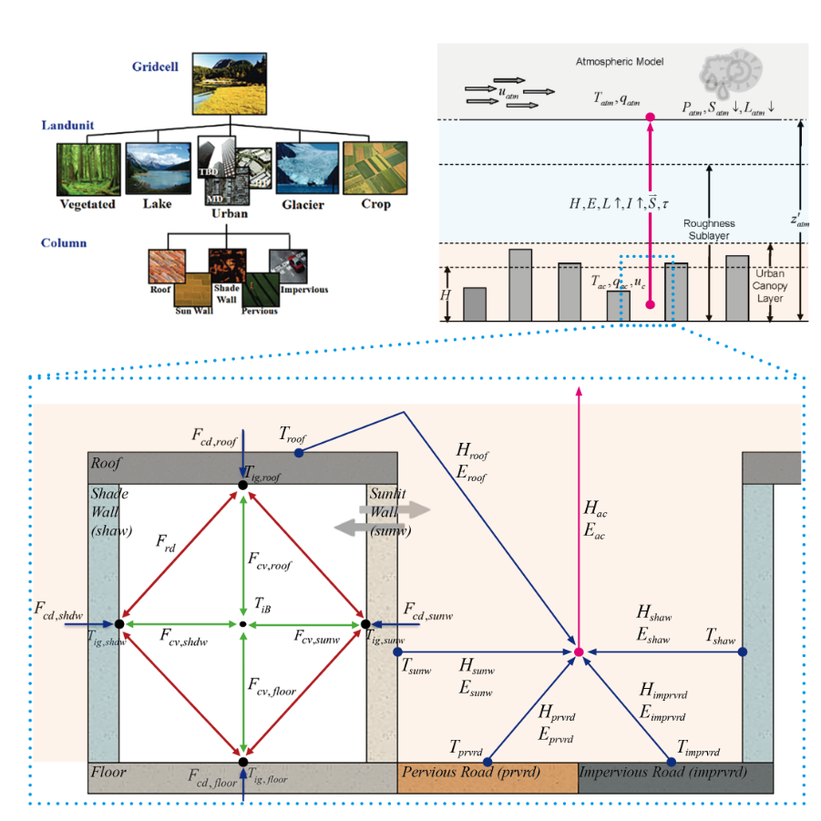
2 Methods

Slide 6
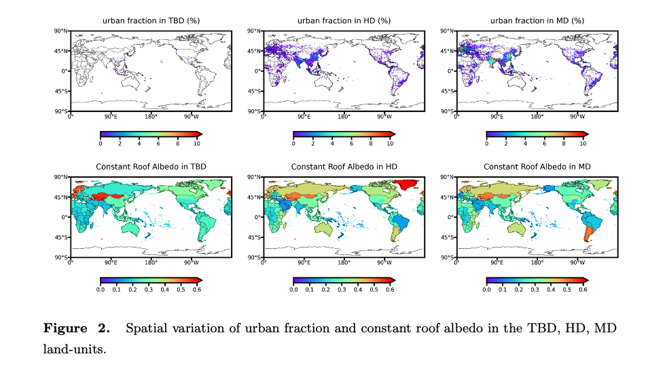
constant urban fraction and urban albedo

Slide 7
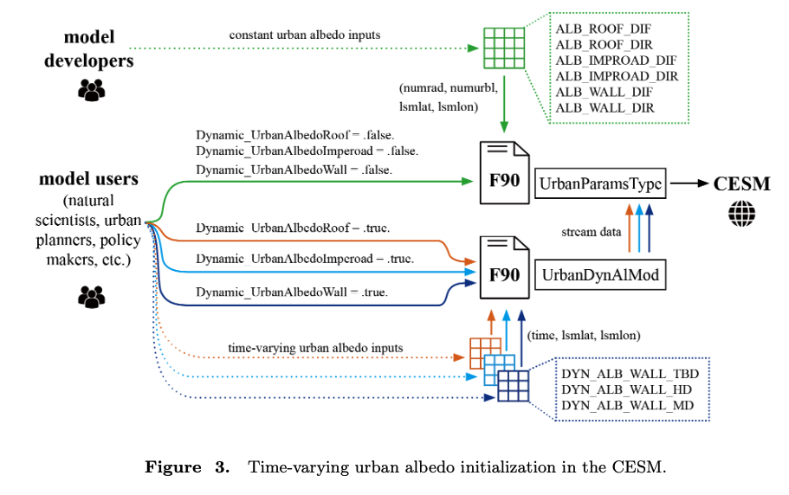
new module ‘UrbanDynAlbMod’

Slide 8
Uncertainty begins.

Slide 9
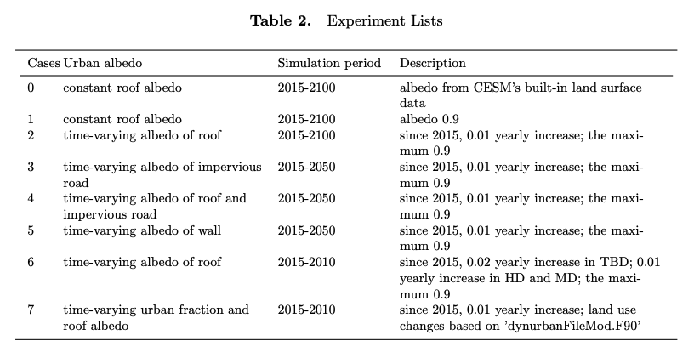
Experiment design
Experiment 1 Case1-Case0 Vs Case2-Case0
Experiment 2 Case2 Vs Case3 Vs Case4 Vs Case5
Experiment 3 Case2 Vs Case6
Experiment 4 Case2 Vs Case7

Slide 10
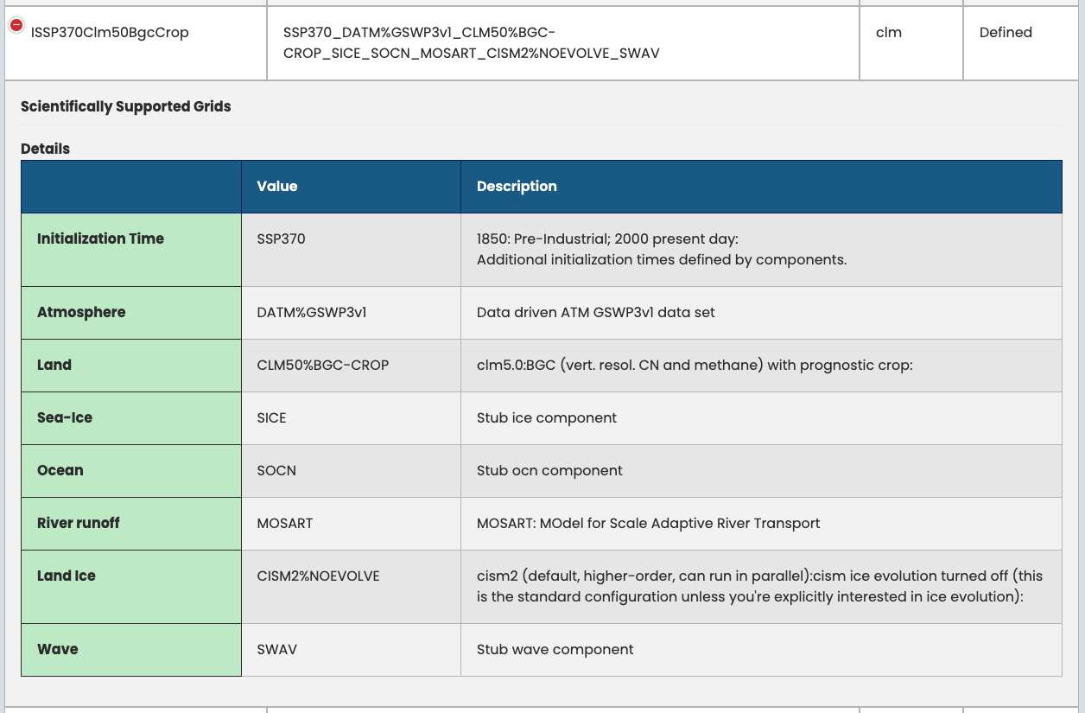
Compset
If using DATM, there seem to be no interaction between land and atmosphere. Dose DATM influence the sensitivity study?
fully coupled(B compsets) or land only(I compsets)?
https://docs.cesm.ucar.edu/models/cesm2/config/compsets.html

Slide 11
2014-12-31
2051-01-01
2000-01-01
2015-01-01
2050-12-31
2100-12-31
default constant albedo
(spin-up)
default constant albedo (branch 0)
0.9 constant roof albedo (branch 1)
dynamic roof albedo (branch2.a )
(branch2.b )
dynamic imperoad albedo (branch3.a )
dynamic roof+imperoad albedo (branch4.a )
dynamic wall albedo (branch5.a )
dynamic roof albedo with TBD, HD, MD (branch6.a )
(branch6.b )
dynamic roof albedo and dynamic urban (branch7.a )
(branch7.b )

Slide 12
Quanfication
land model outputs:
urban heat island(UHI)
surface UHI = urban surface temperature - rural surface temperature
canopy air UHI = urban 2-m air temperature - rural 2-m air temperature
urban heat stress
the National Weather Service (NWS) Heat Index (HI)
Apparent Temperature (AT)
SWBGT
Humidex
Discomfort Index (DI)
urban heat extreme ? urban heat wave ?

Slide 13
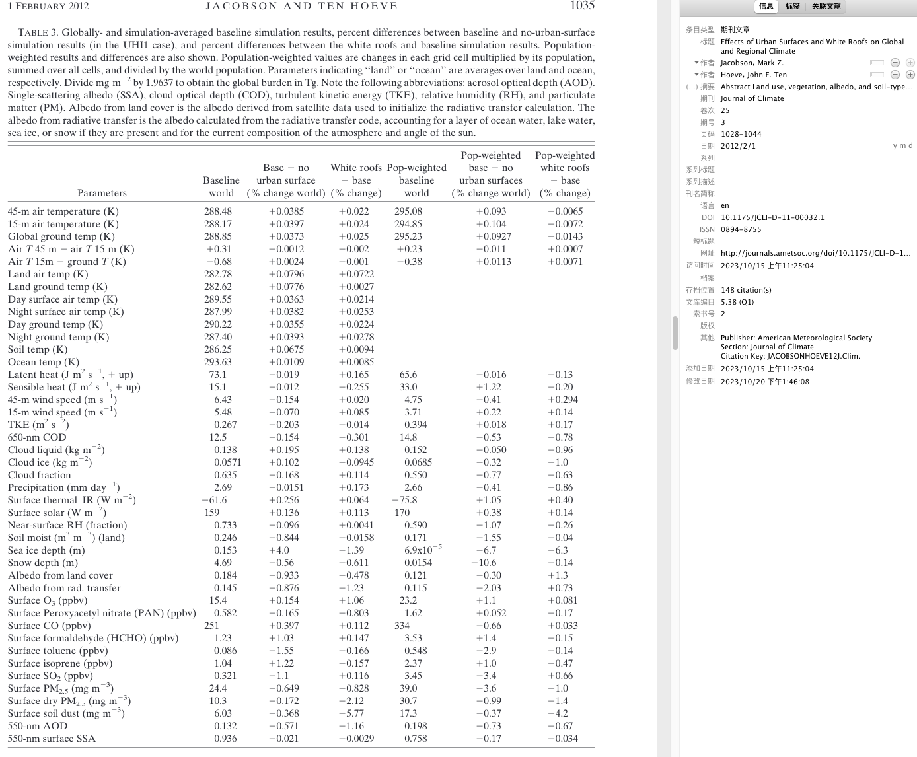
Quanfication
atmosphere model outputs (atmospheric sensitivity)

Slide 14
Question
On my current experiment design: is it ok...?
‘Effects’: shall urban heat extreme / urban heat wave further considered?
Data outputs: There are some many parameters, I have no idea about the selection.
monthly outputs?
shall I use the default outputs or customize output namelist?
if I give detailed analysis on each experiment, the paper will be super long. So I plan to focus on Experiment1 data analysis, and simplify descirption on Experiment2-4.

Slide 15
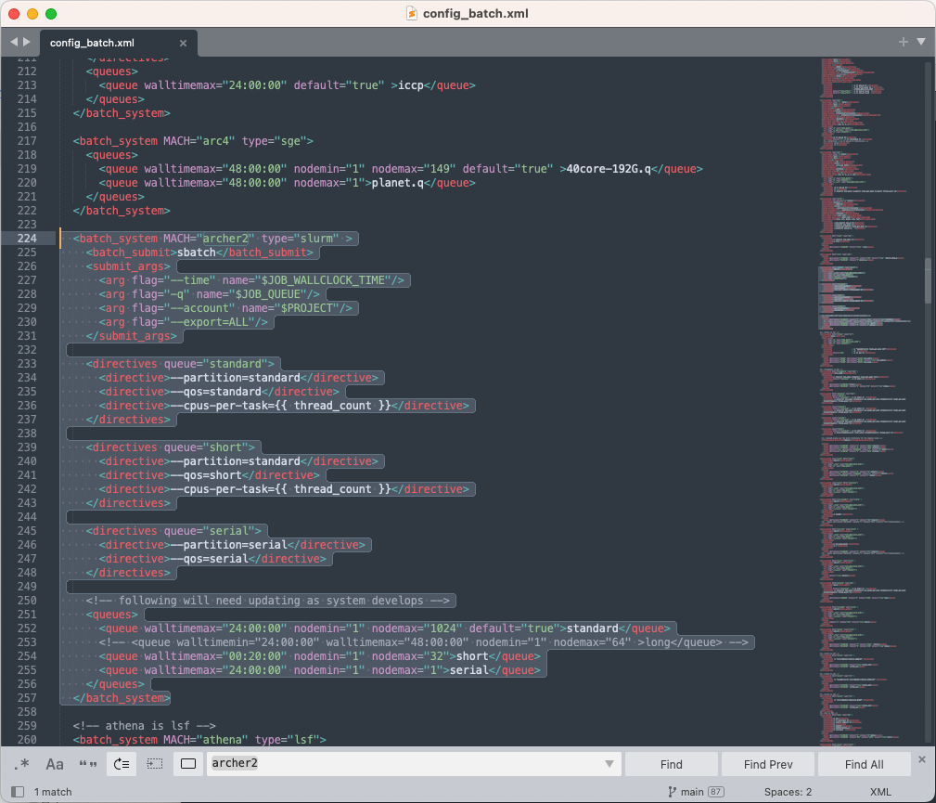
Archer2
In general, how many nodes to use?
shall I change the config_batch.xml?
./xmlquery NTASK, NTHRDS,ROOTPE,NINST
ATM and OCN parallel, and the other components seriel?
NO IDEA :(

Slide 16
