Slide 1
EDA Final Presentation
B00902051 資工四 李益昌 B01901046 電機三 謝沅廷
B01901065 電機三 陳韻竹

Slide 2
Topic
ICCAD Contest 2015
Problem C : Incremental Timing-driven Placement

Slide 3
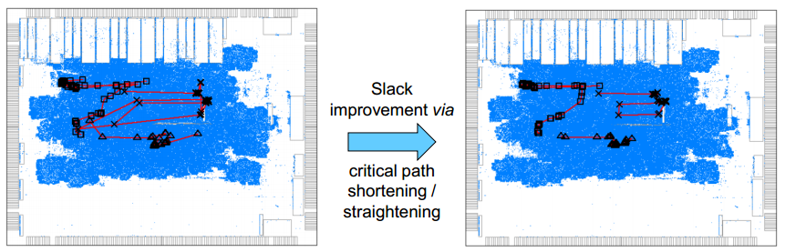
Contest Background
Traditional placement try to optimize total wire length - unaware of individual timing paths
Timing-driven placement (TDP) - based on timer feedback - timing information often becomes inaccurate - fixing one failing path may cause other paths to fail
UI-Timer2.0 : top performer at TAU 2015 timer contest

Slide 4
Contest Description
Preserve overall quality of a given placement - placement density - pin density - routing congestion
Only small local moves can be accepted - limit the maximum movement from a given placement - optimize timing of the network subject to the given constraints
Timing violation improvement (ΔTNS / ΔWNS)

Slide 5
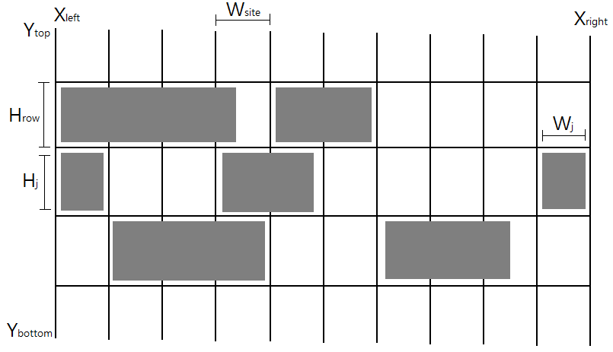
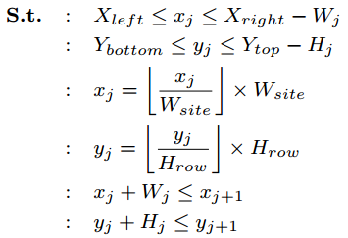
Contest constraints
Soft constraint - similar routing congestion / (pin) density
Hard constraints - Maximum displacement - Legality - Local Clock Buffer (LCB) and clock connection validity

Slide 6
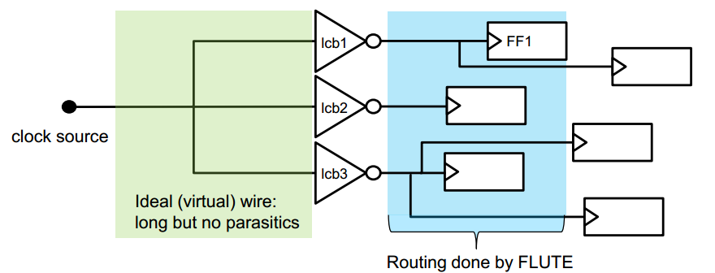
Local Clock Buffer
each FF’s clock is driven by a LCB
one-to-one FF's clock pin & LCB, max LCB fanouts
relatively short signal routing is still done by FLUTE

Slide 7
File format(1/2)
Input files: Benchmarks - .iccad2015, .v, .lef, .def, .sdc, Early.lib, and Late.lib
.iccad2015 : contains the list/location of the other 4 files
.v : connectivity
.lef : SITE, LAYER, MACRO
.def : ROW, COMPONENTS, PINS, NETS
.sdc : initial timing conditions
.lib : early / late timing information

Slide 8
File format(2/2)
Output Files : - .def, .ops
.def : VERSION, DESIGN, COMPONENTS
.ops : FF-to-LCB associations

Slide 9
Input parser and Data structure
Circuit
Cell, Pin, Net, Row, Site, Layer

Slide 10
Algorithm(1/7)
TDP method : - Net-based TDP : convert timing information into net-weights - Dynamic vs. Static approaches : dynamic approaches update net-weights during iterations

Slide 11
Algorithm(2/7)
Lagrangian Relaxation Formulation : - incorporate hard constraints into the objective function - penalty term called Lagrange multiplier (LM) - LMs serve as net-weights
Delay information from HPWL & RC

Slide 12
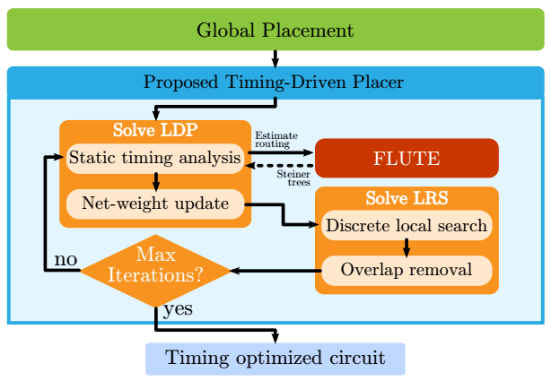
Algorithm(3/7)
delay information → update LMs → move cells → new delay information → new LMs → move cells again
Call Timer every iteration

Slide 13
Algorithm(4/7)
Building specific order - From PI using BFS to find the order

Slide 14
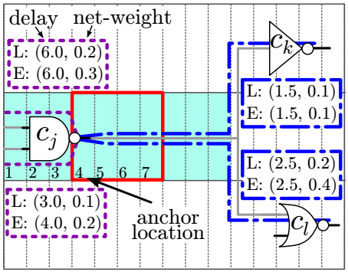
Algorithm(5/7)
discrete local search - net-weights - in a “specific order” - delay : HPWL & RC - cost : delay & net-weights - min-cost position - window size

Slide 15
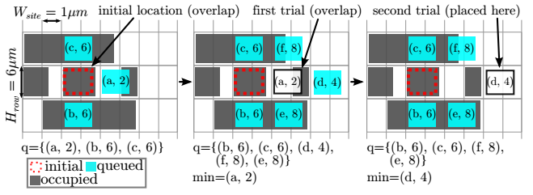
Algorithm(6/7)
overlap removal - build red-black tree of required size of site - build red-black trees: insert empty site in the trees - choose one from the predecessor and the successor

Slide 16
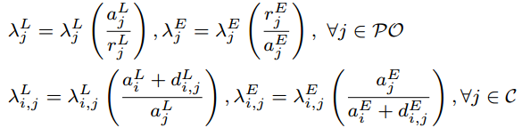
Algorithm(7/7)
update late and early net-weights (LMs) [2] - in a “specific” order too

Slide 17
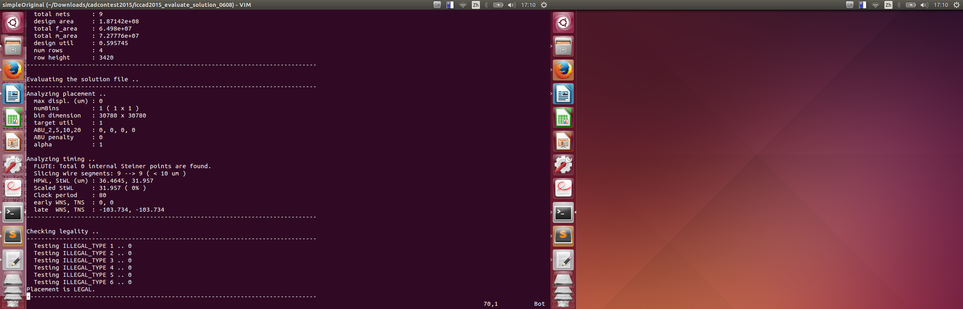
Simple results - simple 'ONE' testcase (1/3)
Result Zero : Original results late WNS, TNS : -103.734, -103.734

Slide 18
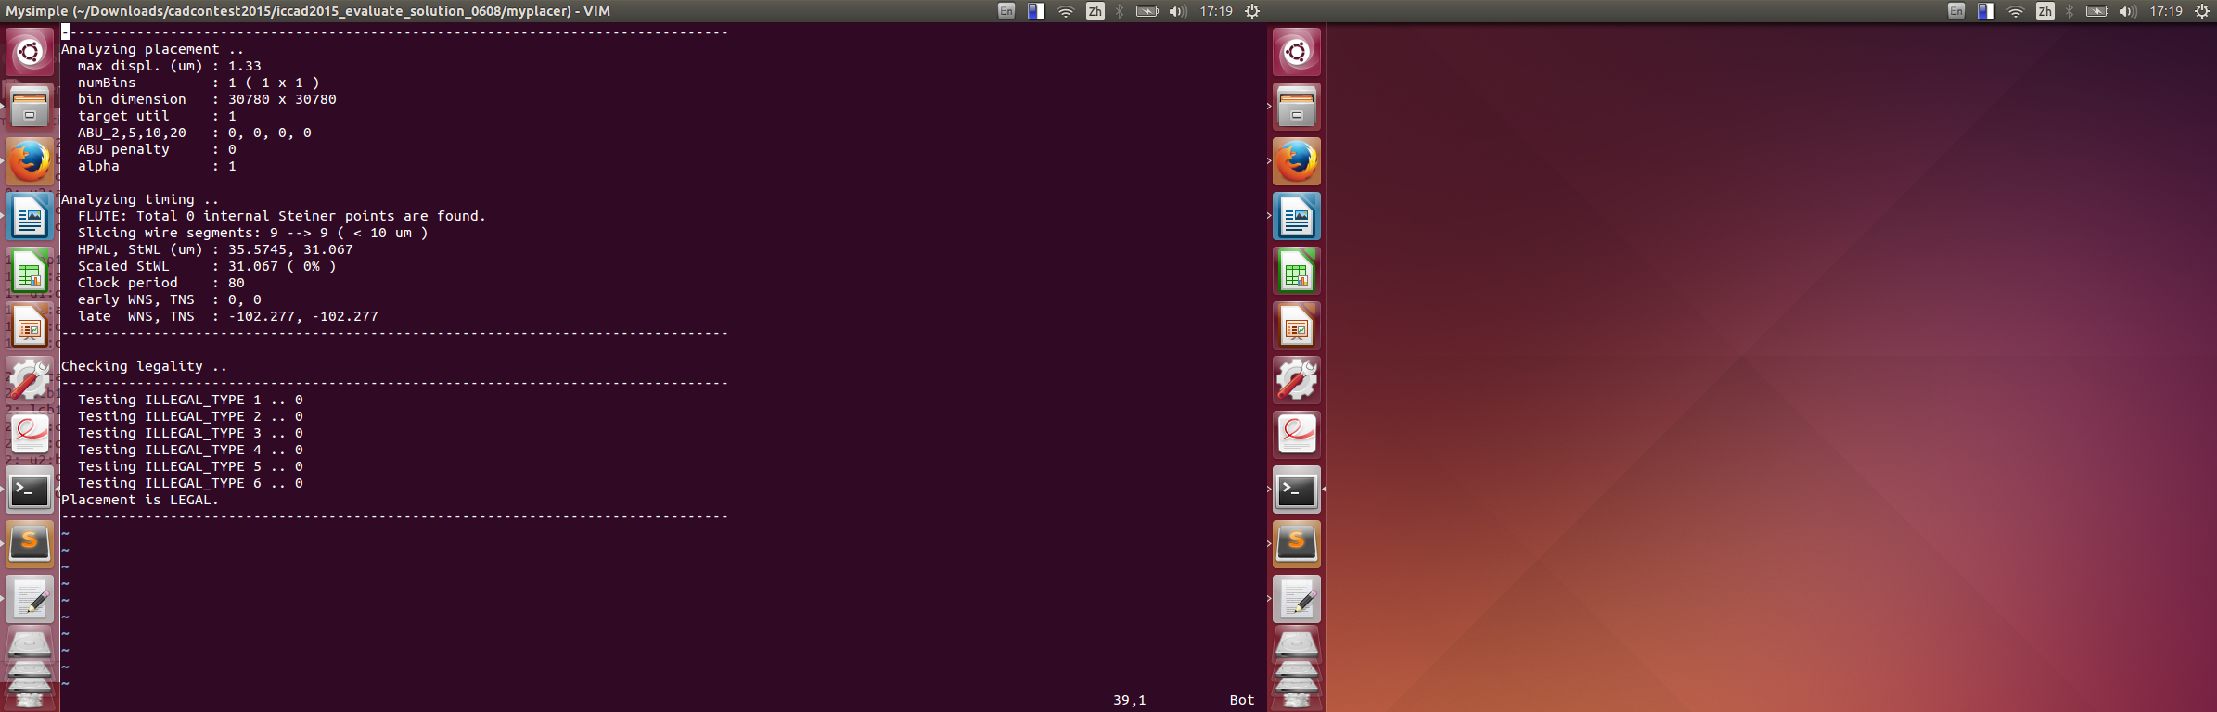
Simple results - simple 'ONE' testcase (2/3)
Result One : using 1 iteration and window size=7 late WNS, TNS : -102.277, -102.277

Slide 19
Simple results - simple 'ONE' testcase (3/3)
Result | iteration | window size | WNS | TNS | max displ. (μm) | overlap
Original | － | － | -103.734 | -103.734 | 0 | 0
One | 1 | 7 | -102.277 | -102.277 | 1.33 | 0
Two | 1 | 10 | -102.711 | -102.711 | 1.9 | 0
Three | 1 | 32 | -104.302 | -104.302 | 3.99 | 1
(after overlap removal) | 1 | 32 | -111.145 | -111.145 | 3.42 | 0
Four | 3 | 7 | -100.172 | -100.172 | 1.33 | 0
Five | 5 | 7 | -100.172 | -100.172 | 1.33 | 0

Slide 20
Simple results - simple ‘TWO' testcase
Result | iteration | window size | WNS | TNS | max displ. (μm) | overlap
Original | － | － | -111.917 | -111.917 | 0 | 0
One | 1 | 7 | -106.078 | -106.078 | 1.33 | 0
Two | 1 | 10 | -103.351 | -103.351 | 1.9 | 0
Three | 1 | 32 | -104.302 | -104.302 | 5.7 | 1
(after overlap removal) | 1 | 32 | -111.145 | -111.145 | 2.47 | 0
Four | 3 | 7 | -106.078 | -106.078 | 1.33 | 0
Five | 5 | 7 | -106.078 | -106.078 | 1.33 | 0

Slide 21
Conclusion
Big windows size - explore more position - but less accuracy
More iteration - better score - but longer run time

Slide 22
Future work
Hybrid TDP(includes Path-based TDP)
A good model for net-weights
Placement including LCBs

Slide 23
References
[1] Chrystian Guth et al. Timing-Driven Placement Based on Dynamic Net-Weighting for Efficient Slack Histogram Compression
[2] H. Tennakoon et al. Nonconvex gate delay modeling and delay optimization

Slide 24
Thanks for listening!
Q&A

