Slide 1
Software Engineering
Methods and Tools
to
build the right product & build it right

Slide 2
Software Life Cycle
Requirements Phase
What to develop? Involves requirements elicitation activities.
Output of this phase are the Requirements Specs & Test Cases
Design Phase
How to develop? A blueprint to translate specs into code is created.
Output of this phase are the Architecture & Detail Design
Implementation Phase
Product Manifestation takes place.
Output of the phase includes Code, Unit Test Results & Documentation
Testing & QA
Verification (right product) & Validation (build right) takes place
QA & Test Results are captures
Maintenance
Bug reports are handled and above phases are repeated to add new features

Slide 3
Common patterns of software life cycle are referred to as
Software Process Models.
Several such process models have been identified or defined.

Slide 4
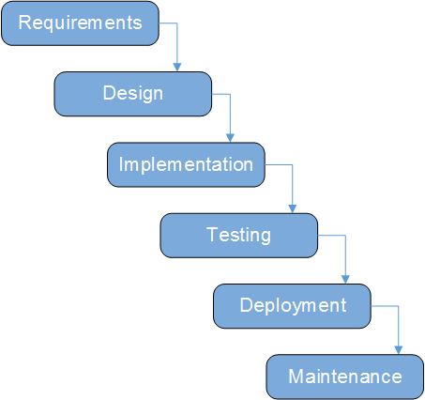
Software Process Models
WaterFall

Slide 5
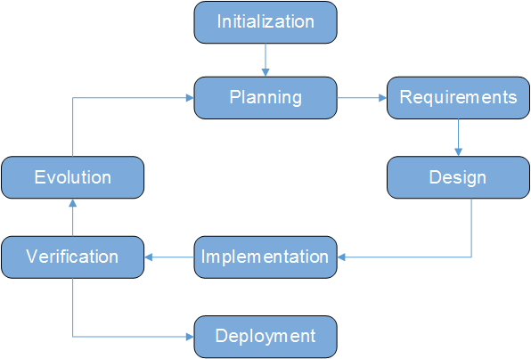
Software Process Models
Iterative

Slide 6
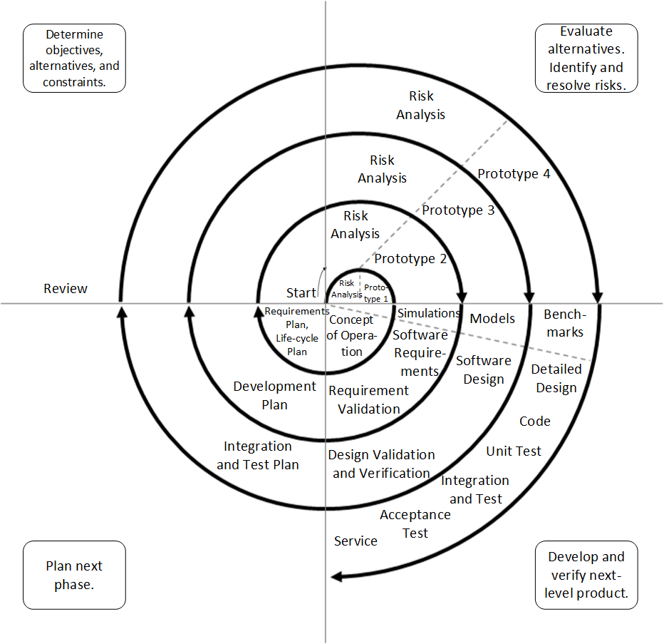
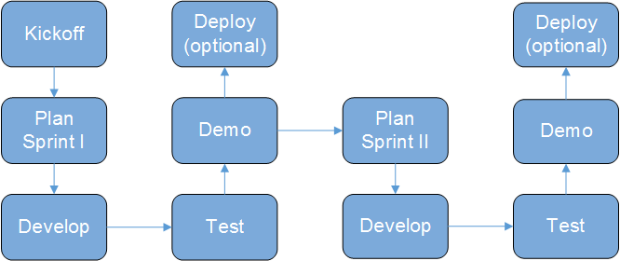
Software Process Models
Spiral
Agile

Slide 7
Irrespective of the underlying process model
a requirements phase to define the product, and
either a formal design phase upfront or refactoring/redesign after the code is written to address maintainability and other software quality
will take place

Slide 8
Software Definition
Functional Requirements
  What functionality the software system provides
    Expressed as
      User Stories (Agile Process Model)
      “shall” statements (traditional IEEE/ISO based process models)
      UML Use Case Diagram
    Verified using
      Acceptance Testing
Non Functional Requirements
  How well the functionality is provided
    Expressed as
      performance, scalability, reliability, availability, security, maintainability, usability, accessibility measures or metrics
    Verified using
      performance, scalability/load, [regression, black box, reliability], stress, security, maintainability, usability, accessibility tests
      Static code analysis
      Models
Software Design
Expressed as
  Architecture (UML Deployment, Component and/or Package Diagram)
  Detailed Design (UML Class, and Sequence, State-Machine, Activity and/or Timing Diagrams)

Slide 9
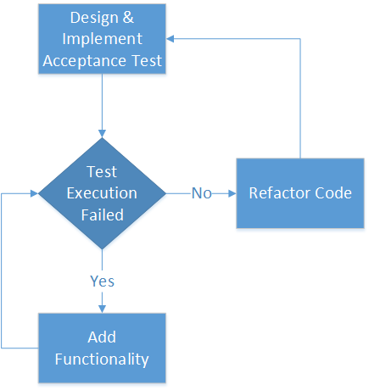
Behaviour (Test) Driven Development
(Android & Java, Espresso, JUnit, Jenkins & Git)
Test Driven development

