Slide 1
ATMOSPHERIC PHYSICS AND WEATHER
EART23001
Week 5 — Atmospheric Dynamics
Professor Paul Connolly
p.connolly@manchester.ac.uk • Simon Building 3.08

Slide 2
Today's Session
Atmospheric Dynamics • approx. 112 minutes
0:00
THEME 1 — Geostrophic balance: pressure-gradient, Coriolis, geostrophic wind
0:26
IN-CLASS DISCUSSION 1 — geostrophic wind speed and direction
0:35
Surface friction, Buys Ballot and wind measurement
0:47
APPLICATIONS — sea breeze, cyclones and global circulation
1:15
THEME 2 — Thermal wind: thickness, vertical shear and jet streams
1:28
THEME 3 — Gradient wind: how curvature modifies geostrophic balance
1:32
EXTENSION — vorticity and Rossby waves (useful context; not core exam material)
1:39
IN-CLASS DISCUSSION 2 — orographic Rossby-wave reasoning
1:48
Aside: ocean–atmosphere interaction (context only, not examined)
1:50
Wrap-up and looking ahead (Week 6 is reading week)
EART23001 Atmospheric Physics & Weather | Week 5

Slide 3
Geostrophic Balance
THEME 1 OF 3
Pressure-gradient force, Coriolis, and the surface wind
⏱ 0:00 – 0:47
EART23001 Atmospheric Physics & Weather | Week 5

Slide 4
The Scales of Atmospheric Motion
Setting the frame — from turbulence to the global circulation
• One framework: from a sea breeze to a jet stream, these are different-sized expressions of the same atmospheric dynamics.
• Microscale (<2 km, minutes): turbulence, individual convective plumes, dust devils — the eddies driving the friction we'll meet shortly.
• Mesoscale (2–2000 km, hours): sea breezes, thunderstorms, mountain waves — today's Part 2 circulations.
• Synoptic scale (≈1000–2500 km, 1–7 days): the highs and lows on a weather map, and the jet streams steering them — today's Part 3.
• Macroscale (>2000 km, days–weeks): the global three-cell circulation and planetary-scale waves — the biggest piece, also in Part 2/3.
  – This is the standard classification used across synoptic and mesoscale meteorology (e.g. Orlanski's scheme) — worth having as a mental map for the rest of the course, not just today.
EART23001 Atmospheric Physics & Weather | Week 5

Slide 5
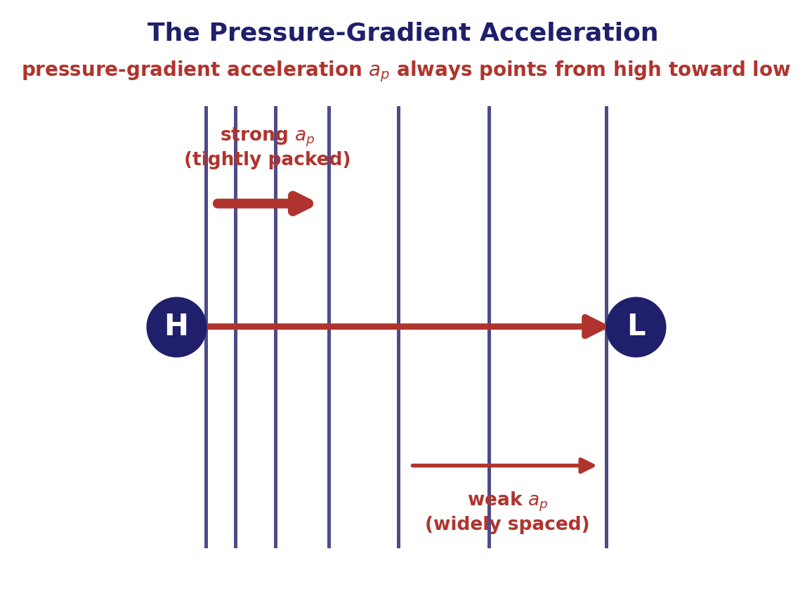
Two Horizontal Forces
Written per unit mass, the force terms appear as accelerations
• Vertical → horizontal: every balance so far has been vertical (hydrostatic); this week adds two horizontal forces that steer the wind.
• Pressure-gradient force: per unit mass, aₚ = −(1/ρ) Δp/Δx. It points from high toward low pressure and is stronger where isobars are closer together.
• Coriolis force: an apparent force in Earth’s rotating frame. Per unit mass, a_c = fv. In the Northern Hemisphere it acts at right angles to the wind, to the right of the motion.
• Per-unit-mass form: dividing each force by mass gives the acceleration terms used in the equation of motion.
EART23001 Atmospheric Physics & Weather | Week 5

Slide 6
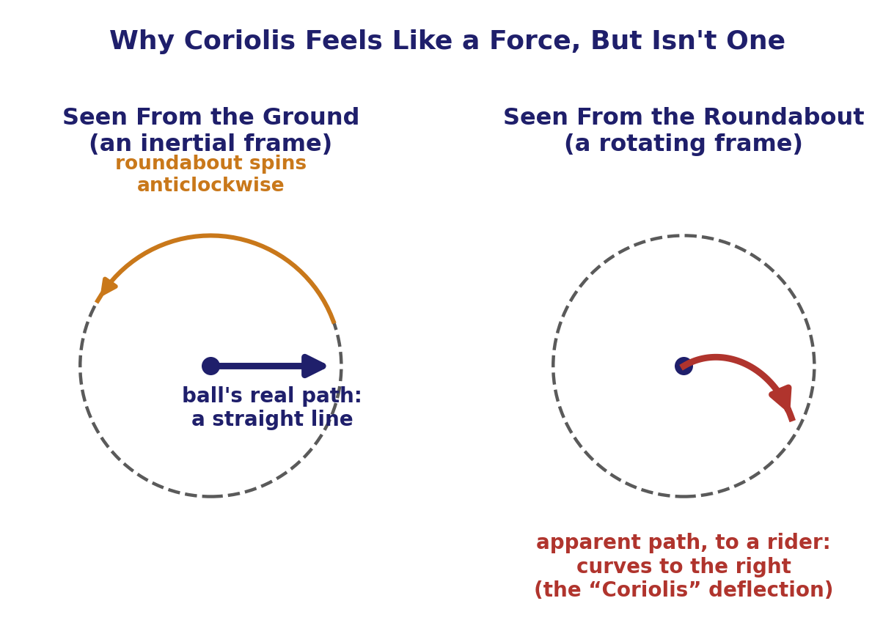
The Coriolis “Force”: A Rotating-Frame Illusion
Why it deflects the wind without ever doing any work
A ball rolled straight from the centre of a spinning roundabout travels in a straight line — but looks like it curves to anyone riding the roundabout. Coriolis is exactly this: Earth is the roundabout.
EART23001 Atmospheric Physics & Weather | Week 5

Slide 7
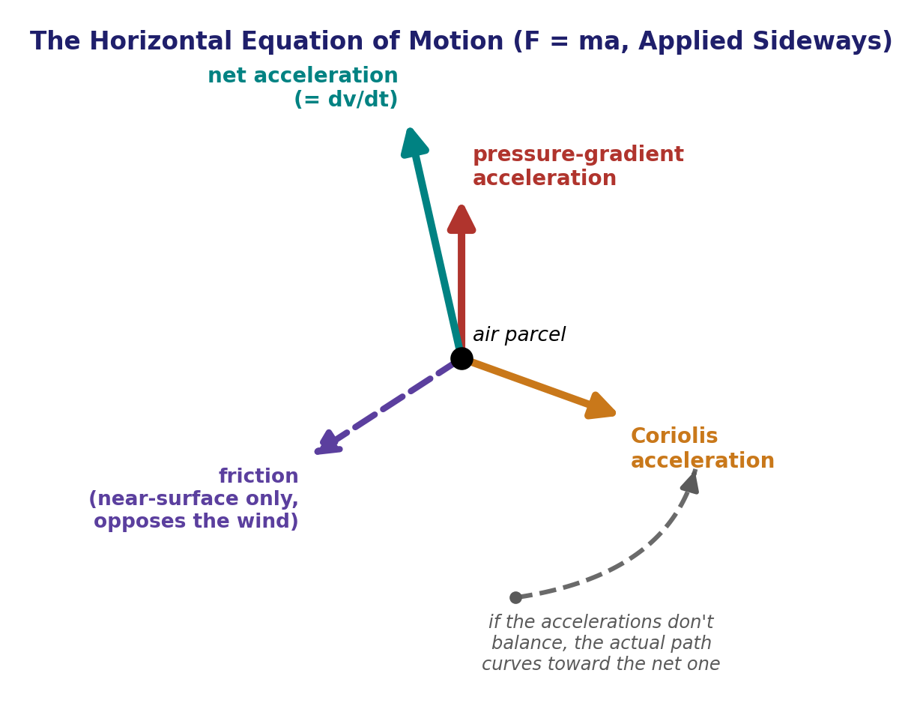
The Horizontal Equation of Motion
F = ma, applied sideways — the general starting point
• Newton’s second law: written per unit mass, dv/dt = (pressure-gradient force per unit mass) + (Coriolis force per unit mass) + (frictional force per unit mass).
• Same law, new direction: hydrostatic balance used force balance vertically; now we apply it horizontally.
• Different balances: drop friction and curvature for geostrophic balance; retain curvature for gradient wind; combine geostrophic balance with hydrostatic thickness for thermal wind.
EART23001 Atmospheric Physics & Weather | Week 5

Slide 8
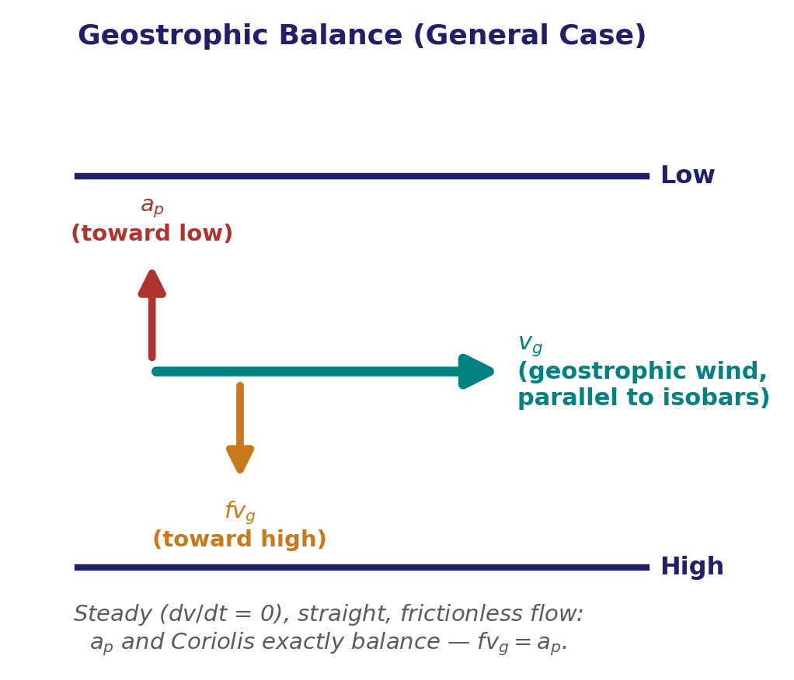
Solving for the Geostrophic Wind
Steady, straight, frictionless flow — crossing out acceleration
• Assumptions: steady flow, approximately straight isobars, and negligible friction (well above the boundary layer).
• Balance: the pressure-gradient force per unit mass and Coriolis force per unit mass are equal and opposite.
• Equation: f v_{g} = aₚ → v_{g} = aₚ/f.
• Geostrophic wind: a solution of Newton’s second law under those assumptions; it is useful away from the tropics for slowly evolving, large-scale flow.
EART23001 Atmospheric Physics & Weather | Week 5

Slide 9
Reading the Force Balance
Four situations, four different balances
• Hydrostatic: the atmosphere sits close to hydrostatic balance: gravity balanced by the vertical pressure-gradient force. It can fail locally where vertical acceleration is large, as inside a strong storm.
• Geostrophic: well above the surface, is close to the geostrophic balance just derived. Curvature, rapid evolution, or residual friction can make it ageostrophic.
• Near surface: friction becomes an essential third force — the assumption we just dropped to get vg. The wind is slower than geostrophic and crosses the isobars toward lower pressure.
• Near equator: f itself becomes small, so ordinary mid-latitude geostrophic balance is a poor approximation and other accelerations matter relatively more.
EART23001 Atmospheric Physics & Weather | Week 5

Slide 10
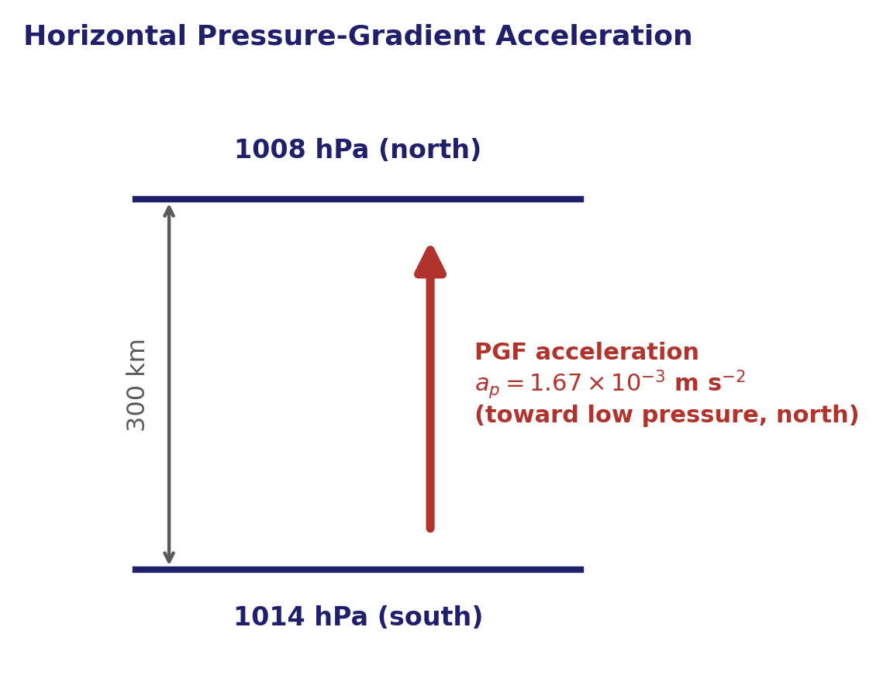
The Pressure-Gradient Force, Quantified
Pressure-gradient force per unit mass — worked example
• Pressure difference: 1014 hPa to the south and 1008 hPa to the north, 300 km apart; take ρ = 1.20 kg m⁻³.
• Force per unit mass: aₚ = Δp/(ρΔx) = 600/(1.20 × 3.00×10⁵) = 1.67×10⁻³ m s⁻².
• Direction: from high toward low pressure — northward here.
• Isobar spacing: halve the distance for the same pressure difference and the pressure-gradient force per unit mass doubles.
EART23001 Atmospheric Physics & Weather | Week 5

Slide 11
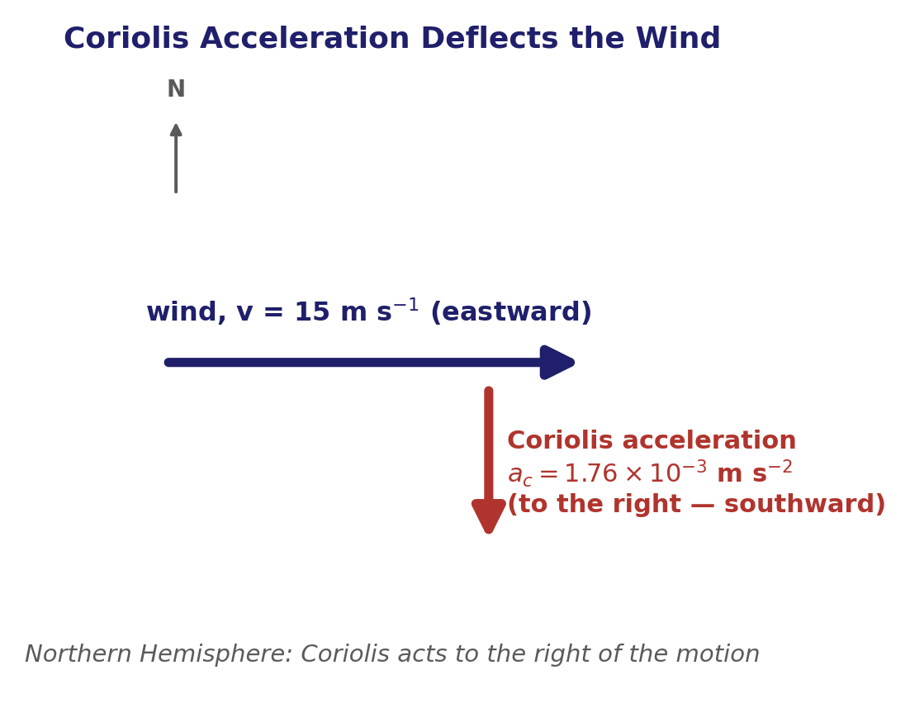
Coriolis Force
The deflecting term — force per unit mass = acceleration
• Coriolis parameter: at 53.5°N (Manchester), f = 2Ω sin53.5° = 1.17×10⁻⁴ s⁻¹.
• Force per unit mass: for v = 15 m s⁻¹, a_{c} = fv = 1.76×10⁻³ m s⁻².
• Direction: in the Northern Hemisphere the Coriolis force acts to the right of the motion — for an eastward wind, southward.
EART23001 Atmospheric Physics & Weather | Week 5

Slide 12
Geostrophic Wind Speed and Direction
IN-CLASS DISCUSSION 1
• Use the pressure gradient from the pressure-gradient question and the latitude from the Coriolis question. Assume straight isobars and negligible friction.
• 1. Estimate the geostrophic wind speed.
• 2. Determine whether the geostrophic wind is approximately eastward or westward.
• 3. State where the lower pressure lies relative to the geostrophic wind in the Northern Hemisphere.
✍ Discuss in pairs, then we'll take answers
Worked-answers sheet, Week 5 — IN CLASS Question

Slide 13
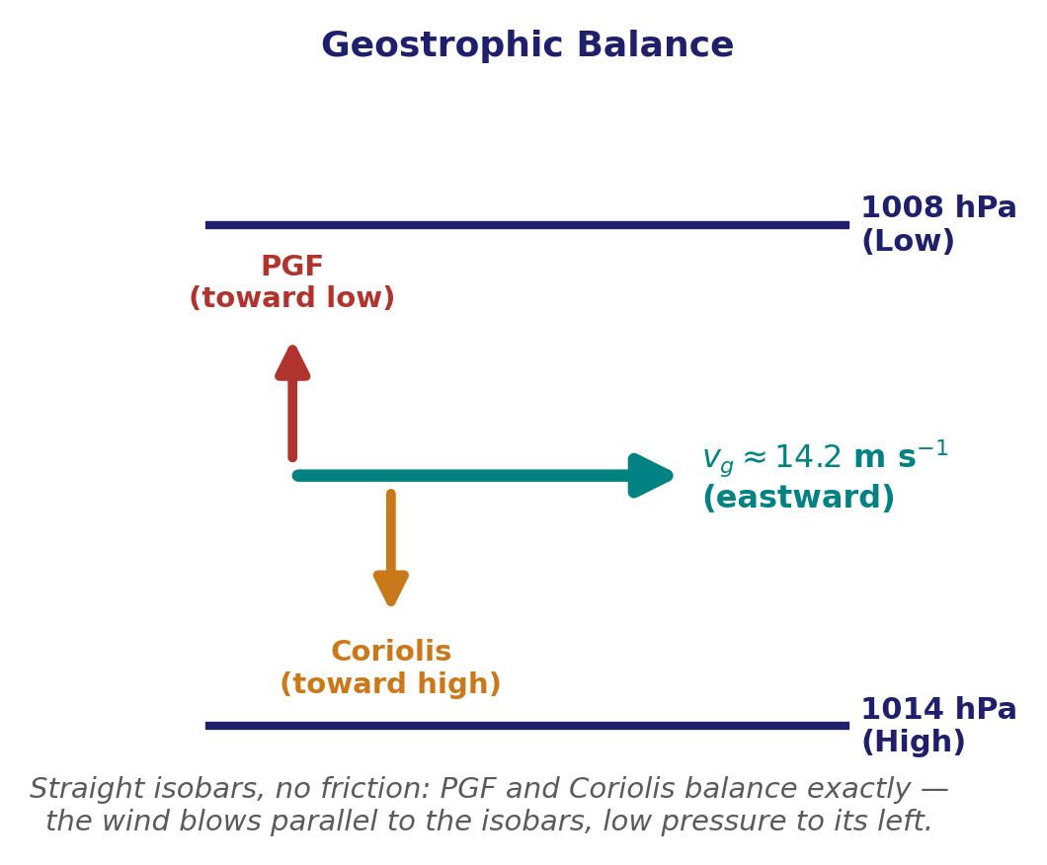
Geostrophic wind speed and direction — worked answer
WORKED ANSWER — DISCUSSION 1
• Geostrophic balance: the pressure-gradient force per unit mass and Coriolis force per unit mass are equal and opposite: f v_g = (1/ρ)|Δp|/Δx.
• Speed: v_g = aₚ/f = 1.67×10⁻³ / 1.17×10⁻⁴ = 14.2 m s⁻¹.
• Direction: the pressure-gradient force is northward, so Coriolis must be southward. In the Northern Hemisphere that requires an eastward wind.
• Rule: low pressure lies to the left of the geostrophic wind.
EART23001 Atmospheric Physics & Weather | Week 5

Slide 14
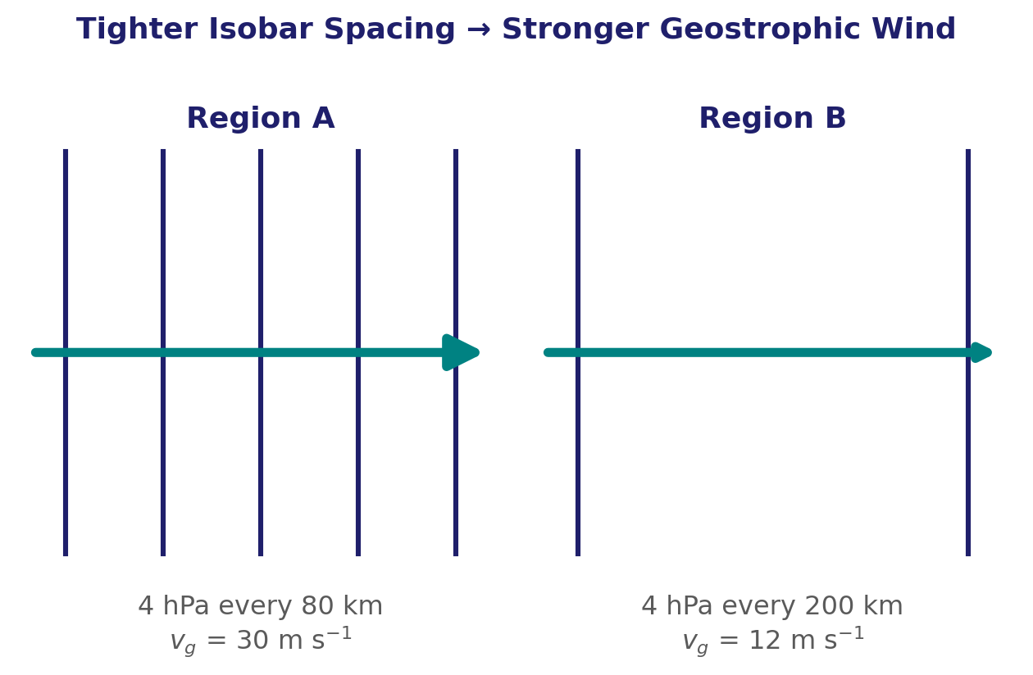
Quick Check: Isobar Spacing and Wind Speed
Geostrophic wind — worked example
• Region A has isobars 4 hPa apart every 80 km; Region B has the same 4 hPa interval every 200 km, at the same latitude and density.
  – Pressure-gradient ratio: |∇p|_{A} / |∇p|_{B} = 200/80 = 2.5.
• At the same f and ρ, geostrophic wind scales directly with the pressure gradient, so the wind-speed ratio is also 2.5.
  – If v_{g} in Region B is 12 m s⁻¹, then v_{g} in Region A = 2.5 × 12 = 30 m s⁻¹.
• Near the surface, friction slows the actual wind and lets it cross the isobars toward lower pressure in both regions.
EART23001 Atmospheric Physics & Weather | Week 5

Slide 15
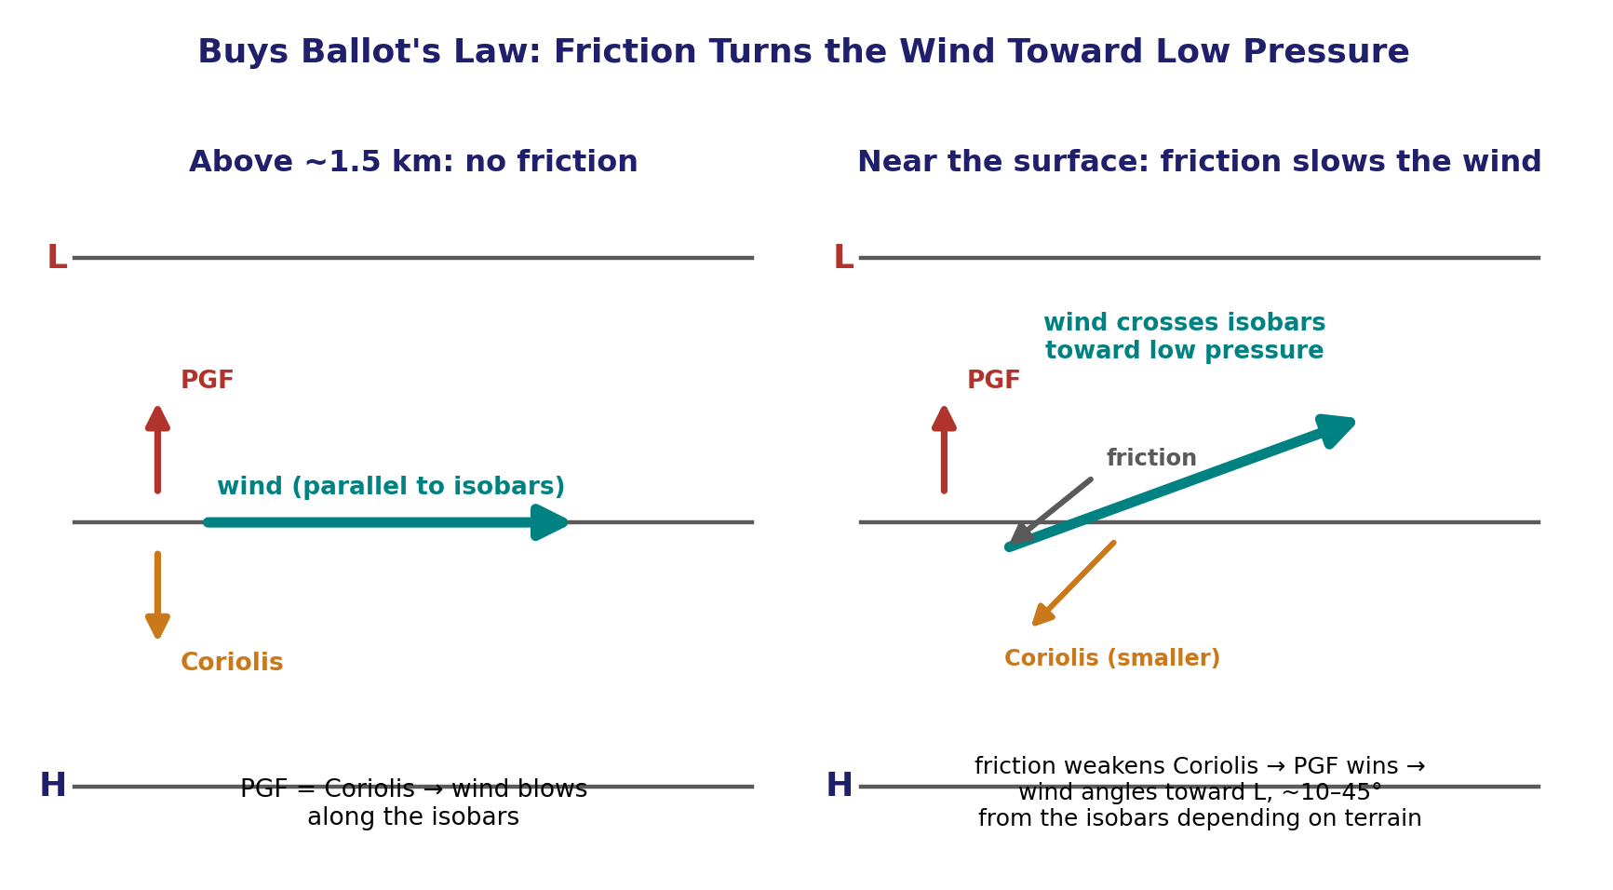
Friction Near the Surface
Buys Ballot's law and crossing the isobars
• Friction: slows the wind, so the Coriolis force per unit mass weakens because a_c = fv. The pressure-gradient force is initially unchanged.
• Result: the pressure-gradient force temporarily wins, accelerating air toward lower pressure until a new three-force balance is reached.
• Crossing angle: roughly 10–20° over smooth sea, up to ~45° over rough terrain, and around 30° over land.
• Buys Ballot’s law: with your back to the surface wind in the Northern Hemisphere, low pressure lies ahead and to your left.
• Backing near the surface: relative to geostrophic flow aloft, friction turns the Northern-Hemisphere surface wind anticlockwise.
EART23001 Atmospheric Physics & Weather | Week 5

Slide 16
How We Actually Measure the Wind
Friction near the surface — and how we observe it in practice
• Direction — a wind vane: an asymmetric fin weathervanes into the flow; direction is read off an angular scale or a potentiometer/encoder.
• Speed at a point — a cup anemometer: three cups on a horizontal spindle rotate at a rate proportional to wind speed; robust, and (unlike a vane) insensitive to direction.
• Fast, fine-scale turbulence — a hot-wire or sonic anemometer: a heated wire cools by forced convection (rate depends on flow speed), or paired ultrasonic transducers time a pulse whose transit time is skewed by the wind — both give the rapid response needed to resolve individual eddies.
• Airspeed on a moving platform — a pitot tube: the pressure difference between a forward-facing and a static port gives speed via Bernoulli's equation, v = √(2Δp/ρ) — the standard aircraft instrument.
• With height — a radiosonde: GPS (or older radar/radio direction-finding) tracks the ascending balloon's horizontal drift; differentiating position with time gives the wind profile all the way up — the same instrument we'll open up properly in Week 10.
EART23001 Atmospheric Physics & Weather | Week 5

Slide 17
From Local Pressure Gradients to Global Circulation
APPLICATIONS / BRIDGE
Sea breezes, cyclones, and the three-cell atmosphere
⏱ 0:47 – 1:15
EART23001 Atmospheric Physics & Weather | Week 5

Slide 18
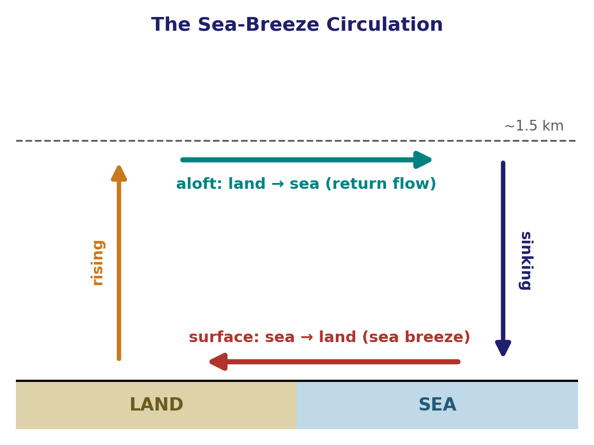
The Sea-Breeze Circulation
A simple pressure contrast, read at two heights
• Example: surface pressure is 1007 hPa over land and 1010 hPa over sea; at 1.5 km it's 850 hPa over land and 846 hPa over sea.
• At the surface: pressure is higher over the sea, so the pressure-gradient acceleration points from sea toward land — the sea-breeze inflow.
• Aloft: pressure is higher over the warmer land column, so the acceleration reverses: land toward sea — the return flow aloft.
• Continuity: closes the loop with rising motion over the warm land and sinking motion over the cooler sea. It strengthens through the day as the land–sea temperature contrast builds, so it's usually best developed in the afternoon, not just after sunrise.
EART23001 Atmospheric Physics & Weather | Week 5

Slide 19
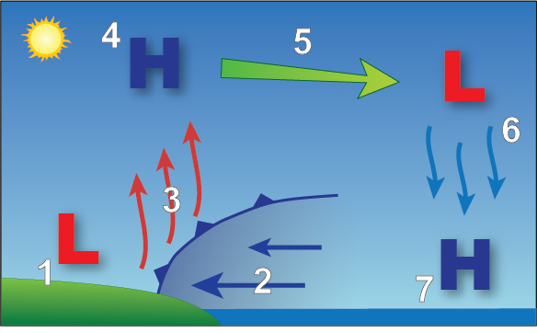
The Sea Breeze, Step by Step
The same circulation, numbered
• 1-2: a surface low forms over the heated land, and surface air flows in from the sea to fill it.
• 3: that inflowing air rises along the convergence line at the coast.
• 4-5: having risen, the air forms a shallow high aloft over land, which feeds a return flow out toward the sea.
• 6-7: the returning air sinks over the cooler sea, completing the loop as a surface high offshore.
EART23001 Atmospheric Physics & Weather | Week 5

Slide 20
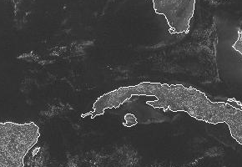
The Sea Breeze, Seen From Space
A real convergence line, marked out in cloud
Opposing sea breezes converge and rise together, marking the line with a band of cumulus cloud. (An animated GIF — play the slide show to see it move.)
EART23001 Atmospheric Physics & Weather | Week 5

Slide 21
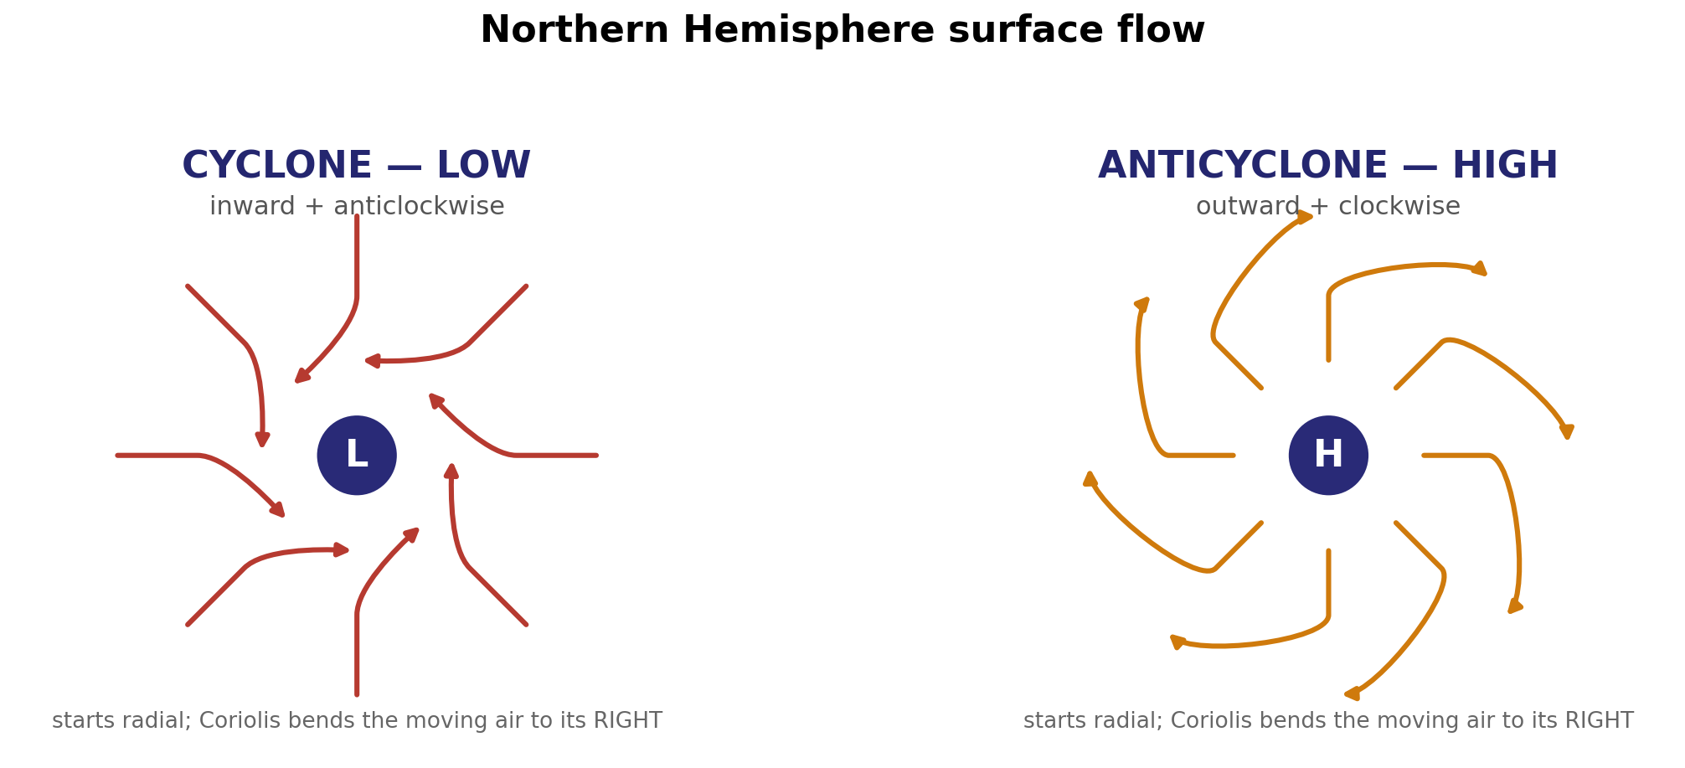
From a Pressure Pattern to Cloud and Rain
Cyclones and anticyclones — reading the surface flow
• Cyclone (low): pressure-gradient force starts the motion inward; Coriolis then bends the moving air to its right → anticlockwise inward spiral (NH).
• Anticyclone (high): pressure-gradient force starts the motion outward; Coriolis bends it to the right → clockwise outward spiral.
• Weather: convergence into lows favours ascent/cloud; divergence from highs favours subsidence/clearer conditions.
EART23001 Atmospheric Physics & Weather | Week 5

Slide 22
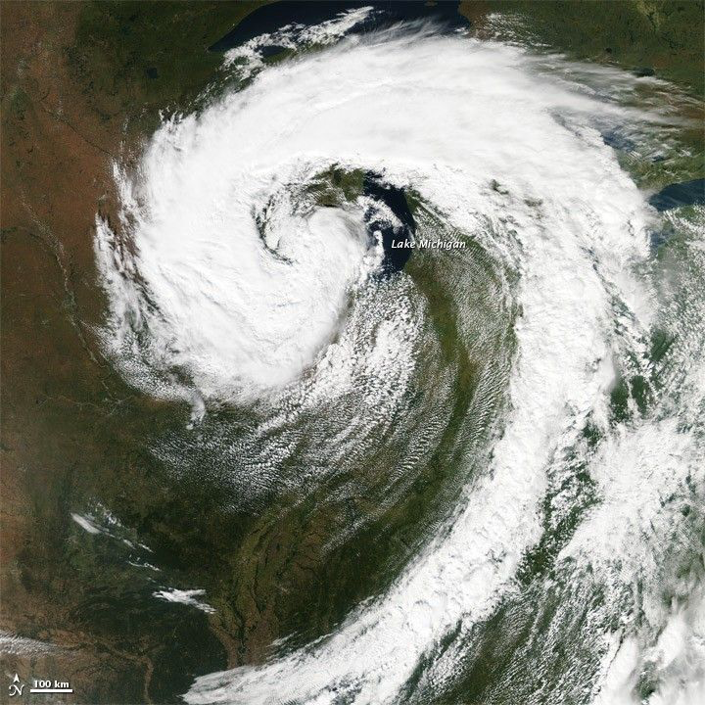
A Real Cyclone, Seen From Space
Same anticlockwise spiral, this time over the US Midwest
A mature mid-latitude cyclone over Lake Michigan, 26 September 2011 — the same anticlockwise inflow just described, made visible by the cloud it lifts. Source: NASA Earth Observatory (MODIS/Aqua).
EART23001 Atmospheric Physics & Weather | Week 5

Slide 23
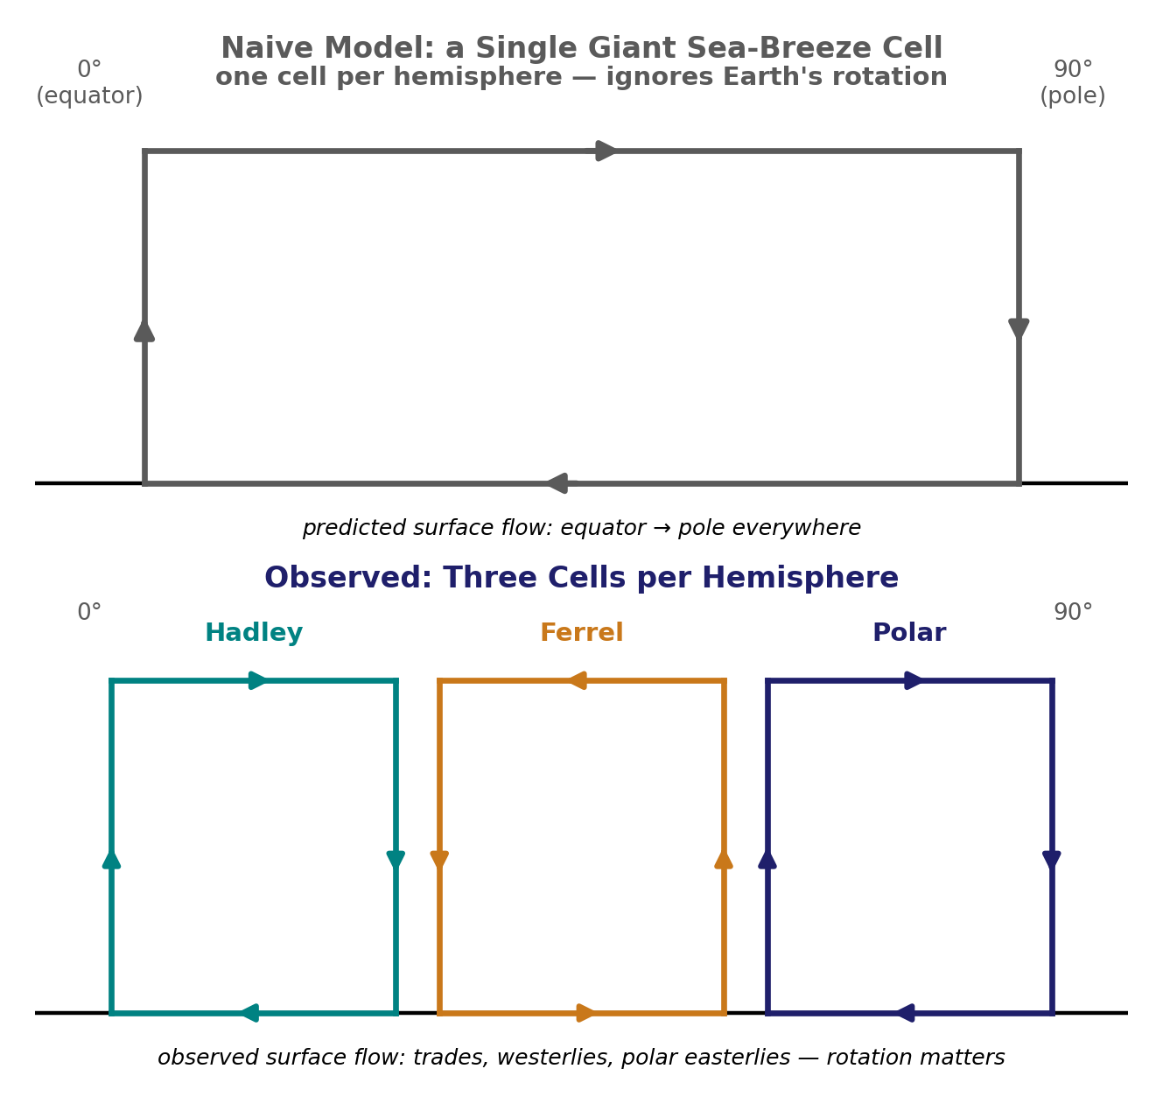
From One Cell to Three
Why Earth's rotation matters
• Naive model: at a global circulation model used a single giant cell per hemisphere: air rising at the equator, moving poleward aloft, sinking at the pole, and returning equatorward at the surface — like one enormous sea breeze.
• Problem: predicts surface flow everywhere from equator to pole. It does not match observation, because it leaves out the Coriolis deflection of that poleward-moving air.
• Coriolis: aloft, Coriolis increasingly turns it eastward. By about 30° latitude it is flowing almost due east and can no longer make further progress poleward.
• Convergence near 30°: from the equatorial side behind it, while almost none can continue past 30° — so the poleward-moving air piles up (converges) aloft at that latitude. Mass continuity then forces it to go somewhere, and down is the only direction left: it sinks.
• Three cells: at 30° is what splits the single cell into three: a direct Hadley cell in the tropics, and two further cells (Ferrel, Polar) needed to carry the remaining heat transport to the pole.
EART23001 Atmospheric Physics & Weather | Week 5

Slide 24
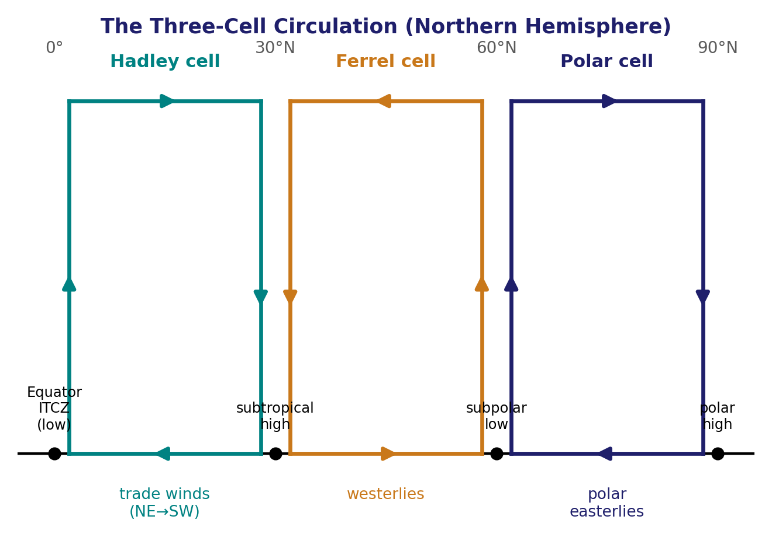
The Three-Cell Circulation
Global circulation — Hadley, Ferrel, and Polar cells
• Equator: broad ascent in the ITCZ is fed by near-surface trade winds converging from both subtropics — the Hadley cell. Rising air releases huge amounts of latent heat, driving the towering clouds that make the ITCZ the wettest latitude band on Earth.
• 30°N: the Hadley cell's descending branch favours a subtropical high; surface flow splits between equatorward trade winds and poleward flow feeding the mid-latitude westerlies — the start of the (thermally indirect) Ferrel cell. Both the equatorial doldrums and the 30° 'horse latitudes' are belts of weak surface wind.
• 60°N: ascent is favoured where the westerlies meet the polar easterlies at the subpolar low / polar front, closing the Ferrel cell and driving the Polar cell.
• Pole: cold air broadly subsides and surface polar easterlies flow back toward the subpolar low.
EART23001 Atmospheric Physics & Weather | Week 5

Slide 25
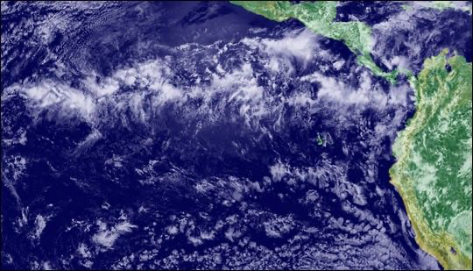
Reading the Latitude Bands: Deserts and Rain Belts
Global circulation — where the table's answers matter
• 0°: ascent (the ITCZ) and converging trade winds — this equatorial ascending belt is associated with persistent tropical rainfall.
• 30°N: descent, a subtropical high, and diverging surface flow — this descending subtropical belt (roughly 20–35°) is associated with many of the world's major deserts.
• 50°N: broadly westerly surface flow, within the Ferrel cell.
• 60°N: ascent near the subpolar low / polar front, where westerlies meet polar easterlies.
• 90°N: broad subsidence, with surface polar easterlies flowing equatorward.
The ITCZ as a real cloud band, eastern tropical Pacific. Source: NASA Earth Observatory / NOAA GOES.
EART23001 Atmospheric Physics & Weather | Week 5

Slide 26
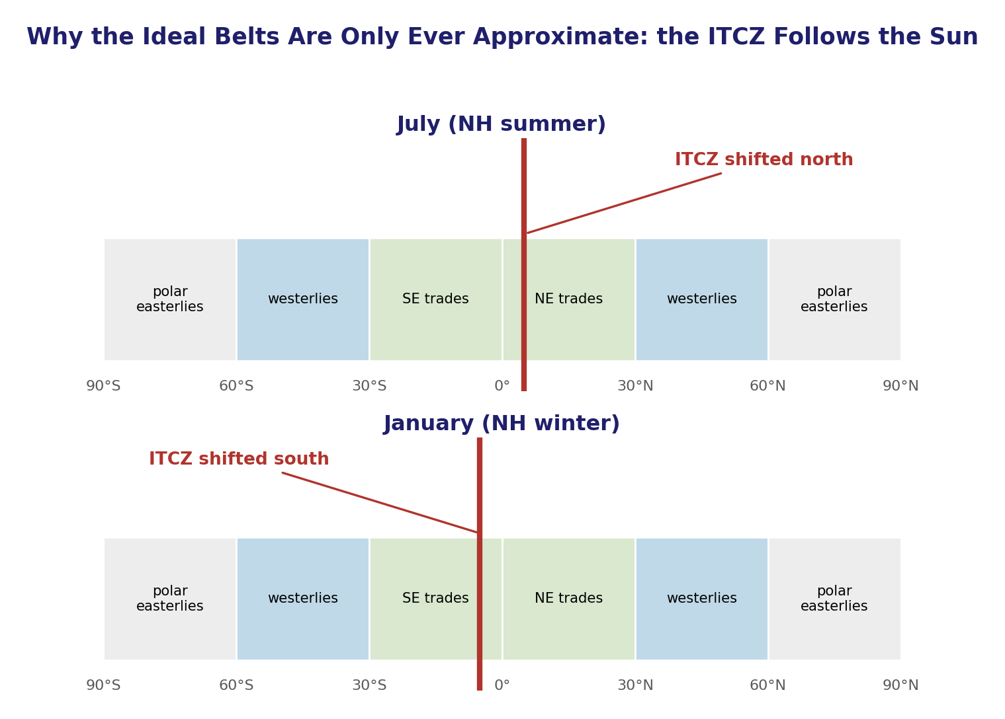
The Real World: Circulation Departs From the Ideal
Global circulation — the seasonal shift
• Idealisation: picture assumes a uniform ocean-covered Earth. In reality, continents and oceans heat at different rates, and large mountain chains alter the surface pressure pattern and deflect the wind.
• Seasonal migration: also means the latitude of most intense heating — and with it, the ITCZ and every belt tied to it — migrates north and south with the seasons, roughly tracking the overhead sun.
• January vs July: the whole pattern sits displaced south of its annual-mean position; in July it sits displaced north. The 'ideal' latitudes quoted for each belt are therefore only ever an annual average, not a fixed line.
• Monsoons: also drives monsoon-type reversals in surface wind direction in some regions, as the ITCZ crosses over them through the year.
EART23001 Atmospheric Physics & Weather | Week 5

Slide 27
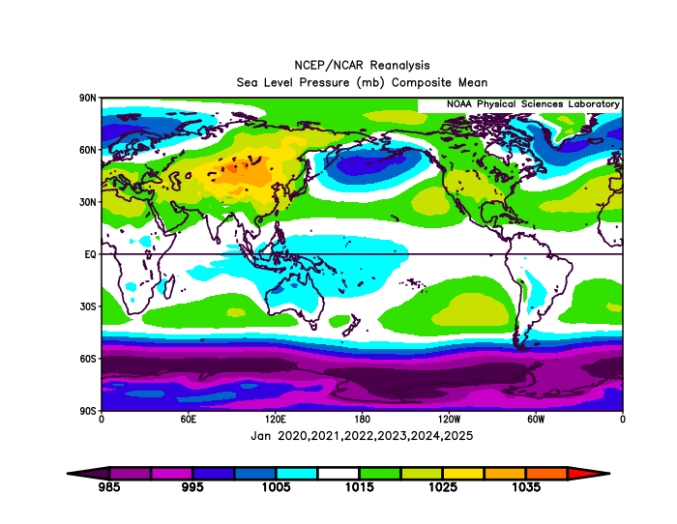
The Real World, From a Reanalysis
A real January mean sea-level pressure map
L
H
L
H
H
H
H
H
H/L = broad centres
January mean sea-level pressure (2020–2025 composite): the real subtropical highs and Siberian High are far stronger, and less zonal, than the idealised belts. Source: NOAA PSL, NCEP/NCAR Reanalysis.
EART23001 Atmospheric Physics & Weather | Week 5

Slide 28
Thermal Wind and Jet Streams
THEME 2 OF 3
How horizontal temperature contrasts create vertical wind shear
⏱ 1:15 – 1:28
EART23001 Atmospheric Physics & Weather | Week 5

Slide 29
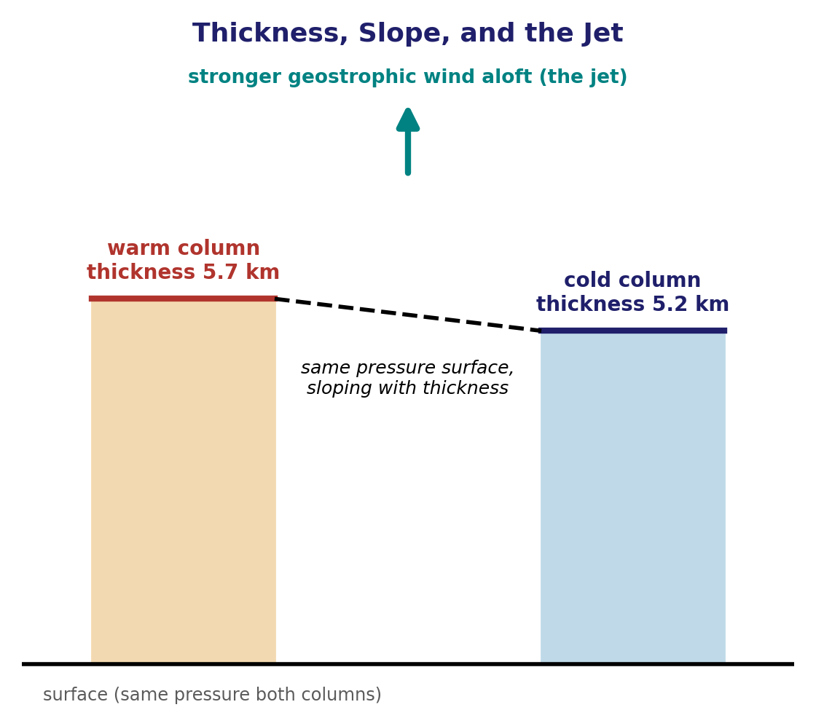
Why Warm Air Raises the Pressure Surface Aloft
Hypsometric equation → sloping pressure surfaces → upper-level pressure gradient
• Same surface pressure: start with neighbouring warm and cold columns having the same pressure at the ground.
• Warm air is less dense: hydrostatic balance therefore makes pressure fall more slowly with height in the warm column.
• Same statement in thickness form: between two fixed pressure levels, the warm column is thicker; a given pressure surface lies higher over warm air.
• Therefore aloft: at the same geometric height, pressure is higher over the warm column than over the cold column, so a horizontal pressure-gradient force develops toward the cold air.
EART23001 Atmospheric Physics & Weather | Week 5

Slide 30




From Hypsometric Equation to Thermal Wind
The missing algebra behind the thermal wind formula
Week 4 link: p = p₀ exp(−z/H), with H = R_dT/g. Warm air → larger H → pressure falls more slowly with height → a fixed pressure surface sits higher. The hypsometric equation gives the same idea for the layer between p₁ and p₂.
1 Read the slope
At fixed p, horizontal variation in z represents the same horizontal PGF you would write at fixed geometric height.
same horizontal PGF, expressed as a pressure-surface height gradient
2 Take the difference
3 Use layer thickness
4 Substitute
Thermal wind is not a separate wind: it is the vertical change (shear) of the geostrophic wind caused by a horizontal temperature gradient.
EART23001 Atmospheric Physics & Weather | Week 5

Slide 31



Thermal Wind
Turning a temperature contrast into jet shear — worked example
At 50°N, temperature falls northward by 8 K over 1000 km between 850 and 300 hPa.
Temperature gradient
Thermal-wind relation
Result
Positive here means increasingly westerly geostrophic wind with height.
Stronger horizontal temperature contrast → stronger vertical shear → a stronger mid-latitude jet.
EART23001 Atmospheric Physics & Weather | Week 5

Slide 32
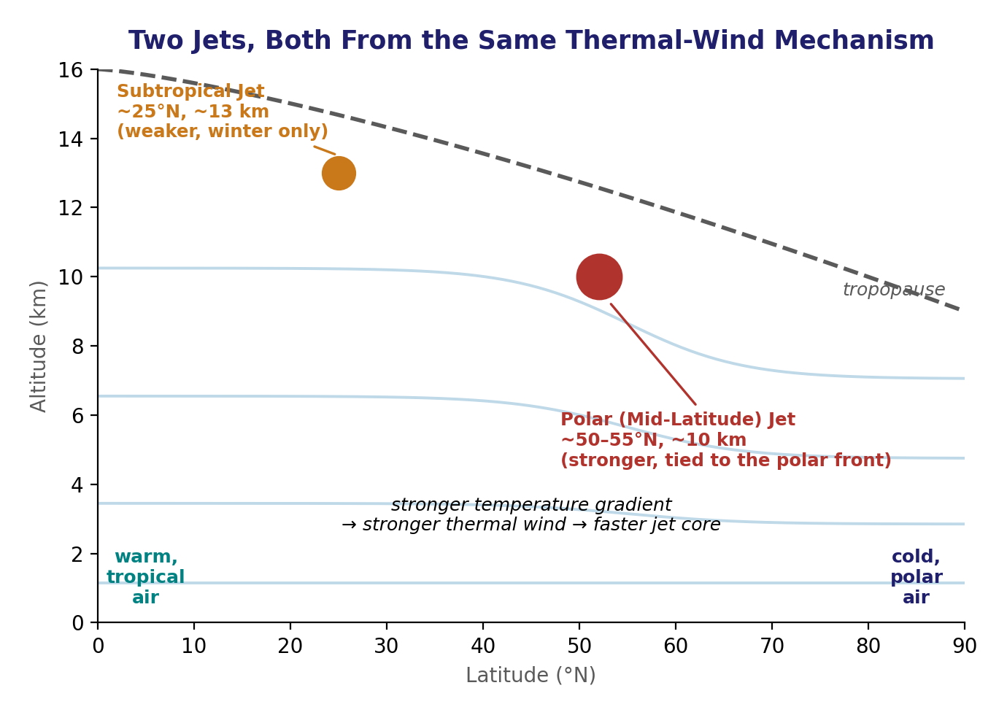
The Jet Streams: Where Thermal Wind Concentrates
Two jets, one mechanism
• Jet stream: is simply the fast core of the upper-level westerlies — a ribbon of air roughly 100–500 km wide and a few km deep, with wind speeds of 100–400 km/hr, found around 7.5–12 km altitude near the tropopause.
• Polar jet: (mid-latitude) jet sits near the polar front, around 50–55°N, where the temperature contrast — and hence the thermal-wind shear — is largest. It is the stronger and more persistent of the two, and shifts north in summer, south in winter.
• Subtropical jet: jet forms near 25°N, close to the poleward edge of the Hadley cell, at a higher altitude (~13 km). It is a wintertime feature, largely absent in summer when the tropical–subtropical temperature contrast weakens.
• Not fixed: are driven by thermal wind, jet position is not fixed: it tracks wherever the temperature gradient is currently strongest, so real jets meander and split rather than forming one continuous ribbon around the globe.
Blue curves = temperature contours
EART23001 Atmospheric Physics & Weather | Week 5

Slide 33
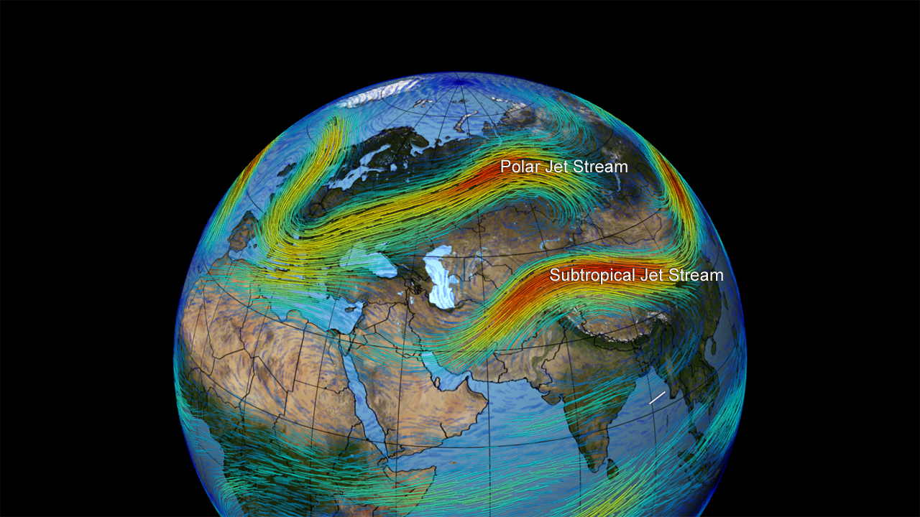
The Jet Streams, Mapped
Both jets, visualised together over Europe and Asia
Modelled wind-speed streamlines showing the polar jet stream and the (weaker, more southerly) subtropical jet stream as distinct fast-moving ribbons.
EART23001 Atmospheric Physics & Weather | Week 5

Slide 34
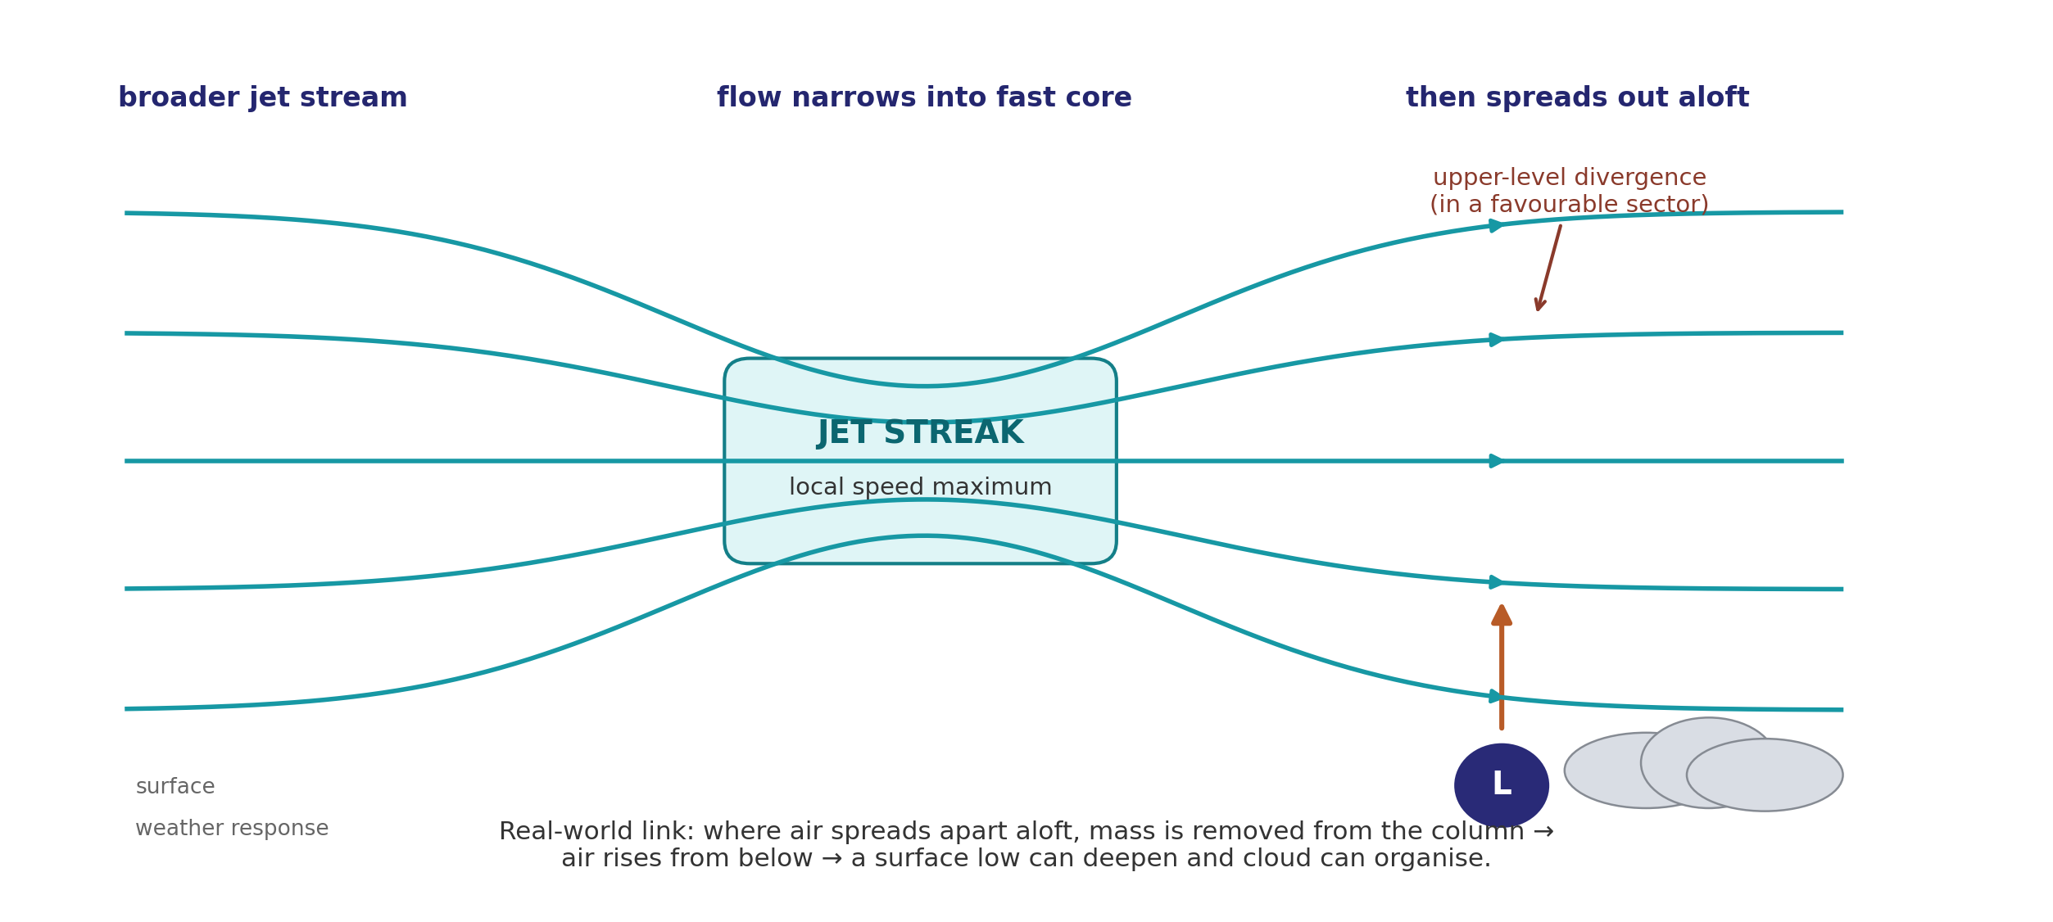
What Is a Jet Streak?
EXTENSION — not core exam
A local maximum in upper-level wind speed — and why forecasters care
EART23001 Atmospheric Physics & Weather | Week 5

Slide 35
THEME 3 OF 3
Gradient Wind
How curvature modifies geostrophic balance
⏱ 1:28 – 1:32
EART23001 Atmospheric Physics & Weather | Week 5

Slide 36

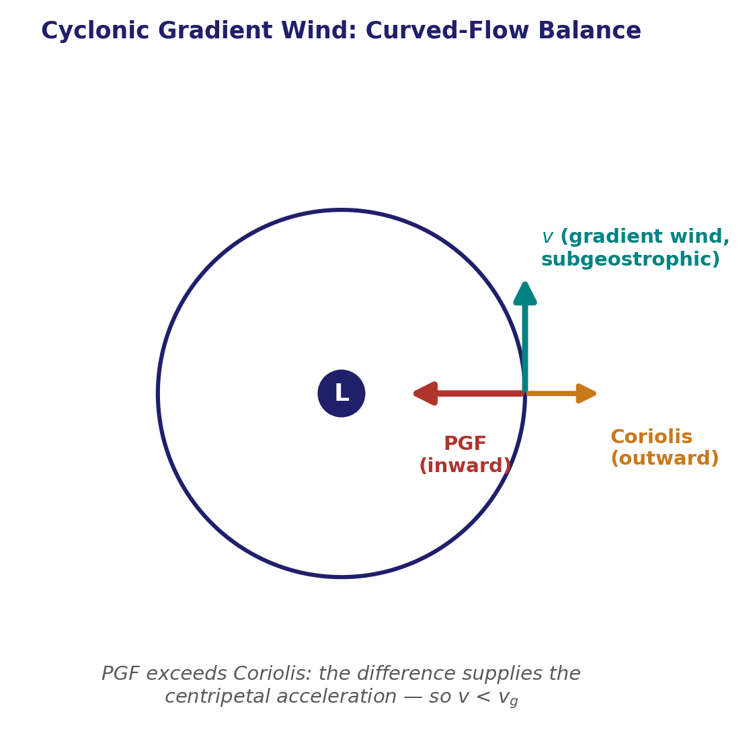


Curved Flow: The Gradient Wind
Beyond geostrophic balance — flow around a curved low
For flow around a curved low, the inward pressure-gradient force must both
oppose the outward Coriolis force and provide the residual inward centripetal acceleration.
At 50°N: R = 500 km, pressure-gradient force per unit mass = 2.0 × 10⁻³ m s⁻²
Physically relevant cyclonic solution:
For the same pressure gradient, geostrophic speed ≈ 17.9 m s⁻¹.
Cyclonic gradient flow is therefore subgeostrophic.
EART23001 Atmospheric Physics & Weather | Week 5

Slide 37
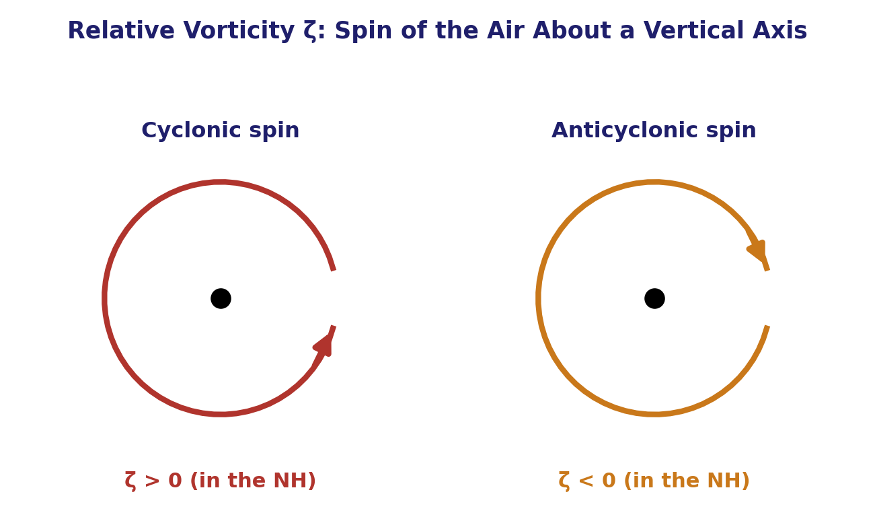
Vorticity: The Spin of the Air
EXTENSION — not core exam
• Relative vorticity: ζ measures the air's own spin about a vertical axis, relative to the ground — exactly like the spin already drawn for cyclones and anticyclones. Cyclonic (anticlockwise, in the NH) spin is ζ > 0; anticyclonic (clockwise) spin is ζ < 0.
• Planetary vorticity: is just f itself, seen a new way: it's the spin any stationary parcel already has, purely from sitting on the rotating Earth — the same f = 2Ω sinφ used all week.
• Absolute vorticity: is the sum of the two: ζ + f — the total spin an outside, non-rotating observer would actually measure.
EART23001 Atmospheric Physics & Weather | Week 5

Slide 38
Conservation of Absolute Vorticity
EXTENSION — not core exam
The rule Discussion 2 is built on
• Conservation: Away from topography, where column depth is roughly constant and friction is weak, absolute vorticity (ζ + f) is approximately conserved following the motion — spin trades between the relative (ζ) and planetary (f) parts.
• Latitude change: if a parcel moves to a latitude where f is larger, its own ζ must fall to compensate, and vice versa — the reasoning used in Discussion 2.
• Potential vorticity: the more general quantity is (ζ + f)/H. When a column is squashed over a ridge, its depth H changes and its relative spin can change too.
EART23001 Atmospheric Physics & Weather | Week 5

Slide 39
Toward a Shallow-Water Model
EXTENSION — not core exam
From force balances to Rossby waves
• Model ingredients: — geostrophic balance, curved (gradient) flow, thermal wind, and now vorticity conservation — are exactly the ingredients of a simple shallow-water model of the atmosphere.
• Next step: asks you to reason through what happens when a westerly flow is deflected by a mountain ridge, by conserving ζ + f as it's displaced north or south.
↔ EART22001 EART22001's own shallow-water practical builds a model using exactly these ingredients — geostrophic balance, curved flow, and Rossby waves. No knowledge of that model is assumed here; today's reasoning stands on its own.
EART23001 Atmospheric Physics & Weather | Week 5

Slide 40
Orographic Rossby-Wave Reasoning
IN-CLASS DISCUSSION 2
EXTENSION — not core exam
• A westerly flow crosses an isolated north–south mountain ridge, displaced poleward on one side of the disturbance and equatorward on the other. The Coriolis parameter f increases with latitude.
• 1. If a parcel moves poleward while conserving absolute vorticity (ζ+f) approximately, how must its relative vorticity change?
• 2. What happens for an equatorward displacement?
• 3. Explain qualitatively how alternating meridional displacements can support a Rossby-wave pattern downstream of the topography.
• 4. Why is geostrophic balance a useful starting point for initialising such a shallow-water experiment?
✍ Discuss in pairs, then we'll take answers
Worked-answers sheet, Week 5 — IN CLASS Question

Slide 41
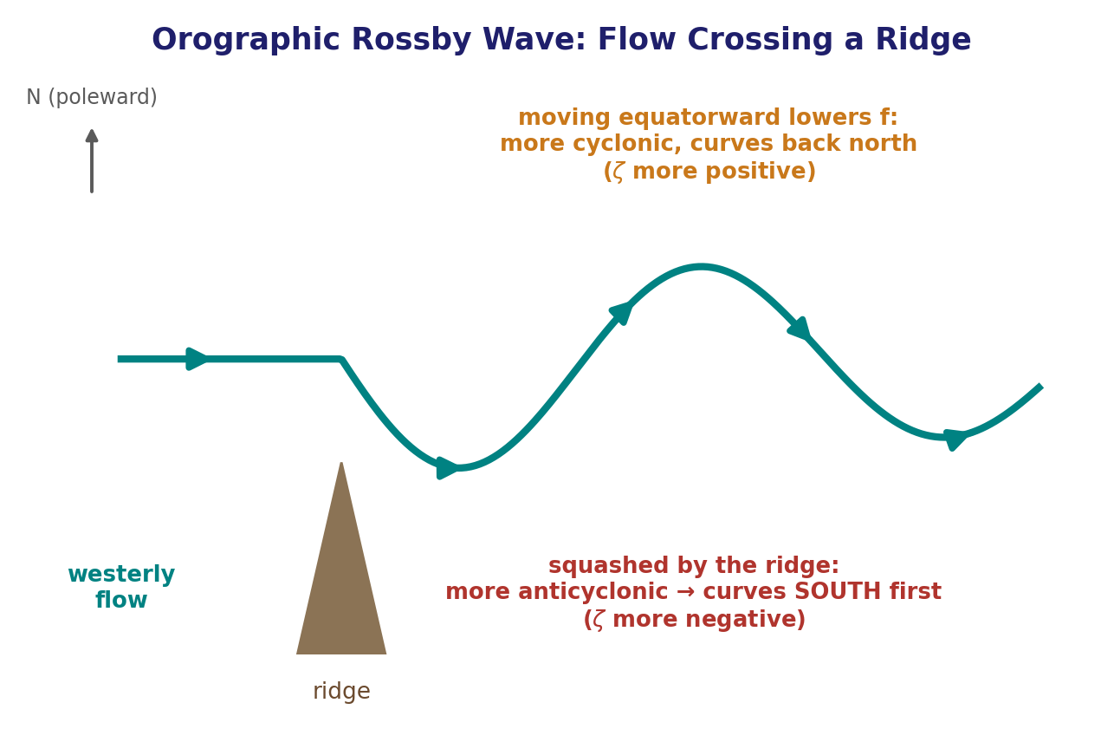
Orographic Rossby-wave reasoning — worked answer
WORKED ANSWER — DISCUSSION 2
EXTENSION — not core exam
• Over the ridge: squashes the air column (its depth shrinks under the rising terrain). Conserving potential vorticity (ζ+f)/(depth), with depth suddenly smaller and f essentially unchanged over that short crossing, forces ζ to decrease — the flow picks up anticyclonic (clockwise, in the NH) spin right over the ridge.
• Anticyclonic turn: turns an eastward flow toward the right of its motion — which, for a westerly, is south. So the flow deflects equatorward FIRST, immediately downstream of the ridge, not poleward.
• Equatorward displacement: now lowers f itself. To keep ζ+f conserved, ζ must rise again (turn cyclonic, anticlockwise), curving the flow back poleward and carrying it north past its original latitude.
  – Overshoot: raises f once more, so ζ must swing anticyclonic again, turning the flow south again — this alternating tug between relative and planetary vorticity is the Rossby-wave pattern, developing downstream of the topography.
  – Balanced initial state: balance minimises spurious fast adjustment: the initial pressure/height and velocity fields are already close to dynamical balance before the orographic perturbation acts.
EART23001 Atmospheric Physics & Weather | Week 5

Slide 42
Aside: Ocean–Atmosphere Interaction
EXTENSION — not core exam
Context only — not examined this course
• Wind drives ocean: a moving fluid. Wind stress at the surface drags on the water and helps drive large, slow-moving ocean currents that carry heat around the globe.
• Ocean feeds back: feed back onto climate and weather: the warm North Atlantic Drift keeps the UK mild for its latitude, while cold currents off Peru and West Africa help maintain the stable, dry conditions behind coastal deserts such as the Atacama.
• ENSO: (an unusually warm eastern Pacific) and La Niña (unusually cool) are the best-known examples of this coupling, and shift rainfall and storm patterns worldwide when they occur.
• Not examined: a whole further course of material — Barry & Chorley (9th ed.), pp. 193–205, is a good next step if you're curious, but nothing here is assessed in EART23001.
EART23001 Atmospheric Physics & Weather | Week 5

Slide 43
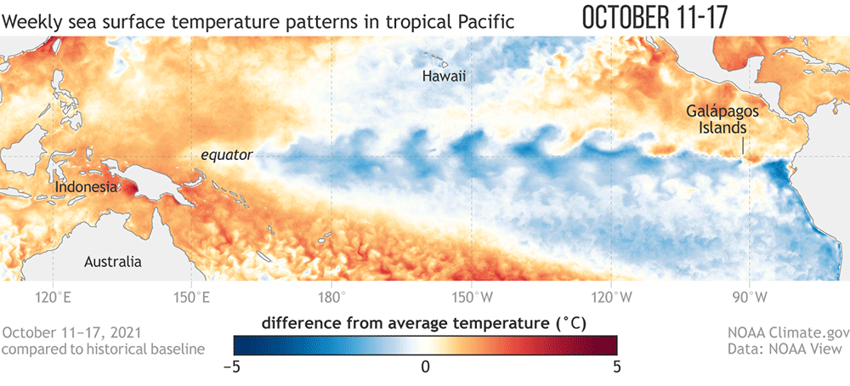
Aside: Ocean–Atmosphere Interaction
EXTENSION — not core exam
Context only — not examined this course
• Wind drives ocean: a moving fluid. Wind stress at the surface drags on the water and helps drive large, slow-moving ocean currents that carry heat around the globe.
• Ocean feeds back: feed back onto climate and weather: the warm North Atlantic Drift keeps the UK mild for its latitude, while cold currents off Peru and West Africa help maintain the stable, dry conditions behind coastal deserts such as the Atacama.
• ENSO: (an unusually warm eastern Pacific) and La Niña (unusually cool) are the best-known examples of this coupling, and shift rainfall and storm patterns worldwide when they occur.
• Not examined: a whole further course of material — Barry & Chorley (9th ed.), pp. 193–205, is a good next step if you're curious, but nothing here is assessed in EART23001.
Weekly sea-surface-temperature anomalies, tropical Pacific, showing La Niña's characteristic cool tongue. Source: NOAA Climate.gov.
EART23001 Atmospheric Physics & Weather | Week 5

Slide 44
What to Take Away From Today
WRAP-UP
• THEME 1 — Geostrophic balance: pressure-gradient and Coriolis forces balance in steady, straight, frictionless flow; surface friction makes the real wind cross isobars toward low pressure.
• APPLICATIONS: the same pressure-gradient reasoning explains sea breezes, cyclone/anticyclone flow, and broad global circulation.
• THEME 2 — Thermal wind: horizontal temperature contrasts create horizontal thickness gradients, so geostrophic wind changes with height and strong upper-level jets emerge.
• THEME 3 — Gradient wind: curvature requires a residual centripetal acceleration, so curved-flow wind speeds differ from straight geostrophic flow.
• EXTENSION — Vorticity and Rossby waves: useful large-scale-dynamics context, but not core examination material for this module.
Next week is reading week — no lecture. Week 7 turns to dry and moist air.
EART23001 Atmospheric Physics & Weather | Week 5

