Slide 1
ATMOSPHERIC PHYSICS AND WEATHER
EART23001
Week 9 — Clouds and Precipitation
Dr Ian Crawford
i.craford@manchester.ac.uk • Simon Building

Slide 2
Today's Session
Clouds and Precipitation • approx. 112 minutes
0:00
Classifying clouds from observable features
0:06
Why pure-water droplets are hard to form: the Kelvin effect
0:11
The molecular picture, and deriving the Kelvin coefficient A_{K}
0:18
Heterogeneous nucleation, and the full Köhler curve
0:28
IN-CLASS DISCUSSION 1 — the same cloud water, divided differently
8 min
0:36
Cloud susceptibility: why extinction grows only as N^{1/3}
0:40
Deriving the √t growth law, then growth by condensation
0:47
Deriving the Stokes terminal fall speed
0:53
Real data: a raindrop deforming in our wind tunnel
1:00
IN-CLASS DISCUSSION 2 — collision–coalescence and spectral broadening
10 min
1:10
The Wegener–Bergeron–Findeisen process, quantitatively
1:15
IN-CLASS DISCUSSION 3 — the WBF process with real numbers
9 min
1:26
How much water is in a cloud?
1:31
Choosing the right observing system: gauge vs radar
1:38
Why large hail needs a strong updraught
1:43
↔ EART22001 — the callback: modelled before it was derived
1:47
Further practice, wrap-up and looking ahead to Week 10
EART23001 Atmospheric Physics & Weather | Week 9

Slide 3
Forming a Cloud Droplet
PART 1 OF 3
From classification, to why pure water resists condensing at all
⏱ 0:00 – 0:47
EART23001 Atmospheric Physics & Weather | Week 9

Slide 4
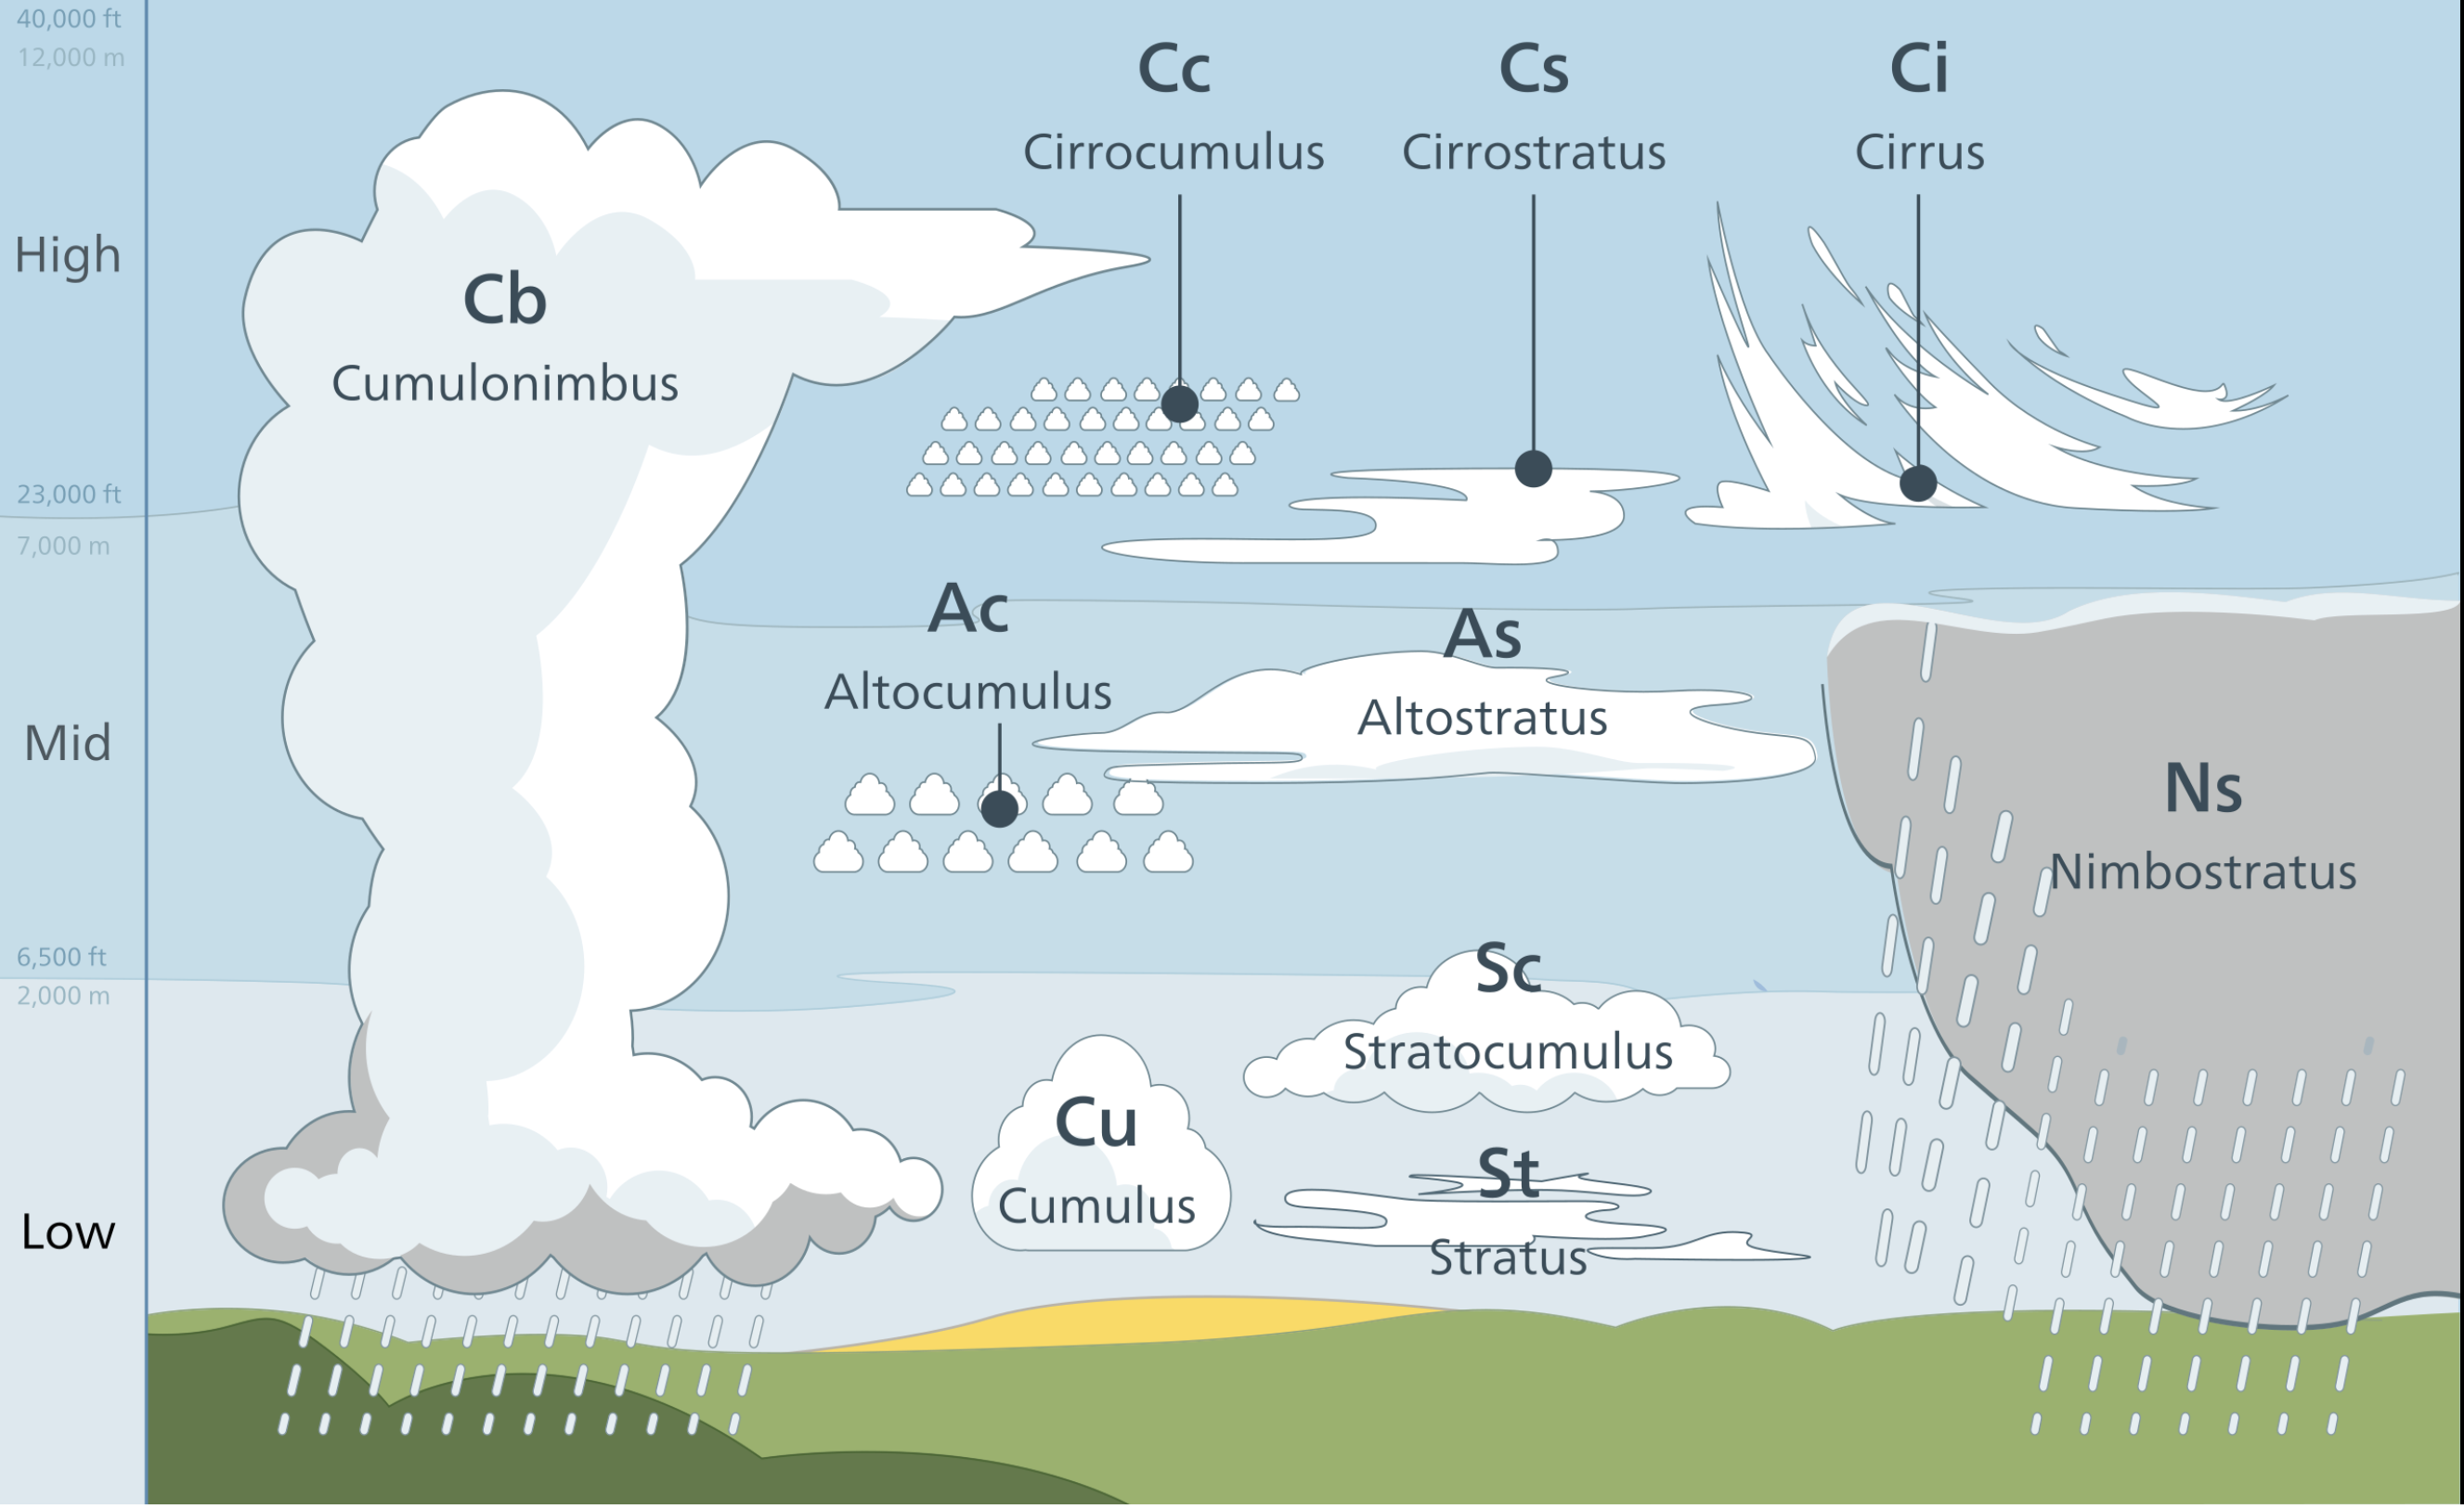
Classifying Clouds From Observable Features
Q1 — shape and altitude, not formation process, is what names a cloud
• Clouds are classified by their FORM (cirro- fibrous/curled, strato- layered, cumulo- heaped) and their ALTITUDE band, not by how they formed.
• Thin, fibrous ice cloud at ~9 km → cirrus. A low, uniform grey layer near 500 m → stratus.
• A deep cloud with a dark base, strong towers and an anvil, heavy showers → cumulonimbus.
• A widespread, thick layered cloud, persistent frontal rain → nimbostratus.
Source: NOAA JetStream, "Common Cloud Names, Shapes, and Altitudes" (public domain).
EART23001 Atmospheric Physics & Weather | Week 9

Slide 5
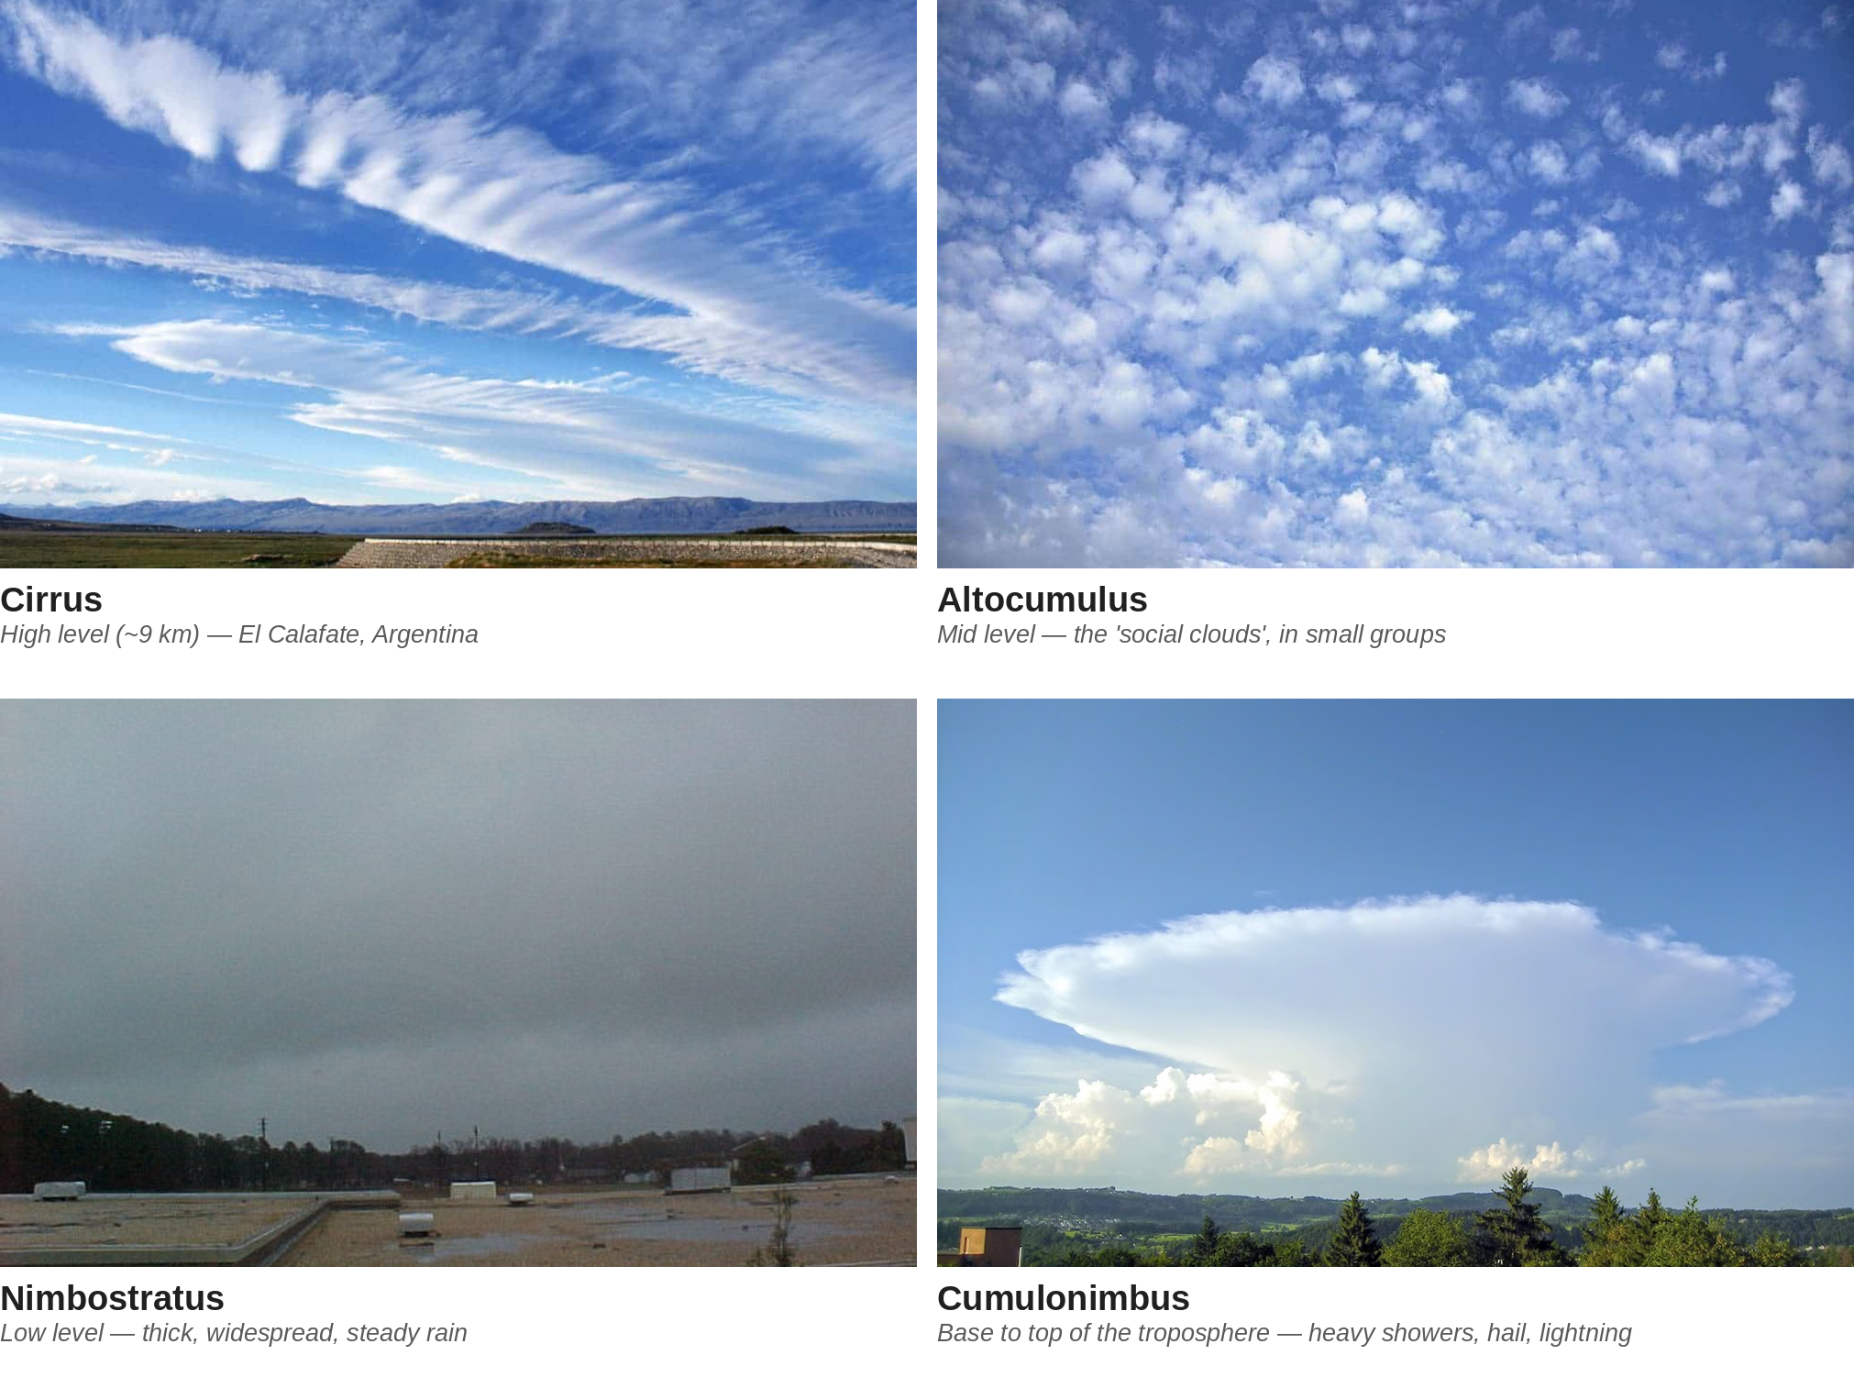
Cloud Types in the Wild
Q1, continued — the classification bands, seen for real
EART23001 Atmospheric Physics & Weather | Week 9

Slide 6
Why Pure-Water Droplets Are Hard to Form
Q2 — surface tension makes a curved surface "leak" vapour faster
• A molecule on a CURVED liquid surface is held less tightly than one on a flat surface — fewer neighbours pulling it inward — so it escapes (evaporates) more easily.
• The smaller the droplet, the sharper the curvature, and the higher the vapour pressure needed just to keep it in equilibrium: the Kelvin effect.
• Equilibrium supersaturation for a pure-water droplet: s_{eq}(r) = 100[exp(A_{K}/r) − 1], with A_{K} = 2σ_{w}M_{w}/(ρ_{w}R*T).
• Using σ_{w}=0.075 N/m, M_{w}=0.018 kg/mol, T=283 K: A_{K} = 1.15×10⁻⁹ m — tiny, but it dominates at droplet scale.
• This is why condensation from PURE vapour onto PURE water essentially never happens in the real atmosphere.
EART23001 Atmospheric Physics & Weather | Week 9

Slide 7
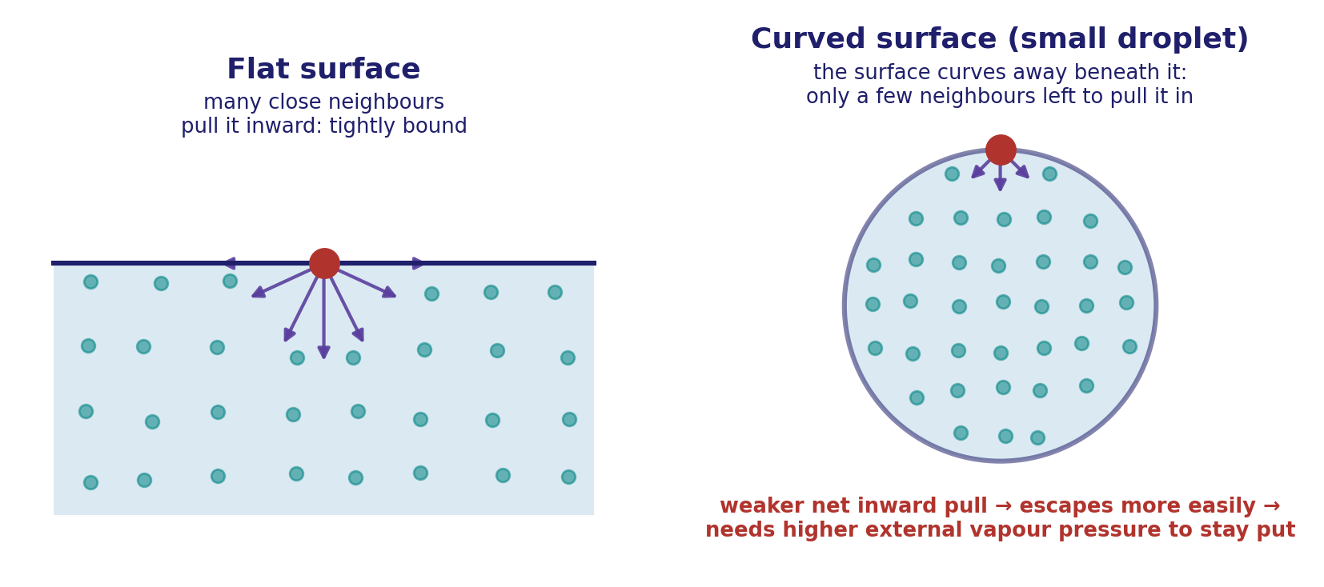
The Molecular Picture
Why a curved surface binds its molecules less tightly than a flat one
On a flat surface, many close neighbours pull a molecule inward; on a small droplet's curved surface far fewer are left — so a higher external vapour pressure is needed to stop it escaping.
EART23001 Atmospheric Physics & Weather | Week 9

Slide 8
Deriving the Kelvin Coefficient A_{K}
Q2 — from a curved surface's extra pressure to the equilibrium vapour-pressure ratio
• A curved surface supports an extra internal pressure (Young–Laplace): Δp = 2σ_{w}/r, over and above the flat-surface value.
• That extra pressure raises the liquid's own chemical potential by an amount Δp·V_{m}, where V_{m}=M_{w}/ρ_{w} is the molar volume of water.
• Equilibrium between liquid and vapour requires this shift to be matched by a change in vapour pressure: RT ln(p_{r}/p∞) = Δp·V_{m} = 2σ_{w}M_{w}/(ρ_{w}r).
• Solving: p_{r}/p∞ = exp(A_{K}/r), with A_{K} = 2σ_{w}M_{w}/(ρ_{w}R*T) — exactly the coefficient used on the previous slide, now derived rather than just stated.
This is the standard classical derivation of the Kelvin equation (Young–Laplace pressure excess + liquid–vapour equilibrium); it uses R* per mole rather than R_d, since it's a property of pure water, not moist air.
EART23001 Atmospheric Physics & Weather | Week 9

Slide 9
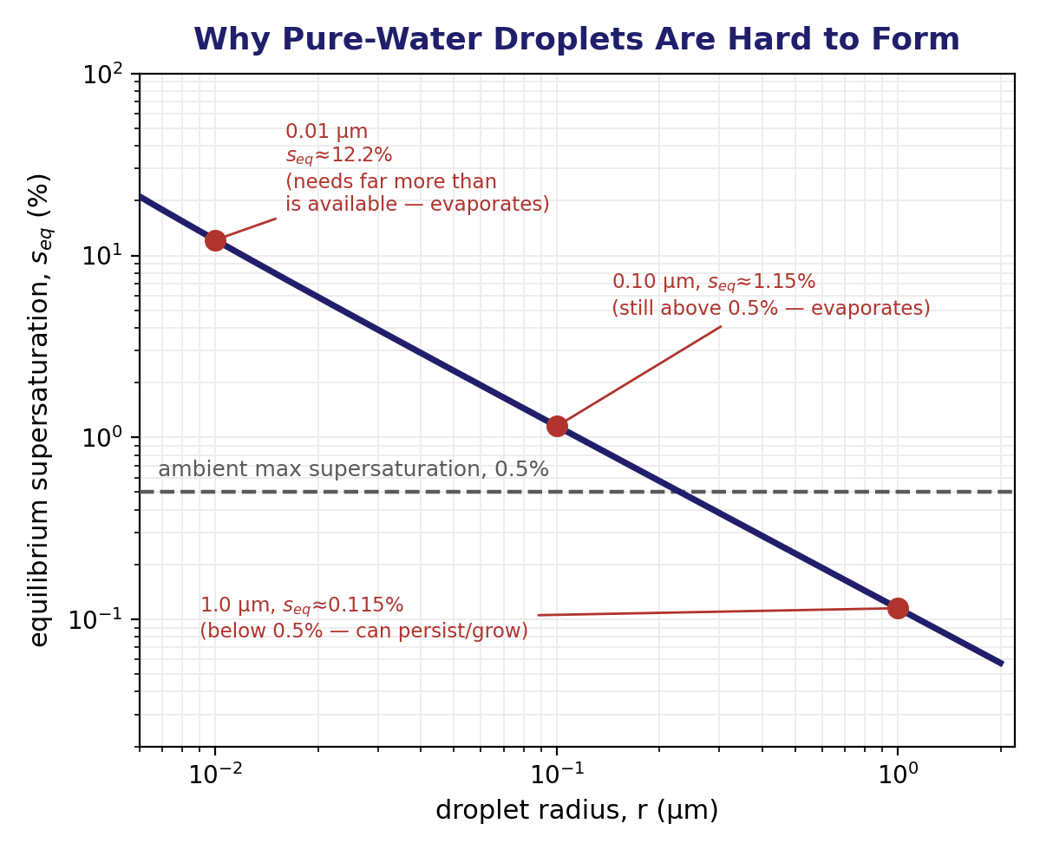
The Kelvin Curve, Worked
Smaller droplets need far more supersaturation than the atmosphere ever supplies
At r=0.01 μm, s_eq≈12.2%; at 0.10 μm, ≈1.15%; at 1.0 μm, ≈0.115%. Against a realistic ambient ceiling of 0.5%, only the 1.0 μm droplet's equilibrium value lies below it — able to persist and grow.
EART23001 Atmospheric Physics & Weather | Week 9

Slide 10
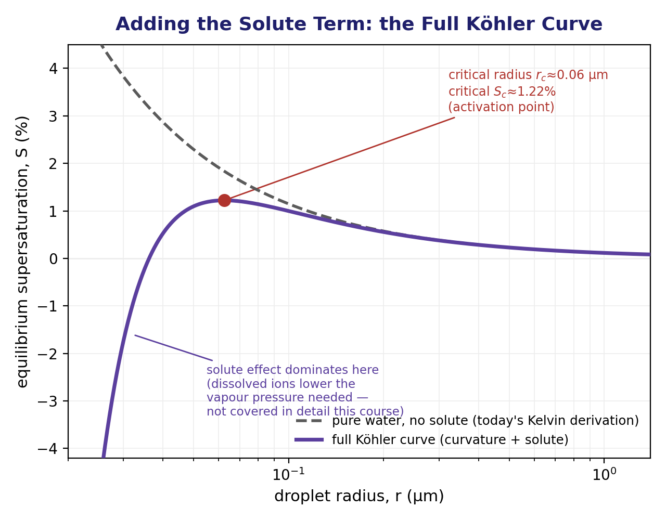
Adding the Solute Term: the Full Köhler Curve
Curvature (today's A_{K}) plus a solute effect not covered in detail this course
A soluble aerosol adds a −B/r³ term: dissolved ions bind water more tightly, lowering vapour pressure. Combined with the Kelvin term, this gives the humped curve and a critical activation point.
EART23001 Atmospheric Physics & Weather | Week 9

Slide 11
Heterogeneous Nucleation
Q2(d) — why real droplets form anyway: real air is never pure
• Real air is full of aerosols — tiny suspended solid and liquid particles — and many are hygroscopic (water-attracting).
• A soluble aerosol lowers the equilibrium vapour pressure needed above its surface (the solute effect, previous slide), directly opposing the Kelvin (curvature) effect.
• The two effects combine so that a wetted, soluble aerosol particle can activate as a cloud condensation nucleus (CCN) at the small supersaturations (a few tenths of a percent) actually found in real clouds — nothing like the 12% a pure-water embryo would need.
• This is the everyday reason real clouds form so readily: they are never really "pure water condensing from pure vapour" — they are aerosol particles being activated.
↔ EART22001 EART22001's own Week 3 practical already used this same activation idea in practice, in a parcel model with bin-microphysics — deciding computationally whether a parcel's aerosol population activates, without deriving where A_K comes from. Today you saw both the molecular picture and the derivation.
EART23001 Atmospheric Physics & Weather | Week 9

Slide 12
Not All Aerosol Is Equal: Size Modes
Q2(d), continued — which particles actually become CCN
• Real atmospheric aerosol spans a huge range of sizes, conventionally split into three modes by diameter.
• Aitken mode (≈10–100 nm): freshly formed, often from combustion or new-particle formation — hugely numerous, but too small for the Kelvin curve's peak to be reachable at realistic supersaturations, so most never activate as CCN.
• Accumulation mode (≈100 nm–1 μm): aged aerosol that has grown by coagulation and condensation — the dominant CCN population in most clouds, since this is exactly the size range where the full Köhler curve's critical supersaturation (a few tenths of a percent) matches what real clouds actually reach.
• Coarse mode (>1 μm): mechanically generated — sea salt, mineral dust — far fewer in number, but large enough to activate even more readily; can matter a lot over ocean and dusty regions specifically.
• So the Heterogeneous Nucleation slide's “real, wetted, soluble aerosol” is, in practice, almost always an accumulation-mode particle — size and aging, not just solubility, decide who gets to be a CCN.
EART23001 Atmospheric Physics & Weather | Week 9

Slide 13
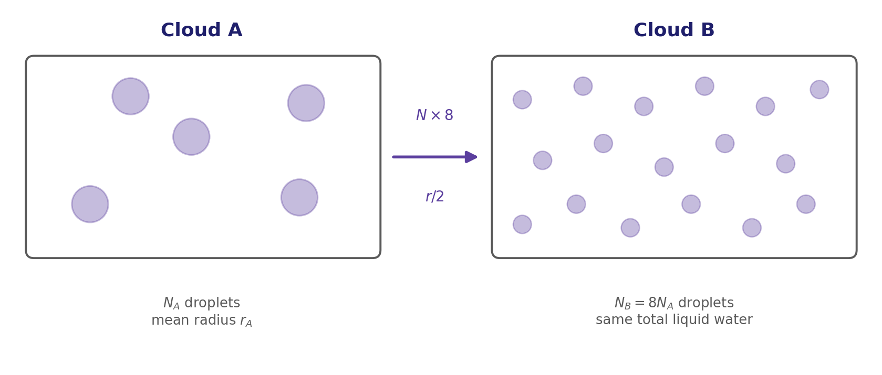
The Same Liquid Water, Divided Differently
Setting up Discussion 1 — what happens to droplet number, size and area together?
Fixed total liquid-water content means N r³ = constant: eight times as many droplets means half the radius each — but NOT half the total surface area.
EART23001 Atmospheric Physics & Weather | Week 9

Slide 14
Dividing the Same Cloud Water
IN-CLASS DISCUSSION 1
• Cloud A: N_{A}=100 cm⁻³ droplets, mean radius r_{A}=10 μm. Cloud B has the SAME liquid-water content but N_{B}=800 cm⁻³.
• 1. Explain why fixed liquid-water content implies N r³ = constant, and calculate r_{B}.
• 2. Define M₂=N r² (an area-related quantity). Calculate the ratio M_{2,B}/M_{2,A}.
• 3. Which cloud has the larger extinction coefficient (extinction ∝ M₂)? Which is more favourable for early collision–coalescence, and why?
✍ Discuss in pairs, then we'll take answers
Worked-answers sheet, Week 9 — IN CLASS Question

Slide 15
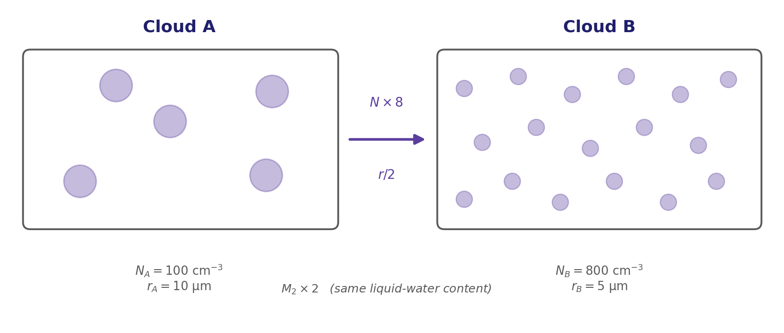
Dividing the Same Cloud Water
WORKED ANSWER — DISCUSSION 1
• Fixed liquid-water content: mass per droplet ∝ r³, so total mass ∝ N r³ = constant.
• r_{B} = r_{A}(N_{A}/N_{B})^{1/3} = 10×(100/800)^{1/3} = 10×0.5 = 5.0 μm.
• M_{2,B}/M_{2,A} = (N_{B}r_{B}²)/(N_{A}r_{A}²) = 8×(5/10)² = 2.
• Eight times the droplets gives half the radius but TWICE the total area measure — so Cloud B has the larger extinction coefficient.
• Cloud A, though, has the larger individual droplets — differential fall speeds and collection become important sooner, so Cloud A is normally more favourable for the early onset of collision–coalescence.
EART23001 Atmospheric Physics & Weather | Week 9

Slide 16
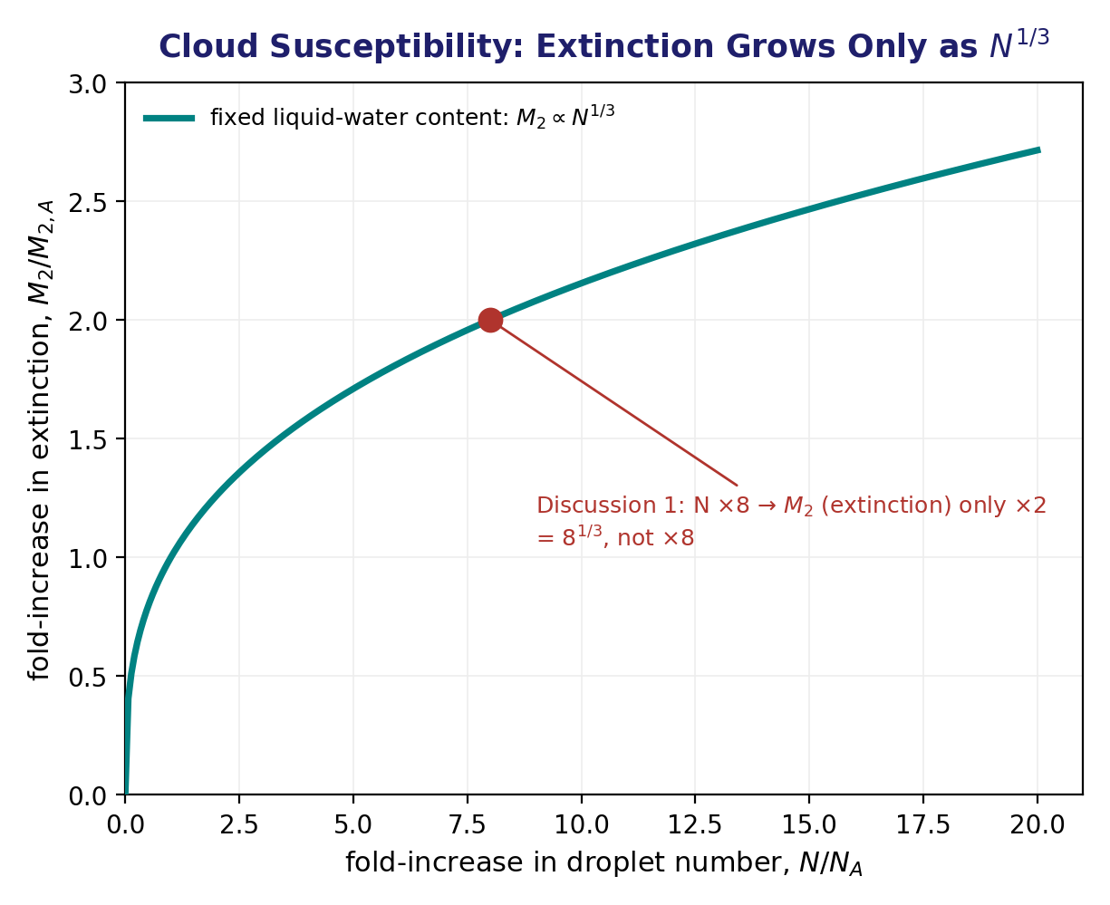
Cloud Susceptibility: Extinction Grows Only as N^{1/3}
Why polluted clouds are only modestly brighter, not proportionally brighter
For fixed liquid-water content, M₂ (∝ extinction) scales as N^(1/3), not N — Discussion 1's ×8 droplets gave only ×2 extinction, the basis of cloud 'susceptibility' to aerosol pollution.
EART23001 Atmospheric Physics & Weather | Week 9

Slide 17
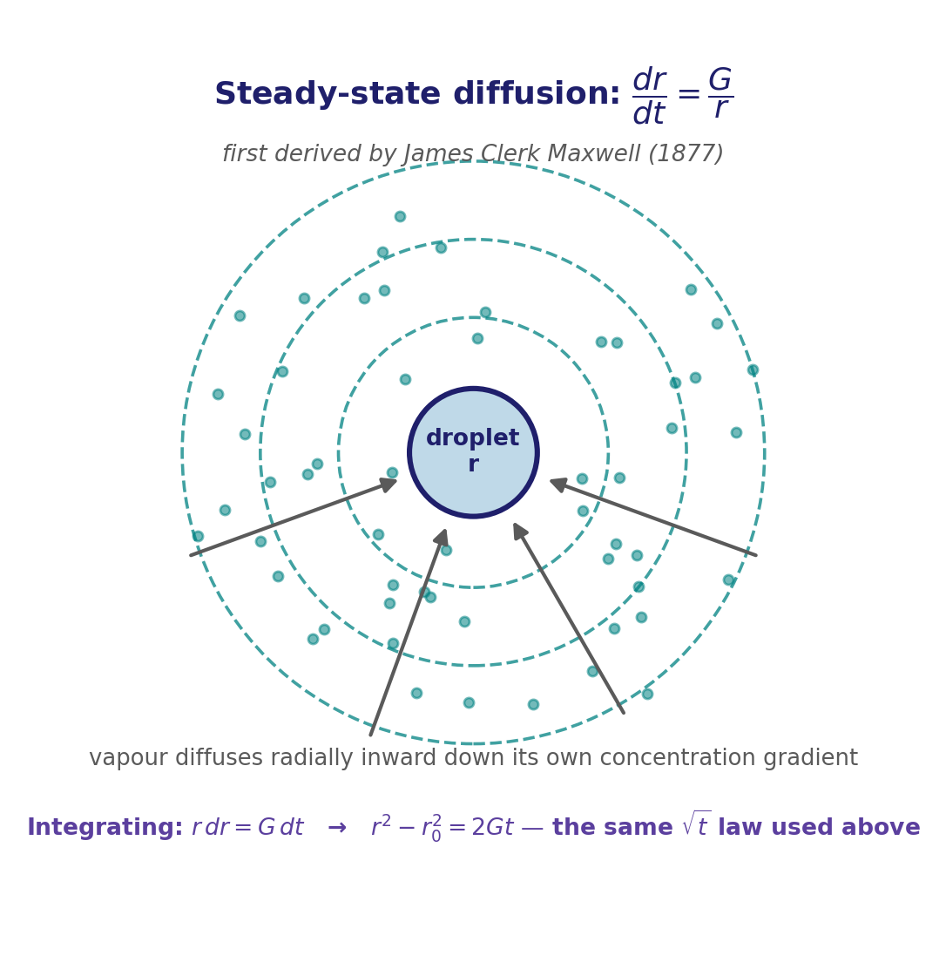
Deriving the √t Growth Law
Where Q4's r² − r₀² = Kt actually comes from: steady-state vapour diffusion
• A droplet growing by condensation is a sink for water vapour: vapour diffuses radially inward, down its own concentration gradient, toward the droplet's surface.
• For steady-state radial diffusion onto a sphere, the growth rate itself falls as 1/r: dr/dt = G/r, where G lumps together the vapour diffusivity and the vapour-density difference driving the flow.
• Separating variables and integrating: r dr = G dt → r²−r₀² = 2Gt — exactly the r²−r₀²=Kt form used on the next slide, now derived rather than just asserted (K=2G).
EART23001 Atmospheric Physics & Weather | Week 9

Slide 18
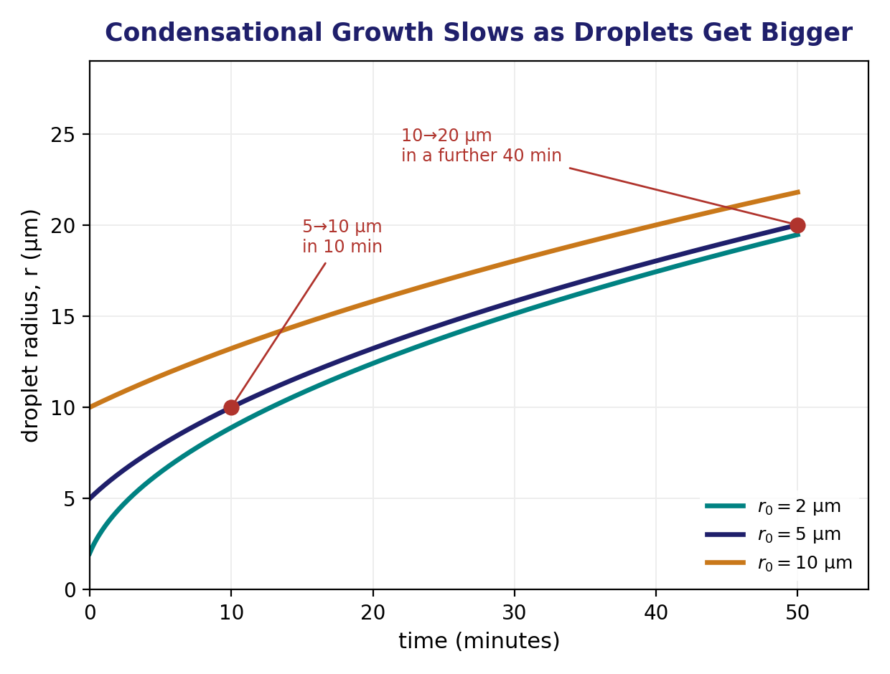
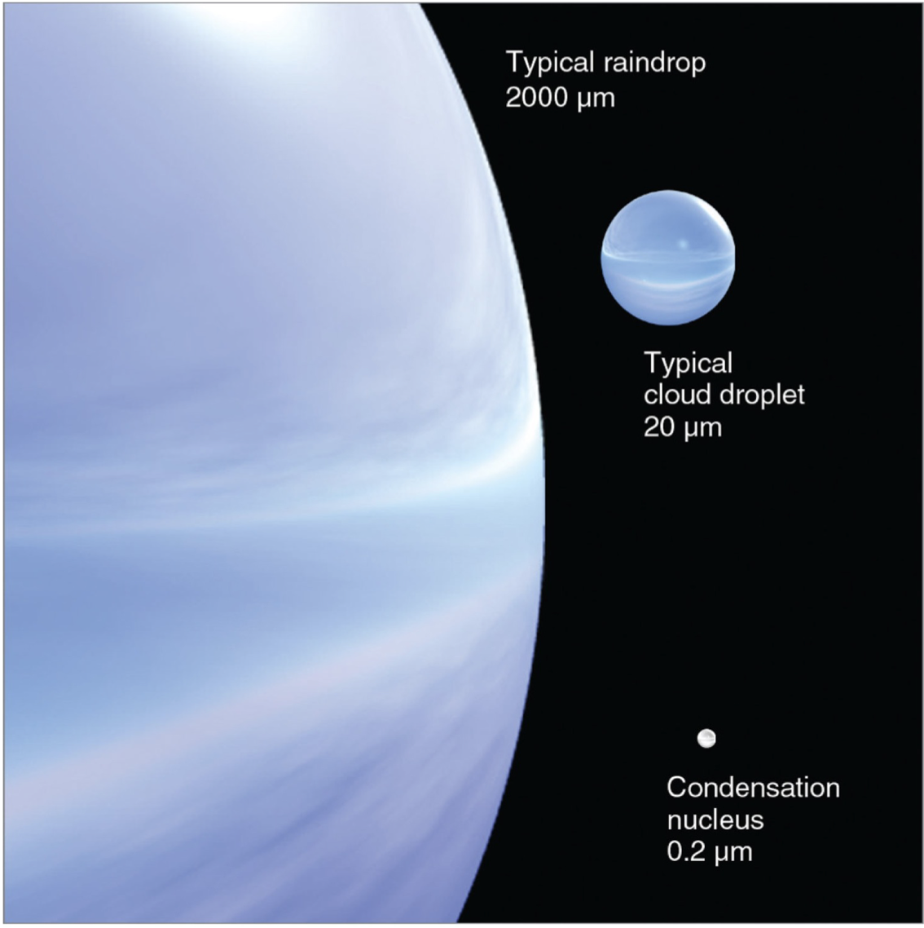
Growth by Condensation
Q4 — why r² − r₀² = Kt can't make raindrops quickly, K = 0.125 μm²/s
• From 5 to 10 μm: t = (10²−5²)/0.125 = 600 s = 10 min.
• From 10 to 20 μm, a further: t = (20²−10²)/0.125 = 2400 s = 40 min.
• If the SAME K unrealistically held all the way to a 1.0 mm raindrop: t = (1000²−20²)/0.125 ≈ 8.0×10⁶ s ≈ 92.6 DAYS.
• The key scaling is r², not r, that grows linearly — condensation is efficient for small cloud droplets but becomes drastically slower as droplets grow, so it alone cannot explain rain in realistic timescales.
• Rain formation needs another mechanism entirely — collision–coalescence and/or ice-phase growth — which is exactly where we're headed next.
Same jump, drawn to scale: nucleus → droplet → raindrop, each step ~100× the radius before it.
EART23001 Atmospheric Physics & Weather | Week 9

Slide 19
Growing a Droplet Into Rain
PART 2 OF 3
From falling faster, to sweeping up smaller droplets, to the ice-phase shortcut
⏱ 0:47 – 1:26
EART23001 Atmospheric Physics & Weather | Week 9

Slide 20
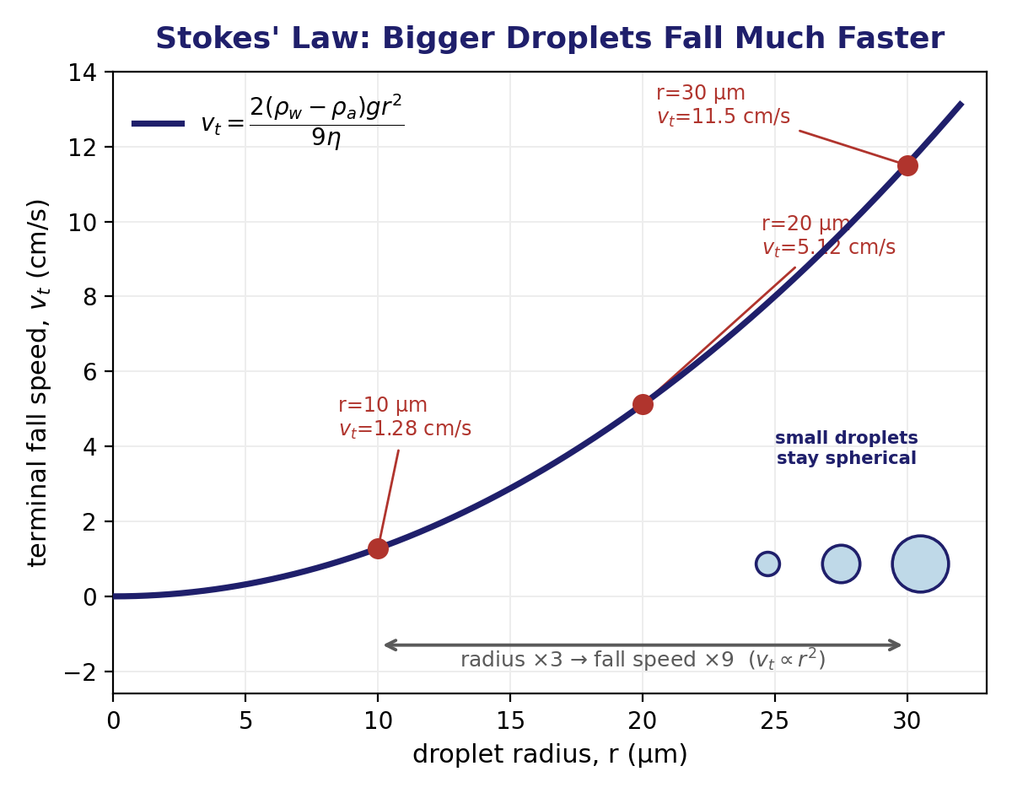
Deriving the Stokes Terminal Fall Speed
Q5 — setting drag equal to net weight
• Upward Stokes drag: F_{D} = 6πηrv_{t}. Downward net weight (buoyancy-corrected): F_{g} = (4/3)πr³(ρ_{w}−ρ_{a})g.
• Setting F_{D}=F_{g} and solving for v_{t} gives v_{t} = 2(ρ_{w}−ρ_{a})gr²/(9η).
• With η=1.7×10⁻⁵ Pa·s: v_{t}(10 μm)=1.28 cm/s, v_{t}(20 μm)=5.12 cm/s, v_{t}(30 μm)=11.5 cm/s.
• Tripling the radius increases the fall speed by 3²=9, exactly as v_{t}∝r² predicts.
• This differential fall speed — bigger droplets fall faster — is precisely what lets a large drop overtake and collect smaller ones.
EART23001 Atmospheric Physics & Weather | Week 9

Slide 21
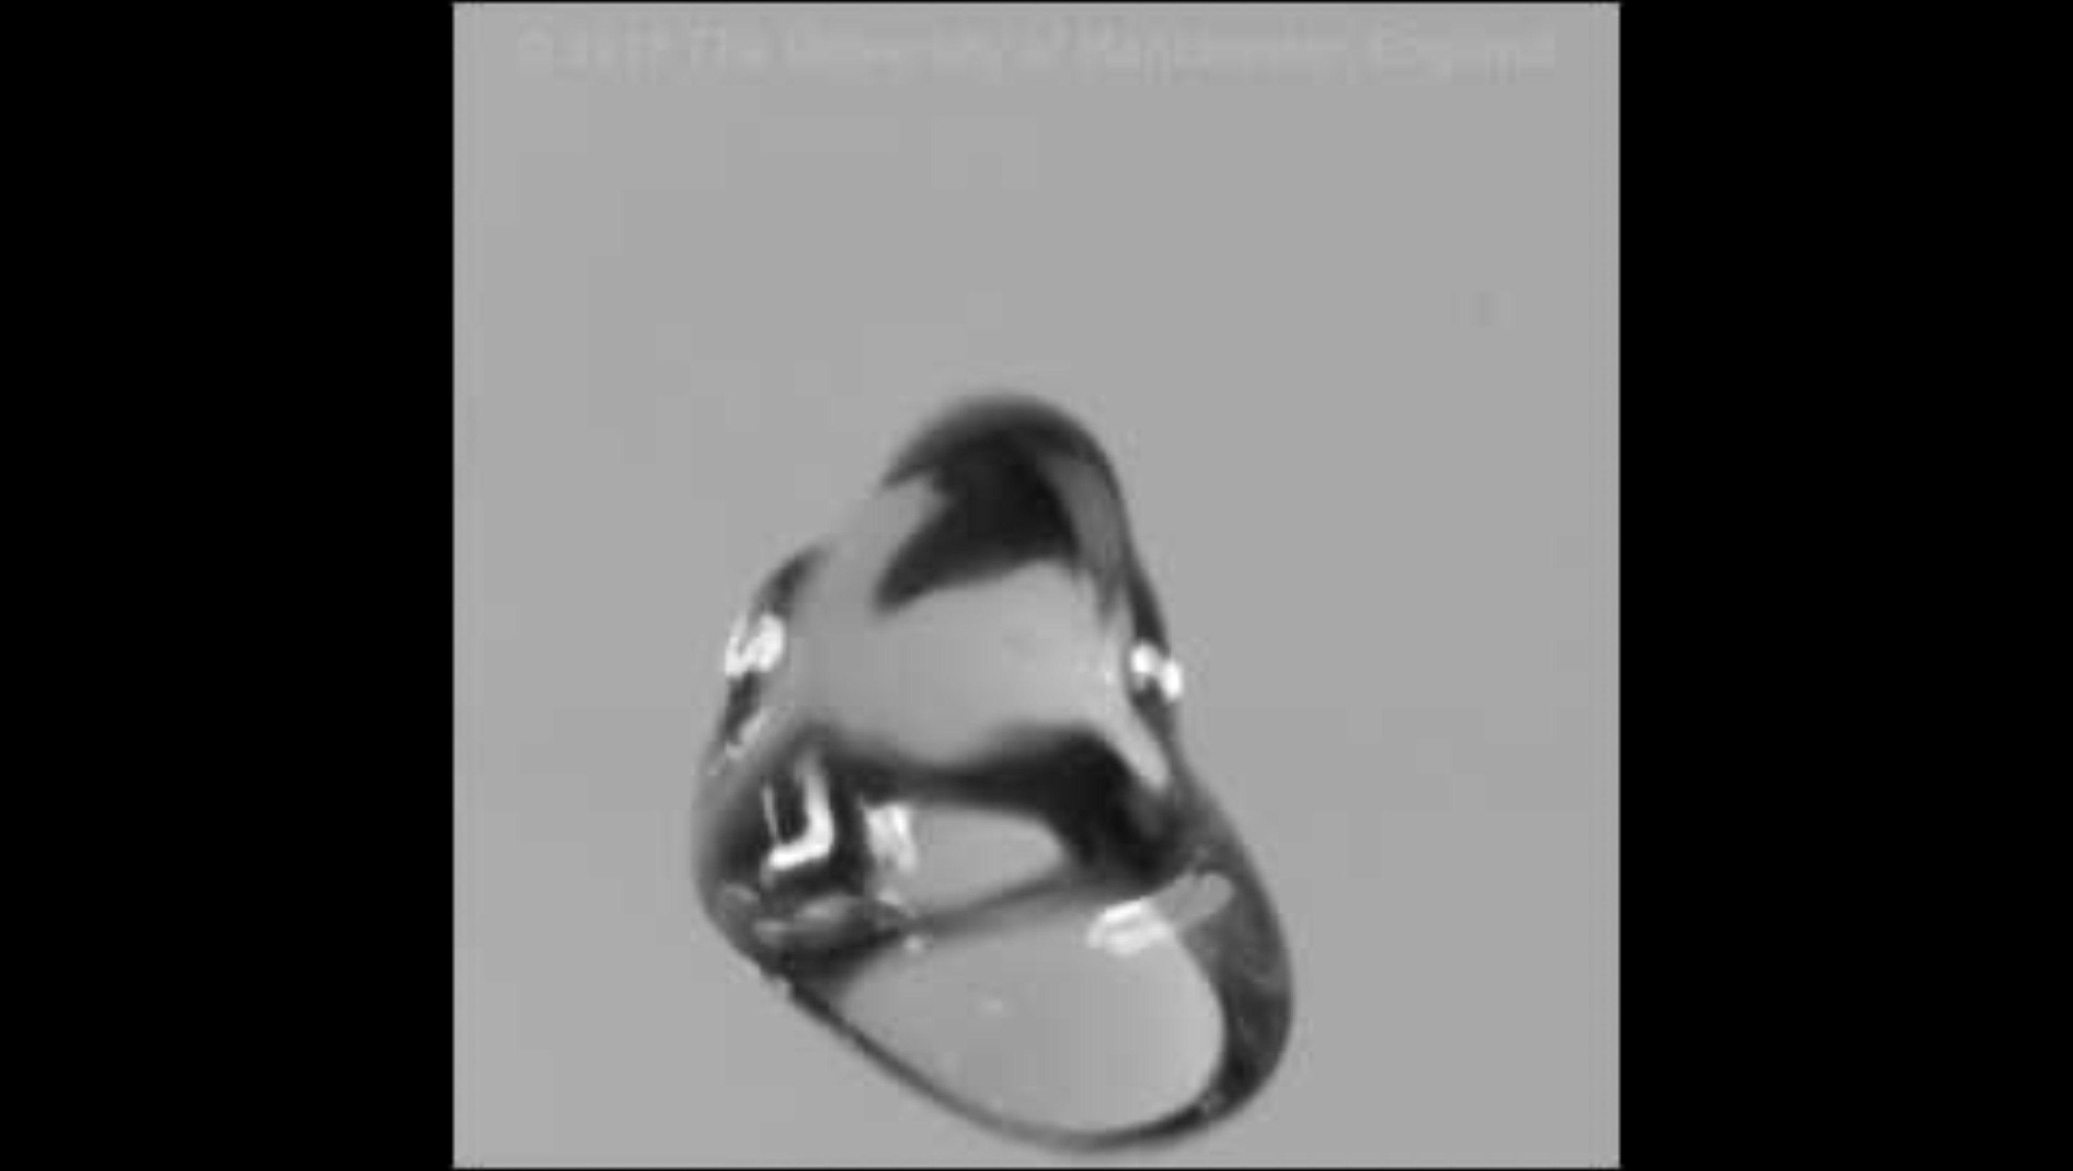
A Real Drop, From Our Own Lab
A raindrop held in our wind tunnel — where the idealised sphere meets reality
A high-speed still of a real drop suspended in our wind tunnel, deforming as airflow acts against its own surface tension — Stokes' law and the E=1 idealisation both break down at larger sizes. Courtesy Prof. Paul Connolly, University of Manchester.
EART23001 Atmospheric Physics & Weather | Week 9

Slide 22
Beyond Stokes: How Big Drops and Hail Really Fall
Q5, continued — why vt∝r² stops working
• Stokes' law (vt∝r²) only holds for small drops at low Reynolds number — extrapolate it naively to a 1 mm raindrop (100× the radius of a 10 μm droplet) and it predicts vt≈128 m/s. The real value is about 4 m/s — Stokes drag badly overestimates large-drop fall speed.
• That's because at larger sizes the flow around the drop is no longer smooth (viscous) — it separates and becomes turbulent in the drop's wake, and drag becomes dominated by form (pressure) drag rather than viscosity: FD∝r²v² instead of FD∝rv.
• Balancing this quadratic drag against weight gives vt∝√r instead of vt∝r² — fall speed grows much more slowly with size once a drop is a few tenths of a millimetre or larger, exactly the deforming, non-spherical regime the wind-tunnel photo shows.
• Real values: a 1 mm raindrop falls at ≈4 m/s; the largest stable raindrops (≈5 mm, right at the point surface tension can no longer hold them together) reach ≈9 m/s; a golf-ball-sized hailstone (≈4 cm) reaches 20–25 m/s — all governed by this quadratic-drag regime, not Stokes.
EART23001 Atmospheric Physics & Weather | Week 9

Slide 23
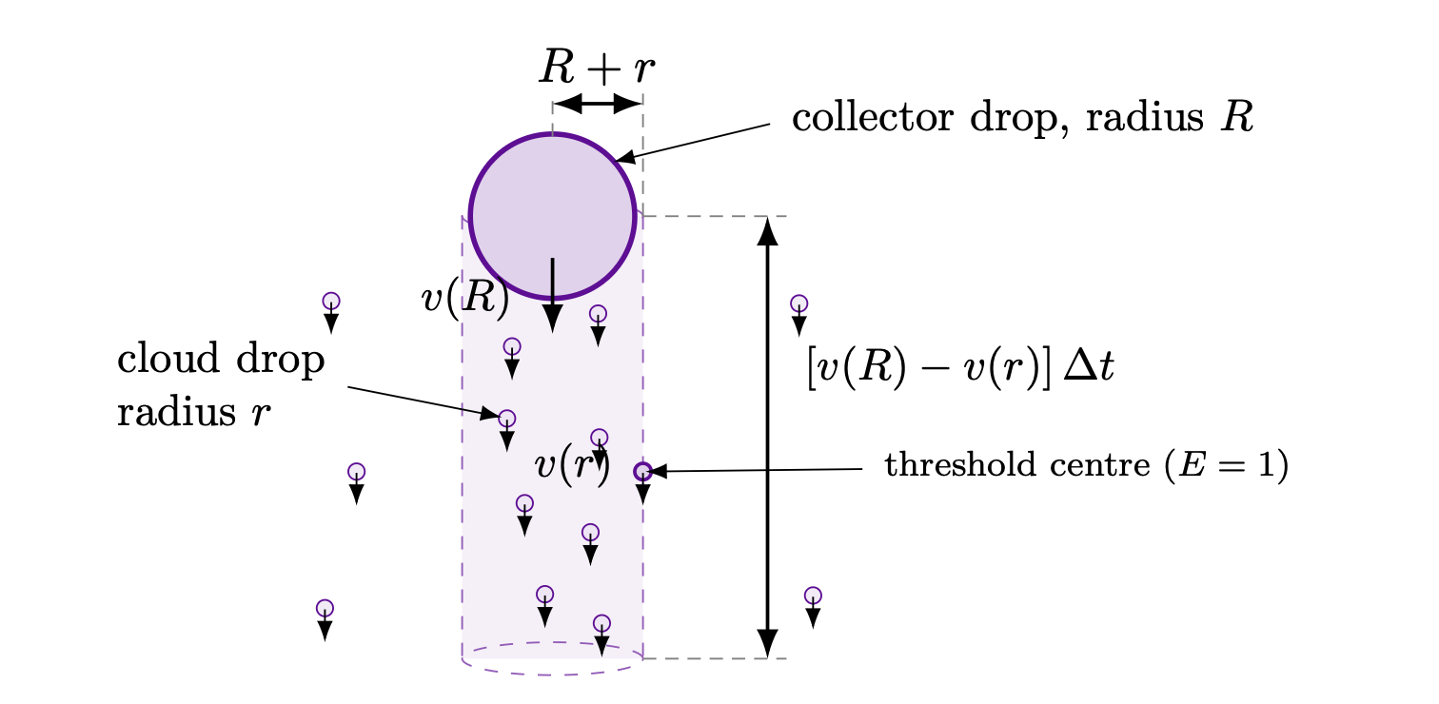
Collision–Coalescence: Setting Up the Growth Rate
Q6 setup — a collector drop sweeping through smaller cloud droplets
• A collector drop of radius R falls through a population of smaller droplets of radius r and number concentration N, at collision efficiency E=1 (idealised).
• Geometrically, it sweeps out a cylinder of radius R+r: any droplet centre inside that cylinder gets collected.
• Sweep-out rate: dV_{swept}/dt = π(R+r)²[v(R)−v(r)]. With c=(4/3)πr³ the volume of one small droplet, the collector's volume grows at dV/dt = π(R+r)²[v(R)−v(r)] N c.
EART23001 Atmospheric Physics & Weather | Week 9

Slide 24
Collision–Coalescence Growth
IN-CLASS DISCUSSION 2
• Assume R≫r and v(R)≫v(r), so R+r≈R and v(R)−v(r)≈v(R)=aR^{b}.
• 1. Show dV/dt ≈ πR²·aR^{b}·Nc, and use V=(4/3)πR³ to show dR/dt = (aNc/4)R^{b}.
• 2. For b=0.5, solve the differential equation for a collector starting at R₀ — show R(t) = [√R₀ + (aNc/8)t]².
• 3. Use this solution to explain why two collectors with different starting radii move FARTHER APART in radius over time — and why collision–coalescence broadens a droplet-size distribution.
✍ Discuss in pairs, then we'll take answers
Worked-answers sheet, Week 9 — IN CLASS Question

Slide 25
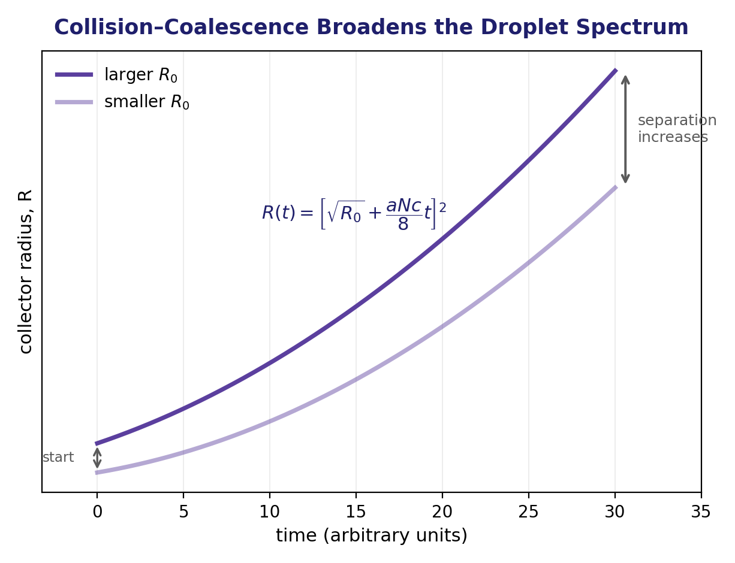
Collision–Coalescence Growth
WORKED ANSWER — DISCUSSION 2
• With R≫r, v(R)≫v(r): dV/dt ≈ πR²v(R)Nc = πaNc·R^{2+b}.
• Since V=(4/3)πR³, dV/dt=4πR²dR/dt. Equating: dR/dt = (aNc/4)R^{b}.
• For b=1/2: R^{-1/2}dR=(aNc/4)dt. Integrating from R₀: 2(√R−√R₀)=(aNc/4)t, so R(t)=[√R₀+(aNc/8)t]².
• Two starting radii both gain the SAME increment in √R over a given time — but squaring means the already-larger collector gets the bigger absolute increase in R. Their separation therefore grows with time, broadening the size distribution — exactly the opposite of condensational growth (Q4), which narrows it.
EART23001 Atmospheric Physics & Weather | Week 9

Slide 26
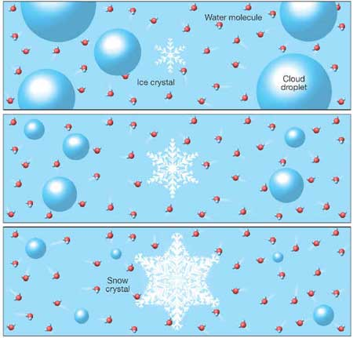
The Ice-Phase Shortcut: Setting Up the WBF Process
Q7 setup — the vapour-pressure gap between water and ice does the work
• Liquid water can exist below 0°C without freezing — SUPERCOOLED water — as long as no ice nucleus triggers it; supercooled droplets are common in real clouds down to about −40°C.
• Saturation vapour pressure over ICE is always lower than over LIQUID water at the same sub-zero temperature: ice is the thermodynamically STABLE phase there, its molecules locked more tightly into a crystal lattice, so fewer escape to the vapour.
• So air that is exactly saturated with respect to liquid water is automatically SUPERSATURATED with respect to ice.
• In a mixed-phase cloud (supercooled droplets + ice crystals coexisting), vapour deposits preferentially onto the ice, lowering the local vapour pressure, which makes the droplets evaporate to replenish it.
• Net result: water is transferred from the liquid droplets to the growing ice crystals — far faster than diffusional growth alone could manage. This is the Wegener–Bergeron–Findeisen (WBF), or "cold cloud", process.
Vapour deposits onto the ice as droplets evaporate to supply it — the ice crystal wins.
EART23001 Atmospheric Physics & Weather | Week 9

Slide 27
The Wegener–Bergeron–Findeisen Process
IN-CLASS DISCUSSION 3
• At −10°C, saturation vapour pressure is 2.86 hPa over liquid water and 2.60 hPa over ice. A mixed-phase cloud is exactly saturated with respect to liquid water.
• 1. What is the actual vapour pressure?
• 2. Calculate the relative humidity with respect to ice.
• 3. Is the air saturated, subsaturated or supersaturated with respect to ice?
• 4. State the resulting direction of net water transfer between supercooled droplets and ice crystals.
✍ Discuss in pairs, then we'll take answers
Worked-answers sheet, Week 9 — IN CLASS Question

Slide 28
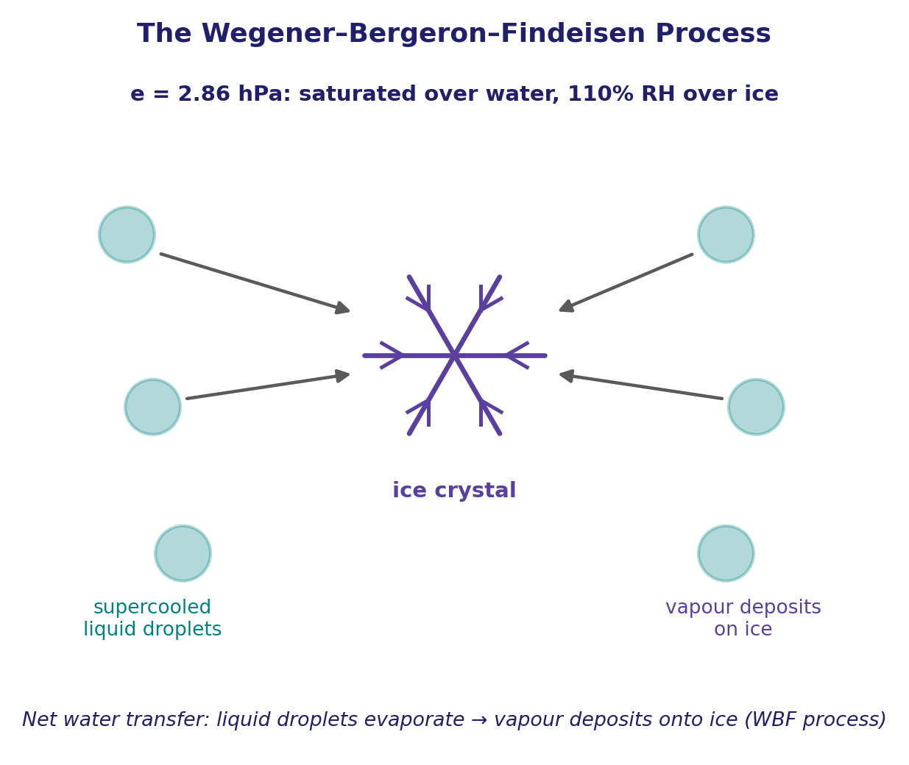
The Wegener–Bergeron–Findeisen Process
WORKED ANSWER — DISCUSSION 3
• The actual vapour pressure is set by liquid-water saturation: e = 2.86 hPa.
• RH_{i} = 100×(2.86/2.60) = 110%.
• The air is SUPERSATURATED with respect to ice (110% > 100%).
• Vapour therefore deposits onto the ice crystals. This lowers the local vapour pressure, making the air slightly subsaturated with respect to liquid water — so the supercooled droplets evaporate to replenish it. Repetition transfers water from droplets to growing ice: the WBF process, in numbers.
EART23001 Atmospheric Physics & Weather | Week 9

Slide 29
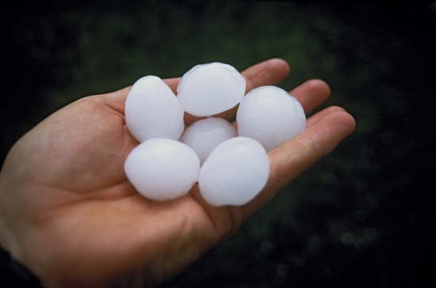
Beyond WBF: Accretion and Aggregation
Q7, continued — the other two ways ice grows
• WBF (just derived) grows ice by vapour deposition — molecule by molecule. It's not the only way ice grows in a mixed-phase cloud.
• Accretion (riming): a falling ice crystal or graupel pellet collides with supercooled liquid droplets, which freeze onto it on contact, releasing latent heat of fusion — the liquid-plus-ice analogue of collision–coalescence, and the main way graupel and hail actually grow.
• Aggregation: ice crystals collide with OTHER ice crystals and stick together — often by mechanically interlocking dendrite arms, helped by crystals becoming “sticky” near 0 to −5°C — building the large snowflakes you actually see falling.
• So a real mixed-phase cloud has (at least) three ice-growth mechanisms running at once — WBF (vapour→ice), accretion (liquid→ice), aggregation (ice→ice) — and which dominates depends on temperature and on how much supercooled liquid vs ice is actually present.
  – Forward link: accretion/riming is exactly the mechanism behind “Why Large Hail Needs a Strong Updraught,” coming up in Part 3.
Golf-ball hail — grown by repeated riming on trips up and down through a storm's supercooled cloud.
EART23001 Atmospheric Physics & Weather | Week 9

Slide 30
From Cloud to Ground
PART 3 OF 3
How much water is up there, how we measure it, and one dramatic extreme
⏱ 1:26 – 1:52
EART23001 Atmospheric Physics & Weather | Week 9

Slide 31
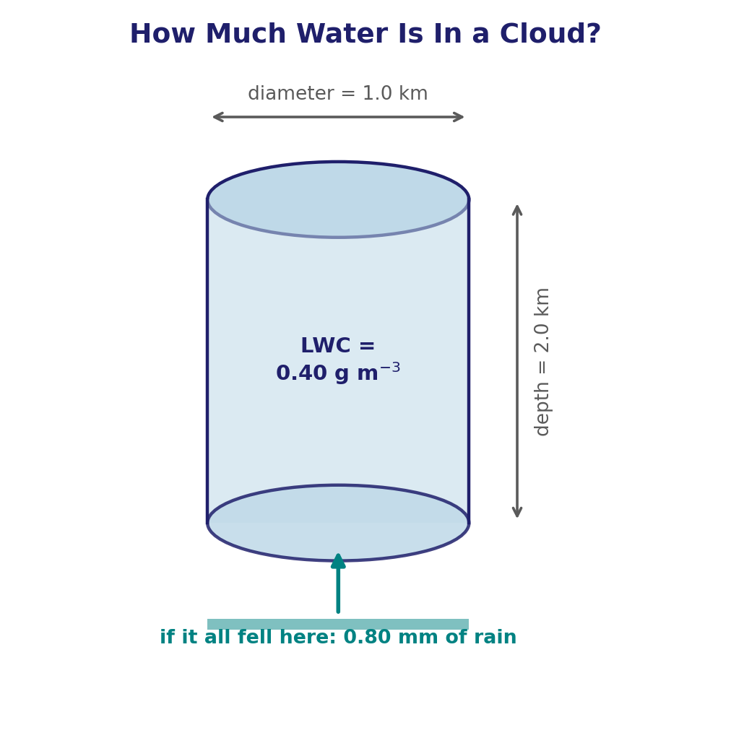
How Much Water Is In a Cloud?
Q8 — a cylinder of cloud, 1.0 km diameter, 2.0 km deep, LWC = 0.40 g/m³
• Volume: A=π(500)²=7.85×10⁵ m², so V=A×2000=1.57×10⁹ m³.
• Mass of liquid water: M=(4.0×10⁻⁴)(1.57×10⁹)=6.28×10⁵ kg.
• Latent heat released condensing it: Q=ML_{v}=(6.28×10⁵)(2.5×10⁶)=1.57×10¹² J.
• If it all fell uniformly on the area beneath the cloud: h=M/(ρ_{w}A)=8.0×10⁻⁴ m = 0.80 mm of rain.
• A modest-looking cloud carries a genuinely large amount of latent heat and water — most of which never reaches the ground as rain at all.
EART23001 Atmospheric Physics & Weather | Week 9

Slide 32
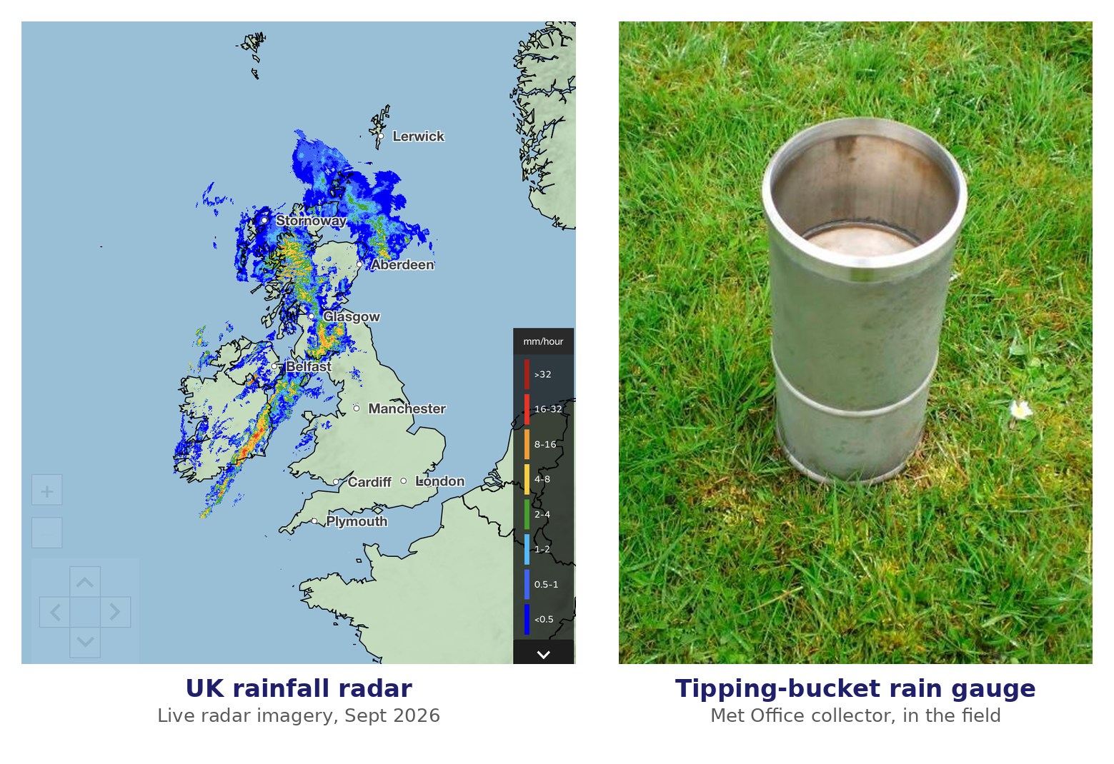
Gauge vs Radar
Q9 — the best instrument depends on exactly what you're asking
• 24-hour accumulation at one exact point → the RAIN GAUGE: it directly collects precipitation right there.
• Tracking a moving band of intense rain across a whole catchment → RADAR: repeated, wide spatial coverage beats a single point.
• Whether rainfall varies strongly across a catchment → RADAR again: one gauge simply cannot resolve spatial pattern.
• Radar doesn't measure rain rate directly — it measures reflectivity Z, then infers R via an empirical Z–R relation (e.g. Z=200R^{1.6}), itself approximate since Z depends on the drop-size distribution too.
• Gauge error: undercatch in strong winds, siting/blockage. Radar error: uncertain Z–R conversion, beam overshoot, attenuation, ground clutter — and precipitation aloft not always reaching the surface.
EART23001 Atmospheric Physics & Weather | Week 9

Slide 33
Reporting the Sky: Oktas and the Ceilometer
Q9, continued — how cloud amount and cloud base are actually measured
• How much of the sky is covered is reported in oktas — eighths of the sky: 0 oktas is clear, 8 oktas is fully overcast — the standard unit on a METAR or synoptic chart.
• Cloud-base height is measured the same way radar measures rain: a ceilometer fires a laser straight up and times how long the backscattered pulse takes to return from the cloud base — lidar, not radio waves, but the identical time-of-flight principle.
• A single ceilometer can pick up multiple layers (it reports the backscatter return from each one it detects) and, scanning or wide-angle versions can estimate the okta coverage automatically — increasingly replacing the traditional human “look up and estimate the eighths” observation.
• Together, oktas and ceilometer height are exactly the two numbers an aviation forecast needs before an aircraft can legally take off or land.
EART23001 Atmospheric Physics & Weather | Week 9

Slide 34
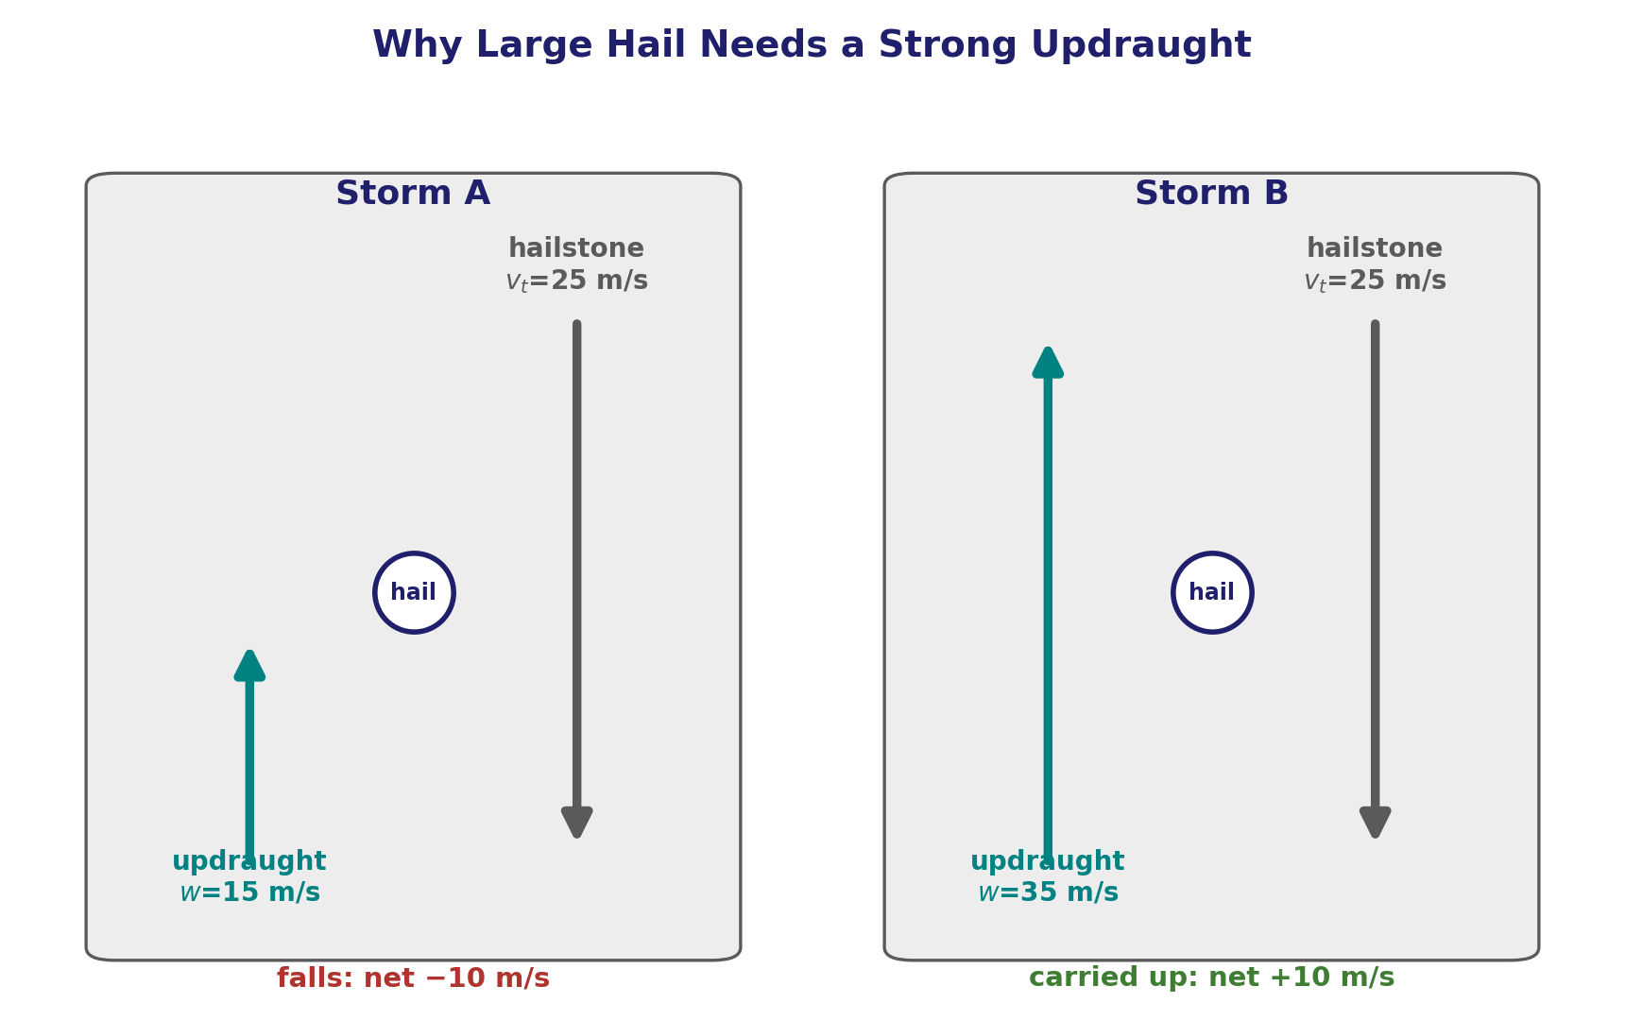
Why Large Hail Needs a Strong Updraught
Q10 — the tug-of-war between terminal fall speed and updraught strength
• A hailstone has a downward terminal speed of 25 m/s. Taking upward as positive, its ground-relative velocity is approximately w−v_{t}.
• Storm A: w=15 m/s → 15−25 = −10 m/s: the hailstone FALLS.
• Storm B: w=35 m/s → 35−25 = +10 m/s: the hailstone is CARRIED UPWARD.
• A strong, deep updraught can keep a large hailstone aloft despite its high terminal speed, repeatedly returning it to supercooled liquid water for further riming and growth — until it finally becomes too heavy even for that updraught to support.
EART23001 Atmospheric Physics & Weather | Week 9

Slide 35
↔ EART22001 — Modelled Before It Was Derived
This week closes a loop that opened weeks ago in the other course
• EART22001's Week 3 parcel practical (a parcel model with bin-microphysics) already used the Kelvin/Köhler idea in practice, to decide whether a parcel's droplets would activate — without deriving where A_{K} actually comes from. Today you derived it properly, from Young–Laplace and the liquid–vapour equilibrium condition.
• EART22001's Week 5 single-column model already simulated warm-rain (collision-coalescence) and ice-formation (WBF-type) processes — several weeks BEFORE this course reached the physics behind them.
• If you modelled either of those and it worked "like magic" at the time, today is the payoff: the same K² and R(t) reasoning you've just derived is what was running inside that model all along.
Per the module's own cross-links notes: this is a deliberate "backward reinforcement" week rather than a same-week partner — the modelling comes first, the full physical derivation catches up 4–6 weeks later.
EART23001 Atmospheric Physics & Weather | Week 9

Slide 36
Further Practice — Try These Yourself
Questions not covered as IN-CLASS discussions today
• Q2 — The Kelvin effect: repeat the calculation for a different temperature and see how A_{K} changes.
• Q4 — Condensational growth: check the doubling-time pattern for a different starting radius.
• Q5 — Stokes fall speed: derive v_{t} for a different fluid viscosity (e.g. a different altitude's air density).
• Q8 — Cloud water content: repeat for a wider or shallower cloud and compare the resulting rainfall depth.
• Q9 — Gauge vs radar: think of a fourth measurement task and decide which instrument suits it best.
• Q10 — Hail: what updraught speed would be needed to support a hailstone with v_{t}=40 m/s?
EART23001 Atmospheric Physics & Weather | Week 9

Slide 37
Wrap-Up: Key Ideas From Today
From an impossible pure-water droplet to a real raindrop on the ground
• Pure water resists condensing (the Kelvin effect) — real clouds form on aerosol CCN instead, at realistic supersaturations.
• Condensation alone is far too slow to build a raindrop — collision–coalescence, driven by differential fall speed, does the heavy lifting, and it BROADENS the size distribution rather than narrowing it.
• The ice phase offers a shortcut: the vapour-pressure gap between water and ice drives water from supercooled droplets onto ice crystals (WBF).
• A cloud carries far more water and latent heat than the rain it actually delivers to the ground — and how you measure that rain depends on exactly what question you're asking.
• Next week (Week 10): reading a real sounding on a tephigram — putting several weeks of lapse-rate and stability reasoning onto one diagram.
EART23001 Atmospheric Physics & Weather | Week 9

