Slide 1
ATMOSPHERIC PHYSICS AND WEATHER
EART23001
Week 8 — Convection and SALR
Professor Paul Connolly
p.connolly@manchester.ac.uk • Simon Building 3.08

Slide 2
Today's Session
Convection and SALR • approx. 120 minutes
0:00
Why a rising, saturated parcel cools more slowly: the SALR
0:07
Potential temperature as a comparison tool
0:12
From surface to cloud base and beyond: DALR below, SALR above
0:19
IN-CLASS DISCUSSION 1 — lift a parcel through cloud base
8 min
0:27
Why stability depends on comparing lapse rates (F = ma)
0:34
Three regimes: stable, conditionally unstable, unstable
0:41
IN-CLASS DISCUSSION 2 — classifying atmospheric stability
8 min
0:49
Stability and cloud form: layered cloud vs cumulus
0:55
Extension: parcel vs environment through an unstable layer
1:01
Temperature inversions: an extreme stable case
1:07
IN-CLASS DISCUSSION 3 — find an inversion, diagnose it
8 min
1:15
Four ways to start vertical motion
1:21
Cloud types at a glance
1:26
The Foehn effect: a worked example, and a real UK case
1:35
Further practice, wrap-up and looking ahead to Week 9
EART23001 Atmospheric Physics & Weather | Week 8

Slide 3
From Dry to Moist Ascent
PART 1 OF 3
Why a saturated parcel cools more slowly than a dry one
⏱ 0:00 – 0:27
EART23001 Atmospheric Physics & Weather | Week 8

Slide 4
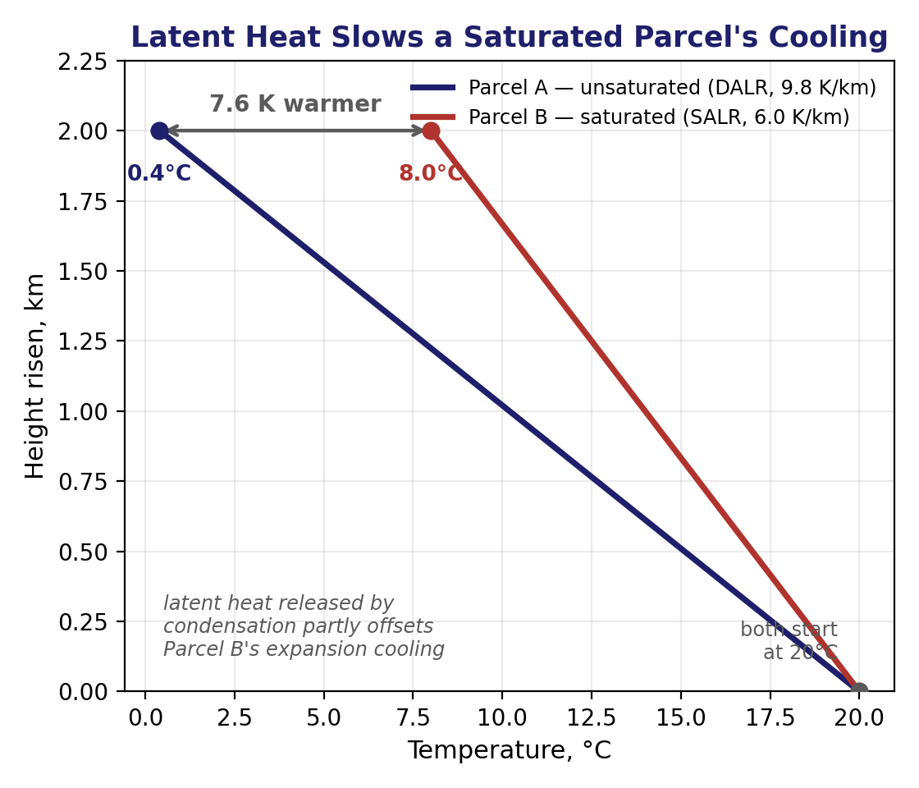
The Saturated Adiabatic Lapse Rate
Q1 — quantifying the effect of latent heating on a rising parcel
• Recap: an unsaturated (dry) parcel cools at the dry adiabatic lapse rate, Γ_{d} ≈ 9.8 K/km (Week 4).
• Once a rising parcel is saturated, condensing water releases latent heat into it, partly offsetting the expansion cooling — it cools more slowly, at the saturated adiabatic lapse rate, Γ_{s}.
• Two parcels start at 20°C and rise 2.0 km: Parcel A stays unsaturated (Γ_{d}) and reaches 20−9.8(2.0) = 0.4°C. Parcel B stays saturated at a representative Γ_{s}=6.0 K/km and reaches 20−6.0(2.0) = 8.0°C.
• Parcel B is 7.6 K warmer after the identical ascent — entirely down to the latent heat it released along the way.
• Γ_{s} isn't a universal constant: it depends on how much vapour is available to condense, which falls off steeply with temperature and pressure — warm, low-level air has far more to give up than cold, high-level air.
EART23001 Atmospheric Physics & Weather | Week 8

Slide 5
Potential Temperature as a Comparison Tool
Q4 — a quick recap and extension from Weeks 3–4
• Recap: potential temperature θ = T(p₀/p)^(R_{d}/c_{p}), with R_{d}/c_{p} = 0.286 and p₀ = 1000 hPa — the temperature a parcel would have if brought dry-adiabatically to 1000 hPa.
• θ is conserved for unsaturated (dry) adiabatic motion, so it lets you compare parcels at different pressures on one common reference level.
• Worked example: an unsaturated parcel at T=280 K, p=800 hPa has θ = 280×(1000/800)^{0.286} = 298.4 K.
• At the SAME pressure, whichever parcel has the larger θ also has the larger actual temperature — so a second parcel with θ=304 K at 800 hPa is the warmer one, no further calculation needed.
• This is exactly why θ is the natural vertical coordinate for the stability arguments coming up next.
EART23001 Atmospheric Physics & Weather | Week 8

Slide 6
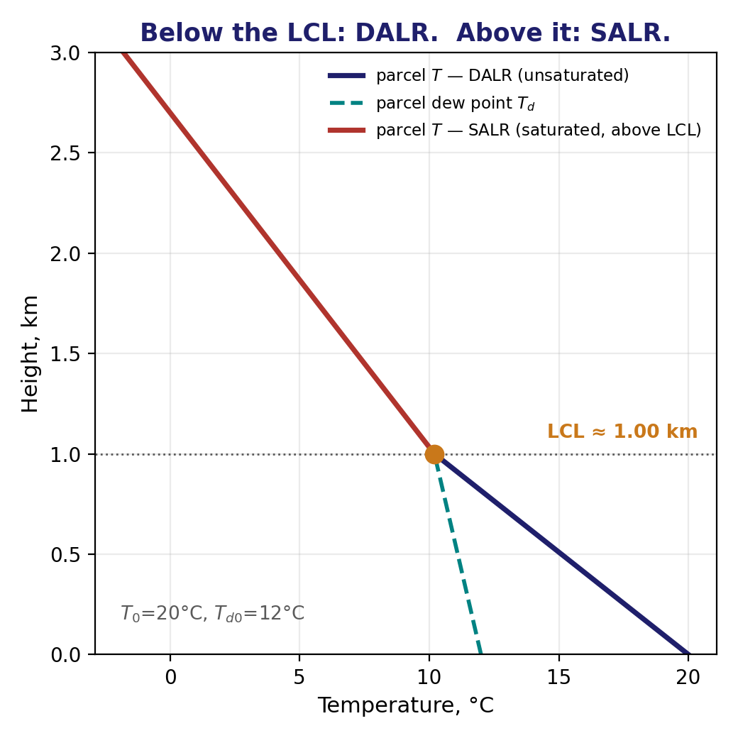
From Surface to Cloud Base — and Beyond
Q2 setup — DALR below the LCL, SALR above it
• Recap from Week 7: an unsaturated parcel cools at Γ_{d} until it reaches its lifting condensation level (LCL), where T=T_{d} and cloud begins to form.
• Above the LCL the parcel is saturated, so it switches onto the SALR, Γ_{s} ≈ 6.0 K/km — cooling more slowly than it did below cloud base.
• The parcel's full temperature profile is therefore a two-part, kinked line: steeper (Γ_{d}) below the LCL, shallower (Γ_{s}) above it.
• This is the calculation behind every cumulus cloud you'll estimate the base height of — and behind how far it can then keep growing once it's saturated.
EART23001 Atmospheric Physics & Weather | Week 8

Slide 7
Lift a Parcel Through Cloud Base
IN-CLASS DISCUSSION 1
• A surface parcel has T=25°C and T_{d}=17°C.
• 1. Estimate its LCL using z_{LCL}=125(T−T_{d}) m.
• 2. Estimate the parcel temperature at the LCL using the DALR.
• 3. If the parcel then rises to 3.0 km, cooling at 6.0 K/km above the LCL, estimate its temperature at 3.0 km.
✍ Discuss in pairs, then we'll take answers
Worked-answers sheet, Week 8 — IN CLASS Question

Slide 8

Lift a Parcel Through Cloud Base
WORKED ANSWER — DISCUSSION 1
• The temperature–dew-point difference is 8°C, so
  – z_{LCL} = 125×8 = 1000 m = 1.0 km.
• Below cloud base, cooling at the DALR,
  – T_{LCL} = 25 − 9.8(1.0) = 15.2°C.
• The parcel then rises a further 2.0 km while saturated, cooling at Γ_{s}=6.0 K/km,
  – T_{3km} = 15.2 − 6.0(2.0) = 3.2°C.
EART23001 Atmospheric Physics & Weather | Week 8

Slide 9
Will It Keep Rising?
PART 2 OF 3
Comparing a displaced parcel to its environment
⏱ 0:27 – 1:15
EART23001 Atmospheric Physics & Weather | Week 8

Slide 10
Why Stability Depends on Comparing Lapse Rates
Newton's second law applied to a displaced parcel
• Displace a parcel upward by a small distance ξ. Its temperature falls at its own lapse rate Γ_{p} (Γ_{d} if dry, Γ_{s} if saturated); the environment's temperature falls at Γ_{env}.
• The parcel's temperature excess over its new surroundings is ΔT = (Γ_{env} − Γ_{p})ξ — and at the same pressure, a warmer parcel is a less dense, more buoyant one.
• Newton's second law for the displacement then gives simple harmonic motion or exponential growth: d²ξ/dt² = K²ξ, with K² = g(Γ_{env} − Γ_{p})/T.
• K² < 0 (Γ_{env} < Γ_{p}): oscillation — the parcel is pushed back. K² = 0: neutral, it stays put. K² > 0 (Γ_{env} > Γ_{p}): exponential runaway — unstable.
• So "stable" simply means the environment's own lapse rate is smaller than the rising parcel's — exactly the comparison the three regimes on the next slide are built from.
EART23001 Atmospheric Physics & Weather | Week 8

Slide 11
Three Regimes
Comparing Γ_env with both Γ_d and Γ_s
• Absolutely stable: Γ_{env} < Γ_{s} < Γ_{d} — even a saturated parcel cools faster than the environment and sinks back.
• Conditionally unstable: Γ_{s} < Γ_{env} < Γ_{d} — an unsaturated parcel is stable, but once it saturates it can become positively buoyant.
• Absolutely unstable: Γ_{env} > Γ_{d} — even a dry, unsaturated parcel keeps accelerating upward.
• In an unstable case the rising air is warmer than its surroundings, so this is also a real transport of heat to higher altitude — this is convection.
EART23001 Atmospheric Physics & Weather | Week 8

Slide 12
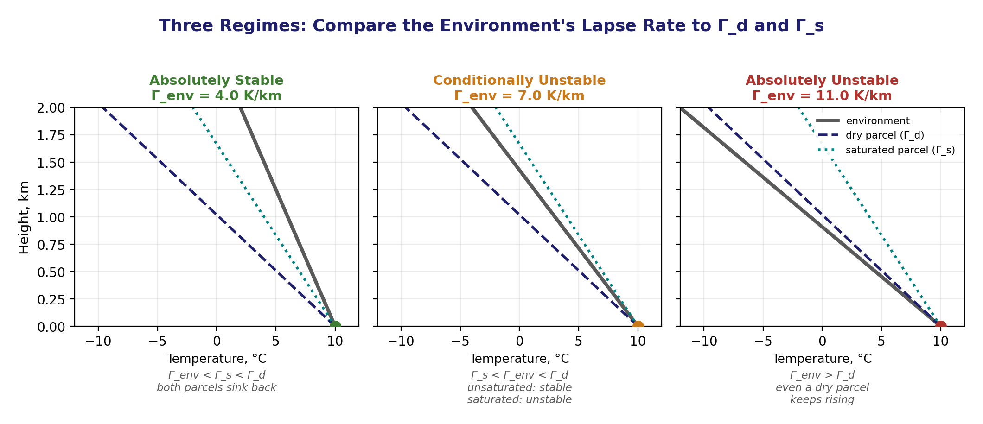
Three Regimes, Side by Side
Same environmental starting point (10°C at the surface), three different lapse rates
Environment (grey) vs a dry parcel (navy dashed, Γ_d) and a saturated parcel (teal dotted, Γ_s) for each regime.
EART23001 Atmospheric Physics & Weather | Week 8

Slide 13
Classifying Atmospheric Stability
IN-CLASS DISCUSSION 2
• For each environmental lapse rate below, classify the atmosphere as absolutely stable, conditionally unstable or absolutely unstable. Use Γ_{s}=6.0 and Γ_{d}=9.8 K/km.
• 1. Γ_{env} = 4.0 K/km
• 2. Γ_{env} = 7.0 K/km
• 3. Γ_{env} = 11.0 K/km
• For each case, state what happens to an air parcel after a small upward displacement.
✍ Discuss in pairs, then we'll take answers
Worked-answers sheet, Week 8 — IN CLASS Question

Slide 14
Classifying Atmospheric Stability
WORKED ANSWER — DISCUSSION 2
• 4.0 < 6.0: absolutely stable. Both dry and saturated lifted parcels cool faster than the environment and tend to become colder/denser, so the displacement is opposed.
• 6.0 < 7.0 < 9.8: conditionally unstable. An unsaturated parcel is stable, but a saturated parcel can cool more slowly than the environment and become positively buoyant.
• 11.0 > 9.8: absolutely unstable. Even an unsaturated lifted parcel remains warmer than the environment and tends to continue rising.
EART23001 Atmospheric Physics & Weather | Week 8

Slide 15
Stability and Cloud Form
Q8 — from a lapse-rate comparison to what you'd actually see in the sky
• Two saturated layers: Layer A has Γ_{env}=3.0 K/km, Layer B has Γ_{env}=8.0 K/km (Γ_{s}=6.0 K/km).
• Layer A: Γ_{env} < Γ_{s}, so it's stable with respect to saturated displacement — a lifted saturated parcel cools faster than the environment and sinks back.
• Layer B: Γ_{env} > Γ_{s}, so it's unstable with respect to saturated displacement — a lifted saturated parcel can become warmer than its environment and keep rising.
• So Layer A favours shallow, horizontally extensive cloud (stratus/altostratus); Layer B favours vertically developing cumulus or cumulonimbus, given enough moisture and a lifting trigger.
EART23001 Atmospheric Physics & Weather | Week 8

Slide 16

Layer A in the Sky: A Stable Saturated Layer
Altostratus undulatus — shallow and horizontally extensive, exactly as Layer A predicts
Altostratus undulatus: a broad, layered mid-level sheet, rippled by wind shear but showing no vertical development — the visible signature of a saturated layer that is stable to displacement (Layer A). Source: Wikimedia Commons.
EART23001 Atmospheric Physics & Weather | Week 8

Slide 17
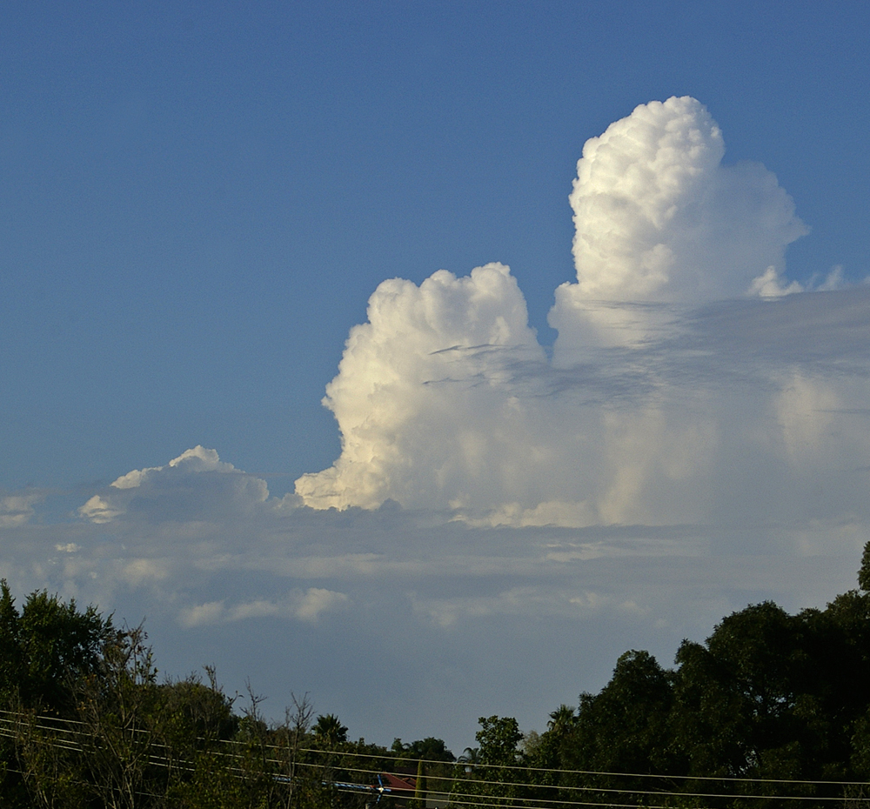
Layer B in the Sky: An Unstable Saturated Layer
Cumulus congestus — vertical development, exactly as Layer B predicts
Cumulus congestus towers rising well above the surrounding cumulus — visible evidence of a saturated parcel that stayed warmer than its environment and kept accelerating upward (Layer B). Source: Wikimedia Commons.
EART23001 Atmospheric Physics & Weather | Week 8

Slide 18
Extension — Parcel vs Environment
Try Q9 yourself: the same reasoning through a conditionally unstable layer
• At 1.0 km, a saturated parcel and its environment are both at 12°C. Between 1 and 3 km the environment cools at 7.5 K/km while the parcel cools at Γ_{s}=6.0 K/km.
• Over 2 km the parcel cools by 12 K, so T_{p} = 0°C at 3 km. The environment cools by 15 K, so T_{e} = −3°C.
• The parcel is therefore 3 K warmer than its environment at 3 km — consistent with Γ_{env}=7.5 > Γ_{s}=6.0, i.e. saturated instability in this layer.
• A warmer parcel than its surroundings tends to keep accelerating upward — exactly Layer B's behaviour from Q8 (and the cumulus congestus photo a moment ago), now worked with real numbers.
EART23001 Atmospheric Physics & Weather | Week 8

Slide 19
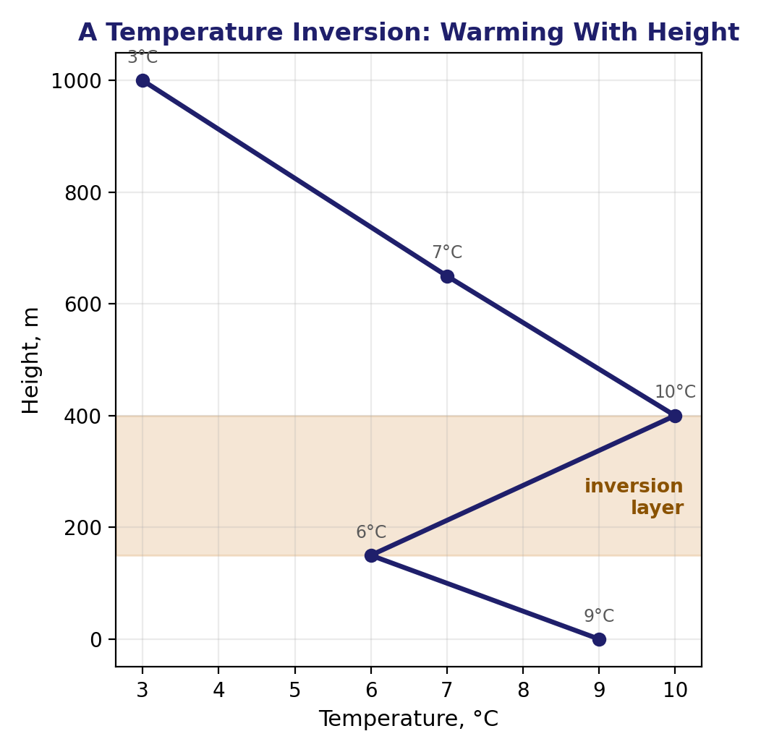
Temperature Inversions: an Extreme Stable Case
Setting up Discussion 3
• An inversion is a layer where temperature INCREASES with height — the most strongly stable case possible, since a displaced parcel becomes far colder and denser than its new surroundings.
• Two common causes: radiative cooling of the ground on a clear night (the air right at the surface cools fastest, leaving warmer air just above it), and the tropopause itself, a permanent large-scale inversion that caps almost all convection and cloud growth.
• Vertical mixing is strongly suppressed through an inversion — which matters enormously for anything emitted near the surface.
EART23001 Atmospheric Physics & Weather | Week 8

Slide 20
Find an Inversion and Diagnose Its Consequences
IN-CLASS DISCUSSION 3
• A morning temperature profile: height (m) 0, 200, 500, 800, 1200 — temperature (°C) 5, 3, 7, 5, 2.
• 1. Between which two levels is there a temperature inversion?
• 2. Calculate the temperature change across that inversion layer.
• 3. Would vertical mixing through the inversion be encouraged or suppressed?
• 4. A city lies below the inversion under light winds. Predict the effect on near-surface pollutant concentration, and explain why.
✍ Discuss in pairs, then we'll take answers
Worked-answers sheet, Week 8 — IN CLASS Question

Slide 21
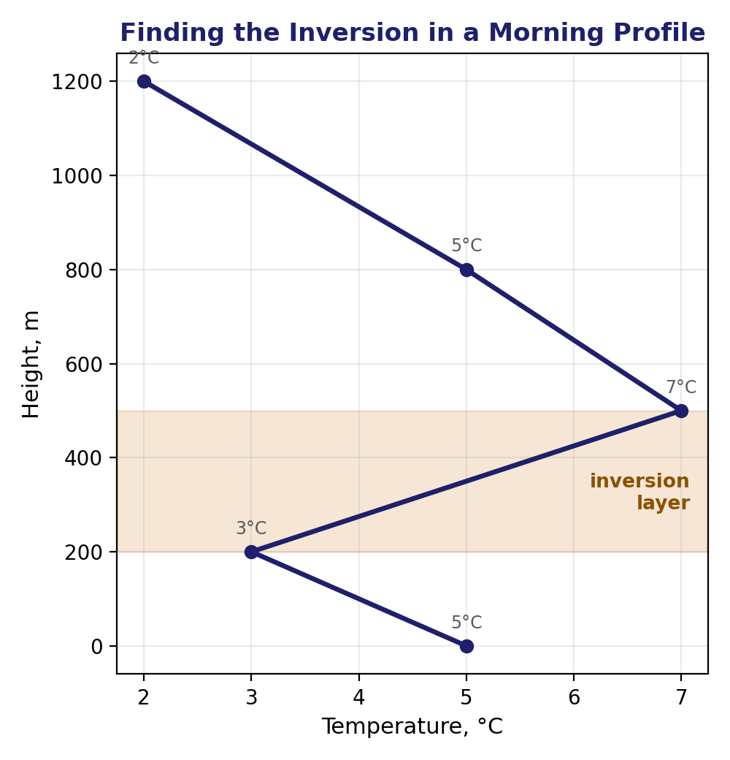
Find an Inversion and Diagnose Its Consequences
WORKED ANSWER — DISCUSSION 3
• Temperature increases from 3°C at 200 m to 7°C at 500 m, so the inversion lies across that layer — a temperature change of +4 K.
• An inversion is strongly stable: a displaced parcel becomes colder and denser than the warmer environment, so vertical mixing is suppressed.
• Under light winds, pollutants emitted near the surface are then trapped in a shallow layer below the inversion and can accumulate to much higher concentrations than they would in a well-mixed atmosphere.
EART23001 Atmospheric Physics & Weather | Week 8

Slide 22
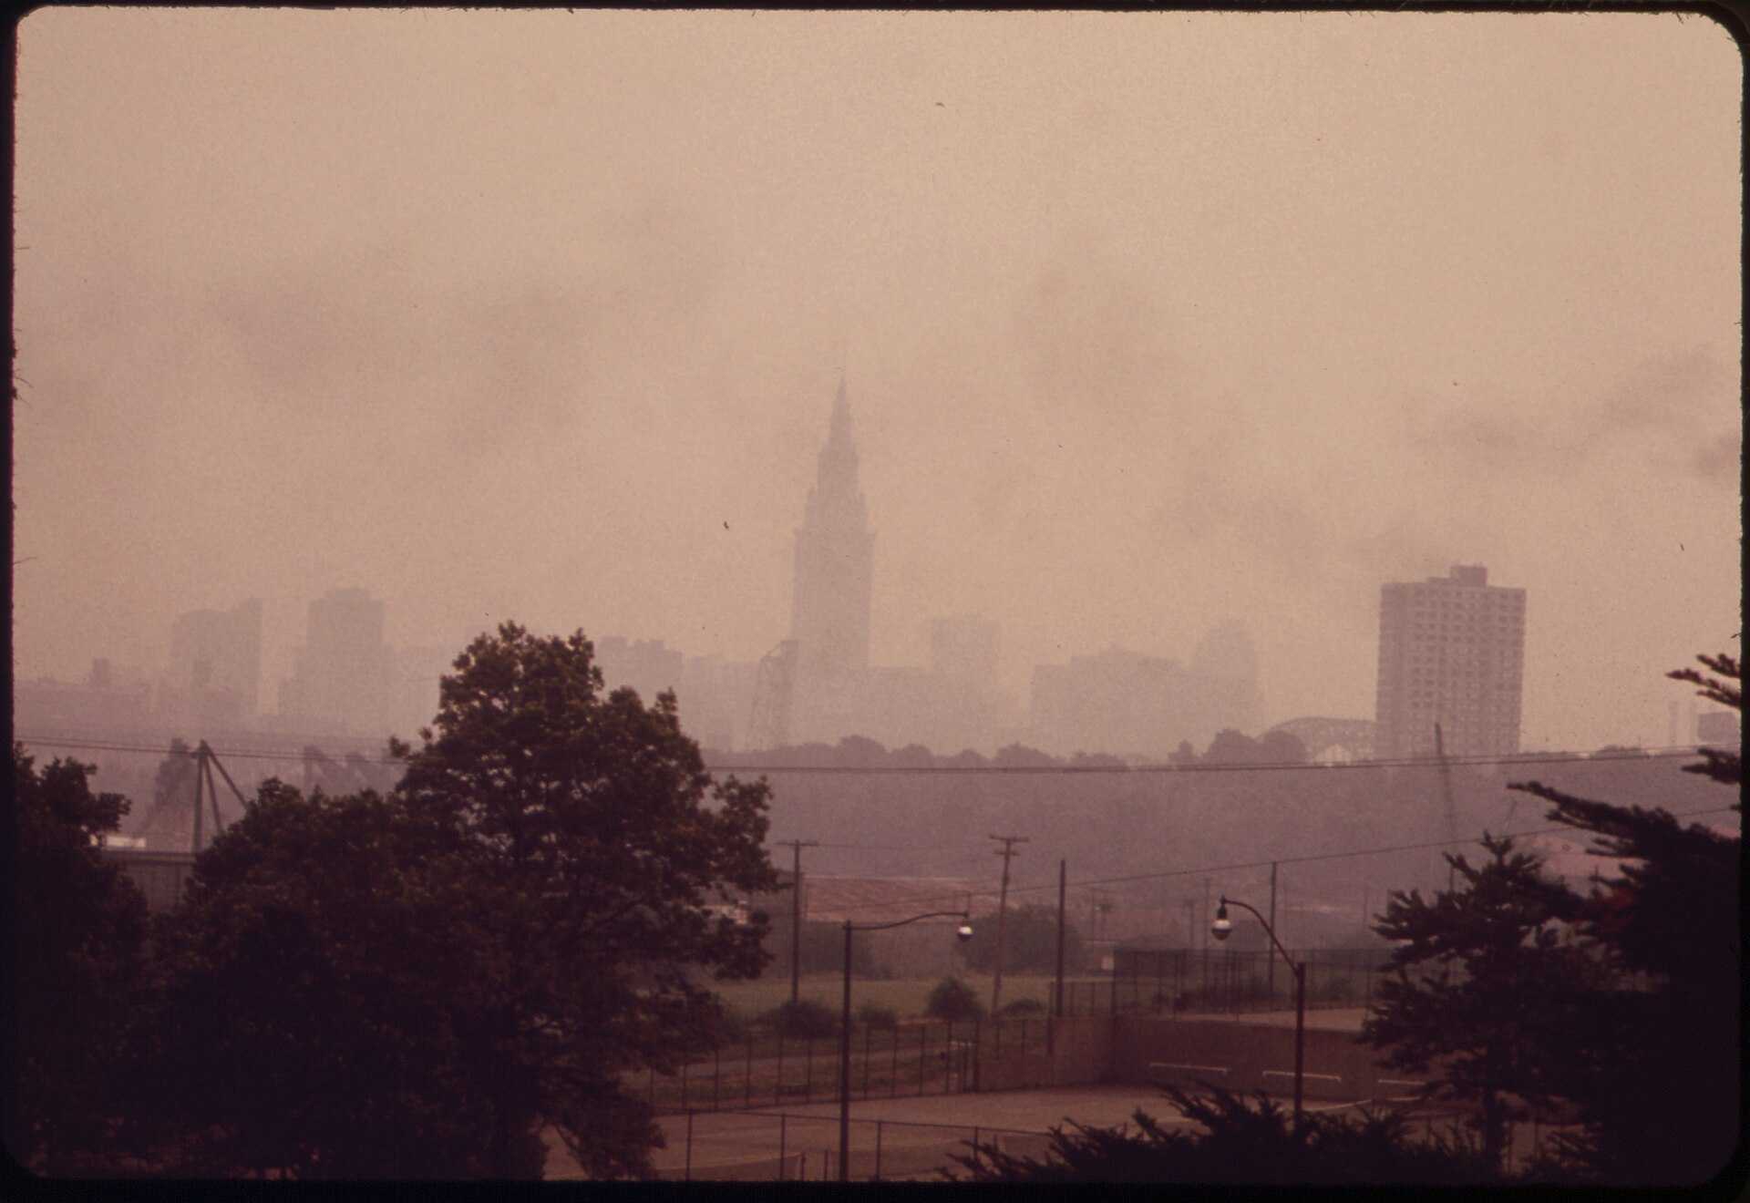
A Real Case: Smog Trapped Under an Inversion
Cleveland, Ohio, 20 July 1973 — a heavy pollution-alert day
Cleveland's skyline, barely visible through smog trapped beneath a low inversion during a July 1973 pollution alert. Source: US National Archives (NARA 550190), public domain.
EART23001 Atmospheric Physics & Weather | Week 8

Slide 23
Convection in the Real World
PART 3 OF 3
What starts it, what it looks like, and a real UK example
⏱ 1:15 – 1:44
EART23001 Atmospheric Physics & Weather | Week 8

Slide 24
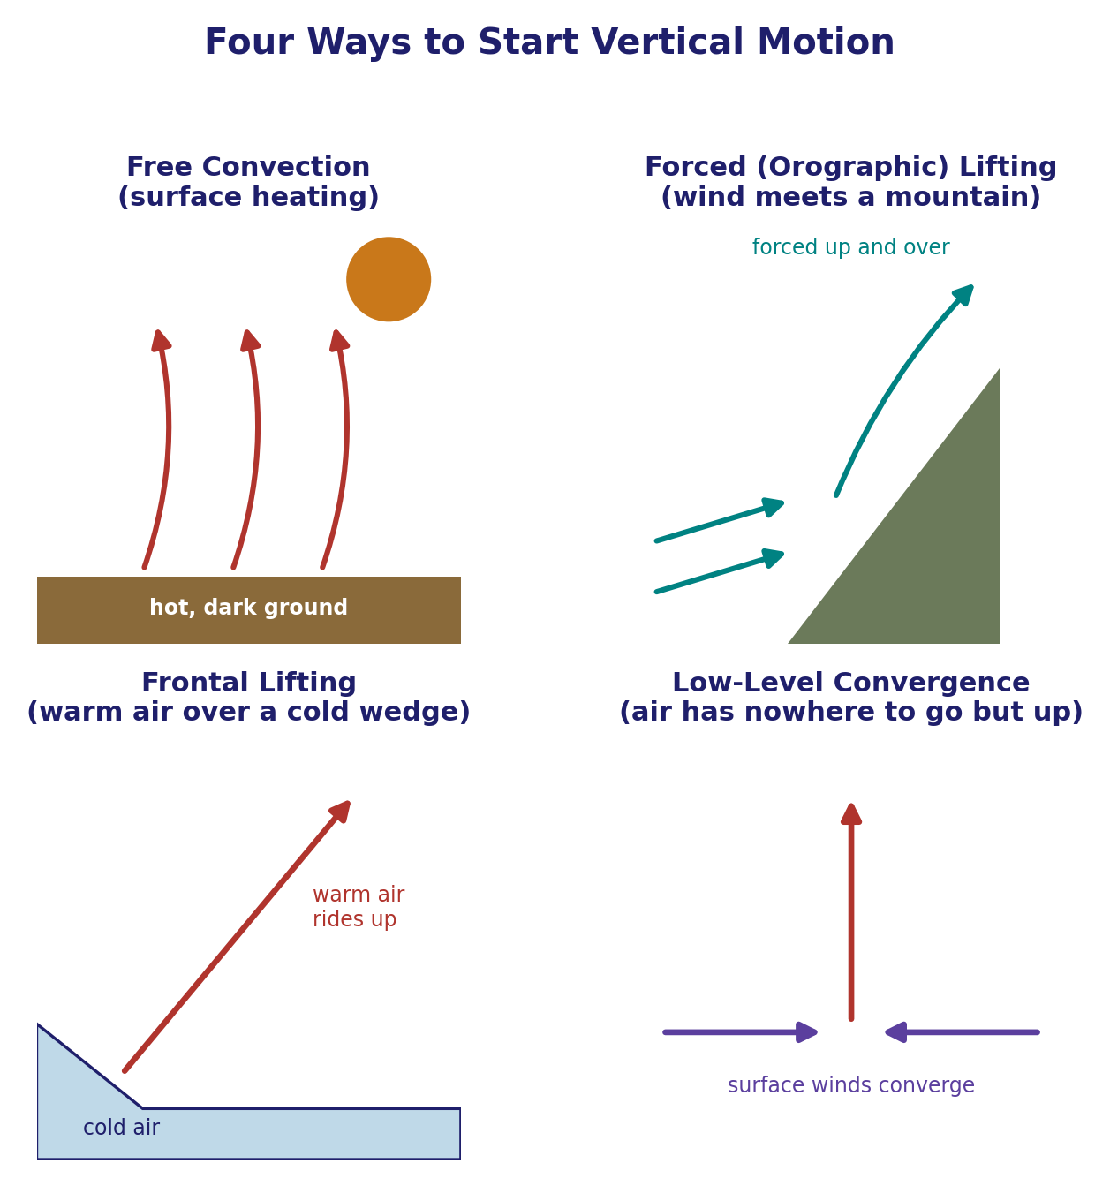
Four Ways to Start Vertical Motion
Q7 — instability alone doesn't create a cloud; something has to trigger the lift
• Free convection: strong surface heating over a dark, absorbing surface makes air buoyant enough to rise on its own — classic afternoon thermals.
• Forced (orographic) lifting: a moist wind meets high ground and is mechanically forced up and over it.
• Frontal lifting: a cold front advances beneath warmer air, wedging it upward.
• Low-level convergence: surface winds arriving from several directions meet along a narrow boundary and have nowhere to go but up.
• Ascent alone doesn't guarantee deep convection: the parcel may still be negatively buoyant, may not reach saturation, or may hit a stable inversion (like the one just discussed) before reaching its level of free convection.
EART23001 Atmospheric Physics & Weather | Week 8

Slide 25
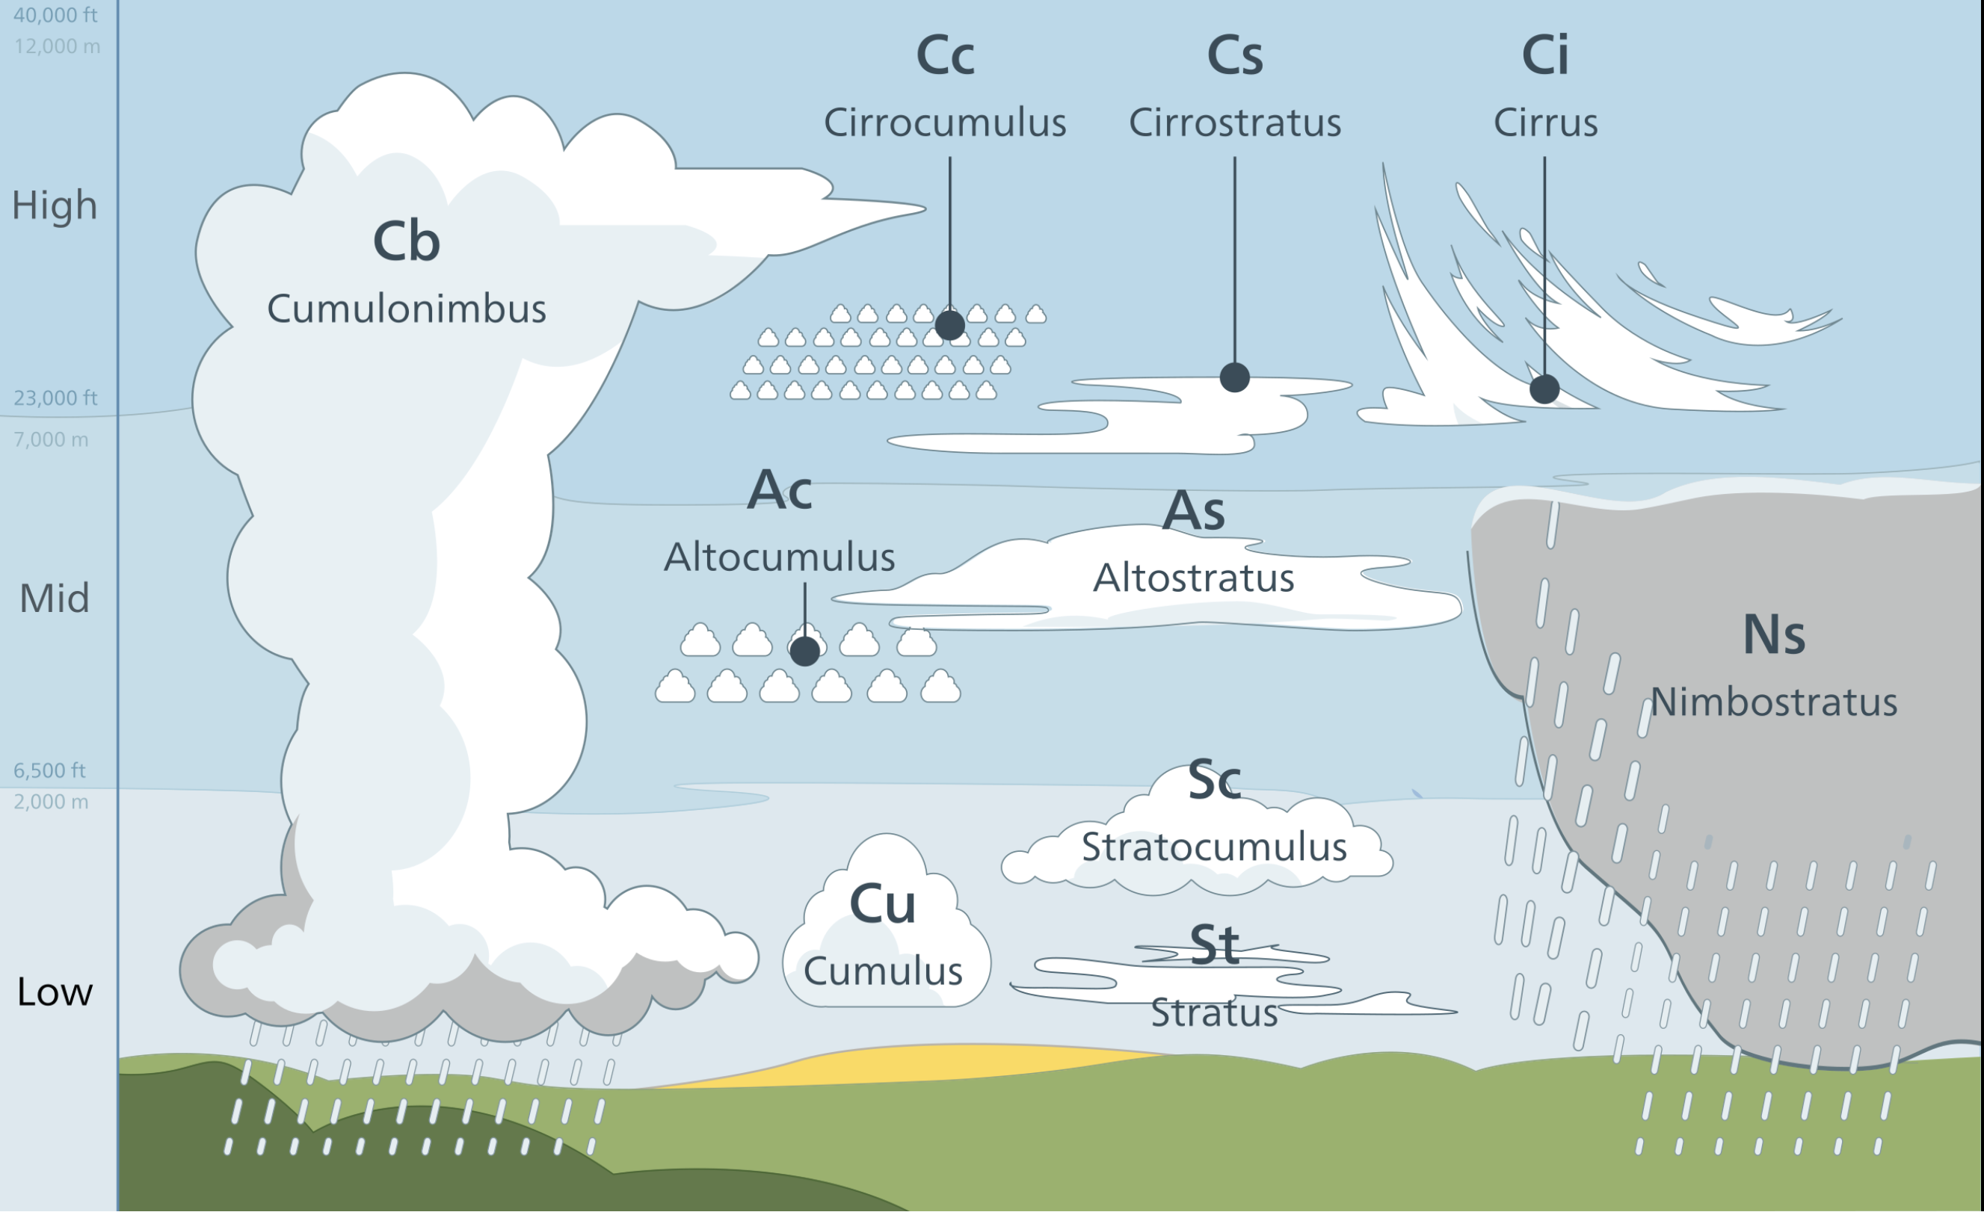
Cloud Types at a Glance
The shape you see is a direct readout of the stability and lifting mechanism above
Standard cloud classification by height and form. Source: NOAA JetStream (public domain), nws-cloud-chart.
EART23001 Atmospheric Physics & Weather | Week 8

Slide 26
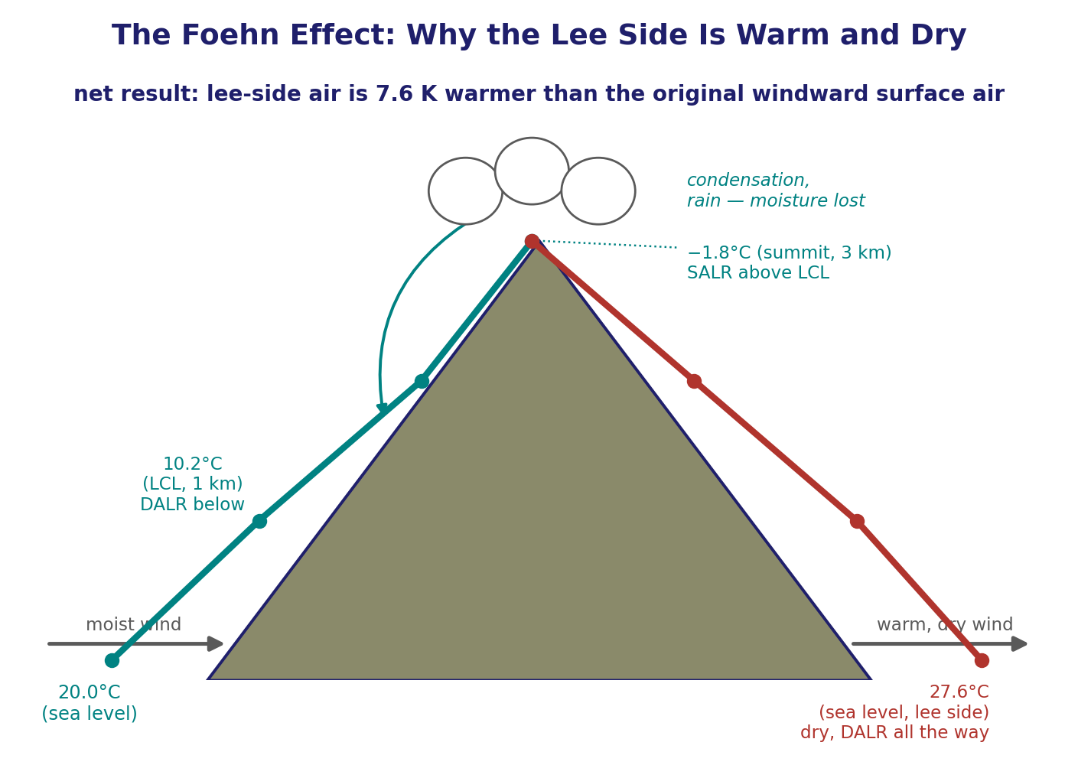
The Foehn Effect
Q6 — a worked example combining everything in this lecture
• Air at 20°C approaches a mountain; its LCL is at 1.0 km and the summit is at 3.0 km. It cools at the DALR below the LCL and at 6.0 K/km while saturated above it.
• From sea level to the 1 km LCL: T = 20 − 9.8(1.0) = 10.2°C. From 1 to 3 km, saturated: cools a further 6.0×2 = 12 K, so T_{summit} = 10.2 − 12 = −1.8°C.
• Condensed water rains out on the windward slope — the air reaching the summit is now dry. Descending 3 km on the lee side, unsaturated, it warms at the full DALR: T_{lee} = −1.8 + 9.8(3) = 27.6°C.
• The lee-side air is 7.6 K warmer than the original windward surface air — warm and dry because the moisture it carried was left behind as rain on the way up.
↔ EART22001 Week 5's single-column model practical simulated this same Foehn-type flow over a ridge — temperature wasn't plotted at the time, but the downwind air came out warmer. Curious? Try adapting that module's own Python scripts to plot it.
EART23001 Atmospheric Physics & Weather | Week 8

Slide 27
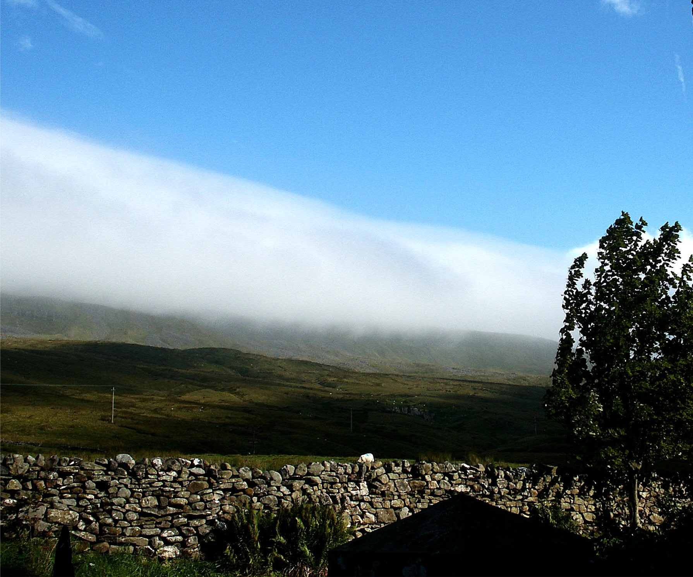
A Real UK Foehn Wind: the Helm Wind
Same physics, a specific Pennine example — and its own local names
The Helm Wind over the south-west slope of the Cross Fell escarpment, Cumbria — a Foehn-type wind (a Foehn in continental Europe, a Chinook in the USA) forming exactly this way over the Pennines.
EART23001 Atmospheric Physics & Weather | Week 8

Slide 28
Further Practice — Try These Yourself
Questions not covered as IN-CLASS discussions today
• Q1 — DALR vs SALR: reproduce the two-parcel arithmetic above for a different ascent depth.
• Q4 — Potential temperature: calculate θ for a parcel of your own choosing and check which of two parcels is warmer at a shared pressure.
• Q6 — Foehn wind: repeat the calculation for a different summit height or starting temperature.
• Q7 — Lifting mechanisms: for one of the four mechanisms, explain in your own words why ascent doesn't guarantee deep convection.
• Q8 — Stability and cloud form: reproduce the Layer A / Layer B reasoning for two lapse rates of your own choosing.
• Q9 — Parcel vs environment: repeat the worked calculation for a different pair of lapse rates.
EART23001 Atmospheric Physics & Weather | Week 8

Slide 29
Wrap-Up: Key Ideas From Today
From latent heat to real convective weather
• A saturated parcel cools more slowly than a dry one (Γ_{s} ≈ 6 K/km vs Γ_{d} ≈ 9.8 K/km) because condensation releases latent heat into it.
• Comparing the environment's own lapse rate to Γ_{d} and Γ_{s} tells you whether a displaced parcel is pushed back (stable), only unstable once saturated (conditionally unstable), or unstable outright.
• An inversion is the most strongly stable case of all, and traps whatever is emitted beneath it.
• Real convection also needs a trigger — surface heating, orographic lifting, a front, or convergence — and enough moisture and depth of instability to develop.
• The Foehn effect ties all of it together: moist ascent, rainout, and dry descent leave the lee side measurably warmer than the windward start.
Next week: Clouds & Precipitation — droplet formation, the Kelvin equation and supersaturation, once air has actually reached its LCL and kept rising.
EART23001 Atmospheric Physics & Weather | Week 8

