Slide 1
ATMOSPHERIC PHYSICS AND WEATHER
EART23001
Week 1 — Discovering the Atmosphere (Part 1)
Dr Ian Crawford
i.crawford@manchester.ac.uk • Simon Building

Slide 2
Today's Session
Discovering the Atmosphere — Part 1 • approx. 105 minutes
0:00
Why understand the atmosphere? A short history
0:16
IN-CLASS DISCUSSION 1 — fast communication & forecasting
8 min
0:24
How we observe the atmosphere today, in situ and remotely
0:34
IN-CLASS DISCUSSION 2 — in situ or remote, active or passive?
8 min
0:42
IN-CLASS DISCUSSION 3 — can a sparse schedule miss an event?
8 min
0:50
Satellites and measurement science
0:56
IN-CLASS DISCUSSION 4 — choosing the right observing system
8 min
1:04
Reading week & mid-semester assessment — housekeeping
1:06
Structure and composition of the atmosphere
1:14
Where did our atmosphere come from?
1:26
Ozone: chemistry, the ozone hole, and a policy success story
1:42
Wrap-up and looking ahead to Week 2
EART23001 Atmospheric Physics & Weather | Week 1

Slide 3
Why Understand the Atmosphere?
Setting the scene
• Weather forecasting — protecting life, property, travel and infrastructure.
• Climate — establishing normal ranges, identifying extremes and long-term change.
• Health and safety — air quality warnings, aviation, shipping, road travel.
• Economics — agriculture, energy demand, supply chains all depend on weather.
• Research — understanding the physical and chemical processes that drive it all.
  Everything in this module builds towards being able to read, measure and predict the state of the atmosphere.
EART23001 Atmospheric Physics & Weather | Week 1

Slide 4
A Short History of Discovery
PART 1 OF 6
From folklore to physics-based forecasting
⏱ 0:04 – 0:16
EART23001 Atmospheric Physics & Weather | Week 1

Slide 5
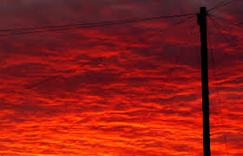
Before Instruments: Folklore and Observation
History
• For most of human history, weather prediction relied on observation, experience and oral tradition.
• “Red sky at night, shepherd's delight; red sky in the morning, shepherd's warning.”
  – A red evening sky means high pressure (and drier weather) is arriving from the west.
  – A red sky at dawn means that fair-weather system has already passed through, and wetter weather may follow.
• These sayings encode real physics — the scattering of sunlight by moisture and dust in an approaching or departing air mass — without any formal theory behind them.
EART23001 Atmospheric Physics & Weather | Week 1

Slide 6
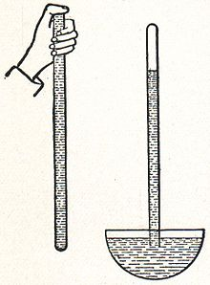
The First Instruments (17th–18th Century)
History
• 1643 — Torricelli (Italy) invents the barometer and links air pressure to changing weather.
• 1724 — Fahrenheit develops the mercury thermometer and a reliable temperature scale.
• 1755 — Lambert invents a reliable hygrometer, making humidity measurable for the first time.
  – For the first time, weather could be quantified rather than just described.
EART23001 Atmospheric Physics & Weather | Week 1

Slide 7
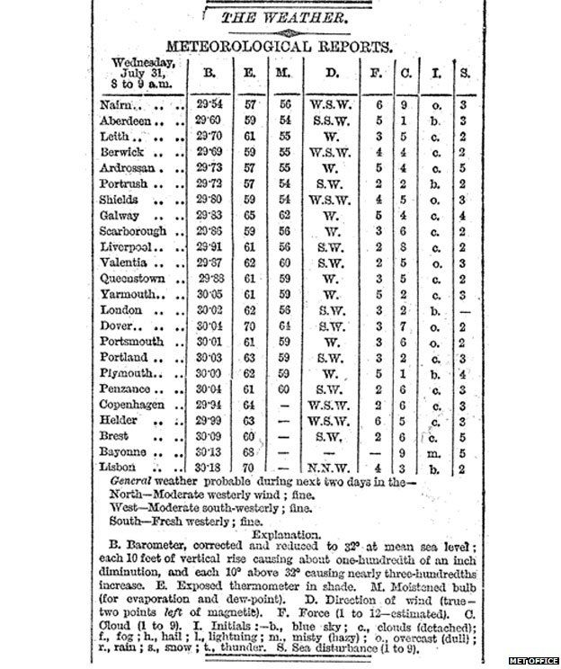
Towards Organised Forecasting (19th Century)
History
• 1765 — Lavoisier begins daily pressure, humidity and wind measurements in France.
• 1844 — The electric telegraph and Morse code let weather data travel faster than the weather itself.
• 1855 — France sets up the first national storm-warning system.
• 1861 — Admiral FitzRoy produces the first synoptic chart and daily “weather forecast”, distributed by telegraph and newspaper.
EART23001 Atmospheric Physics & Weather | Week 1

Slide 8
Why did fast communication transform forecasting?
IN-CLASS DISCUSSION 1
• A mid-latitude weather system travels eastwards at 15 m s⁻¹.
• 1. How far does it travel in 6 hours?
• 2. A set of observations takes 8 hours to reach a forecasting office. Do they still describe the weather system at the place they were recorded? Quantify your answer.
• 3. Use your calculation to explain why telegraphy was such a major development for synoptic forecasting.
✍ Discuss in pairs, then we'll take answers
Worked-answers sheet, Week 1 — IN CLASS Question

Slide 9
Fast communication and forecasting — worked answer
WORKED ANSWER — DISCUSSION 1
• In 6 hours: d = vt = 15 × 21,600 s = 3.24 × 10⁵ m ≈ 324 km.
• In 8 hours: d = 15 × 28,800 s = 4.32 × 10⁵ m ≈ 432 km.
• An observation delayed by 8 hours can describe a system that has already moved several hundred kilometres downstream — it is describing yesterday's weather, not today's.
• Telegraphy let observations from many sites be assembled almost simultaneously, making it possible to build a genuinely synoptic (same-time) picture and issue warnings before a system arrived.
  – Takeaway: a forecast is only as good as the currency of the data feeding it — a theme that recurs throughout this course.
EART23001 Atmospheric Physics & Weather | Week 1

Slide 10
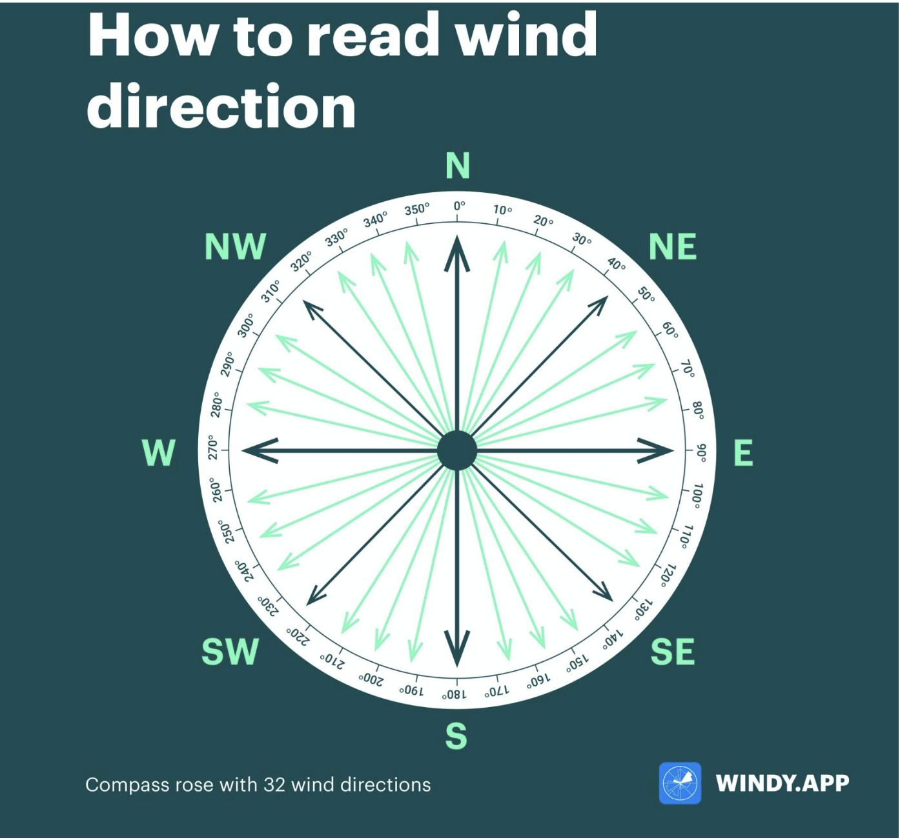
Measuring Wind: Direction and Speed
History — instruments
• Wind direction is defined as the direction the wind is blowing FROM, not towards.
• 1450 — Alberti's wind vane/plate anemometer measured force via deflection angle (a similar design was sketched by Leonardo da Vinci).
• 1845 — Robinson's four-cup anemometer (Armagh Observatory); reduced to three cups in 1926 by Patterson.
• 1805 — Beaufort devises a wind-force scale from naval observation, later calibrated against measured wind speed — still used today (0 = calm, 12 = hurricane force).
EART23001 Atmospheric Physics & Weather | Week 1

Slide 11
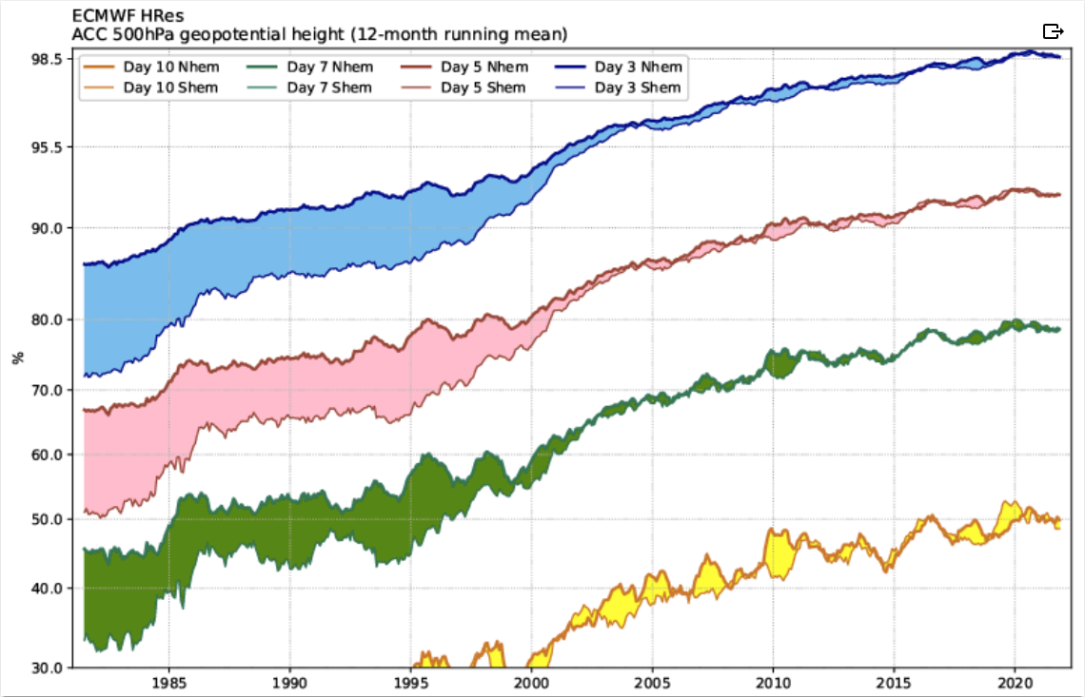
20th Century: Physics and Computing Take Over
History
• 1922 — Lewis Fry Richardson proposes that the atmosphere obeys the laws of physics and can, in principle, be calculated numerically.
• 1955 — Electronic computers finally make it possible to complete those calculations within the period being forecast.
• Since then: satellites, denser observing networks and ever-greater computing power have steadily improved forecast skill.
• Today — machine learning / AI models are trained on decades of reanalysis data and increasingly complement (and sometimes outperform) traditional numerical weather prediction for short-range forecasts.
Forecast skill (ECMWF): the number of days ahead a forecast stays useful has roughly doubled since the 1980s.
EART23001 Atmospheric Physics & Weather | Week 1

Slide 12
How We Observe the Atmosphere Today
PART 2 OF 6
From a single back-garden thermometer to a global network
⏱ 0:24 – 0:34
EART23001 Atmospheric Physics & Weather | Week 1

Slide 13
Why Measure the Atmosphere?
Observing networks
• To determine climate (normal ranges) — for comparison between places, and to identify extremes and long-term change.
• As initial conditions for forecast models — a forecast is only as good as the data that initialises it.
• For health and safety — air/sea/road travel warnings, air quality alerts.
• For economics — agriculture, energy demand, supply chains.
• For research — often specialised, and over shorter time scales.
EART23001 Atmospheric Physics & Weather | Week 1

Slide 14
The Traditional Surface Network
Observing networks
• Surface pressure.
• Temperature — dry- and wet-bulb readings give moisture content (relative humidity, saturation vapour pressure).
• Wind — speed and direction.
• Precipitation — amount and duration.
• Radiation — sunshine hours, shortwave/longwave/net.
• Visibility, cloud cover, present weather.
  Synoptic observations are made at least every 6 hours (0000, 0600, 1200, 1800 UTC) at roughly 10,000 land stations, 7,000 ships and 3,000 buoys reporting to the WMO.
EART23001 Atmospheric Physics & Weather | Week 1

Slide 15
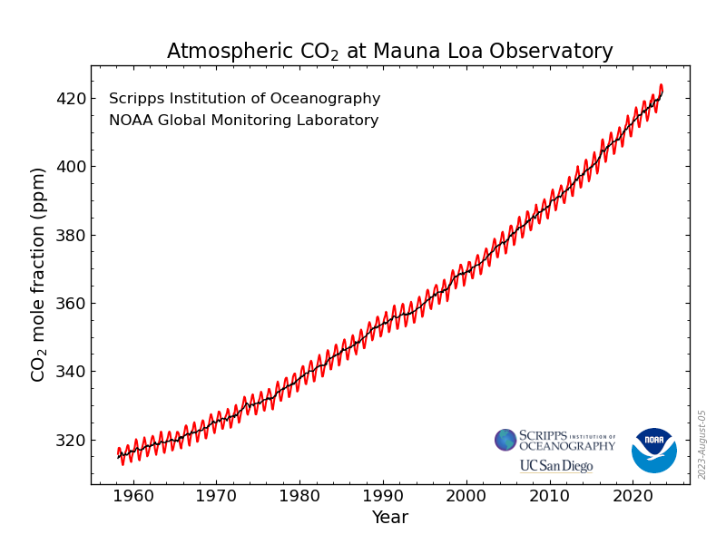
The Global Atmosphere Watch (GAW)
Beyond weather — monitoring composition
• A World Meteorological Organisation initiative monitoring the changing composition of the atmosphere, not just day-to-day weather.
• Priorities: greenhouse gases (CO₂, CH₄) for climate change; O₃ and UV for climate and health; reactive gases and precipitation chemistry for pollution.
• ~30 Global stations (often remote, e.g. Mauna Loa, Jungfraujoch), 400+ Regional stations and ~100 Contributing stations worldwide.
  – The continuous Mauna Loa CO₂ record below is one of the most iconic long-term GAW datasets — the annual wiggle is the Northern Hemisphere growing season; the steady rise is the human fingerprint.
EART23001 Atmospheric Physics & Weather | Week 1

Slide 16
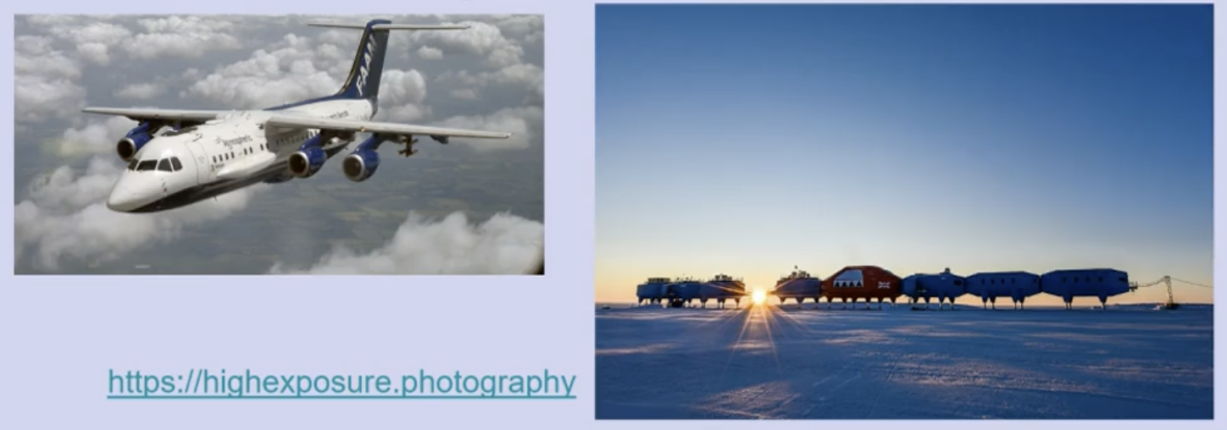
Beyond Weather: More Complex Measurements
Observing networks
• We also need to track changes in atmospheric composition that drive longer-term change in weather and climate.
• These measurements are more specialised and less common than routine weather observations.
• They may be short, project-based campaigns (e.g. the UK's FAAM research aircraft) or organised long-term monitoring, often concentrated in sensitive regions such as the Arctic and Antarctic.
EART23001 Atmospheric Physics & Weather | Week 1

Slide 17
In Situ vs Remote Sensing — Active vs Passive
Measurement science
• In situ: the sensor is immersed in the air being measured (e.g. a thermometer, a radiosonde in flight).
• Remote sensing: the measurement is made without contact with the target (e.g. radar, lidar, satellite imagers).
  – Active remote sensing — the instrument transmits its own energy and measures the return (radar, lidar, ceilometer).
  – Passive remote sensing — the instrument measures naturally emitted or reflected radiation (most satellite imagers).
• Ground-based remote sensing includes radar, lidar and the Dobson spectrometer (ozone); airborne and satellite platforms extend this to regional and global scales.
EART23001 Atmospheric Physics & Weather | Week 1

Slide 18
In situ or remote? Active or passive?
IN-CLASS DISCUSSION 2
• Classify each system as in situ or remote sensing. For remote-sensing systems, also say whether it is mainly active or passive.
• 1. A radiosonde measuring temperature and humidity as it ascends.
• 2. A weather radar transmitting microwave pulses and receiving echoes from precipitation.
• 3. A ceilometer transmitting laser pulses to determine cloud-base height.
• 4. A satellite measuring naturally emitted infrared radiation from the Earth–atmosphere system.
✍ Discuss in pairs, then we'll take answers
Worked-answers sheet, Week 1 — IN CLASS Question

Slide 19
In situ / remote, active / passive — worked answer
WORKED ANSWER — DISCUSSION 2
• 1. Radiosonde — in situ; its sensors sit directly in the air being sampled.
• 2. Weather radar — active remote sensing; it transmits energy and measures the return.
• 3. Ceilometer — active remote sensing; it transmits laser pulses and measures backscatter.
• 4. Infrared satellite imager/sounder — passive remote sensing; it detects naturally emitted radiation.
EART23001 Atmospheric Physics & Weather | Week 1

Slide 20
Can a sparse observing schedule miss a short-lived event?
IN-CLASS DISCUSSION 3
• A sharp wind-shift line lasts 20 minutes. A traditional synoptic station reports only every 3 hours (00, 03, 06 UTC…); a nearby automatic station stores 1-minute values.
• Assume the 20-minute event is equally likely to start at any time in the 3-hour gap between synoptic reports.
• 1. What's the probability that a synoptic report time falls inside the 20-minute event?
• 2. Hence, what's the probability that the event is missed entirely?
• 3. The automatic station shows the shift between its 10:17 and 10:18 readings. To what precision can you time it?
• 4. Why should sampling frequency be chosen with reference to the timescale of the phenomenon?
✍ Discuss in pairs, then we'll take answers
Worked-answers sheet, Week 1 — IN CLASS Question

Slide 21
Sampling frequency and aliasing — worked answer
WORKED ANSWER — DISCUSSION 3
• There are 180 minutes between synoptic reports. A report falls inside the 20-minute event with probability 20/180 ≈ 0.111 — about 11%.
• So the event is missed entirely with probability 1 − 0.111 ≈ 0.889 — about 89%.
• The automatic record changes between 10:17 and 10:18, so the passage can be timed to within about a minute (≈ ±0.5 min using the midpoint).
  – Takeaway: a sampling interval much longer than the phenomenon's own timescale can miss or alias it completely — here, sampling 180× faster caught an event the synoptic network would very likely have missed.
EART23001 Atmospheric Physics & Weather | Week 1

Slide 22
Satellites and Measurement Science
PART 3 OF 6
From an anemometer on a rooftop to an instrument in orbit
⏱ 0:50 – 0:56
EART23001 Atmospheric Physics & Weather | Week 1

Slide 23
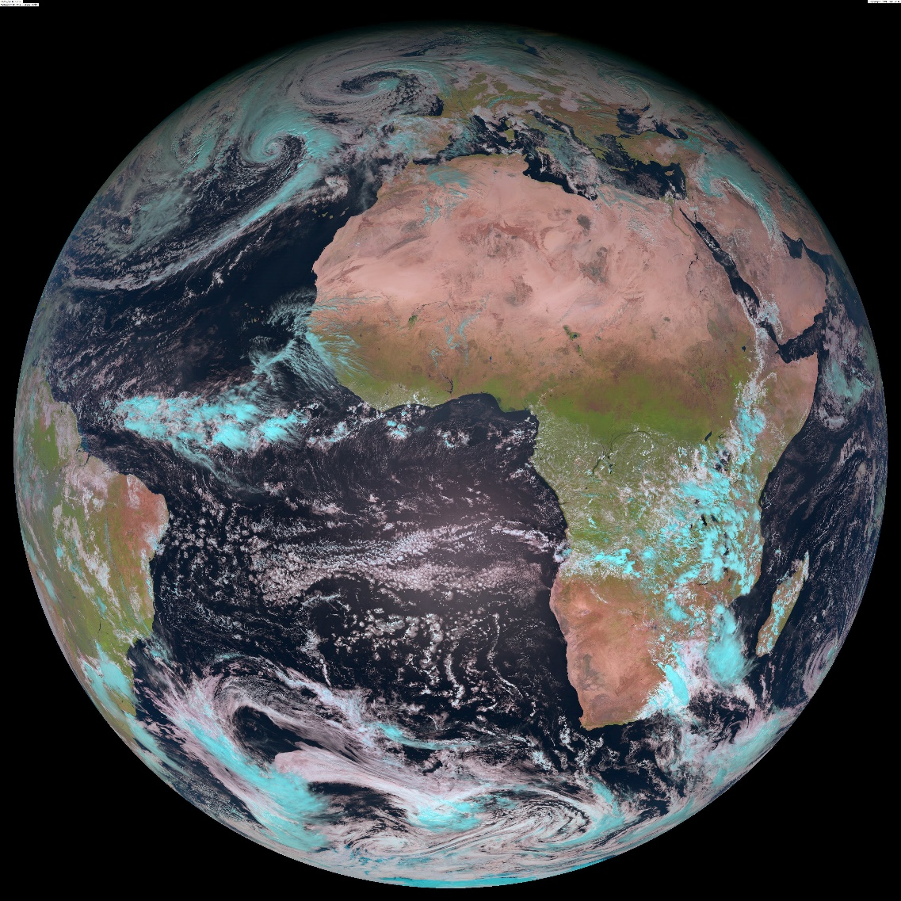
Satellite Orbits: Geostationary vs Polar-Orbiting
Measurement science
• Geostationary — orbits the equator once per day, so stays above a fixed point. Altitude ≈ 35,786 km. Good for continuous imagery of one region (e.g. visible/IR loops).
• Polar-orbiting — passes pole to pole as the Earth rotates beneath it, giving global coverage in stripes. Altitude of a few hundred km; one orbit ≈ 100 minutes; the whole Earth can be imaged roughly twice a day.
EART23001 Atmospheric Physics & Weather | Week 1

Slide 24
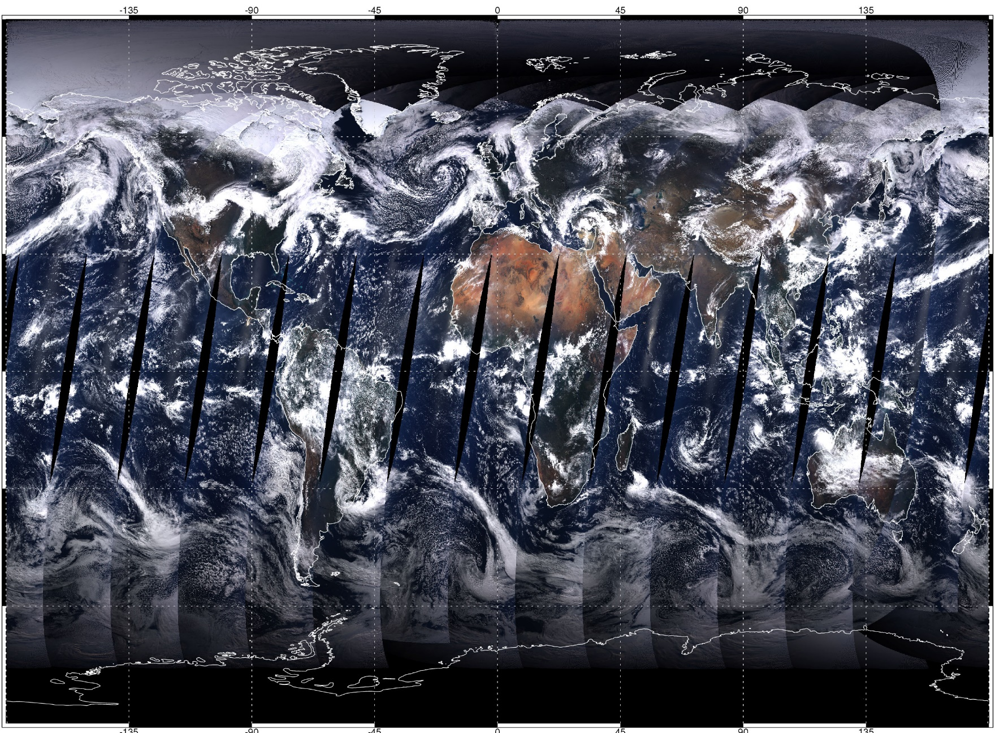
Polar-Orbiting Composite Imagery
Measurement science
A composite built from successive polar-orbit passes — note the characteristic swath boundaries.
EART23001 Atmospheric Physics & Weather | Week 1

Slide 25
Anatomy of a Measurement System
Instrument requirements, ground to orbit
• Every measurement system needs: a sensor that responds reproducibly to the target property, a transducer to quantify that response, a calibration relating response to the true value, and a recording device (historically, a trained human observer).
• Ground instruments are chosen for accuracy, precision, robustness and reliability, matched to the site — often at the cost of size and response time.
• Satellite instruments must additionally be small, light, low-power, extremely reliable and tolerant of the space environment — with no possibility of on-site maintenance, so continuous ground-truthing is essential to catch drift (e.g. in ozone retrievals).
EART23001 Atmospheric Physics & Weather | Week 1

Slide 26
Choose the observations you actually need
IN-CLASS DISCUSSION 4
• A forecaster has: A) surface thermometer/hygrometer, B) barometer, C) anemometer/wind vane, D) rain gauge, E) weather radar, F) ceilometer, G) radiosonde, H) satellite imager.
• For each task, choose the single most useful system and justify it in one sentence. If another system would add genuinely useful complementary information, name it too.
• 1. Warn Manchester Airport about low cloud and poor visibility.
• 2. Determine whether a line of heavy showers is approaching Manchester in the next hour.
• 3. Measure the vertical temperature/humidity structure before a possible convective outbreak.
• 4. Establish whether surface pressure is falling rapidly as a depression approaches.
✍ Discuss in pairs, then we'll take answers
Worked-answers sheet, Week 1 — IN CLASS Question. By now you've met every system on this list.

Slide 27
Choosing the right observing system — worked answer
WORKED ANSWER — DISCUSSION 4
• 1. Ceilometer (F) — directly measures cloud-base height. Also useful: A, since humidity helps diagnose near-surface saturation/fog.
• 2. Weather radar (E) — shows location, intensity and motion of precipitation. Also useful: H, for wider cloud-system context.
• 3. Radiosonde (G) — directly profiles temperature and humidity with height. Also useful: A, for representative surface conditions.
• 4. Barometer (B) — directly measures pressure tendency. Also useful: C, since an approaching depression often brings systematic wind changes.
  – The key skill: pick the instrument that constrains the specific process in question, rather than listing everything available.
EART23001 Atmospheric Physics & Weather | Week 1

Slide 28
Reading Week & Mid-Semester Assessment
Housekeeping
• There are no lectures in Week 6 (Reading Week) for this course.
• Please use that week to complete your mid-semester assessment — it should take a couple of hours.
• The assessment is a set of relatively short questions around a theme: some calculations, an occasional equation, and short descriptions/explanations rather than an essay.
• It is designed to confirm you are comfortable with the basic physics covered so far.
EART23001 Atmospheric Physics & Weather | Week 1

Slide 29
Structure and Composition of the Atmosphere
PART 4 OF 6
From near-vacuum standards to the layers overhead
⏱ 1:06 – 1:14
EART23001 Atmospheric Physics & Weather | Week 1

Slide 30
The Standard Atmosphere
Structure
• Standard Temperature and Pressure (STP):
T = 273–293 K (0–20°C)
p = 1013.15 hPa (mbar)
• Air density at sea level, ρₐ ≈ 1.2 kg m⁻³, decreasing exponentially with height.
• The “edge” of the atmosphere is conventionally set at ~100 km.
• 90% of the atmosphere's mass lies below ~16 km (the decadal scale height, ≈ 0.25% of Earth's radius).
EART23001 Atmospheric Physics & Weather | Week 1

Slide 31
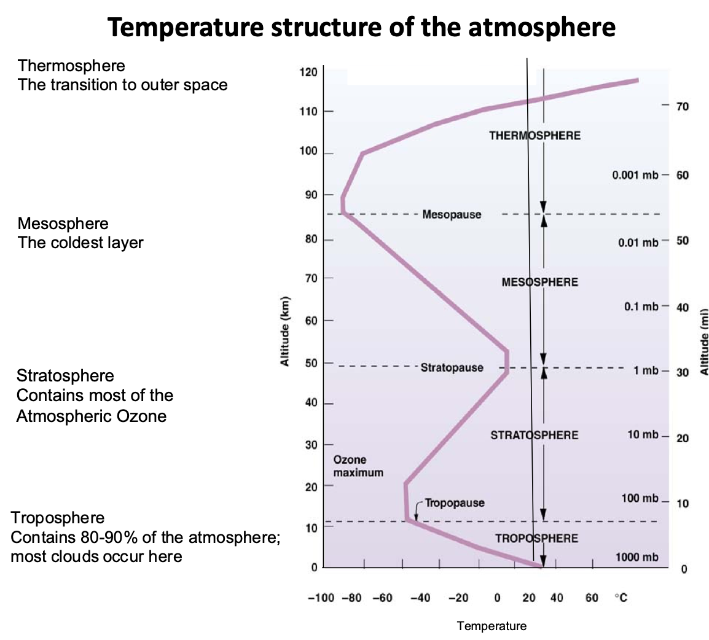
The Layered Atmosphere
Structure
Temperature structure defines the layers — each pause marks a reversal in the lapse rate.
EART23001 Atmospheric Physics & Weather | Week 1

Slide 32
The Layers, One by One
Structure
• Troposphere — below ~12 km; T decreases at ~6.5 K km⁻¹; where almost all “weather” happens.
• Tropopause — T ≈ 210 K; height varies with season and latitude (higher in summer / the tropics).
• Stratosphere — ~12–50 km; T increases at ~3 K km⁻¹, warmed by UV absorption in the ozone layer.
• Stratopause — ~50 km, T ≈ 260 K.
• Mesosphere — ~50–80 km; T decreases again at ~3–6 K km⁻¹.
• Mesopause — the coldest point in the atmosphere: T ≈ 170 K at ~80 km.
• Thermosphere / Ionosphere — T rises above 1000 K due to UV absorption by atomic oxygen; free electrons build up (ionosphere).
• Exosphere — 500–1000+ km; the transition to true space, where molecules continuously escape.
EART23001 Atmospheric Physics & Weather | Week 1

Slide 33
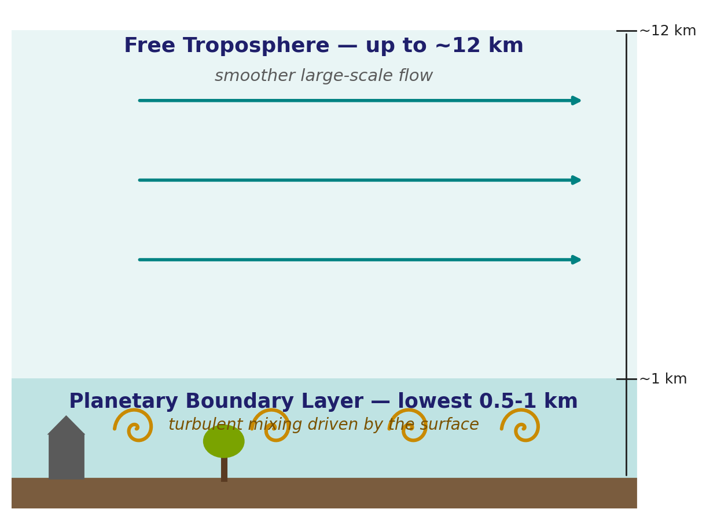
Inside the Troposphere: The Boundary Layer
Structure
• Planetary Boundary Layer (PBL) — the lowest 500–1000 m; strongly influenced by the surface, topography, local winds and weather. This is where most human activity, and most pollution, occurs.
• Turbosphere — up to ~10 km; motion on all scales mixes the air and keeps the relative proportions of the major gases essentially uniform.
  – Key idea (returning in Weeks 3–4): temperature falls through the free troposphere because air expands and cools as it rises into lower pressure — kinetic energy is converted into work done on the surroundings.
EART23001 Atmospheric Physics & Weather | Week 1

Slide 34
Where Did Our Atmosphere Come From?
PART 5 OF 6
4.6 billion years in four stages
⏱ 1:14 – 1:26
EART23001 Atmospheric Physics & Weather | Week 1

Slide 35
Earth Is Unusual: A Quick Comparison
Origin of the atmosphere
• Compare present-day atmospheric composition across the Solar System:
• Hydrogen (H₂) — Sun 92.5%, Earth 0.00005%, Jupiter 90%.
• Helium (He) — Sun 5.7%, Earth 0.00052%, Jupiter 10%.
• Oxygen (O₂) — Earth 21%, essentially absent from the Sun/Jupiter's visible envelope.
• Nitrogen (N₂) — Earth 75.5%, likewise distinctive.
  Earth's atmosphere is not a leftover of the solar nebula — it has been reprocessed by the planet's own geological and biological history.
EART23001 Atmospheric Physics & Weather | Week 1

Slide 36
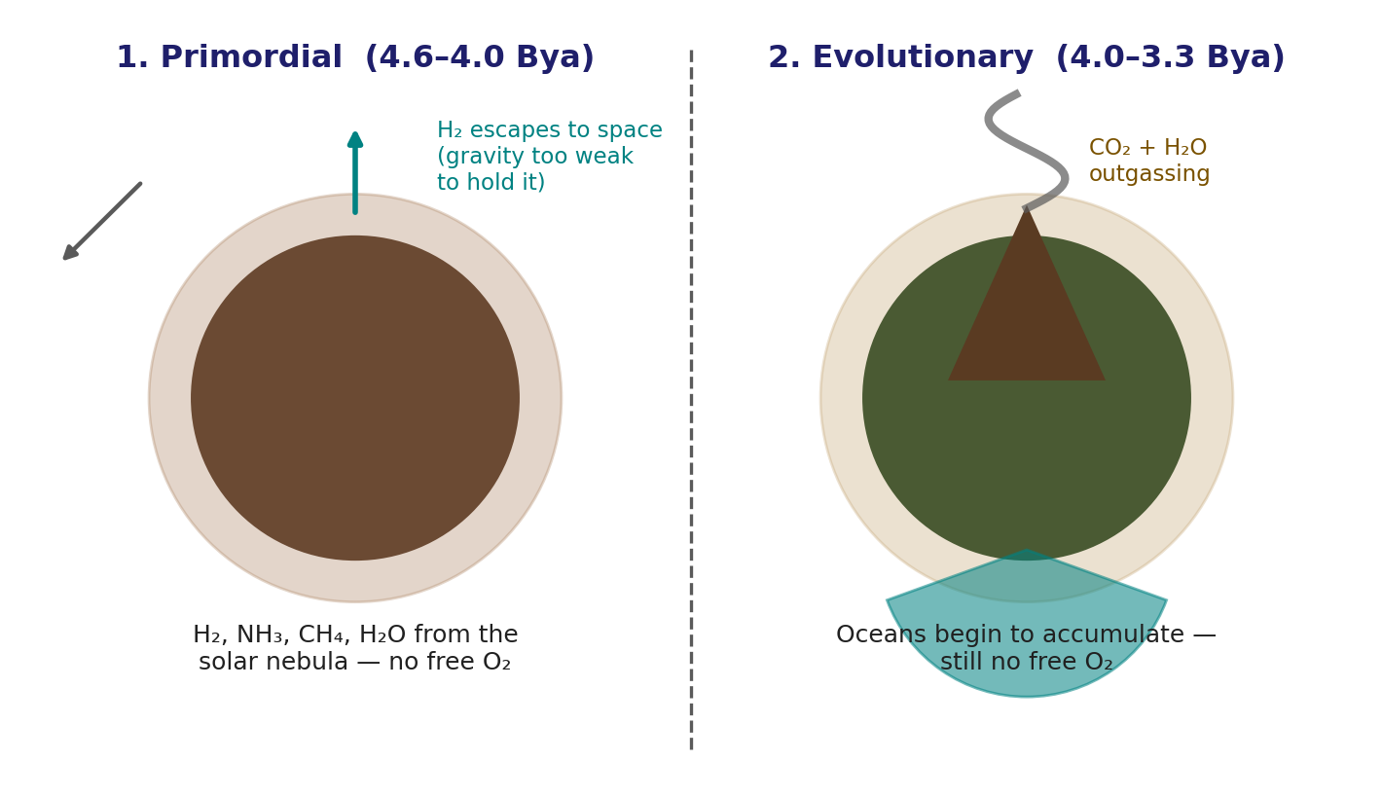
Four Stages, Part A: No Oxygen Yet
Origin of the atmosphere
• 1. Primordial (4.6–4.0 Bya) — H₂, NH₃, CH₄ and H₂O from the solar nebula; no oxygen. Hydrogen was lost to space because Earth's gravity was too weak to retain it.
• 2. Evolutionary (4.0–3.3 Bya) — volcanic outgassing of CO₂ and H₂O vapour; clouds and rain form and surface water accumulates. Still no free oxygen.
EART23001 Atmospheric Physics & Weather | Week 1

Slide 37
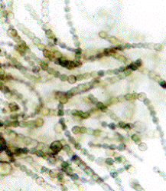
Four Stages, Part B: Life Makes Oxygen
Origin of the atmosphere
• 3. Living atmosphere (3.3 Bya–500 Mya) — oceans condense (~3.3 Bya); cyanobacteria (right) and, later, plants begin photosynthesis
(nCO₂ + nH₂O → nCH₂O + nO₂)
water photo-dissociates
(2H₂O + hν → 2H₂ + O₂)
building up O₂ and, with it, ozone.
• 4. Modern atmosphere (500 Mya–present) — rising O₂ supports more complex life and expands the ozone shield; today's O₂ level was reached by ~0.3 Bya.
EART23001 Atmospheric Physics & Weather | Week 1

Slide 38
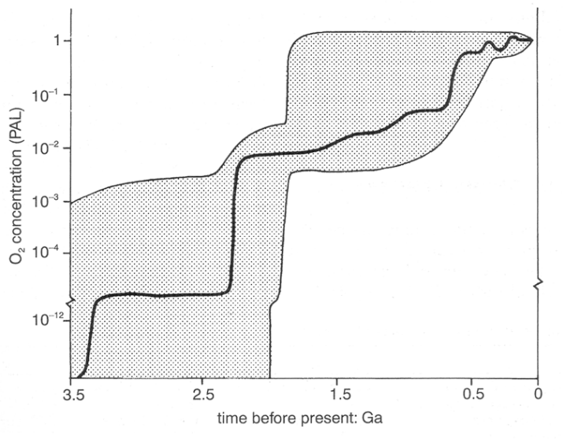
Two Billion Years to Build Up Oxygen
Origin of the atmosphere
O₂ concentration relative to today's level (PAL), against time before present — the shaded band reflects scientific uncertainty in the reconstruction.
EART23001 Atmospheric Physics & Weather | Week 1

Slide 39
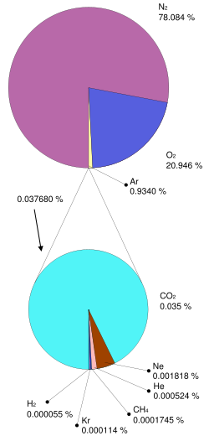
The Modern Atmosphere's Composition
Origin of the atmosphere
• N₂ 78.08%
• O₂ 20.95%
• Ar 0.93%
• CO₂ 0.038% (and rising — see Week 12)
• Trace: Ne, He, CH₄, Kr, H₂
  – Plus a highly variable amount of water vapour, roughly 0.2–2.6% depending on temperature and location — the single most variable major constituent.
EART23001 Atmospheric Physics & Weather | Week 1

Slide 40
Ozone: Chemistry, the Hole, and a Policy Success
PART 6 OF 6
Why we pause on one trace gas before moving on
⏱ 1:26 – 1:42
EART23001 Atmospheric Physics & Weather | Week 1

Slide 41
Why Pause on Ozone?
Ozone
• For most of this course we focus on the troposphere — the layer that generates our weather.
• But it is the ozone layer that creates the temperature inversion at the tropopause, effectively acting as the “lid” on our weather.
• Ozone's UV shielding also helped enable complex life on land.
• It is also a rare example of an environmental problem largely avoided through international political action — worth understanding as a case study in applied atmospheric science.
EART23001 Atmospheric Physics & Weather | Week 1

Slide 42
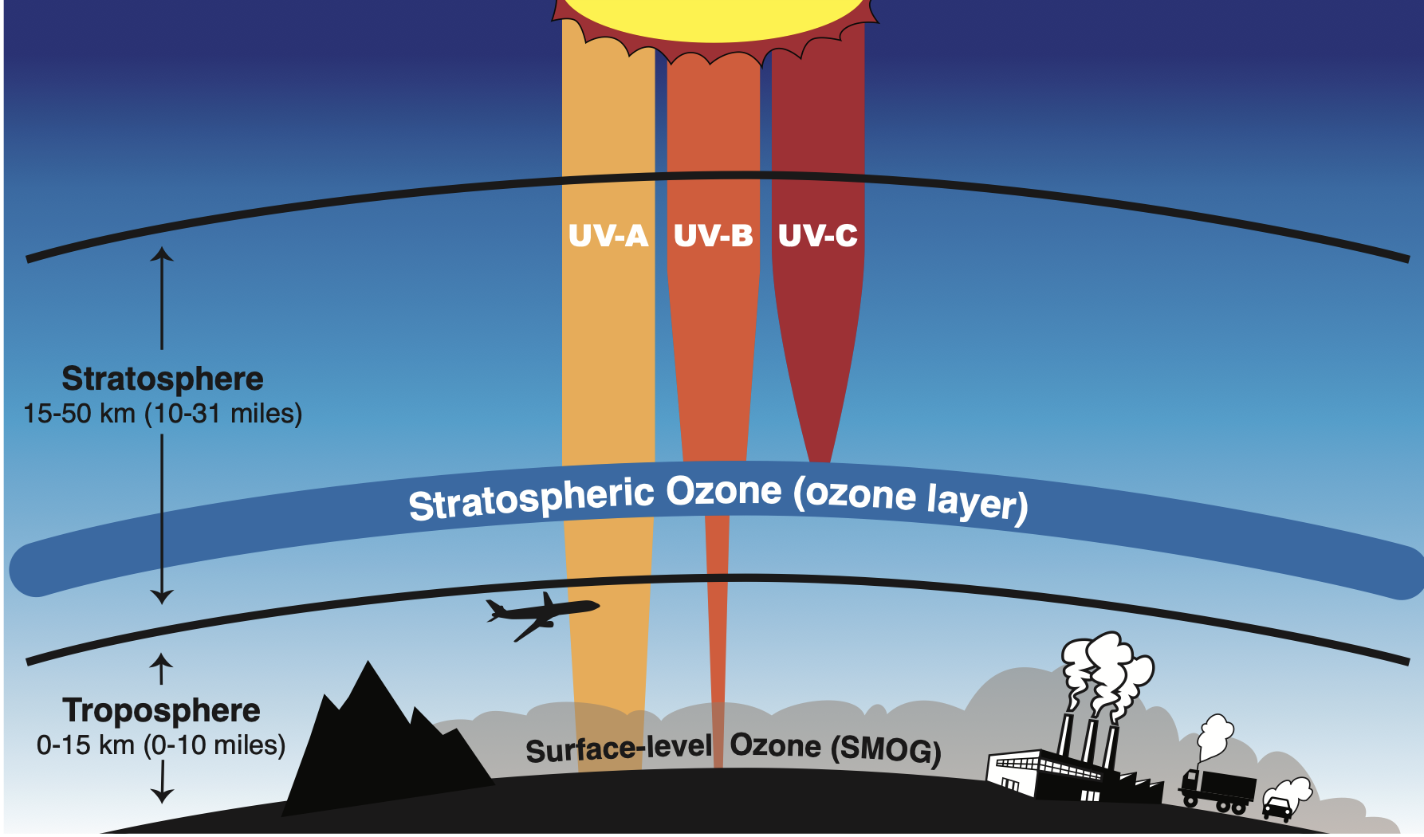
The Chapman Mechanism (1930s)
Ozone chemistry
• Dissociation: O₂ + hν → O + O
(short-wave UV, λ < 242 nm)
• Formation: O₂ + O + M → O₃ + M
(three-body collision)
• Destruction, in balance with formation:
  O₃ + hν → O₂ + O
  O + O₃ → 2O₂
  (240 < λ < 320 nm)
• Peak ozone production occurs where UV and O₂ are both abundant (~20–40 km, ~10–12 ppm) — but peak concentration does not coincide with peak production, because ozone is transported and its lifetime (3–4 months) is long compared with that transport.
EART23001 Atmospheric Physics & Weather | Week 1

Slide 43
The Ozone Hole
Ozone — depletion
• A sudden, localised deficiency of ozone over Antarctica each austral spring, beginning as the sun rises after the polar night and lasting ~2 months.
• Cause: man-made CFCs, extremely long-lived molecules vented from the troposphere into the stratosphere.
• Inside the isolated circumpolar vortex, ice particles in polar stratospheric clouds provide surfaces for reactions that release Cl₂; sunlight then photo-dissociates Cl₂ to Cl, which rapidly destroys ozone.
• Similar chemistry occurs in the Arctic, but temperatures there are rarely low enough for the same severity or duration.
EART23001 Atmospheric Physics & Weather | Week 1

Slide 44
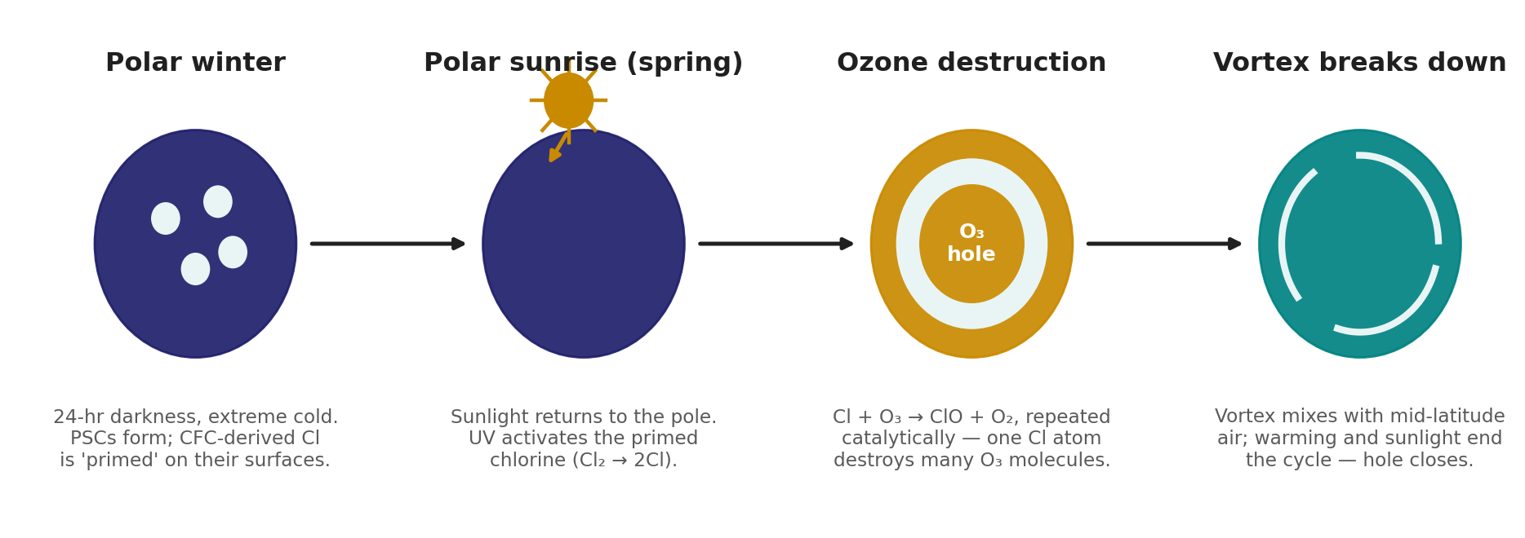
Why Spring? The Seasonal Mechanism
Ozone — depletion
Chlorine is primed on polar stratospheric clouds through the dark winter, then activated by returning spring sunlight — the hole closes once the vortex breaks down.
EART23001 Atmospheric Physics & Weather | Week 1

Slide 45
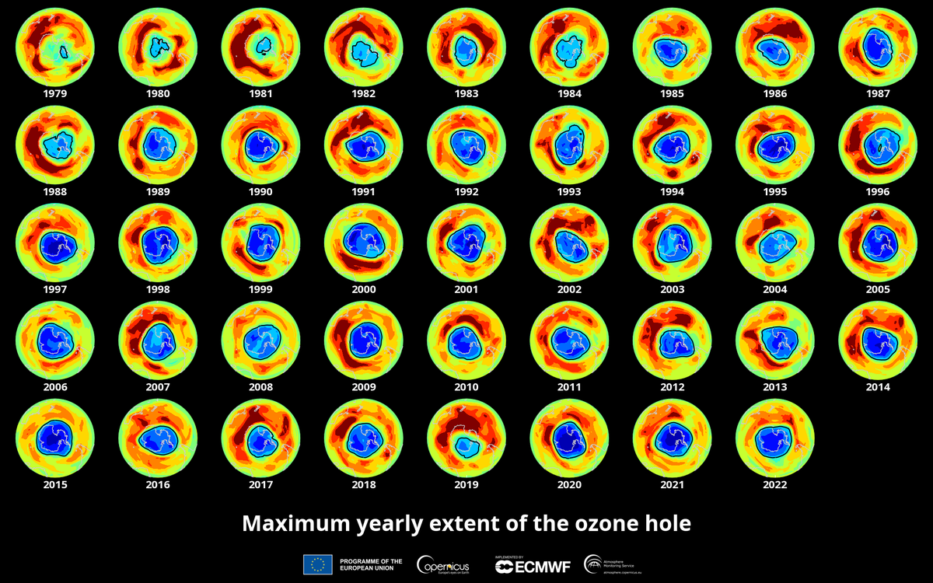
The Ozone Hole, Year by Year
Ozone — monitoring
Maximum yearly extent of the Antarctic ozone hole, 1979–2022 (Copernicus/ECMWF).
EART23001 Atmospheric Physics & Weather | Week 1

Slide 46
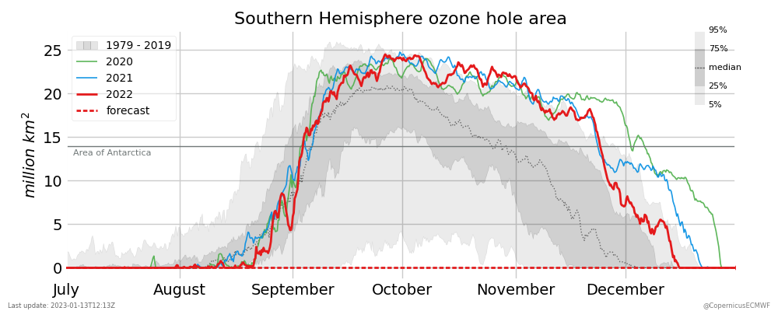
Has the Ozone Hole Recovered?
Ozone — monitoring
Recent years remain within the historical envelope — recovery is real, but slow.
EART23001 Atmospheric Physics & Weather | Week 1

Slide 47
The Montreal Protocol
Ozone — an environmental success (probably)
• CFCs were banned under the Montreal Protocol in 1992.
• Chlorine loading of the atmosphere is now declining, though an unambiguous long-term increase in ozone is still hard to confirm.
• It was somewhat fortunate that CFCs, rather than compounds with even greater ozone-depleting potential (e.g. bromine-containing gases), were the ones in widespread use.
• Caveat: CFCs and many of their replacements are also potent greenhouse gases — the ozone story and the climate story are linked, not separate.
EART23001 Atmospheric Physics & Weather | Week 1

Slide 48
What to Take Away From Today
WRAP-UP
• Forecasting improved in step with measurement, communication and computing — not any one of these alone.
• Every instrument choice is a trade-off between accuracy, robustness, size, power and cost.
• The atmosphere's layered structure and composition are the product of 4.6 billion years of physics, chemistry and biology.
• The ozone layer both shapes our weather and stands as a case study in successful environmental policy.
Next week: Discovering the Atmosphere, Part 2.
EART23001 Atmospheric Physics & Weather | Week 1

