Slide 1
ATMOSPHERIC PHYSICS AND WEATHER
EART23001
Week 2 — Discovering the Atmosphere (Part 2)
Dr Ian Crawford
i.crawford@manchester.ac.uk • Simon Building

Slide 2
Today's Session
Discovering the Atmosphere — Part 2 • approx. 99 minutes
0:00
Composition of the atmosphere: reading very small numbers
0:10
Why density falls with height, and an exponential model
0:19
IN-CLASS DISCUSSION 1 — the exponential density profile
8 min
0:27
How far up before density is negligible? Where the model breaks down
0:33
From description to diagnosis: reading a temperature profile
0:41
IN-CLASS DISCUSSION 2 — diagnose the layers from data
8 min
0:49
Ozone's double role, the spring ozone-hole recap, and the atmosphere's “lid”
0:59
Measuring ozone: the Dobson unit
1:03
Why the ozone hole matters for weather
1:06
Preview: modelling a rising air parcel ↔ EART22001
1:12
Dry adiabatic cooling, vapour pressure and relative humidity
1:21
IN-CLASS DISCUSSION 3 — a rising parcel: pressure, cooling and saturation
8 min
1:29
Same liquid water, different droplet number
1:35
A real example: ship tracks and the Twomey effect
1:37
Wrap-up and looking ahead to Week 3
EART23001 Atmospheric Physics & Weather | Week 2

Slide 3
Quantifying the Atmosphere
PART 1 OF 3
Composition, and why density falls the way it does
⏱ 0:04 – 0:33
EART23001 Atmospheric Physics & Weather | Week 2

Slide 4
The Recipe of Dry Air
Composition
• Near the surface, dry air is approximately 78.08% N₂, 20.95% O₂ and 0.93% Ar by mole fraction.
• Everything else is a trace gas, often reported in parts per million (ppm) rather than percent: 1% = 10,000 ppm.
• Background CO₂ is currently about 420 ppm — that is, 420 molecules in every million. As a percentage, that's just 0.042%.
• Water vapour is deliberately excluded from the “dry air” reference mixture because, unlike N₂, O₂ and Ar, its concentration varies enormously with place, height and time — from near 0% to a few percent.
  – Abundance alone doesn't determine importance: CO₂ and O₃ are tiny in mole fraction but dominate the atmosphere's radiation budget and chemistry — a theme that runs through the rest of this course.
EART23001 Atmospheric Physics & Weather | Week 2

Slide 5
Trace Gases in Perspective
Composition
• CO₂ isn't even the rarest gas that matters: methane (CH₄) sits at about 1.9 ppm and nitrous oxide (N₂O) at about 0.33 ppm — both far scarcer than CO₂'s 420 ppm.
• Yet both are potent greenhouse gases, molecule for molecule far stronger absorbers than CO₂ — we'll quantify exactly what “potent” means, and why, in Week 12.
• Ozone is the extreme case for a different reason: its abundance varies by roughly three orders of magnitude with altitude alone — a few ppb near the surface, rising to around 10 ppm in the stratospheric peak.
  – The general lesson: for a trace constituent, always ask both “how much” and “how radiatively or chemically active”, and — as ozone will remind us again shortly — “where”.
EART23001 Atmospheric Physics & Weather | Week 2

Slide 6
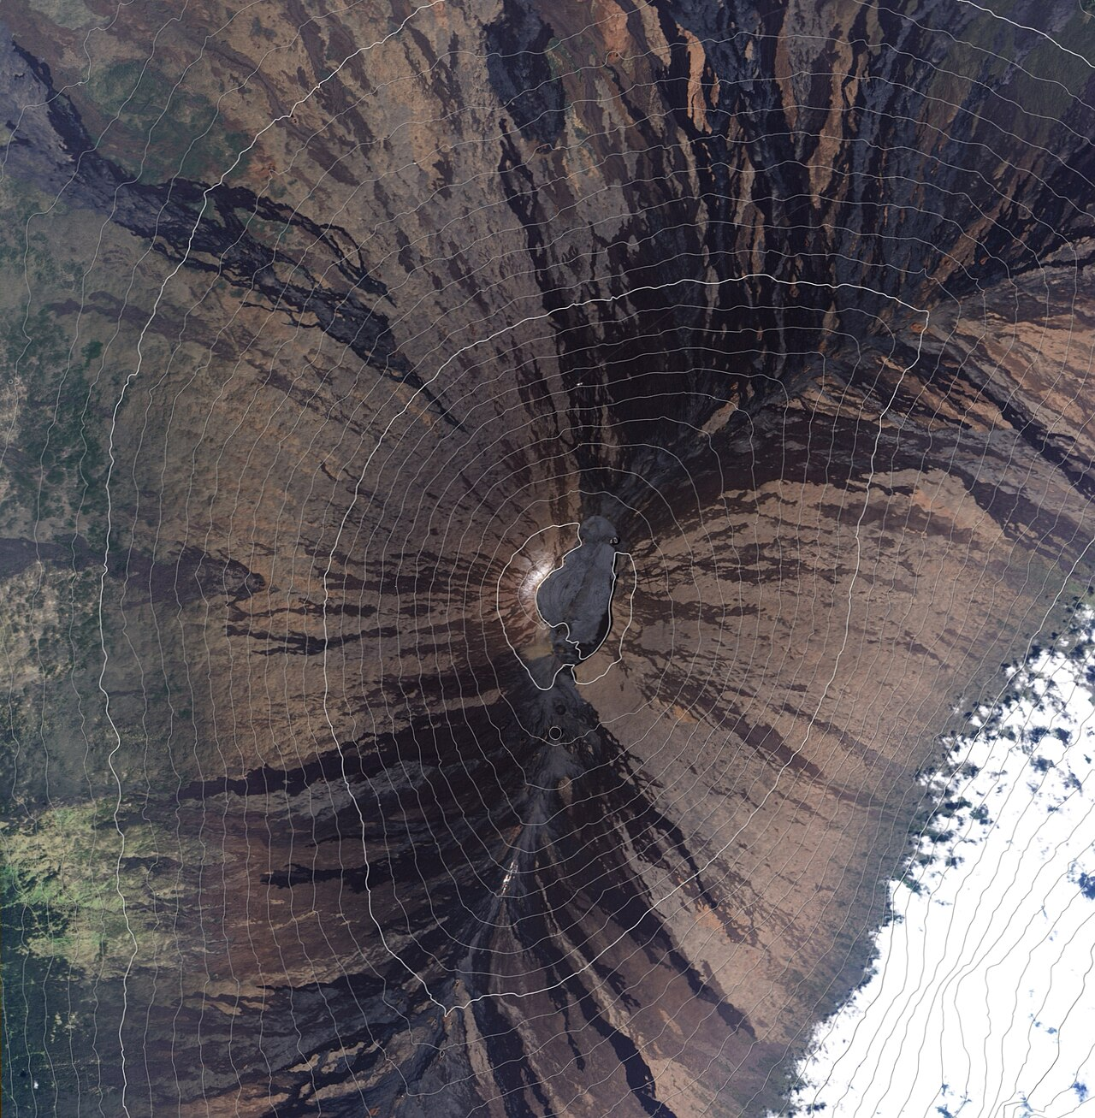
Measuring What's There
Composition — from Mauna Loa to satellites
• Remember the Global Atmosphere Watch (GAW) network from last week — this is how we actually know CO₂ is 420 ppm and rising.
• Ground stations (e.g. Mauna Loa, chosen for its remoteness from local pollution sources) provide the longest, most precise composition records.
• Satellite instruments now map CO₂, CH₄ and O₃ globally, trading some precision at a point for coverage everywhere.
  – We'll come back to the long-term CO₂ record itself in Week 12, when we look at the global energy balance.
Mauna Loa Observatory. Source: Wikimedia Commons.
EART23001 Atmospheric Physics & Weather | Week 2

Slide 7
Why Does Density Fall With Height?
Density
• Intuitively: the air at any level has to support the weight of all the air above it. Higher up, there's less air above — so pressure, and therefore density, must be lower.
• We'll derive this properly from a force balance in Week 4 (hydrostatic balance, dp/dz = −ρg). For now, we just need a working model of how density falls off.
• The simplest useful model treats the atmosphere as isothermal (constant temperature) and asks: over what height does density fall by a fixed factor?
EART23001 Atmospheric Physics & Weather | Week 2

Slide 8
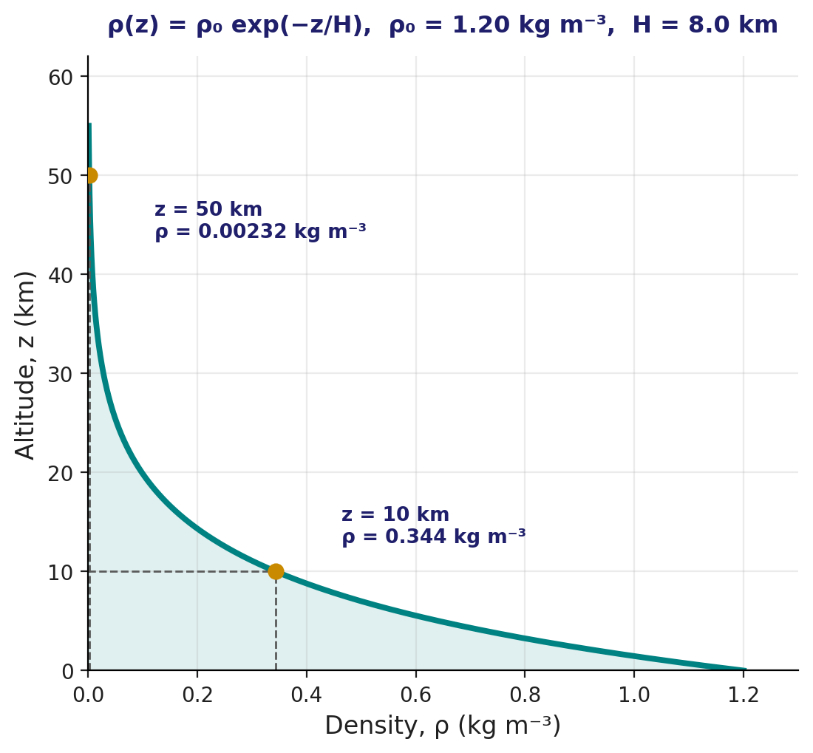
An Exponential Model of Density
Density
• For an isothermal atmosphere, density falls off exponentially with height:
ρ(z) = ρ₀ exp(−z/H)
• ρ₀ = 1.20 kg m⁻³ is the sea-level density; H is the scale height — the altitude over which density falls by a factor of e (≈ 2.718).
• For Earth's lower atmosphere, H ≈ 8.0 km.
EART23001 Atmospheric Physics & Weather | Week 2

Slide 9
Quick Check: Density at 5 km
Density — worked example
• Before the discussion question, let's warm up together: what's the density at z = 5 km?
  ρ(5) = 1.20 × exp(−5/8) = 1.20 × 0.535 = 0.642 kg m⁻³
• So density has already fallen by nearly half in just 5 km — the decay is fast near the surface because it's exponential, not linear.
• Keep that method in mind — the discussion question asks you to push it further, to 10 km and 50 km.
EART23001 Atmospheric Physics & Weather | Week 2

Slide 10
An exponential density profile
IN-CLASS DISCUSSION 1
• Assume an isothermal atmosphere with ρ(z) = ρ₀ exp(−z/H),
where ρ₀ = 1.20 kg m⁻³ and H = 8.0 km.
• 1. Calculate the density at 10 km.
• 2. Calculate the density at 50 km.
• 3. By what factor has the density fallen between the surface and 50 km?
• 4. Give one reason why this simple expression should not be extrapolated uncritically to several hundred kilometers altitude.
✍ Discuss in pairs, then we'll take answers
Worked-answers sheet, Week 2 — IN CLASS Question

Slide 11
The exponential density profile — worked answer
WORKED ANSWER — DISCUSSION 1
• At 10 km: ρ = 1.20 exp(−10/8) = 0.344 kg m⁻³.
• At 50 km: ρ = 1.20 exp(−50/8) = 2.32 × 10⁻³ kg m⁻³.
• The decrease factor is 1.20 / (2.32×10⁻³) ≈ 5.2 × 10² — density is roughly 520 times smaller at 50 km than at the surface.
  – The model assumes a constant scale height — effectively constant temperature and gravity and unchanging composition. In reality temperature and composition both change strongly with altitude, so one constant H cannot describe the whole upper atmosphere.
EART23001 Atmospheric Physics & Weather | Week 2

Slide 12
How Far Up Before Density Is Negligible?
Density — limits of the model
• Using the same model: for ρ/ρ₀ = 0.10, z = H ln 10 = 8.0 × 2.303 ≈ 18.4 km.
• For ρ/ρ₀ = 0.01, z = H ln 100 = 8.0 × 4.605 ≈ 36.8 km.
• So the idealised density reaches 10% at 18.4 km and 1% at 36.8 km — both still well within the stratosphere.
  – Push the same formula to, say, 300 km and it badly overstates how thin the air really is — real satellites orbit through measurable drag at altitudes this simple model would call essentially airless, because temperature and composition change so much through the upper atmosphere.
EART23001 Atmospheric Physics & Weather | Week 2

Slide 13
Layers and Ozone, From Data
PART 2 OF 3
Diagnosing structure quantitatively, rather than just naming it
⏱ 0:33 – 1:06
EART23001 Atmospheric Physics & Weather | Week 2

Slide 14
Last Week's Layers, This Week's Numbers
Method
• Last week we named the layers by their temperature behaviour: troposphere (where our weather happens), stratosphere (warmed by ozone), mesosphere, and beyond — moving outward from the surface.
• This week's question is different: given only a table of numbers, with no labels attached, could you have found those same boundaries yourself?
  – That's not just an exam skill — it's exactly what a radiosonde processing system or a forecast model does constantly. Nobody hands it a labelled diagram, only numbers.
EART23001 Atmospheric Physics & Weather | Week 2

Slide 15
From Description to Diagnosis
Method
• Last week we named the layers (troposphere, stratosphere, mesosphere…) from their temperature behaviour. This week we derive them directly from numbers.
• The tool is the lapse rate: Γ = −ΔT/Δz, the rate at which temperature falls with height over some layer.
• Method: compute Γ between successive levels in a table. Where Γ is positive and roughly constant, you're inside a well-mixed layer (like the troposphere). Where the sign of Γ flips — temperature starts rising with height instead of falling — you've crossed a “pause” into the next layer.
• A temperature increase with height is called a temperature inversion, and it strongly suppresses vertical mixing — we'll return to why that matters for pollution in Week 8.
EART23001 Atmospheric Physics & Weather | Week 2

Slide 16
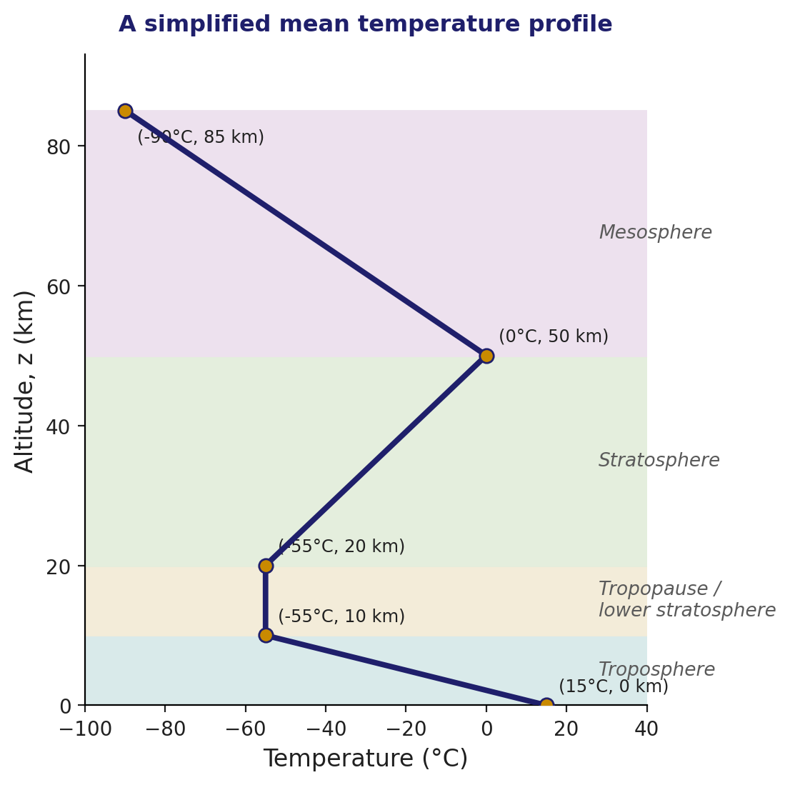
Reading the Profile
Method
• Here's a simplified mean temperature profile, plotted rather than tabulated.
• Before we work through the numbers together: which segments look like a single well-mixed layer, and where do you see the lapse rate change sign?
• Keep the shape of this curve in mind — you'll be asked to read the same features straight off a table in the discussion question.
EART23001 Atmospheric Physics & Weather | Week 2

Slide 17
Quick Check: The Layer Between 10 and 20 km
Method — worked example
• Let's warm up on one segment together, using the same profile: temperature is −55°C at both 10 km and 20 km.
  Γ = ΔT/Δz = 0 / 10 = 0.0 K km⁻¹ — an isothermal layer, quite different from the 7.0 K km⁻¹ we'd find near the surface.
• A lapse rate of exactly zero is itself a diagnostic clue, not a boring result — in practice, the World Meteorological Organization defines the tropopause as the level where Γ first falls to 2 K km⁻¹ or less and stays there.
• Keep this method ready — the discussion question asks you to apply it to the rest of the table yourself.
EART23001 Atmospheric Physics & Weather | Week 2

Slide 18
Diagnose the layers from a temperature profile
IN-CLASS DISCUSSION 2
• Altitude (km): 0 10 20 50 85
• Temperature (°C): 15 −55 −55 0 −90
• 1. Calculate the mean lapse rate between 0 and 10 km.
• 2. Identify the broad atmospheric layer represented by 0–10 km.
• 3. Which layer is represented by the temperature increase from 20 to 50 km?
• 4. What feature near 10–20 km separates these two layers?
• 5. Why can ozone absorption produce a temperature increase with height in the stratosphere?
✍ Discuss in pairs, then we'll take answers
Worked-answers sheet, Week 2 — IN CLASS Question

Slide 19
Diagnosing the layers — worked answer
WORKED ANSWER — DISCUSSION 2
• Temperature falls by 70 K over 10 km, so Γ = 70/10 = 7.0 K km⁻¹.
• 0–10 km is the troposphere. The warming from 20 to 50 km is characteristic of the stratosphere.
• The transition region (10–20 km) is the tropopause / lower stratosphere, where the tropospheric decrease of temperature with height becomes very small or reverses.
  – Ozone absorbs solar ultraviolet radiation; the absorbed energy heats the surrounding air, providing a radiative heat source within the stratosphere and allowing temperature to increase with height — this is the physical link between Part 1's chemistry and the shape of the curve you just read.
EART23001 Atmospheric Physics & Weather | Week 2

Slide 20
Ozone's Double Role
Ozone — same molecule, different altitude
• Two instruments both report “enhanced ozone” — but the consequence depends entirely on where in the atmosphere it's measured.
  – A surface monitoring station in a polluted summer air mass: ozone here is a strong oxidant, and elevated concentrations damage respiratory health, vegetation and materials. This is an air-quality problem.
  – A balloon instrument at 25 km, in the stratosphere: ozone here absorbs biologically damaging ultraviolet radiation before it reaches the surface. This is the protective role.
• The molecule is identical — its effect on us depends on where it sits in the vertical structure we've just been diagnosing.
EART23001 Atmospheric Physics & Weather | Week 2

Slide 21
Why Does the Ozone Hole Form in Spring?
Ozone — depletion, a quick recap
• You saw the full mechanism and diagram last week — here's the causal chain in one breath, since it's worth being able to reason through in words, not just recall as a picture:
  – CFC-derived chlorine reaches the stratosphere → the cold, isolated winter vortex allows polar stratospheric clouds (PSCs) to form → chlorine is chemically primed on PSC surfaces → spring sunlight activates that chlorine → rapid catalytic ozone loss.
• Why not during the dark winter itself? Because the activating step needs sunlight, which is absent for months at the pole.
• What ends it? As spring progresses the vortex weakens and breaks down, the stratosphere warms, PSCs disappear, and mixing with ozone-rich air from lower latitudes increases.
EART23001 Atmospheric Physics & Weather | Week 2

Slide 22
The Ozone Layer as the Atmosphere's Lid
Ozone — why it matters structurally
• The stratospheric warming you just diagnosed from the table isn't a curiosity — it's what defines the tropopause as a real physical boundary, not just a label.
• Because temperature increases through the stratosphere, that layer is very stably stratified: air parcels strongly resist moving vertically through it.
• That stability is exactly why almost all “weather” — clouds, storms, mixing — stays confined below the tropopause, in the layer we live in.
  – We'll formalise this idea of stability from a lapse-rate comparison properly in Weeks 3–4; for now, the key point is that ozone chemistry in Part 1's sense directly produces the vertical structure you diagnosed in Part 2.
EART23001 Atmospheric Physics & Weather | Week 2

Slide 23
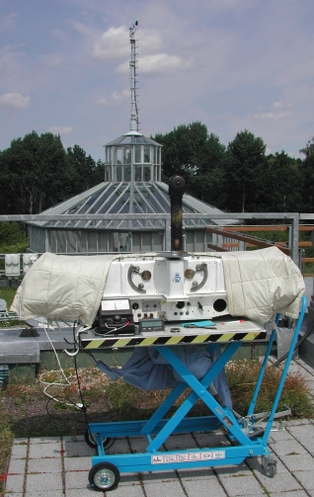
Measuring Ozone: The Dobson Unit
Ozone — instruments
• Total column ozone is conventionally reported in Dobson Units (DU) — the thickness the entire overhead ozone column would occupy if compressed to standard temperature and pressure at the surface.
• A typical mid-latitude column is around 300 DU (a layer just 3 mm thick); the Antarctic ozone hole is conventionally defined as column ozone falling below 220 DU.
• Both ground-based Dobson spectrometers (recall Week 1's remote-sensing instruments) and satellite sounders provide long, cross-checked records — essential for confirming the Montreal Protocol is actually working, not just assumed to be.
A Dobson spectrophotometer. Source: Wikimedia Commons.
EART23001 Atmospheric Physics & Weather | Week 2

Slide 24
Why the Ozone Hole Matters for Weather
Ozone — a downstream effect on the atmosphere below it
• Each spring the ozone hole cools the lower polar stratosphere sharply — a trend strong and persistent enough to leave a mark on Southern Hemisphere circulation, not just on surface UV.
• That springtime cooling widens the temperature contrast between the pole and the equator — exactly the gradient that drives the mid-latitude jet.
  – The result: a stronger, more southward-shifted polar jet stream, carrying Southern Hemisphere storm tracks and rainfall patterns with it.
• The knock-on effect reaches the ocean too — strengthened westerlies drive stronger subtropical gyres and more vigorous Southern Ocean circulation.
• Climate models attribute a real share of the observed shift in Southern Hemisphere atmospheric circulation to exactly this ozone-driven stratospheric cooling.
EART23001 Atmospheric Physics & Weather | Week 2

Slide 25
A First Look at Parcels
PART 3 OF 3
A modelling preview — where physics meets the practicals you're running elsewhere
⏱ 1:06 – 1:37
EART23001 Atmospheric Physics & Weather | Week 2

Slide 26
Why Model a Rising Air Parcel?
Modelling preview
• So far this week has been about the atmosphere at rest: composition, and how density and temperature vary with height.
• But weather happens because air moves — and the simplest useful idealisation of moving air is a parcel: an imaginary blob of air that keeps its own identity as it rises or sinks.
• This is a preview only — the full physics (the first law of thermodynamics, adiabatic processes) is developed properly in Week 3. Today we just want the shape of the argument and the punchline: rising air cools, and cooling air can saturate.
↔ EART22001 Students taking EART22001 build a parcel model computationally in next week's practical — same physical picture, opposite direction of travel: physics first here, code first there.
EART23001 Atmospheric Physics & Weather | Week 2

Slide 27
Dry Adiabatic Cooling
Modelling preview
• As a parcel rises, the pressure around it falls, so it expands. If no heat is exchanged with its surroundings (“adiabatic”), that expansion costs energy — and the parcel's own temperature falls.
• For a dry parcel, this is captured by:
  T₂ = T₁ (p₂ / p₁)^{n}, where n = R_{d}/c_{p} ≈ 0.286
• Notice this needs no assumption about moisture at all — it's a purely mechanical, expansion-driven cooling, and it happens to every rising parcel of air, cloudy or not.
R_{d} – specific gas constant for dry air = 287 J kg⁻¹ K⁻¹
c_{p} – specific heat capacity of dry air at constant pressure = 1004 J kg⁻¹ K⁻¹
EART23001 Atmospheric Physics & Weather | Week 2

Slide 28
Vapour, Saturation and RH
Modelling preview — notation we'll use all course
• e — the actual water-vapour partial pressure in the air.
• eₛ(T) — the saturation vapour pressure: the maximum e the air can hold at temperature T before condensation starts. eₛ falls steeply as T falls.
• Relative humidity, RH = 100 × e/eₛ. When e reaches eₛ, RH = 100% and the air is saturated.
• Saturation ratio 𝒮 = e/eₛ; supersaturation s = (𝒮 − 1) × 100%.
  – Put the two ideas together: a rising parcel cools (previous slide), so eₛ(T) falls — meaning RH climbs even if e itself barely changes. That's the physical route from “air rises” to “cloud forms”.
↔ EART22001 This is exactly the e / eₛ / RH notation EART22001's own Pressure–Temperature–Humidity chapter uses — one consistent notation across both courses from here on.
EART23001 Atmospheric Physics & Weather | Week 2

Slide 29
Quick Check: A Smaller Rise, to 900 hPa
Modelling preview — worked example
• Same parcel, T₁ = 290 K, p₁ = 1000 hPa — but suppose it only rises to p₂ = 900 hPa.
  T₂ = 290 × (900/1000)^{0.286} ≈ 281.4 K — about 8.6 K of cooling.
• The next discussion question asks about a bigger rise, to 850 hPa — roughly double the pressure drop, and it cools the parcel by roughly 13 K. Cooling isn't linear in the pressure drop, but the trend is the one that matters: a bigger ascent means more cooling, and so a better chance of reaching saturation.
EART23001 Atmospheric Physics & Weather | Week 2

Slide 30
A rising parcel: pressure, cooling, saturation
IN-CLASS DISCUSSION 3
• A dry air parcel starts at p₁ = 1000 hPa, T₁ = 290 K, and rises to p₂ = 850 hPa. Treat the ascent as dry adiabatic.
At the initial level e = 12.0 hPa; use eₛ(290 K) = 19.2 hPa and eₛ(T₂) = 11.7 hPa.
• 1. Calculate T₂ using T₂ = T₁(p₂/p₁)^{0.286}.
• 2. Calculate the initial relative humidity, RH = 100e/eₛ.
• 3. Using eₛ(T₂), calculate the saturation ratio 𝒮 = e/eₛ and the supersaturation s = (𝒮−1)×100%.
• 4. In one or two sentences, explain why rising motion can lead to cloud formation.
✍ Discuss in pairs, then we'll take answers
Worked-answers sheet, Week 2 — IN CLASS Question

Slide 31
Pressure, cooling and saturation — worked answer
WORKED ANSWER — DISCUSSION 3
• T₂ = 290 × (850/1000)^{0.286} = 276.8 K.
• Initial RH = 100 × 12.0/19.2 = 62.5%.
• At the upper level: 𝒮 = 12.0/11.7 = 1.0256, so s = 2.56%.
  – The exact supersaturation number here is exaggerated by assuming e barely changes before condensation — a real parcel model updates both vapour content and temperature continuously, and condensation itself limits how far supersaturation can climb.
  The physical chain is the important takeaway: ascent lowers pressure → the parcel expands and cools adiabatically → eₛ(T) falls rapidly → saturation is reached, and a cloud can form.
EART23001 Atmospheric Physics & Weather | Week 2

Slide 32
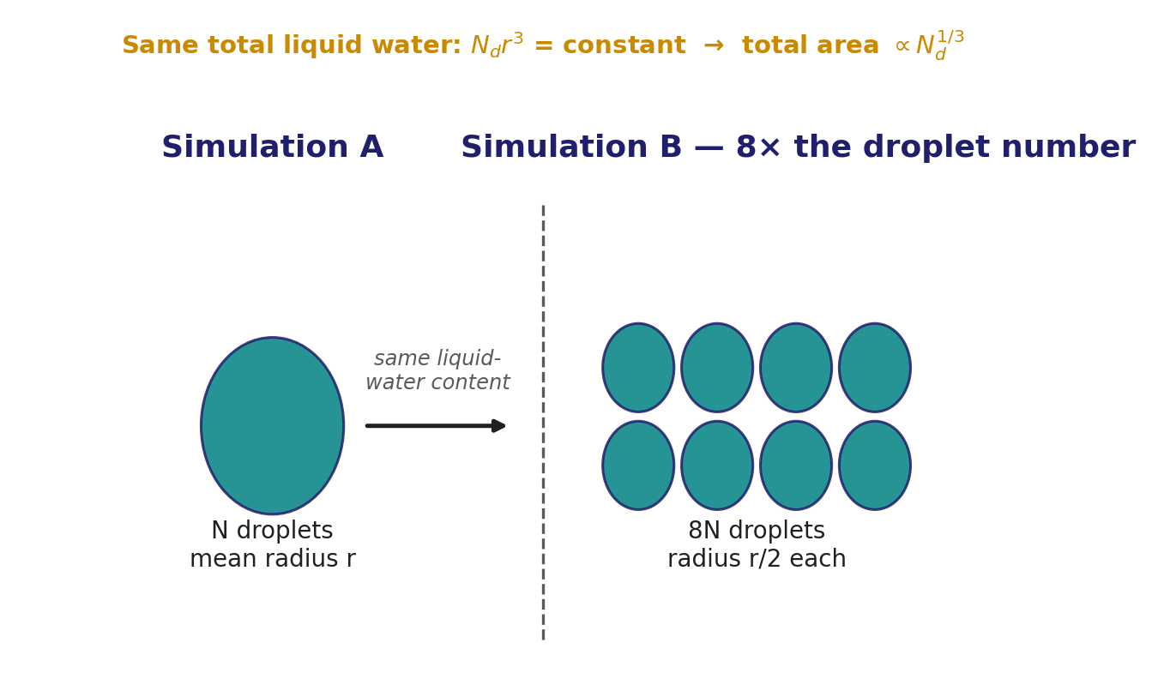
Same Liquid Water, Different Droplet Number
Modelling preview — clouds
• A model cloud holds the same total liquid-water content in two simulations, but Simulation B has 8× the droplet number concentration (N_{d}) of Simulation A.
• Since droplet mass scales as r³, fixed liquid water means N_{d}·r³ = constant, so r shrinks as N_{d}^{−1/3} — 8× the droplets means half the radius.
• Total projected droplet area scales as N_{d}·r², which works out to N_{d}^{1/3} — so Simulation B's droplets, despite being smaller, present twice the total area to sunlight.
  – More droplet surface generally means more extinction of solar radiation through the cloud — a simple but powerful link between droplet number and how a cloud interacts with radiation. The full physics of why droplet number changes in the first place is Week 9's topic.
EART23001 Atmospheric Physics & Weather | Week 2

Slide 33
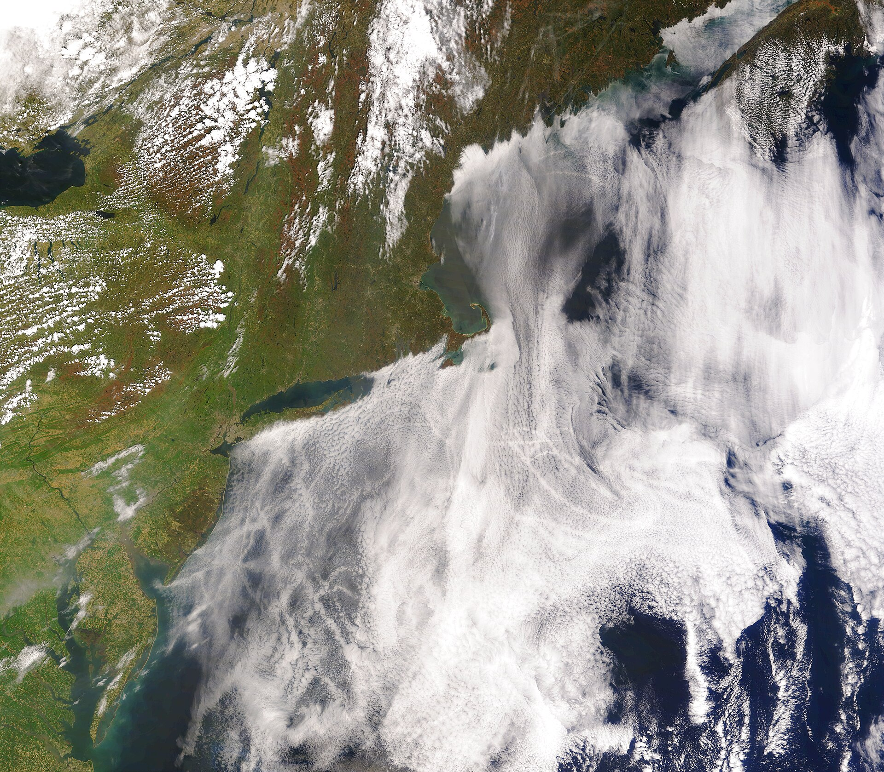
A Real Example: Ship Tracks
Modelling preview — clouds, seen from space
• Ship exhaust seeds extra cloud-condensation nuclei into marine stratocumulus, dividing the same liquid water among many more, smaller droplets — exactly the Simulation A vs B scaling from the last slide.
– More, smaller droplets scatter more sunlight, so the ship's wake shows up as a brighter streak against the surrounding cloud — a real-world Twomey effect, visible from orbit.
Ship tracks in marine stratocumulus (MODIS). Source: Wikimedia Commons.
EART23001 Atmospheric Physics & Weather | Week 2

Slide 34
Where This Goes Next
Modelling preview — the road ahead
• Today's parcel and droplet arguments were deliberately simplified previews — sketches of a physical picture, not the full derivation.
• Week 9 (Clouds and Precipitation) returns to both ideas properly: the Kelvin/curvature effect on real droplets, and the full droplet-growth physics behind the scaling you just saw.
• Week 3 (next week) picks up the thermodynamics thread directly: the first law, adiabatic processes, and where that 0.286 exponent actually comes from.
↔ EART22001 If you're taking EART22001, you'll build a parcel model in Python next week — including the Köhler/Kelvin equation this deck's droplet argument is a first step towards — from the code side, while EART23001 develops the same physics from first principles over the coming weeks.
EART23001 Atmospheric Physics & Weather | Week 2

Slide 35
What to Take Away From Today
WRAP-UP
• Small numbers matter: trace gases measured in ppm can dominate the atmosphere's radiation budget and chemistry.
• An exponential density model, ρ(z) = ρ₀exp(−z/H), is a simple but powerful idealisation — and knowing its assumptions matters as much as using the formula.
• Layers aren't just named from a diagram — they can be diagnosed directly from a lapse-rate calculation on real numbers.
• A rising parcel cools adiabatically; that simple mechanical fact is the first step towards understanding clouds.
Next week: Physics of the Atmosphere — the ideal gas law, and where that 0.286 comes from.
EART23001 Atmospheric Physics & Weather | Week 2

