Slide 1
ATMOSPHERIC PHYSICS AND WEATHER
EART23001
Week 7 — Dry and Moist Air
Professor Paul Connolly
p.connolly@manchester.ac.uk • Simon Building 3.08

Slide 2
Today's Session
Dry and Moist Air • approx. 112 minutes
0:00
Why water vapour matters, even though it's a minor gas by mass
0:05
Phase changes of water and latent heat
0:12
Latent heat in a rising, cooling parcel
0:18
Water vapour as a gas: partial pressure e and its gas constant
0:25
Saturation vapour pressure, relative humidity and the dew point
0:36
IN-CLASS DISCUSSION 1 — relative humidity and dew point
8 min
0:44
Extension: how much does that water vapour weigh?
0:49
Mixing ratio and specific humidity
0:57
IN-CLASS DISCUSSION 2 — mixing ratio and specific humidity
8 min
1:05
Why moist air is less dense than dry air
1:11
Measuring humidity: the psychrometer, and why ventilation matters
1:19
From surface measurements to cloud-base height
1:26
IN-CLASS DISCUSSION 3 — estimating cloud-base height
8 min
1:34
Latent heating by condensation: the energy inside a raincloud
1:40
↔ EART22001, right now — modelling last fortnight's dynamics
1:46
Further practice, wrap-up and looking ahead to Week 8
EART23001 Atmospheric Physics & Weather | Week 7

Slide 3
Describing Moist Air
PART 1 OF 2
Four ways of measuring how much water vapour is in the air
⏱ 0:00 – 1:11
EART23001 Atmospheric Physics & Weather | Week 7

Slide 4
Why Water Vapour Matters
So far we've treated the atmosphere as dry air
• We've used the laws of physics governing vertical and horizontal motion, but only for dry air.
• Water is the single most important atmospheric constituent for weather (and for the greenhouse effect) — and it's the only one we routinely find in all three phases: vapour, liquid and solid.
• There is about 10¹⁶ kg of water in the whole atmosphere at any one time, mostly as vapour — if it all condensed and fell at once it would form a layer only ~25 mm deep over the globe.
• Yet the average residence time of a water molecule in the atmosphere is only about 10 days — moisture is constantly cycling in and out, which is exactly why it dominates day-to-day weather.
• Reading: Wallace and Hobbs, chapters on atmospheric thermodynamics and moisture.
EART23001 Atmospheric Physics & Weather | Week 7

Slide 5
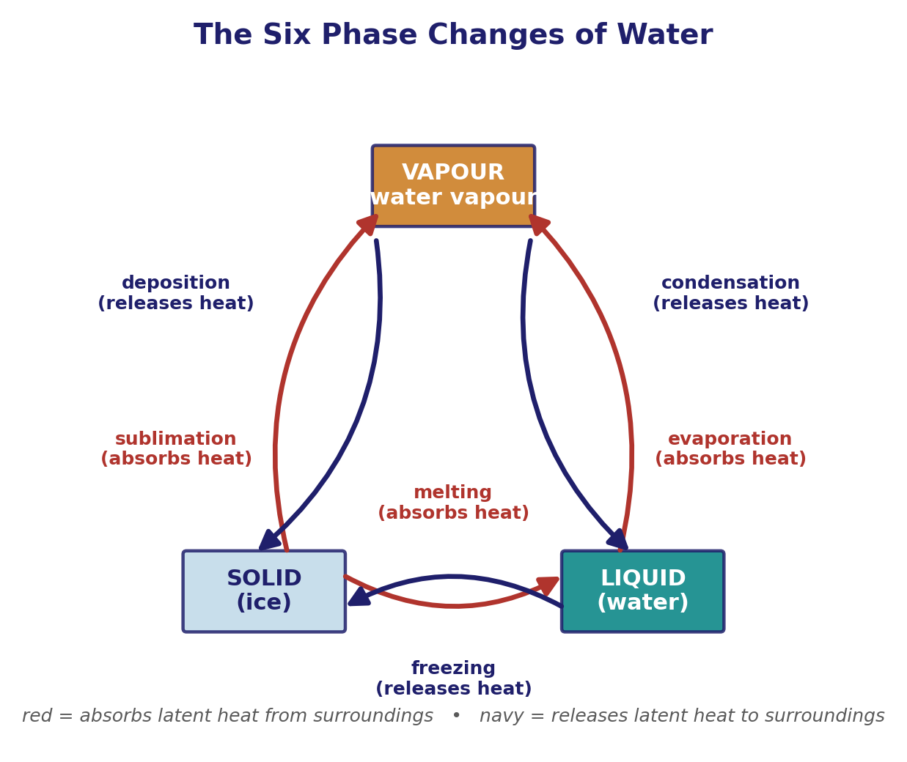
The Six Phase Changes of Water
Q1 — every change between solid, liquid and vapour moves latent heat
• Three phases, six possible transitions: melting/freezing (solid ↔ liquid), evaporation/condensation (liquid ↔ vapour), sublimation/deposition (solid ↔ vapour).
• Moving to a less-ordered phase (melting, evaporation, sublimation) always absorbs latent heat from the surroundings; moving to a more-ordered phase (freezing, condensation, deposition) always releases it.
• The latent heat of vaporisation, L_{v} ≈ 2.5×10⁶ J/kg, is by far the largest of the six — this is why moist processes dominate the atmosphere's energy budget.
• Condensation and deposition matter most for cloud formation: they turn vapour into liquid droplets or ice and release that latent heat straight into the surrounding air.
EART23001 Atmospheric Physics & Weather | Week 7

Slide 6
Latent Heat in a Rising Parcel
Why this matters every time air rises
• From earlier lectures: temperature and pressure both fall with altitude in the troposphere, so a rising air parcel expands and cools.
• As it cools, the water vapour it carries eventually reaches saturation and begins to condense.
• Condensation releases latent heat directly into the parcel, offsetting part of the adiabatic cooling — exactly why the saturated (moist) adiabatic lapse rate is smaller than the dry one (Week 4).
• Try Q1 yourself: for each of the six changes on the previous slide, state the direction of the change and whether heat is absorbed or released — check your answers against the figure.
↔ EART22001 EART22001's Week 3 parcel-in-a-container model already showed you this directly — the parcel's own lapse rate changes once a cloud forms inside it, from exactly this latent-heat release.
EART23001 Atmospheric Physics & Weather | Week 7

Slide 7
Water Vapour Is Just Another Gas
Q3 setup — the ideal gas law applies to vapour too
• We already used the ideal gas law for dry air; water vapour is simply another gas mixed into the atmosphere and obeys the same law.
• Its partial pressure is called the vapour pressure, e, with e = ρ_{v} R_{v} T, and its own specific gas constant R_{v} = 461.5 J kg⁻¹ K⁻¹.
• Compare R_{d} ≈ 287 J kg⁻¹ K⁻¹ for dry air: water molecules are lighter, so their specific gas constant is larger.
• Typical e is only a few tens of hPa against a total pressure p ≈ 1000 hPa — water vapour is always a minor gas by pressure, even though it dominates the weather.
• ε = R_{d}/R_{v} ≈ 0.622 (equivalently M_{v}/M_{d}) will turn up again and again this lecture.
EART23001 Atmospheric Physics & Weather | Week 7

Slide 8
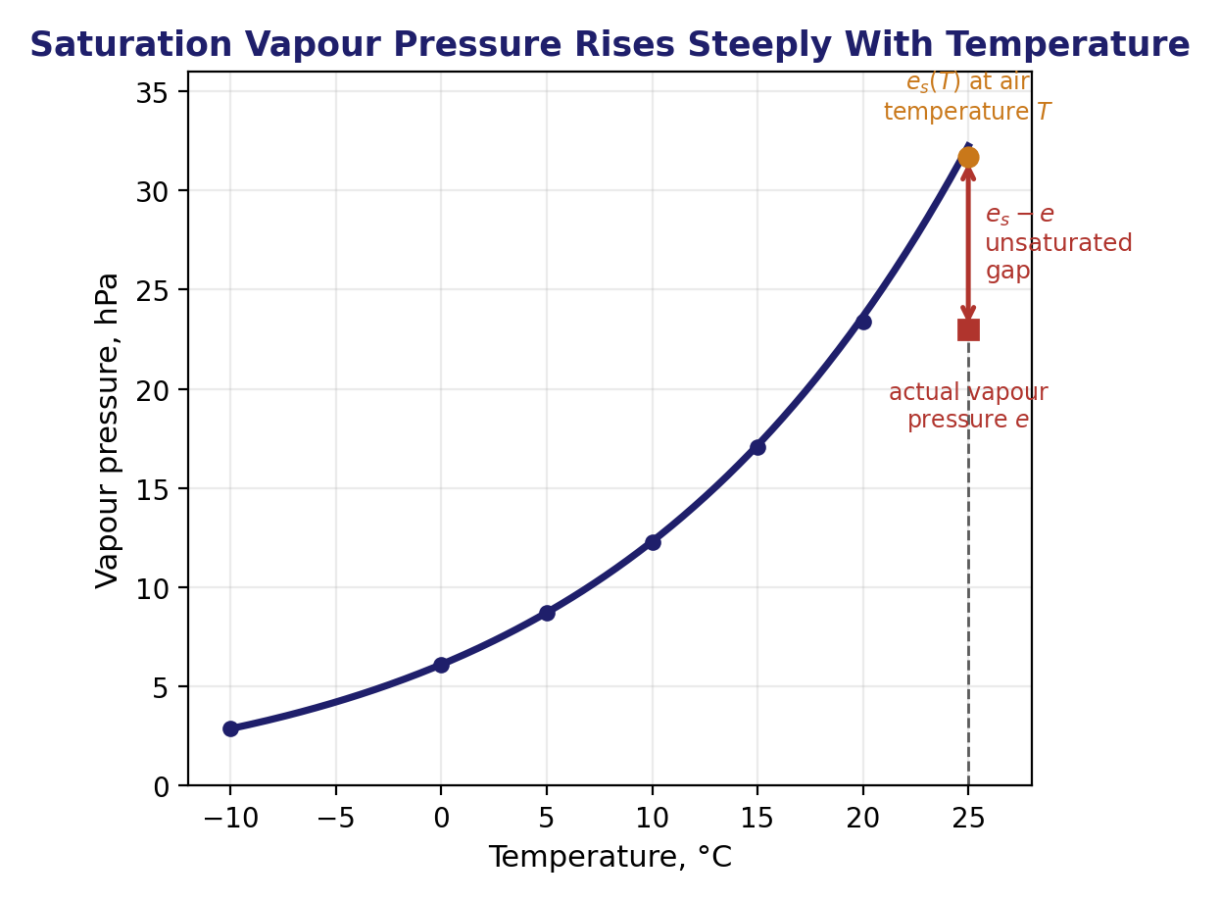
Saturation, Relative Humidity and the Dew Point
Q2 setup — three ways of describing "how humid"
• Leave air in contact with a water surface long enough and it reaches a dynamic equilibrium — molecules leave and rejoin the surface at equal rates. The air is then saturated, with e equal to the saturation vapour pressure, e_{s}(T).
• e_{s}(T) rises steeply and non-linearly with temperature, roughly doubling every 10°C — warm air can hold far more vapour before saturating than cold air.
• Relative humidity compares the two: RH = 100 e/e_{s}(T) — the percentage of the way to saturation at the current temperature.
• The dew point, T_{d}, is the temperature at which the air's own vapour pressure e would equal the saturation value: e_{s}(T_{d}) = e. Cool the air to T_{d} (with e unchanged) and it saturates.
EART23001 Atmospheric Physics & Weather | Week 7

Slide 9
The Saturation Vapour Pressure Equation
Q2 setup, continued — making “roughly doubles every 10°C” exact
• The qualitative rule on the last slide (es roughly doubles every 10°C) comes from the Clausius–Clapeyron equation, which links the slope of the saturation curve to the latent heat itself: des/dT = Lv·es / (Rv·T²).
• Treating Lv as constant over the range we care about and integrating from a reference point (T0 = 273.15 K, es0 = 6.11 hPa, the triple point of water) gives an explicit formula: es(T) = es0·exp[ (Lv/Rv)·(1/T0 − 1/T) ].
• Check it against the rule of thumb: with Lv ≈ 2.5×10⁶ J/kg and Rv = 461.5 J/(kg·K), this gives es(10°C) ≈ 12.3 hPa — almost exactly double es(0°C) = 6.11 hPa.
• The same equation applies over ice, but with a smaller latent heat (sublimation rather than vaporisation) and its own reference value — and the resulting es,ice(T) is lower than es,water(T) at the same sub-zero temperature.
  – Physically: ice is the more stable phase below 0°C, its molecules more tightly locked in the crystal lattice, so equilibrium is reached at a lower vapour pressure.
  – This water-vs-ice gap is small but not academic — it's the entire engine behind the Wegener–Bergeron–Findeisen process in mixed-phase clouds, which Week 9 derives properly.
EART23001 Atmospheric Physics & Weather | Week 7

Slide 10
Relative Humidity and Dew Point
IN-CLASS DISCUSSION 1
• At 25°C, an air parcel has water-vapour partial pressure e = 17.0 hPa.
• 1. Calculate the relative humidity, RH = 100 e/e_{s}(T).
• 2. Use the saturation-vapour-pressure table on your worksheet to estimate the dew-point temperature.
• 3. Explain physically what would happen if the parcel were cooled below its dew point while its water-vapour content initially stayed the same.
✍ Discuss in pairs, then we'll take answers
Worked-answers sheet, Week 7 — IN CLASS Question

Slide 11

Relative Humidity and Dew Point
WORKED ANSWER — DISCUSSION 1
• At 25°C, e_{s} = 31.67 hPa, so
  – RH = 100 × (17.0 / 31.67) = 53.7%.
• The dew point is where e_{s}(T_{d}) = e = 17.0 hPa. The table gives e_{s} ≈ 17.04 hPa at 15°C, so
  – T_{d} ≈ 15°C.
• Cooling below 15°C would make e_{s}(T) smaller than the parcel's actual e — the air becomes supersaturated, and condensation onto available nuclei brings the vapour content back down toward saturation.
• This is exactly how dew, fog and cloud form: air cooling below its own dew point.
EART23001 Atmospheric Physics & Weather | Week 7
Dew: air cooled below its dew point overnight. Source: Wikimedia Commons.

Slide 12
Extension — Weighing the Water Vapour
Try Q3 yourself: the same air as Discussion 1
• Rearranging e = ρ_{v} R_{v} T for the density of the vapour itself:
  – ρ_{v} = e / (R_{v} T).
• Converting e = 17.0 hPa = 1700 Pa and T = 25°C = 298.15 K:
  – ρ_{v} = 1700 / (461.5 × 298.15) = 1.24×10⁻² kg/m³ ≈ 12.4 g/m³.
• For comparison, dry air near the surface is roughly 1.2 kg/m³ — so this warm, fairly humid air is only about 1% water vapour by mass, yet that 1% drives essentially all the weather in this course.
EART23001 Atmospheric Physics & Weather | Week 7

Slide 13
Mixing Ratio and Specific Humidity
Q4 setup — two more ways of measuring "how much"
• The water-vapour mixing ratio is the mass of water vapour per unit mass of DRY air: r_{v} = m_{w}/m_{d}.
• The specific humidity is the mass of water vapour per unit mass of MOIST (total) air: q = m_{w}/(m_{w}+m_{d}).
• In pressure form, from the ideal gas law applied to each gas separately: r_{v} = ε e/(p−e), with ε = R_{d}/R_{v} ≈ 0.622.
• Because atmospheric water vapour is always a small fraction of the total mass (r_{v} ≪ 1), q = r_{v}/(1+r_{v}) ≈ r_{v} — the two are numerically close.
EART23001 Atmospheric Physics & Weather | Week 7

Slide 14
Mixing Ratio and Specific Humidity
IN-CLASS DISCUSSION 2
• At total pressure p = 1000 hPa and vapour pressure e = 17.0 hPa (the same air as Discussion 1):
• 1. Calculate the mixing ratio, r_{v} = ε e/(p−e).
• 2. Starting from the definitions of r_{v} and q, show that q = r_{v}/(1+r_{v}), and calculate q.
• 3. Give both in g/kg, and explain why they're numerically so similar for ordinary atmospheric air.
✍ Discuss in pairs, then we'll take answers
Worked-answers sheet, Week 7 — IN CLASS Question

Slide 15
Mixing Ratio and Specific Humidity
WORKED ANSWER — DISCUSSION 2
• r_{v} = 0.622 × 17.0/(1000−17.0) = 0.01075 kg/kg = 10.75 g/kg.
• Since r_{v} = m_{w}/m_{d}, we have m_{w} = r_{v} m_{d}. Substituting into q = m_{w}/(m_{w}+m_{d}) gives
  – q = r_{v} m_{d} / (r_{v} m_{d} + m_{d}) = r_{v}/(1+r_{v}).
• q = 0.01075/1.01075 = 0.01064 kg/kg = 10.64 g/kg.
• r_{v} and q differ by only about 1% here because r_{v} ≪ 1, so 1+r_{v} ≈ 1 — for ordinary atmospheric air the two are effectively interchangeable.
EART23001 Atmospheric Physics & Weather | Week 7

Slide 16
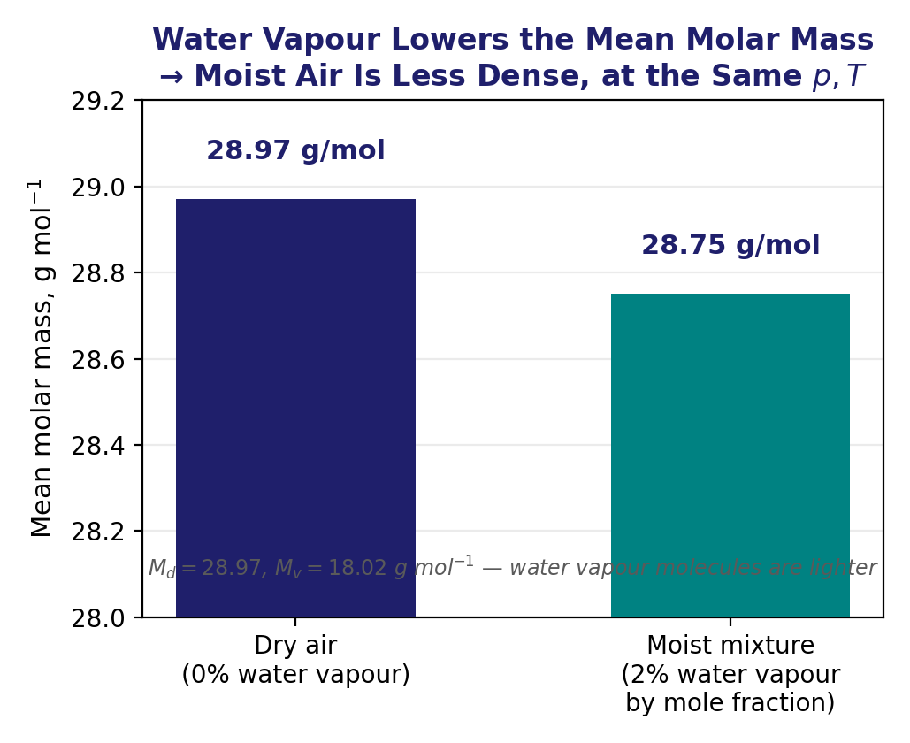
Why Moist Air Is Less Dense Than Dry Air
Q5 — a surprising consequence of adding a lighter gas
• Air is a mixture of dry-air molecules (mean molar mass M_{d} = 28.97 g/mol) and water-vapour molecules (M_{v} = 18.02 g/mol) — noticeably lighter.
• For a mixture that is 2% water vapour by mole fraction, the mean molar mass is M = 0.98(28.97) + 0.02(18.02) = 28.75 g/mol.
• From the ideal gas law, ρ = pM/(R*T) at fixed p and T — density is directly proportional to mean molar mass.
• So replacing some dry-air molecules with lighter water-vapour molecules LOWERS the density at the same p and T: humid air is less dense than dry air, not more — despite feeling "heavy" and oppressive.
EART23001 Atmospheric Physics & Weather | Week 7

Slide 17
Moist Air in Action
PART 2 OF 2
Measuring humidity, finding cloud base, and the energy it carries
⏱ 1:11 – 1:52
EART23001 Atmospheric Physics & Weather | Week 7

Slide 18
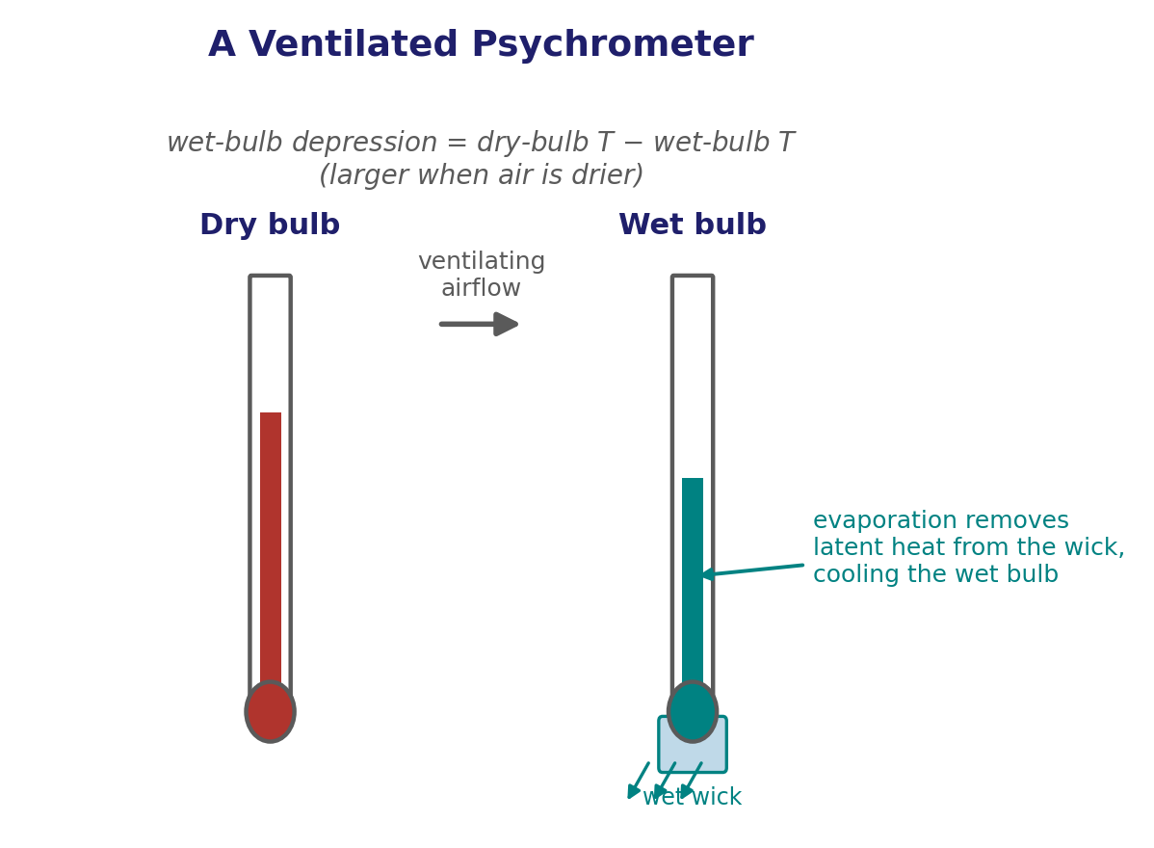
Measuring Humidity: the Psychrometer
Q7 — turning two thermometer readings into a humidity value
• A psychrometer pairs two thermometers: a dry bulb (ordinary air temperature) and a wet bulb (its bulb wrapped in a wetted wick).
• Evaporation from the wick removes latent heat, cooling the wet bulb below the dry-bulb temperature — unless the air is already saturated, in which case there's no net evaporation and the two read the same.
• The wet-bulb depression (dry-bulb minus wet-bulb temperature) grows as the air gets drier — it's the working "signal" that tables and formulas convert into RH, dew point, or vapour pressure.
• An approximate relation used with the two readings is e ≈ e_{s}(T_{w}) − Ap(T−T_{w}), where A is a small instrument-specific "psychrometer constant".
EART23001 Atmospheric Physics & Weather | Week 7

Slide 19
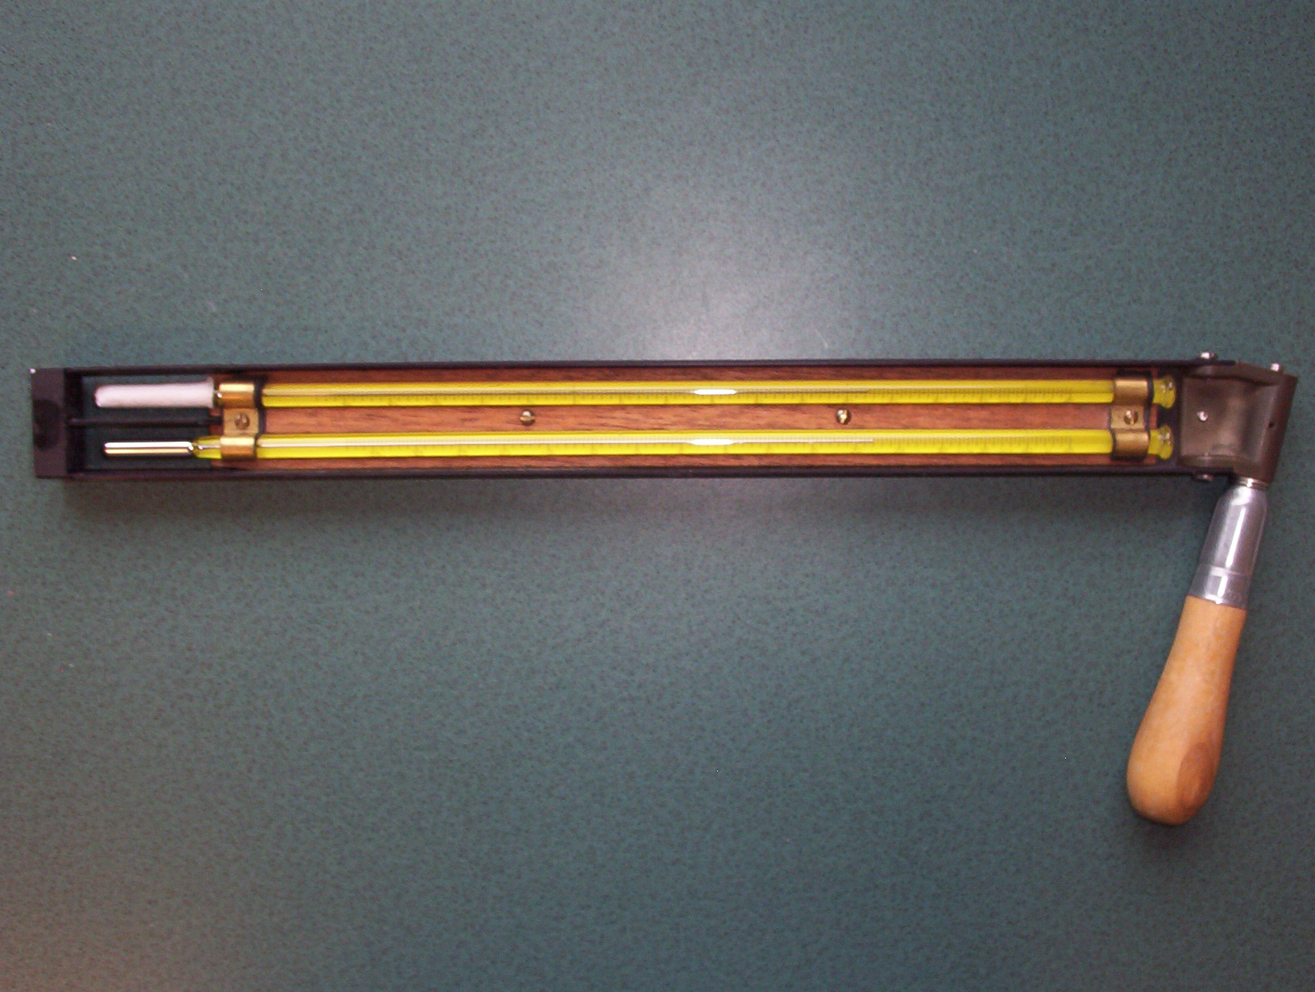
Why Ventilation Matters
Q7 continued
• Ventilating the wick — drawing air across it at a steady rate — is essential for a good reading.
• Without airflow, evaporated vapour would build up in a thin, locally saturated layer right around the wick, slowing further evaporation and giving an unrepresentative (too warm) wet-bulb reading.
• A sling psychrometer whirls the thermometers through the air by hand; an aspirated psychrometer draws air past them with a small fan — both exist purely to keep that ventilation steady and reproducible.
• It's also why a Stevenson screen — the standard white louvred housing for weather-station thermometers — has louvred sides: it shields the thermometers from direct sun and rain while still letting air circulate freely.
A sling psychrometer in use — whirling it ventilates both thermometers by hand. Source: Wikimedia Commons.
EART23001 Atmospheric Physics & Weather | Week 7

Slide 20
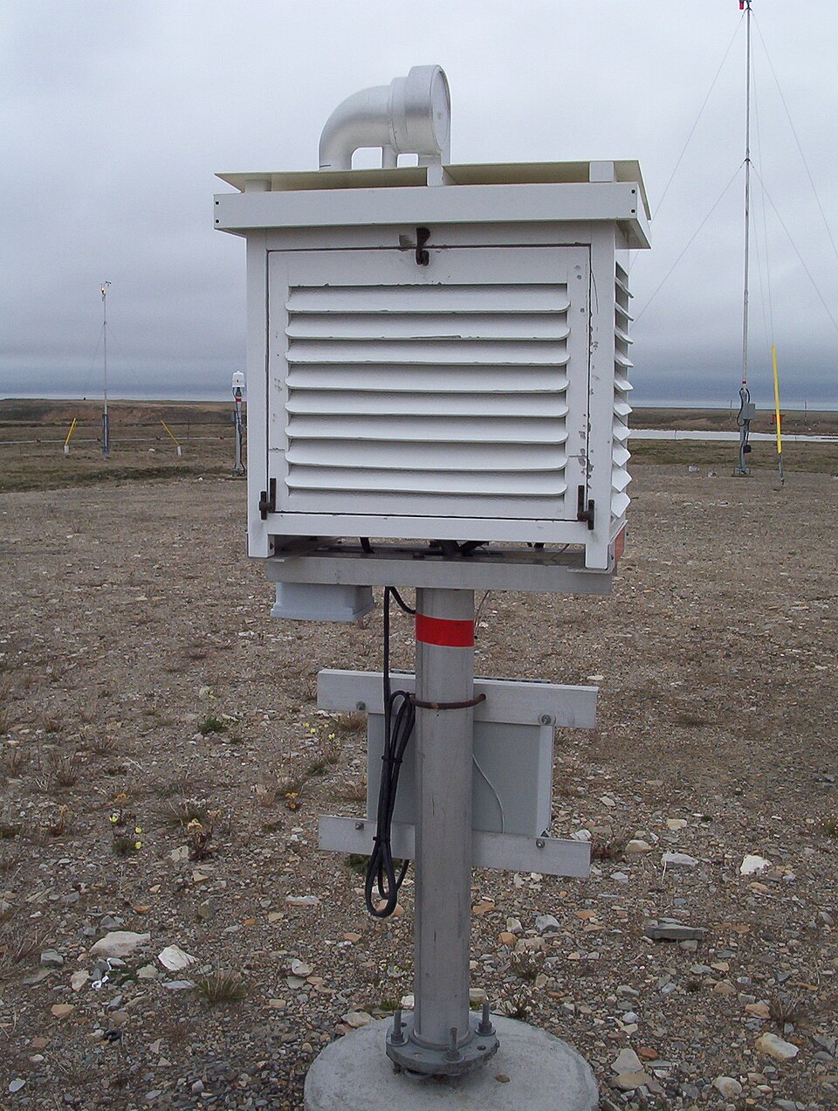
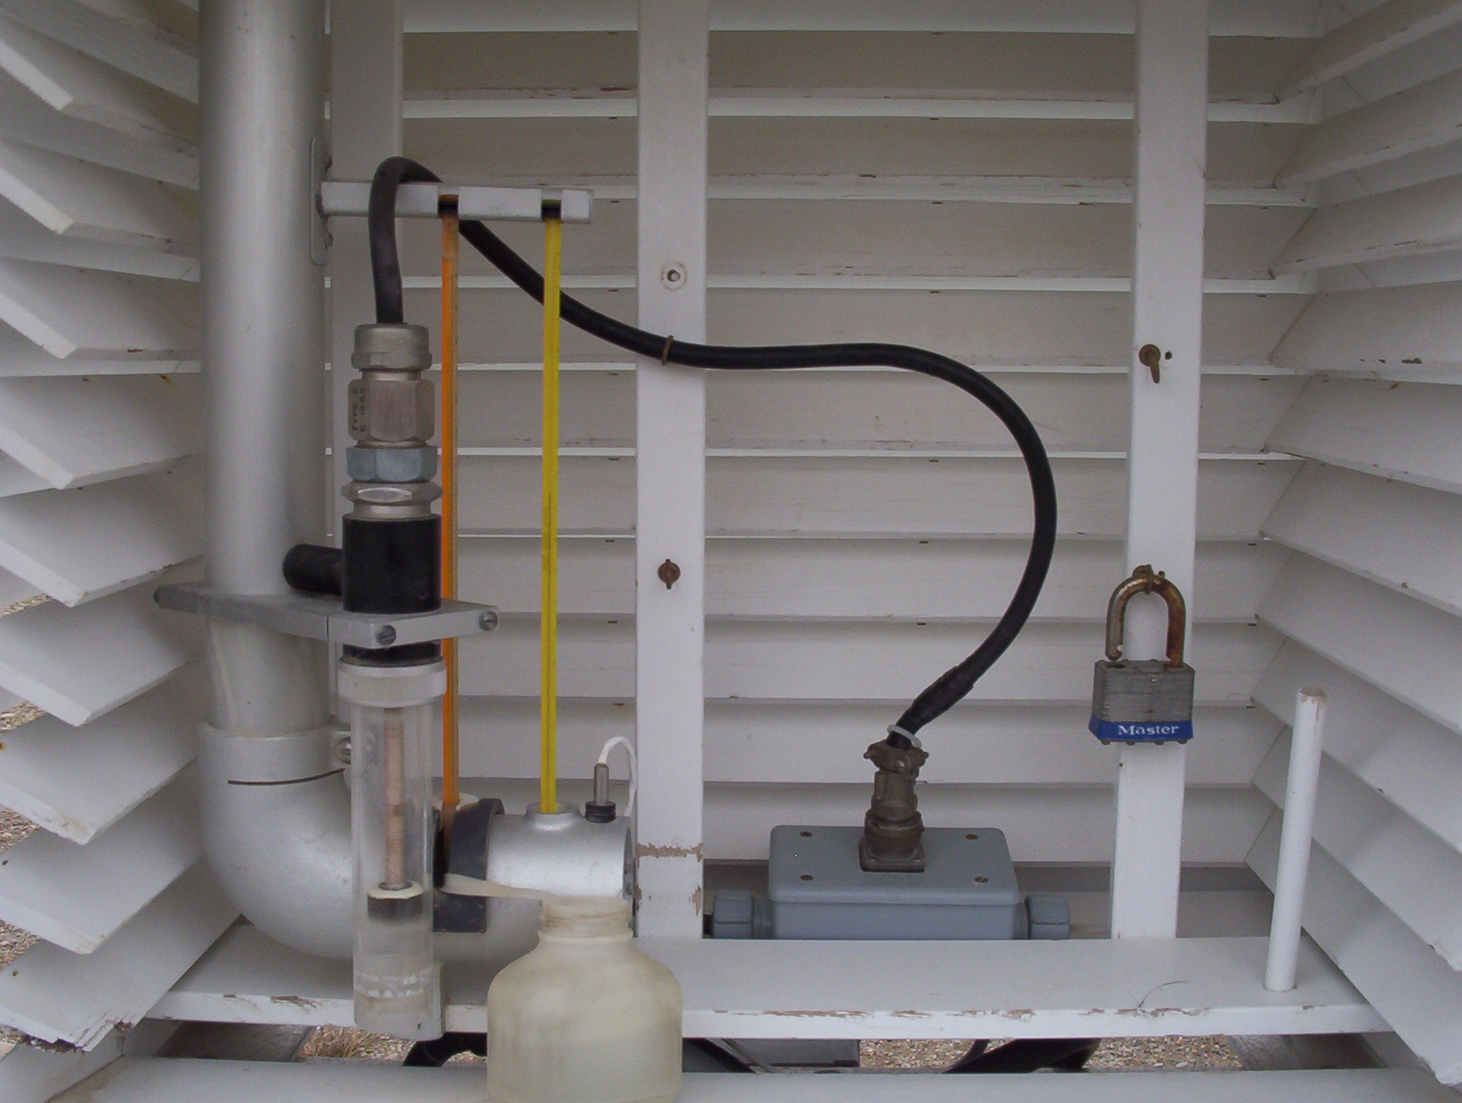
The Stevenson Screen
A real weather-station housing, inside and out
• The standard housing for weather-station thermometers: white (reflects solar radiation), louvred (lets air circulate freely) and raised on legs (clear of ground heating).
• Its whole design serves the same goal as ventilating a psychrometer — a representative air-temperature reading, not one biased by direct sun, rain, or a stagnant layer of trapped air.
Exterior: louvred, white-painted, elevated. Source: Wikimedia Commons.
Interior: thermometers clear of the louvred walls and floor. Source: Wikimedia Commons.
EART23001 Atmospheric Physics & Weather | Week 7

Slide 21
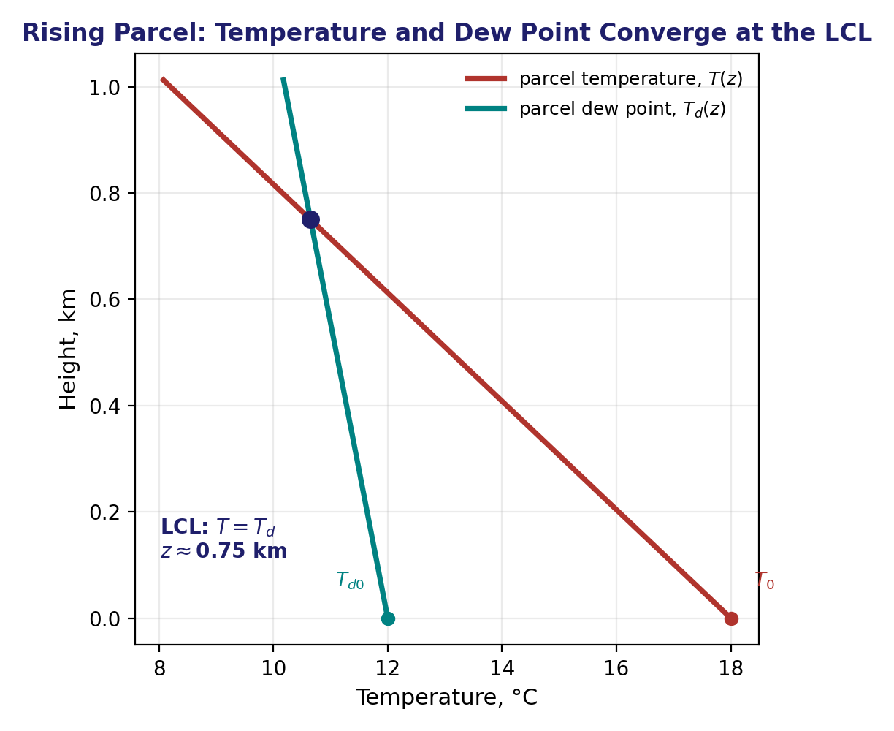
From Surface Measurements to Cloud Base
Q6 setup — where will a rising parcel's cloud base be?
• A rising, unsaturated parcel cools at the dry adiabatic lapse rate, Γ_{d} ≈ 9.8 K/km (Week 4) — its temperature falls quickly with height.
• Its dew point also falls as it rises, because expansion lowers the vapour pressure — but far more slowly, at only Γ_{dew} ≈ 1.8 K/km.
• The lifting condensation level (LCL) — the cloud base — is the height where the two converge: T(z) = T_{d}(z).
• Setting T₀−Γ_{d}z = T_{d0}−Γ_{dew}z and solving gives z_{LCL} = (T₀−T_{d0})/(Γ_{d}−Γ_{dew}) ≈ 125(T₀−T_{d0}) metres, for temperatures in °C.
EART23001 Atmospheric Physics & Weather | Week 7

Slide 22
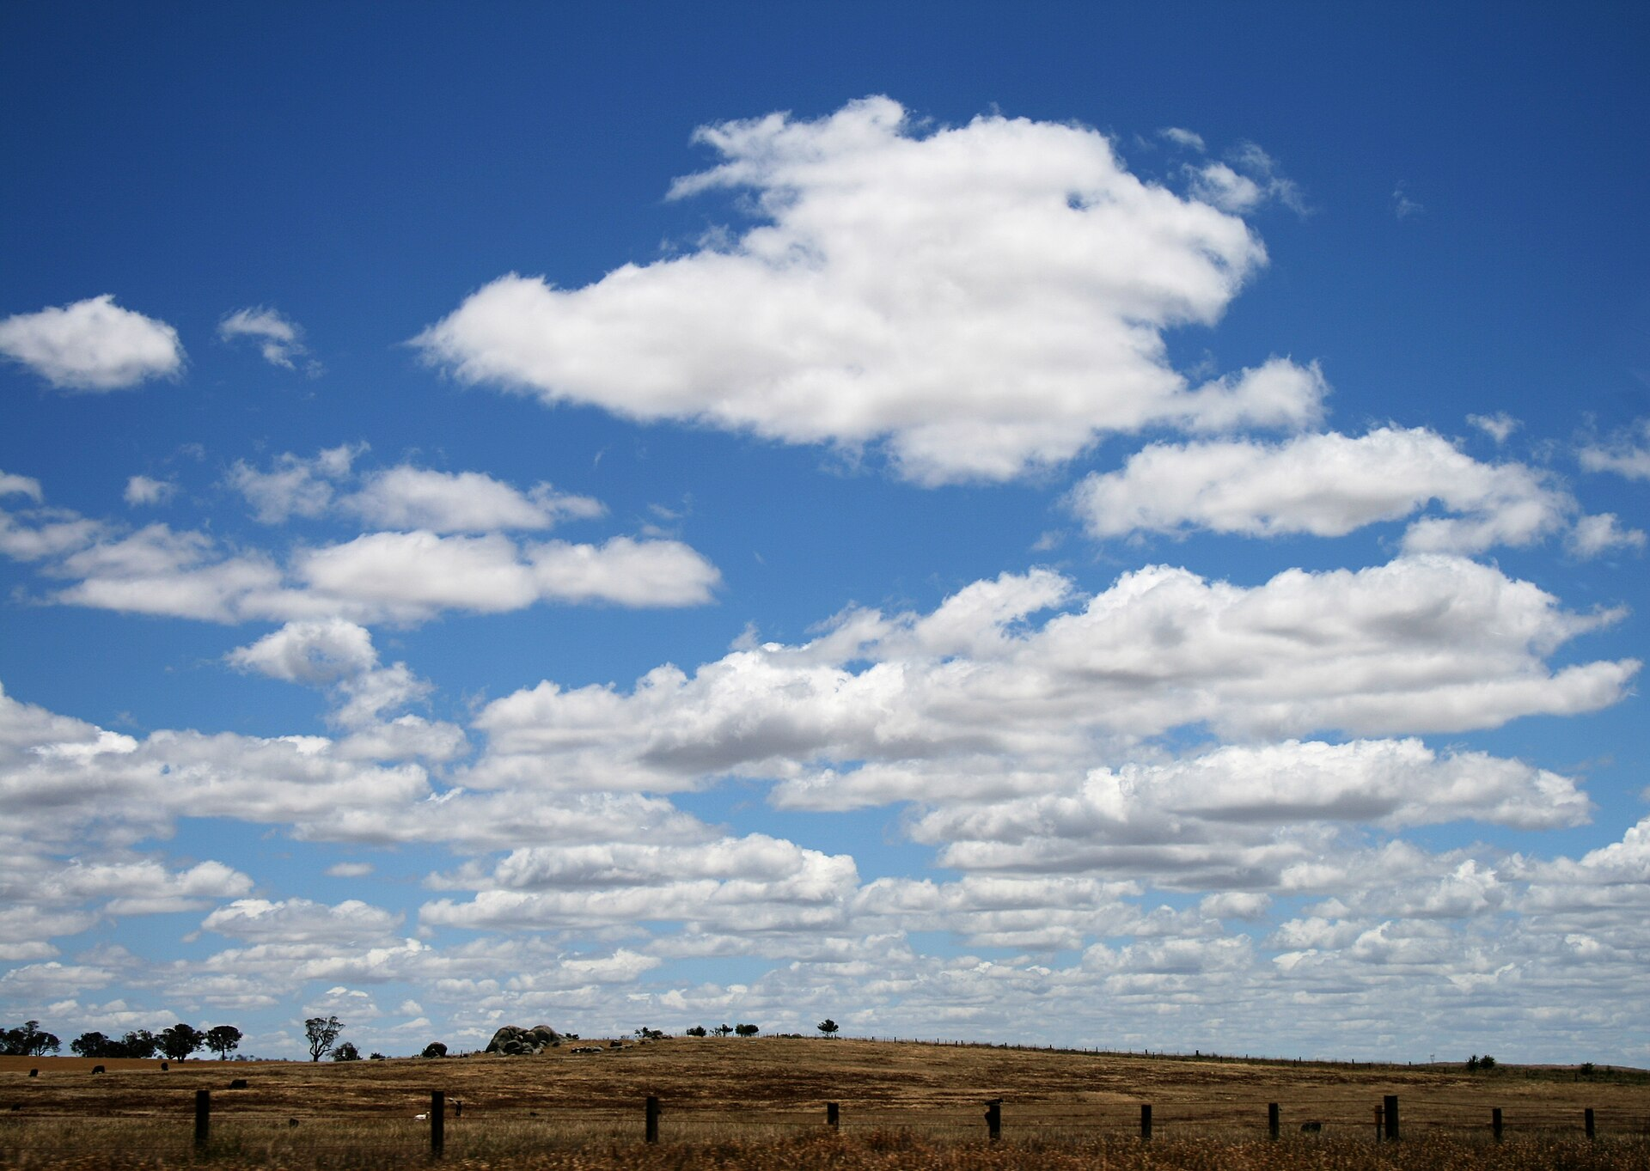
What Cloud Base Actually Looks Like
The LCL isn't just a line on a graph
Cumulus humilis over a field — every cloud's flat, sharply defined base sits at that column's lifting condensation level, because neighbouring parcels rising through similar air all condense at about the same height. Source: Wikimedia Commons.
EART23001 Atmospheric Physics & Weather | Week 7

Slide 23
Estimating Cloud-Base Height
IN-CLASS DISCUSSION 3
• For a surface temperature T₀ = 22°C and dew point T_{d0} = 14°C:
• 1. Show that z_{LCL} ≈ (T₀−T_{d0})/(Γ_{d}−Γ_{dew}), and hence recover z_{LCL} ≈ 125(T₀−T_{d0}) m.
• 2. Estimate the LCL height for these numbers.
• 3. Explain physically why a bigger surface T₀−T_{d0} gap usually means a higher cloud base.
✍ Discuss in pairs, then we'll take answers
Worked-answers sheet, Week 7 — IN CLASS Question

Slide 24
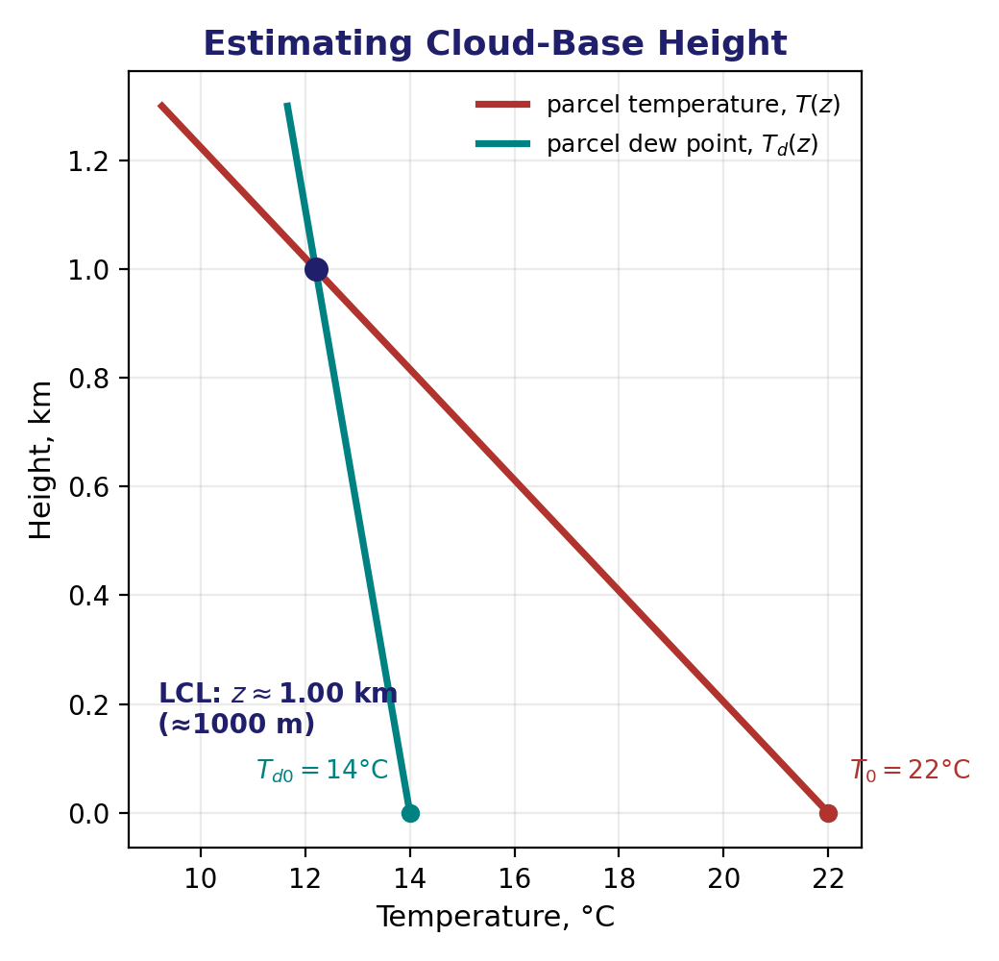
Estimating Cloud-Base Height
WORKED ANSWER — DISCUSSION 3
• At the LCL, T₀−Γ_{d}z = T_{d0}−Γ_{dew}z, so
  – z_{LCL} = (T₀−T_{d0})/(Γ_{d}−Γ_{dew}) = (22−14)/(9.8−1.8) = 8/8.0 = 1.00 km = 1000 m.
• That matches the rule of thumb z_{LCL} ≈ 125 × (T₀−T_{d0}) = 125 × 8 = 1000 m.
• The parcel's temperature falls fast (9.8 K/km) while its dew point falls slowly (1.8 K/km); a bigger starting gap simply takes more ascent — more height — before the two catch up. So a drier start (bigger T₀−T_{d0}) means a higher cloud base.
EART23001 Atmospheric Physics & Weather | Week 7

Slide 25
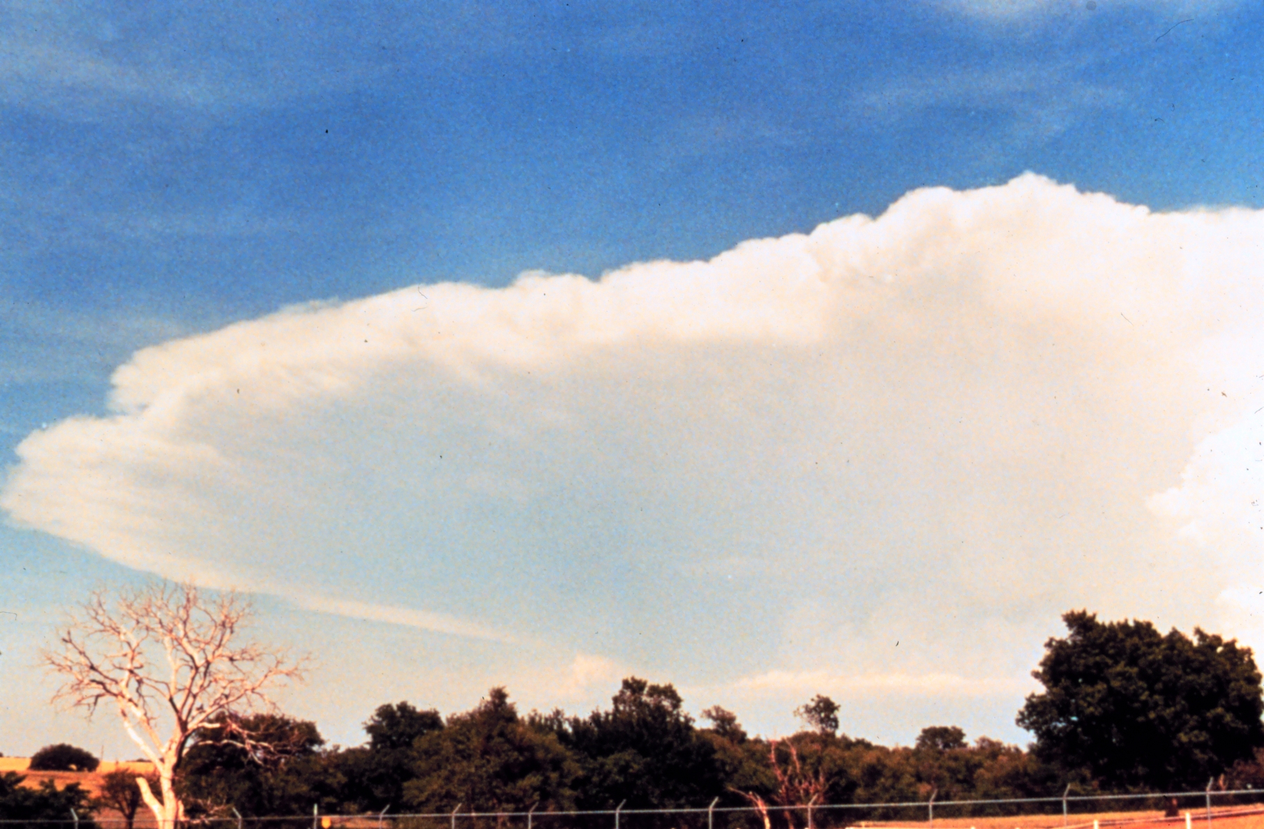
Latent Heating by Condensation
Q8 — the energy hidden inside a raincloud
• Every gram of water that condenses inside a rising cloud releases its latent heat, L_{v} ≈ 2.5×10⁶ J/kg, directly into the surrounding air.
• Example: condensing 2.0 kg of water releases Q = mL_{v} = 2.0 × 2.5×10⁶ = 5.0×10⁶ J.
• If that energy alone warmed 1000 kg of air (c_{p} = 1004 J kg⁻¹ K⁻¹):
  – ΔT = Q/(mc_{p}) = 5.0×10⁶/(1000×1004) ≈ 5.0 K.
• The real atmosphere spreads this heat far more broadly than one isolated air mass — but the number shows why condensation is one of the atmosphere's biggest energy sources, and a key driver of storm intensification.
A cumulonimbus — the visible scale of latent heat released as vapour condenses and freezes all the way up the tower. Source: Wikimedia Commons.
EART23001 Atmospheric Physics & Weather | Week 7

Slide 26
Meanwhile, in EART22001...
Same calendar week — modelling last fortnight's dynamics
• Two weeks ago (our own Week 5) we derived the geostrophic wind, the gradient wind, and vorticity conservation from physical reasoning.
• This week, EART22001's "Shallow Water Modelling" session builds a numerical model of exactly that physics, from Newton's second law and circular motion: pressure-gradient force, Coriolis (f = 2Ω sinφ), geostrophic wind (u_{g}, v_{g}), gradient wind (v_{gr}), and vorticity (ζ) — even Rossby waves.
• To make that solvable over a limited area, their model doesn't vary f with latitude in full: it uses the beta-plane approximation, f ≈ f₀ + βy — a Coriolis parameter fixed at a reference latitude (f₀) plus a term that captures just its local northward gradient, β = df/dy.
• That's the right order for learning: understand the physics first, then watch (or build) the model that encodes it — beta-plane approximation and all.
• Their notation matches ours exactly — f, u_{g}, v_{g}, v_{gr} and ζ are all used the same way in both courses.
↔ EART22001 Shallow Water Modelling, this week — pressure-gradient force, Coriolis (on a beta plane), geostrophic/gradient wind, vorticity and Rossby waves, coded up from the physics we derived in our own Week 5.
EART23001 Atmospheric Physics & Weather | Week 7

Slide 27
Further Practice — Try These Yourself
Five worksheet questions not covered as IN-CLASS discussions today
• Q1 — Phase changes: state the direction and heat effect for all six transitions (the six-phase diagram earlier has the answers — check your own reasoning against it).
• Q3 — Water-vapour density: using Discussion 1's numbers, find ρ_{v} from e = ρ_{v} R_{v} T (worked as an extension above).
• Q5 — Why moist air is less dense: the molar-mass argument (also covered above) — make sure you can reproduce the arithmetic yourself.
• Q7 — The psychrometer: explain the three qualitative questions about wet-bulb cooling, saturation, and ventilation in your own words.
• Q8 — Latent heating by condensation: repeat the calculation for a different mass of condensed water.
EART23001 Atmospheric Physics & Weather | Week 7

Slide 28
Wrap-Up: Key Ideas From Today
Four ways of saying "how much water vapour", and what it does
• Water vapour is just another gas (e = ρ_{v} R_{v} T), but one whose amount is capped by temperature through e_{s}(T).
• RH, dew point, mixing ratio and specific humidity are four different (but closely related) ways of saying "how much water vapour is in the air".
• Adding water vapour lowers the mean molar mass of air, making moist air very slightly less dense than dry air at the same p, T.
• The lifting condensation level marks where a rising parcel's temperature and dew point converge — the base of the cloud it will form.
• Every phase change that forms cloud (condensation, deposition) releases latent heat — one of the atmosphere's largest and most concentrated energy sources.
Next week: Convection and the Saturated Adiabatic Lapse Rate (SALR) — what happens once a parcel passes its LCL and keeps rising.
EART23001 Atmospheric Physics & Weather | Week 7

