Slide 1
ATMOSPHERIC PHYSICS AND WEATHER
EART23001
Week 12 — Global Energy: Balance and Climate
Professor Paul Connolly
p.connolly@manchester.ac.uk • Simon Building 3.08
The final lecture of the course — from Earth's energy budget to why climate varies

Slide 2
Today's Session
Global energy and climate — the final lecture • approx. 112 minutes
0:00
Why this lecture closes the course
0:02
From solar luminosity to the solar constant
0:07
Disk vs sphere: why the global mean is S₀/4
0:12
Albedo and the absorbed solar flux
0:16
Stefan–Boltzmann's law and radiative equilibrium
0:21
IN-CLASS DISCUSSION 1 — Earth's effective radiating temperature
12 min
0:33
The 33.4 K gap: why we need a greenhouse effect
0:36
Wien's law: separating solar shortwave from terrestrial longwave
0:41
The atmospheric window and spectral selectivity
0:45
Building a one-layer greenhouse model
0:49
IN-CLASS DISCUSSION 2 — the one-layer greenhouse model
12 min
1:01
Why the model runs too hot: what real atmospheres add
1:05
Venus: the greenhouse effect taken to an extreme
1:10
Cloud albedo and the M₂ framework — back to Week 9
1:16
IN-CLASS DISCUSSION 3 — cloud droplet number, M₂ and albedo
12 min
1:28
Classifying climate feedbacks
1:33
Radiative imbalance by latitude: why energy must move poleward
1:37
Circulation and weather systems as the transport mechanism
1:40
Milankovitch cycles: the orbital pacemaker of climate
1:46
Closing the loop with EART22001
1:48
Course wrap-up — the six ILOs across twelve weeks
EART23001 Atmospheric Physics & Weather | Week 12

Slide 3
The Earth's Energy Budget
PART 1 OF 4
Why the whole climate system starts from a simple balance: energy in versus energy out
⏱ 0:00 – 0:36
EART23001 Atmospheric Physics & Weather | Week 12

Slide 4
Why This Lecture Closes the Course
Twelve weeks of atmospheric physics, one final unifying question
• Every week so far has asked a local question: how does pressure vary with height (Week 4)? How does air rise and cool (Weeks 2-3)? Why do clouds form and precipitation grow (Week 9)? Why do mid-latitude storms develop (Week 11)?
• Today asks the global question underneath all of them: what sets Earth's temperature in the first place, and why does it vary the way it does — by season, by latitude, and over geological time?
• The answer is a balance: averaged over a long enough period, the rate at which Earth absorbs energy from the Sun is approximately equal to the rate at which it radiates energy back to space. It's only approximate — if Earth's heat content is changing (as it is now, with the oceans warming), the two sides differ slightly, by the small imbalance that is actually heating the planet. Almost everything in this lecture builds on that near-balance, applied with increasing realism.
• It closes the loop: the same physics that has been running quietly underneath every previous week — radiation, Stefan-Boltzmann's law, feedbacks involving clouds and circulation — is what actually sets the numbers (288 K, the seasons, the ice ages) that made all those earlier weeks make sense.
EART23001 Atmospheric Physics & Weather | Week 12

Slide 5
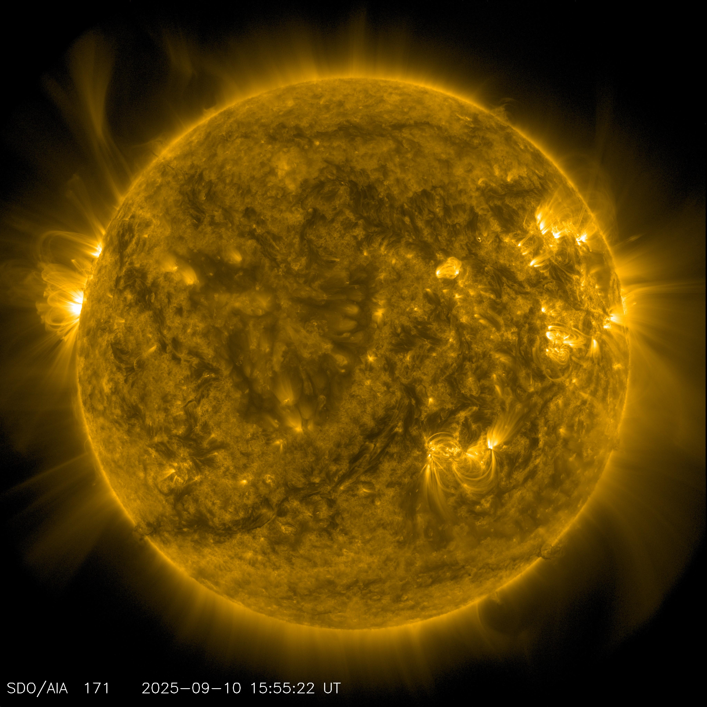
From Solar Luminosity to the Solar Constant
The Sun radiates isotropically — spread that power over a sphere at Earth's distance
• The Sun emits a total power (luminosity) L☉ = 3.828 × 10²⁶ W in all directions. At Earth's mean distance d = 1.496 × 10¹¹ m, that power is spread over the surface of an enormous sphere of radius d.
• The solar constant is that power divided by the sphere's surface area: S₀ = L☉ / (4πd²).
• S₀ = 3.828×10²⁶ / [4π(1.496×10¹¹)²] = 1.361×10³ W m⁻² — the irradiance on a surface facing the Sun directly, just outside Earth's atmosphere.
• This single number, together with Earth's albedo, is the entire external energy input driving every atmospheric process this course has covered.
Source: NASA / Solar Dynamics Observatory (SDO), Atmospheric Imaging Assembly (AIA 171 Å).
EART23001 Atmospheric Physics & Weather | Week 12

Slide 6
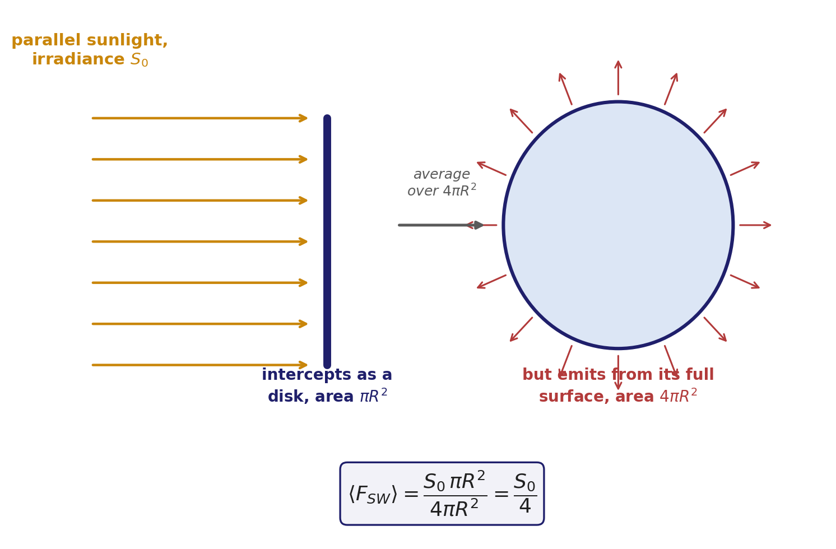
Disk vs Sphere: Why the Global Mean Is S₀/4
Earth intercepts sunlight as a disk, but radiates — and receives, averaged — over a full sphere
• Earth intercepts sunlight only over its cross-sectional disk, area πR² — the shadow it casts. That power is then shared out over Earth's full spherical surface, area 4πR², as the planet rotates and different latitudes see different angles.
• So the global- and time-averaged incoming solar flux is ⟨F_{SW}⟩ = S₀πR²/4πR² = S₀/4 ≈ 1361/4 ≈ 340 W m⁻² — the number every energy-balance calculation today starts from.
• This factor of 4 is purely geometric, with nothing to do with the atmosphere — it reappears for Venus later this lecture, and for any other planet.
EART23001 Atmospheric Physics & Weather | Week 12

Slide 7
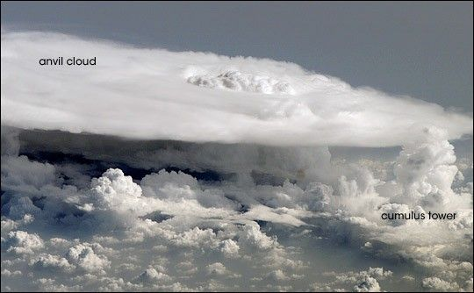
Albedo and the Absorbed Solar Flux
Not all incoming sunlight is absorbed — some is reflected straight back to space
• Planetary albedo, α, is the fraction of incoming solar radiation reflected back to space by clouds, ice, snow, aerosols and the surface itself, without being absorbed.
• Earth's albedo is about α = 0.30 — nearly a third of incoming sunlight is reflected away, mostly by clouds, including bright reflective ones like the cumulonimbus anvil below.
• The globally averaged absorbed solar flux is therefore F_{abs} = (1-α)S₀/4 = 0.70 × 1361/4 = 238.2 W m⁻².
• Albedo is not fixed: cloud cover, sea ice and snow cover all change it — which is exactly why cloud albedo (Part 3) and ice-albedo feedback (also Part 3) matter so much for how climate can change.
Source: Nasa
EART23001 Atmospheric Physics & Weather | Week 12

Slide 8
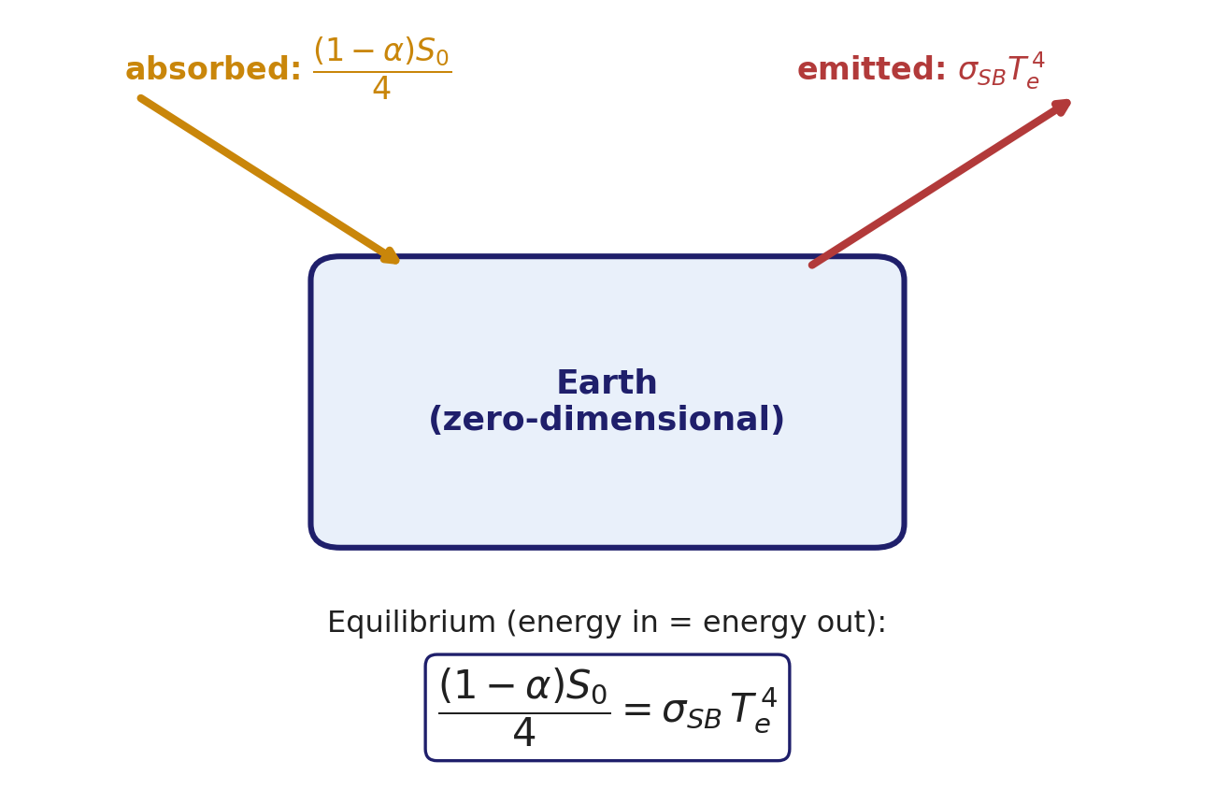
Stefan–Boltzmann's Law and Radiative Equilibrium
A hotter blackbody radiates much more strongly — with a very steep T⁴ dependence
• Stefan-Boltzmann's law: a blackbody at temperature T emits a flux F = σ_{SB} T⁴, where σ_{SB} = 5.67×10⁻⁸ W m⁻² K⁻⁴. Doubling temperature increases emitted flux by a factor of 16.
• In the simplest possible model of Earth's temperature — treating the whole planet as a single blackbody in radiative equilibrium — energy absorbed must equal energy emitted: (1-α)S₀/4 = σ_{SB} T_{e}⁴.
• T_{e} here is called the effective radiating temperature: the temperature a blackbody would need to have to radiate away exactly as much longwave energy as Earth absorbs in shortwave.
• This one equation, rearranged for T_{e}, is exactly what Discussion 1 (next) asks you to work through by hand.
EART23001 Atmospheric Physics & Weather | Week 12

Slide 9
Earth's Effective Radiating Temperature
IN-CLASS DISCUSSION 1
• Take Earth's planetary albedo to be α = 0.30. In simple zero-dimensional radiative equilibrium: (1-α)S₀/4 = σ_{SB} T_{e}⁴.
• 1. Calculate the globally averaged absorbed solar flux, F_{abs}.
• 2. Calculate T_{e}.
• 3. Compare T_{e} with a representative global-mean surface temperature of 288 K, and calculate the difference.
• 4. As a simple grey diagnostic, write F_{out} = ε_{eff} σ_{SB} T_{s}⁴. Using T_{s} = 288 K, find the effective emissivity ε_{eff} needed for F_{out} = F_{abs}. Is this the emissivity of the physical surface itself?
✍ Discuss in pairs, then we'll take answers
Worked-answers sheet, Week 12 — IN CLASS Question (Q2)

Slide 10
T_{e} = 254.6 K — A Real, Persistent 33.4 K Gap
WORKED ANSWER — DISCUSSION 1
• F_{abs} = 0.70 × 1361/4 = 238.2 W m⁻².
• T_{e} = (238.2 / 5.67×10⁻⁸)^{1/4} = 254.6 K — well below freezing.
• The real global-mean surface is about 288 - 254.6 = 33.4 K warmer than this simple radiating temperature.
• Effective emissivity: ε_{eff} = F_{out} / (σ_{SB} T_{s}⁴) = 238.2 / [5.67×10⁻⁸ × 288⁴] ≈ 0.61. Substituting back, T_{s} = [238.2/(0.61 × 5.67×10⁻⁸)]^{1/4} ≈ 288 K, confirming consistency.
• This 0.61 is NOT the physical surface's emissivity — the real surface emits almost as a perfect blackbody (emissivity ≈ 1) in the thermal infrared. It's an effective property of the whole surface-atmosphere system, reflecting that much of the radiation that actually escapes to space is emitted from colder levels higher up in the atmosphere, not from the warm surface directly.
EART23001 Atmospheric Physics & Weather | Week 12

Slide 11
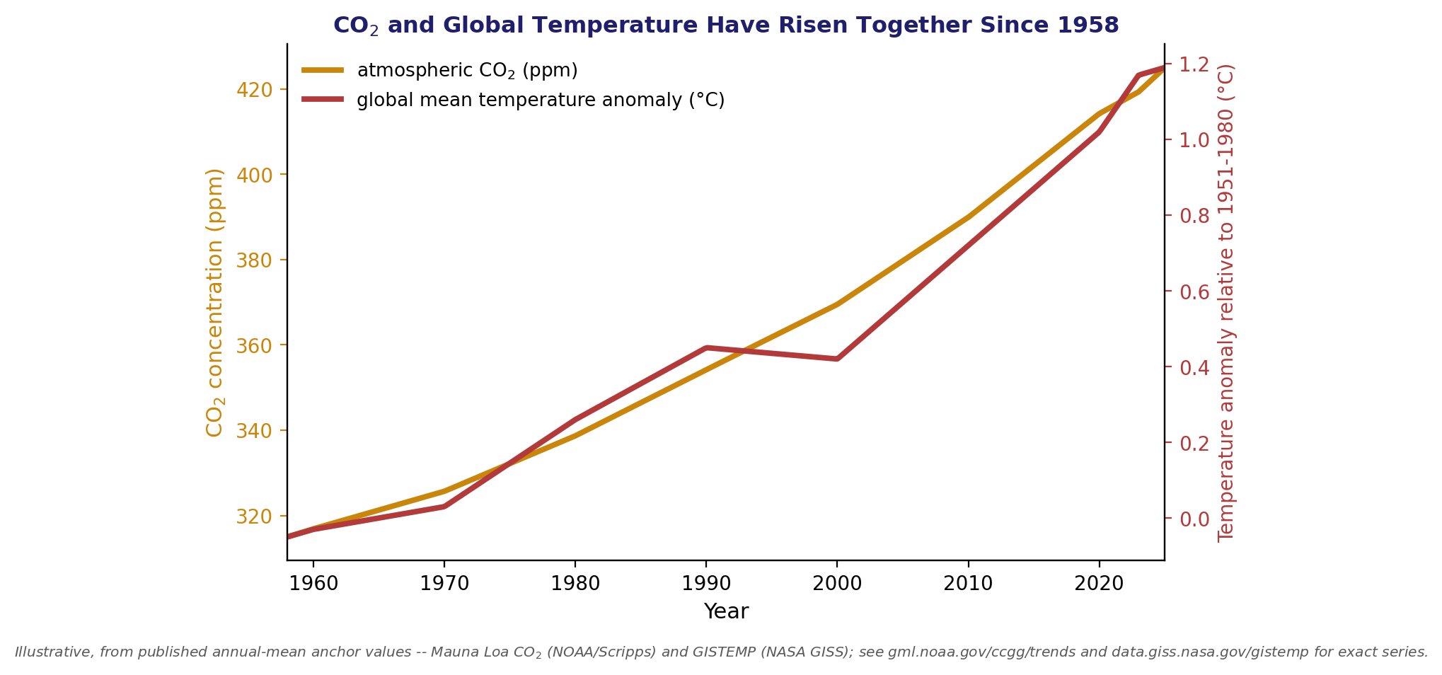
The 33.4 K Gap: Why We Need a Greenhouse Effect
T_{e} is a real physical quantity — it's just not the temperature we feel at the surface
• T_{e} = 254.6 K is the temperature of the level (roughly mid-troposphere) from which Earth's longwave emission effectively escapes to space, averaged over the whole planet.
• The surface is warmer than T_{e} because the atmosphere absorbs outgoing longwave radiation and re-emits part of it back down — the greenhouse effect.
• The size of the effect depends on how well the atmosphere absorbs longwave radiation — mainly water vapour, CO₂ and clouds. CO₂ and global temperature have risen together since 1958.
• IN-CLASS DEMO: an IR lamp on a sealed jar of CO₂ (from an Alka-Seltzer tablet) vs a jar of ordinary air shows this same absorption mechanism directly.
EART23001 Atmospheric Physics & Weather | Week 12

Slide 12
The Greenhouse Effect
PART 2 OF 4
Why the atmosphere can let sunlight in while trapping heat — built up from first principles
⏱ 0:36 – 1:10
EART23001 Atmospheric Physics & Weather | Week 12

Slide 13
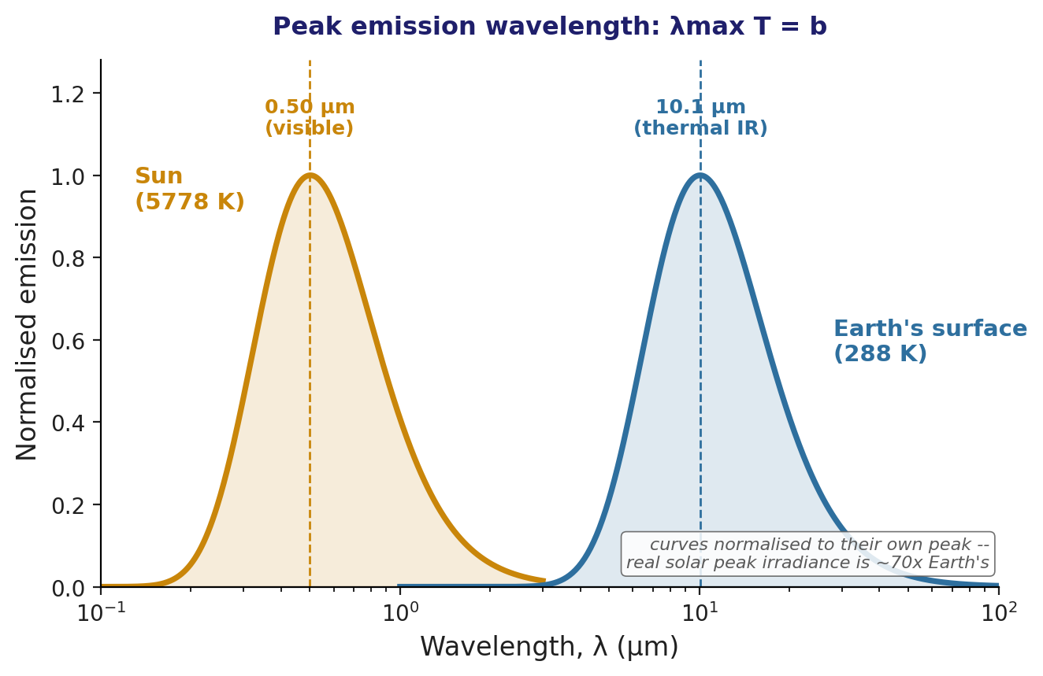
Wien's Law: Sun vs Earth
The Sun and Earth peak in completely different parts of the spectrum
• Wien's displacement law: peak blackbody emission occurs at λ_{max} = b/T, with b = 2.898×10⁻³ m K.
• Sun (T = 5778 K): λ_{max} = 5.02×10⁻⁷ m = 0.50 μm — visible light. Earth's surface (T = 288 K): λ_{max} = 1.01×10⁻⁵ m = 10.1 μm — thermal infrared, over 20× longer.
• The two curves below are each normalised to their OWN peak, to show shape rather than brightness — the Sun's actual peak spectral irradiance, as received at Earth, is around 70× Earth's own, not equal to it.
• This is Week 3's own 'peak emission wavelength' figure finally paying off: because solar and terrestrial radiation occupy such different bands, the atmosphere can, in principle, treat them completely differently.
EART23001 Atmospheric Physics & Weather | Week 12

Slide 14

The Atmospheric Window and Spectral Selectivity
Atmospheric absorption depends strongly on wavelength — that's the whole mechanism
• Solar and terrestrial radiation occupy such different wavelength bands that the atmosphere doesn't have to treat all radiation the same way — and it doesn't.
• The atmosphere doesn't absorb much visible light, but it does SCATTER it: molecules scatter blue light preferentially (why the sky is blue and sunsets are red, below), and clouds/aerosols scatter a substantial share back to space (Earth's albedo). Scattered light isn't absorbed, so it's not simply 'ignored' either.
• By contrast, it strongly ABSORBS much of the infrared (water vapour, CO₂, methane, clouds) — except a genuine 'atmospheric window' around 8-12 μm, which lets some thermal emission escape directly. This selectivity is the physical basis of the greenhouse effect.
Source: Wikimedia Commons, “Rayleigh scattering after sunset at 500m altitude” (CC BY-SA; uploader credit unconfirmed — see note).
EART23001 Atmospheric Physics & Weather | Week 12

Slide 15
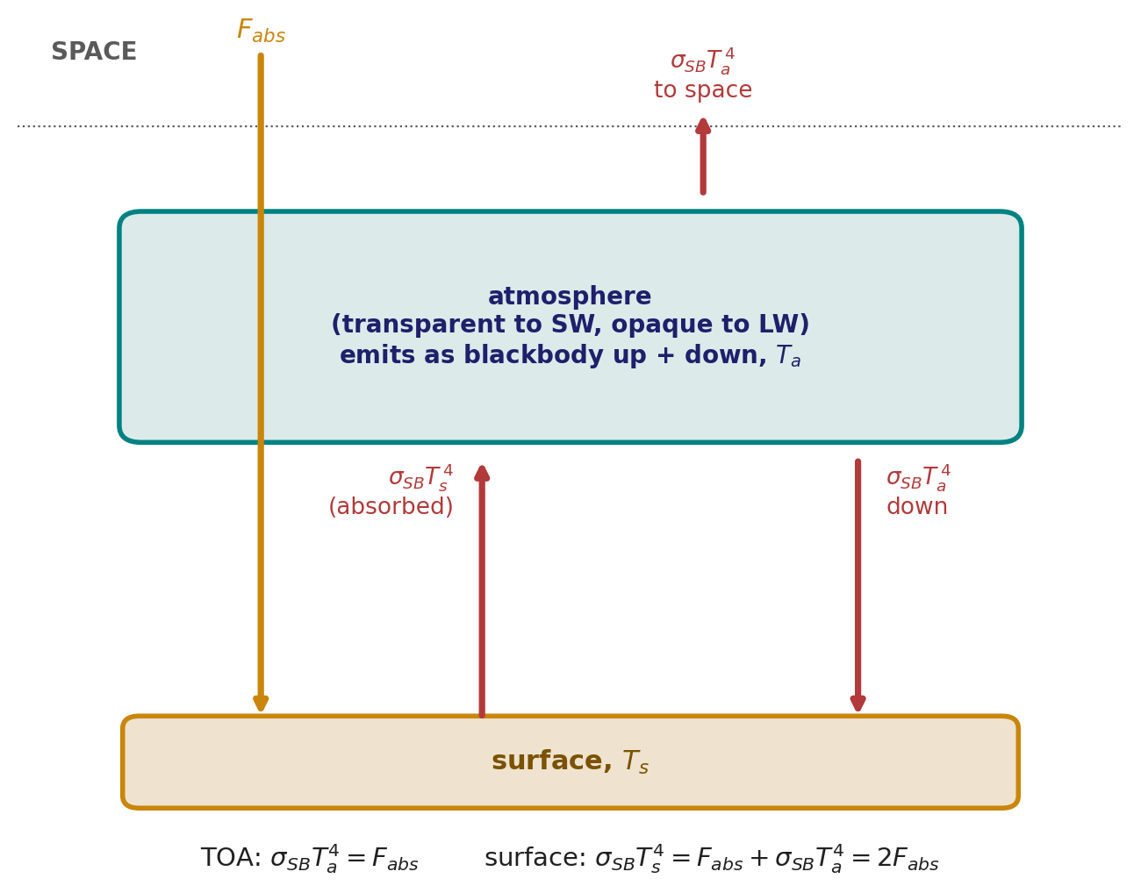
Building a One-Layer Greenhouse Model
The simplest atmosphere that can show the mechanism: transparent to SW, opaque to LW
• Model setup: a single atmospheric layer that is completely transparent to solar (shortwave) radiation, but absorbs ALL terrestrial (longwave) radiation reaching it, and re-emits as a blackbody equally upward and downward.
• At the top of the atmosphere, radiative equilibrium requires the atmosphere's own emission to balance the absorbed solar flux: σ_{SB} T_{a}⁴ = F_{abs} — using F_{abs} = 238.2 W m⁻² from Discussion 1.
• At the surface, the balance now includes TWO inputs: the absorbed sunlight passing straight through, plus the atmosphere's downward longwave emission: σ_{SB} T_{s}⁴ = F_{abs} + σ_{SB} T_{a}⁴ = 2F_{abs}.
• Discussion 2 (next) works through exactly these two balances by hand.
EART23001 Atmospheric Physics & Weather | Week 12

Slide 16
A One-Layer Greenhouse Model
IN-CLASS DISCUSSION 2
• A model atmosphere is transparent to solar radiation but absorbs ALL terrestrial longwave radiation, and emits as a blackbody equally up and down. Use F_{abs} = 238.2 W m⁻² from Discussion 1.
• 1. At the top of the atmosphere, radiative equilibrium requires σ_{SB} T_{a}⁴ = F_{abs}. Calculate the atmospheric emitting temperature T_{a}.
• 2. The surface receives absorbed sunlight PLUS downward atmospheric longwave radiation: σ_{SB} T_{s}⁴ = F_{abs} + σ_{SB} T_{a}⁴ = 2F_{abs}. Calculate T_{s}.
• 3. Compare this T_{s} with T_{e} from Discussion 1, and with the real mean surface temperature of about 288 K.
• 4. What does the fact that the one-layer model is too warm tell you about its assumptions?
✍ Discuss in pairs, then we'll take answers
Worked-answers sheet, Week 12 — IN CLASS Question (Q5)

Slide 17
T_{s} = 302.8 K — Warmer Than Reality, and That's Informative
WORKED ANSWER — DISCUSSION 2
• At the top of the atmosphere: T_{a} = (238.2/σ_{SB})^{1/4} = 254.6 K — the same effective radiating temperature as before (as it must be: the TOA balance hasn't changed).
• At the surface: T_{s} = [2(238.2)/σ_{SB}]^{1/4} = 302.8 K. Equivalently, T_{s} = 2^{1/4}T_{e} — doubling the flux the surface must balance raises T by a factor of 2^{1/4} ≈ 1.19.
• This IS the greenhouse mechanism working: the surface (302.8 K) is warmer than T_{e} (254.6 K) purely because of downward re-emission from the absorbing atmosphere above it.
• But 302.8 K overshoots the real 288 K by about 15 K. This tells us a single blackbody layer is too crude: real longwave absorption is wavelength-dependent (the atmospheric window lets some radiation escape directly), clouds and vertical temperature structure matter, and non-radiative sensible/latent heat fluxes also move energy that this all-radiative model ignores entirely.
EART23001 Atmospheric Physics & Weather | Week 12

Slide 18
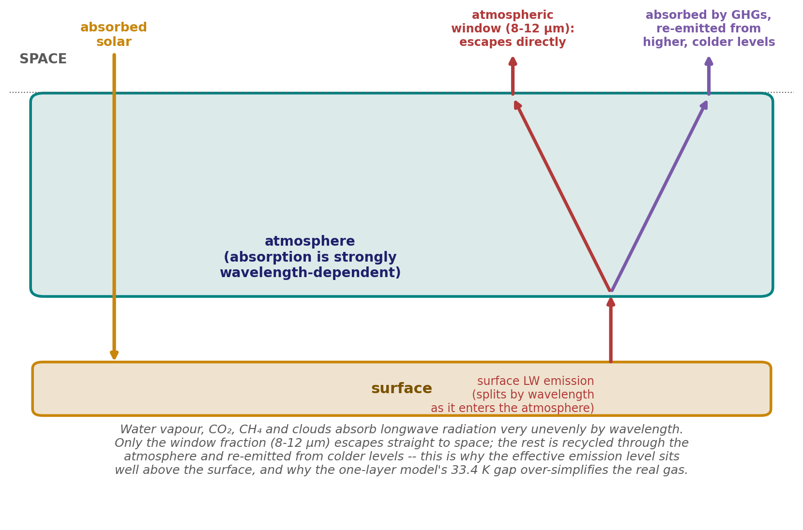
Why the Model Runs Too Hot
A single blackbody layer captures the mechanism, but not the magnitude
• Wavelength-dependent absorption: real greenhouse gases absorb strongly in some bands and barely at all in others — the atmospheric window (below) lets a fraction of surface emission escape straight to space, while the one-layer model assumed 100% absorption everywhere in the longwave.
• Vertical structure: the real atmosphere is a stack of many layers at different temperatures, not one uniform slab — radiation genuinely escaping to space comes from a range of altitudes, mostly from cooler layers than the surface.
• Clouds and non-radiative fluxes: clouds both reflect sunlight and absorb/re-emit longwave radiation (Part 3); sensible and latent heat (Weeks 8-9) also move energy from the surface into the atmosphere without any radiation at all.
Original diagram; underlying data/style: hyperphysics.phy-astr.gsu.edu/hbase/thermo/Earthebal.html; IPCC AR4 and AR6
EART23001 Atmospheric Physics & Weather | Week 12

Slide 19
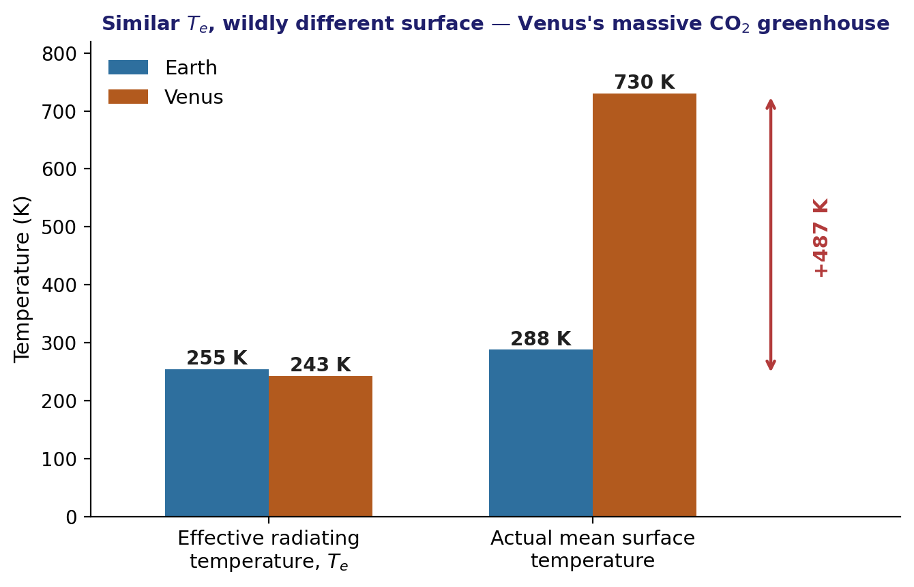
Venus: The Greenhouse Effect Taken to an Extreme
Higher albedo than Earth, yet a surface hot enough to melt lead
• Venus: distance d_{V} = 1.08×10¹¹ m, albedo 0.70 — far higher than Earth's 0.30, since Venus is covered in thick, reflective cloud.
• S_{V} = 2.63×10³ W m⁻², giving T_{e,V} = 243 K — actually slightly COLDER than Earth's T_{e}, since the high albedo more than compensates for being closer to the Sun.
• Yet Venus's actual surface temperature is about 730 K — some 487 K hotter than T_{e,V}, dwarfing Earth's 33.4 K gap.
• Why: a massive CO₂ atmosphere with enormous infrared optical depth. Radiation escapes to space from high, cold levels, while the deep atmosphere and surface stay extremely hot — high cloud-top albedo cuts absorbed sunlight but barely touches this longwave effect.
EART23001 Atmospheric Physics & Weather | Week 12

Slide 20
Clouds, Feedbacks and Circulation
PART 3 OF 4
How clouds change the energy balance, how the system responds to being pushed, and how energy actually moves
⏱ 1:10 – 1:40
EART23001 Atmospheric Physics & Weather | Week 12

Slide 21
Cloud Albedo and the M₂ Framework
The same droplet-size framework from cloud microphysics now sets a cloud's brightness
• Recall from Week 9 (and its own preview all the way back in Week 2): for a fixed liquid-water content, dividing the same water mass among MORE, SMALLER droplets increases the total droplet surface area available to scatter sunlight.
• Define the area-related second moment M₂ = Nr² (droplet number concentration × radius squared). Cloud-droplet extinction — and hence how much sunlight a cloud reflects — is approximately proportional to M₂.
• A simple approximate cloud-albedo relation: A_{c} ≈ X/(X+15.4), where X = πM₂Δz — note this saturates: once a cloud is already bright, adding more extinction gives diminishing returns in reflected fraction.
• This is exactly the Twomey effect from Week 9, now connected directly to the planetary energy balance: more (smaller) droplets at fixed water content → brighter clouds → higher albedo → cooling effect on climate.
ILO 5 — cloud types and cloud/rain formation processes, connected here to the energy budget (ILO 2)
EART23001 Atmospheric Physics & Weather | Week 12

Slide 22
Cloud Droplet Number, M₂, Extinction and Albedo
IN-CLASS DISCUSSION 3
• Cloud A is Δz = 500 m deep with N_{A} = 100 cm⁻³ droplets of radius r_{A} = 10 μm. Cloud B has the same liquid-water content and depth, but N_{B} = 800 cm⁻³. Use M₂ = Nr² and A_{c} ≈ X/(X+15.4), X = πM₂Δz.
• 1. Use constant liquid-water content (Nr³ = constant) to find r_{B}.
• 2. Convert concentrations to m⁻³ and calculate M₂ for both clouds. By what factor does M₂ change?
• 3. Calculate X and A_{c} for each cloud. Why doesn't doubling M₂ double the albedo?
• 4. Show that M₂ ∝ N^{1/3} at fixed liquid-water content. Estimate the fractional change in M₂ for a 30% increase in N. What's the likely sign of the shortwave effect on Earth's energy balance if a cloud brightens this way?
✍ Discuss in pairs, then we'll take answers
Worked-answers sheet, Week 12 — IN CLASS Question (Q3)

Slide 23
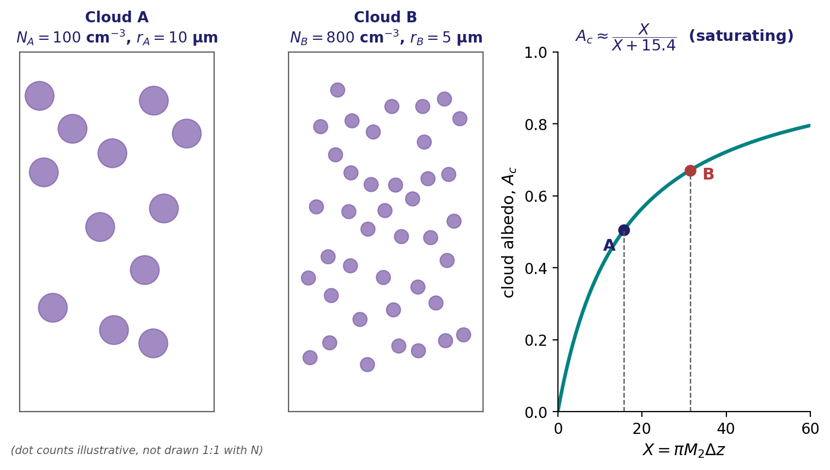
Albedo Rises From 0.51 to 0.67 — But It Saturates
WORKED ANSWER — DISCUSSION 3
• r_{B} = 10(100/800)^{1/3} = 5.0 μm. M₂,A = (1.00×10⁸)(10⁻⁵)² = 1.00×10⁻² m⁻¹; M₂,B = 2.00×10⁻² m⁻¹ — M₂ doubles, so extinction roughly doubles too.
• X_{A} = 15.71 → A_{c,A} = 0.505. X_{B} = 31.42 → A_{c,B} = 0.671. Albedo doesn't double because the relation saturates — an already-bright cloud has lower marginal susceptibility to added extinction.
• At fixed liquid-water content, r ∝ N^{-1/3}, so M₂ ∝ N^{1/3}: a 30% increase in N gives only ≈9-10% more M₂. A brighter cloud reflects more shortwave to space — an immediate COOLING influence, all else equal.
EART23001 Atmospheric Physics & Weather | Week 12

Slide 24
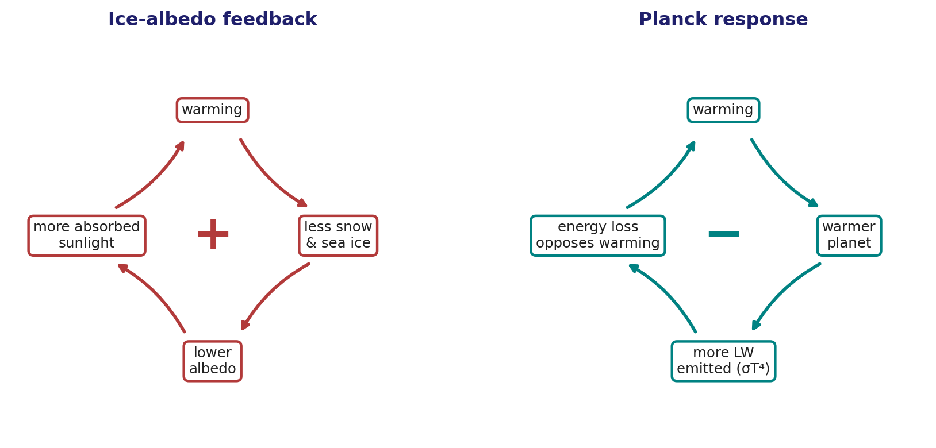
Classifying Climate Feedbacks
When the climate system is nudged, does the response amplify or oppose the nudge?
• Ice-albedo and water-vapour feedbacks: warming → less snow/sea ice (or more water vapour) → lower albedo (or stronger absorption) → more warming. Both POSITIVE — they amplify the initial change.
• The Planck response: warming → more longwave emission to space (F = σ_{SB}T⁴) → this energy loss opposes the warming. NEGATIVE — this T⁴ dependence is why radiative equilibrium exists at all.
• Cloud feedback: clouds both reflect shortwave AND absorb/emit longwave, so the net effect depends on how their height, thickness and phase change. SIGN DEPENDS ON DETAILS — the biggest remaining source of climate-projection uncertainty.
EART23001 Atmospheric Physics & Weather | Week 12

Slide 25
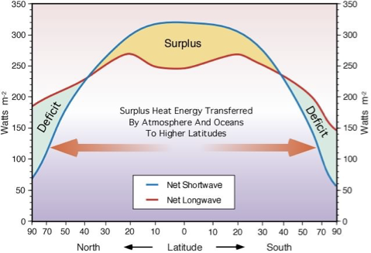
Radiative Imbalance by Latitude
Both curves below are plotted as positive numbers — but positive means opposite things
• Sign convention: positive net shortwave means energy is being ADDED to the surface-atmosphere column; positive net longwave means energy is being TAKEN AWAY from it. Both are drawn as ordinary positive curves — it's what each one physically represents that differs.
• Where the Net Shortwave curve sits ABOVE Net Longwave (low latitudes): more is being added than taken away — a SURPLUS. Where Net Longwave sits above Net Shortwave (high latitudes): more is being taken away than added — a DEFICIT.
• If nothing moved energy between these bands, the tropics would keep warming and the poles keep cooling indefinitely. Since neither happens, this imbalance itself must be driving a poleward transport of heat — by the atmosphere and the oceans.
Figure as used in the original course material (source citation not given on that slide; not independently verified — see note).
EART23001 Atmospheric Physics & Weather | Week 12

Slide 26
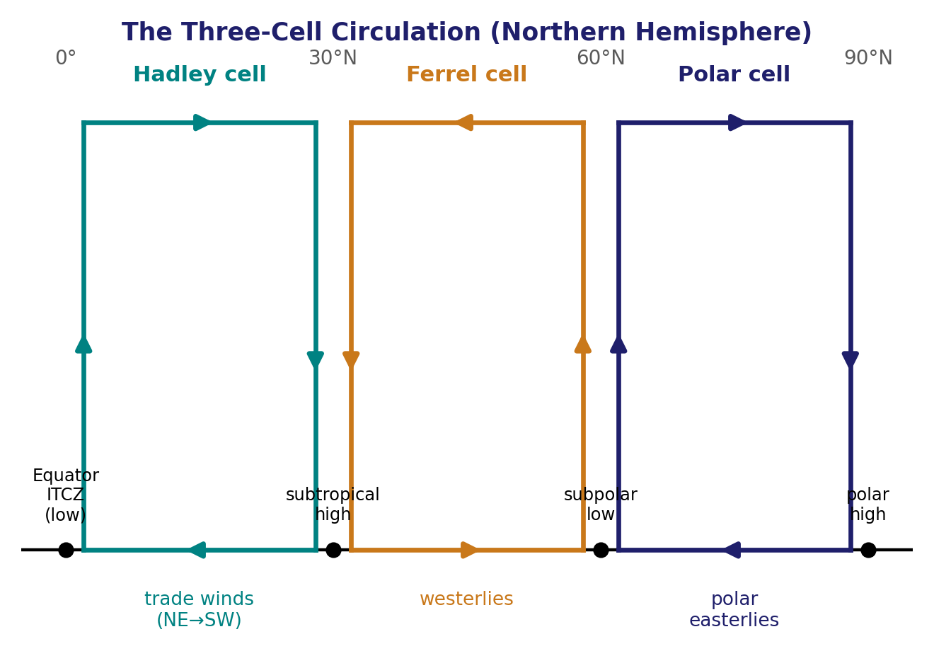
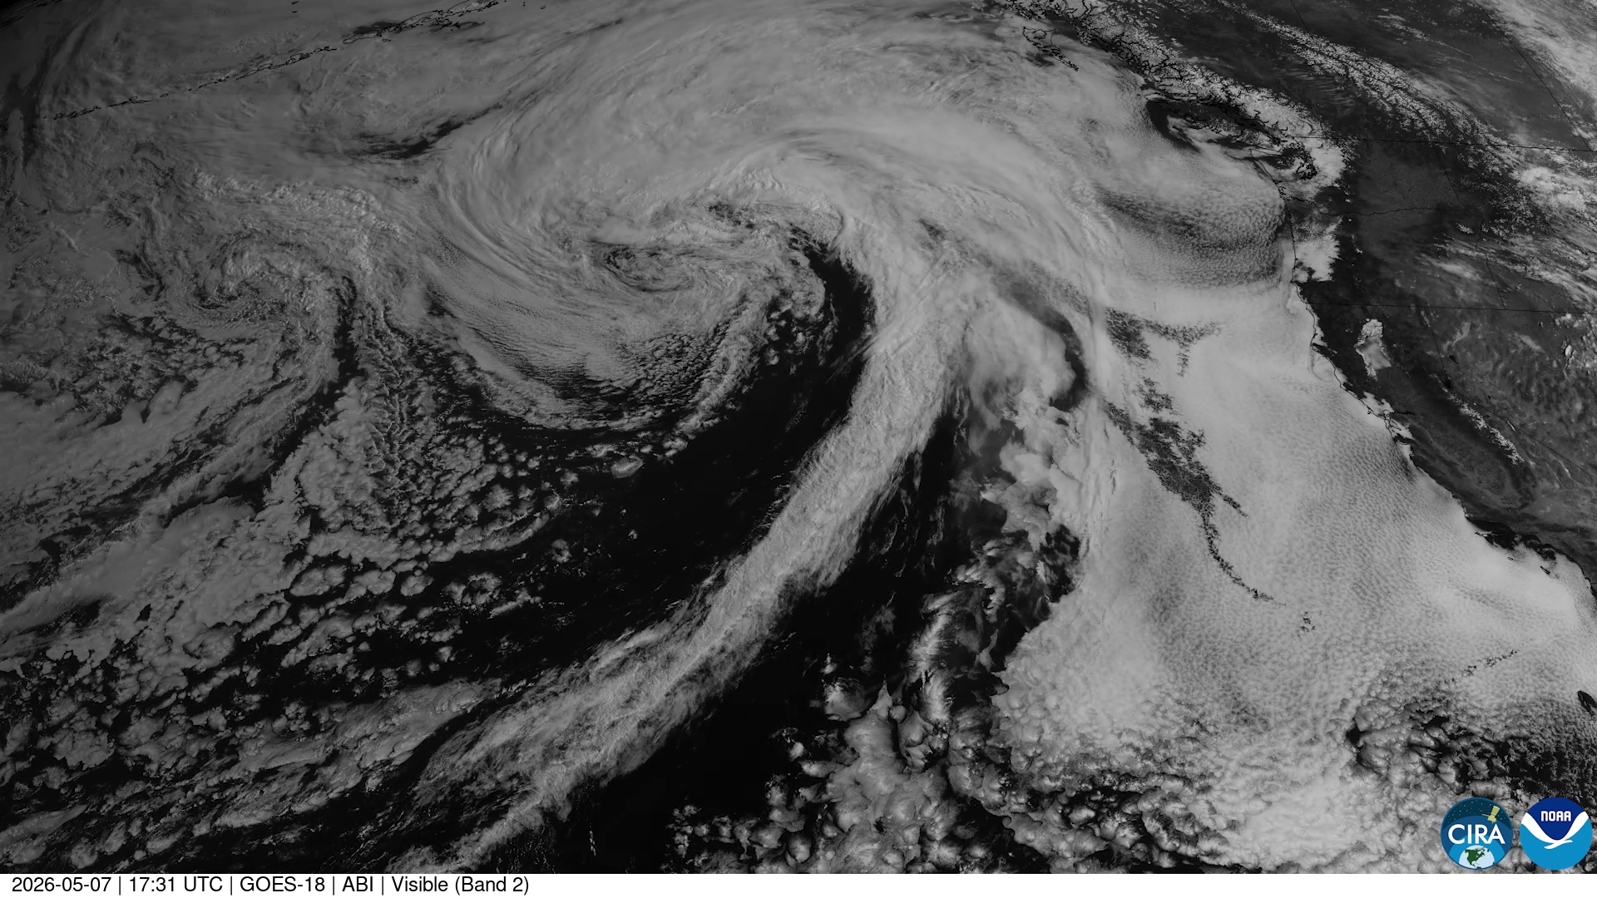
Circulation as the Transport Mechanism
Three mechanisms, one cause: the latitude-dependent radiative imbalance
• The Hadley circulation (Week 5) and mid-latitude storm systems (Week 11) both exist largely BECAUSE of this radiative imbalance — and ocean currents are a second, slower poleward pathway alongside them.
• All three are direct physical consequences of the single latitude-dependent imbalance shown on the previous slide.
The three-cell circulation (Week 5): a direct response to the tropical energy surplus.
A real classic comma-shaped mid-latitude cyclone — click to play. Source: NOAA GOES-18 / CIRA.
EART23001 Atmospheric Physics & Weather | Week 12

Slide 27
Orbital Variability and Course Wrap-Up
PART 4 OF 4
How Earth's orbit itself paces the ice ages, and what twelve weeks of atmospheric physics add up to
⏱ 1:40 – 1:52
EART23001 Atmospheric Physics & Weather | Week 12

Slide 28
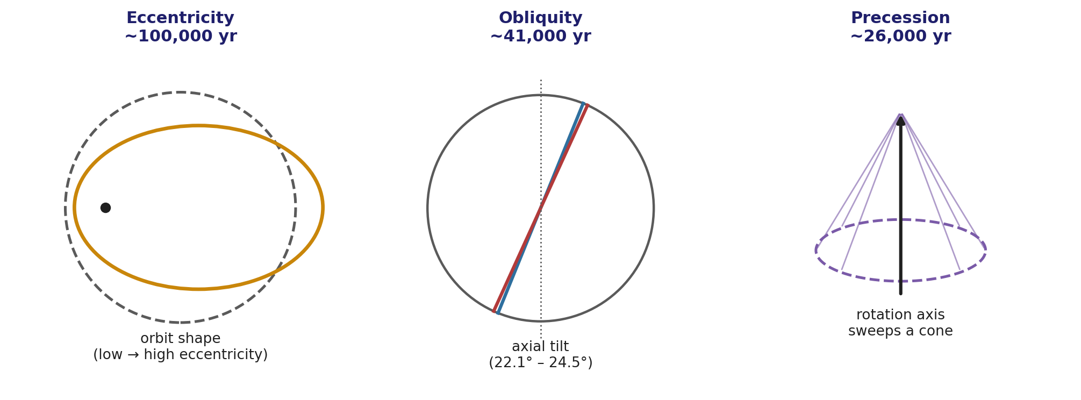
Milankovitch Cycles
Three independent, slow, predictable variations in Earth's orbit and orientation
• Eccentricity (~100,000 yr): the orbit's shape varies from nearly circular to elliptical. Obliquity (~41,000 yr): axial tilt varies between 22.1° and 24.5°, changing seasonal contrast. Precession (~26,000 yr): the rotation axis's orientation sweeps around, changing which season occurs at closest approach to the Sun.
• None of these change the total annual global-mean solar input by much — they redistribute it by season and latitude, so their climate influence comes from the seasonal/geographic contrasts (and feedbacks, e.g. ice-albedo) those changes trigger.
EART23001 Atmospheric Physics & Weather | Week 12

Slide 29
Closing the Loop With EART22001
The single best moment in the course to make the two modules visibly connect
• In EART22001 Week 2 — ten weeks before this lecture — you built an orbital-wobble model and used FFT/time-series analysis to pull out the same three periodicities (~100,000, ~41,000 and ~26,000 years) from simulated orbital data.
• That exercise was, at the time, a pure signal-processing/orbital-mechanics problem. Today it becomes physical: those exact periodicities are imprinted in the geological record (ice cores, ocean sediments) precisely because they pace the ice ages, via the seasonal/latitudinal radiation changes and feedbacks just described.
• This is a genuinely rare case in the two-module structure: the same mathematical periods, derived independently in each module from completely different starting points (orbital mechanics there, radiative energy balance here), converge on the same physical phenomenon.
↔ EART22001 EART22001 Week 2's orbital-wobble FFT modelling exercise recovers exactly these three periods (~100k/41k/26k yr) from simulated orbital data — the same numbers, arrived at independently, now given their climatic meaning.
EART23001 Atmospheric Physics & Weather | Week 12

Slide 30
Week 12 Wrap-Up
• Earth's temperature starts from one balance: absorbed solar flux (1-α)S₀/4 equals emitted longwave flux σ_{SB} T_{e}⁴ — giving T_{e} = 254.6 K, some 33.4 K below the real surface temperature.
• That gap is the greenhouse effect: spectral separation (Wien's law) lets the atmosphere be selectively transparent to sunlight and opaque to Earth's own heat; even the crudest one-layer model captures the mechanism (T_{s} = 302.8 K), while its 15 K overshoot shows exactly what real atmospheres add.
• Clouds set part of the albedo that started this whole balance — the M₂ = Nr² framework from Week 9 connects droplet microphysics directly to planetary energy balance and to climate feedbacks (positive: ice-albedo, water vapour; negative: the Planck response; uncertain: clouds).
• The latitude-dependent radiative imbalance (surplus in the tropics, deficit at the poles) is the reason Hadley circulation and mid-latitude storm systems exist at all — and slow orbital variations (Milankovitch) modulate that whole balance on 20,000-100,000-year timescales.
EART23001 Atmospheric Physics & Weather | Week 12

Slide 31
Twelve Weeks of Atmospheric Physics
A whole-course wrap-up — the six module ILOs, and where each was built
ILO 1
Describe the basic properties of the atmosphere
Weeks 1-2: composition, structure, hydrostatic balance
ILO 2
Apply the basic laws of physics governing the atmosphere
Throughout — culminating today in Stefan-Boltzmann's law and radiative equilibrium
ILO 3
Describe and explain drivers of atmospheric motion, synoptic to global scale
Weeks 5 & 11: Hadley circulation, geostrophic wind, mid-latitude cyclones — driven by today's latitudinal energy imbalance
ILO 4
Explain the physical behaviour of dry and moist air
Weeks 3, 7-8: thermodynamics, stability, moist processes
ILO 5
Describe cloud types and cloud/rain formation processes
Week 9: cloud microphysics, the Twomey effect — reused today for cloud albedo
ILO 6
Explain how dynamics and thermodynamics combine into observable weather
Weeks 10-12: tephigrams, forecasting, and today's global energy balance closing the loop
EART23001 Atmospheric Physics & Weather | Week 12

